Slide 1
IRC II: Weeks 1-4 Progress Report
Organizing Research Papers Using Text Embeddings and Clustering
By: Henry Roeth

Slide 2
Setting Up My Environment
I first created a project folder on my laptop and backed it up to a GitHub repository at:
https://github.com/henryroeth/research-paper-organizer
I then created a virtual Python environment in Visual Studio Code and began installing dependencies

Slide 3
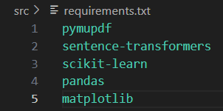
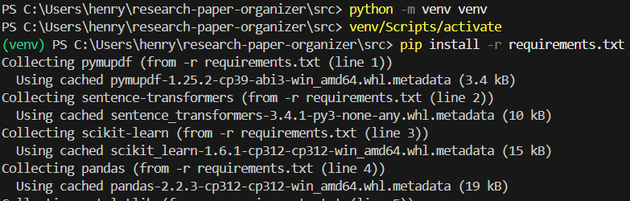
Setting Up My Environment
`pymupdf` - extract data from PDFs
`sentence-transformers` - capture the semantics of sentences
`scikit-learn` - all-purpose machine learning
`pandas` - data analysis
`matplotlib` - data visualization

Slide 4
Downloading a Dataset
I implemented a Python script that uses the arXiv API to fetch 1000 research papers about Physics, Biology, and Literature
I then randomly downloaded 500 PDFs based on relevance and availability

Slide 5
Python Logic for Analysis
Open a lightweight pre-trained SentenceTransformer (`all-MiniLM-L6-v2’) model to encode text into embeddings
Use PyMuPDF to extract abstracts from research papers in PDF format
Convert the extracted text (abstracts) into vector embeddings using the model
Apply KMeans clustering on embeddings, then reduce dimensions using PCA to visualize the clusters

Slide 6
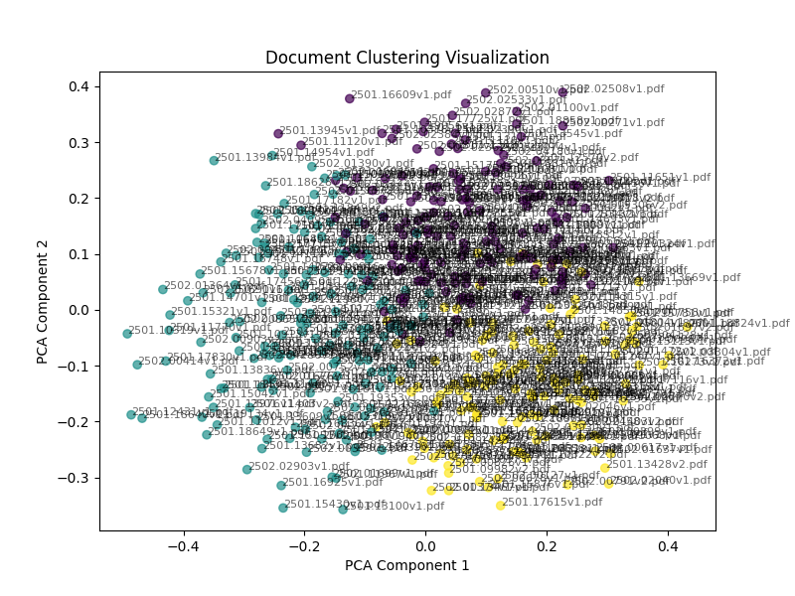
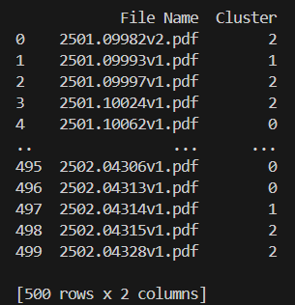
Results

Slide 7
Moving Forward
Research more on text embeddings, clustering algorithms, and machine learning models
Document and break down each part of the existing code to improve understanding
Implement a simple and user-friendly GUI for easier interaction with the tool
Run more analyses on the tool and try to improve it
Begin composing the final research document

