Slide 1
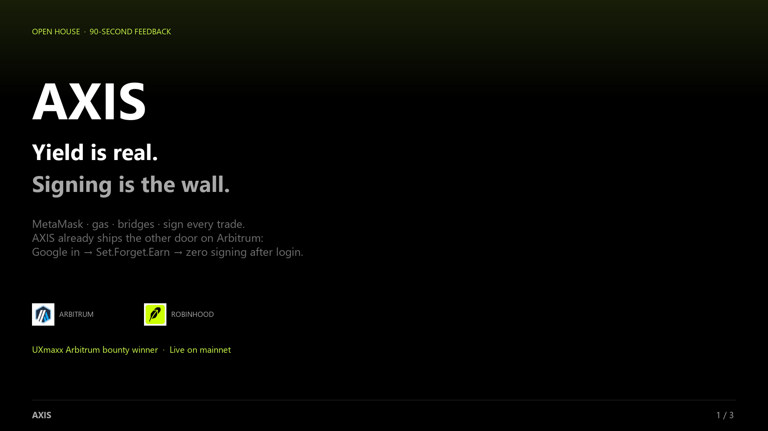
Notes:
I’m Henry. DeFi yield is real — normal people still bounce on MetaMask, gas, and sign-every-trade. AXIS already won UXmaxx on Arbitrum: Google login, Set.Forget.Earn, zero signing after login. That’s live money today.

Slide 2
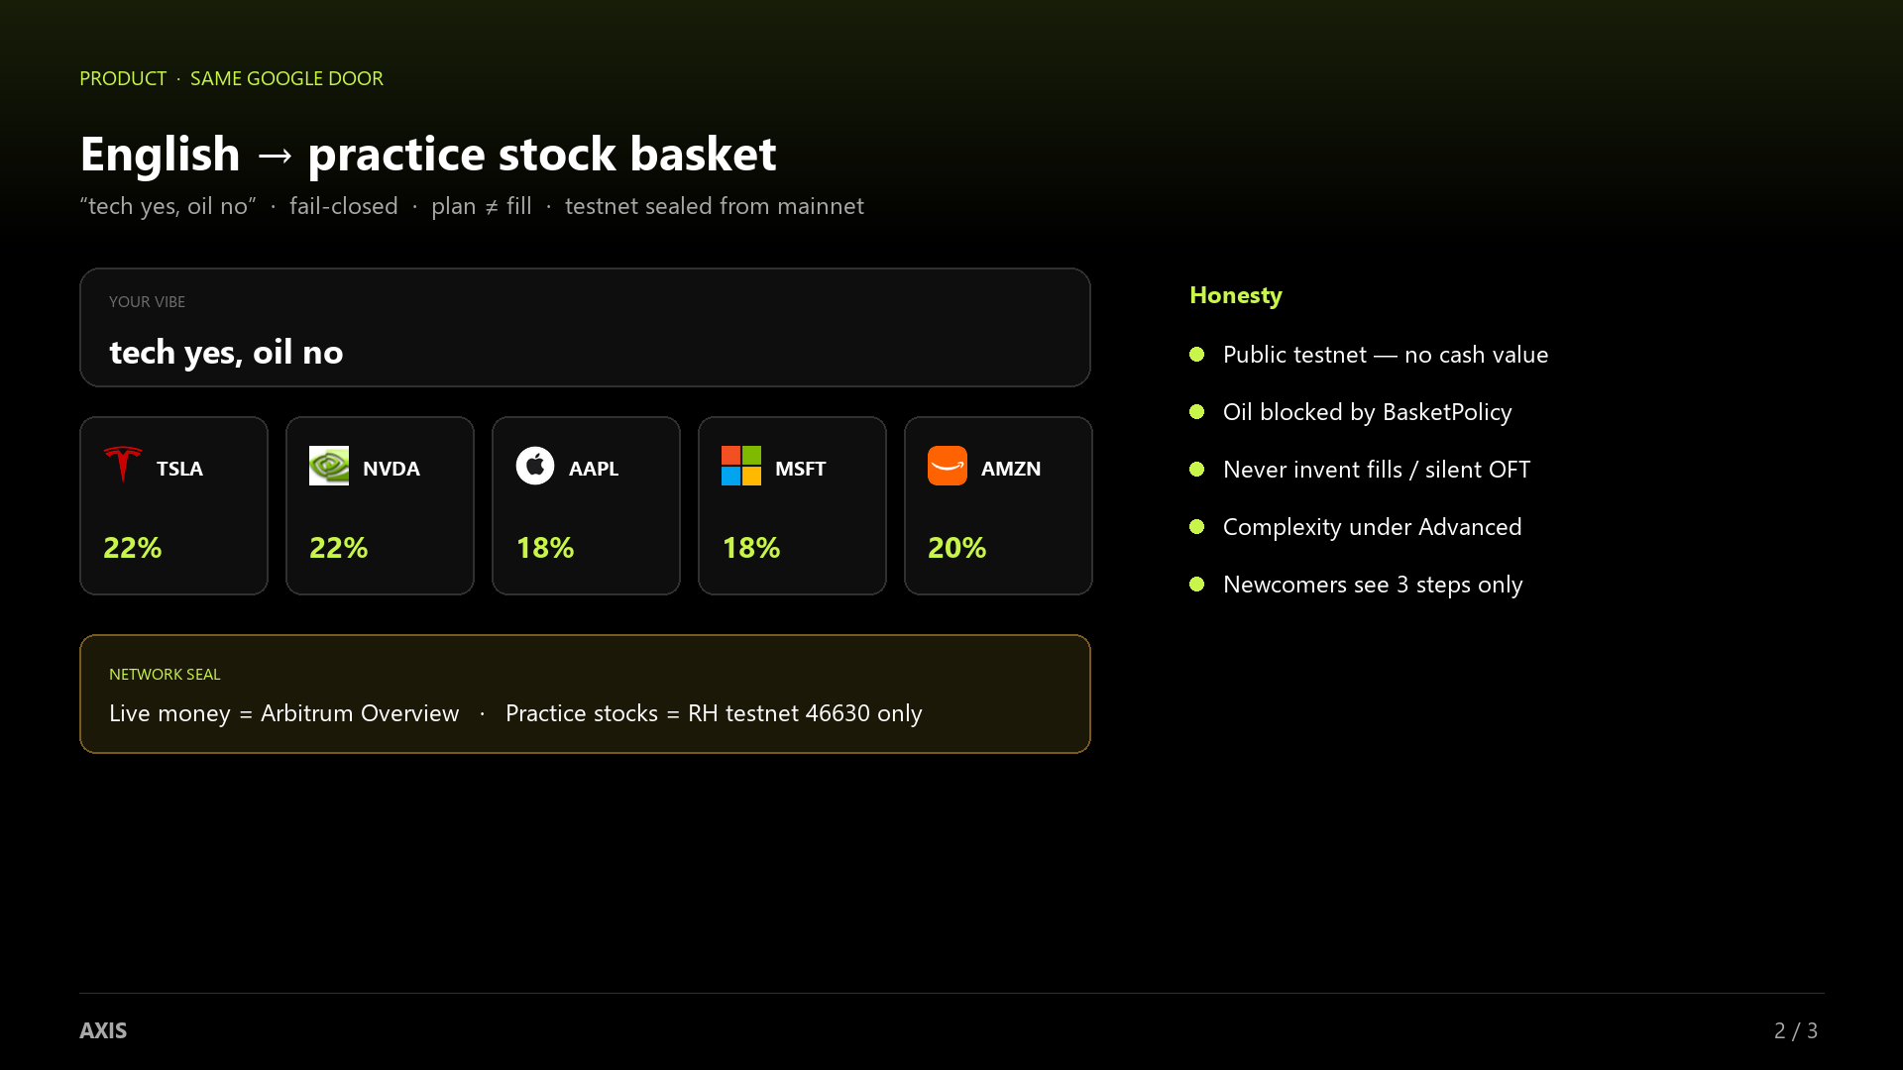
Notes:
For Open House we put US stock tokens under that same Google door. You say ‘tech yes, oil no’ — AXIS builds a Robinhood Chain practice basket. Testnet only. Plan is not a fill. Live Arbitrum yield stays on a separate tab — no loophole.

Slide 3
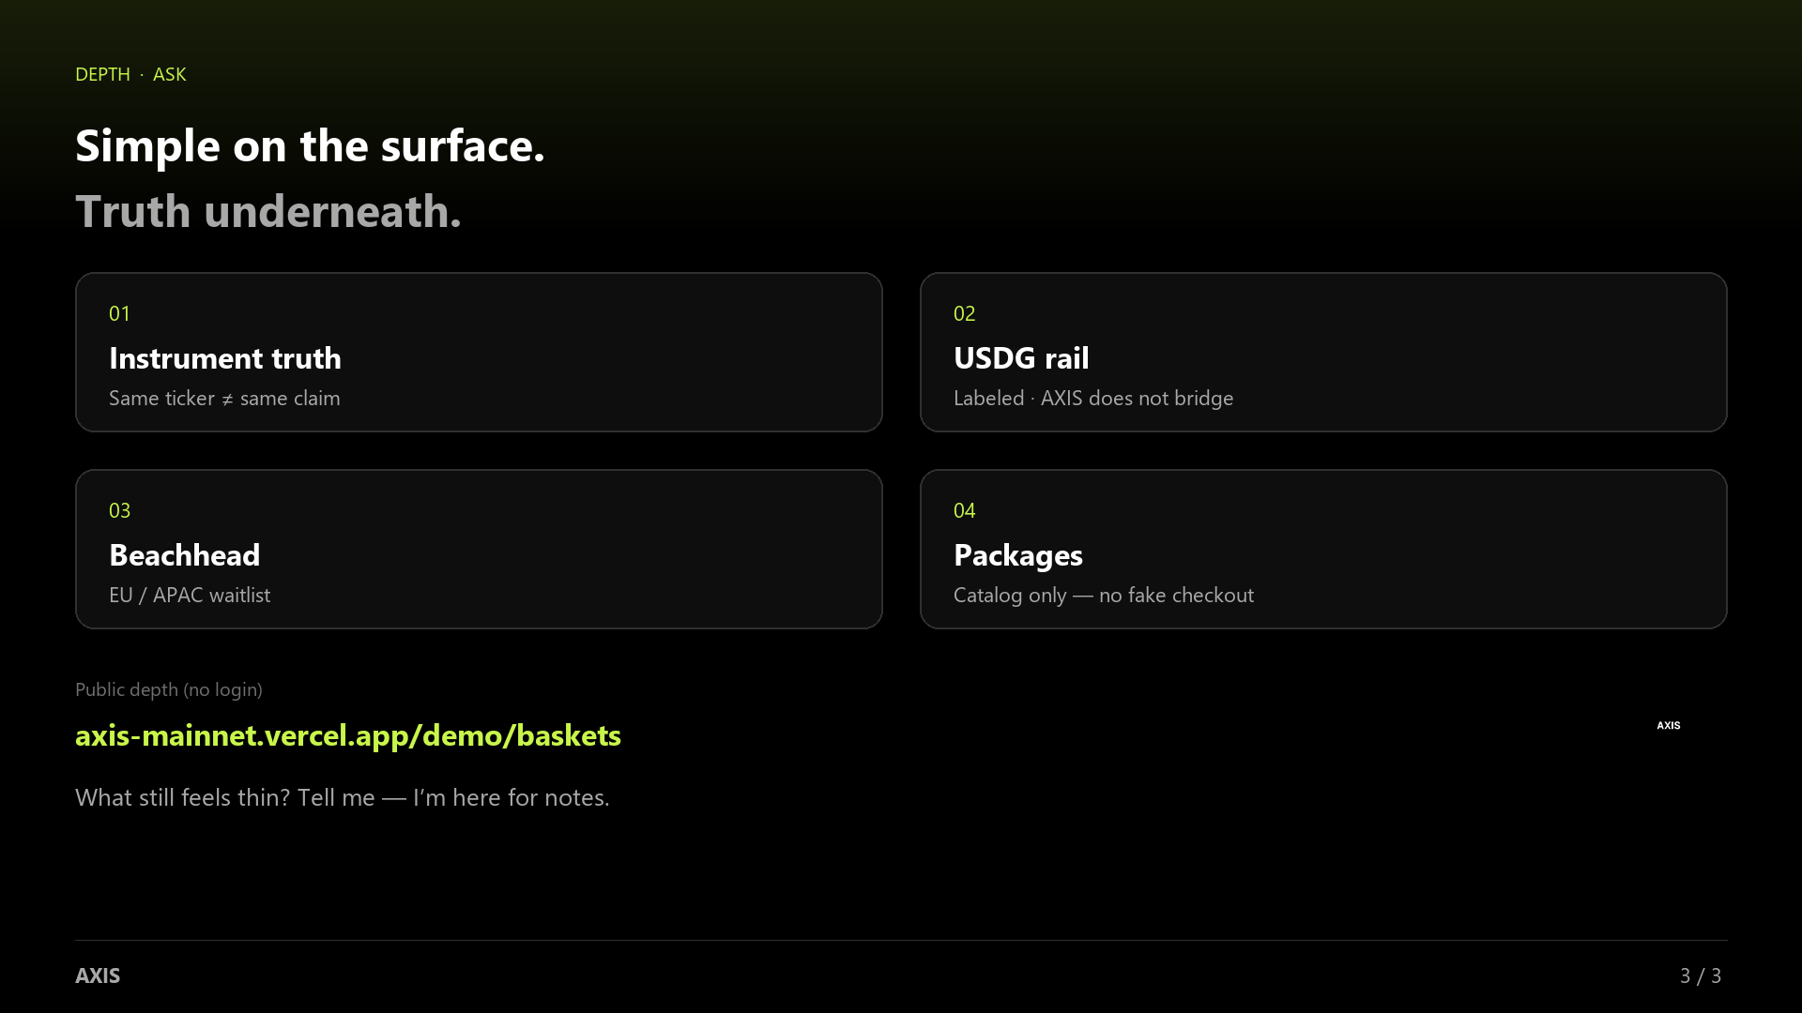
Notes:
Judges score attract and retain, so we shipped depth behind a simple path: instrument truth, labeled USDG rail, EU/APAC beachhead, packages. Walk it at axis-mainnet.vercel.app/demo/baskets. What still feels thin? I’m here for notes.

