Slide 1
Detecting and Measuring Transit and Planet-Star Radius Ratio of Exoplanet HD 189733 b
Investigator: Henry Shi¹
Co-Investigators: Aaron Burke¹, Mark Vincent Guevarra¹
¹Department of Physics and Astronomy
Stony Brook University
Stony Brook, NY 11794, USA
Notes:
So in this lab we investigated detecting and measuring the transit of HD 189733 b, and using it to calculate the planet-star radius ratio.

Slide 2
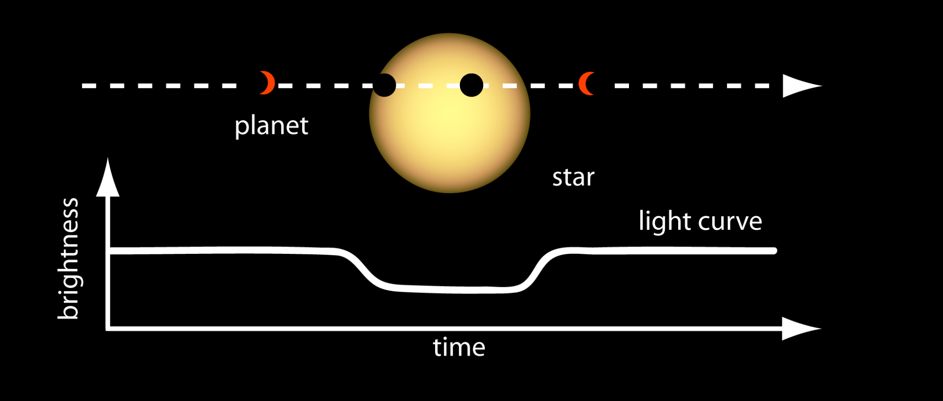
Background and Introduction
Exoplanets: planets orbiting other stars
Transit: detection of exoplanet when it passes in front of star and blocks light
Observation date: 31 August – 01 September 2022
Objectives
Detect transit of exoplanet HD 189733 b
Measure transit depth
Calculate planet-to-star radius ratio
Overview schematic of exoplanet transit [NASA Ames]
Notes:
The background of this lab is detecting and measuring the transit of exoplanet HD 189733 b. A transit is when an exoplanet passes in front of a star and blocks some light. And this causes the star’s brightness to decrease.
We observed on the night of august 31st.

Slide 3
Target Selection
HD 189733
RA = 20^{h} 00^{m} 43.713^{s}, Dec = +22º 42’ 39.073”
BY Draconis Variable
Spectral type K2V
Bright star: 7.648 (V) or 8.578 (B) app mag
One of the largest exoplanet transit dips: 2.5% [1]
Frequently referenced
HD 189733 properties obtained from SIMBAD
[1] Cauley, P. W., Redfield, S., & Jensen, A. G. 2017, The Astronomical Journal, 153, 217, doi: 10.3847/1538-3881/aa6a15
Notes:
We chose our target because it’s one of the largest exoplanet transit dips, and because it is a bright target. So it’s also frequently referenced in the literature. This would be a feasible target for our lab.
pronounce K2V as “K 2 5”

Slide 4
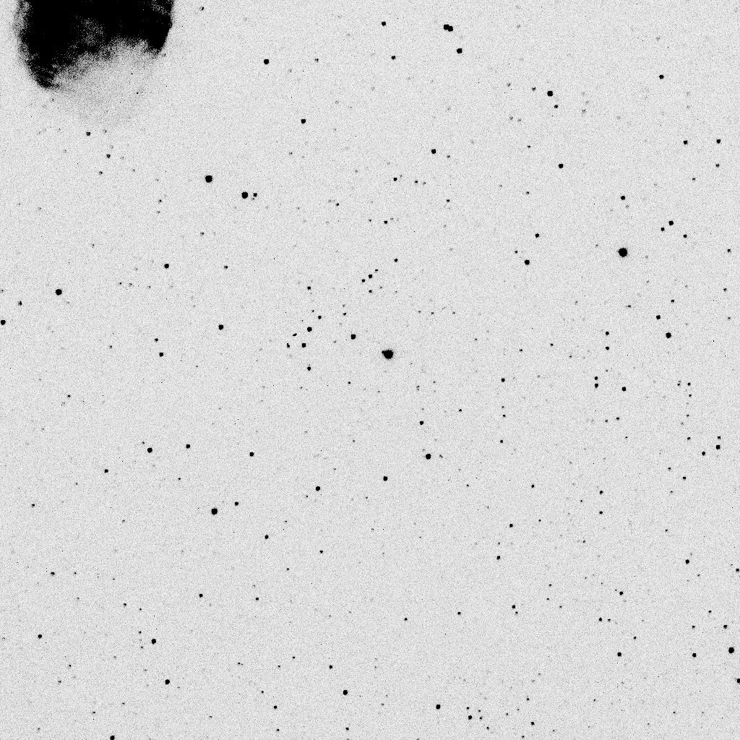
Data Acquisition
Equipment
Mt. Stony Brook 14-inch telescope
Hα filter + STL-1001E CCD camera
Procedure
1 observing run on Aug 31 - Sep 01
~600 images of target star
Exposure times
Early: 30s
Middle: 10s
Late: 12s
Take dark and flat frames, apply corrections to science images
A representative calibrated science image after dark and flat corrections. HD 189733 is indicated in red.
Notes:
We used the telescope on ESS with the H alpha filter and imagine CCD.
We took about 600 science images. We took the darks and flats and applied the master dark and flat to all images to correct them.
Here is an example of a calibrated science image.

Slide 5
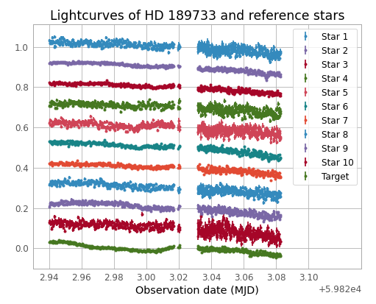
Data Reduction
Dark and flat corrections + astrometric coordinate solving
Source extraction
Detect stars in each science image
Aperture photometry
Extract counts of target + 10 reference stars, divide by exposure time to get flux
Normalize stars by their average flux
Plot normalized flux vs time
We observe: atmospheric seeing causes reference star fluxes to decrease over time
Lightcurves of HD 189733 and reference stars.
Notes:
We reduce the data through this procedure. So after the dark and flat corrections, we solve for the coordinates of the science mages using astrometry.net.
We used source extractor to detect stars and aperture photometry on the coordinates of science and reference stars to get their flux counts. And we normalized the flux counts of each star over its average flux. We have these vertically offset lightcurves and the reference stars follow more or less the same trend. And you can notice a dip in the brightness of the target star.

Slide 6
Data Reduction
Correcting target star for seeing
Create a mean reference star lightcurve
For each image: Calculate mean flux of all 10 reference stars + error on mean
Each star flux weighted on noise
Reduces statistical uncertainty of star fluxes and systematic uncertainty from star variabilities
Divide target star lightcurve by mean reference star lightcurve
Accounts for atmospheric seeing changes
Notes:
We divide target star lightcurve by mean reference star lightcurve to find the target star flux relative to reference star fluxes, and this accounts to atmospheric

Slide 7
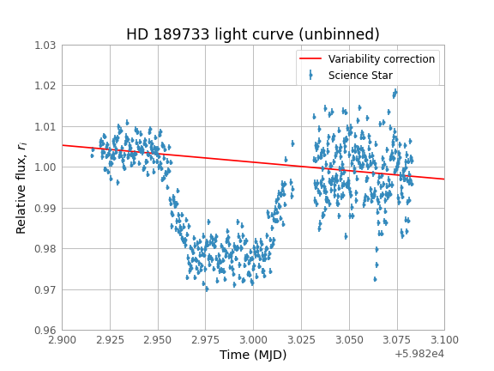
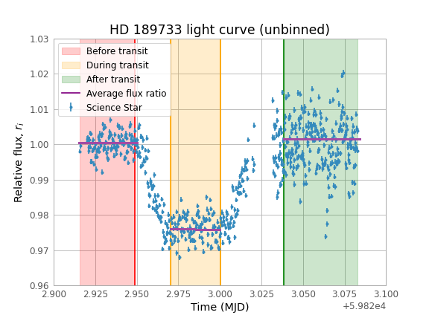
Results
HD 189733 is a BY Draconis variable star
Correct with linear fit to data before and after transit
Lightcurve without variability correction. Luminosity of HD 189733 decreases through observing run.
Lightcurve with variability correction and fitted means before, during, and after transit
Notes:
Upon normalizing the target star flux curve by the weighted mean reference star fluxes, we obtain the following lightcurve, which still shows a downward flux trend. This is because HD 189733 is a variable star. We correct for this variability using a linear fit to the baseline pre- and post-transit flux values, and here the variability correction model is shown over the data.
After dividing the data by this linear variability correction model, we obtain the corrected unbinned lightcurve. In order to find the transit depth, we take the mean of each segment before, during, and after the transit, as shown by the cut intervals in the diagram. And we took these means through linear fit.

Slide 8
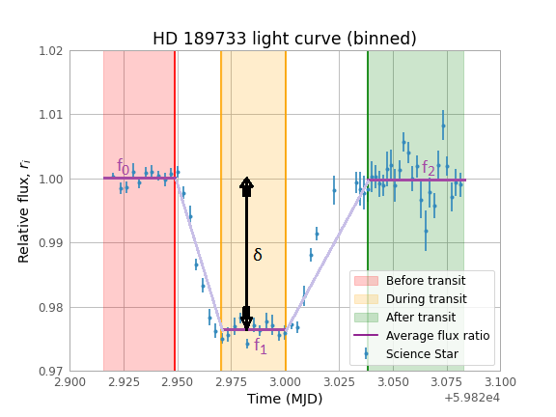
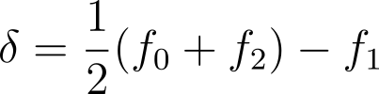
Results
Mean flux calculated with linear fit to binned data
Flux before transit: f₀ = 1.0001 ± 0.0009
Flux during transit: f₁ = 0.9766 ± 0.0015
Flux after transit: f₂ = 1.0001 ± 0.0012
Transit depth, δ
Difference between mean in-transit flux f₁ and mean baseline flux ½(f₀+f₂) [1]
δ = 2.3500 ± 0.0017%
Lightcurve binned in 10-point intervals.
[1] Winn, J. N. 2010, Transits and Occultations, arXiv, doi: 10.48550/ARXIV.1001.2010
Notes:
So with a linear fit to the unbinned data, we calculated the mean flux before, during, and after the transit. And we calculated the transit depth with this formula and got a 2.35% depth with a 0.0017% uncertainty, which is a significant detection.
And this diagram shows the method for calculating transit depth

Slide 9
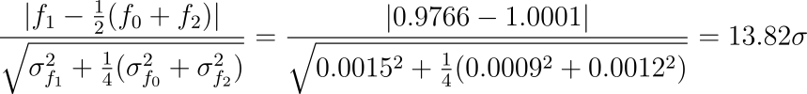
Analysis and Discussion
Transit detection
Detection significant (13.82σ > 3σ)
Transit depth
Experimental: δ = 2.3500 ± 0.0017%
Literature: δ = 2.40% [2]
Agrees with literature (0.29σ < 3σ)
[2] Cauley, P. W., Redfield, S., & Jensen, A. G. 2017, The Astronomical Journal, 153, 217, doi: 10.3847/1538-3881/aa6a15
Notes:
Transit depth agrees with the literature depth of 2.4%.

Slide 10
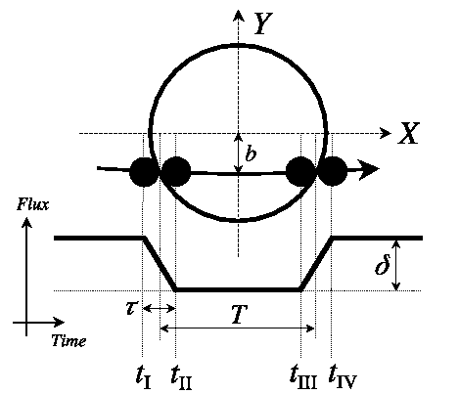
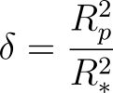
Analysis and Discussion
Planet-to-star radius ratio R_{p}/R* [1]
Planet disk crosses star disk during transit
Transit depth: proportion of star flux covered by planet, or ratio of disk areas
Result: R_{p}/R* = 0.153 ± 0.006
A diagram showing the calculation of transit depth δ from baseline and transit fluxes. The transit depth is equivalent to planet-to-star area ratio. [2]
[1] 2022, Caltech. https://exoplanetarchive.ipac.caltech.edu/docs/transit/transit algorithms.html
[2] Winn, J. N. 2010, Transits and Occultations, arXiv, doi: 10.48550/ARXIV.1001.2010
Notes:
From the transit depth we calculate the planet-to-star radius ratio. And in a transit, the disk of the planet passes in front of the star disk, so the amount of starlight blocked is just the ratio of the disk areas, hence the radius squared ratio.
So we find the radius ratio by taking the square root of transit depth determined earlier and we get δ = 0.153 with a measurement uncertainty of 0.006.

Slide 11
Analysis and Discussion
Planet-to-star radius ratio
Experimental: R_{p}/R* = 0.153 ± 0.006
Literature: R_{p}/R* = 0.155 [1]
Agrees with literature (0.33σ < 3σ)
[1] Sing, D. K., Désert, J.-M., Lecavelier des Etangs, A., et al. 2009, A&A, 505, 891, doi: 10.1051/0004-6361/200912776
Notes:
So we see that our experimental planet-to-star radius depth agrees with literature value of 0.155, as indicated by the significance of 0.33 sigma less than 3 sigma..

Slide 12
Sources of error
Systematic error
Telescope focus
Photometric aperture may contain too few or too many pixels of target star
Star became brighter later in night possibly due to focus improving
Compensate by reducing exposure time 30s to 12s, to keep pixel counts in linear regime
Variability in star
Divide by linear fit to baseline flux
Statistical error
CCD thermal noise
Seeing
Decreases SNR
Reduces flux when star is lower
Correct for this by normalizing over mean reference star lightcurve
Data is Poisson
Uncertainty in each data point
Notes:
There were several sources of error in our investigation and we attempted to mitigate them.

Slide 13
Conclusions
Results
Successful detection of transit 13.82σ > 3σ
Transit depth 2.3500 ± 0.0017% agrees with literature (0.29σ < 3σ)
Planet-to-star radius ratio 0.153 ± 0.006 agrees with literature (0.33σ < 3σ)
Sources of Error: telescope focus, stellar variability, seeing, CCD noise
Future investigations
Based on planet-to-star radius ratio and star radius, calculate HD 189733 b radius
Notes:
So in conclusion, we successfully detected the transit of exoplanet HD 189733 b and our results of transit depth and radius ratio both agree with literature. The error in our investigation results from telescope focus, seeing, and CCD noise.
A future investigation would be to use the planet-to-star radius ratio and a measurement of stellar radius from temperature and luminosity to calculate the exoplanet’s radius.

