Slide 1

Parallel Programmability
and the Cowichan Problems
Parallel Programmability
and the Cowichan Problems
Andrew Borzenko
Cameron Gorrie

Slide 2
The Parallel Problem
Parallel hardware is becoming ubiquitous faster than developers are learning how to use it effectively.
  as a result, hundreds of parallel programming systems for various systems and programming languages have cropped up—with various degrees of polish, usefulness, and success
Wilson [94] developed a set of “toy” problems to implement using various parallel systems to assess their degrees of programmability, dubbed the “Cowichan problems”.
We have implemented an updated version of the Cowichan problem set using two state-of-the-art parallel systems in order to assess ease of implementation and overall usefulness
We define programmability a qualitative metric encompassing effort on the part of the application developer—how difficult it is to get ideas “onto paper” with the parallel system (intuitiveness).

Slide 3
Message Passing Interface
Message Passing Interface (MPI) is a specification for an API that allows many computers to communicate with one another.
Boost.MPI is a library for message passing in high-performance parallel applications.
Boost MPI is not a completely new parallel programming library. Rather, it is a C++-friendly interface to the standard Message Passing Interface, the most popular library interface for high-performance, distributed computing.
MPICH is an MPI implementation that efficiently supports various computation and communication platforms.
There are other implementations of MPI, but we used MPICH since it is platform independent (in particular, it runs on windows)
Sources: boost.org, www.mcs.anl.gov

Slide 4

Threading Building Blocks
TBB is a high-level parallelism library developed by Intel for
C++ developers, incorporating many basic threading ideas not covered by system call interfaces
  It also contains primitives and classes that implement a form of the data-parallel paradigm; refer to this as TBB/DP
The data-parallel paradigm (DP) expresses work-sharing by doing exactly the same thing to (potentially) large collections of data
  Worker sub-processes cannot communicate
  Programmer defines the data domain (where),
  and the operation to do with that data (what)
  Key Insight: TBB decides the how (i.e.
  splitting up the range onto different workers)

Slide 5
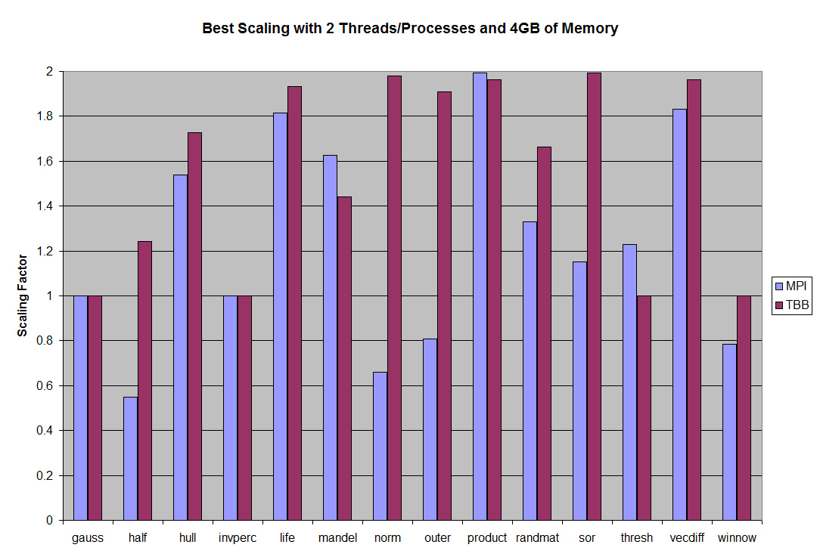

Slide 6
Performance Analysis
Problems that are hard to parallelize in both: gauss, invperc, winnow
Problems that perform better with MPI: mandel (due to use of task farm), thresh, product
Problems that perform better with TBB: half, hull, life, norm, outer, randmat, sor, vecdiff
Generally, TBB performs better because of the low cost of communicating the result—MPI communication is done between nodes that do not share any memory, while TBB uses threads and does use shared memory.

Slide 7

Some programming problems are impossible to effectively parallelize.
Developers looking to effectively utilize parallel hardware aren't always starting at square one. The opposite is probably true, in fact—an existing serial codebase is being “parallelized”.
The natural question that arises from these developers is a simple one: “can my code be made
parallel, or am I wasting my time?”
The Invasion Percolation problem
from the Cowichan problem can be
solved in parallel, but the serial im-
plementation is orders of magnitude
faster. This is because every step of
evaluation depends on the results of the previous step.
              Some programming problems are impossible to effectively parallelize, and—more broadly—some problems cannot be phrased in the “language” of a specific parallel system.

Slide 8
MPI: Practical Uses
Running on supercomputers or clusters
Algorithms should be restricted to those that have very good parallelization potential, due to slow communication speed
Boost::MPI is good choice for algorithms that work on enormous datasets that cannot necessarily fit in the memory of a single node
  The best-case scenario for parallel speed-up was with the matrix vector product cowichan problem.
  We used 8 machines (on CDF), with 1 process per machine.
  The resulting speed-up was 6.4, that is, the MPI implementation was able to solve the problem at 640% of the speed of the serial version.

Slide 9
MPI: Point-by-Point
ADVANTAGES
DISADVANTAGES
Full support for both primitive and user-defined data types
Built-in operations on arrays, vectors, strings
Boost.Serialization facilitates transfer of arbitrary data between nodes
Allows heterogeneous operations on aggregates
Support for process groups
Synchronization is hidden from the user
Boost::MPI and MPICH are both very well-maintained and platform independent
Very invasive code modification or restructuring required for existing applications, as MPI must be used everywhere
Slow startup/shutdown when using a lot of nodes
Performance limited by communication since memory is not shared between nodes
Precisely the same executable must be used on every node.
Memory usage can be a problem when running multiple nodes on the same computer
Generally, requires large datasets to show performance benefits

Slide 10
TBB/DP: Point-by-Point
ADVANTAGES
DISADVANTAGES
Simple set-up and non-invasive code modification needs for existing applications (very drop-in friendly)
Conceptually simple—a low learning curve contributes to a good level of programmability
Shared memory architecture is familiar to application developers
Well-maintained by a large company, and cross-platform
Work is split automatically; write for n processors rather than a specific #
Good parallel speed-up, even for small datasets
Implements work-stealing
Expressing problems as data-parallel problems (identical sub-tasks) can be the most challenging part, and some problems do not translate well to this paradigm
Work can only be split up locally; there is no cluster or network capability
Work can only be split into new threads; therefore, as of now, there is no support for GPU programming

Slide 11
Code Examples
int lo, hi; /* work controls */
int r, c; /* loop indices */
int rank;
// work
if (get_block_rows_mpi (world, 0, nr, &lo, &hi)) {
for (r = lo; r < hi; r ++) {
result[r] = matrix[r * nc] * vector[0];
for (c = 1; c < nc; c++) {
result[r] += matrix[r*nc + c] * vector[c];
}
}
}
// broadcast result
for (rank = 0; rank < world.size (); rank++){
if (get_block_rows_mpi
(world, 0, nr, &lo, &hi, rank)) {
broadcast (world, &result[lo], hi-lo, rank);
}
}
// use TBB to iterate over the given range
parallel_for(
blocked_range2d<size_t,size_t>
(0, BOARD_SIZE, 0, BOARD_SIZE),
myGame, auto_partitioner());
...
void Game::operator()(const blocked_range2d<size_t,size_t>& range) const {
// calculate this section of the game
for (y in range.rows())‏ {
for (x in range.cols()) {
int peers = sumNeighbours(x, y);
if (peers<2 || peers>3)‏
(*second)[y][x] = 0;
elif (peers == 3)‏
(*second)[y][x] = 1;
else
(*second)[y][x] = (*first)[y][x];
}
}
}
MATRIX-VECTOR PRODUCT
Implementation of product using Boost::MPI
GAME OF LIFE
Implementation of life using TBB/DP

Slide 12
Conclusions
MPI, while being an extremely powerful platform, has a prohibitively large number of disadvantages that make it a poor choice for the wider audience of application developers.
TBB and data parallelism is relatively simple to program, but lacks the ability to distribute work over a network or cluster. It is, however, a good choice if work will remain on the same computer.
A novel library with a high degree of programmability that combines local and distributed parallel processing approaches would fill the gap.
  an application could simply use both TBB and MPI for the same purpose—but this “solution” has a very low degree of programmmability due to its complexity and the extreme amount of effort required by the application developer.

