Slide 1
De novo assembly validation
Tools and techniques to evaluate de novo assemblies in the NGS era.
Martin Norling

Slide 2
Why do we need assembly validation?
Is my assembly correct?
I used all the assemblers – now, which result should I use?
Is this assembly good enough for annotation?
Notes:
We started touching a little bit on this yesterday when we did kmer-estimation of genome sizes and calculated assembly statistics to try to evaluate which assembly was better from the programs we used.

Slide 3
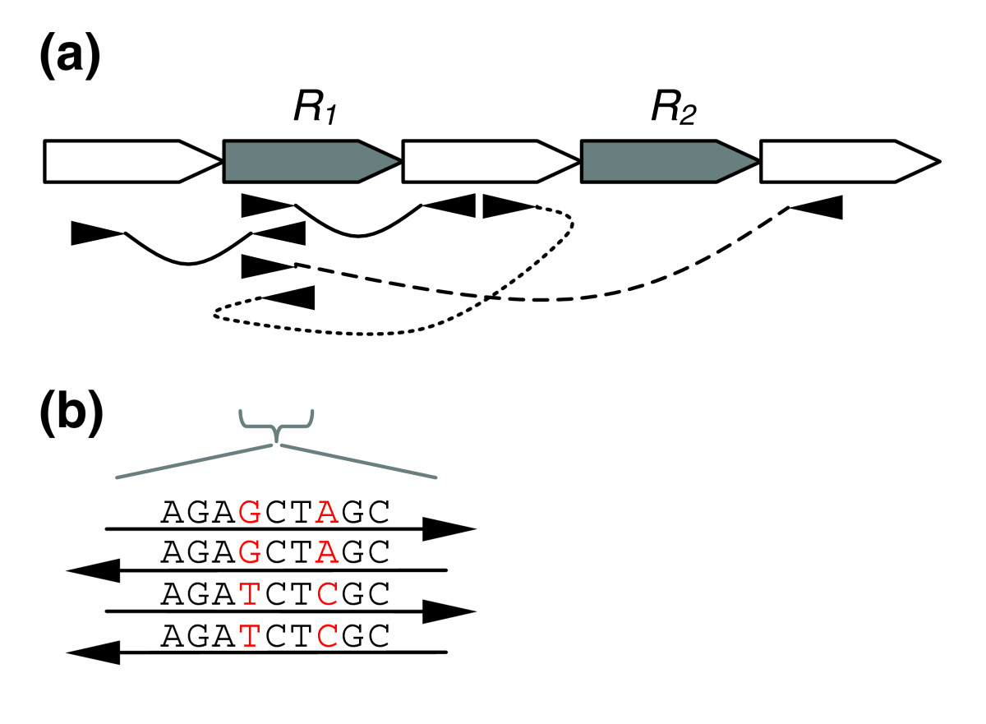
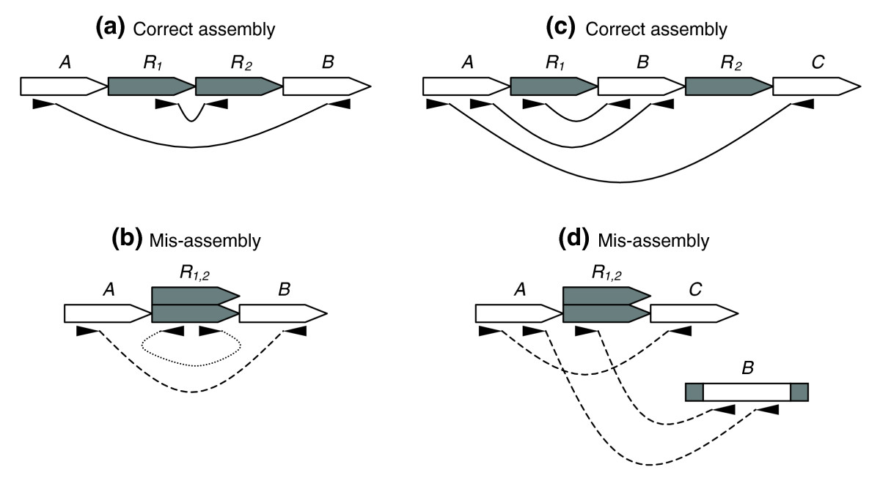
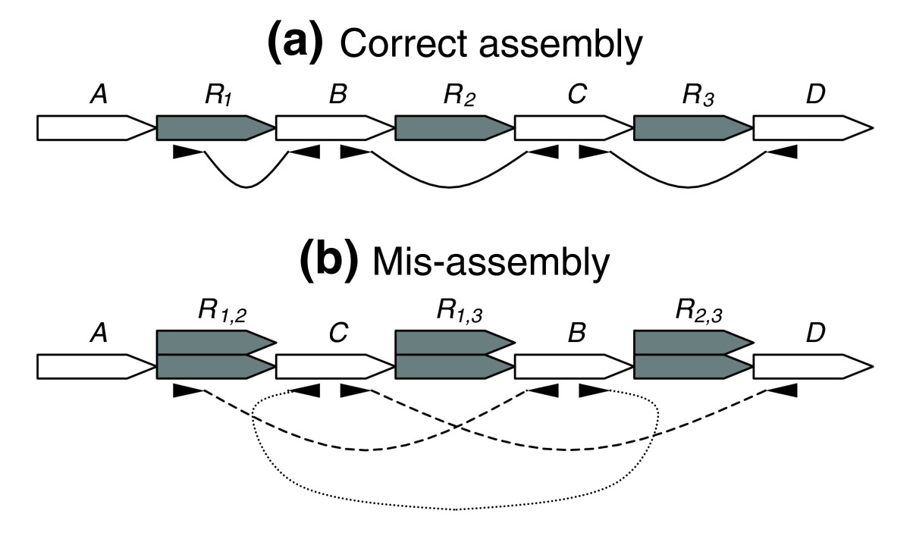
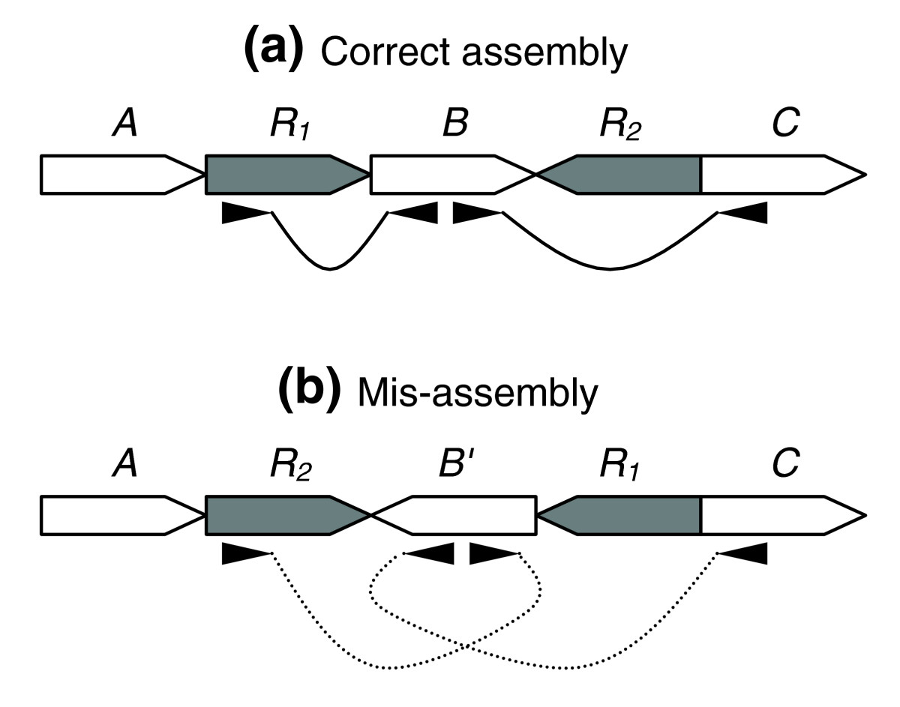
RepeatsRepeatsRepeatsRepeatsRepeatsRepeatsRepeatsRepeats
Overlapping non-identical reads
(false SNP in mapping)
Collapsed repeats
(too high coverage in mapping)
Wrong contig order
Inversions

Slide 4
Sources of assembly errors
Assembler Name | Algorithm | Input
Arachne | OLC | Sanger
CAP3 | OLC | Sanger
TIGR | Greedy | Sanger
Newbler | OLC | 454/Roche
Edena | OLC | Illumina
SGA | OLC | Illumina
MaSuRCA | De Bruijn/OLC | Illumina
MIRA | De Bruijn/OLC | Illumina/PacBio/454/Sanger
Velvet | De Bruijn | Illumina
ALLPATHS | De Bruijn | Illumina/PacBio
ABySS | De Bruijn | Illumina
SOAPdenovo | De Bruijn | Illumina
Spades | De Bruijn | Illumina/PacBio
CLC | De Bruijn | Illumina/454
CABOG | OLC | Hybrid
Every species has it’s own surprises,
Every sequencing chemistry has it’s strengths and weaknesses,
Every assembly program has it’s own set of heuristics.

Slide 5
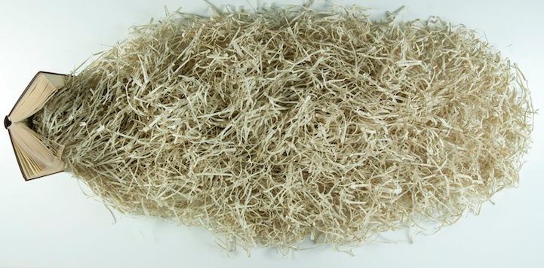
Copying a book without the original
How can we validate an assembly, without knowing what it’s supposed to look like?
Notes:
We can’t compare to what the ideal result would be, but we can compare towards the _expected_ result of an assembly.

Slide 6
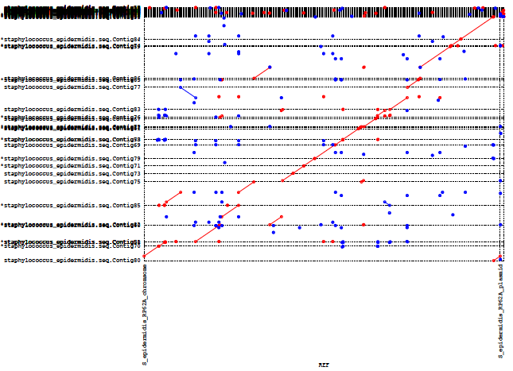
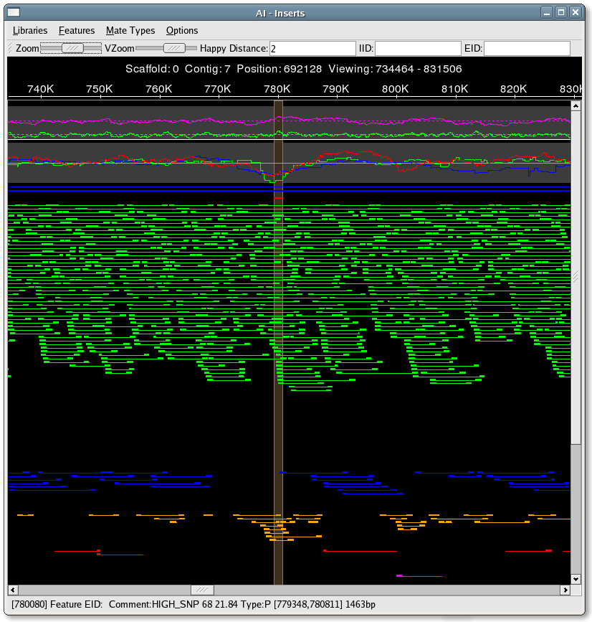
Validation using a reference
Counting errors not always possible:
Reference almost always absent.
Error types are not weighted accordingly.
Visualization is useful, however:
No automation
Does not scale on large genomes
Looks like this is difficult even
with the answer…

Slide 7
Without a reference
There is no a real recipe, or a tool. We can only suggest some best practice.
Statistics (N50, etc.)
Congruency with raw sequencing data:
  Alignments
  QAtools
  FRCbam
  KAT
  REAPR
Gene space
  CEGMA and BUSCO
  reference genes
  transcriptome

Slide 8
Standard metrics
Standard contiguity measures:
#contigs, #scaffolds, max contig length, %Ns, etc.
N50 is the MOST abused metric typically refers to a contig (or scaffold) length:
The length of longest contig such that the sum of contigs longer than it reaches half of the genome size (some time it refer to the contig itself)
Many programs use the total assembly size as a proxy for the genome size; this is sometimes completely misleading: Use NG50!
NG20, NG80 are often computed, it is important also to find more ”easy to understand metrics”:
- contigs larger than 1 kbp sum to 93% of the genome size
- contigs larger than 10 kbp sum to 48% of the genome size
- contigs larger than 100 kbp sum to 19% of the genome size
N50
NG50
Assembly size
Genome size
Genome
Assembly
3 contigs
100 kbp
5 contigs
30 kbp

Slide 9
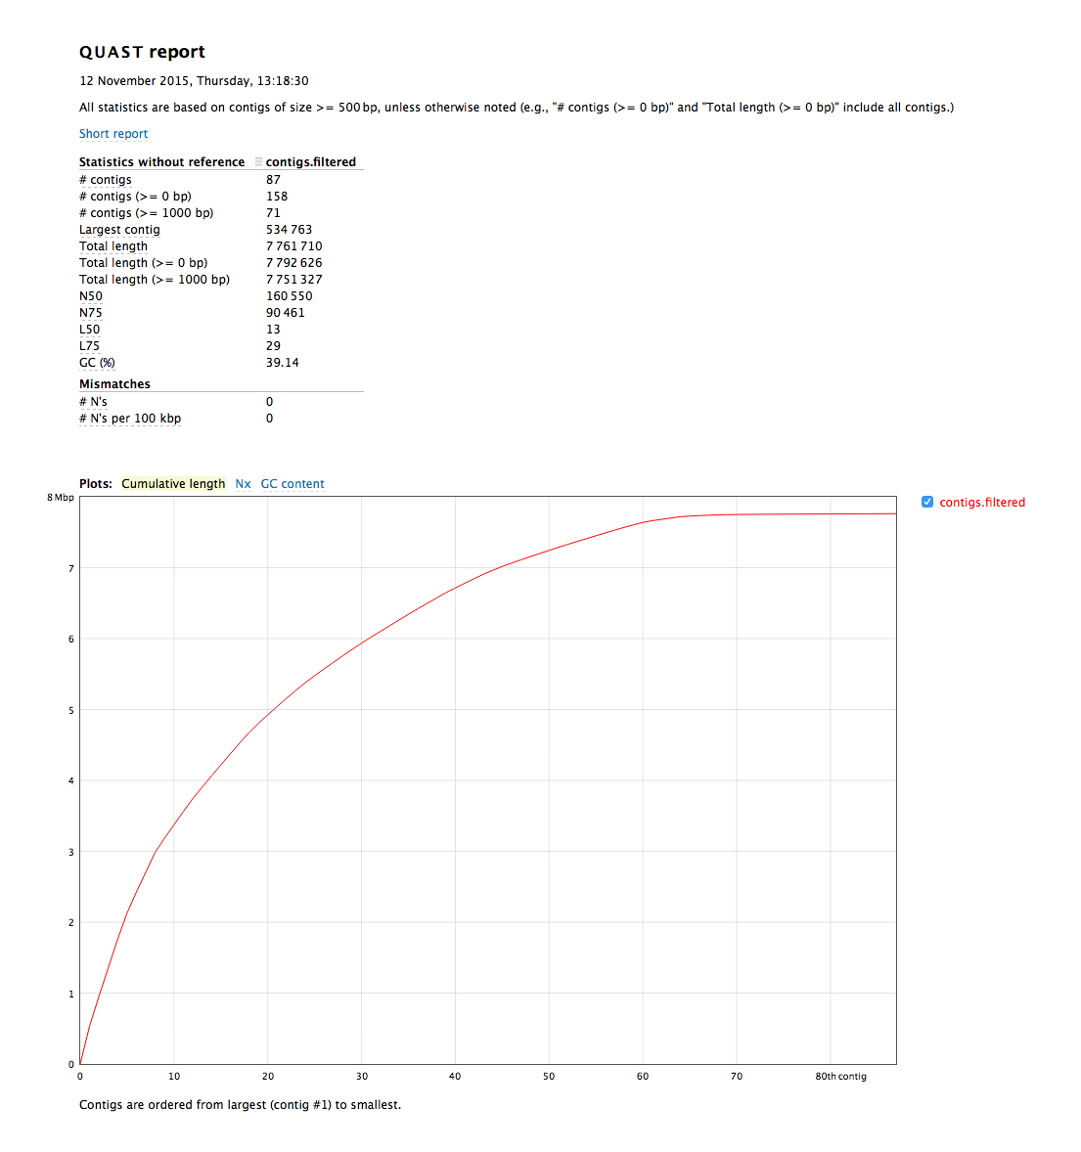
QUAST
Quality Assessment Tool for Genome Assemblies
You’ve already used QUAST in the previous tutorial. It quickly creates PDF and HTML reports on cumulative contig sizes, and basic sequencing statistics.

Slide 10
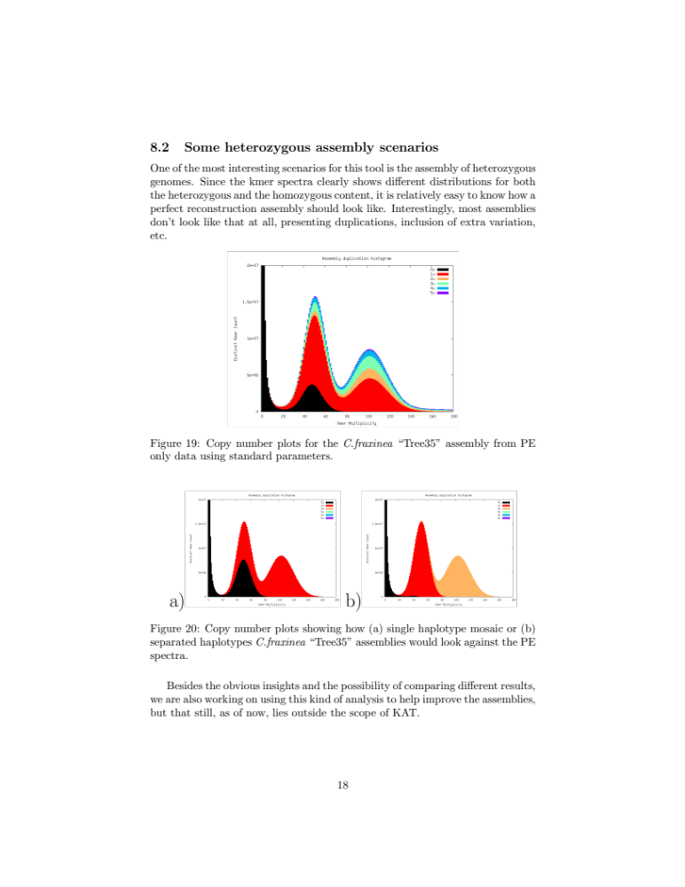
K.A.T
You worked with the Kmer Analysis Toolkit earlier as well. It produces (among other things) statistics on how the kmers within the reads where used in the assembly.

Slide 11
Paired statistics
Using paired ends or mate-pairs gives access to a lot of features to validate:
Are both pairs in the assembly?
Are the pairs in the right order?
Are the pairs at the correct distance?
All these things are good indicators of problems!

Slide 12
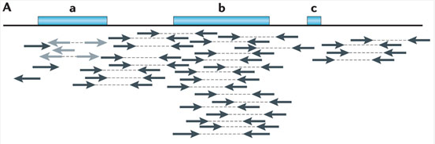
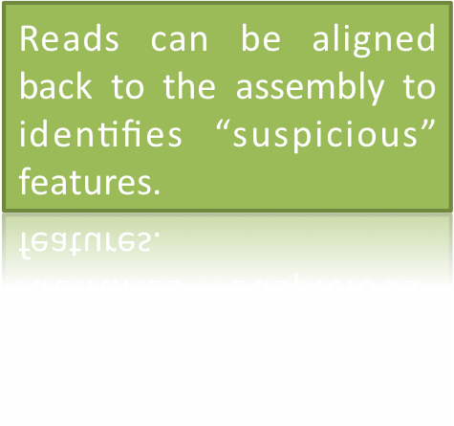
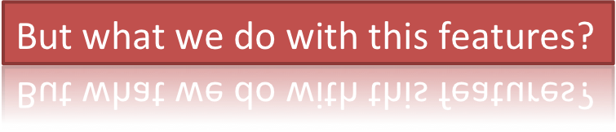
Data congruency
Idea: Map read-pairs back to assembly and look for discrepancies like:
  no read coverage
  no span coverage
  too long/short pair distances

Slide 13
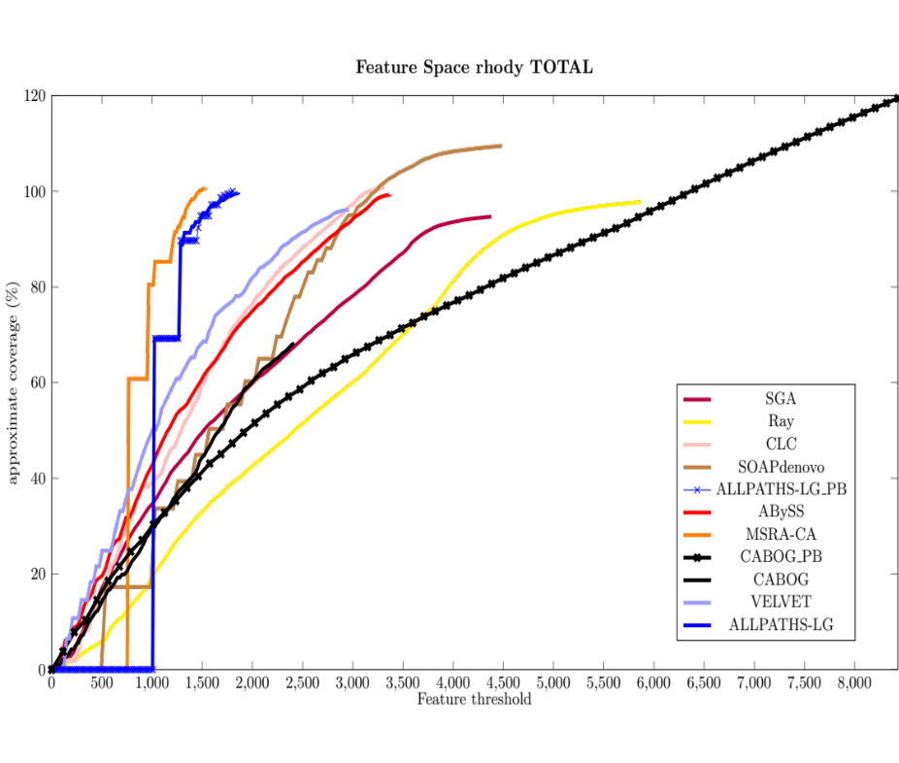
FRCurve
The Feature Response Curve (FRCurve) characterizes the sensitivity (coverage) of the sequence assembler as a function of its discrimination threshold (number of features ).
Feature Response Curve:
Overcomes limits of standard indicators (i.e. N50)
Captures trade-off between quality and contiguity
Features can be used to identify problematic regions
Single features can be plotted to identify assembler-specific bias
FRC^{bam} predicted “Assemblathon 2” outcome
FRC^{bam} (Vezzi et al. 2012)

Slide 14
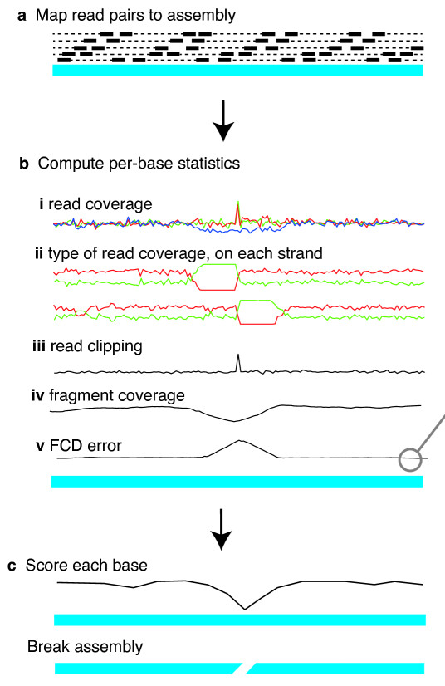
REAPR
Uses same principle of FRCurve:
Identifies suspicious/erroneous positions
Breaks assemblies in suspicious positions
The “broken assembly” is more fragmented but hopefully more corrected (REAPR cannot make things worse…)
REAPR (Hunt et al. 2013)

Slide 15
Gene space
CEGMA (http://korflab.ucdavis.edu/datasets/cegma/)
HMM:s for 248 core eukaryotic genes aligned to your assembly to assess completeness of gene space
“complete”: 70% aligned
“partial”: 30% aligned
BUSCO(http://busco.ezlab.org/)
Assessing genome assembly and annotation completeness with Benchmarking Universal Single-Copy Orthologs
Similar idea based on aa or nt alignments of
Golden standard genes from own species
Transcriptome assembly
Reference species protein set
Use e.g. GSNAP/BLAT (nt), exonerate/SCIPIO (aa)

Slide 16
CEGMA and BUSCO
This is an odd time. CEGMA is obsolete, but BUSCO hasn’t really come into use. CEGMA allows comparison to earlier studies, but BUSCO is easier to use and more flexible.

Slide 17
Validation Analyses
Restriction maps
Optical mapping
Sanger sequencing
RNAseq
etc.
Never forget that whatever fancy things we do in the computer, it’s never as good as actually going back to the lab and verifying an assembly.

Slide 18

Getting to results in time can sometimes be stressful for researchers, but taking the extra time to validate your work will allow you to trust it going forward!

Slide 19

Questions?
The de novo validation exercise is available at
http://scilifelab.github.io/courses/denovo/1511/exercises/denovo_validation

