Slide 1

De Novo Genome Assembly - Introduction
Henrik Lantz - BILS/SciLife/Uppsala University

Slide 2
De Novo Assembly - Scope
De novo genome assembly of eukaryote genomes
Bioinformatics in general, programs in particular
Practical experience
Ease of entry - not memorization

Slide 3
Schedule - de novo assembly course
Monday November 16
9 - 9.15 Welcome to the course
9.15 - 10.00 NGS Sequence technologies (Henrik Lantz)
10.00 - 10.20 Coffee break
10.20 - 11.00 Quality assessment (Henrik Lantz+Mahesh Panchal)
11.00 - 12.00 Computer exercise - Quality assessment
12.00 - 12.45 Lunch
12.45 - 13.30 Genome assembly (Henrik Lantz)
13.30 - 17.00 Computer exercise (incl. coffee break) - Genome assembly
18.00 - Dinner at Lingon
Tuesday November 17
9.00 - 10.00 Assembly validation (Martin Norling)
10.00 - 10.20 Coffee break
10.20 - 12.00 Computer exercise - Assembly validation
12.00 - 12.45 Lunch
12.45 - 15.00 Computer exercise - Assembly validation contd. (incl. coffee break)
15.00 - 17.00 Discussion of exercises + evaluation
All lectures and exercises in this room!

Slide 4
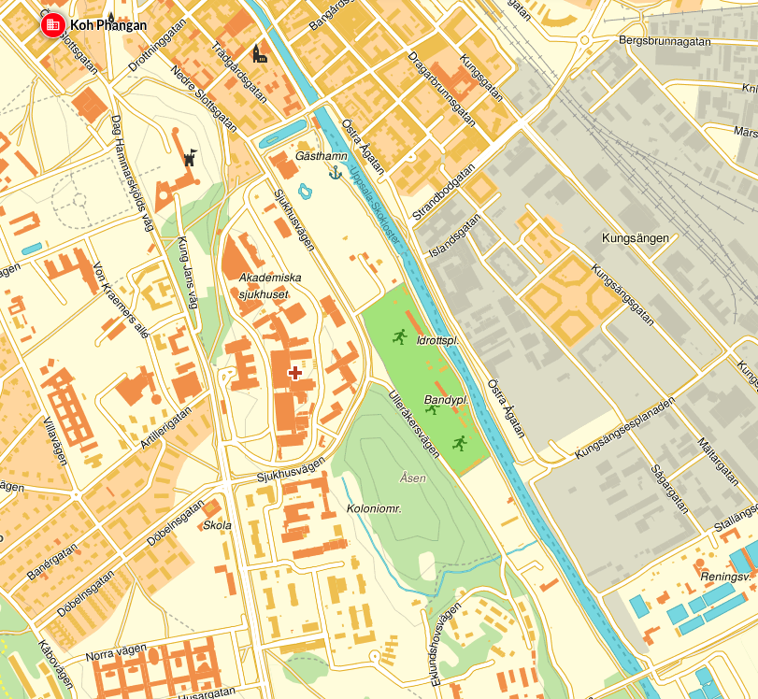
Practical info
Coffee breaks
Lunch
Dinner at
Koh Phangan 18.00
Övre slottsgatan 12

Slide 5
De Novo Genome Assembly - Sequence Technologies
Henrik Lantz - BILS/SciLife/Uppsala University

Slide 6

De novo genome project workflow
Extracting DNA (and RNA) - as much DNA as possible! Single individual and haploid tissue if possible!
Choosing best sequence technology for the project
Sequencing
Quality assessment and other pre-assembly investigations
Assembly
Assembly validation
Assembly comparisons
Repeat masking?
Annotation

Slide 7
NGS Sequence technologies
Deprecated
  454
  Solid
Supported, not used much in genome assembly
  Ion Torrent (Ion PGM)
  Ion Proton
Current workhorses
  Illumina
  Pacific biosciences
Up and coming
  Oxford Nanopore
  10x genomics - GemCode

Slide 8
Supporting technologies
BioNano (Irys system)
Dovetail genomics (Chicago libraries)

Slide 9
NGS sequencing
Genomic DNA is fragmented (not Nanopore) and sequenced -> millions of small sequences (reads) from random parts of the genome
Depending on sequence technology, reads can be from 100 bp up to 100kb in length

Slide 10
Assembly
Reads
5x
2x
Coverage
Assembly
Overlapping
reads
Consensus sequence = genome
Usually the haploid genome that is reported
Coverage = number of reads that support a certain position
Average coverage often asked for/reported

Slide 11
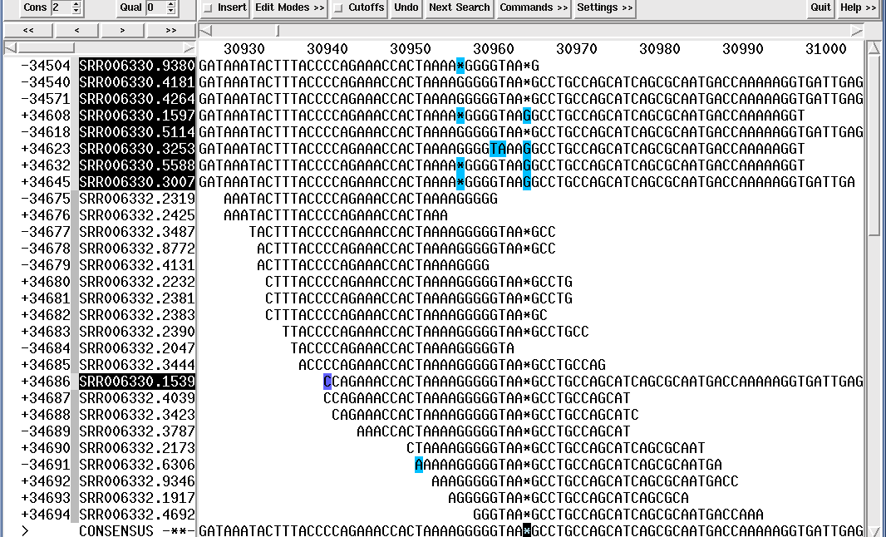
.ace file of assembly

Slide 12
Average Coverage
Example: I know that the genome I am sequencing is 10 Mbases. I want a 50x coverage to do a good assembly. I am ordering 125 bp Illumina reads. How many reads do I need?
(125xN)/10e+6=50
N=(50x10e+6)/125=4e+6 (4 million reads)
A Illumina lane gives you 180x2 million reads (PE)

Slide 13
Fastq format
@HWI-ST0866_0110:5:1101:1264:2090#GATCAG/1
AGGCACTCCCTGCAGGTGTTGGACCACCTGGCTGAGCCACAGCGTCGCTTCCTGCTGCCAGGGCCTCGGAGAGGGTGGCTGTGGAGACACTGTGGGAGCA
+HWI-ST0866_0110:5:1101:1264:2090#GATCAG/1
^_P\`ccceeceeeee[b[beedaae_fdddde_cfhheedfeeh__`aeadd`d]baccc\[TKT\]_\ZQT^a[W[^^aW`^`aX^X^`_Y]^aBBBB
@HWI-ST0866_0110:5:1101:1418:2201#GATCAG/1
TCTTTATTGGCATCAGGCATCACCACACCATGGTTCTTGGCTCCCATGTTGGCCTGGACTCTCTTGCCATTCCGGGATCCTCTCTCATAGATGTACTCGC
+HWI-ST0866_0110:5:1101:1418:2201#GATCAG/1
__P`ccceegge]eghhhhdfhhhhhhhhhfhhefghffffhffhhfheg^eeffgfegf`fghhhffhhggadcX[`bbbbbbbbbcbbbcbR]aabaa
Quality values in increasing order:
!"#$%&'()*+,-./0123456789:;<=>?@ABCDEFGHIJKLMNOPQRSTUVWXYZ[\]^_`abcdefghijklmnopqrstuvwxyz{|}~
You might get the data in a .sff or .bam format. Fastq-reads are easy to extract from both of these binary (compressed) formats!

Slide 14
Fasta format
>asmbl_2719
AGCACCTAGAGCAGGATGGGAGGTCTCTCCTTGCTGTGGCAGAGGCAGATCTCCTTTCCC
AACACCTAGCAGTATGAACTAGTGAGCTCCTGACTGTTTTCCAGTGGTAATGAGGTGTGA
CCCGCTGCAGCTGCACACTGAATTCTCTCAGTTCCCCGAGGCCAGCCCAGCAGTGTGGGC
AATGCTTTGTTTGTGTGCTGTTGACCATTCC
>asmbl_2702
GTCTGCACTGGGAATGCCCCCTGGAGCAGAACCATTGCCATGGATAAGGACACTACATTT
CCTGGTGTTAAGGTGAATATAACCTCCAGGTTAAGGATGACATTAATTTCAATTACAGCT
TGCCTCTTGTAAGCTAAGCAGTTAATCAACAAGCTATACTGTGACTACACCCTTAGATCA
ATAGCTGGGAAAACATCACCTCCCCCAAATACTCCACCTCTTAACTGCACTCTTTGAAAG
AAGTACAGGCCAGAGTTTAGCTGATCCATCCCTGTGGCTAATCGTCCTGCTTACAAGCTG
CAATATTTTTTAAAACCAGACAATTGGTAGAGGTTTAAACATCAGCCAAGCTGTTCAATT
TACAGCAGGTTAAGCATTCCTGAAACTGTGATCACTGATATATTTGGGTCAGTCAGATGT
CTTGTTAGTGCTT
>asmbl_2701
ACAAACAAAACAAAATAAAACAAAGGAAACAAGCAAAAAAAACCATCATACAATCCCATG
TGTCCAAGAGCTTTACTGTGAAATCAACTATGGAGTCAAAACAATAGAAAAGCTTCCAGA
TTTCTGTATTCCAGGCTGAGACAAGTTTGTAAATACTTCCAGAAATTGCCAACAAGCCTG
CAGGGTAACATCTCTAATGCACACCTCCCTGATACGAAATGCAGAGCACCTTAACTTCTT
CAGCCCTCCCCCAGTCACAACCAGCTATAAATCCTGCCCTTCACTTGTTGGAATATCTCA
TCATAAGGGAAGCATTTTTTAGGCTGAGAAATACAAATCCACCTTGACGGAGCCGGTCAG
GCATATACATGGGCTATGCTGCTGATAGGTTTGTACCAAGCACTCCTAGTGTGAGAATAA

Slide 15
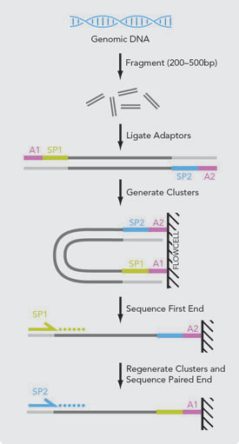
Paired-End

Slide 16
Insert size
Insert size
Read 1
DNA-fragment
Read 2
Adapter+primer
Inner mate distance

Slide 17
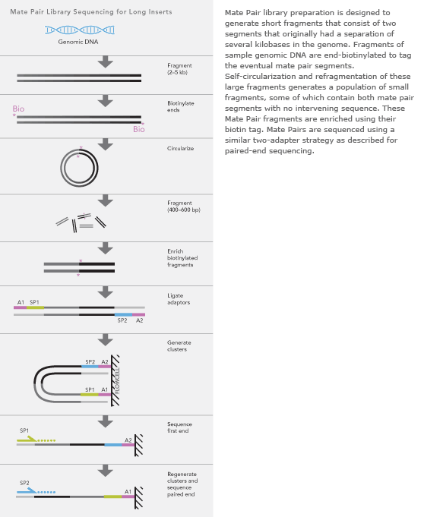
Mate-pair
Used to get long
Insert-sizes
Large amounts of high quality
DNA needed.

Slide 18
Contigs and scaffolds
Contig = a continuous stretch of nucleotides resulting from the assembly of several reads
Scaffold = several contigs stitched together with NNNs in between
Paired-end reads
NNN
NNN
contig1
contig2
contig3
NNN
NNN
scaffold1

Slide 19
N50 - contigs of this size or larger include 50 % of the assembly
>contig1
TTTATGTCCGTAGCATGTAGACATATGGCA 30 bp 30
>contig2
AGTCTTGAGCCGAATTCGTG 20 bp 30+20=50 (>45)
>contig3
GTTGGAGCTATTCAGCGTAC 20 bp
>contig4
ACAAATGATC 10 bp
>contig5
CGCTTCGAAC 10 bp
90 bp total
50% of total = 45
L50 = number of contigs that include 50% if the assembly. Here, L50=2!
N50=20!

Slide 20
NG50 - compared with genome size rather than assembly size
N50 - contigs of this size or larger include 50 % of the assembly
NG50 - contigs of this size or larger include 50 % of the genome
NG50 is a better approximation of assembly quality, but can sometimes not be calculated, e.g., the genome size is unknown
Can be quite different from N50, e.g., genome is 1,5 Gb but assembly is 1 Gb due to non-assembled repeats

Slide 21
NGS Sequence technologies
Deprecated
  454
  Solid
Supported, not used much in genome assembly
  Ion Torrent (Ion PGM)
  Ion Proton
Current workhorses
  Illumina
  Pacific biosciences
Up and coming
  Oxford Nanopore
  10x genomics - GemCode

Slide 22
Sequencing technology comparison
Sequencing system | Read length | Yield
Illumina Hi-Seq 2500 | 2x125 bp | 180 M read pairs/lane, 28 Gbp/lane
Illumina HiSeqX | 2x150 bp | 350 M read pairs/lane, 78Gbp/lane
Illumina MiSeq | Up to 2x300 bp | 18 M read pairs/lane, 7.4Gbp/run
PacBio | 1-20 (70) kb | 1.3 Gb/SMRTcell
Oxford Nanopore | 1-100kb | ?

Slide 23
Error rates and types
Sequencing system | Error type | Error rate
Illumina | Substitutions | 0.1%
PacBio | Insertions | 0.001-15% depending on read length
Oxford Nanopore | Substitutions, indels | 38%

Slide 24

Illumina technology

Slide 25
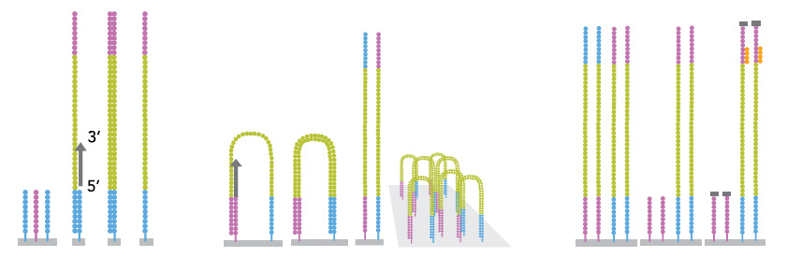
Illumina
Pros: Huge yield, cheap, reliable, read length “long enough” (100-300 bp), industry standard=huge amount of available software
Cons: GC-problems, quality-dip at end of reads, long running time for Hi-Seq, short insert-sizes

Slide 26
PacBio technology

Slide 27
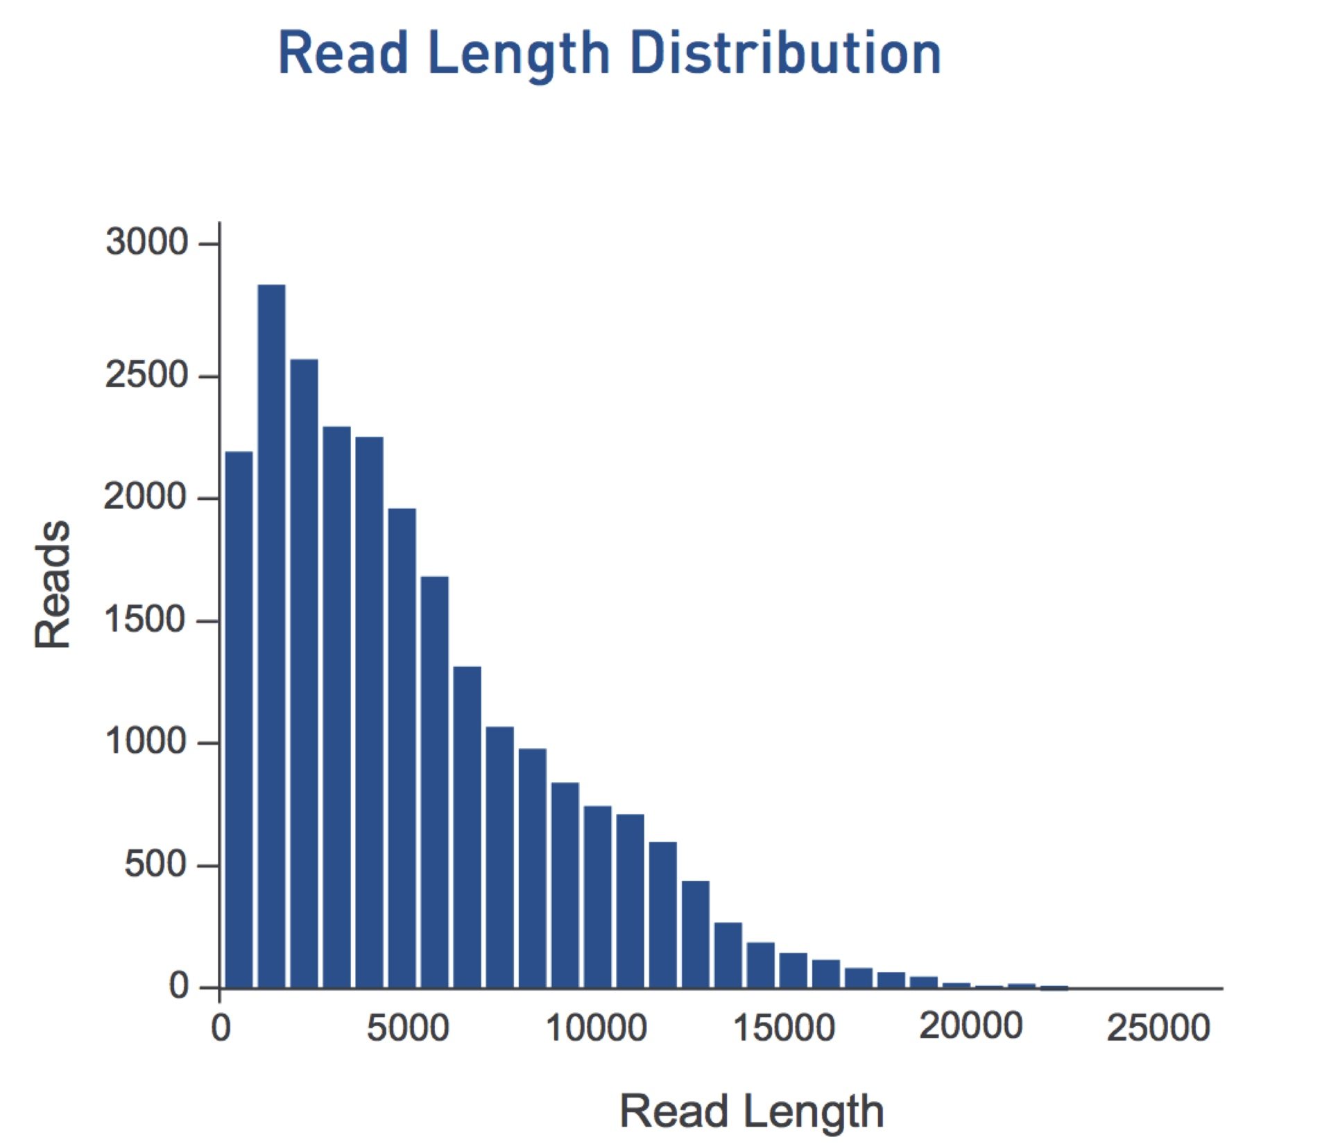
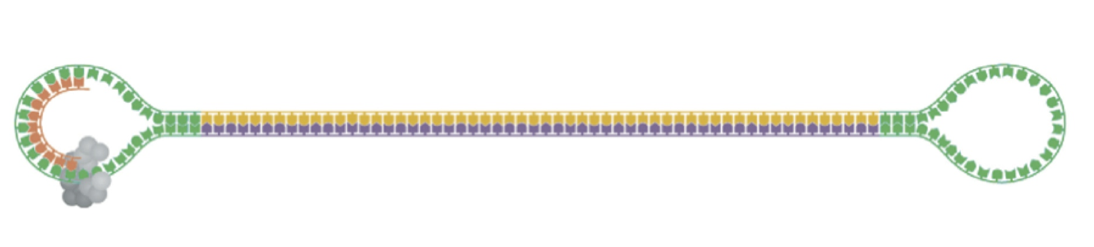
Pacific Biosciences
Pros: Long reads (average 4.5 kbp), single molecules
Cons: High error rate on longer fragments (15%), expensive

Slide 28
Nanopore technology

Slide 29
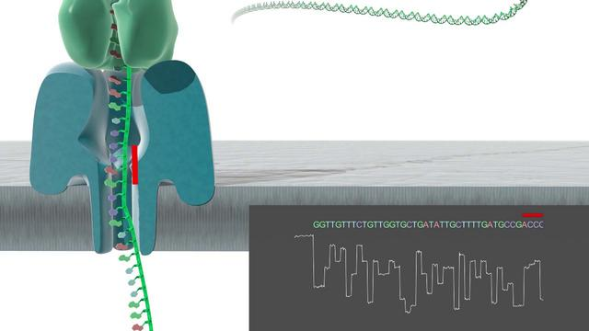
Nanopore
Pros: Extremely long sequences, single molecule, portable
Cons: Very high error rates (38%!)

Slide 30
10x genomics
Long DNA fragments are separated in gel beads (gems) and then sequenced with Illumina HiSeq -> artificial long reads

Slide 31
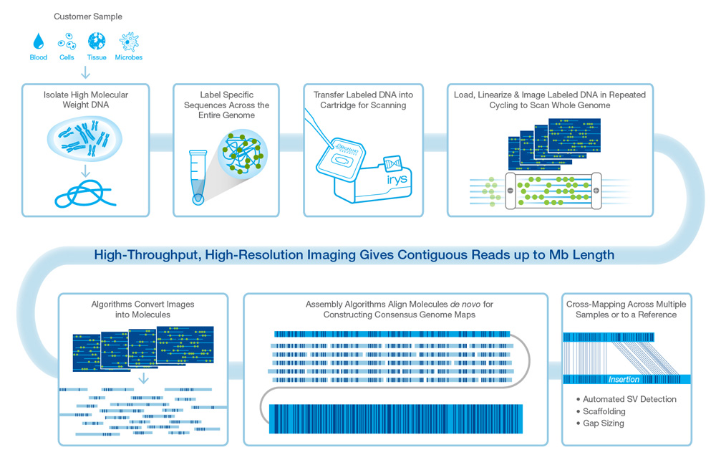
BioNano

Slide 32
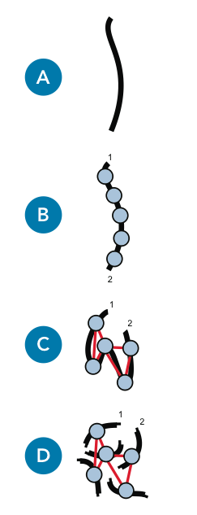
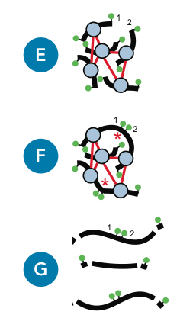
Dovetail Genomics

Slide 33
You need help?
BILS is a VR-financed organization that offers bioinformatics support to all projects in Sweden. Please go to https://bils.se/resources/supportform/index.php to apply for support.
Biosupport.se is perfect for shorter questions.

Slide 34
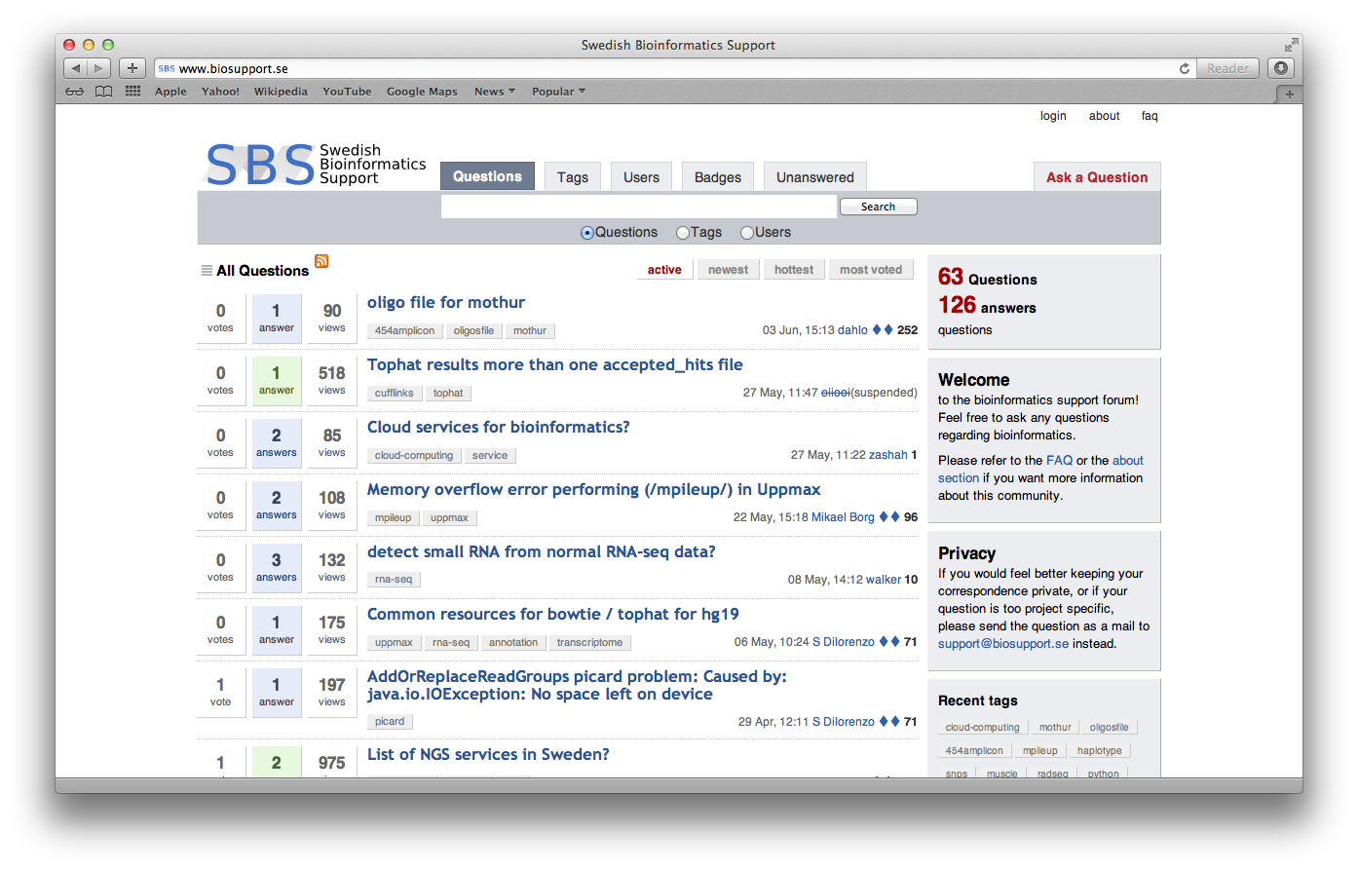
Biosupport.se

