Slide 1

TERRAINICA
Land acquisition intelligence.
terrainica.com
Start in Lithuania. Scale across Europe

Slide 2
TEAM
terrainica.com
Henry Otuadinma
Founder & Product Developer
Professional background in enterprise software engineering
Built Terrainica end-to-end
35+ state data integrations
PostgreSQL/PostGIS geospatial database
SQL-based deterministic decision engine, no black box model.
Current support:
Vilnius Tech Business Accelerator Program
Industry Validation through LNTPA engagement
Terrainica combines enterprise software engineering and geospatial intelligence to streamline land acquisition decisions.

Slide 3
THE PROBLEM
terrainica.com
The most important decision in land acquisition
happens with the worst information.
What if you spent six weeks evaluating a parcel only to discover it could never be developed?
15+
3-6 wks
€500+
State registries a developer must check manually. RC, NTR, KPD, AAA, TPSV, UETK, OSM, Copernicus, and more. None of them talk to each other.
To screen a single parcel before a purchase decision. In a competitive market, the best sites are gone in days.
Per-parcel cost using architects or legal consultants for a pre-selection check before any formal due diligence has even started.
The cost of getting it wrong:
A Lithuanian commercial developer who commits to a parcel with undiscovered planning restrictions faces project delays of 12 - 24 months, legal costs of €20,000 -100,000, and in severe cases total loss of acquisition investment. This happens every year, in every municipality. It is preventable.

Slide 4

terrainica.com
WHY NOW?
Land acquisition is a
€500M+ information problem.
Commercial real estate transactions in Lithuania grew 25.8% in 2025. Prices rose 12.1% across major cities. Competition for the best parcels is intensifying. Most of those deals still begin with weeks of manual research across fifteen or more state registries - none of which talks to each other.
Market is hot and competitive
No software product existed for this
State data is now accessible
In a fast-moving market, the developer with faster information wins deals. The cost of slow pre-acquisition is rising in direct proportion to market activity.
Zero commercial-grade pre-acquisition intelligence platforms existed in Lithuania before Terrainica.
RC, NTR, KPD, AAA, TPSV, UETK, and 30+ more Lithuanian state registries now expose machine-readable data. The technical layer that makes Terrainica possible just became viable.

Slide 5
terrainica.com
PRODUCT
Terrainica transforms weeks of fragmented research into acquisition intelligence in under 10 seconds.
SPEED
DISCOVERY
< 10-second intelligence
Opportunity feed on login
Score any of 835,777 Lithuanian parcels. 11 signals from 35+ state sources computed instantly. Risk flags surfaced instantly. Composite score 0 - 100. Sub-10-second end-to-end: parcel ID to bilingual PDF report.
Buildable parcels ranked by signal score, surfaced by category (strong acquisition candidates, distressed land, conversion potential, NTR pre-registration, etc.) before a user enters a single ID.
SCALE
MONITORING
Batch evaluation
Watchlist + change alerts
Upload a list of hundreds of parcels. Score them all simultaneously. Download batch PDF reports. A full portfolio screening that previously took weeks now takes minutes.
Pin any parcel. Receive automatic notifications when state register changes affect it: new planning constraints, ownership changes, encumbrances, or score movement.
Plus: Scoring profile customisation · Sell-intent signals · Continuous register monitoring

Slide 6
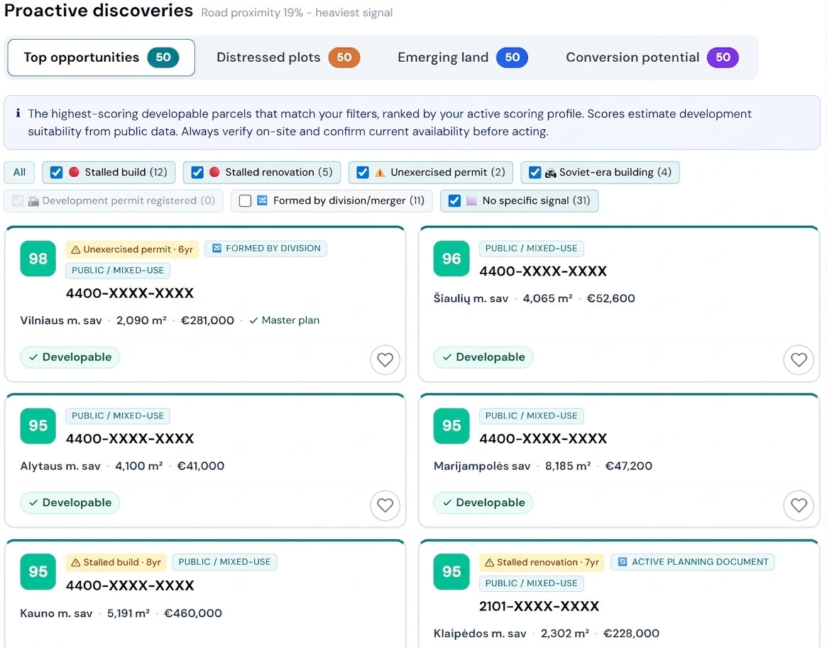
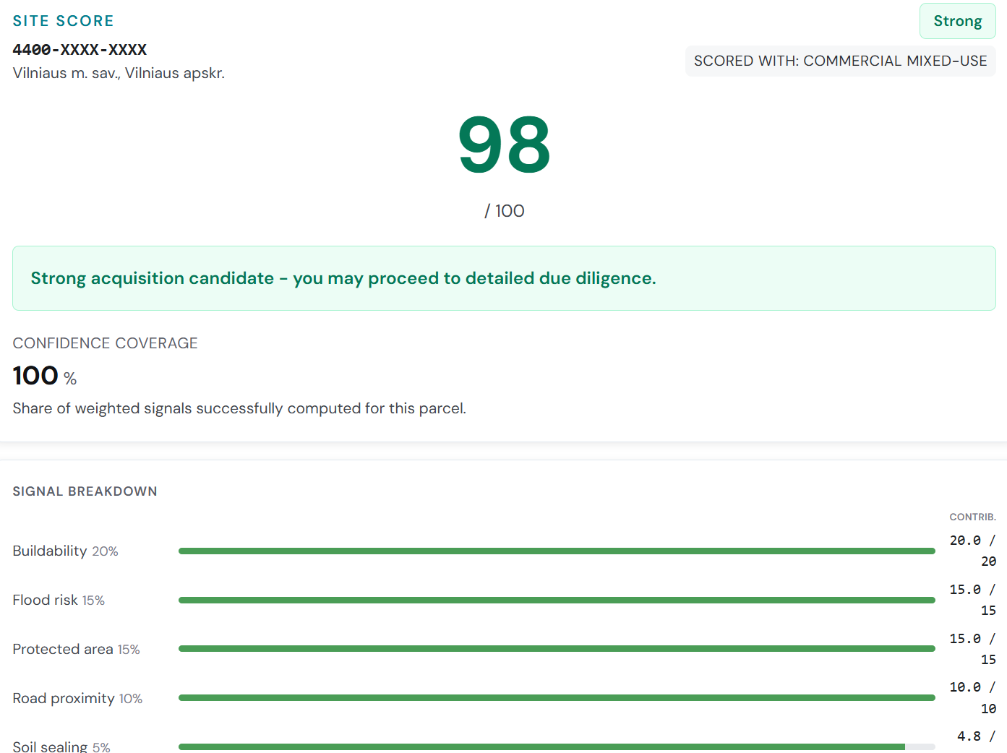
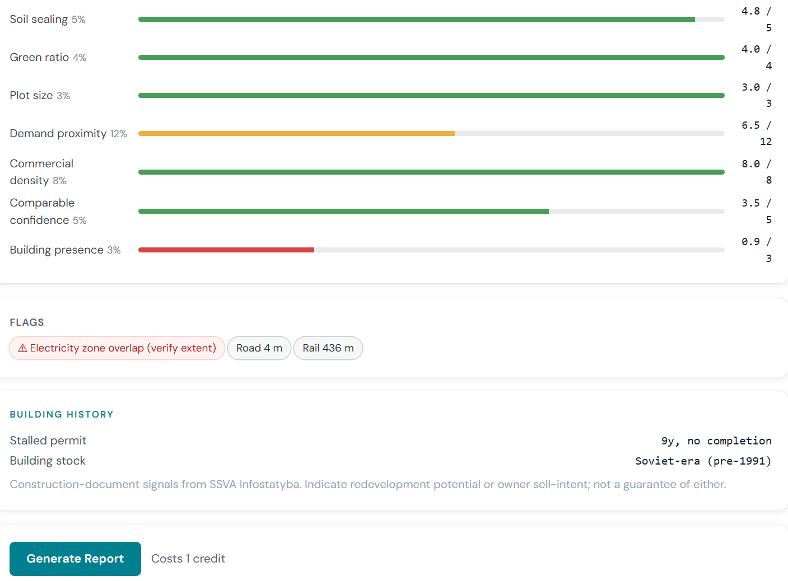
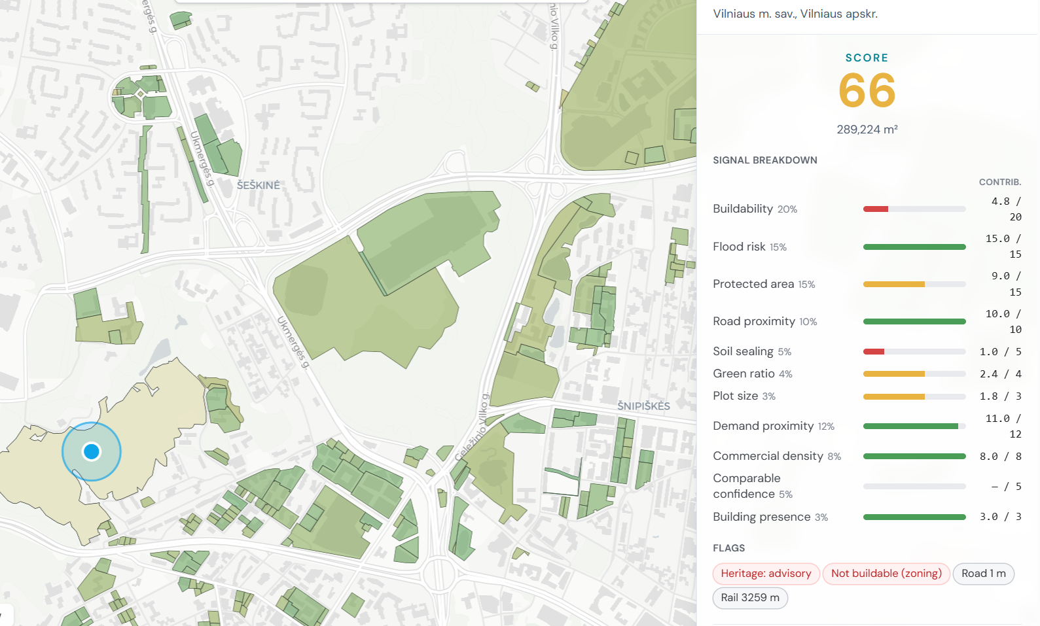
WHAT IT LOOKS LIKE
terrainica.com
Single parcel Evaluation result
Opportunities View
Map View

Slide 7
PRODUCT STATUS
terrainica.com
Industry validated.
Product live.
INDUSTRY VALIDATION
Validated by the President of Lithuanian Real Estate Development Association (LNTPA), the professional body representing the industry Terrainica serves - at a dedicated platform evaluation session.
835,777
35+
Evaluate
Reporting
Live state data
sources integrated
Single or bulk parcel evaluation via CSV upload or from opportunities feeds
Single or bulk bilingual reports with Seller motivation, Buildability assessment, Constraints, Signal Details, Dated data sources, etc.
Lithuanian land
parcels indexed
A map view for faster visual evaluations within a location
First paying enterprise customer

Slide 8
WHO USES TERRAINICA?
terrainica.com
People working in one of real estate's most fragmented sectors.
Primary
Secondary
Commercial property developers
Land acquisition teams
Real estate investment funds
Planning consultants
Architects
Land investors
Aspiring homeowners
Future
Municipalities
Infrastructure developers

Slide 9
BUSINESS MODEL
terrainica.com
Four revenue streams.
One platform.
1
NOW
2
NOW
3
NOW
4
PHASE 2
Credits
Professional SaaS
Enterprise
Marketplace
€50 / report
€500 / month
Custom
2 - 5% commission
Pay-per-use
€6,000 / year
Until pricing is validated
Network effect
Low-friction entry. Individual report generation for occasional users or first-time evaluations. No commitment required.
Full platform access. Unlimited parcel scoring, batch evaluation, watchlist, opportunity feed, and scoring profile customisation. Billed annually.
API access + white-label reporting + custom data integrations + volume SLA. Designed for RE investment funds and large developer groups screening 1,000+ parcels/month.
Pre-qualified land listings with embedded scores. Developers pay credits to contact verified motivated sellers. Supply sourced from continuous register monitoring.

Slide 10
COMPETITIVE LANDSCAPE
terrainica.com
Terrainica lets you know a site won’t work before you spend on finding out.
GIS consultants take days and cost €1,000+. Public registers require technical expertise and separate logins for each. Terrainica combines screening, discovery, monitoring, and portfolio analysis into a single acquisition workflow.
Manual / consultant
GIS consultant
Public registers
TERRAINICA
Target user
Professional
Specialist
Expert
Commercial developer
Composite score
✗
✗
✗
✓ 11 signals
Speed
Days-wks
Days-wks
Hours
< 10 seconds
Batch / portfolio
✗
✗
✗
✓
Opportunity feed
✗
✗
✗
✓
Watchlist + alerts
✗
✗
✗
✓
Cost / parcel
€300+
€50-200
Hours
Fraction

Slide 11
terrainica.com
NEXT STEPS
From parcel tool to European
land intelligence infrastructure.
1
2
3
2026
2027
2028+
First paying customers.
Pricing validation.
Product refinement
→
Lithuania market expansion.
Baltic rollout
→
Poland.
Additional EU markets

Slide 12
terrainica.com
THE ASK
Help us reach the first customers. Then help us scale.
Mentorship
Network
Acceleration
Go-to-market strategy, first enterprise sales conversations, and pricing validation with real commercial developers.
Introductions to commercial RE developers, investment funds, and Registrų Centras for deeper data access partnerships.
Runway to close the first paid enterprise subscription by Q3 2026 and prepare the Latvia / Estonia expansion for Q1 2027.
Mentorship
Network
Acceleration
The technology is built. The data is live. The market is unserved.

Slide 13


