Slide 1

CS50P Final project
“Weather Forecast 5 Days”
By Henry Wat
GitHub: https://github.com/henrywat
edX: henrywat_8
Calgary, Canada
12 March 2024

Slide 2
Objectives
Study OpenWeatherMap's API.
Request the weather forecast by sending the city name and date.
Handle responses in JSON format.
How to simulate a test program.

Slide 3
Required package
pytest
request
request_mock

Slide 4
PROGRAM functions
main – Displays a greeting message asking for the required city and date. Then displays the resulting weather.
valid_date – to validate of the input date.
fetch_weather_data – requests and receive data by calling the API.
format_weather_data – organizes and returns information.

Slide 5
PROGRAM TEST
test_validate_date
test_format_weather_data
test_fetch_weather_data_success
test_fetch_weather_data_not_found
test_fetch_weather_data_api_failure

Slide 6
obstacles
Took lot of time to figure out how to test a function whose results change over time.

Slide 7
preparation
Create and activate the python virtual environment.
Install the necessary packing refer to requirements.txt.

Slide 8
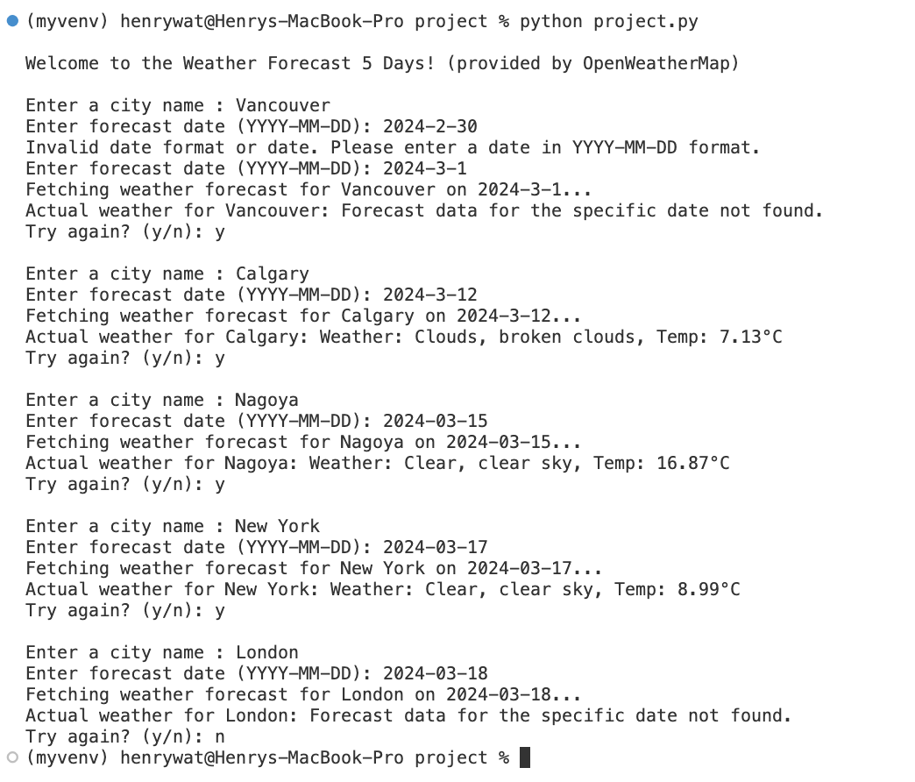
Outcomes

Slide 9
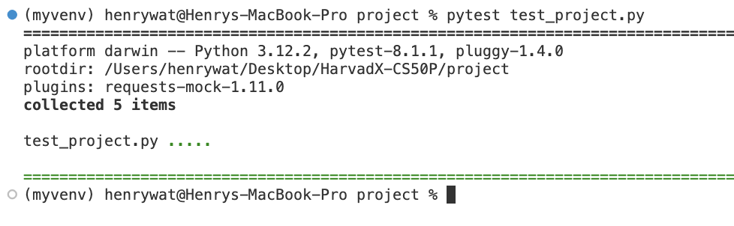
Test result

Slide 10
Thank you
CS50P Final Project
WEATHER FORECAST 5 DAYS
By Henry Wat
12 March 2024

