Slide 1
The U.S. Clinical-Trial Investigator Supply
A preliminary descriptive analysis of FDA BMIS Form 1572 filings, benchmarked against industry trials; China CFDI registry supplement
Strict persons · 2009–2025 · generated 2026-11-07
PRELIMINARY ANALYSIS ONLY — NOT FOR DECISION-MAKING
FDA BMIS (Form 1572, thru Aug 2026) · clinicaltrials.gov API v2 · github.com/henryweimd/bmis1572

Slide 2
What this is (and isn’t)
Supply = clinical investigators (CIs) named on Form 1572 filings in FDA’s BMIS file.
Persons are name+site clusters: Strict (headline), Merged, Raw bound the identity call.
Active in year = ≥1 receipt; headline window 2009–2025.
Demand = industry-led interventional trials (clinicaltrials.gov API), starts + running.
Benchmarks are year-level ratios — no record-level CI↔trial linkage exists.
BMIS covers CDER IND drugs/biologics only; FDA states it is not comprehensive.
2008 is file ramp-up, 2026 partial (thru Aug); both excluded from growth stats.
PRELIMINARY ANALYSIS ONLY — NOT FOR DECISION-MAKING
FDA BMIS (Form 1572, thru Aug 2026) · clinicaltrials.gov API v2 · github.com/henryweimd/bmis1572

Slide 3
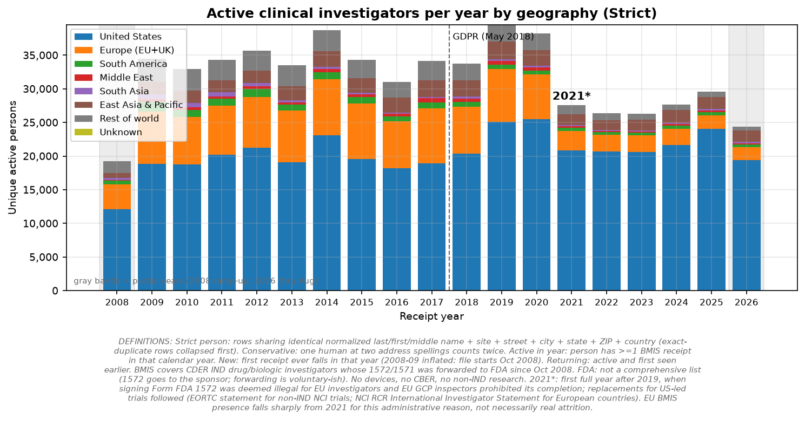
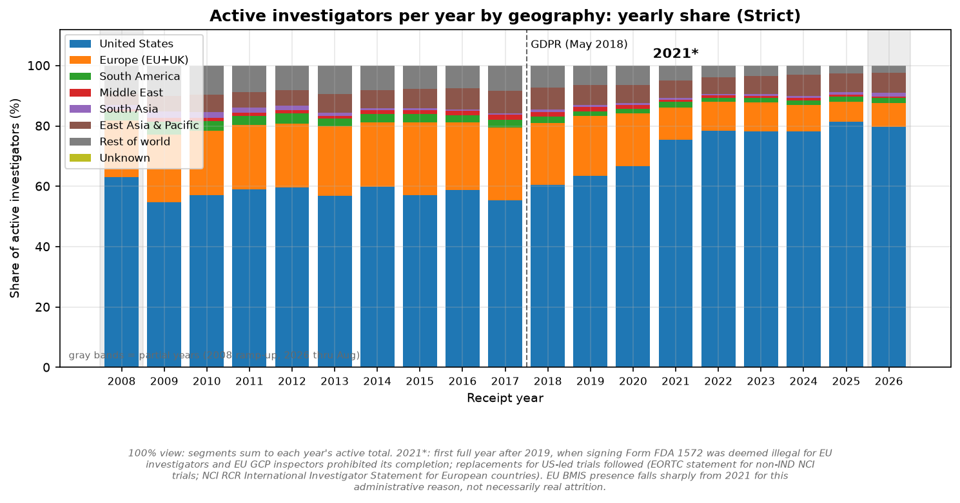
Headline: global flat-to-down, U.S. up
Global active CIs: 34,468 → 29,596 (-14.1%).
U.S. active CIs: 18,838 → 24,084 (+27.8%).
Ex-U.S. decline concentrates in 2020–21; no EU break at GDPR (May 2018).
2021* follows the 2019 EU Form 1572 restriction (EORTC + NCI RCR replacements): the EU drop is administrative, not proven attrition.
Strict persons; receipt-year activity. Right = yearly share: EU 19.9% (2019) → 10.7% (2021).
PRELIMINARY ANALYSIS ONLY — NOT FOR DECISION-MAKING
FDA BMIS (Form 1572, thru Aug 2026) · clinicaltrials.gov API v2 · github.com/henryweimd/bmis1572

Slide 4
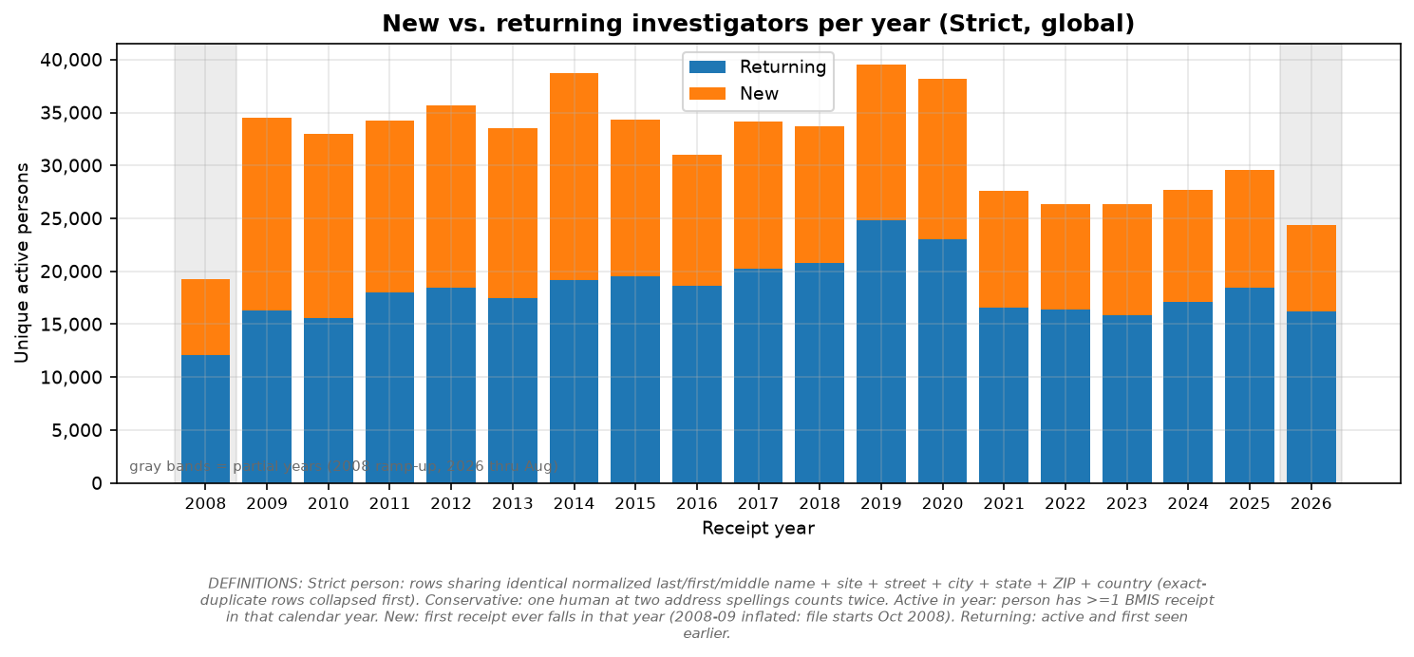
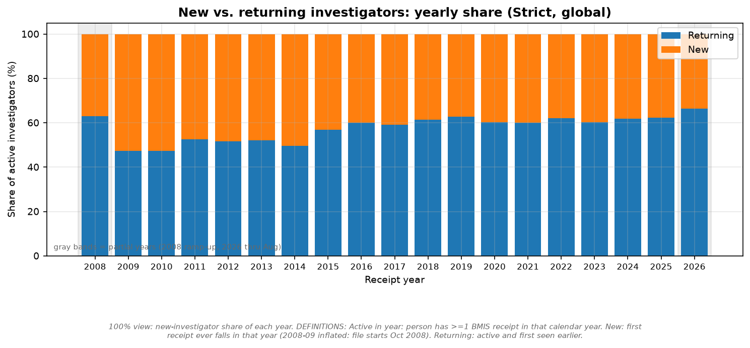
Fewer newcomers; a stable returning core
38% of 2025 actives are first-timers; the rest return.
Entry is dominated by one-and-done dynamics (next).
Right panel: new-investigator share of each year.
New = first receipt ever in that year.
PRELIMINARY ANALYSIS ONLY — NOT FOR DECISION-MAKING
FDA BMIS (Form 1572, thru Aug 2026) · clinicaltrials.gov API v2 · github.com/henryweimd/bmis1572

Slide 5
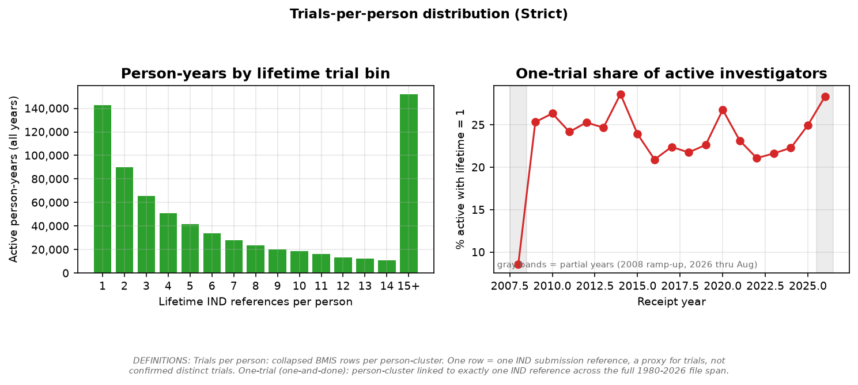
Half of investigators are one-and-done
49.3% of persons have exactly one lifetime IND reference.
Median 2, mean 3.85 trials per investigator.
A thin right tail of hyper-active CIs carries the top bins.
One row = one IND reference: a proxy, not confirmed distinct trials.
PRELIMINARY ANALYSIS ONLY — NOT FOR DECISION-MAKING
FDA BMIS (Form 1572, thru Aug 2026) · clinicaltrials.gov API v2 · github.com/henryweimd/bmis1572

Slide 6
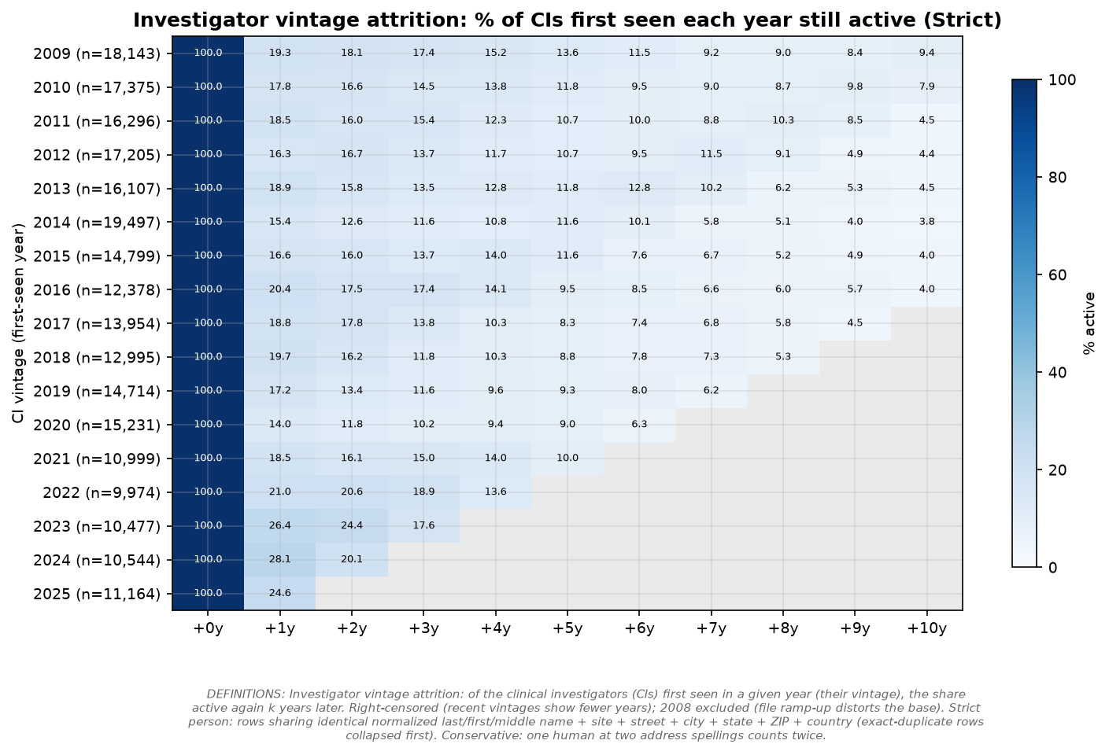
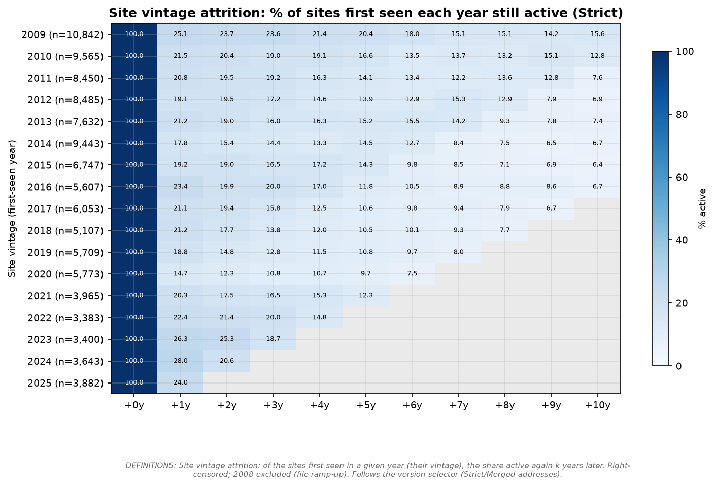
Vintage attrition: steep, then flat
≈19% of the 2009 CI vintage is active a year later; ≈9% a decade later.
Curves look alike across vintages: most attrition is immediate.
Sites persist longer: ≈25% / ≈16% for the 2009 site vintage.
Vintage = first seen in that year. Right-censored; 2008 excluded.
PRELIMINARY ANALYSIS ONLY — NOT FOR DECISION-MAKING
FDA BMIS (Form 1572, thru Aug 2026) · clinicaltrials.gov API v2 · github.com/henryweimd/bmis1572

Slide 7
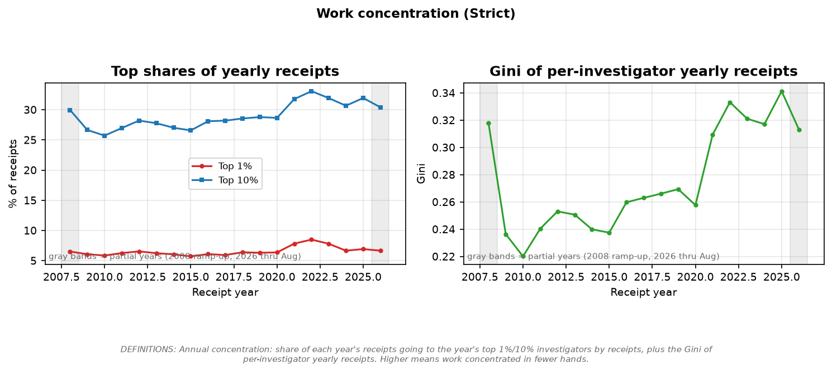
Work is concentrating
Top-10% receipt share: 27% → 32%.
Gini of yearly receipts: 0.24 → 0.34.
Annual within-year concentration among actives.
PRELIMINARY ANALYSIS ONLY — NOT FOR DECISION-MAKING
FDA BMIS (Form 1572, thru Aug 2026) · clinicaltrials.gov API v2 · github.com/henryweimd/bmis1572

Slide 8
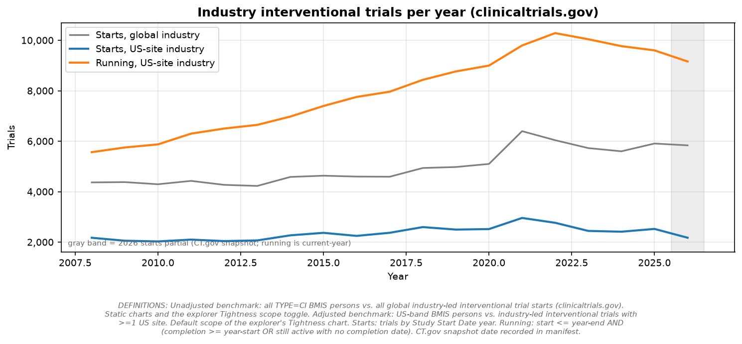
Demand: industry trial starts
Global industry starts: 5,911 in 2025.
U.S.-site running trials: 9,604 in 2025.
Starts and supply are not independent — ratios describe, not explain.
clinicaltrials.gov API v2, interventional + industry lead sponsor.
PRELIMINARY ANALYSIS ONLY — NOT FOR DECISION-MAKING
FDA BMIS (Form 1572, thru Aug 2026) · clinicaltrials.gov API v2 · github.com/henryweimd/bmis1572

Slide 9
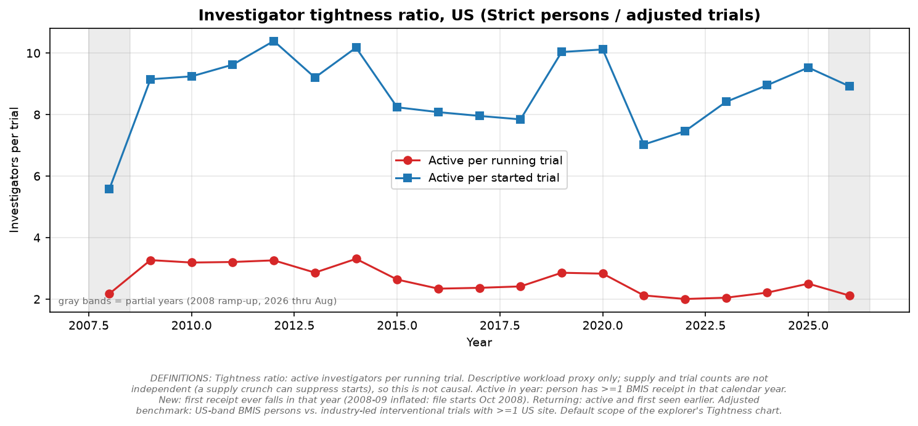
Tightness: investigators per running trial
U.S. CIs per running trial: 3.3 → 2.5.
Adjusted scope: U.S. investigators vs. U.S.-site trials.
Ecological ratio; supply constraints can move trial counts.
PRELIMINARY ANALYSIS ONLY — NOT FOR DECISION-MAKING
FDA BMIS (Form 1572, thru Aug 2026) · clinicaltrials.gov API v2 · github.com/henryweimd/bmis1572

Slide 10
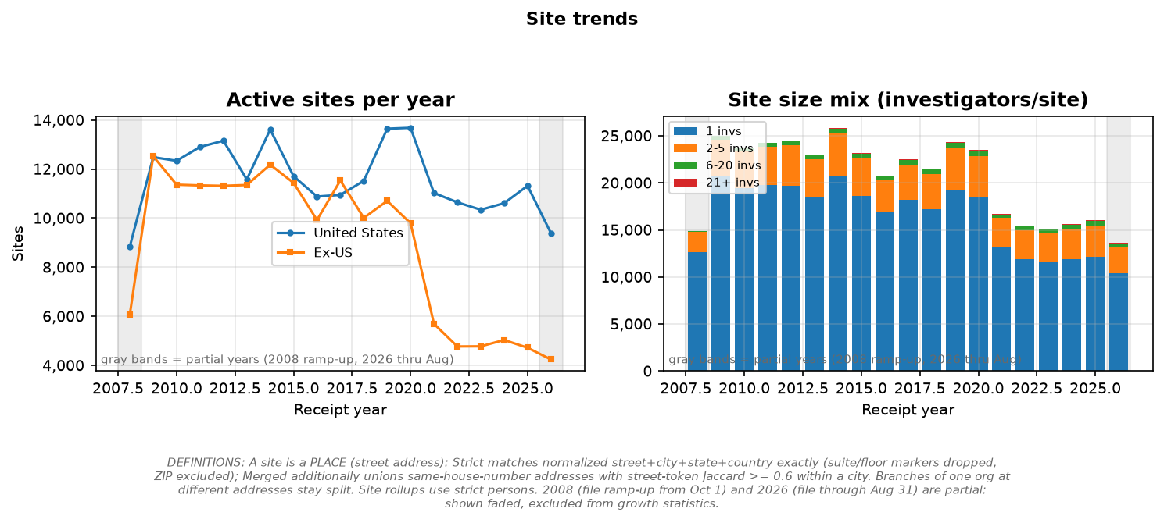
Sites: where the work happens
16,036 active sites in 2025 (Strict addresses).
Solo-investigator sites dominate; mega-centers are few.
All-time leader: THE UNIVERSITY OF TEXAS MD ANDERSON CANCER CENTER (847 CIs, 5,390 refs).
Site = street address; branches of one org stay split.
PRELIMINARY ANALYSIS ONLY — NOT FOR DECISION-MAKING
FDA BMIS (Form 1572, thru Aug 2026) · clinicaltrials.gov API v2 · github.com/henryweimd/bmis1572

Slide 11
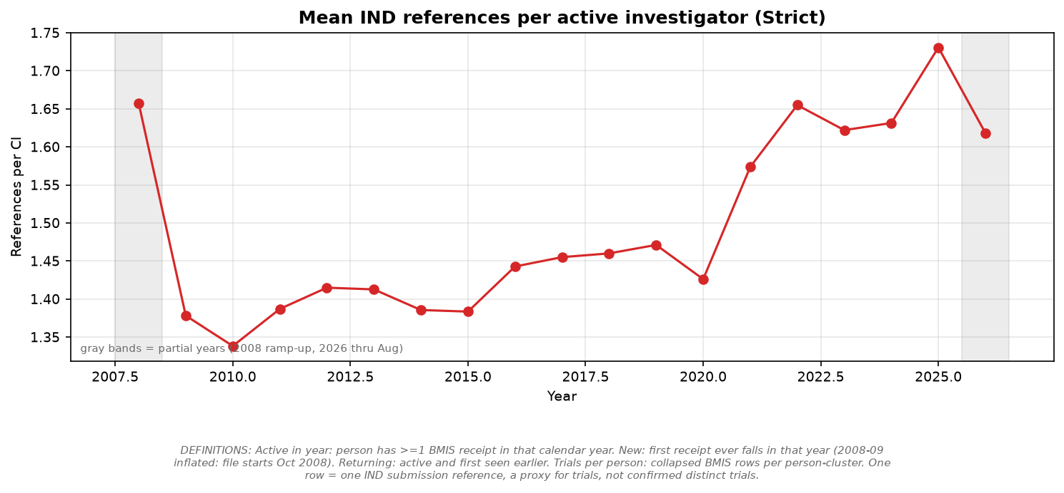
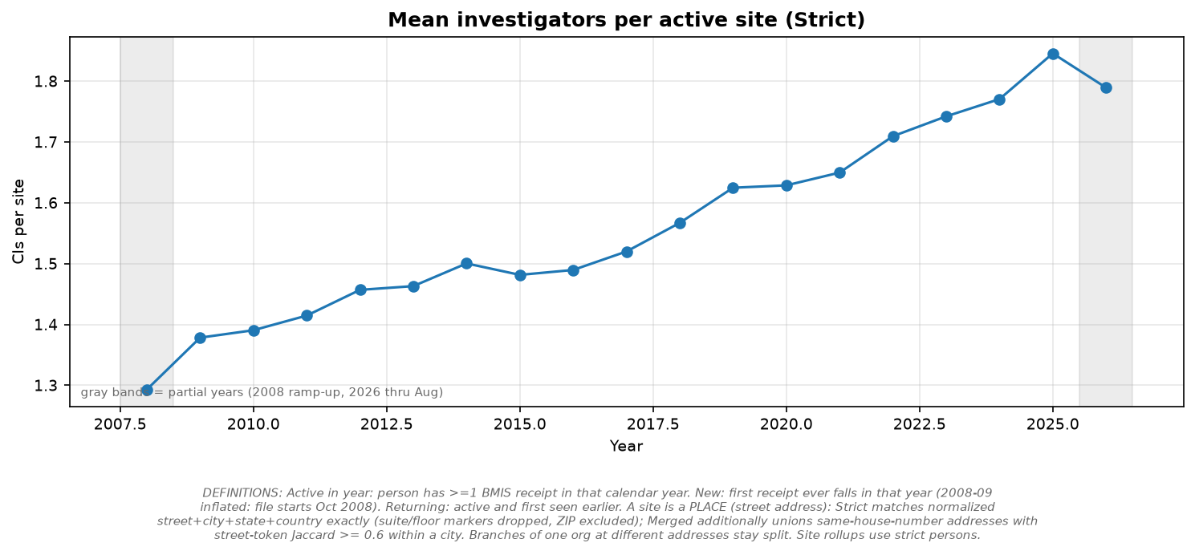
Intensification: fewer hands, more load
References per active CI: 1.38 → 1.73.
CIs per active site: 1.38 → 1.85.
Work concentrates on repeat investigators at busier sites.
Strict persons/addresses; 2008 and 2026 partial.
PRELIMINARY ANALYSIS ONLY — NOT FOR DECISION-MAKING
FDA BMIS (Form 1572, thru Aug 2026) · clinicaltrials.gov API v2 · github.com/henryweimd/bmis1572

Slide 12
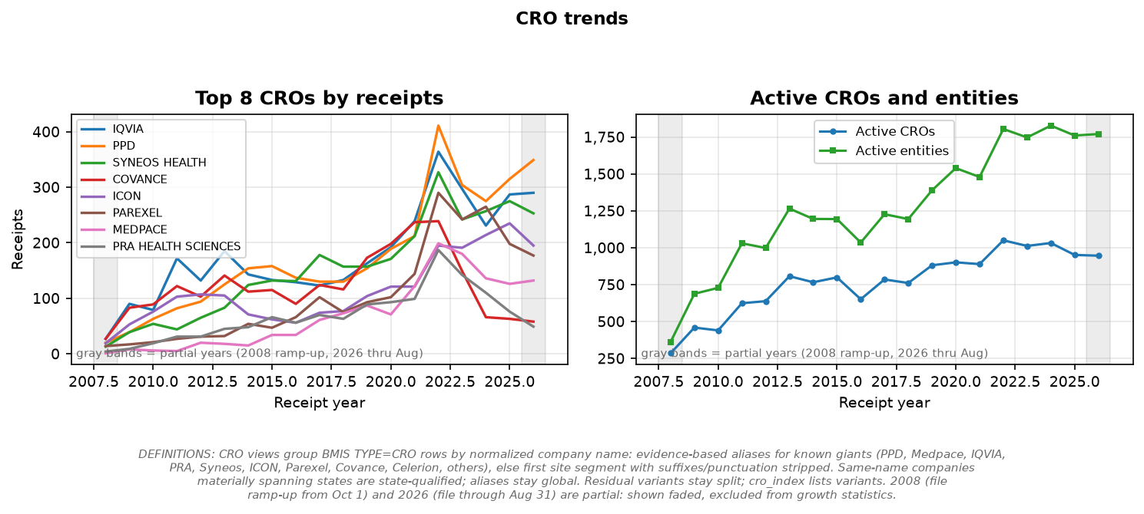
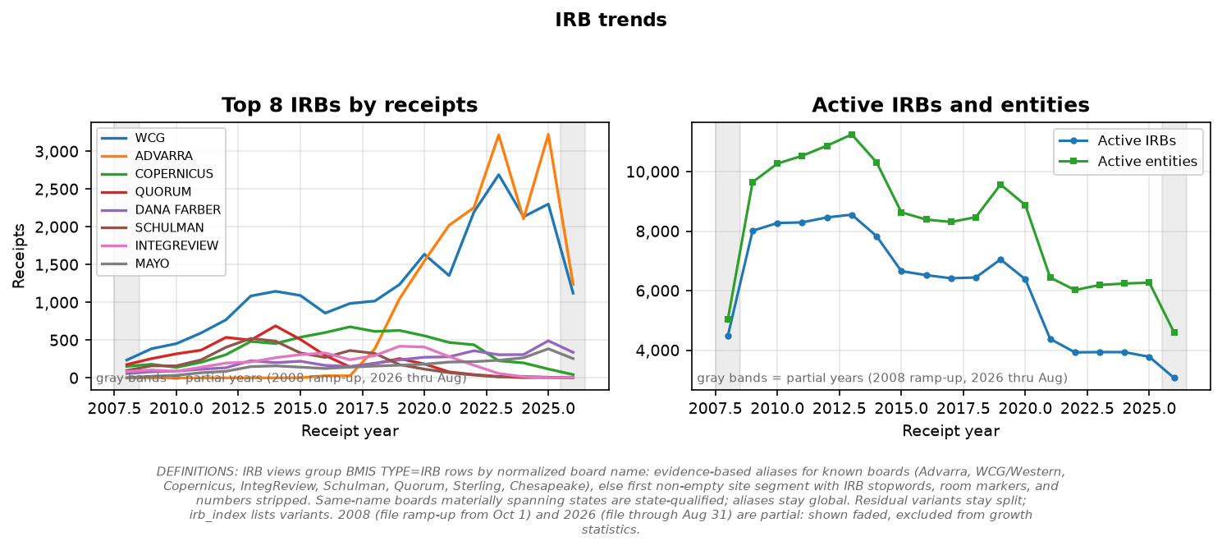
CROs and IRBs in context
951 CROs and 3,779 IRBs active in 2025.
All-time receipt leaders: PPD / WCG.
Normalized company/board groupings; residual variants audited.
PRELIMINARY ANALYSIS ONLY — NOT FOR DECISION-MAKING
FDA BMIS (Form 1572, thru Aug 2026) · clinicaltrials.gov API v2 · github.com/henryweimd/bmis1572

Slide 13
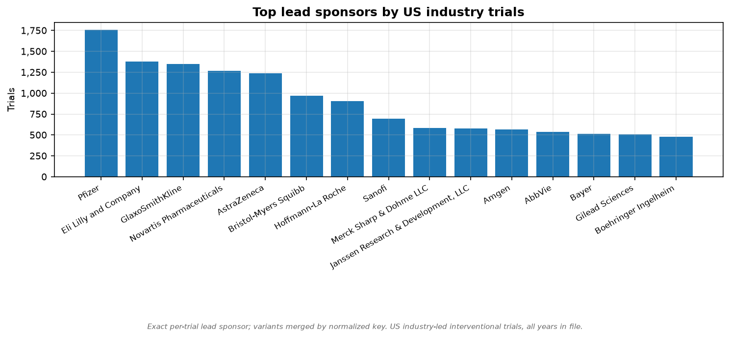
Demand side: US industry trials
53,543 US industry-led interventional trials from 7,940 sponsors.
Top sponsor: Pfizer (1,760 trials).
Top phase: P1 (12,914 trials).
38,731 trials (72%) name ≥1 study official.
clinicaltrials.gov API v2, all years in file.
PRELIMINARY ANALYSIS ONLY — NOT FOR DECISION-MAKING
FDA BMIS (Form 1572, thru Aug 2026) · clinicaltrials.gov API v2 · github.com/henryweimd/bmis1572

Slide 14
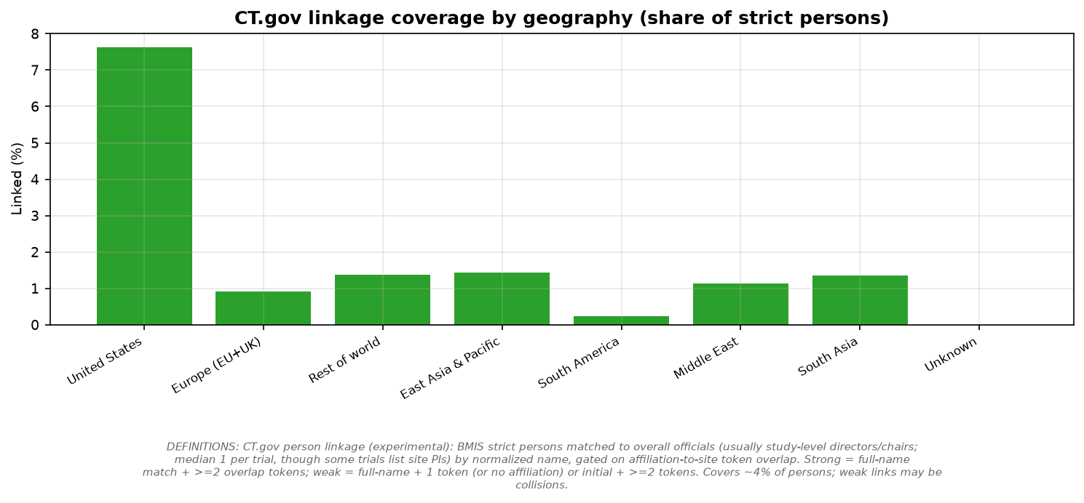
Person linkage: BMIS ↔ CT.gov (experimental)
13,956 BMIS persons match ≥1 study official (11,961 strong / 12,696 weak links).
Most-linked: Williams, Dorian (43 trials).
Name + affiliation-overlap match; most trials name only study-level officials, so coverage is thin and KOL-skewed.
Weak links may be name collisions. See Definitions.
PRELIMINARY ANALYSIS ONLY — NOT FOR DECISION-MAKING
FDA BMIS (Form 1572, thru Aug 2026) · clinicaltrials.gov API v2 · github.com/henryweimd/bmis1572

Slide 15
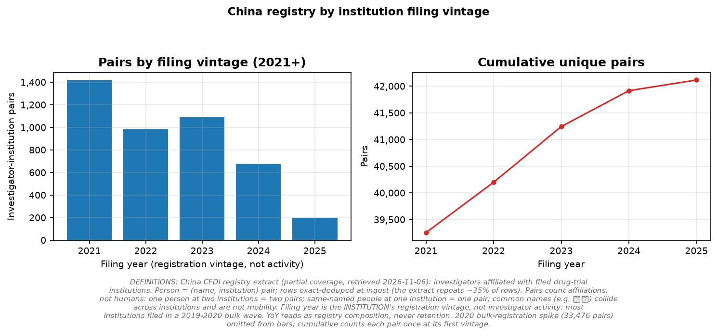
China: registry stock by filing vintage
42,117 investigator-institution pairs; 34,077 names; 1,818 institutions.
Bulk 2019–20 registration wave (33,476 pairs in 2020); graphs read 2021+.
Filing year is institution vintage, not investigator activity.
Pairs count affiliations, not humans; common names collide. Partial extract, retrieved 2026-11-06.
PRELIMINARY ANALYSIS ONLY — NOT FOR DECISION-MAKING
FDA BMIS (Form 1572, thru Aug 2026) · clinicaltrials.gov API v2 · github.com/henryweimd/bmis1572

Slide 16
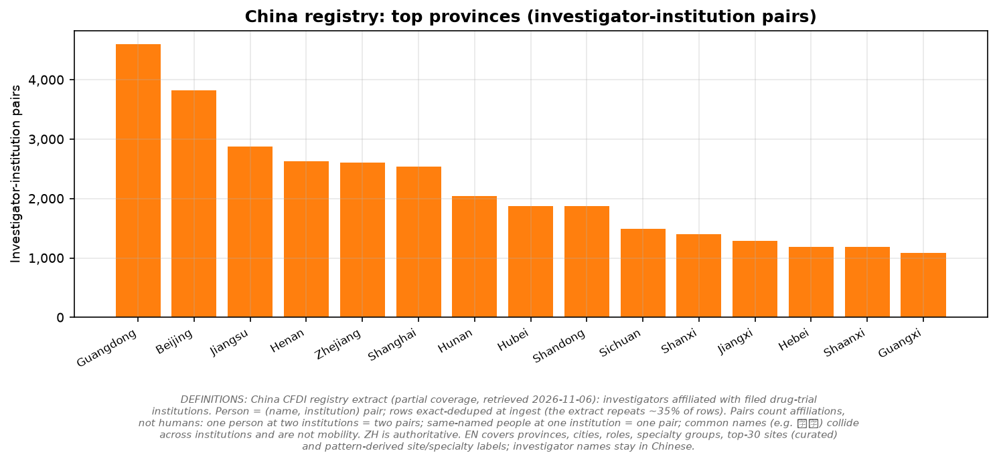
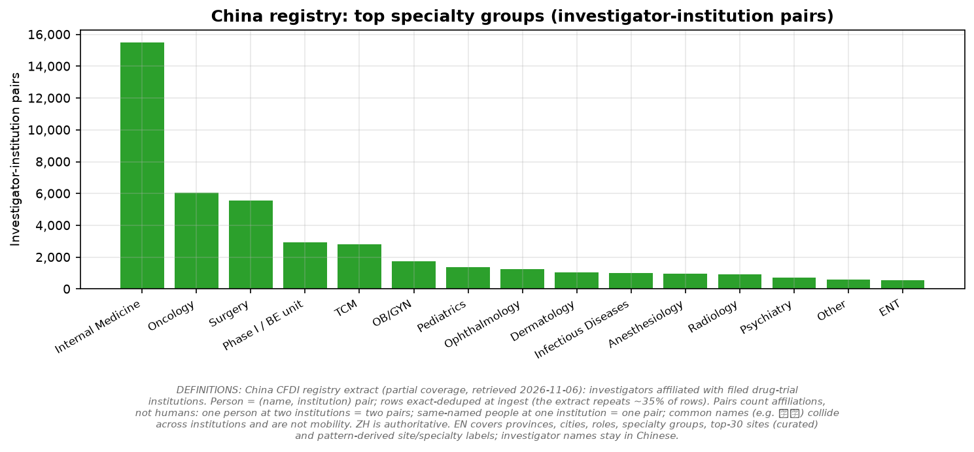
China: provinces & specialties
Top province: Guangdong (4,600 pairs).
Top specialty group: Internal Medicine (15,515 pairs).
ZH authoritative; EN labels curated or pattern-derived.
PRELIMINARY ANALYSIS ONLY — NOT FOR DECISION-MAKING
FDA BMIS (Form 1572, thru Aug 2026) · clinicaltrials.gov API v2 · github.com/henryweimd/bmis1572

Slide 17
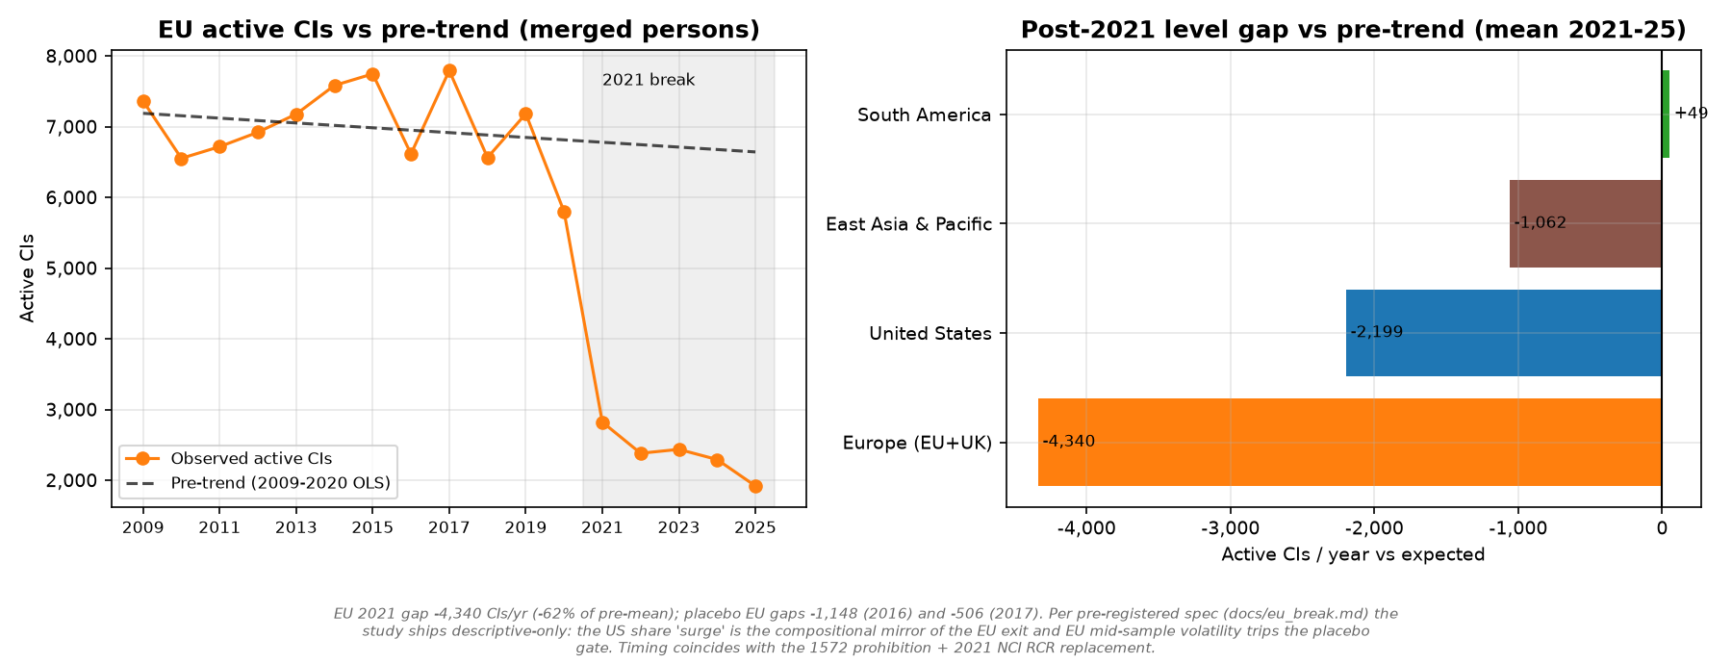
EU break: permanent, EU-specific — descriptive
EU runs 4,339/yr below its 2009–20 pre-trend (62% of pre-mean); share gap -10.7pp.
Placebo EU gaps (-1,148, -505) are 3–8× smaller; no control band collapses in level terms.
US share ‘surge’ is the compositional mirror of the EU exit (US level fell too) — the denominator collapsed.
Pre-registered verdict: descriptive-only. Timing coincides with the 1572 prohibition + 2021 NCI RCR replacement.
Merged persons; pre-trend OLS 2009–20, post mean 2021–25. Spec: docs/eu_break.md.
PRELIMINARY ANALYSIS ONLY — NOT FOR DECISION-MAKING
FDA BMIS (Form 1572, thru Aug 2026) · clinicaltrials.gov API v2 · github.com/henryweimd/bmis1572

Slide 18
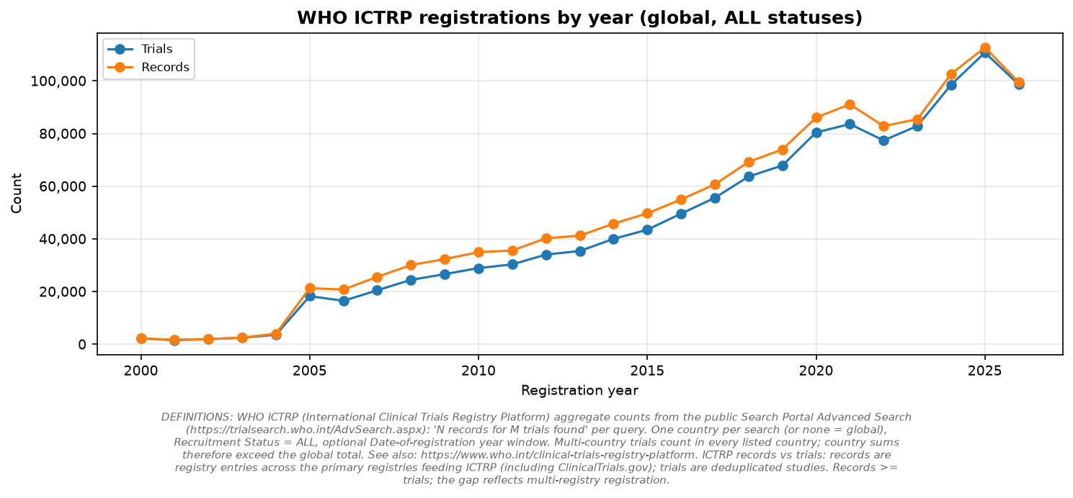
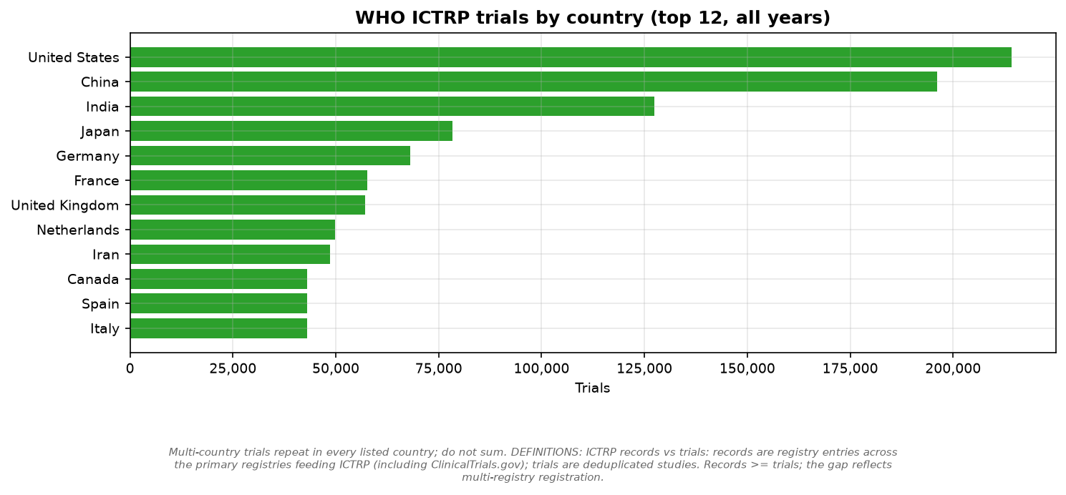
Global context: WHO ICTRP
1,175,909 trials / 1,285,607 records worldwide.
Top: United States (214,203), China (196,046), India (127,479).
Multi-country trials repeat per country; registration year, ALL statuses.
Aggregate portal counts retrieved 2026-11-07; no trial-level data.
PRELIMINARY ANALYSIS ONLY — NOT FOR DECISION-MAKING
FDA BMIS (Form 1572, thru Aug 2026) · clinicaltrials.gov API v2 · github.com/henryweimd/bmis1572

Slide 19
Limitations & what’s next
No therapeutic-area or phase fields in BMIS; rows carry date + site only.
Person↔trial linkage is name-based, thin and KOL-skewed; site cross-check is institution×city (both experimental).
Person/site counts are ranges across versions, not exact headcounts.
Next: therapeutic-area mix via matched trials; global linkage; cross-site tracking.
PRELIMINARY ANALYSIS ONLY — NOT FOR DECISION-MAKING
FDA BMIS (Form 1572, thru Aug 2026) · clinicaltrials.gov API v2 · github.com/henryweimd/bmis1572

Slide 20
Sources & reproducibility
Supply: FDA BMIS quarterly file — https://www.fda.gov/drugs/drug-approvals-and-databases/bioresearch-monitoring-information-system-bmis
Demand: clinicaltrials.gov Data API v2 — https://clinicaltrials.gov/data-api/api
Global context: WHO ICTRP Search Portal — https://trialsearch.who.int/AdvSearch.aspx
China: CFDI drug-institution filing extract — https://beian.cfdi.org.cn/CTMDS/apps/pub/drugPublic1.jsp
All code, methods, definitions: https://github.com/henryweimd/bmis1572
Rebuild locally: uv run python pipeline/build.py
PRELIMINARY ANALYSIS ONLY — NOT FOR DECISION-MAKING
FDA BMIS (Form 1572, thru Aug 2026) · clinicaltrials.gov API v2 · github.com/henryweimd/bmis1572

