Slide 1
Link to this page: {BP Ticker Plant Overview<GO>}
Add to MyBP Favorites
Ticker Plant Overview
R&D Ticker Plant & Data Products
01/2012 - Version 6.0

Slide 2
Topics to be Covered
What is the Ticker Plant
Ticker Plant Internals
Ticker Plant database and Requests
Real time Update (Monitoring)
New things happening in Ticker Plant

Slide 3
What is Ticker Plant
Real Time update provider of all securities for Bloomberg Terminal, B-Pipe and API.
Premier database for real-time and intra-day market data world-wide.
24 x 7 Real-time Price Broadcasts
Intra-day Historical Prices (Up To 245 Days*)
We are one of the biggest users of Machines and Storage resources in Bloomberg.

Slide 4
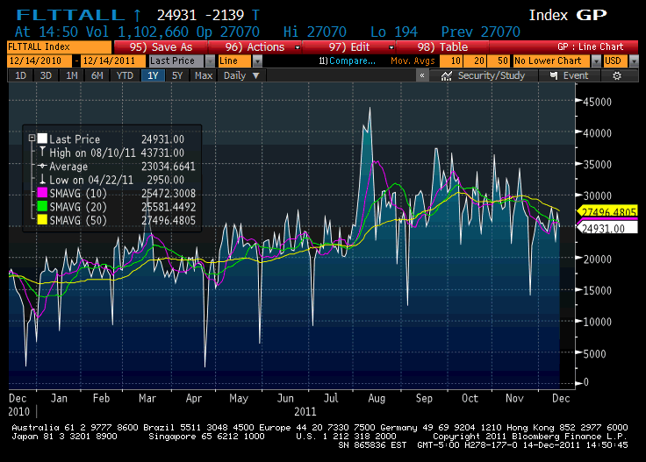
A Typical Day in the Ticker Plant
~ 30 Billion/Day ticks processed with Peak of 43 Billions/Day

Slide 5
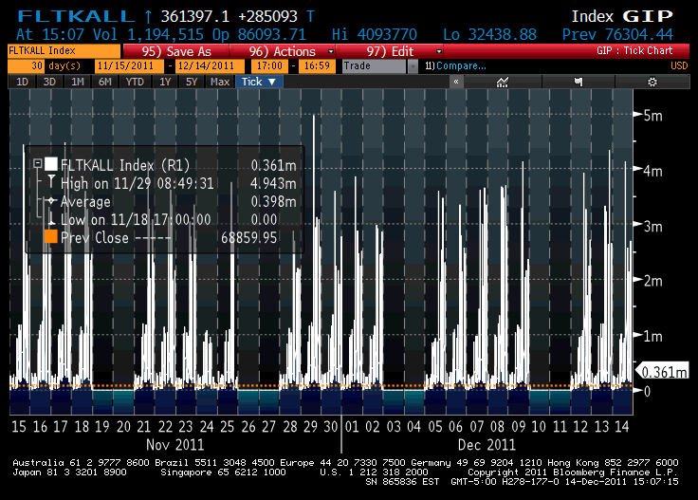
A Typical Day in the Ticker Plant
Sustained peak tick rates > 3Mil/Sec with peak of 5Mil/Sec

Slide 6
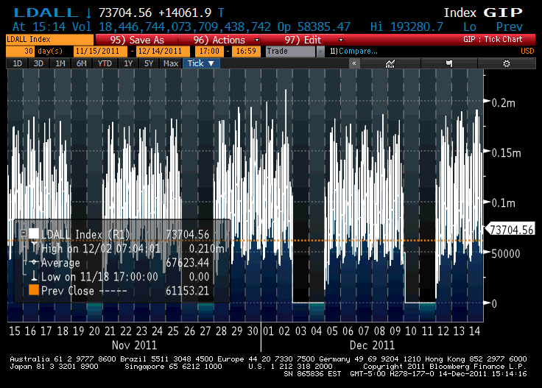
A Typical Day in the Ticker Plant
Sustained data request rates > 150,000/sec

Slide 7
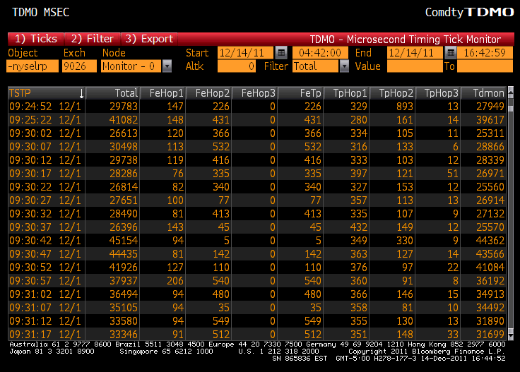
A Typical Day in the Ticker Plant
We do all this with tick reception broadcast time < 50 msec

Slide 8
Ticker Plant Internals
Configured into 15 “mini” Ticker Plants (Flavors) to spread incoming load
Ticker Plant runs on
Sun M9000 : 64 Cores(2.4GHz)/384GB RAM
IBM P7-795 : 64 Cores (4.0GHz)/486GB RAM
IBM P6-595 : 64 Cores (5.0GHz)/500GB RAM
LTPs Sun M5000 : 32 Cores (2.4 GHz)/192GB RAM
LTPs AIX P7-750 : 32 Cores (3.5 GHz)/186GB RAM
LTPs AIX P6-550 : 8 Cores (4.2 GHz)/125GB RAM
LTP : Local Ticker Plant

Slide 9

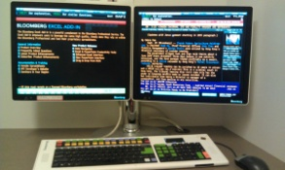
Ticker Plant High Level View
API
B-Pipe
Gserv/EServ Machine
Ticker Plant
Gateways
Front Ends
User Machine
Storage Area Network
Exchange
New York &
Princeton
Data Centers
Exchange
Network File System

Slide 10
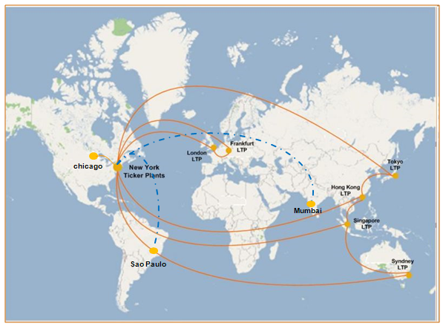
Local Ticker Plants
Note : Dotted line in Blue is proposed LTP sites.

Slide 11

LTP Bloomberg RT data flow
8411 JP
Ticker Plant NY & NJ
LTP
MSFT US
VOD LN
LTP

Slide 12
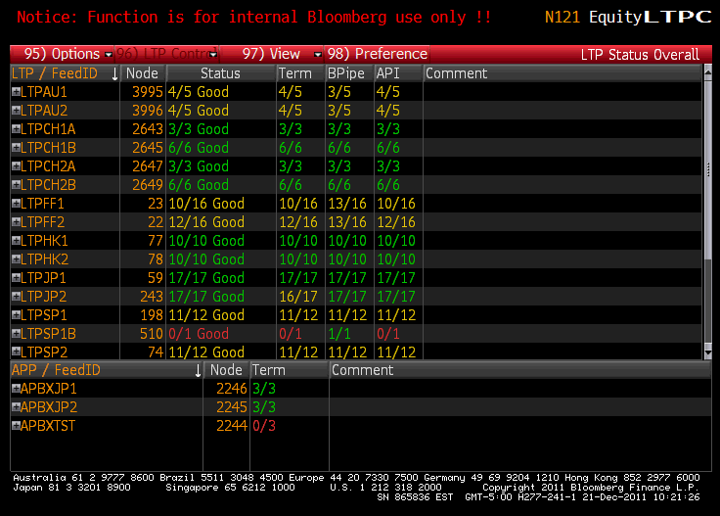
Controlling LTPs

Slide 13
Types of Ticker Machine
Production machines:
Flavor 0 – Equities, Currencies, etc
Flavor 1/10/11/12 – OPRA (Options)
Flavor 2 – Government Securities
Flavor 3 – US Equities
Flavor 4 – MSG Scrapping
Flavor 5 – MSG Scrapping
Flavor 6 – US BBO
Flavor 7 – Equity Volatility
Flavor 8 – TRAK
Flavor 9 – Currencies
Flavor 13 – Commodities
Flavor 14 – BBO
Client beta machine: (tkr33)
Beta machines: (tkr14, 21, 29, 30)
Test machines

Slide 14
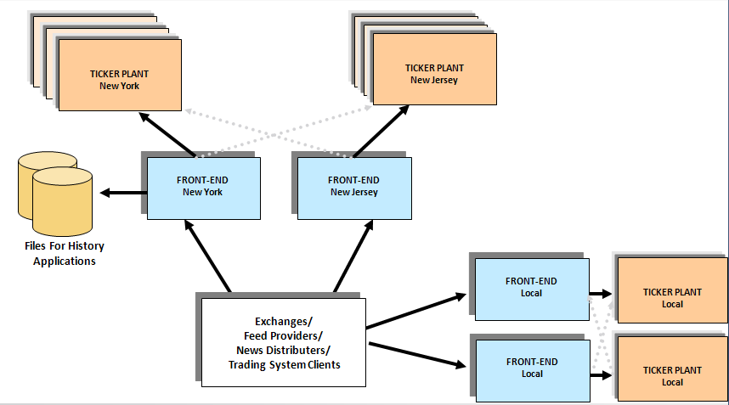
Data distribution

Slide 15
Load Balance/FallBack
Load Balance: All Ticker Machines in a given flavor have replicated data, this is done to distribute user load.
FallBack master: automatically redirects users off of any machine in its flavor that it determines is in trouble.

Slide 16
Ticker Plant Database
Database days 0 to 240*
Object ID’s (Securities)
Headers
Ticks
Additional storage (DbCache, BerkeleyDB)
Note : Days beyond 240 can be queried only by privileged functions via request server

Slide 17
The Ticker Database
Proprietary database designed for high speed data update and retrieval
Originally written in Fortran, now in C/C++.
Partitioned into 4 memory areas for efficient use of processors (= speed)
Database objects:
Header: Object summary record
Ticks: Individual transaction records
Tables BBO
Currently supports up to 32M objects.

Slide 18
Database Days
Day 0 - Current trading day. Runs from previous calendar day to 18:00 current day (EST). Data exists on disk and in memory.
Day 1-240 – History days. Created from “old” Day 0 at system date switch. Data accessed from appropriate file/machine
All Time in Ticker plant is EST.

Slide 19
Intra-Day History (up to 245 days)
Flavor 0/3/9/13
245 days of intra-day prices (headers & ticks)
File set for each history day ~ 250 GB.
Flavor 1/10/11/12
35 Days Of intra-day prices (headers & ticks)
File set for each history day ~ 140 GB.
Flavor 2
45 Days Of intra-day prices (headers & ticks)
File set for each history day ~ 200 GB.

Slide 20
Object Definition (Object ID)
Object ID: Unique identifier for each object in the database:
For example: MSFT|2045|0000
M
S
F
T
2
0
4
5
0
0
0
0
Object Name
Exchange Byte
Option Key
Object Name: Any combination of printable characters (8 characters)
Exchange Id: Identifies source of data. (a.k.a. exbyte, exchange byte. Represented as an hexadecimal number).
Option Key: Identifies specifically option securities (put/call price. Represented as a hexadecimal number).

Slide 21
Composite Objects
Composite objects: Collect data from several sources into a single central object. E.g. IBM <EQUITY>
IBM UN (NYSE)
IBM UP (Pacific)
IBM UT (NASDAQ)
IBM US
Composite object: header and tick stream
Local source: header only
Data comes in under each local object and automatically updates composite
Some of countries with composite : US, Japan, China, India, Germany, Russia, Korea etc.

Slide 22
Object Header
Summary record for an object
Pointers (Links) To Object’s Ticks
Current State Of Object
Updated as each tick is processed
256 bytes in size
~50 fields used for data
Rest used for internal ticker plant data
Some fields are mapped to exchange specific fields while some are standards i.e. Open/Last/High

Slide 23
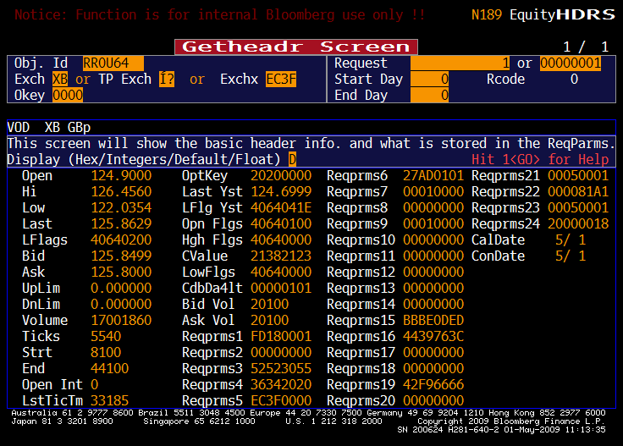
Viewing Headers with HDRS

Slide 24
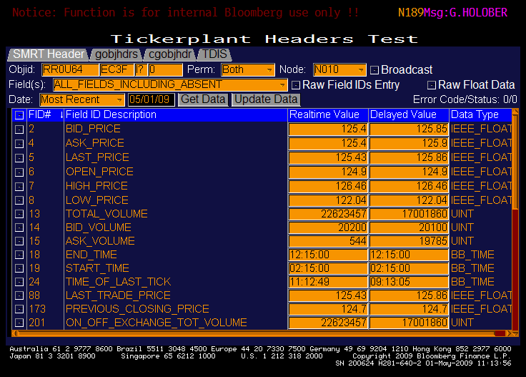
Viewing Headers with HDRS SMRT

Slide 25
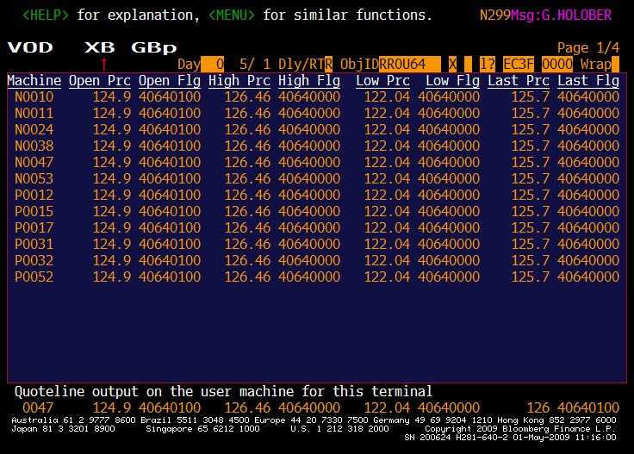
TDIS Example

Slide 26
Ticks
Records of individual transactions for object
Linked to object’s header and each other by pointers to form a tick stream
Time, price, volume and flag are stored
Flag provides additional information
Tick type
Source of tick (source id# - not exch byte)
Market Maker Id
Tick condition code

Slide 27
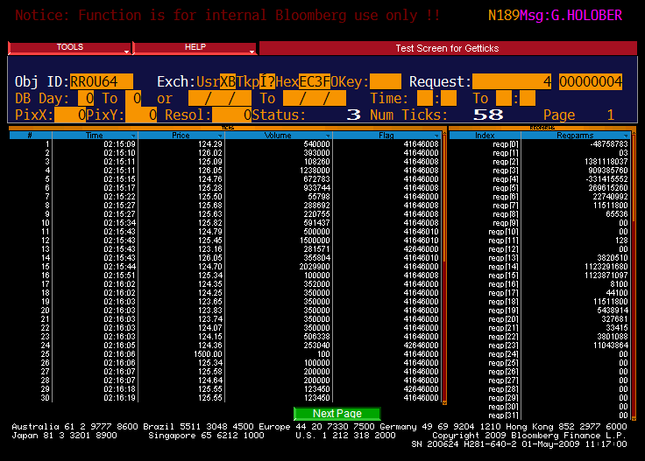
Viewing Ticks - GTIC

Slide 28
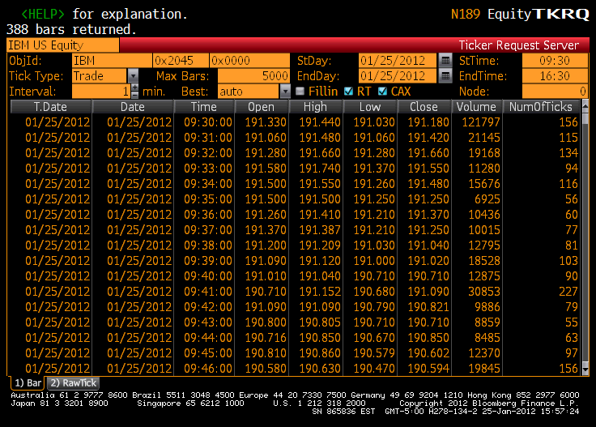
Viewing Ticks - TKRQ

Slide 29
Accessing Ticker Plant Data
DTicDb (Big Side)
TicDb and Request Server (Ticker Plant)
Monitoring

Slide 30
Data Requests
~250 User machines make requests for Ticker Plant data
User includes: user servers, trading systems, portfolio, auto-execution machines.
DTicDb: “Smart Program” examines each request and routes to appropriate Ticker based on:
Exch Byte
Requested Db Day
Flavor
Request Load Distribution
Enables

Slide 31
Request Routing
Ticker Plant “redirect” facility redefines routing list:
Enable-X: allows routing to specified Tickers based on exchange byte
ALTK <GO> : Internal BB users can point to a specific machine (caution: ALTK’s remain in effect until removed)
VSAT 7 <GO>: Tells where the terminal is pointed to for different requests

Slide 32
Real time Update (Monitor)
Most reliable machine in each flavor selected as Monitor machines.
Control critical functions & value added pricing from a single machine.
All Ticker machine capable of filling Monitor role:
Quick switch in event of monitor crash
Maintain monitor functions during system turnaround

Slide 33
Real time Update Continued ..
Monitor machine sends the data out via
Processor com rings
tee_mon server (TCP based server where B-Pipe/API connects)
PGM (Pragmatic General Multicast)

Slide 34
Monitoring Detail
Process by which we provide real-time price updates to users (Terminal/B-Pipe/API)
Monitor Subscription, behind the scene
User request comes to primary machine (as displayed by VSAT7)
Response of this request is a 16 bit stream ID indicating the type of buffer to be searched for requested data.
If Real time update request comes for first time then the subscription is broadcasted to all the machines in a given flavor, including the Monitor machine.
The client gets the real-time update by filtering the interested object from supplied buffer stream, identified by stream ID.

Slide 35
Monitoring Detail Continued ..
Monitored data contains Fixed Fields such as Last Price, Time etc along with additional Tag/Value fields.
Consumer of Monitor Data
Terminal
B-Pipe
API
B-Pipe/API gets real time updates by directly connecting to Ticker Plant over TCP/PGM.

Slide 36
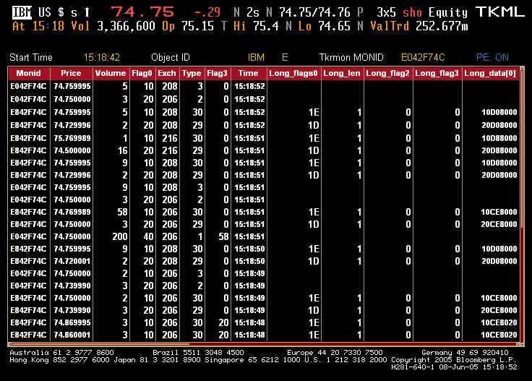
Monitor Stream - TKML

Slide 37
Ticker System Restart
New code is being delivered to production machine
Starts each business day at 17:15 EST (Ticker Plant Midnight)
Must be transparent to users
Some production machines are restarted while others kept up
Copy data received today to archival history machines (For HP, GIP, etc)
Release front ends and redirect users to newly turned machines.

Slide 38
Noturn machines
No-Turn machines:
Not required to be restarted daily anymore
Pre-creates days for future data on the fly (5 in advance)
Still needs to be restarted once every week. Solution is with the dynamic OAI project currently being worked on.
Converted set of machines:
All flavor 0/1/3/4/5/6/7/8/10/11/12/13/14
7 out of 10 for flavor 2(conversion in progress)
3 out of 10 for flavor 9 (conversion in progress)
Implemented as a real 7-day database system

Slide 39
Ongoing projects
Low Latency work
One Box where exchange data is directly delivered to Ticker Box.
Continued addition of LTP Machines across the Globe.
Scalable Ticker Plant
Increases ticker plant’s capacity on demand.
Unified Data Delivery
One common tick format to distribute across the Bloomberg.
Linux Migration
Object ID Validation
Self checking database , Designed for fast lookup by Object ID
Self Describing Tick Request

Slide 40
Where to Find this Presentation
BP TICKER PLANT OVERVIEW<GO>

Slide 41
Document History
Date | Version | Updated by
January, 2012 | Version 6.0 | Vinay Kumar
August , 2011 | Version 5.3/5.4 | Philippe Annen / Harj Purewal
August, 2010 | Version 5.2 | Philippe Annen
May, 2010 | Version 5.1 | Craig Bizjak
April, 2010 | Version 5.0 | Craig Bizjak
January 23, 2005 | Version 4.1 | Mike Liebskind
June 8, 2005 | Version 4.0 | Craig Bizjak
October 28, 2003 | Version 3.0 | Craig Bizjak
October 16, 2003 | Version 2.1 added Link to front slide | Shelley Winkler
July 28, 2003 | Version 1.0 –Originally referred to as Ticker Plant Basics | Craig Bizjak

