Slide 1
Learning Git From the inside OUT
http://github.com/henryxiang/learn-git
Sept 1, 2015

Slide 2
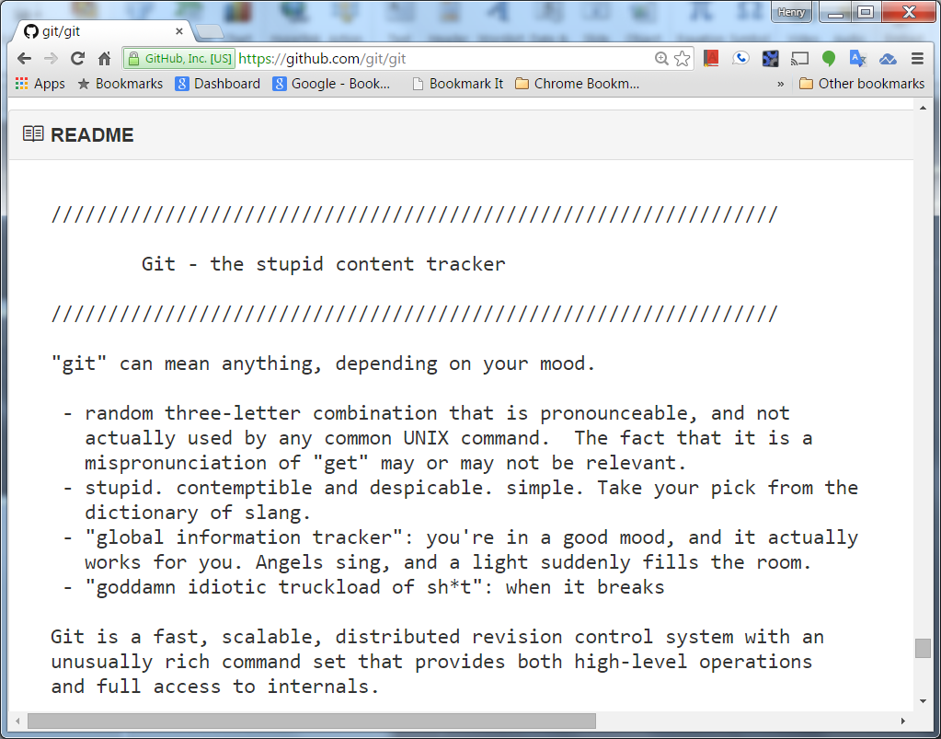
What Is Git?

Slide 3
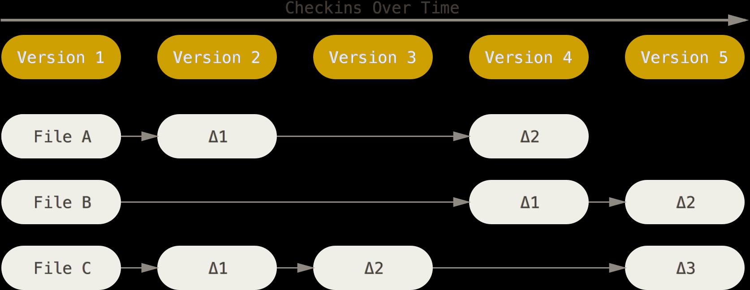
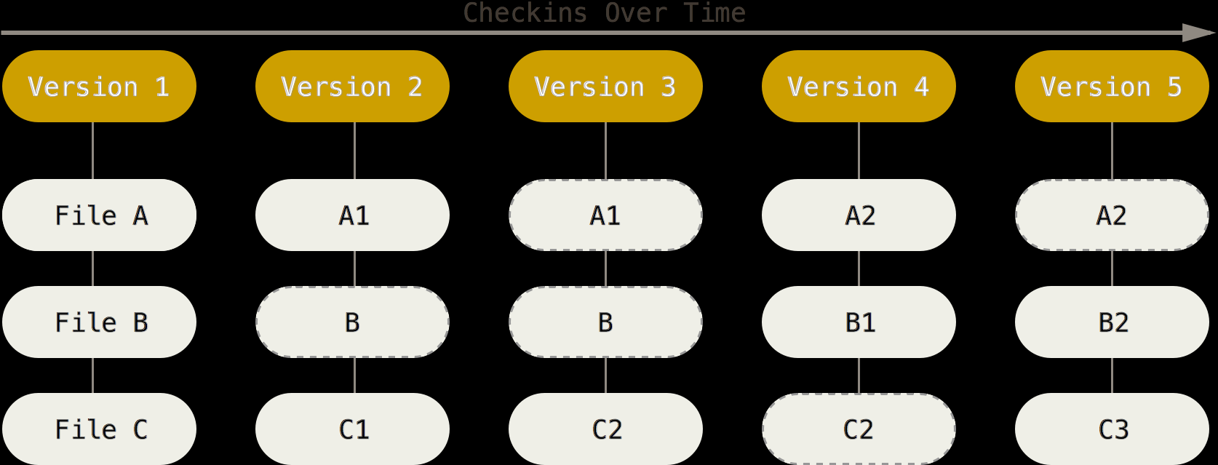
Git Takes Snapshots not Diffs

Slide 4
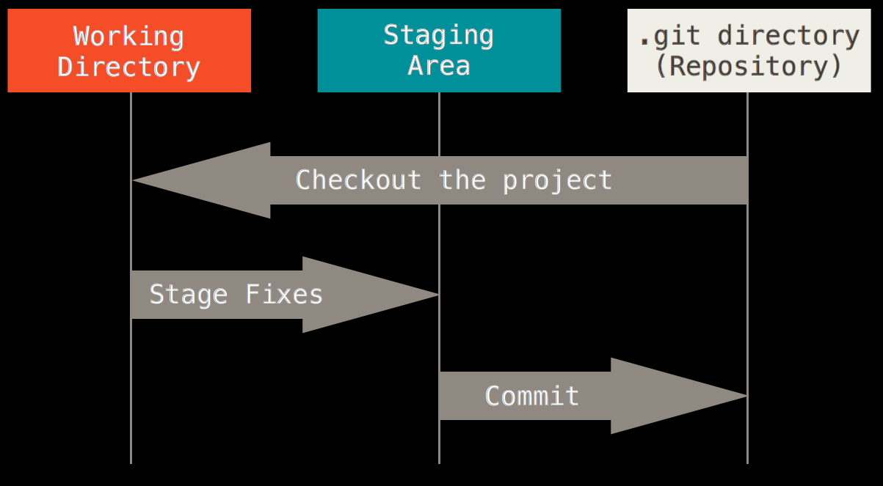
Three States of Files
Three state of files: committed, modified, staged
git checkout, git add, git commit

Slide 5
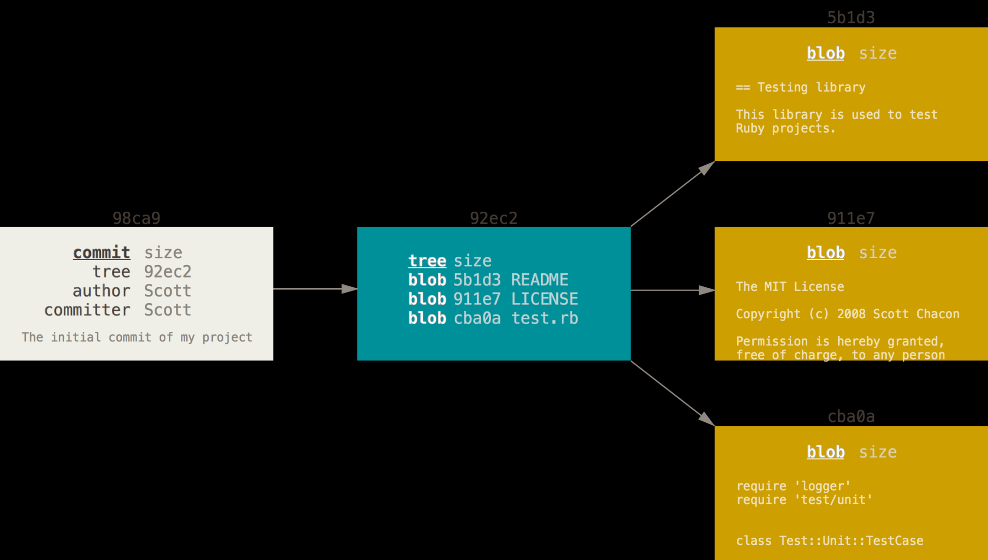
Git Object Model
Three types of objects: commit, tree, and blob

Slide 6
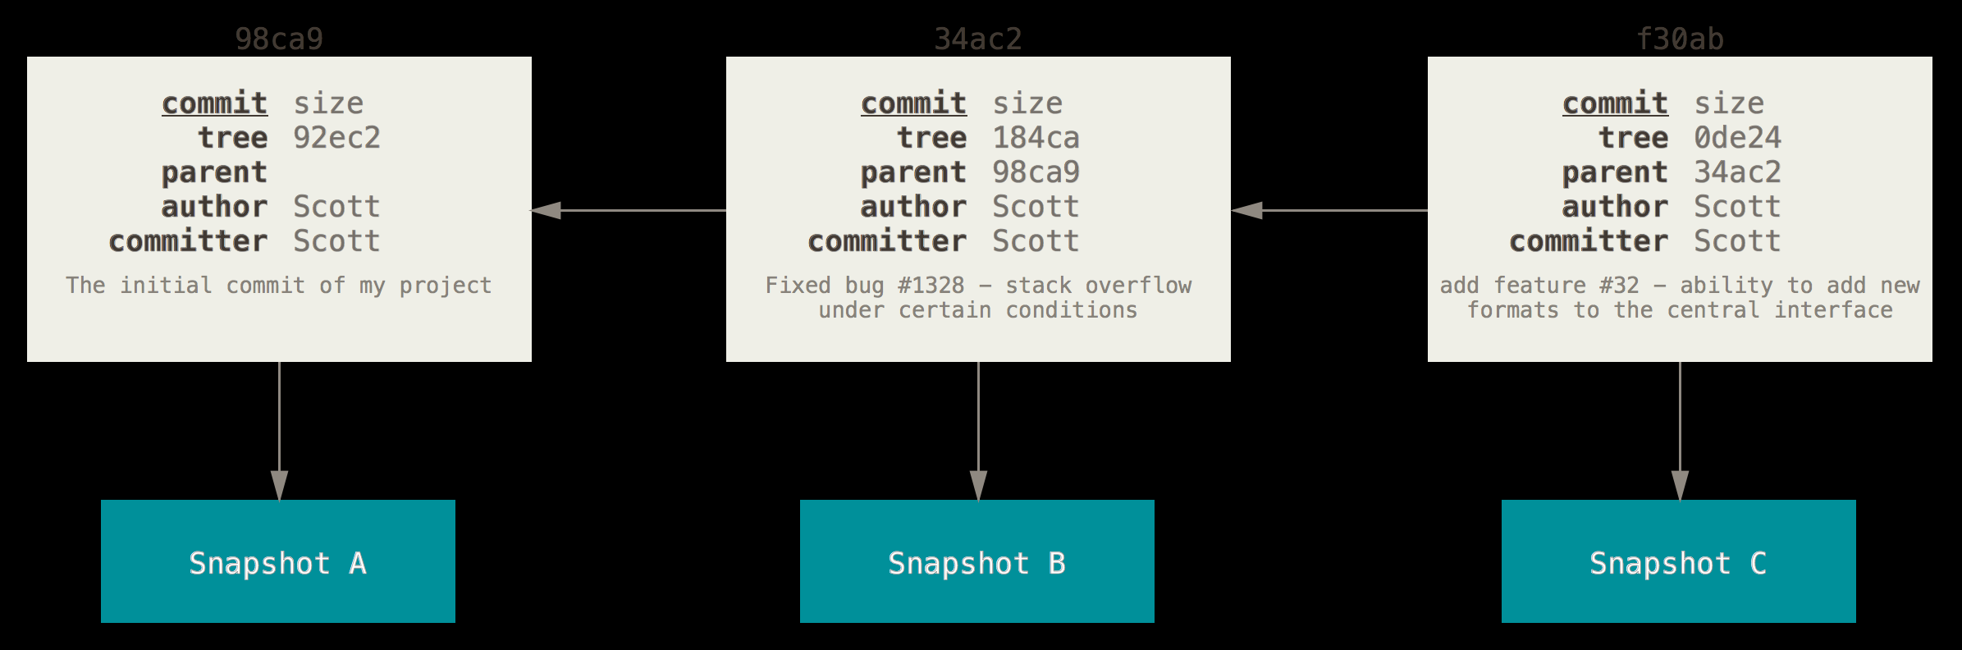
Commits and Their Parents
Every commit except the first one has a pointer that references its parent.

Slide 7
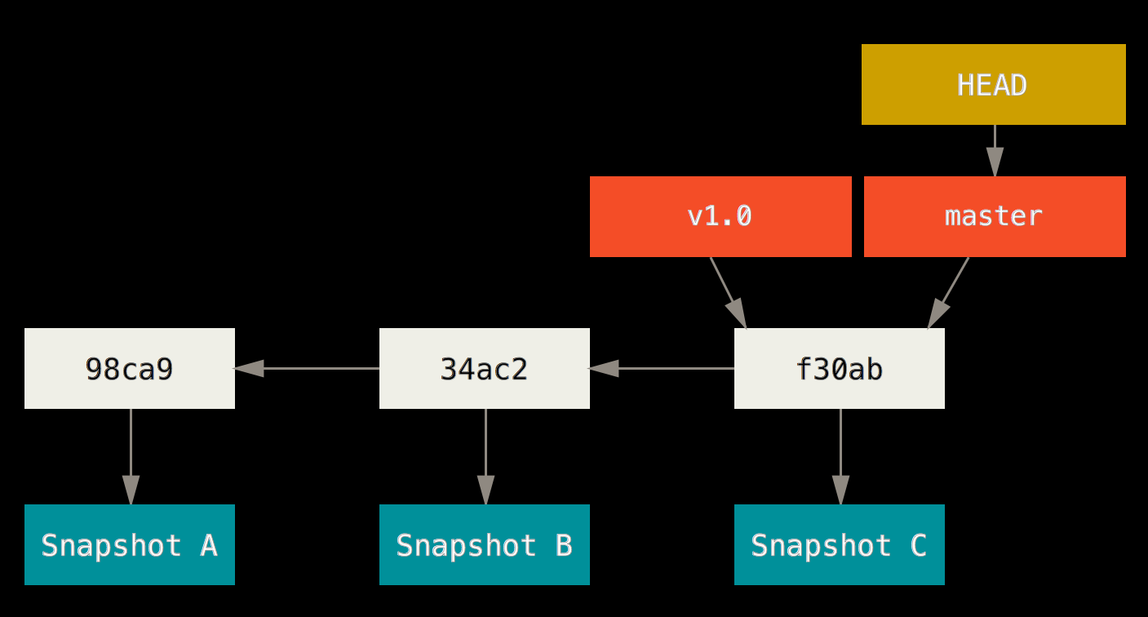
Git Branch
Git branch is a light-weight pointer that points to one of the commits.

Slide 8
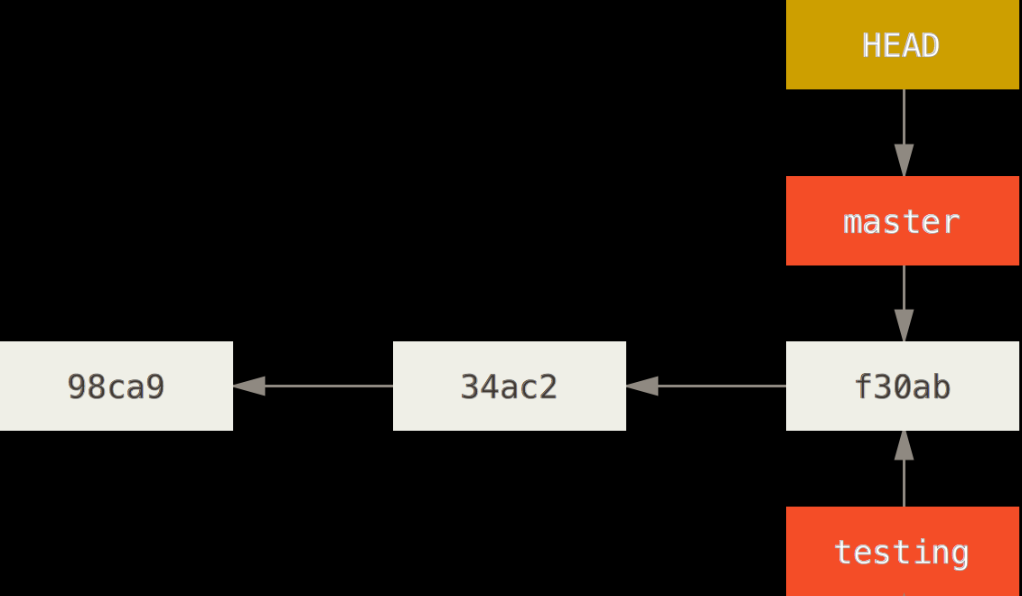
Create a New Branch
$ git branch testing

Slide 9
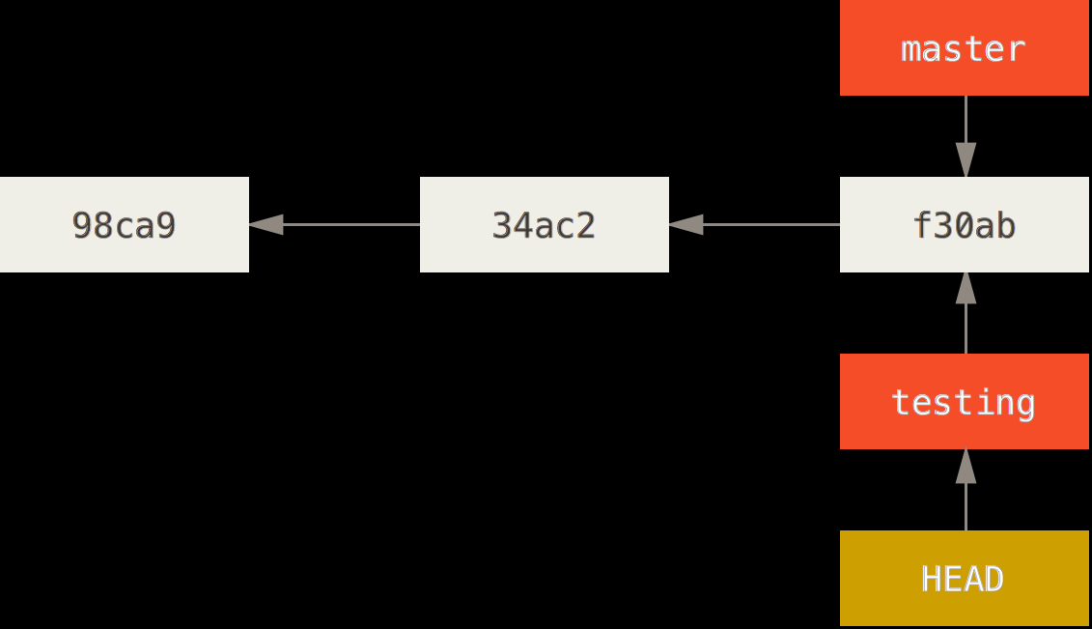
Switching Branch
$ git branch testing
$ git checkout testing
$ git checkout –b testing

Slide 10
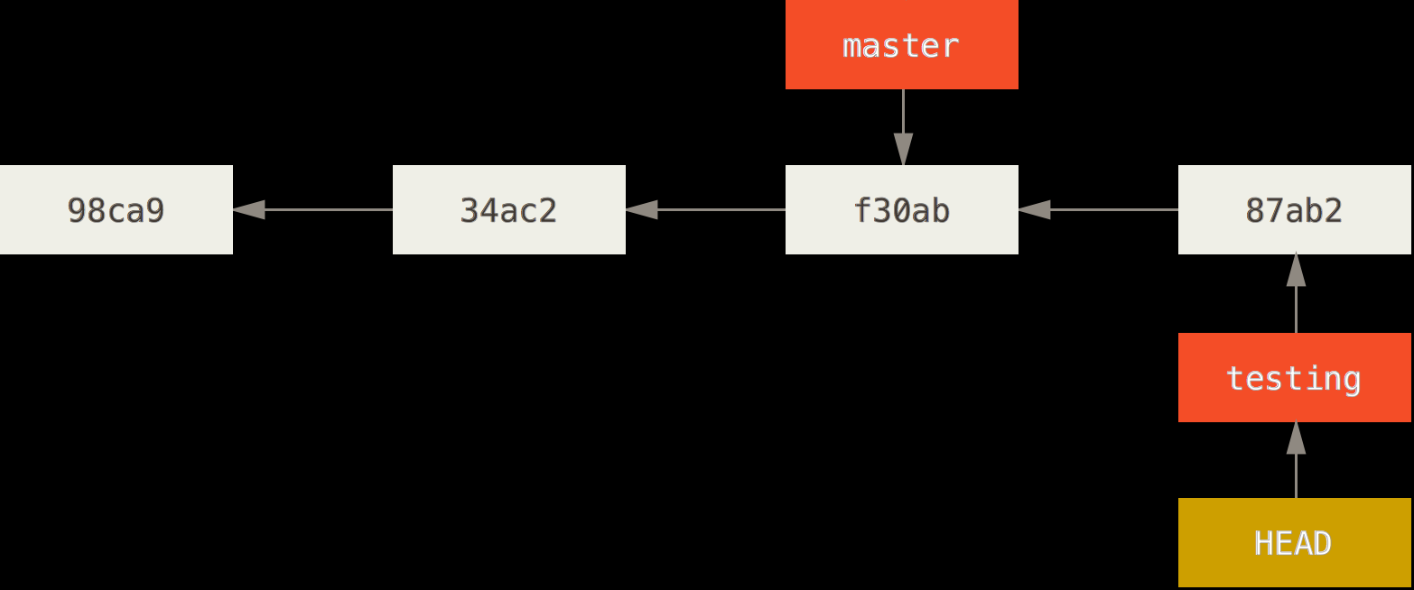
Committed Changes on Testing Branch
$ git commit –a –m ‘made some changes’

Slide 11
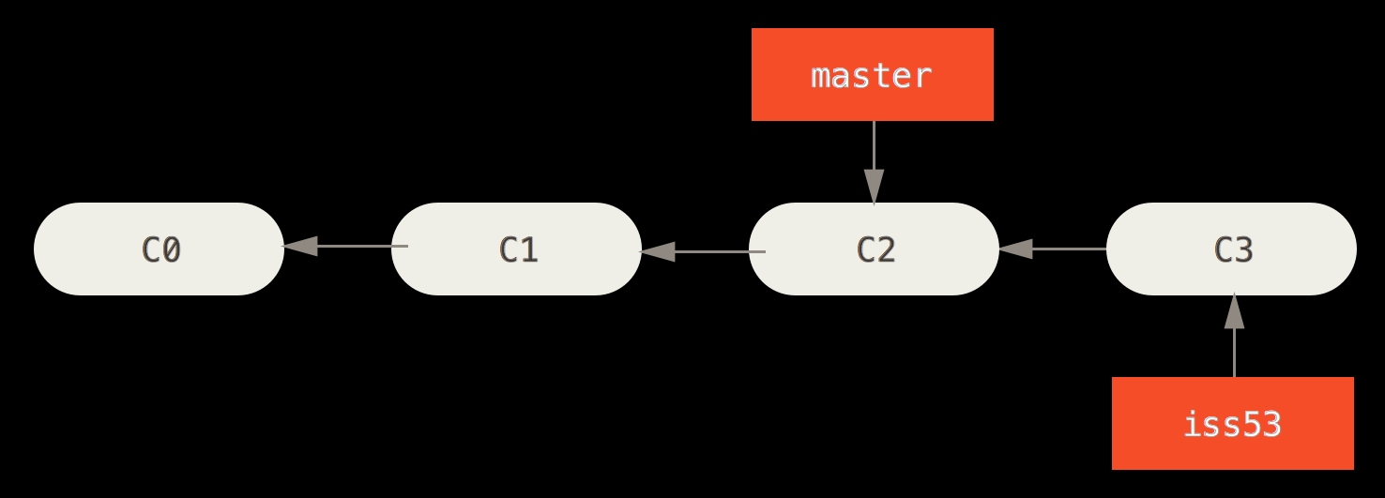
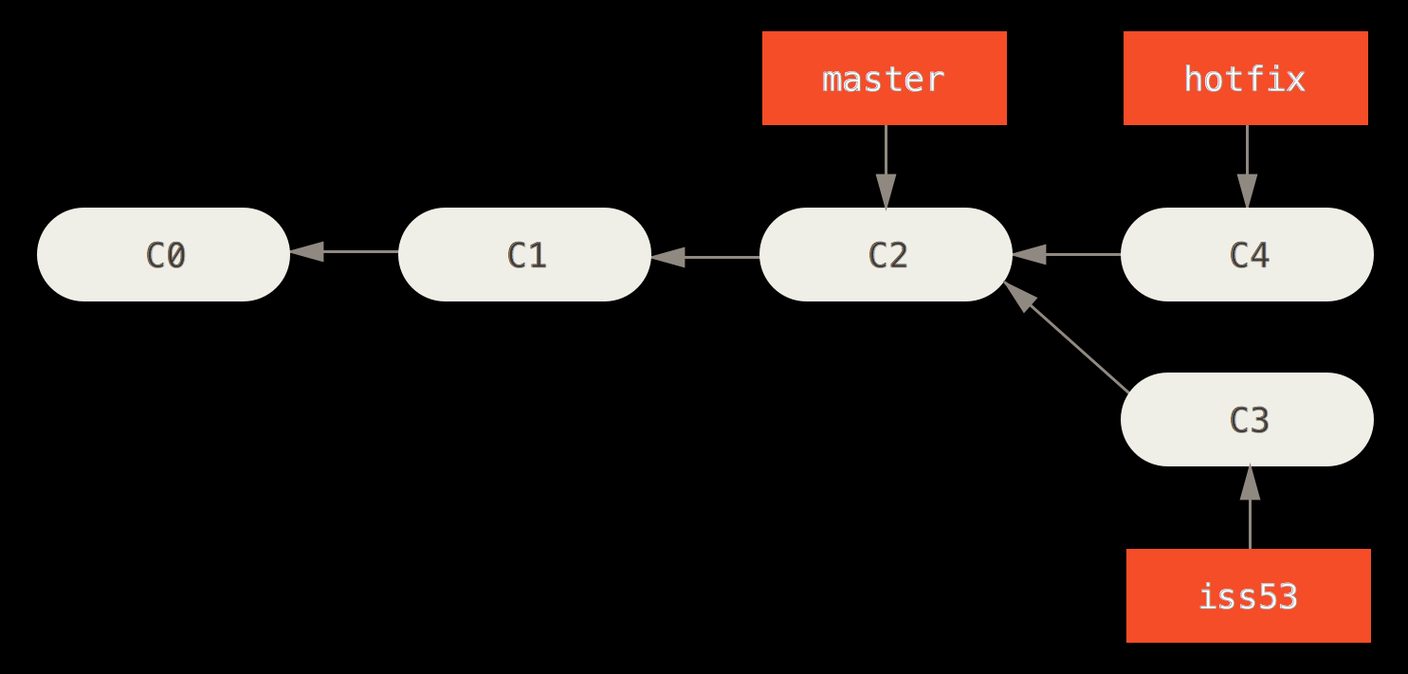
Divergent Branches

Slide 12
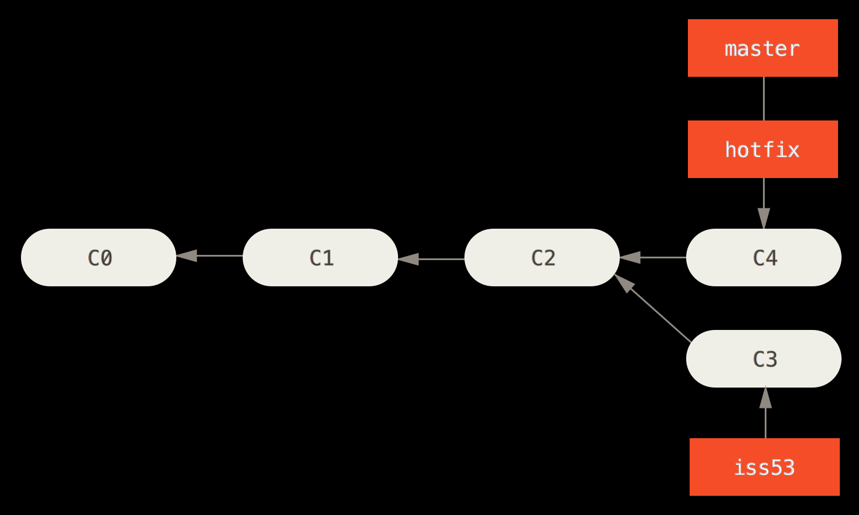
Fast-Forward Merge
$ git checkout master
$ git merge hotfix

Slide 13
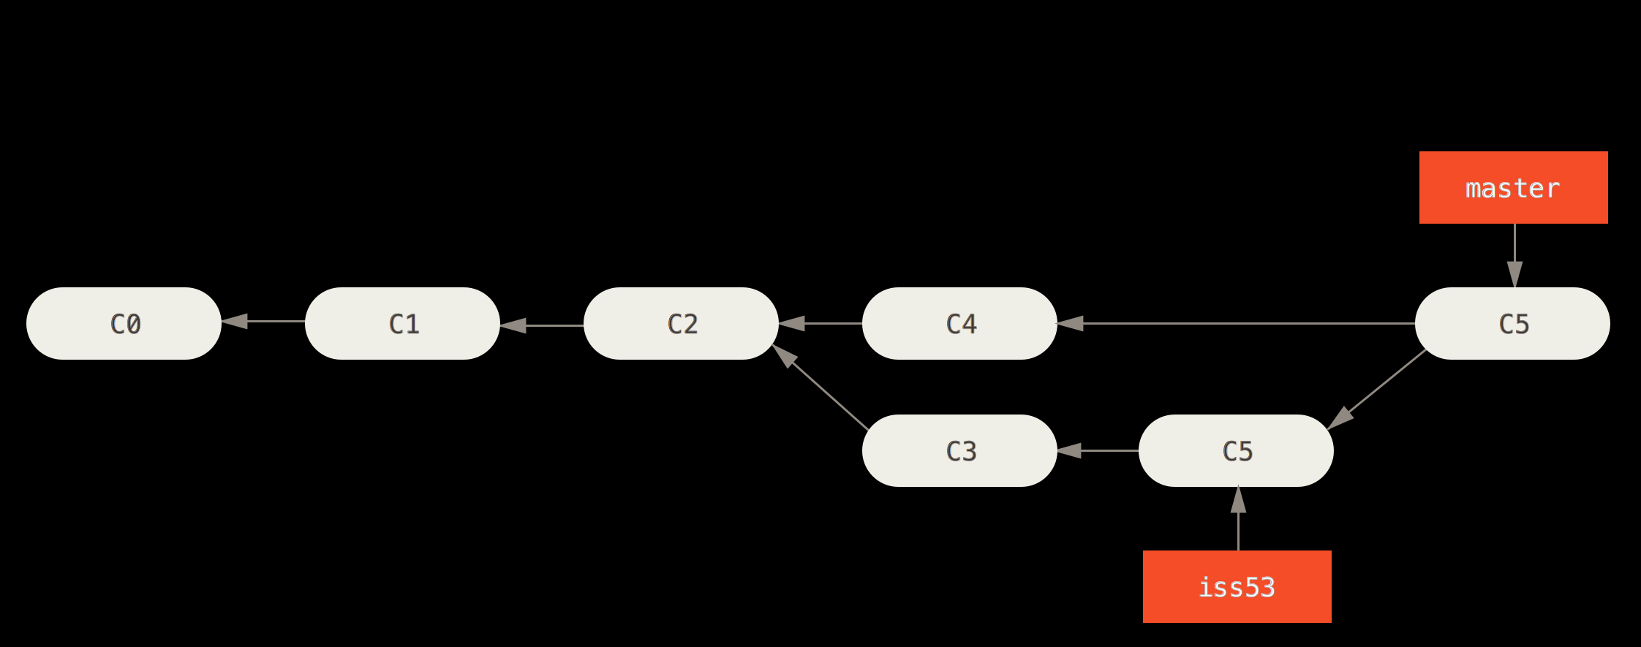
Three-Way Merge
C6
$ git checkout master
$ git merge iss53
If there are conflicts, resolve conflicts, and then commit to finalize the merge.
$ git commit –m ‘merged in changes in iss53’

Slide 14
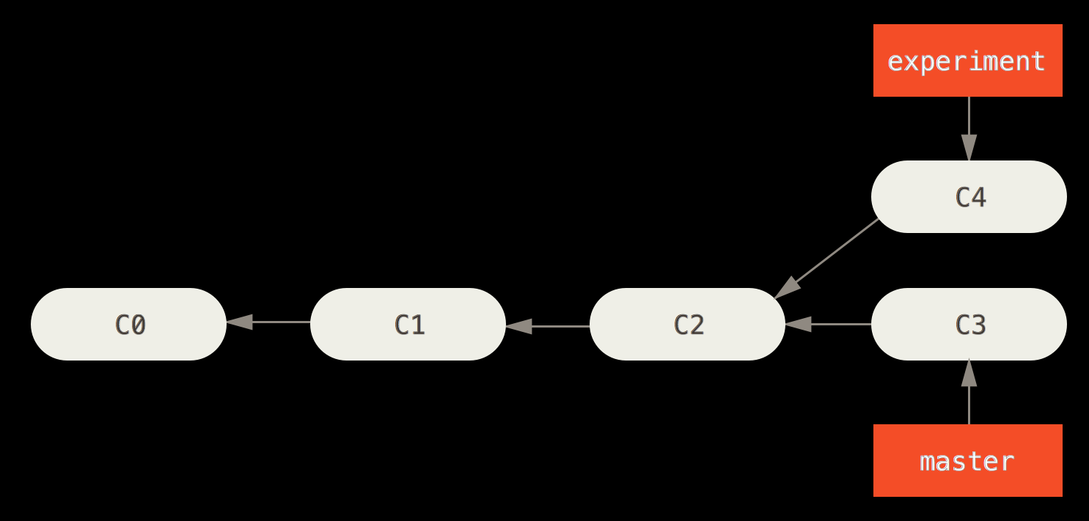
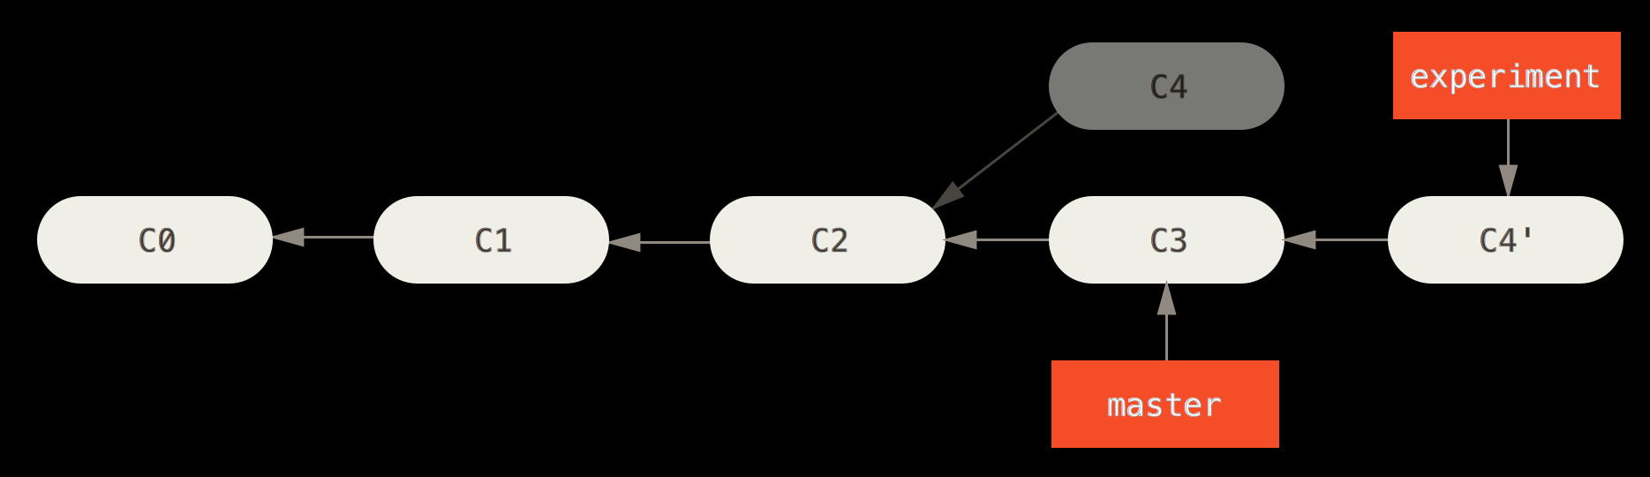
Rebasing
$ git checkout experiment
$ git rebase master

Slide 15
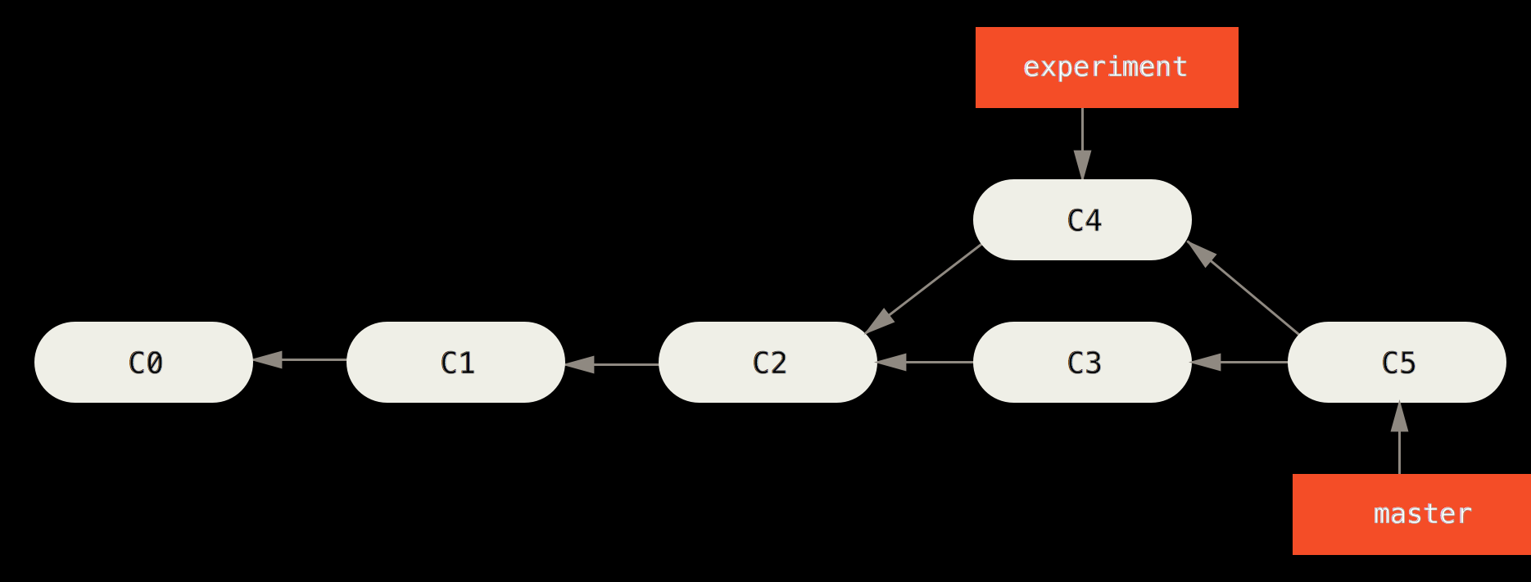
Merge vs Rebase

Slide 16
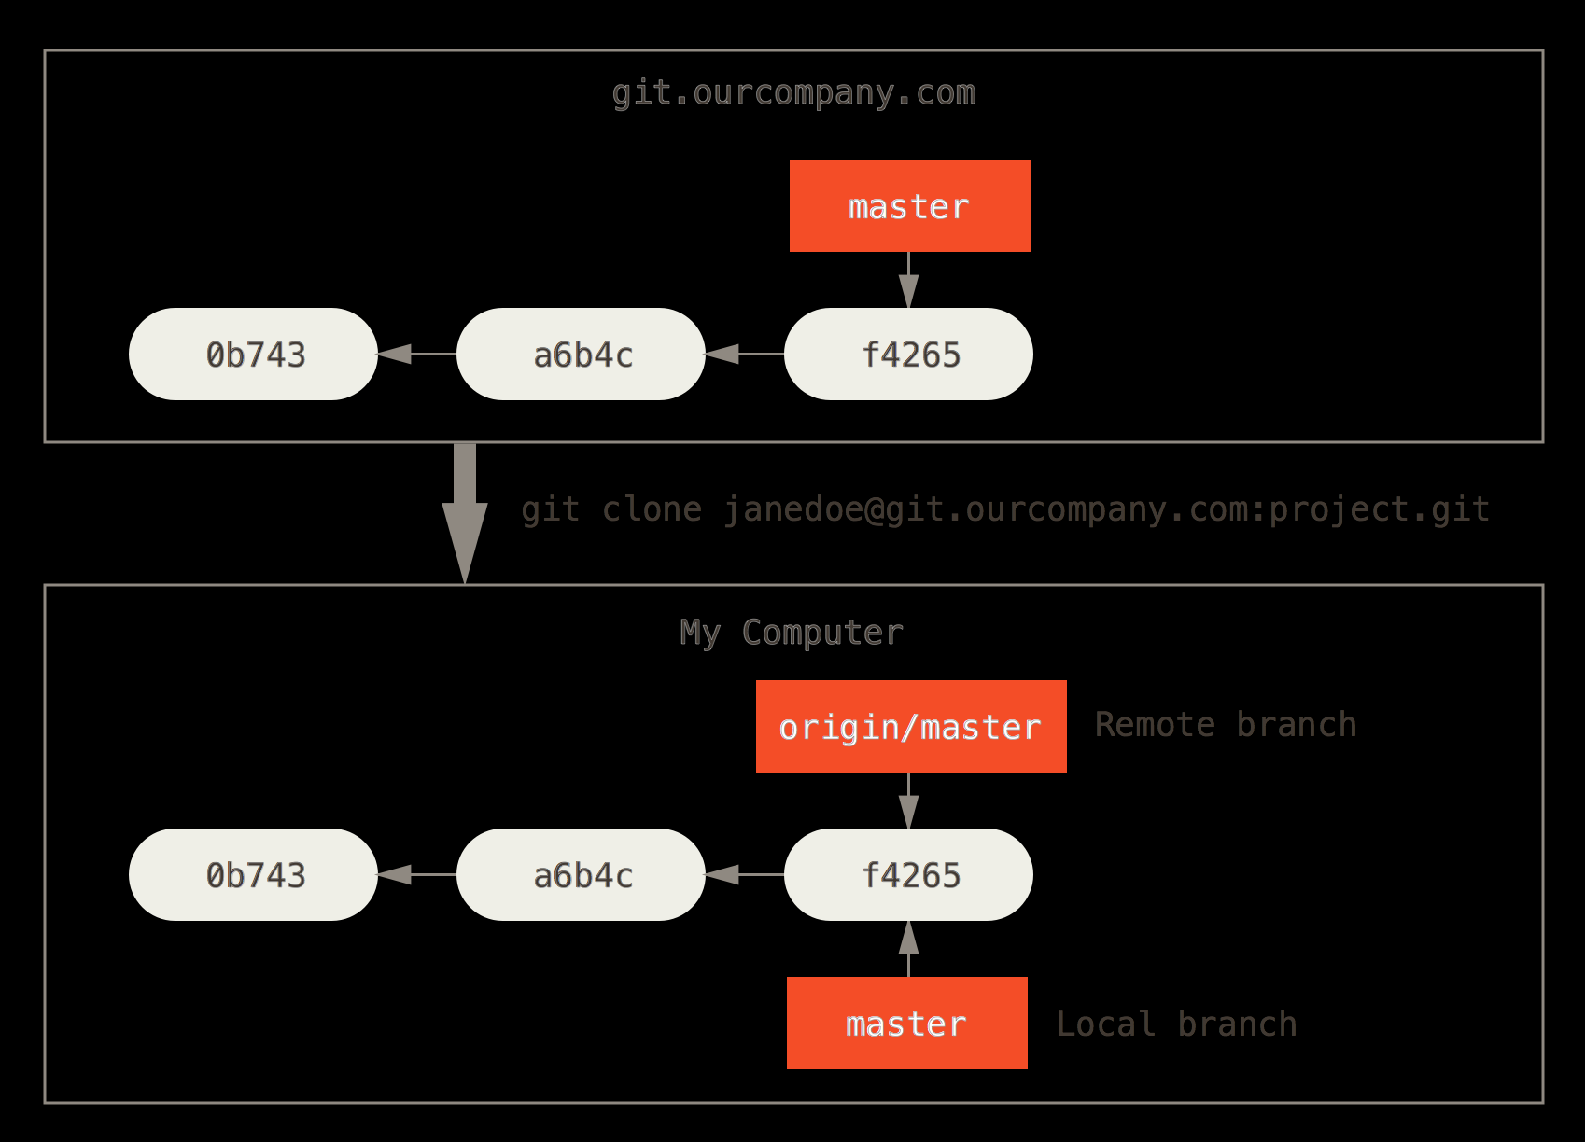
Remote Branches

Slide 17
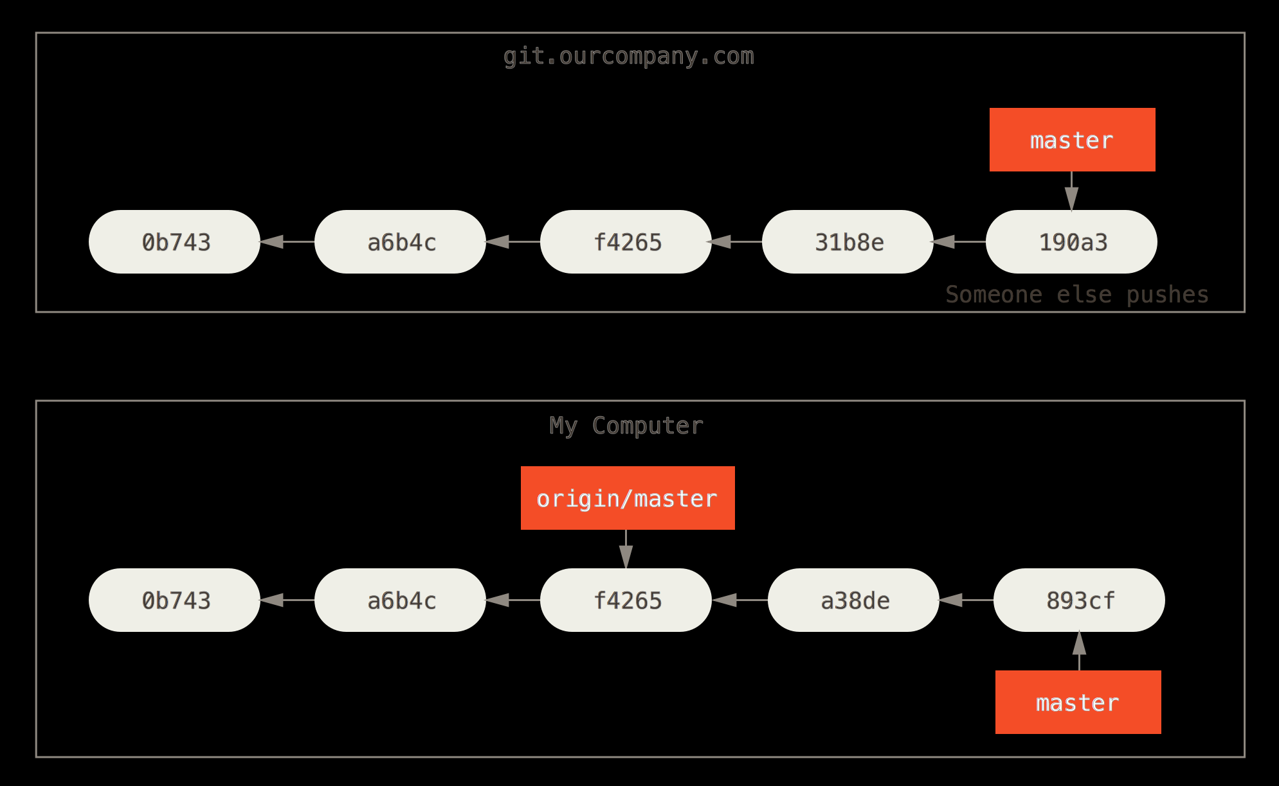
Local/Remote Divergence

Slide 18
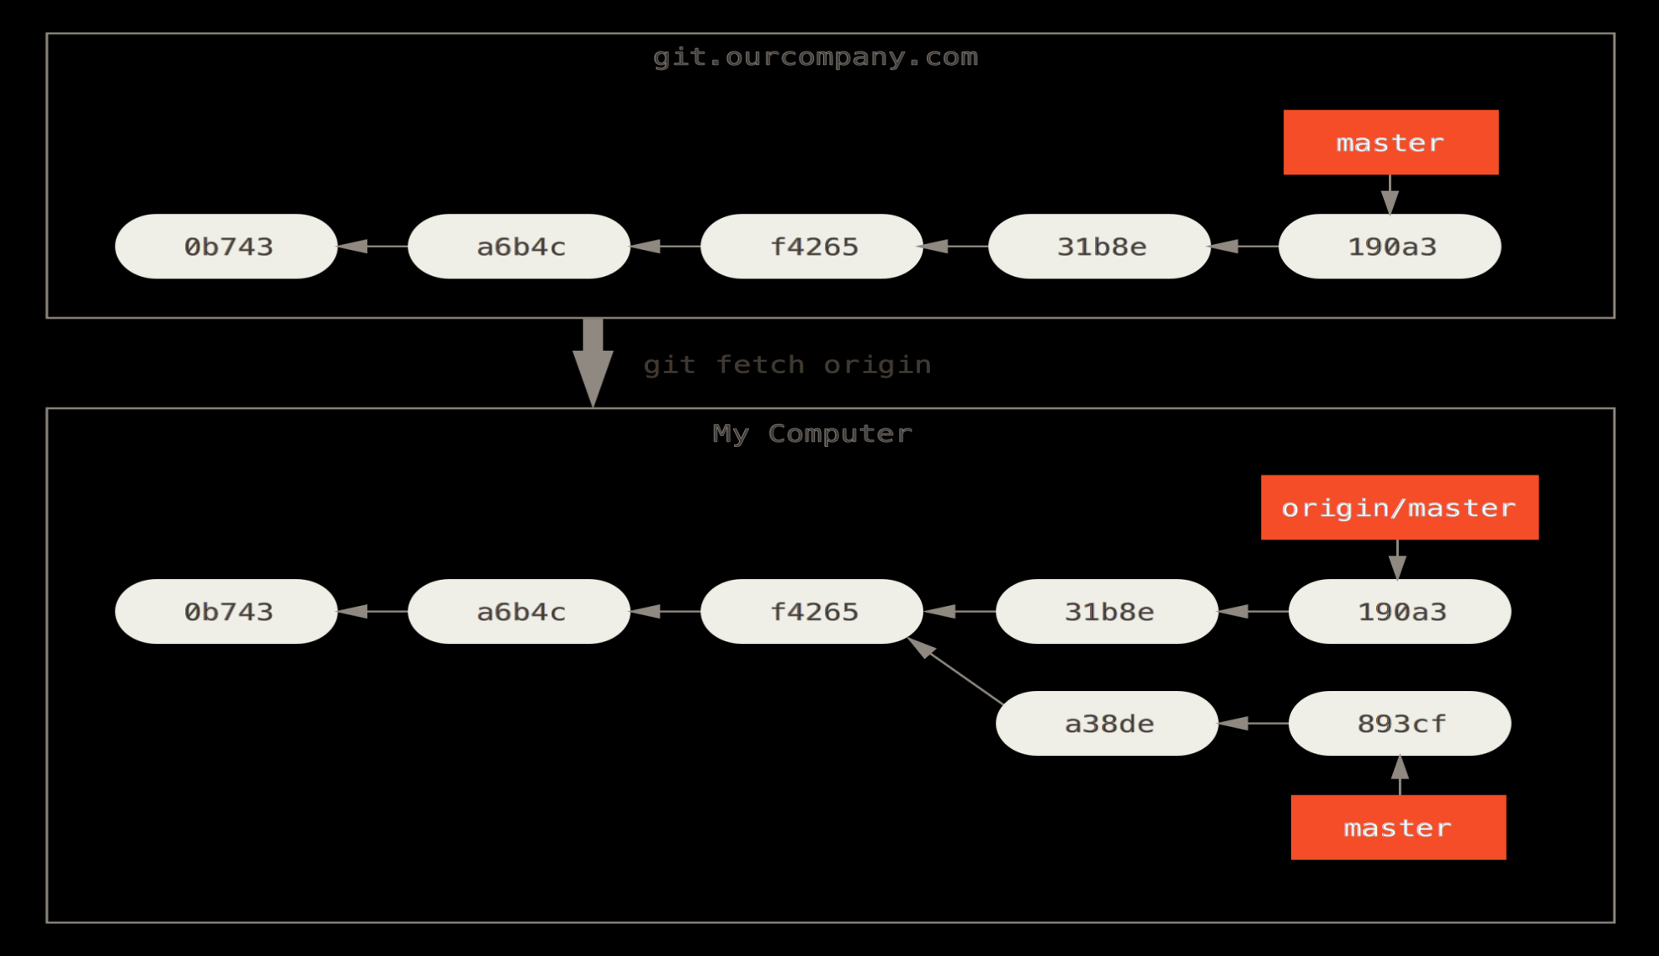
Update Local Reference to Remote Branch
$ git fetch origin
$ git merge FETCH_HEAD
$ git pull origin

Slide 19
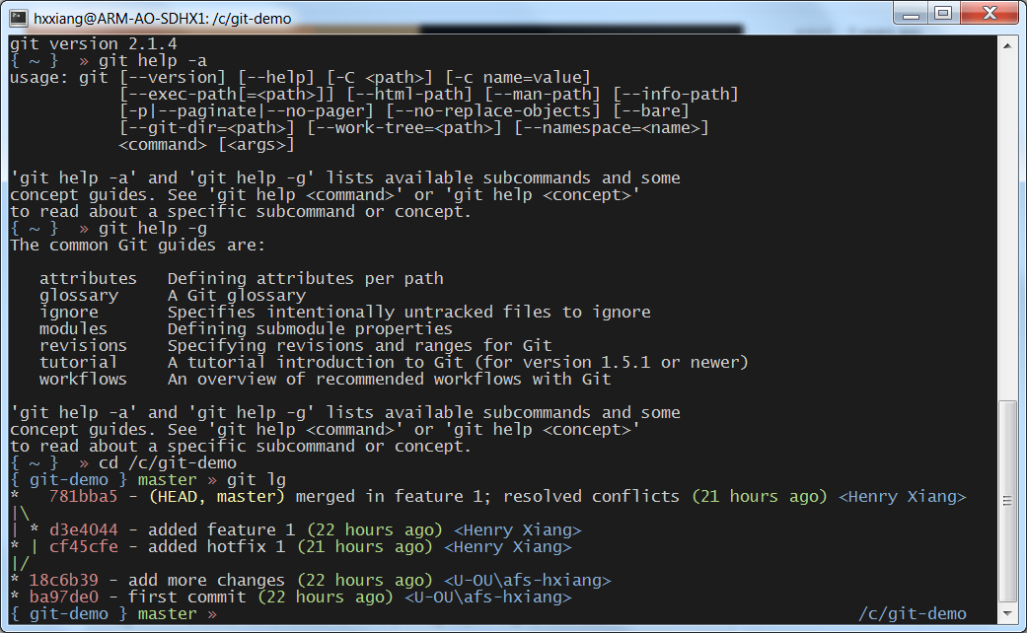
Examples

Slide 20
Resources
Git Help (git help –g, git help –w <topic>)
Pro Git by Scott Chacon and Ben Straub
Github Education
Atlassin Git Tutorials
YouTube (search for git)
Slideshare.net (search for git)

