Slide 1
Quarterly Performance Report
29th September 2025

Slide 2
Revenue Analysis by Organization
Organization | Value
Acme Corp | 1250000
Globex Inc | 980000
Wayne Ent | 1560000
Stark Ind | 2100000
OsCorp | 875000
Acme Corp | 1320000
Globex Inc | 1050000
Wayne Ent | 1680000
Stark Ind | 2250000
OsCorp | 940000
Acme Corp | 1410000
Globex Inc | 1120000
Wayne Ent | 1790000
Stark Ind | 2400000
OsCorp | 1020000

Slide 3
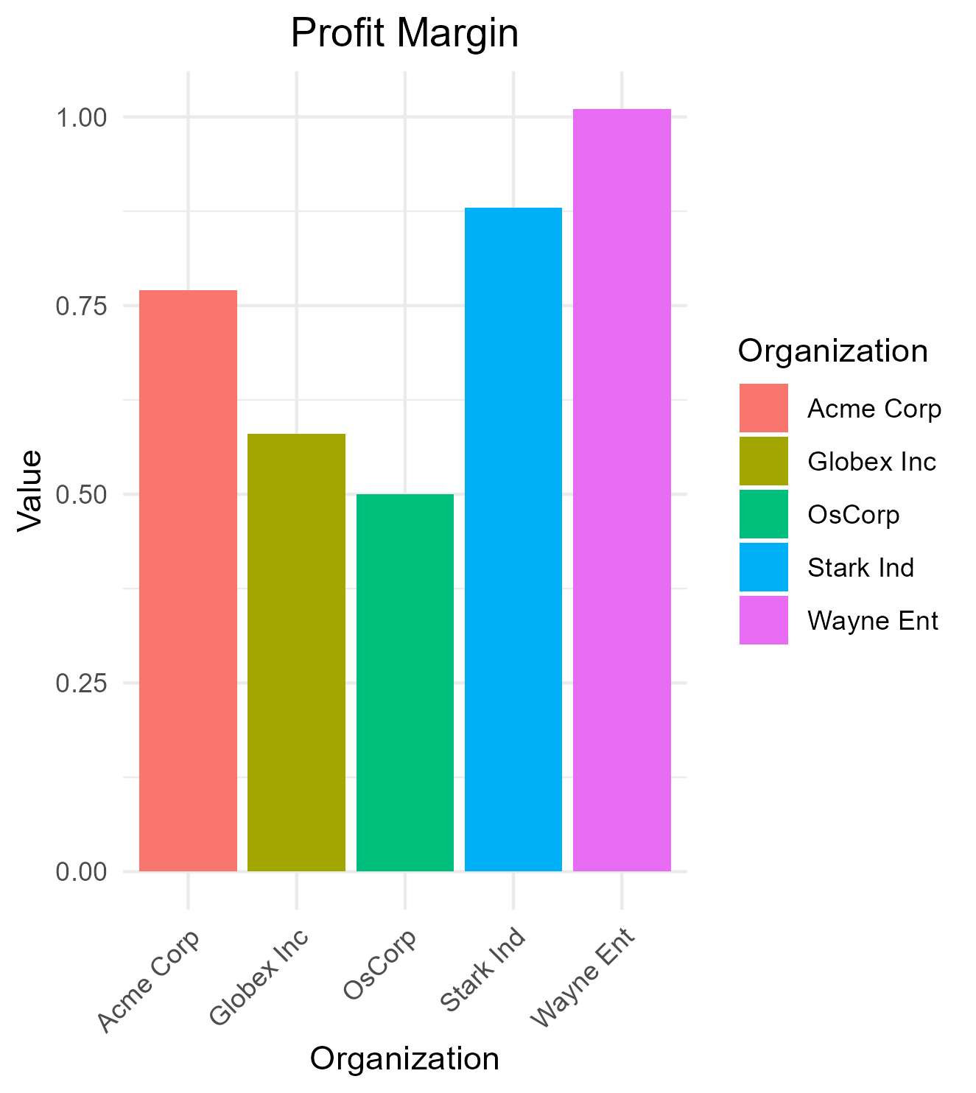
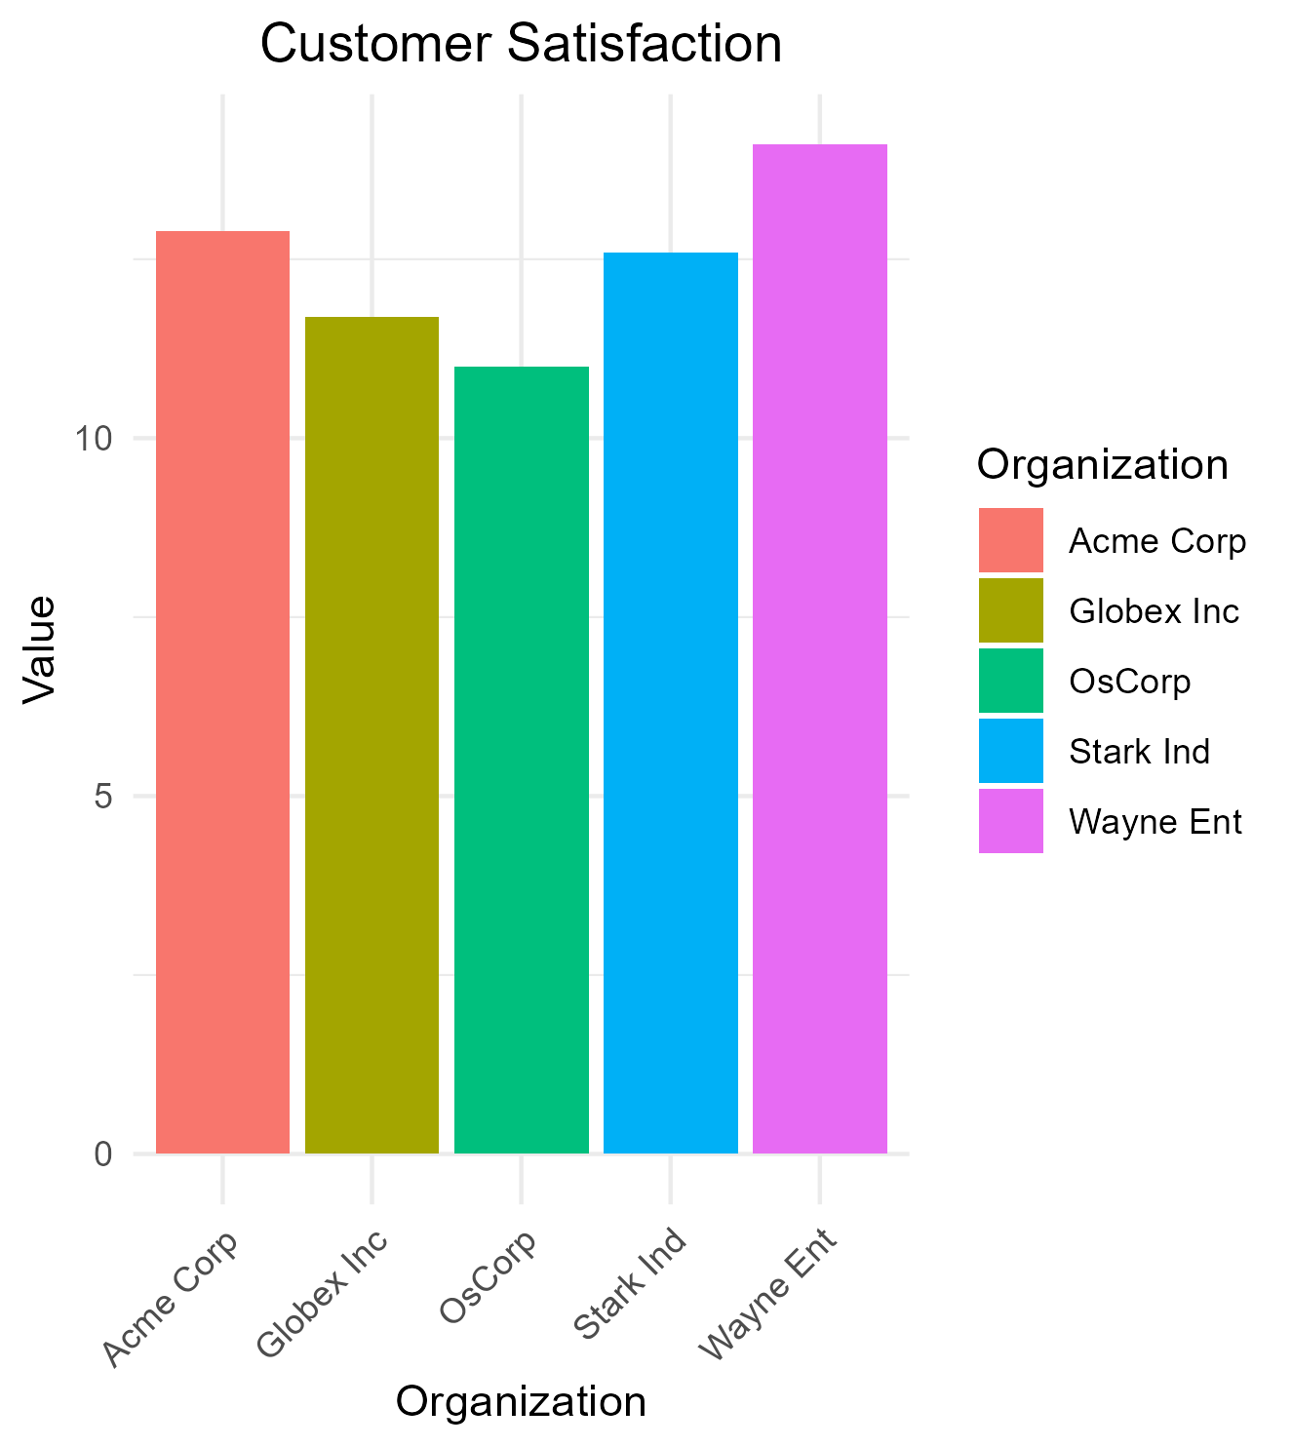
Profit Margin and Customer Satisfaction Comparison

Slide 4
Market Share Analysis
Organization | Value
Acme Corp | 0.15
Globex Inc | 0.12
Wayne Ent | 0.18
Stark Ind | 0.22
OsCorp | 0.09
Acme Corp | 0.16
Globex Inc | 0.13
Wayne Ent | 0.19
Stark Ind | 0.23
OsCorp | 0.10
Acme Corp | 0.17
Globex Inc | 0.14
Wayne Ent | 0.20
Stark Ind | 0.24
OsCorp | 0.11

Slide 5
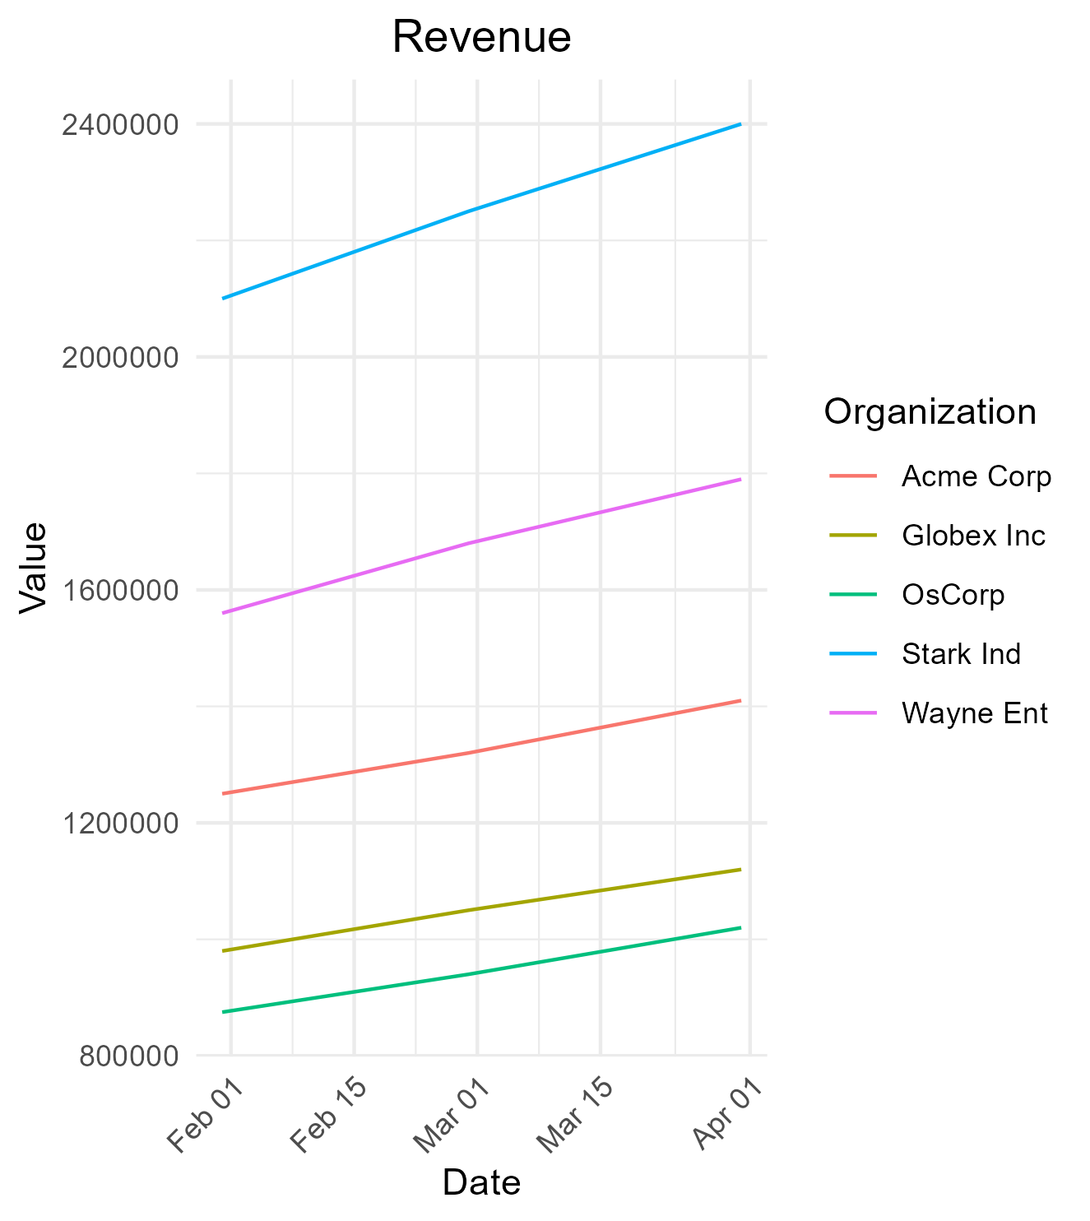
Q1 Performance Summary
Organization | Value
Acme Corp | 0.24
Globex Inc | 0.18
Wayne Ent | 0.32
Stark Ind | 0.28
OsCorp | 0.15
Acme Corp | 0.26
Globex Inc | 0.19
Wayne Ent | 0.34
Stark Ind | 0.29
OsCorp | 0.17
Acme Corp | 0.27
Globex Inc | 0.21
Wayne Ent | 0.35
Stark Ind | 0.31
OsCorp | 0.18

Slide 6
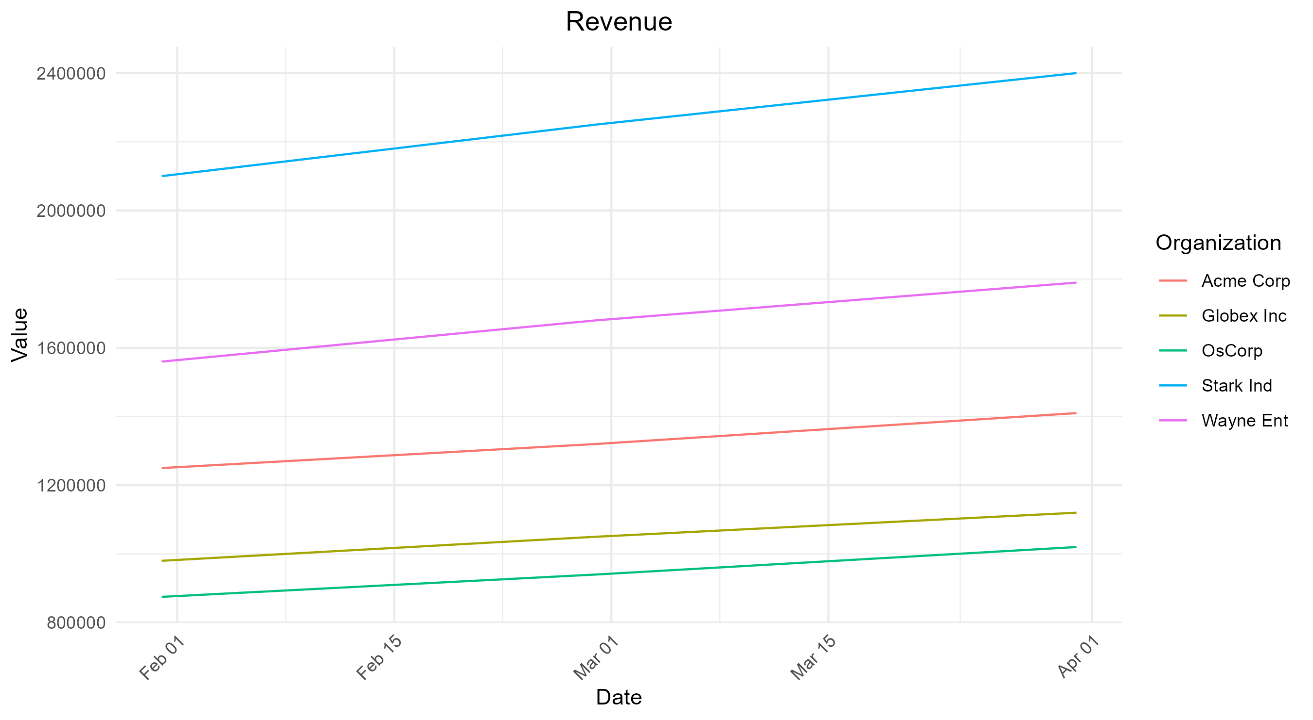
Revenue Trends Across Q1

Slide 7
Organizational Performance Dashboard
Organization | Value
Acme Corp | 1250000
Globex Inc | 980000
Wayne Ent | 1560000
Stark Ind | 2100000
OsCorp | 875000
Acme Corp | 1320000
Globex Inc | 1050000
Wayne Ent | 1680000
Stark Ind | 2250000
OsCorp | 940000
Acme Corp | 1410000
Globex Inc | 1120000
Wayne Ent | 1790000
Stark Ind | 2400000
OsCorp | 1020000

Slide 8
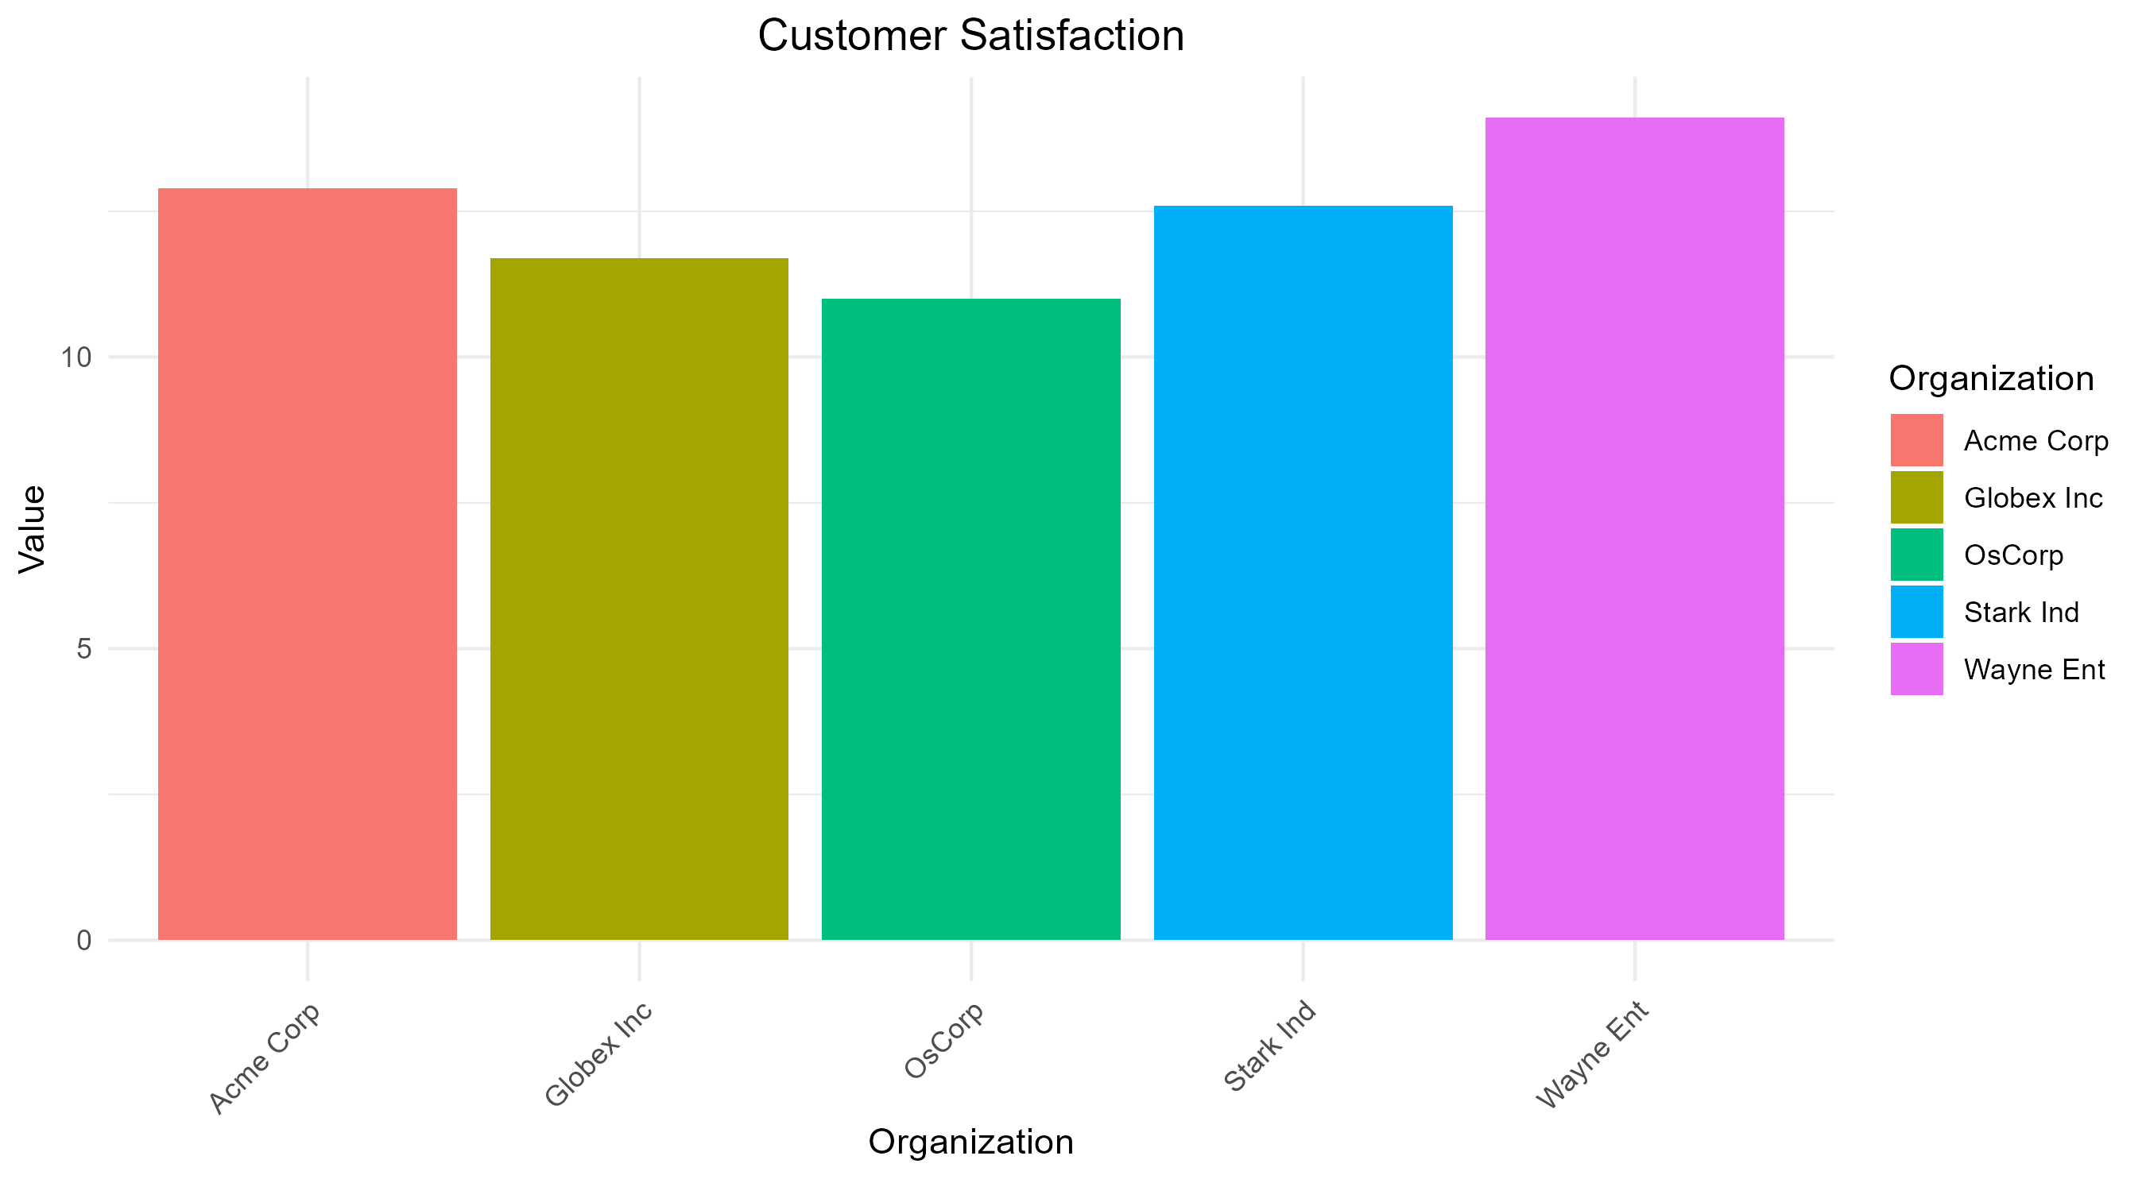
Executive Summary and Key Insights

