Slide 1
CSCE 313 – Machine Problems
Sept 7, 2015

Slide 2
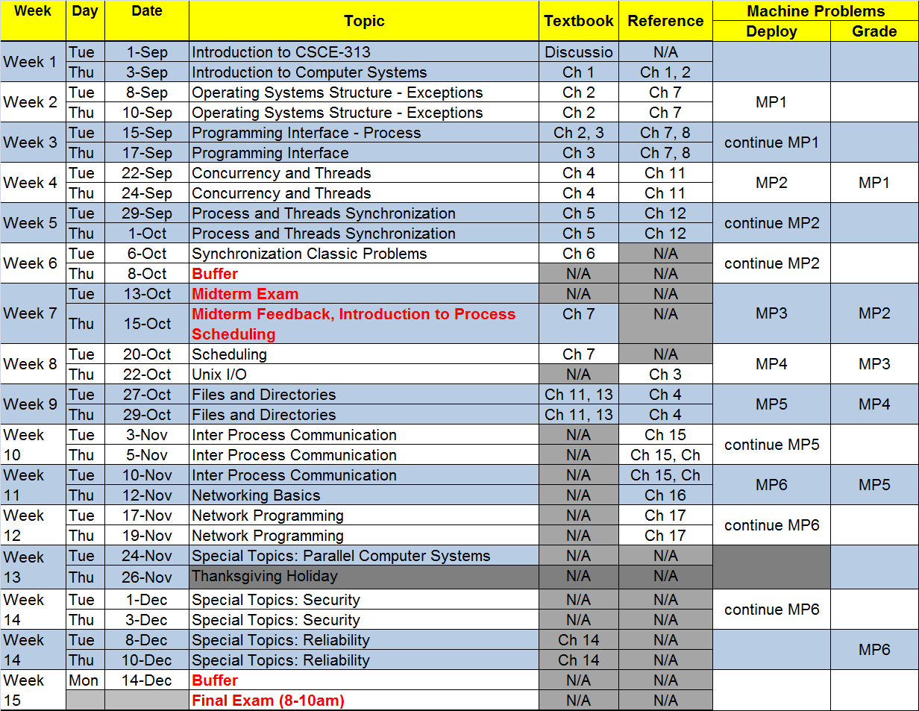
Lectures and Machine Problems Calendar
CSCE-313 Fall 2015

Slide 3
Machine Problems (MP’s)
Total 6/7 MP’s of varying complexity
Point allocation (subject to minor change) is as follows (MP1..7)
    15, 20, 8, 12, 15, 15, 15, 15
Some MP’s may also allocate opportunities for bonus points
MP’s are designed to stay in sync with subject matter covered in class
MP 1 and 2 are designed to get the students ramped up on understanding C memory allocation, pointer arithmetic, etc.
  Rest of the MP’s leverage class learning
CSCE-313 Fall 2015

Slide 4
MP Teams
Team Membership
  You are expected to work in teams of 2
  A one-time change of Sections is permitted to accommodate schedule constraints and/or team partner
    Approval is at the discretion of your TA’s
    Approval is subject to the # of requests for change and our ability to accommodate the students in the classroom
  Team memberships must be finalized by Sept 10
  Any unresolved situations will need to be brought to the Instructor’s notice for quick resolution given the brevity of MP schedule
CSCE-313 Fall 2015

Slide 5
MP Code Turnin
Students must strictly follow the instructions provided in Machine Problem statement
  It is difficult to grade unless instructions are not followed
Code must be turned in on “csnet” by 11:59pm on the due date
  Due date for most labs will be on Sunday at midnight
But, grades will be published through “ecampus”
CSCE-313 Fall 2015

Slide 6
MP Grading
Grading Method
  Grading Rubric will be published for each MP on release
  MP’s will be graded in the Lab for functionality and performance
  Both team members must be present in the lab for grading and must be prepared to explain their work as requested by the TA
  TA’s reserve the right to grade some aspects of machine problems (e.g. reports) offline
  Code not graded on the “grading day” will be assessed late penalty based on the date of “csnet” turnin and will be graded only in the next lab session
CSCE-313 Fall 2015

