Slide 1



Slide 3
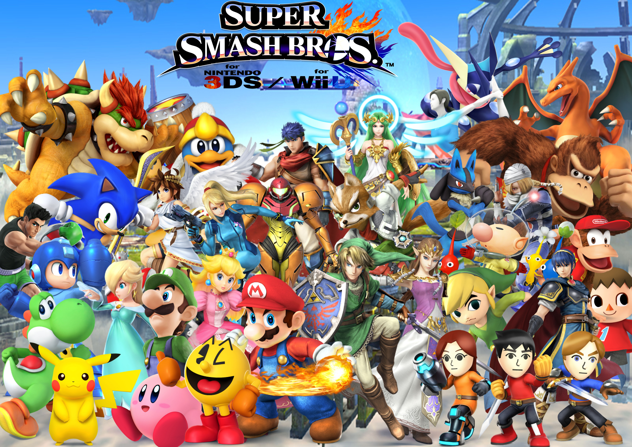
Inspiration

Slide 4

Organizing Tournaments Now
Host

Slide 5

Organizing Tournaments Now
Contacts Players
Host
Players

Slide 6
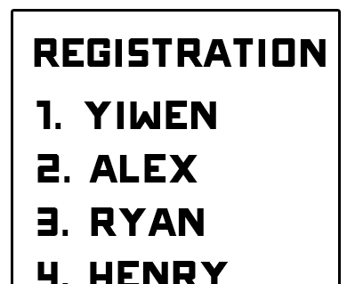
Organizing Tournaments Now
Contacts Players
Host
Players
Signs up for tournament
Registration

Slide 7

Organizing Tournaments Now
Host
Players
Manually enters players from registration sheet into database and manually create brackets/initial pairings
Database
Registration

Slide 8
Organizing Tournaments Now
Host
Pays entry fee
Players
Database

Slide 9
Organizing Tournaments Now
Give Results
Host
Players
Manually advance bracket and create new pairings
Players compete
Database

Slide 10
Organizing Tournaments Now
Manual prizing to winners
Host
Players
Determines rankings
Database

Slide 11
TournUp makes this process much easier for both hosts and players with automated bracket generation and payment systems.

Slide 12
Using TournUp
Host
Players
Creates tournament

Slide 13
Using TournUp
Send link
Host
Players
Get link

Slide 14
Using TournUp
Host
Players
Sign up
Pay

Slide 15
Using TournUp
Host
Players
Enter results
Tournament Pairings
Run tournament and handle logistics

Slide 16
Using TournUp
Host
Players
Prizes

Slide 17



How it works

Slide 18
App Demo

