Slide 1
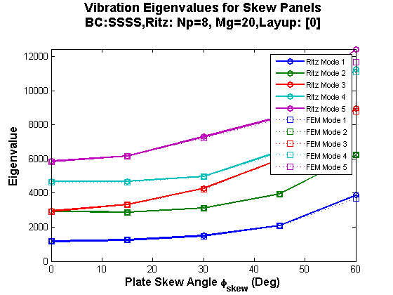
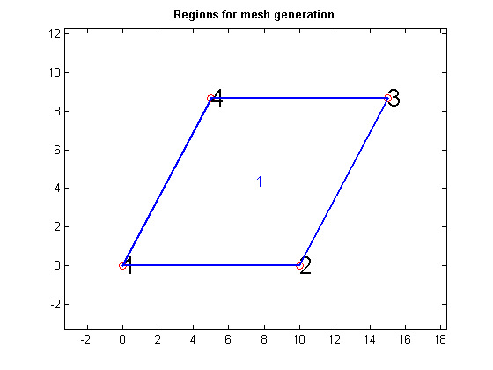
Case 7: SSSS Isotropic Skew Plate: Free Vibration
Dimensions: 10”x10”
Material: Aluminum
Properties
t=0.1”
E = 10 E6 msi
Nu = 0.3
Rho = 0.1

Slide 2
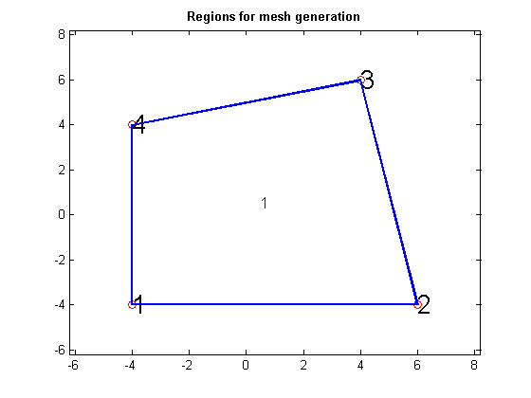
Case 15: SSSS Isotropic Quad Plate: Free Vibration
Material: Aluminum
Properties
t=0.1”
E = 10 E6 msi
Nu = 0.3
Rho = 0.1

Slide 3
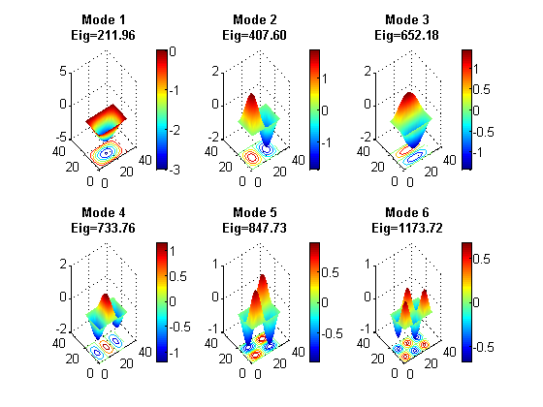
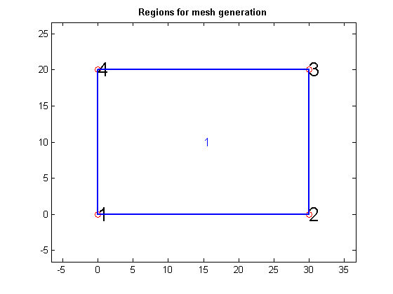
Case 16: SSSS Isotropic Rectangular Plate: Free Vibration
Dimensions: 30”x20”
Material: Aluminum
Properties
t=0.1”
E = 10 E6 msi
Nu = 0.3
Rho = 0.1

