Slide 1
第四章 图论基础
物理结构和逻辑结构的数学方法

Slide 2
第四章 图论基础
4.1 基本术语
4.2 矩阵与向量空间
4.3 图算法
4.4 生成树算法

Slide 3
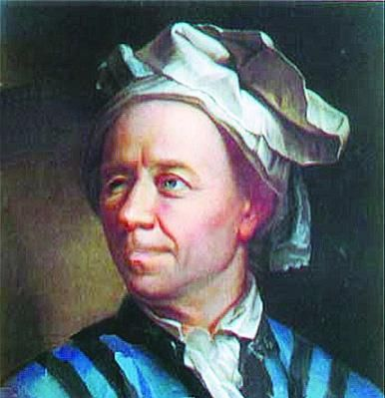
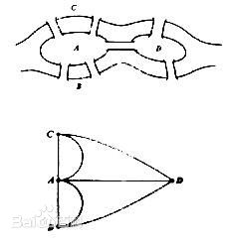
图论起源
哥尼斯堡七桥问题；
1736年，29岁的欧拉发表了《哥尼斯堡的七座桥》的论文；
回答了当地居民的散步问题，证明了更为广泛的有关一笔画的三条结论，通常称之为“欧拉定理”。

Slide 4
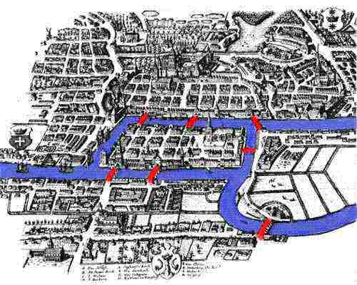
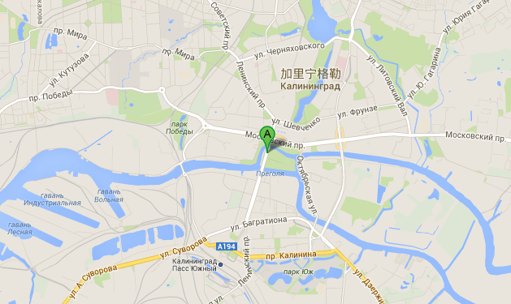
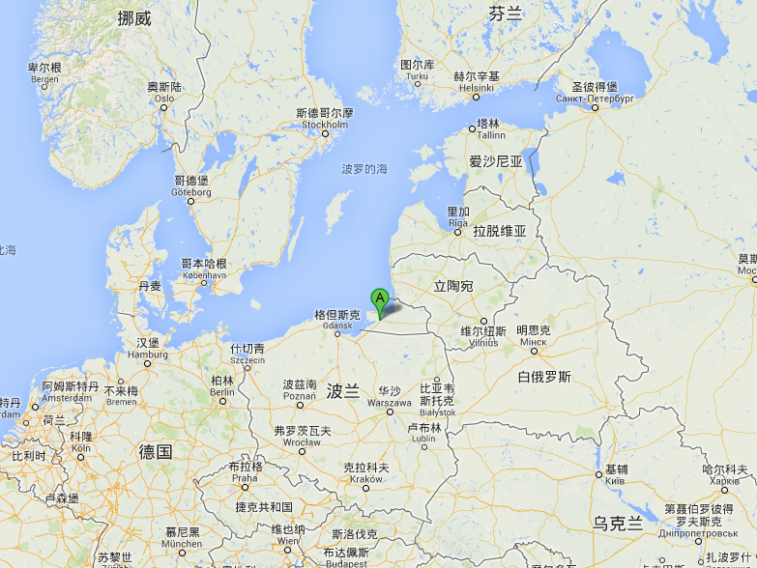
哥尼斯堡/加里宁格勒的位置
1km

Slide 5
欧拉定理
连到一点的数目如是奇数条，就称为奇点，如果是偶数条就称为偶点；
连通图可以一笔画的重要条件是：奇点的数目不是0 个就是2 个；
要想一笔画成，必须中间点均是偶点，也就是有来路必有另一条去路，奇点只可能在两端，因此任何图能一笔画成，奇点要么没有要么在两端。

Slide 6
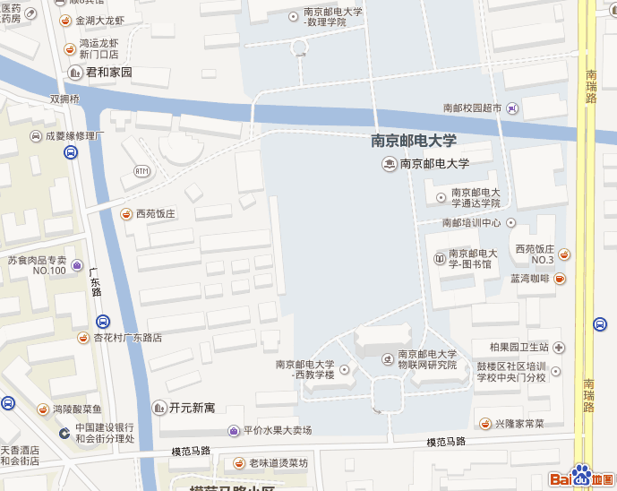
南邮六桥问题
A
C
B

Slide 7
抽象化定义
E := {b1, b2, b3, b4, b5, b6}
A
V := {A, B, C}
b4
G := (V, E)，序偶
b1
|E| = 6，size of graph（尺度）
|V| = 3，order of graph（阶数）
C
b2
b3
deg(A) = 4，节点A的度数
b5
B
b6
deg(B) = 5
deg(C) = 3
deg(G) = 12 = 2|E|，图G的度数
<deg(v)> = 2|E| / |V|
= 4
证明

Slide 8
形式化定义

Slide 9

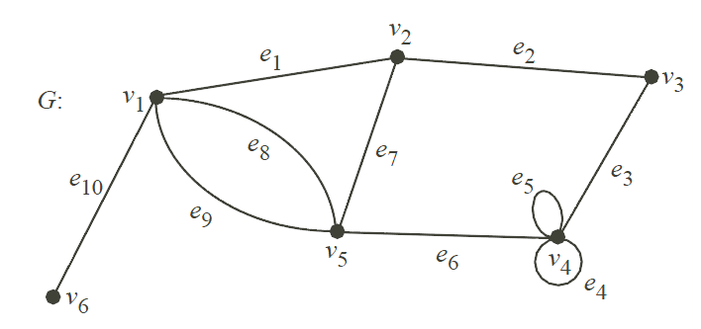
途径（Walk）
图中存在关联关系的点边，交替出现的序列

Slide 10
迹（Trail）
无重复边的walk
e₉

Slide 11
路（Path）
除始末点外无重复点的walk/trail

Slide 12
其他常用术语
开途径：起末点不相同的途径
闭途径：超末点相同的途径
开迹、闭迹/回路(Circuit)
开路、闭路/圈(Cycle)
途径长度：途径所含边的个数
奇/偶圈：圈的长度为奇数/偶数
最短路：两点间长度最小的路
图的直径：所有最短路的最大值
图的围长：最短圈的长度
图的周长：最长圈的长度

Slide 13
图的运算

Slide 14
图的关系运算
G₁(V₁, E₁)，G₂(V₂, E₂)
G₁为G₂的子图，iff.，V₁ 是 V₂ 子集，且 E₁是 E₂子集。
G₁为G₂的生成子图， V₁＝V₂ 。
G₁为G₂的边导出子图， V₁包含E₁的所有端点。
G₁ = G₂[E₁]
G₁为G₂的点导出子图， E₁包含V₁的所有关联边。
G₁ = G₂[V₁]
G₁为G₂补(图)， iff.，V₁=V₂，且E₁是E₂补集。

Slide 15
其他运算
并
G₁(V₁, E₁) ∪G₂(V₂, E₂) = (V₁∪V₂, E₁∪E₂)
交
G₁(V₁, E₁) ∩G₂(V₂, E₂) = (V₁ ∩ V₂, E₁ ∩ E₂)
异或/环和
G₁(V₁, E₁)^G₂(V₂, E₂) = (V₁∪V₂, E₁∪ E₂)[E₁^E₂]

Slide 16
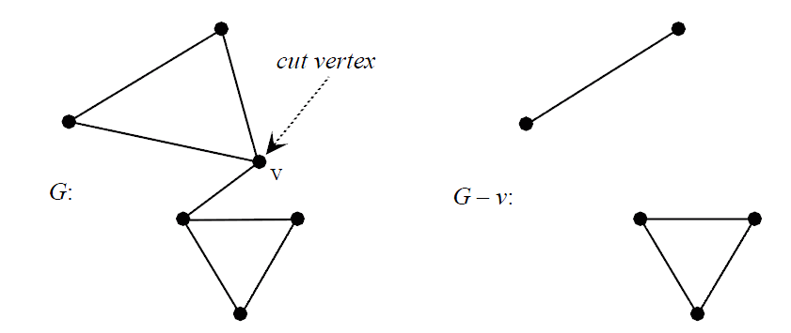
点割集(Vertex Cut)
点割集 F，是 E 的子集，当
G(V, E) - F = (V - F, E - {e_{ij} | i or j 属于F}) 是不连通的；
G(V, E) - H 是连通的，对于所有 H 是 F 的真子集。
割点v，
F 仅含点v

Slide 17
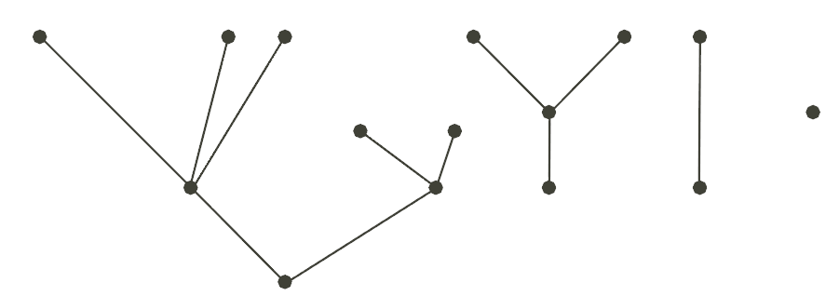
树与林

Slide 18
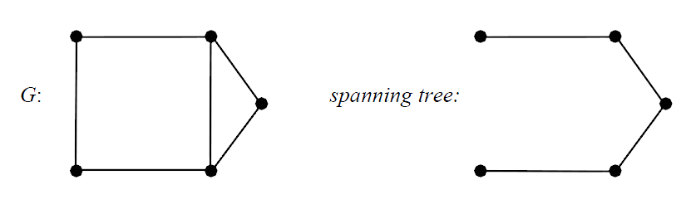
树的等价定义、生成树
G(V, E)是树；
G是连通的，且|E| = |V| - 1；
G无圈，且|E| = |V| - 1；
G的任意两点之间，存在唯一条路；
G是连通的，删除任意一边后为非连通；
G无圈，增加任意一边后，正好有一个圈。

Slide 19
第四章 图论基础
4.1 基本术语
4.2 矩阵与向量空间
4.3 图算法
4.4 生成树算法

Slide 20
邻接矩阵

Slide 21
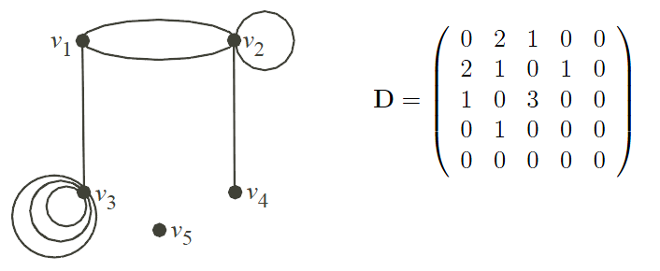


邻接矩阵

Slide 22
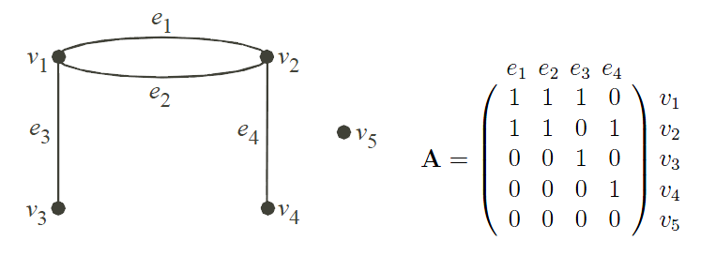

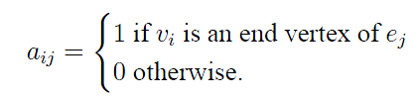
关联矩阵

Slide 23
第四章 图论基础
4.1 基本术语
4.2 矩阵与向量空间
4.3 图算法
4.4 生成树算法

Slide 24
可达性

Slide 25

可达性矩阵
图 G(V, E)，邻接矩形为 D
可达性矩阵：R = (r_{ij})

Slide 26
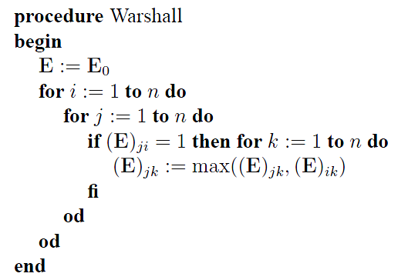
Warshall算法
E₀：D中大于0的元素用1替代
R = E_{n}
[Prob]时间复杂度？

Slide 27
从某点起查找特定的点或边

Slide 28
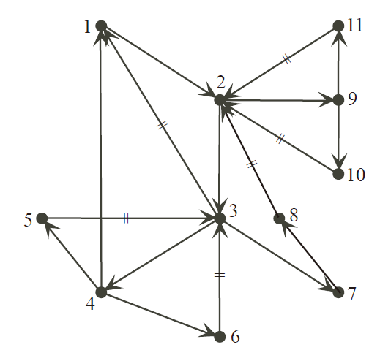
深度优先查找
r：起始点
e：关联边
v：下一点
r = FAHTER(v)
所有点 x 关联边查找完成时，返回父节点；
否则选择x的关联边e，到下一点y
如果y已查过，则e为回退边；
如果y未查过，e为树边，以y替代x重复第1步

Slide 29
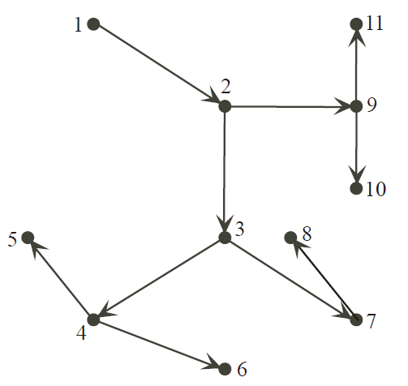
DFS树

Slide 30
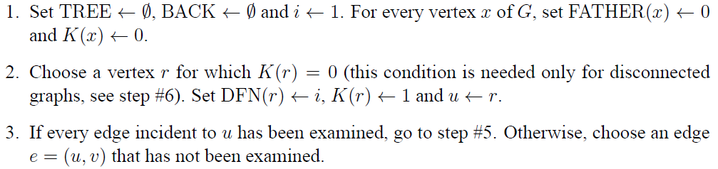
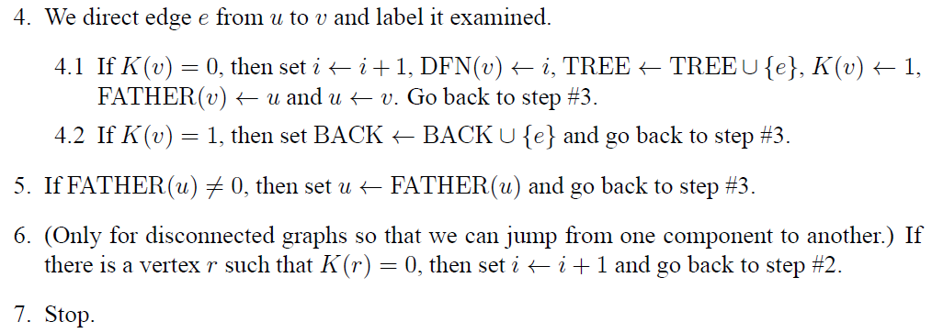
DFS形式化算法

Slide 31
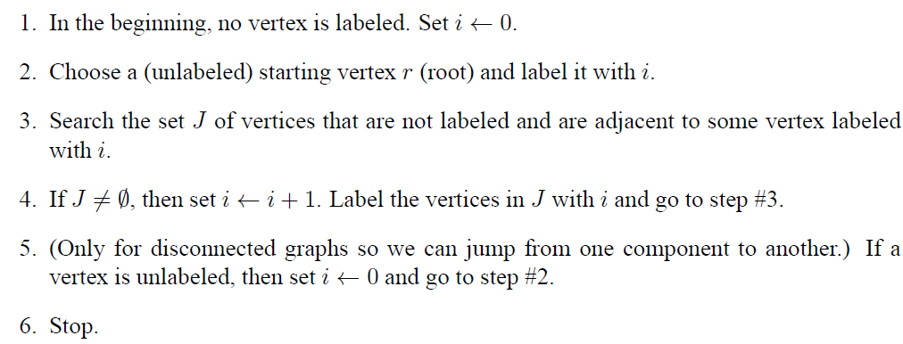
宽度/广度优先查找

Slide 32
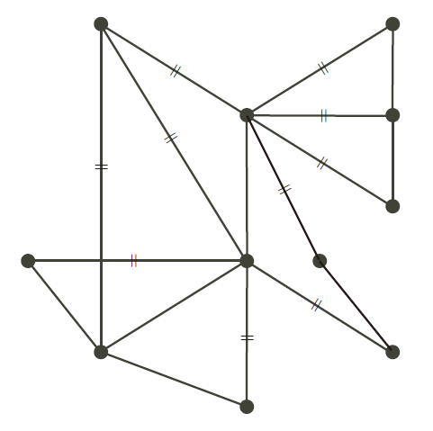
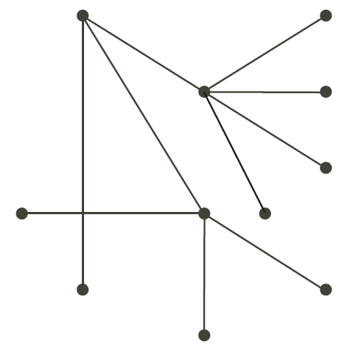
BFS树

Slide 33
最轻/短路径

Slide 34
目标问题
边权重(weight)、路径权重
权重最小路，按字面为最轻路
通信网中，把最短称为最短跳数，最轻称为最小成本
如果不存在特定两点间最轻路，也需明确
B
10
2
A
4
3
D
5
C
1

Slide 35
Dijkstra算法
Dijkstra(G)
for each v ∈ V
d[v] = ∞;
d[s] = 0; S = ∅; Q = V;
while (Q ≠ ∅)
u = ExtractMin(Q);
S = S U {u};
for each v ∈ u->Adj[]
if (d[v] > d[u]+w(u,v))
d[v] = d[u]+w(u,v);
B
10
2
A
4
3
D
5
C
1
Q中d[u]最小者
Relaxation Step
Q->DecreaseKey()完成排序

Slide 36
计算过程,step0,step1
d[A]=0, d[B]=d[C]=d[D]=∞,
S = ∅; Q = {A,B,C,D}
u=A; S={A}; Q={B,C,D}
u->Adj[]={B,C}; d[B]=10,d[C]=5
B
10
2
A
4
3
D
5
C
1

Slide 37
计算过程,step2
u=A; S={A}; Q={B,C,D}
u->Adj[]={B,C}; d[B]=10,d[C]=5
u=C; S={A,C};Q={B,D};d[D]=6,d[B]=9
B
10
2
A
4
3
D
5
C
1

Slide 38
计算过程,step3,step4
u=C; S={A,C};Q={B,D};d[D]=6,d[B]=9
u=D;S={A,C,D};Q={B};d[B]=8
d=B;S={A,B,C,D};Q=∅
B
10
2
同时得到最小生成树
A
4
3
D
5
C
1
[Prob]时间复杂度？

Slide 39
第四章 图论基础
4.1 基本术语
4.2 矩阵与向量空间
4.3 图算法
4.4 生成树算法

Slide 40
Kruskal算法
将一条权最小的边加入子图T中，并保证不形成圈。
如果当前弧加入后不形成圈，则加入这条弧，如果当前弧加入后会形成圈，则不加入这条弧，并考虑下一条弧。

Slide 41
Kruskal算法
Kruskal()
{
T = ∅;
for each v ∈ V
MakeSet(v);
sort E by increasing edge weight w
for each (u,v) ∈ E (in sorted order)
if FindSet(u) ≠ FindSet(v)
T = T U {{u,v}};
Union(FindSet(u), FindSet(v));
}

Slide 42
Kruskal算法，计算用例
2
19
Kruskal()
{
T = ∅;
for each v ∈ V
MakeSet(v);
sort E by increasing edge weight w
for each (u,v) ∈ E (in sorted order)
if FindSet(u) ≠ FindSet(v)
T = T U {{u,v}};
Union(FindSet(u), FindSet(v));
}
9
14
17
8
25
5
21
13
1

Slide 43
Kruskal算法，7个单节点子树
2
19
Kruskal()
{
T = ∅;
for each v ∈ V
MakeSet(v);
sort E by increasing edge weight w
for each (u,v) ∈ E (in sorted order)
if FindSet(u) ≠ FindSet(v)
T = T U {{u,v}};
Union(FindSet(u), FindSet(v));
}
9
14
17
8
25
5
21
13
1

Slide 44
Kruskal算法，边集E排序
2
19
Kruskal()
{
T = ∅;
for each v ∈ V
MakeSet(v);
sort E by increasing edge weight w
for each (u,v) ∈ E (in sorted order)
if FindSet(u) ≠ FindSet(v)
T = T U {{u,v}};
Union(FindSet(u), FindSet(v));
}
9
14
17
8
25
5
21
13
1

Slide 45
Kruskal算法，选取权重最小边
2
19
Kruskal()
{
T = ∅;
for each v ∈ V
MakeSet(v);
sort E by increasing edge weight w
for each (u,v) ∈ E (in sorted order)
if FindSet(u) ≠ FindSet(v)
T = T U {{u,v}};
Union(FindSet(u), FindSet(v));
}
9
14
17
8
25
5
21
13
1?

Slide 46
Kruskal算法，合并子树
2
19
Kruskal()
{
T = ∅;
for each v ∈ V
MakeSet(v);
sort E by increasing edge weight w
for each (u,v) ∈ E (in sorted order)
if FindSet(u) ≠ FindSet(v)
T = T U {{u,v}};
Union(FindSet(u), FindSet(v));
}
9
14
17
8
25
5
21
13
1

Slide 47
Kruskal算法，再选次小权重边
2?
19
Kruskal()
{
T = ∅;
for each v ∈ V
MakeSet(v);
sort E by increasing edge weight w
for each (u,v) ∈ E (in sorted order)
if FindSet(u) ≠ FindSet(v)
T = T U {{u,v}};
Union(FindSet(u), FindSet(v));
}
9
14
17
8
25
5
21
13
1

Slide 48
Kruskal算法，再合并子树
2
19
Kruskal()
{
T = ∅;
for each v ∈ V
MakeSet(v);
sort E by increasing edge weight w
for each (u,v) ∈ E (in sorted order)
if FindSet(u) ≠ FindSet(v)
T = T U {{u,v}};
Union(FindSet(u), FindSet(v));
}
9
14
17
8
25
5
21
13
1

Slide 49
Kruskal算法，重复选边
2
19
Kruskal()
{
T = ∅;
for each v ∈ V
MakeSet(v);
sort E by increasing edge weight w
for each (u,v) ∈ E (in sorted order)
if FindSet(u) ≠ FindSet(v)
T = T U {{u,v}};
Union(FindSet(u), FindSet(v));
}
9
14
17
8
25
5?
21
13
1

Slide 50
Kruskal算法，再合并子树
2
19
Kruskal()
{
T = ∅;
for each v ∈ V
MakeSet(v);
sort E by increasing edge weight w
for each (u,v) ∈ E (in sorted order)
if FindSet(u) ≠ FindSet(v)
T = T U {{u,v}};
Union(FindSet(u), FindSet(v));
}
9
14
17
8
25
5
21
13
1

Slide 51
Kruskal算法，再选边
2
19
Kruskal()
{
T = ∅;
for each v ∈ V
MakeSet(v);
sort E by increasing edge weight w
for each (u,v) ∈ E (in sorted order)
if FindSet(u) ≠ FindSet(v)
T = T U {{u,v}};
Union(FindSet(u), FindSet(v));
}
9
14
17
8?
25
5
21
13
1

Slide 52
Kruskal算法，再次合并子树
2
19
Kruskal()
{
T = ∅;
for each v ∈ V
MakeSet(v);
sort E by increasing edge weight w
for each (u,v) ∈ E (in sorted order)
if FindSet(u) ≠ FindSet(v)
T = T U {{u,v}};
Union(FindSet(u), FindSet(v));
}
9
14
17
8
25
5
21
13
1

Slide 53
Kruskal算法，选到回路边
2
19
Kruskal()
{
T = ∅;
for each v ∈ V
MakeSet(v);
sort E by increasing edge weight w
for each (u,v) ∈ E (in sorted order)
if FindSet(u) ≠ FindSet(v)
T = T U {{u,v}};
Union(FindSet(u), FindSet(v));
}
9?
14
17
8
25
5
21
13
1

Slide 54
Kruskal算法，不需合并也不加集
2
19
Kruskal()
{
T = ∅;
for each v ∈ V
MakeSet(v);
sort E by increasing edge weight w
for each (u,v) ∈ E (in sorted order)
if FindSet(u) ≠ FindSet(v)
T = T U {{u,v}};
Union(FindSet(u), FindSet(v));
}
9
14
17
8
25
5
21
13
1

Slide 55
Kruskal算法，再选边
2
19
Kruskal()
{
T = ∅;
for each v ∈ V
MakeSet(v);
sort E by increasing edge weight w
for each (u,v) ∈ E (in sorted order)
if FindSet(u) ≠ FindSet(v)
T = T U {{u,v}};
Union(FindSet(u), FindSet(v));
}
9
14
17
8
25
5
21
13?
1

Slide 56
Kruskal算法，再合并子树
2
19
Kruskal()
{
T = ∅;
for each v ∈ V
MakeSet(v);
sort E by increasing edge weight w
for each (u,v) ∈ E (in sorted order)
if FindSet(u) ≠ FindSet(v)
T = T U {{u,v}};
Union(FindSet(u), FindSet(v));
}
9
14
17
8
25
5
21
13
1

Slide 57
Kruskal算法，再选边
2
19
Kruskal()
{
T = ∅;
for each v ∈ V
MakeSet(v);
sort E by increasing edge weight w
for each (u,v) ∈ E (in sorted order)
if FindSet(u) ≠ FindSet(v)
T = T U {{u,v}};
Union(FindSet(u), FindSet(v));
}
9
14?
17
8
25
5
21
13
1

Slide 58
Kruskal算法，再合并
2
19
Kruskal()
{
T = ∅;
for each v ∈ V
MakeSet(v);
sort E by increasing edge weight w
for each (u,v) ∈ E (in sorted order)
if FindSet(u) ≠ FindSet(v)
T = T U {{u,v}};
Union(FindSet(u), FindSet(v));
}
9
14
17
8
25
5
21
13
1

Slide 59
Kruskal算法，再选边、不合并
2
19
Kruskal()
{
T = ∅;
for each v ∈ V
MakeSet(v);
sort E by increasing edge weight w
for each (u,v) ∈ E (in sorted order)
if FindSet(u) ≠ FindSet(v)
T = T U {{u,v}};
Union(FindSet(u), FindSet(v));
}
9
14
17?
8
25
5
21
13
1

Slide 60
Kruskal算法，同样结果
2
19?
Kruskal()
{
T = ∅;
for each v ∈ V
MakeSet(v);
sort E by increasing edge weight w
for each (u,v) ∈ E (in sorted order)
if FindSet(u) ≠ FindSet(v)
T = T U {{u,v}};
Union(FindSet(u), FindSet(v));
}
9
14
17
8
25
5
21
13
1

Slide 61
Kruskal算法，仍然不合并
2
19
Kruskal()
{
T = ∅;
for each v ∈ V
MakeSet(v);
sort E by increasing edge weight w
for each (u,v) ∈ E (in sorted order)
if FindSet(u) ≠ FindSet(v)
T = T U {{u,v}};
Union(FindSet(u), FindSet(v));
}
9
14
17
8
25
5
21?
13
1

Slide 62
Kruskal算法，最后一条同样
2
19
Kruskal()
{
T = ∅;
for each v ∈ V
MakeSet(v);
sort E by increasing edge weight w
for each (u,v) ∈ E (in sorted order)
if FindSet(u) ≠ FindSet(v)
T = T U {{u,v}};
Union(FindSet(u), FindSet(v));
}
9
14
17
8
25?
5
21
13
1

Slide 63
Kruskal算法，得到MST
2
19
Kruskal()
{
T = ∅;
for each v ∈ V
MakeSet(v);
sort E by increasing edge weight w
for each (u,v) ∈ E (in sorted order)
if FindSet(u) ≠ FindSet(v)
T = T U {{u,v}};
Union(FindSet(u), FindSet(v));
}
9
14
17
8
25
5
21
13
1

Slide 64
Kruskal算法
2
19
Kruskal()
{
T = ∅;
for each v ∈ V
MakeSet(v);
sort E by increasing edge weight w
for each (u,v) ∈ E (in sorted order)
if FindSet(u) ≠ FindSet(v)
T = T U {{u,v}};
Union(FindSet(u), FindSet(v));
}
9
14
17
8
25
5
21
13
1
[Prob]时间复杂度？

Slide 65
Prim算法
不断扩展一棵子树 T = (S , F), F 为E子集，直到S 包括全部顶点，得到最小生成树T。
每次增加一条边，使得这条边是由当前子树结点集S 及其补集S 所形成的边割集的最小边。

Slide 66
Prim算法
MST-Prim(G, w, r)
Q = V[G];
for each u ∈ Q
key[u] = ∞;
key[r] = 0;
p[r] = NULL;
while (Q not empty)
u = ExtractMin(Q);
for each v ∈ Adj[u]
if (v ∈ Q and w(u,v) < key[v])
p[v] = u;
key[v] = w(u,v);

Slide 67
Prim算法，计算用例
MST-Prim(G, w, r)
Q = V[G];
for each u ∈ Q
key[u] = ∞;
key[r] = 0;
p[r] = NULL;
while (Q not empty)
u = ExtractMin(Q);
for each v ∈ Adj[u]
if (v ∈ Q and w(u,v) < key[v])
p[v] = u;
key[v] = w(u,v);
6
4
5
9
14
2
10
15
3
8

Slide 68
Prim算法,初始化
MST-Prim(G, w, r)
Q = V[G];
for each u ∈ Q
key[u] = ∞;
key[r] = 0;
p[r] = NULL;
while (Q not empty)
u = ExtractMin(Q);
for each v ∈ Adj[u]
if (v ∈ Q and w(u,v) < key[v])
p[v] = u;
key[v] = w(u,v);
6
∞
4
5
9
∞
∞
∞
14
2
10
15
∞
∞
∞
3
∞
8

Slide 69
Prim算法，根选择
MST-Prim(G, w, r)
Q = V[G];
for each u ∈ Q
key[u] = ∞;
key[r] = 0;
p[r] = NULL;
while (Q not empty)
u = ExtractMin(Q);
for each v ∈ Adj[u]
if (v ∈ Q and w(u,v) < key[v])
p[v] = u;
key[v] = w(u,v);
6
∞
4
5
9
∞
∞
∞
14
2
10
15
r
0
∞
∞
3
∞
8
Pick a start vertex r

Slide 70
Prim算法，集合Q更新
MST-Prim(G, w, r)
Q = V[G];
for each u ∈ Q
key[u] = ∞;
key[r] = 0;
p[r] = NULL;
while (Q not empty)
u = ExtractMin(Q);
for each v ∈ Adj[u]
if (v ∈ Q and w(u,v) < key[v])
p[v] = u;
key[v] = w(u,v);
6
∞
4
5
9
∞
∞
∞
14
2
10
15
u
0
∞
∞
3
∞
8
Red vertices have been removed from Q

Slide 71
Prim算法，下一节点v
MST-Prim(G, w, r)
Q = V[G];
for each u ∈ Q
key[u] = ∞;
key[r] = 0;
p[r] = NULL;
while (Q not empty)
u = ExtractMin(Q);
for each v ∈ Adj[u]
if (v ∈ Q and w(u,v) < key[v])
p[v] = u;
key[v] = w(u,v);
6
∞
4
5
9
∞
∞
∞
14
2
10
15
u
0
∞
∞
3
3
8
Red arrows indicate parent pointers

Slide 72
Prim算法，其他节点
MST-Prim(G, w, r)
Q = V[G];
for each u ∈ Q
key[u] = ∞;
key[r] = 0;
p[r] = NULL;
while (Q not empty)
u = ExtractMin(Q);
for each v ∈ Adj[u]
if (v ∈ Q and w(u,v) < key[v])
p[v] = u;
key[v] = w(u,v);
6
∞
4
5
9
14
∞
∞
14
2
10
15
u
0
∞
∞
3
3
8

Slide 73
Prim算法，Q中Key最小节点
MST-Prim(G, w, r)
Q = V[G];
for each u ∈ Q
key[u] = ∞;
key[r] = 0;
p[r] = NULL;
while (Q not empty)
u = ExtractMin(Q);
for each v ∈ Adj[u]
if (v ∈ Q and w(u,v) < key[v])
p[v] = u;
key[v] = w(u,v);
6
∞
4
5
9
14
∞
∞
14
2
10
15
0
∞
∞
3
3
8
u

Slide 74
Prim算法，下一节点
MST-Prim(G, w, r)
Q = V[G];
for each u ∈ Q
key[u] = ∞;
key[r] = 0;
p[r] = NULL;
while (Q not empty)
u = ExtractMin(Q);
for each v ∈ Adj[u]
if (v ∈ Q and w(u,v) < key[v])
p[v] = u;
key[v] = w(u,v);
6
∞
4
5
9
14
∞
∞
14
2
10
15
0
8
∞
3
3
8
u

Slide 75
Prim算法，下一节点，更新
MST-Prim(G, w, r)
Q = V[G];
for each u ∈ Q
key[u] = ∞;
key[r] = 0;
p[r] = NULL;
while (Q not empty)
u = ExtractMin(Q);
for each v ∈ Adj[u]
if (v ∈ Q and w(u,v) < key[v])
p[v] = u;
key[v] = w(u,v);
6
∞
4
5
9
10
∞
∞
14
2
10
15
0
8
∞
3
3
8
u

Slide 76
Prim算法，再选最小节点
MST-Prim(G, w, r)
Q = V[G];
for each u ∈ Q
key[u] = ∞;
key[r] = 0;
p[r] = NULL;
while (Q not empty)
u = ExtractMin(Q);
for each v ∈ Adj[u]
if (v ∈ Q and w(u,v) < key[v])
p[v] = u;
key[v] = w(u,v);
6
∞
4
5
9
10
∞
∞
14
2
10
15
0
8
∞
3
3
8
u

Slide 77
Prim算法，最小节点发生变化
MST-Prim(G, w, r)
Q = V[G];
for each u ∈ Q
key[u] = ∞;
key[r] = 0;
p[r] = NULL;
while (Q not empty)
u = ExtractMin(Q);
for each v ∈ Adj[u]
if (v ∈ Q and w(u,v) < key[v])
p[v] = u;
key[v] = w(u,v);
6
∞
4
5
9
10
2
∞
14
2
10
15
0
8
∞
3
3
8
u

Slide 78
Prim算法
MST-Prim(G, w, r)
Q = V[G];
for each u ∈ Q
key[u] = ∞;
key[r] = 0;
p[r] = NULL;
while (Q not empty)
u = ExtractMin(Q);
for each v ∈ Adj[u]
if (v ∈ Q and w(u,v) < key[v])
p[v] = u;
key[v] = w(u,v);
6
∞
4
5
9
10
2
∞
14
2
10
15
0
8
15
3
3
8
u

Slide 79
Prim算法，选最小节点
u
MST-Prim(G, w, r)
Q = V[G];
for each u ∈ Q
key[u] = ∞;
key[r] = 0;
p[r] = NULL;
while (Q not empty)
u = ExtractMin(Q);
for each v ∈ Adj[u]
if (v ∈ Q and w(u,v) < key[v])
p[v] = u;
key[v] = w(u,v);
6
∞
4
5
9
10
2
∞
14
2
10
15
0
8
15
3
3
8

Slide 80
Prim算法
u
MST-Prim(G, w, r)
Q = V[G];
for each u ∈ Q
key[u] = ∞;
key[r] = 0;
p[r] = NULL;
while (Q not empty)
u = ExtractMin(Q);
for each v ∈ Adj[u]
if (v ∈ Q and w(u,v) < key[v])
p[v] = u;
key[v] = w(u,v);
6
∞
4
5
9
10
2
9
14
2
10
15
0
8
15
3
3
8

Slide 81
Prim算法，下一节点
u
MST-Prim(G, w, r)
Q = V[G];
for each u ∈ Q
key[u] = ∞;
key[r] = 0;
p[r] = NULL;
while (Q not empty)
u = ExtractMin(Q);
for each v ∈ Adj[u]
if (v ∈ Q and w(u,v) < key[v])
p[v] = u;
key[v] = w(u,v);
6
4
4
5
9
10
2
9
14
2
10
15
0
8
15
3
3
8

Slide 82
Prim算法，权值和路更新
u
MST-Prim(G, w, r)
Q = V[G];
for each u ∈ Q
key[u] = ∞;
key[r] = 0;
p[r] = NULL;
while (Q not empty)
u = ExtractMin(Q);
for each v ∈ Adj[u]
if (v ∈ Q and w(u,v) < key[v])
p[v] = u;
key[v] = w(u,v);
6
4
4
5
9
5
2
9
14
2
10
15
0
8
15
3
3
8

Slide 83
Prim算法，再选无更新
u
MST-Prim(G, w, r)
Q = V[G];
for each u ∈ Q
key[u] = ∞;
key[r] = 0;
p[r] = NULL;
while (Q not empty)
u = ExtractMin(Q);
for each v ∈ Adj[u]
if (v ∈ Q and w(u,v) < key[v])
p[v] = u;
key[v] = w(u,v);
6
4
4
5
9
5
2
9
14
2
10
15
0
8
15
3
3
8

Slide 84
Prim算法，同样结果
u
MST-Prim(G, w, r)
Q = V[G];
for each u ∈ Q
key[u] = ∞;
key[r] = 0;
p[r] = NULL;
while (Q not empty)
u = ExtractMin(Q);
for each v ∈ Adj[u]
if (v ∈ Q and w(u,v) < key[v])
p[v] = u;
key[v] = w(u,v);
6
4
4
5
9
5
2
9
14
2
10
15
0
8
15
3
3
8

Slide 85
Prim算法，依然同样
u
MST-Prim(G, w, r)
Q = V[G];
for each u ∈ Q
key[u] = ∞;
key[r] = 0;
p[r] = NULL;
while (Q not empty)
u = ExtractMin(Q);
for each v ∈ Adj[u]
if (v ∈ Q and w(u,v) < key[v])
p[v] = u;
key[v] = w(u,v);
6
4
4
5
9
5
2
9
14
2
10
15
0
8
15
3
3
8

Slide 86
Prim算法，Q中最后一个
MST-Prim(G, w, r)
Q = V[G];
for each u ∈ Q
key[u] = ∞;
key[r] = 0;
p[r] = NULL;
while (Q not empty)
u = ExtractMin(Q);
for each v ∈ Adj[u]
if (v ∈ Q and w(u,v) < key[v])
p[v] = u;
key[v] = w(u,v);
6
4
4
5
9
5
2
9
14
2
u
10
15
0
8
15
3
3
8

Slide 87
Prim算法
MST-Prim(G, w, r)
Q = V[G];
for each u ∈ Q
key[u] = ∞;
key[r] = 0;
p[r] = NULL;
while (Q not empty)
u = ExtractMin(Q);
for each v ∈ Adj[u]
if (v ∈ Q and w(u,v) < key[v])
p[v] = u;
key[v] = w(u,v);
What is the hidden code?

Slide 88
Prim算法,Q排序
MST-Prim(G, w, r)
Q = V[G];
for each u ∈ Q
key[u] = ∞;
key[r] = 0;
p[r] = NULL;
while (Q not empty)
u = ExtractMin(Q);
for each v ∈ Adj[u]
if (v ∈ Q and w(u,v) < key[v])
p[v] = u;
DecreaseKey(v, w(u,v));

Slide 89
Prim算法，复杂度推算
MST-Prim(G, w, r)
Q = V[G];
for each u ∈ Q
key[u] = ∞;
key[r] = 0;
p[r] = NULL;
while (Q not empty)
u = ExtractMin(Q);
for each v ∈ Adj[u]
if (v ∈ Q and w(u,v) < key[v])
p[v] = u;
DecreaseKey(v, w(u,v));
How often is ExtractMin() called?
How often is DecreaseKey() called?

Slide 90
Prim算法
MST-Prim(G, w, r)
Q = V[G];
for each u ∈ Q
key[u] = ∞;
key[r] = 0;
p[r] = NULL;
while (Q not empty)
u = ExtractMin(Q);
for each v ∈ Adj[u]
if (v ∈ Q and w(u,v) < key[v])
p[v] = u;
key[v] = w(u,v);
Depends on queue，Q binary heap: O(E lg V) Fibonacci heap: O(V lg V + E)

Slide 91
第四章 图论基础
4.1 证明图的平均节点度为2倍的图尺度与图阶数之商。
4.2 如何从图的关联矩阵求得邻接矩阵？
4.3 推算Warshall算法的时间复杂度。
4.4 推算Dijkstra算法的时间复杂度。

