Slide 1
Using Mobile Technologies to Support Corporate Loyalty Services
Henrik Stepanyan

Slide 2
Rationale
Paul a manager of a multinational organisation
wants to incentivise cycling
Employ a loyalty scheme
Every day cycling = 1 stamp
1 stamp = $1 off inside bike shop
Environmentally friendly
More Reliable
Notes:
Love of new technologies
LOve of mobile technologies
Placement

Slide 3
The Solution
“A general-purpose system to encompass loyalty programs via use of up-and-coming Near-Field Communication (NFC) technologies that are integrated inside modern smart phones. Moreover, elements of gamification can be added as an extra dimension of loyalty to corporate persuasive technologies.” - Proposal

Slide 4
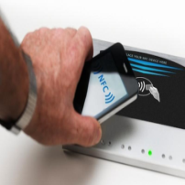

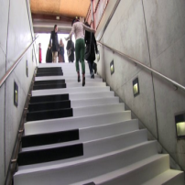
The State of Art - Reseach
NFC
Newest trend
Ozdenizci 2010
Gamification
Game elements to improve engagement
Montola 2005
Persuasive Technologies
‘Captology’
B.J Fogg 2002
Mobile revolution
Notes:
Started by reading loads of papers

Slide 5
The State of Art - Technology
Problems with current solutions
Using proprietary communication technology
(if any)
Too specialised on a specific type of loyalty scheme
More resembling a digital wallet of loyalty card barcodes
no elements of gamification or captology

Slide 6
Methodology
Industry expert to define scope
Iterative development design
Notes:
Participatory Design
HCI Design->Prototype->Evaluate

Slide 7
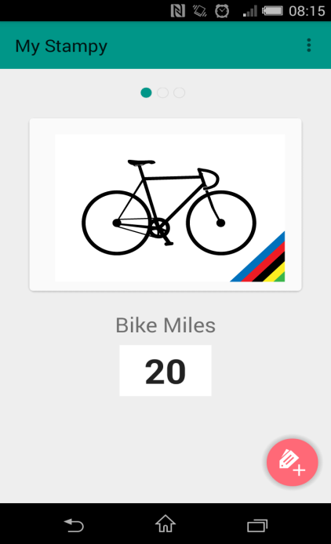
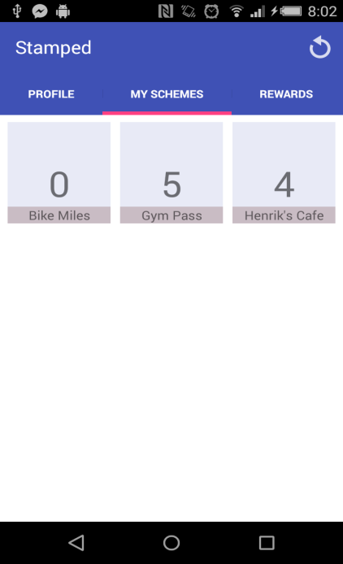
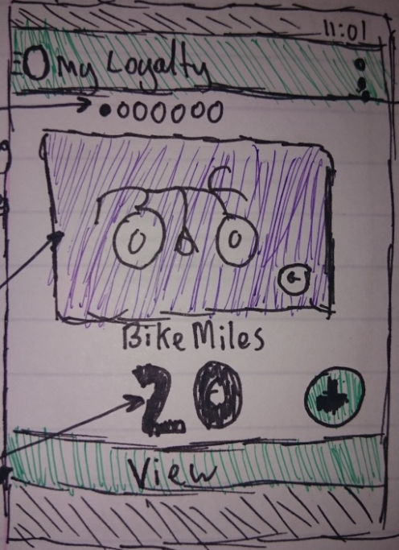
Methodology - Design
Design
Prototype
Evaluate
Evaluate
Evaluate
Design
1. Wire Frame
2. Mockup
3. Current Prototype

Slide 8
Conclusive Plans

Slide 9
Conclusive Plans
Loyalty Reader
Loyalty Manager
Backend
70
80
85

