Slide 1

어린이 환경 교육 어플
컴퓨터공학과 201635948 김채원
Notes:
http://www.flaticon.com/free-icon/sprout_237704#term=tree&page=1&position=87

Slide 2
02
개발
구성도
CONTENTS
03
시나리오
01
개발
동기
포니부하곰
Notes:
http://www.flaticon.com/free-icon/sprout_237704#term=tree&page=1&position=87

Slide 3
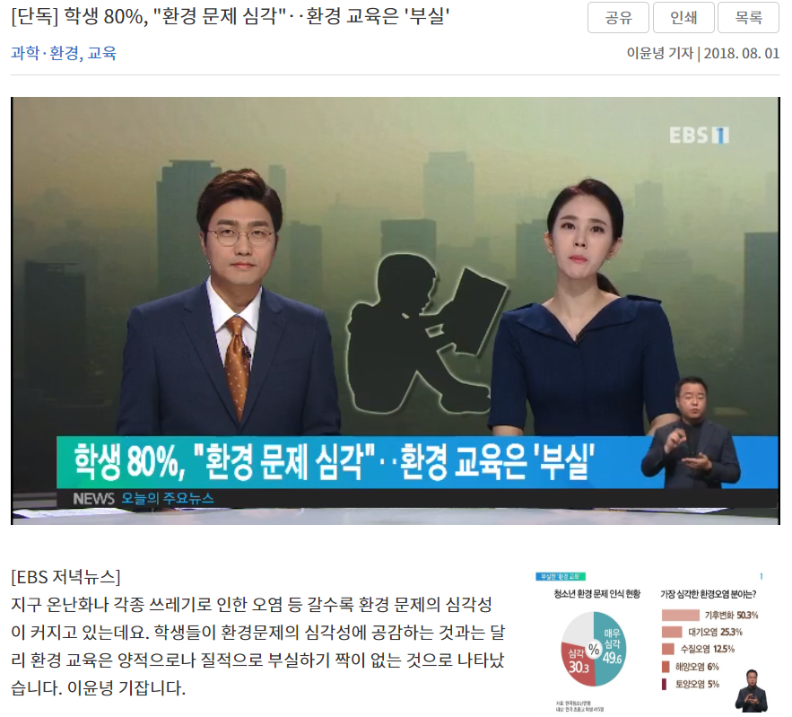
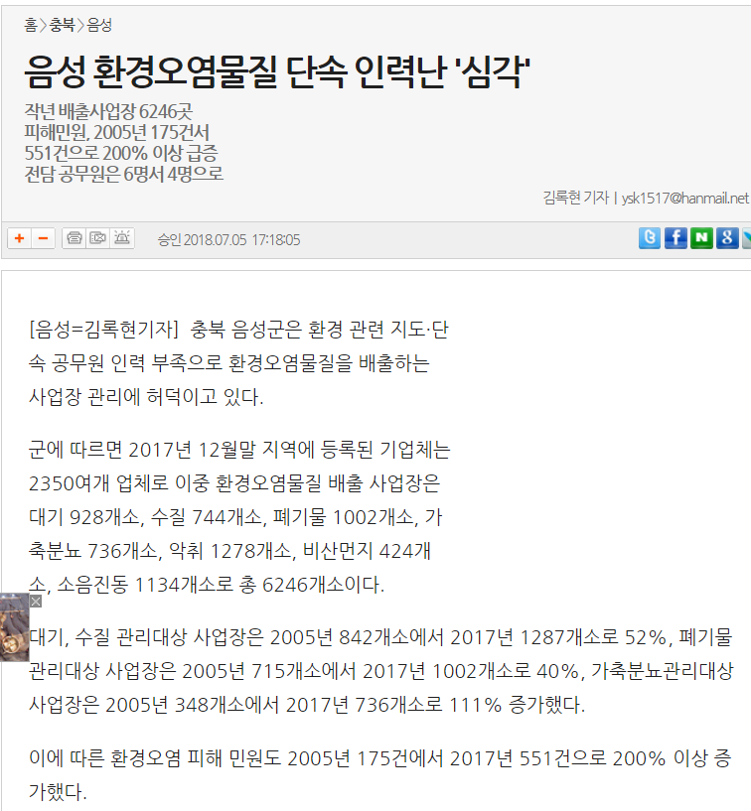
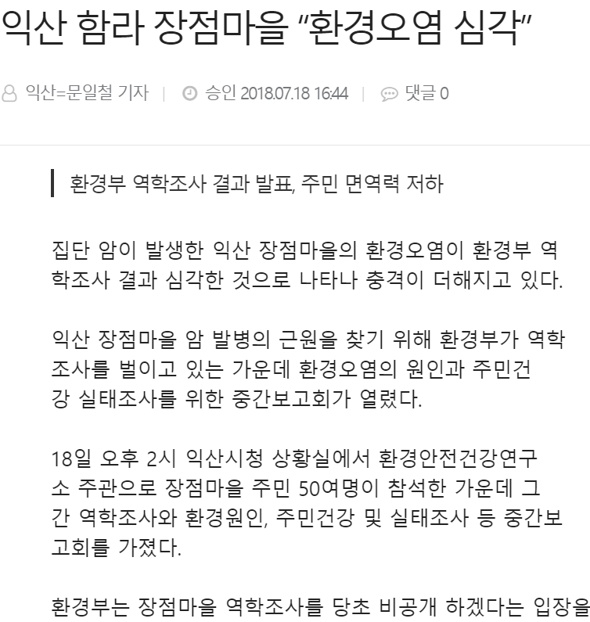
목적
TEXT
Notes:
http://www.flaticon.com/free-icon/sprout_237704#term=tree&page=1&position=87

Slide 4


주제
TEXT
어린이 환경 보호 교육
Notes:
http://www.flaticon.com/free-icon/sprout_237704#term=tree&page=1&position=87

Slide 5
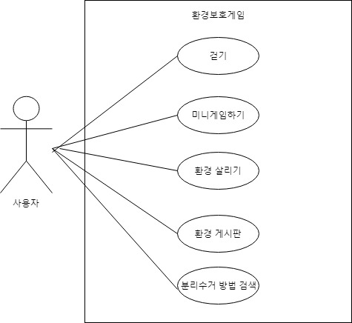
개발구성도
포니부하곰
TEXT
Notes:
http://www.flaticon.com/free-icon/sprout_237704#term=tree&page=1&position=87

Slide 6
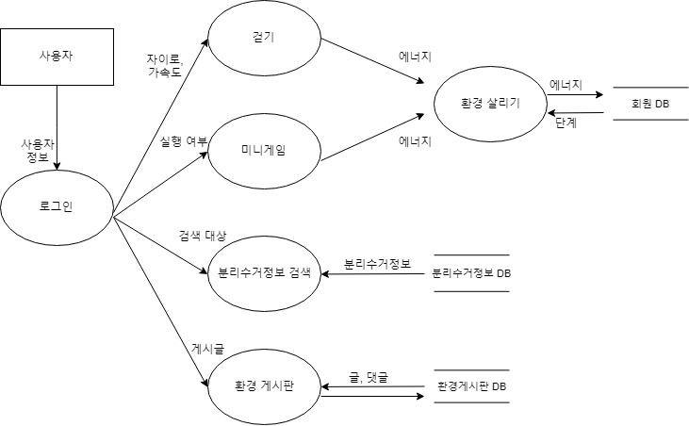
개발구성도
포니부하곰
TEXT
Notes:
http://www.flaticon.com/free-icon/sprout_237704#term=tree&page=1&position=87

Slide 7
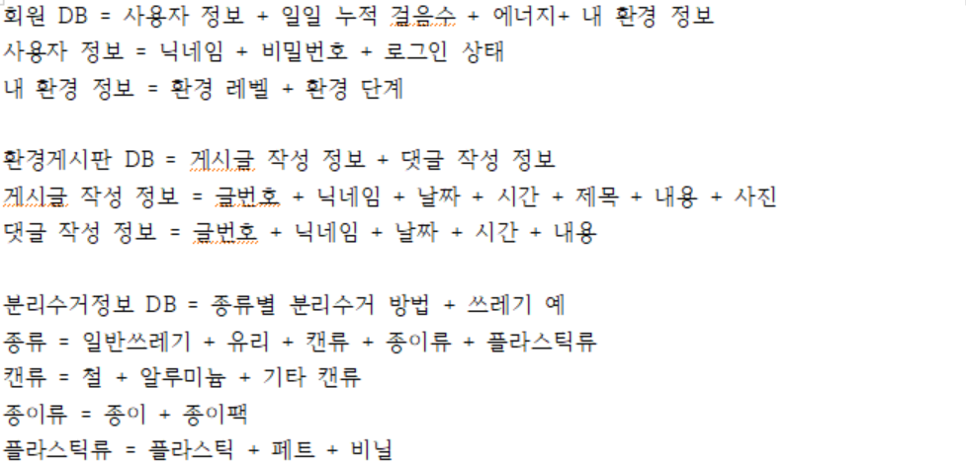
개발구성도
포니부하곰
TEXT
Notes:
http://www.flaticon.com/free-icon/sprout_237704#term=tree&page=1&position=87

Slide 8
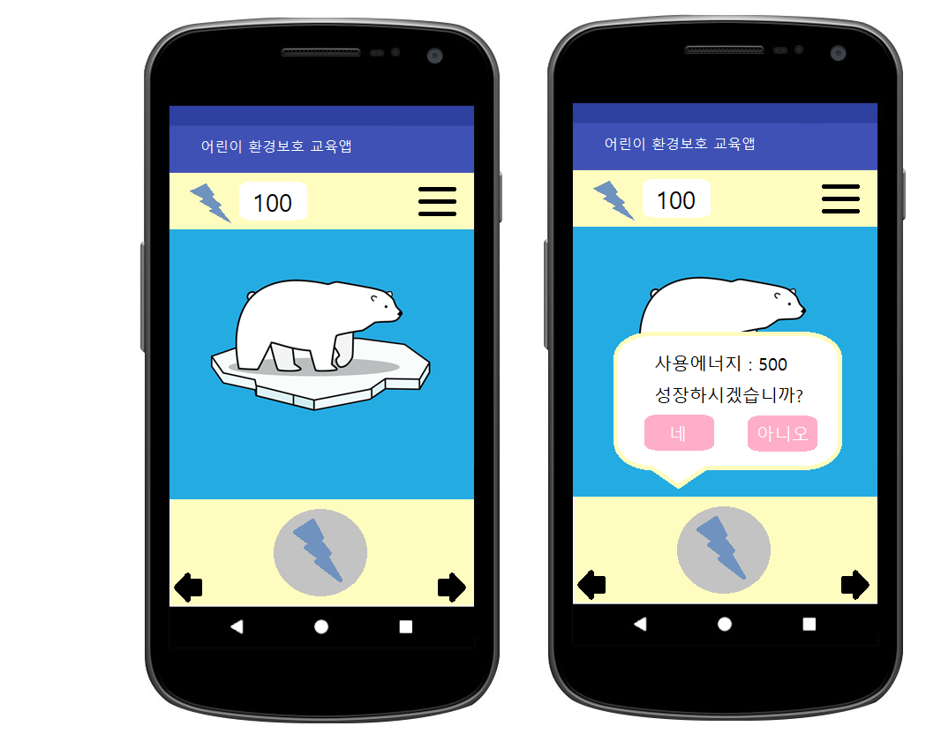
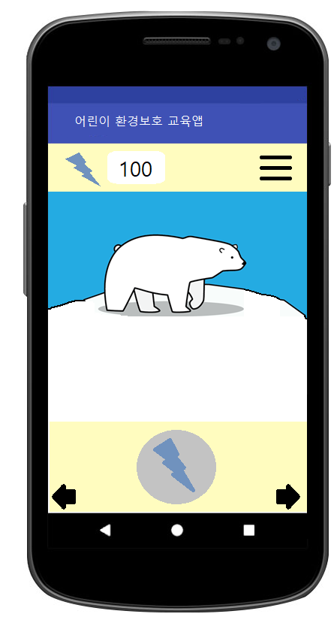
시나리오
포니부하곰
TEXT
Notes:
http://www.flaticon.com/free-icon/sprout_237704#term=tree&page=1&position=87

Slide 9
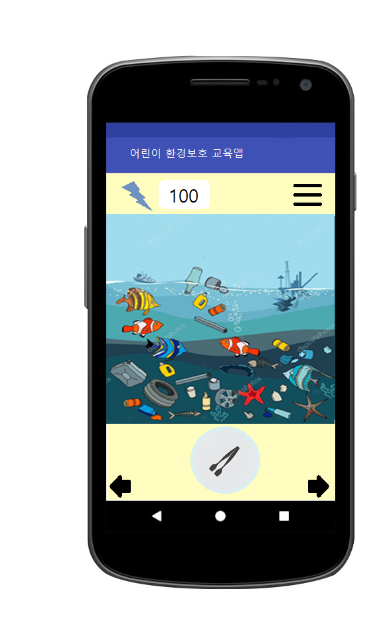
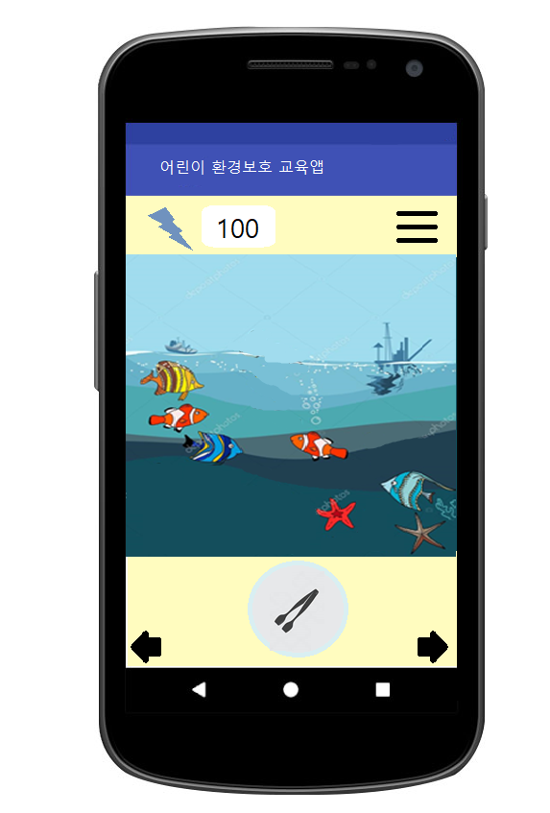
시나리오
포니부하곰
TEXT
Notes:
http://www.flaticon.com/free-icon/sprout_237704#term=tree&page=1&position=87

Slide 10
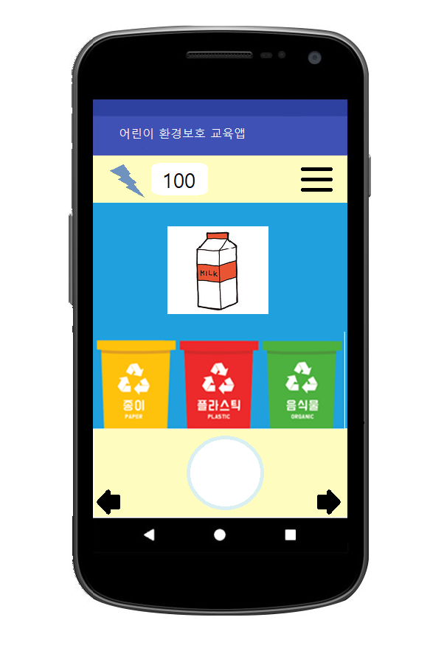
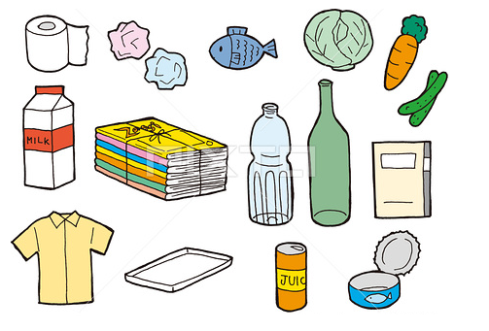
시나리오
포니부하곰
TEXT
Notes:
http://www.flaticon.com/free-icon/sprout_237704#term=tree&page=1&position=87

Slide 11
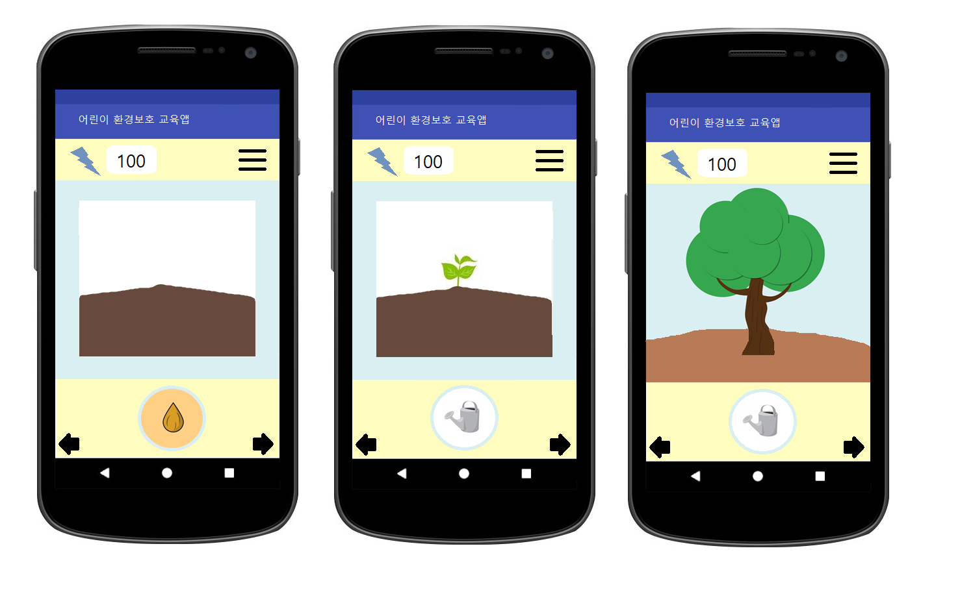
시나리오
포니부하곰
TEXT
Notes:
http://www.flaticon.com/free-icon/sprout_237704#term=tree&page=1&position=87

Slide 12
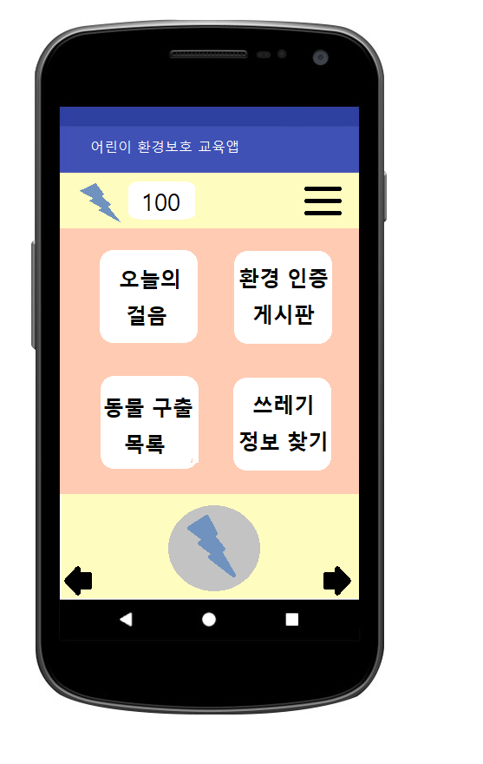
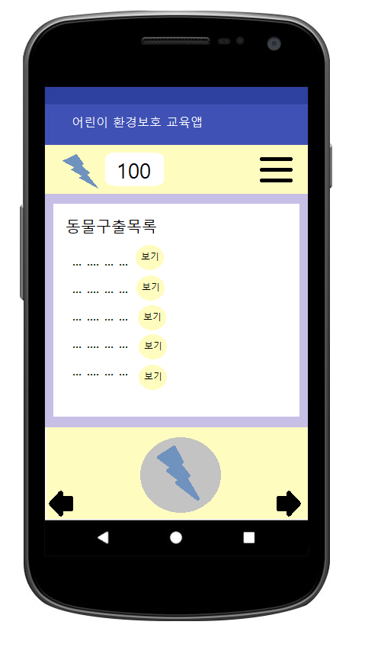
시나리오
TEXT
Notes:
http://www.flaticon.com/free-icon/sprout_237704#term=tree&page=1&position=87

Slide 13
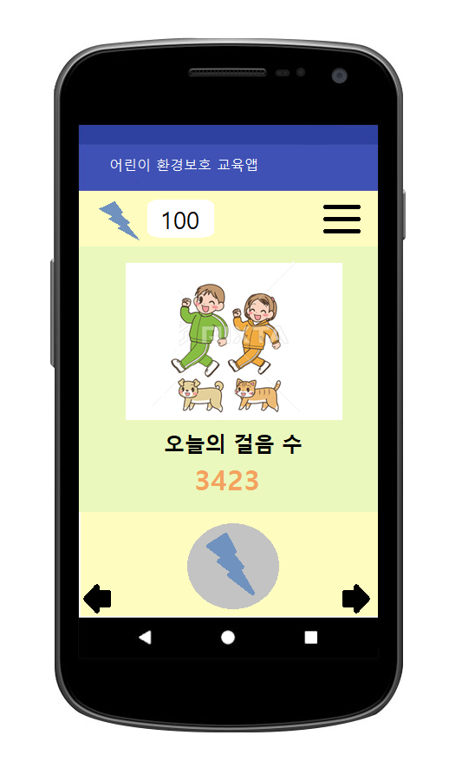
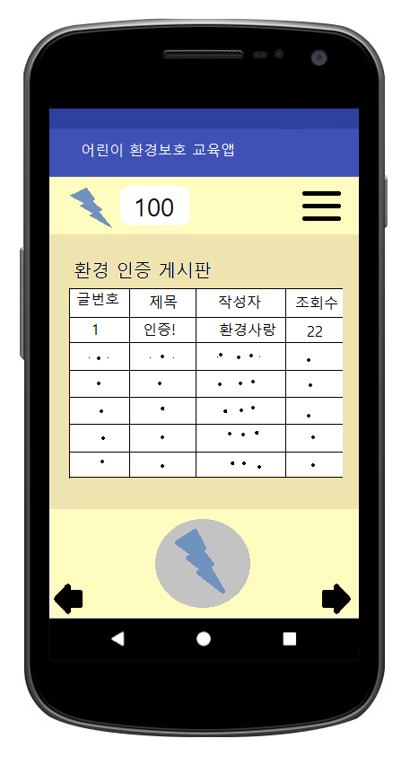
시나리오
TEXT
Notes:
http://www.flaticon.com/free-icon/sprout_237704#term=tree&page=1&position=87

Slide 14
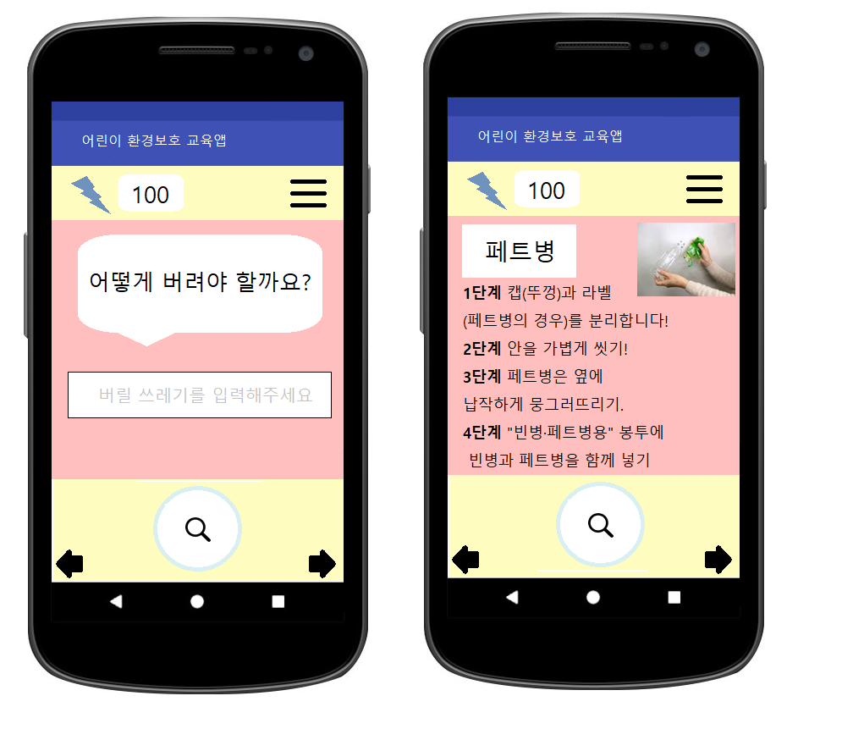
시나리오
포니부하곰
TEXT
Notes:
http://www.flaticon.com/free-icon/sprout_237704#term=tree&page=1&position=87

Slide 15
THANK YOU
Notes:
http://www.flaticon.com/free-icon/sprout_237704#term=tree&page=1&position=87

