Slide 1

LG U+ SIM Online Application Guide for Foreigners
(Step-by-Step Guide)

Slide 2
SIM Self Registration – Requirements
Please prepare the following informations before starting the registration process:
Alien Registration Card (ARC)
Valid email address
Mobile phone number
Residential address
Selected SIM plan
Bank account details
✔ Verification Methods:
KakaoTalk (Name must match ARC exactly)
PASS application
Credit card verification

Slide 3
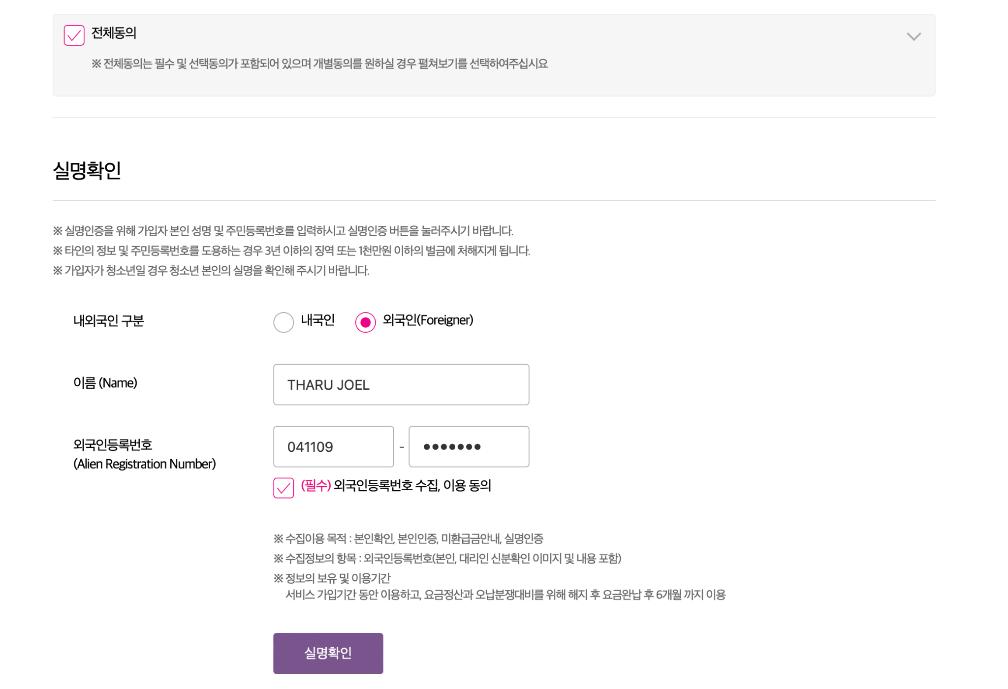
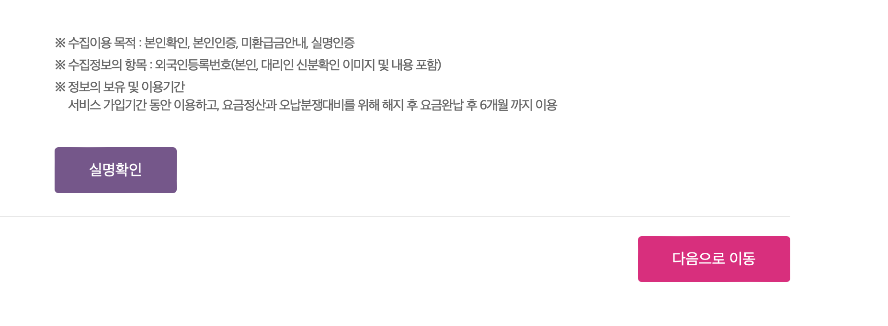
Easy self sign-in
⚠️ Please use the same name as your ARC.
Also, check your Kakao profile and make sure your name matches your ARC exactly.
This is important for identity verification.
GLOBAL TOP NET
1234
Click !
Click

Slide 4
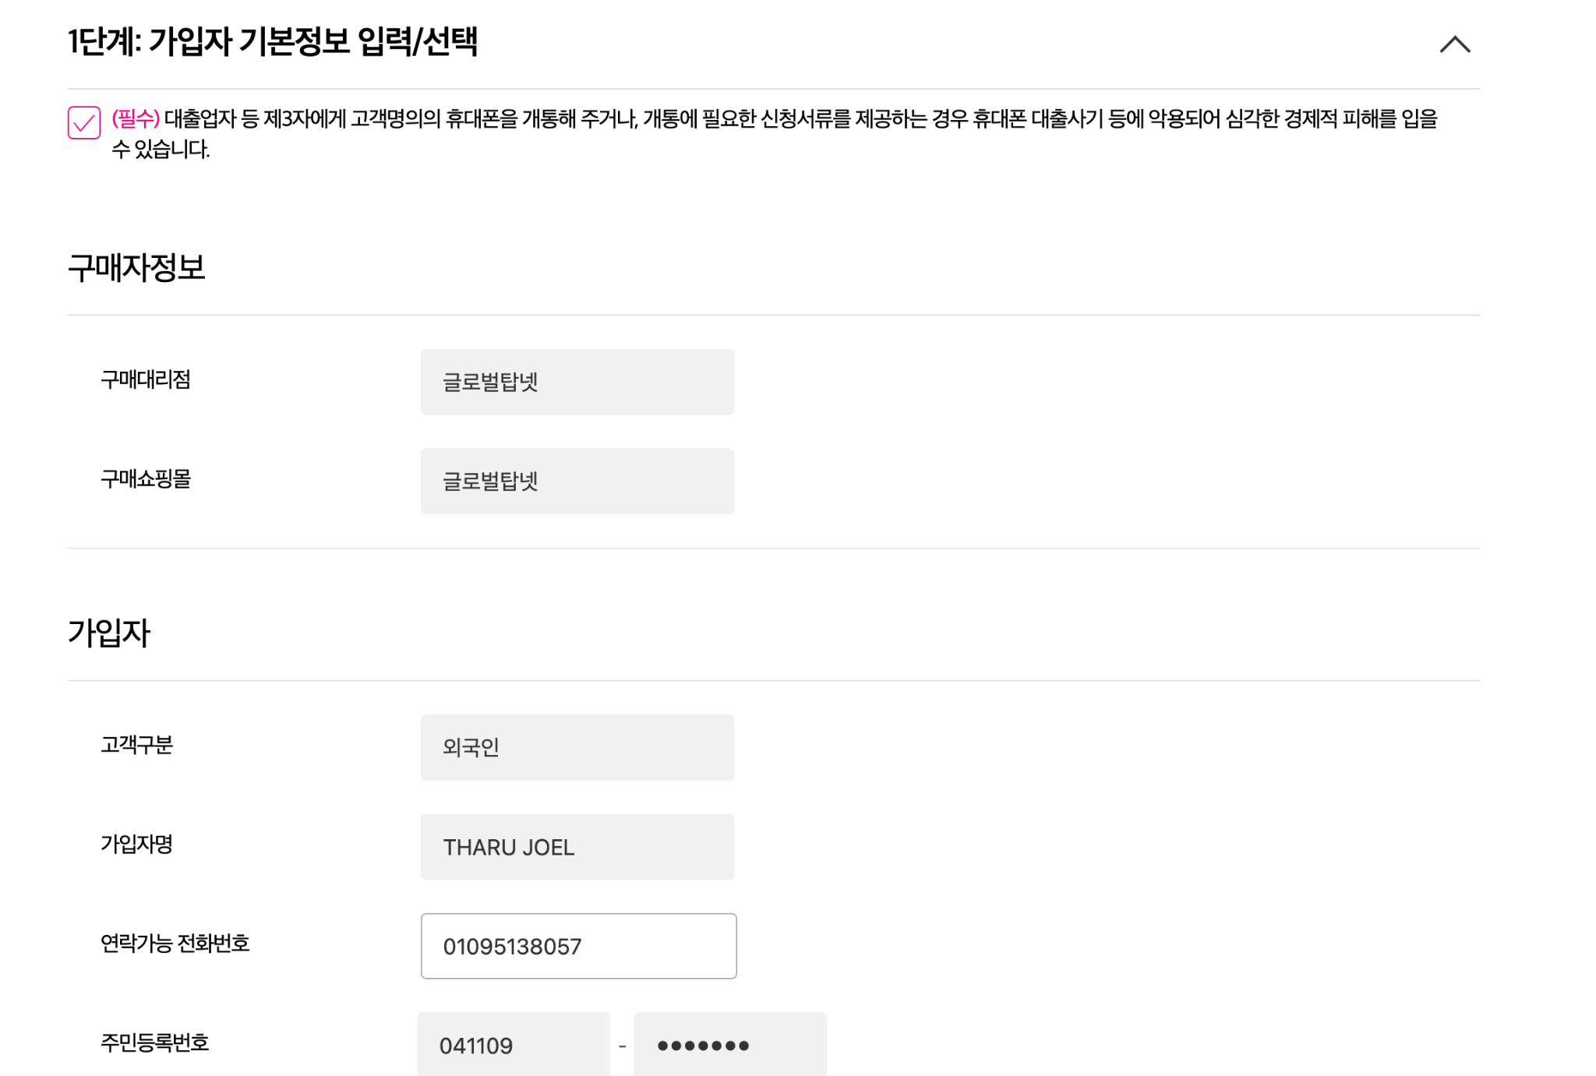
2. Easy self sign-in
GLOBAL TOP NET
101-1234-4678
1234

Slide 5
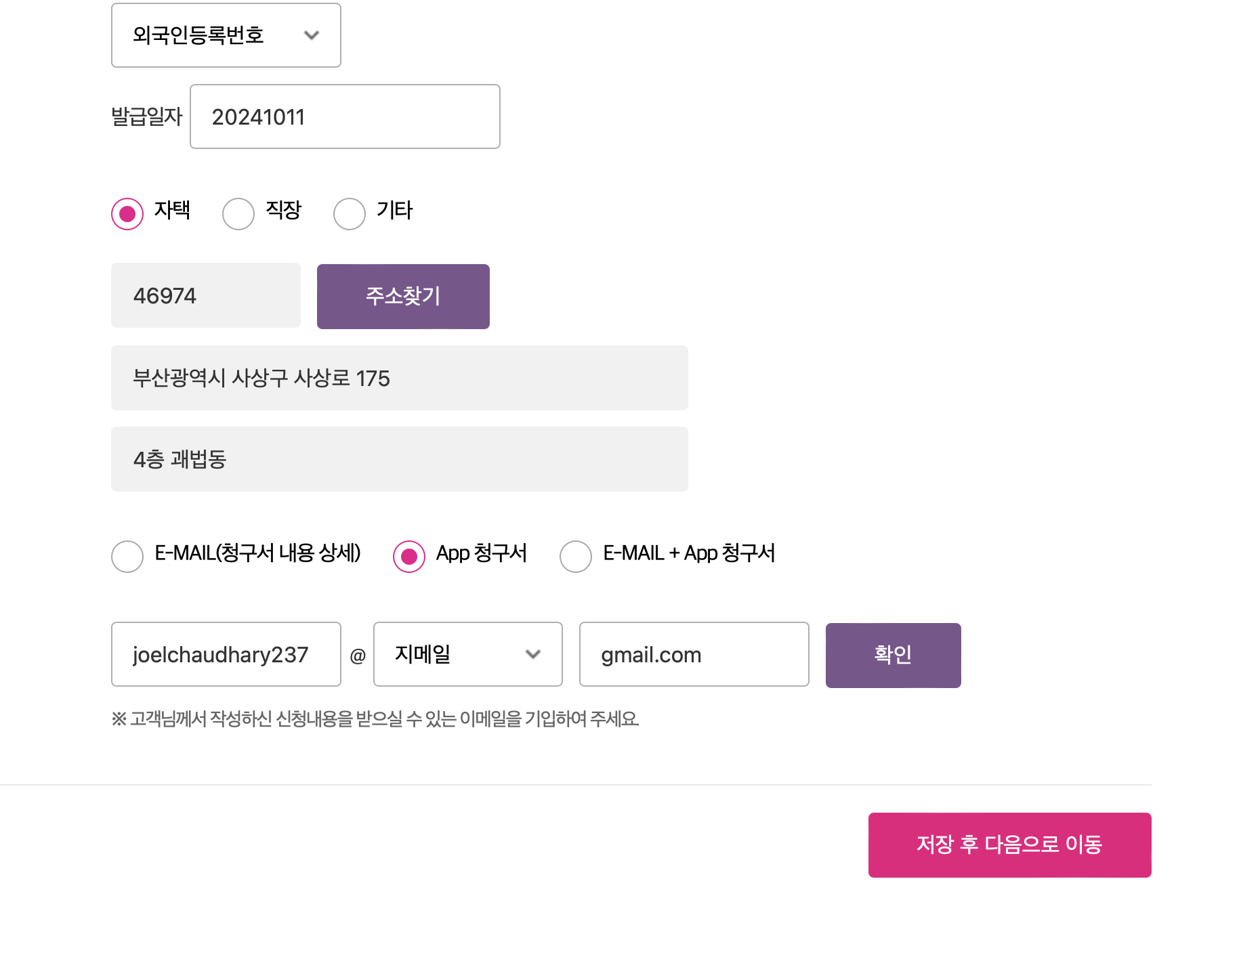
3. Easy self sign-in
👉 발급일자 = Issue date
📍ARC Front side, below your photo (bottom area)
📅 Format: YYYY.MM.DD
20171126
Find your address here
GLOBAL TOP NET

Slide 6
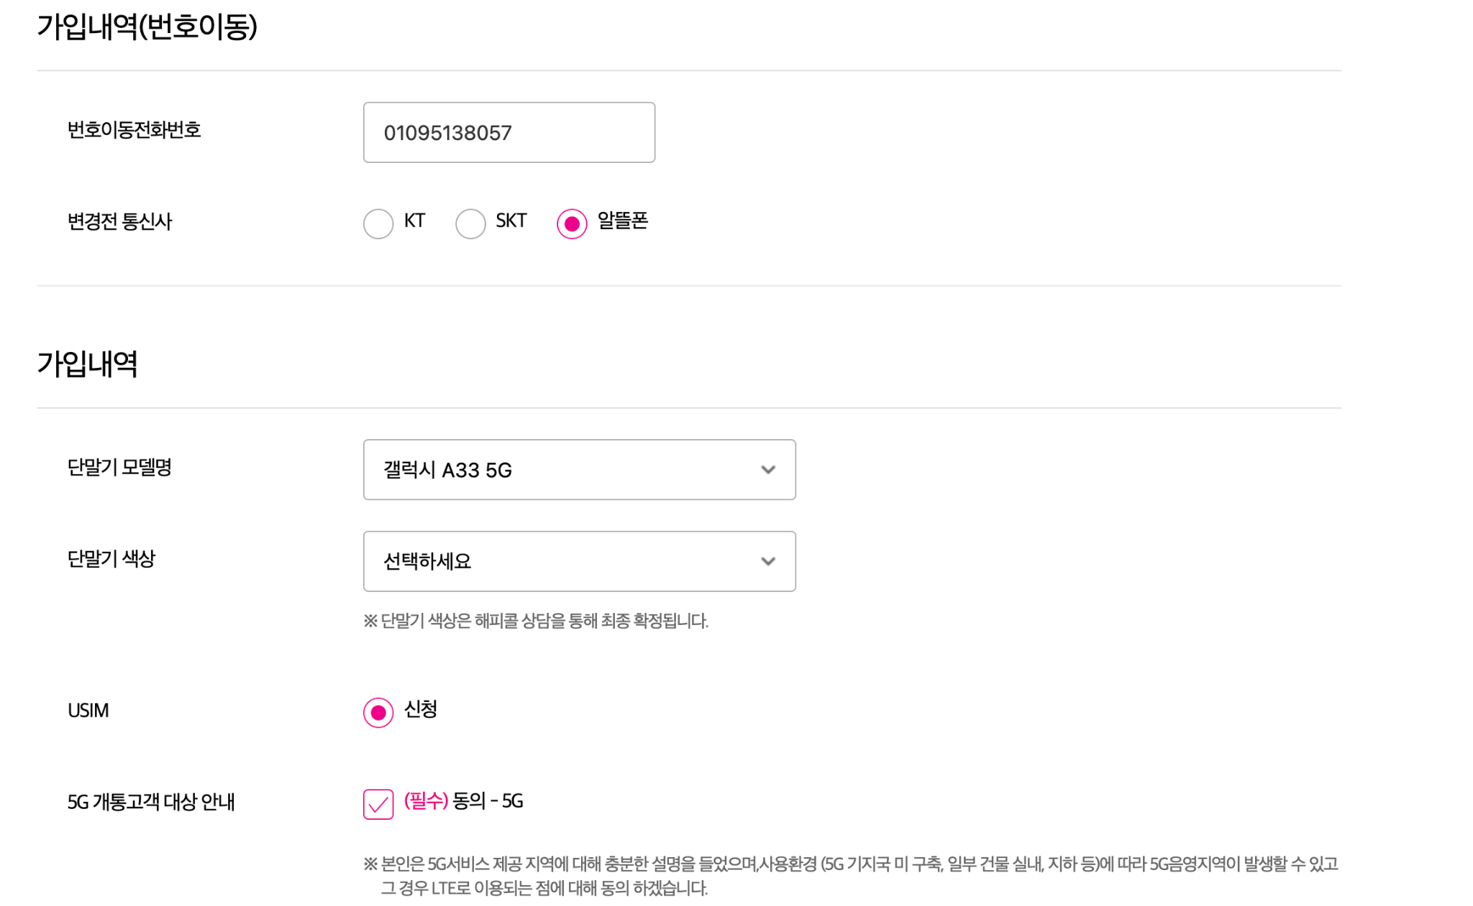
4. Easy self sign-in
⚠️ Altul SIM has different types—dial 114 to hear your SIM type at the start of the call make a note and later let us know your official SIM name.
01034563784
*Select same

Slide 7
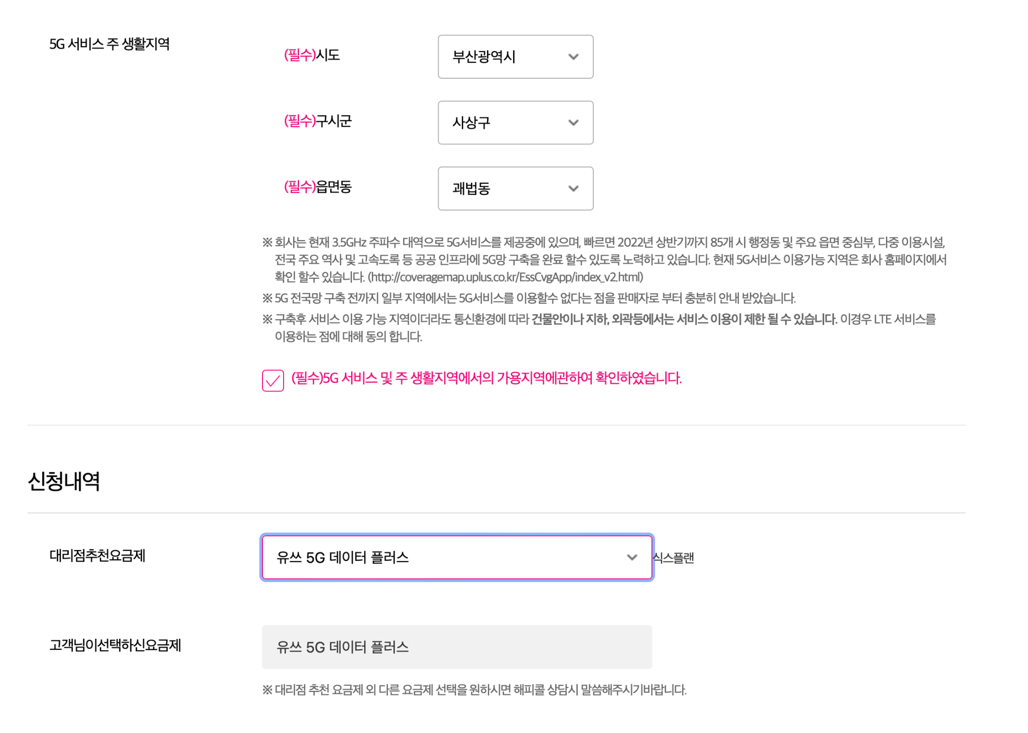
5. Easy self sign-in
Choose the sim plan name

Slide 8
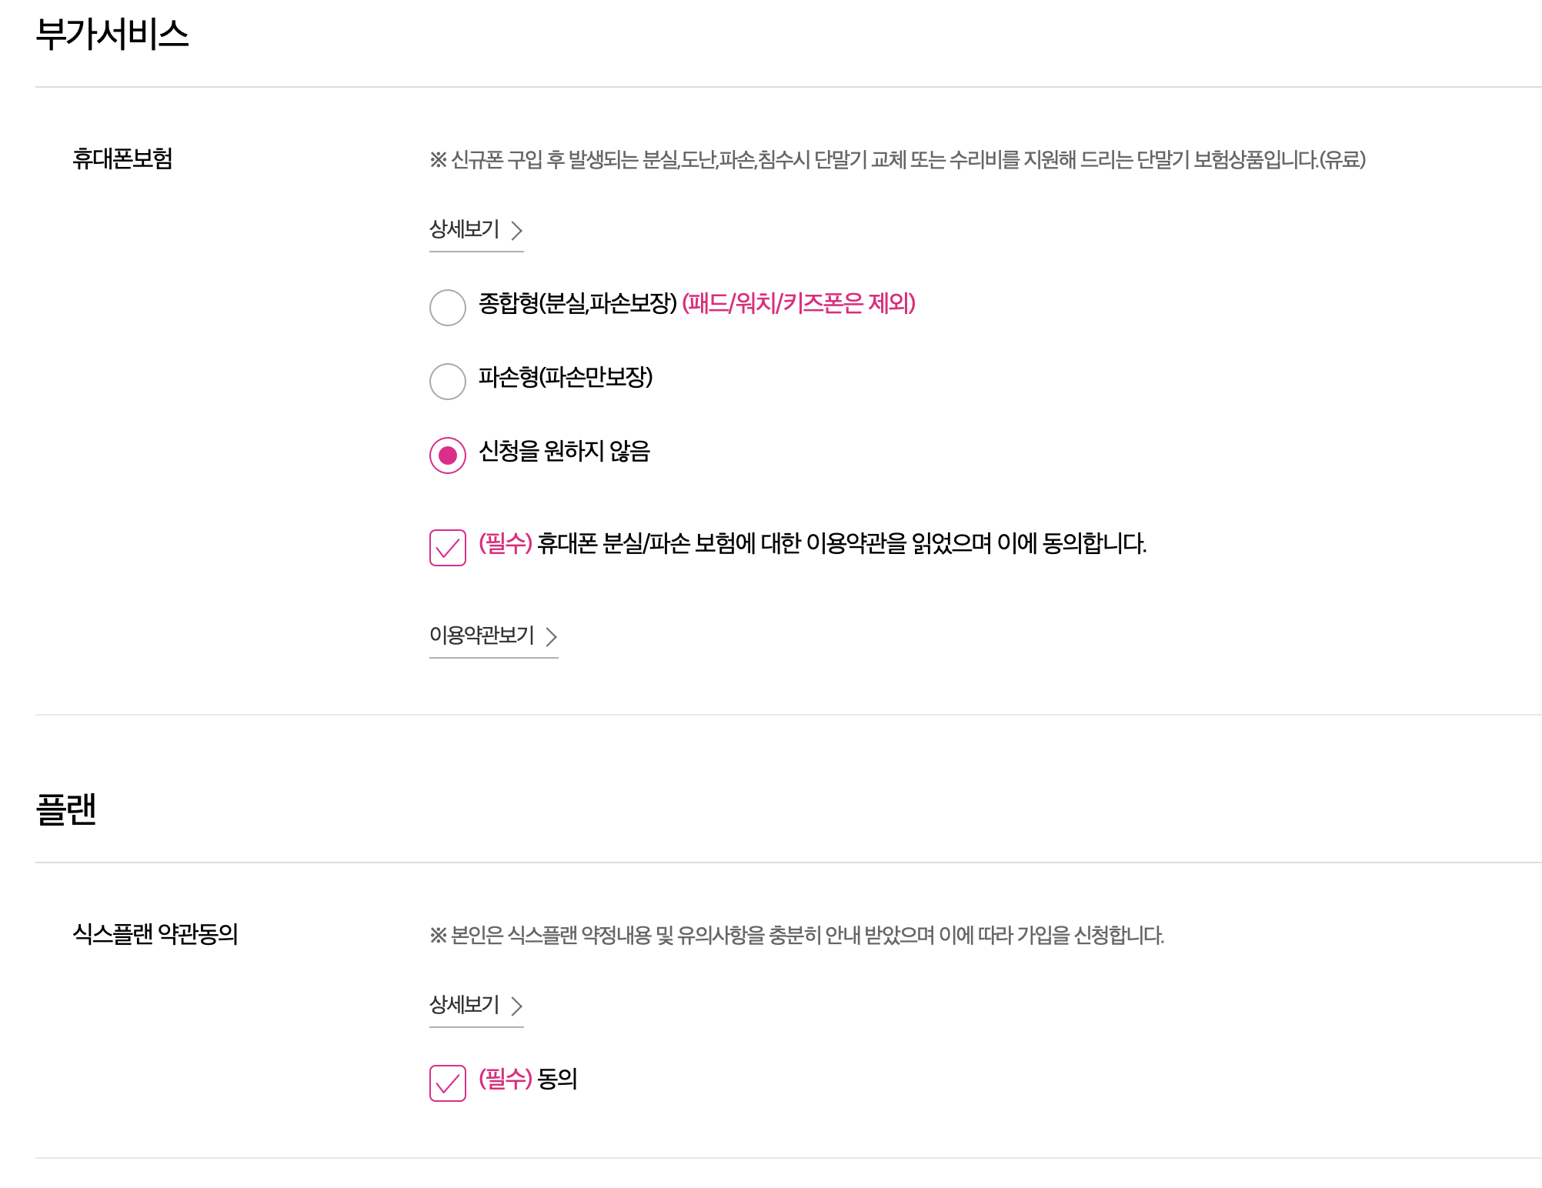
6. Easy self sign-in

Slide 9
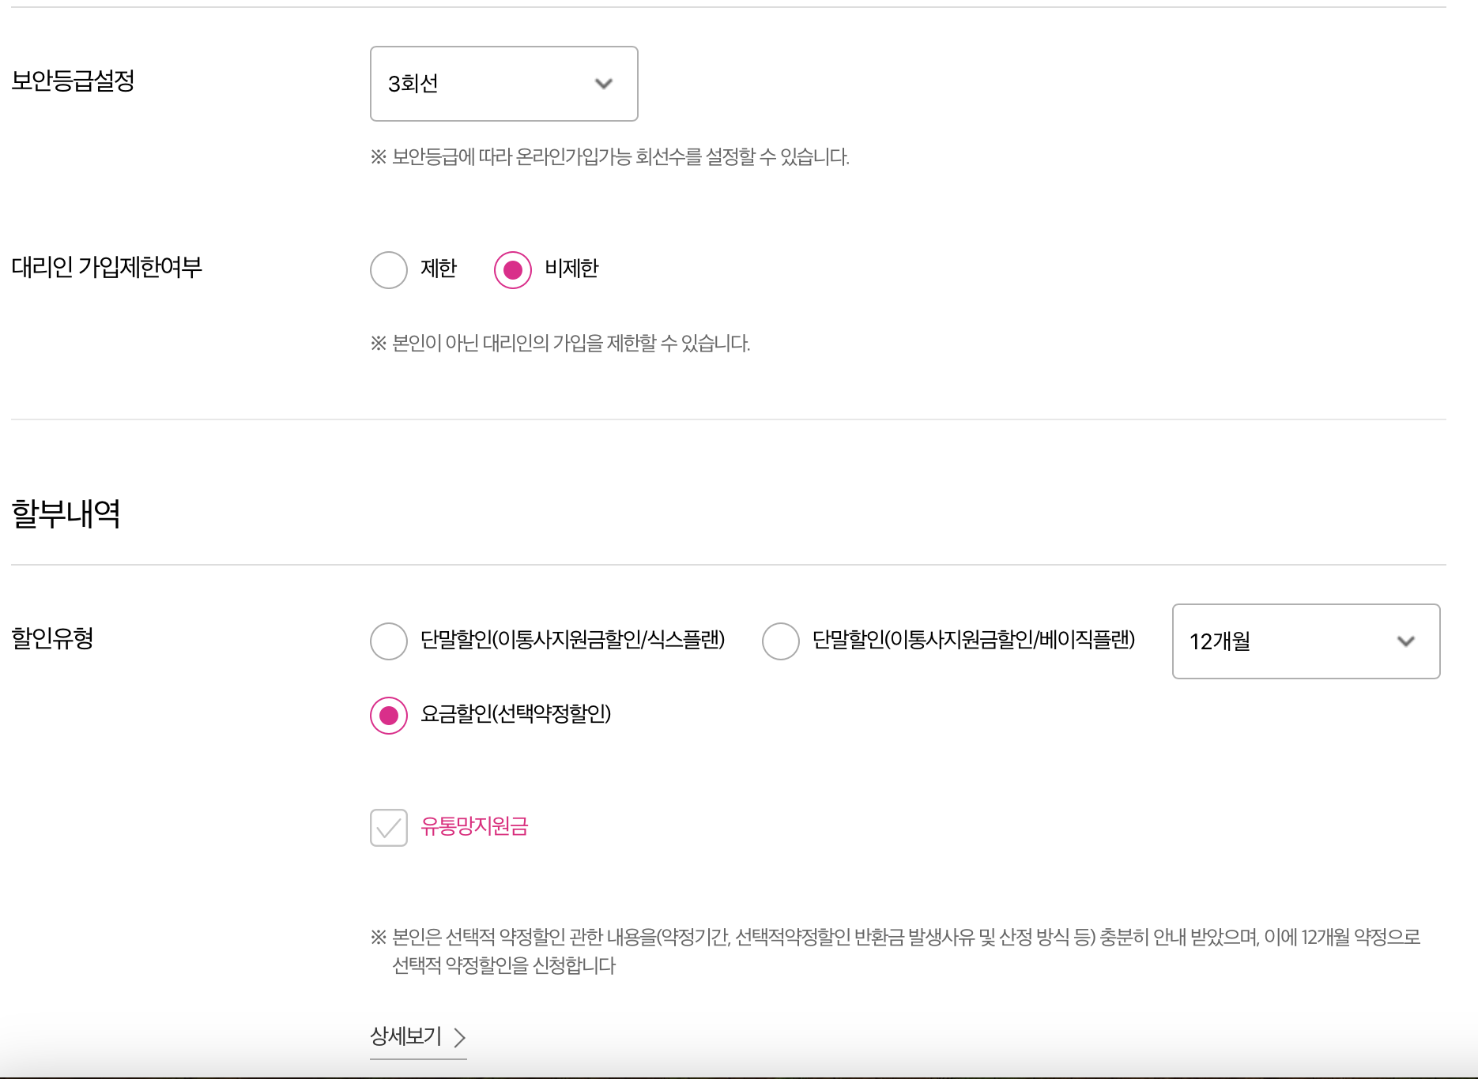
7. Easy self sign-in

Slide 10
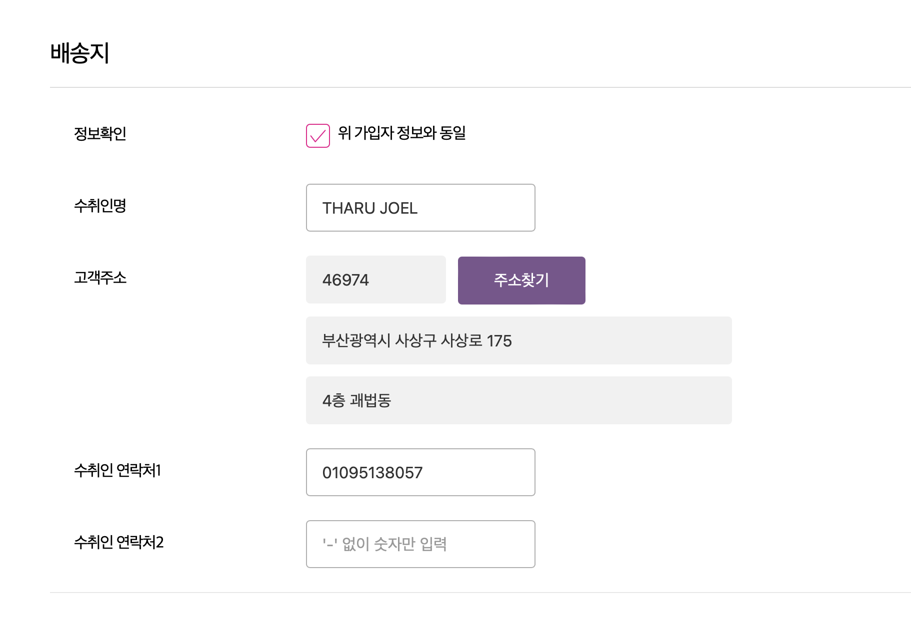
8. Easy self sign-in
GLOBAL TOP NET
Your name
Find your address here
010-1234-4678
Your number

Slide 11
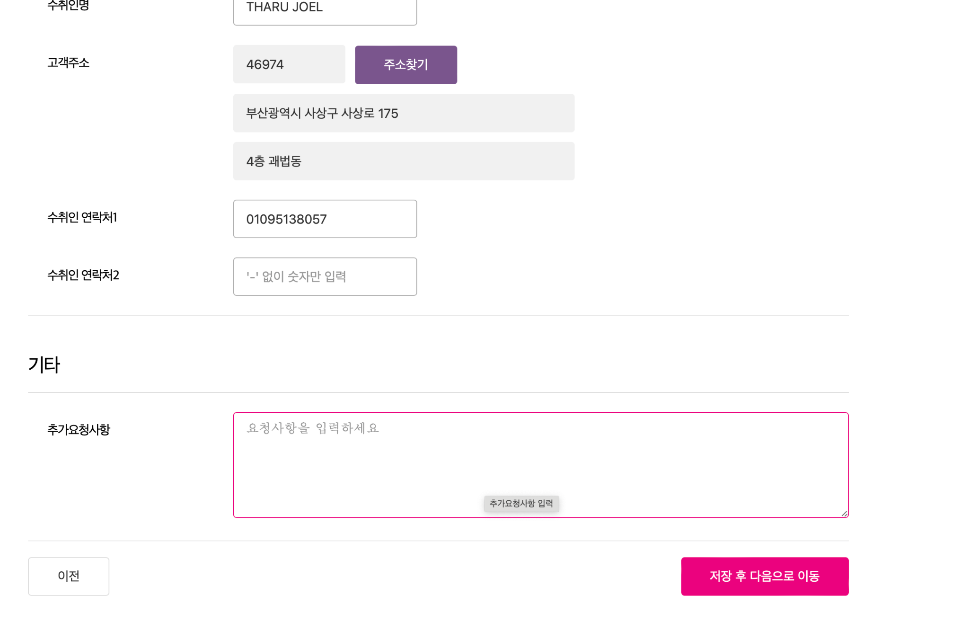
9. Easy self sign-in
Global topnet
01034563784
Click

Slide 12
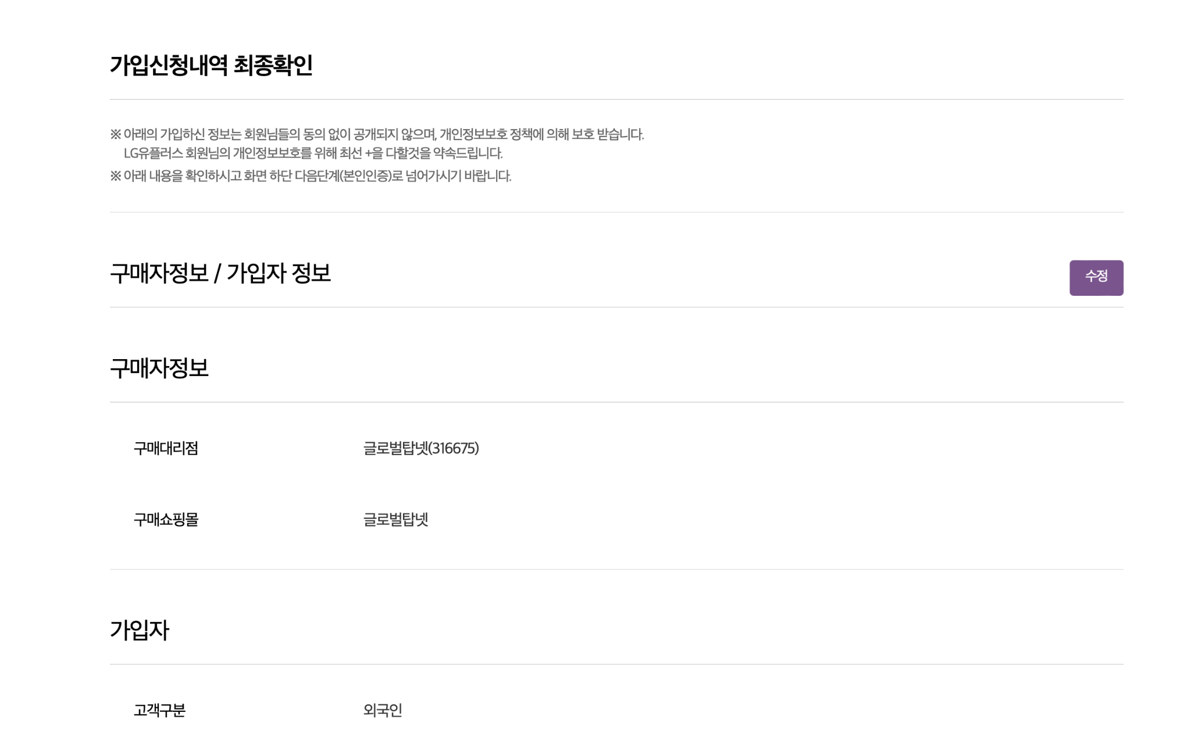
10. Easy self sign-in
Please scroll down and review your information.

Slide 13
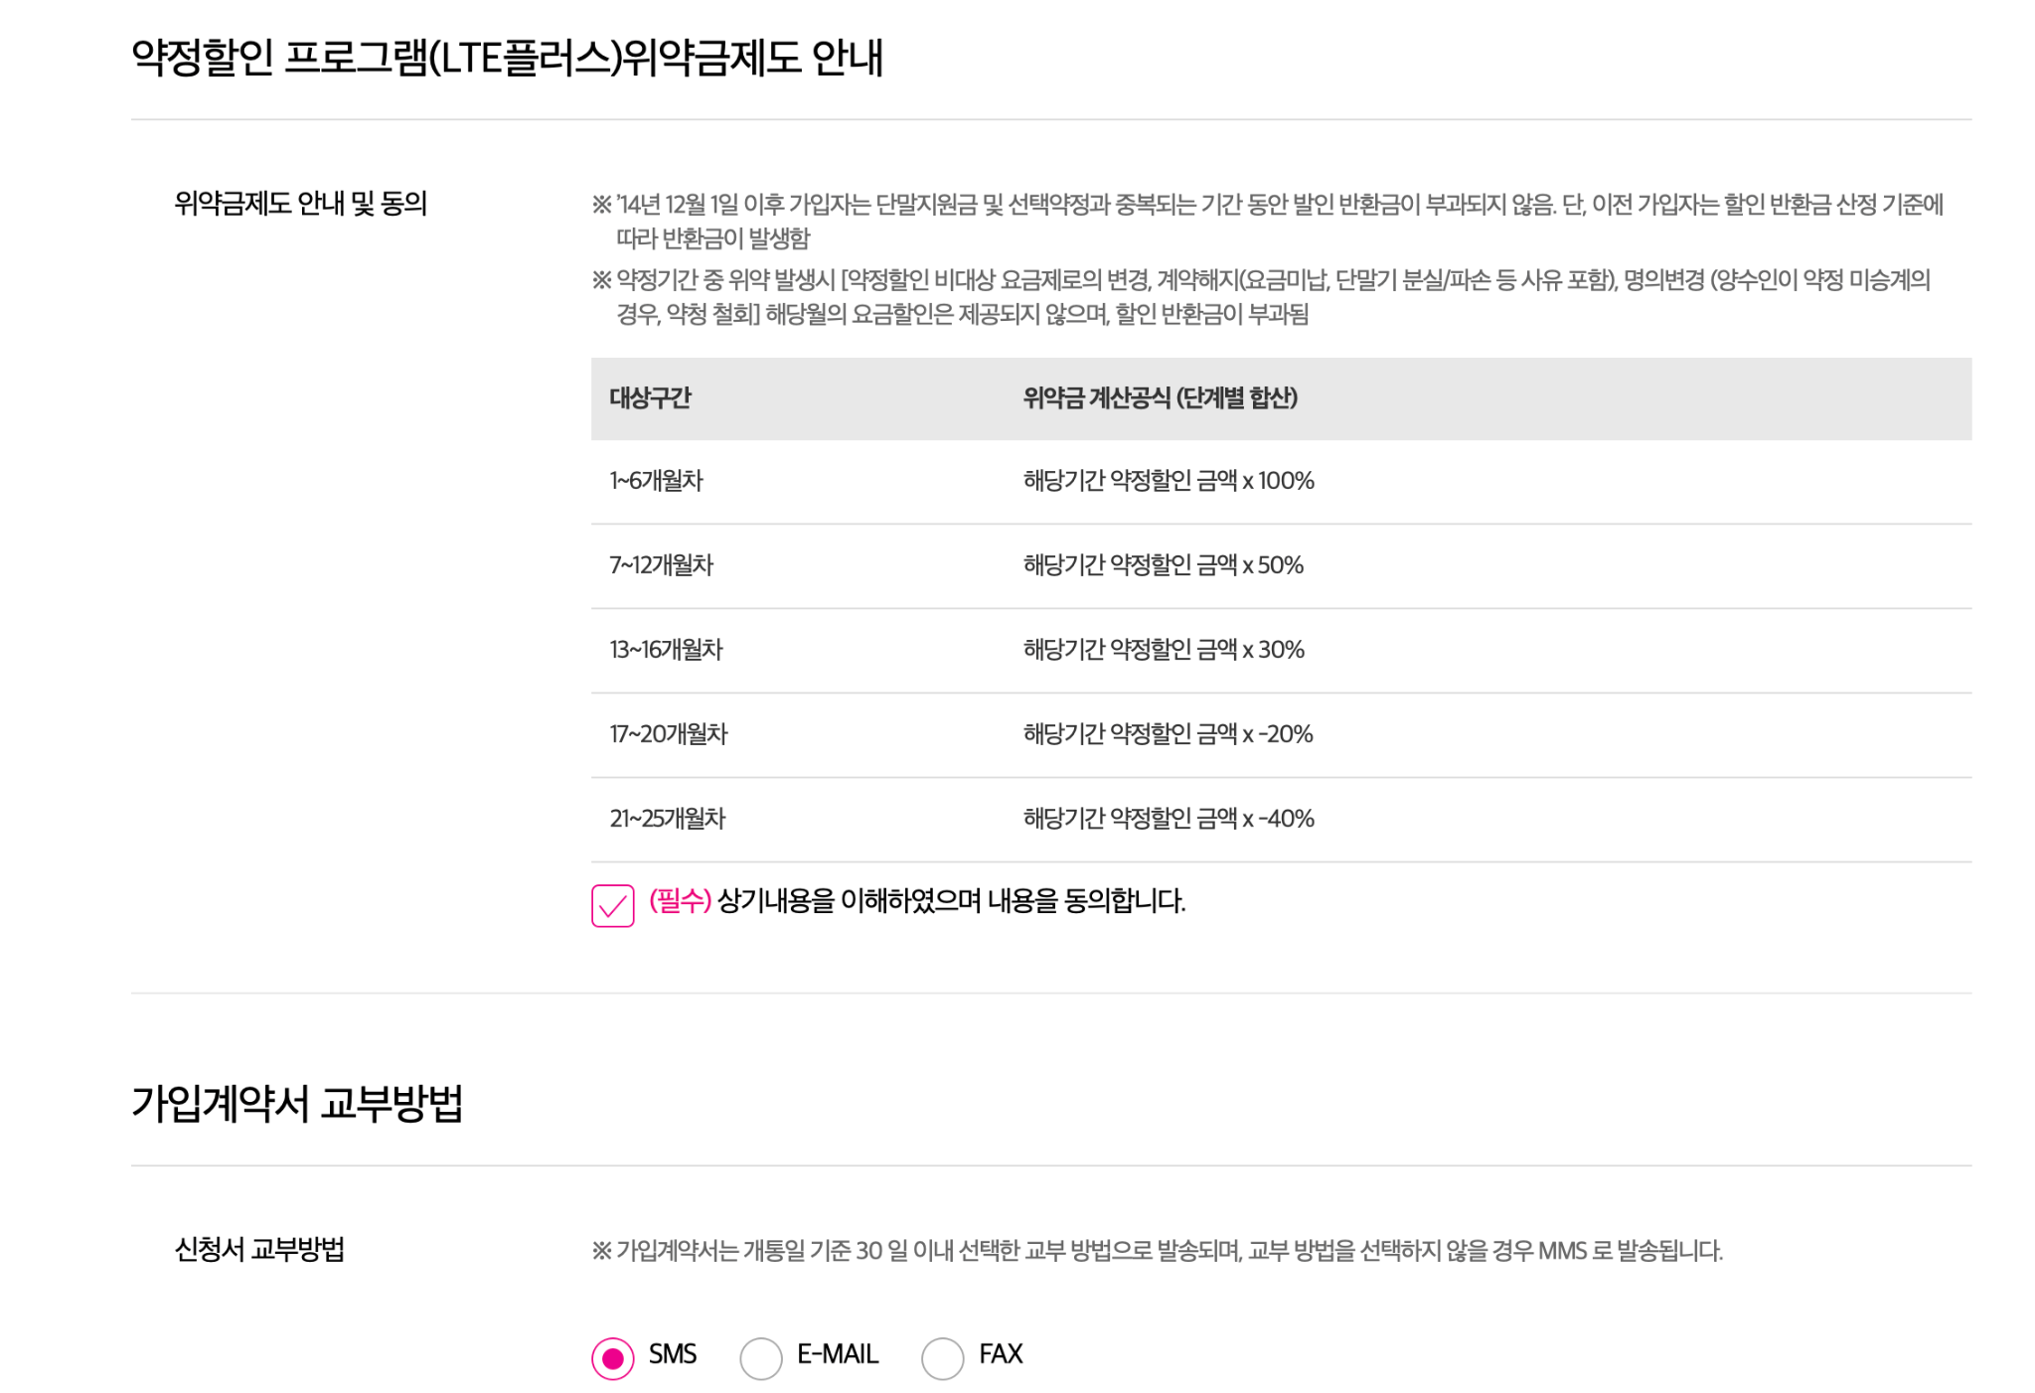
11. Easy self sign-in

Slide 14
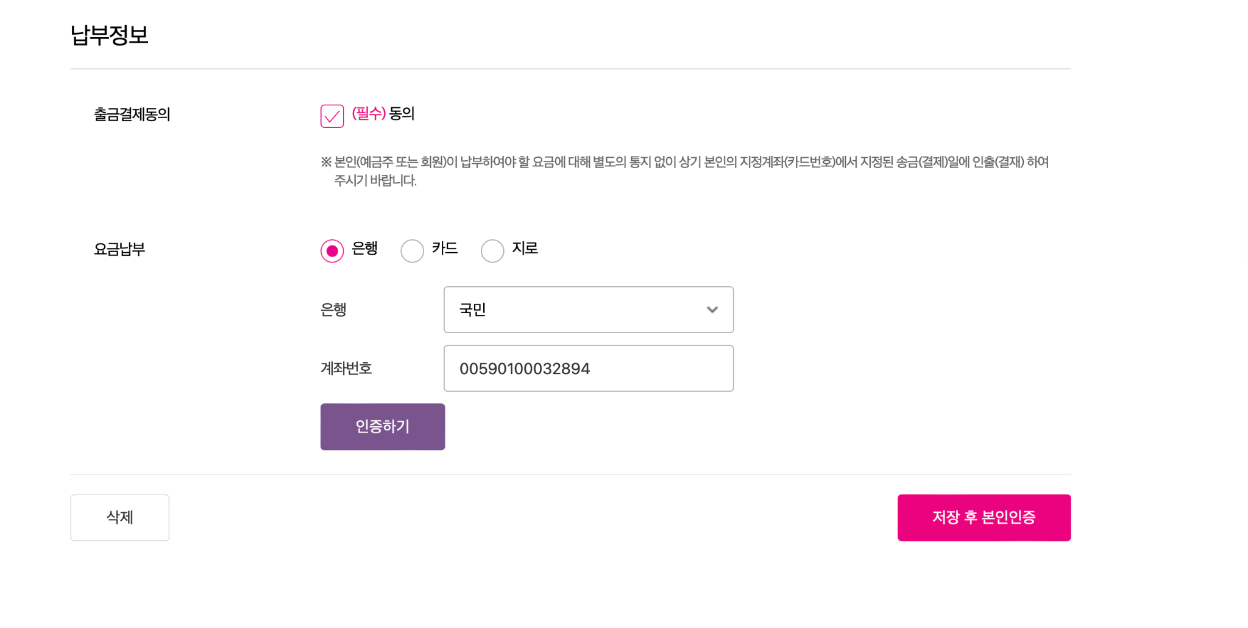
12. Easy self sign-in
Insert your account information
123456789022336

Slide 15
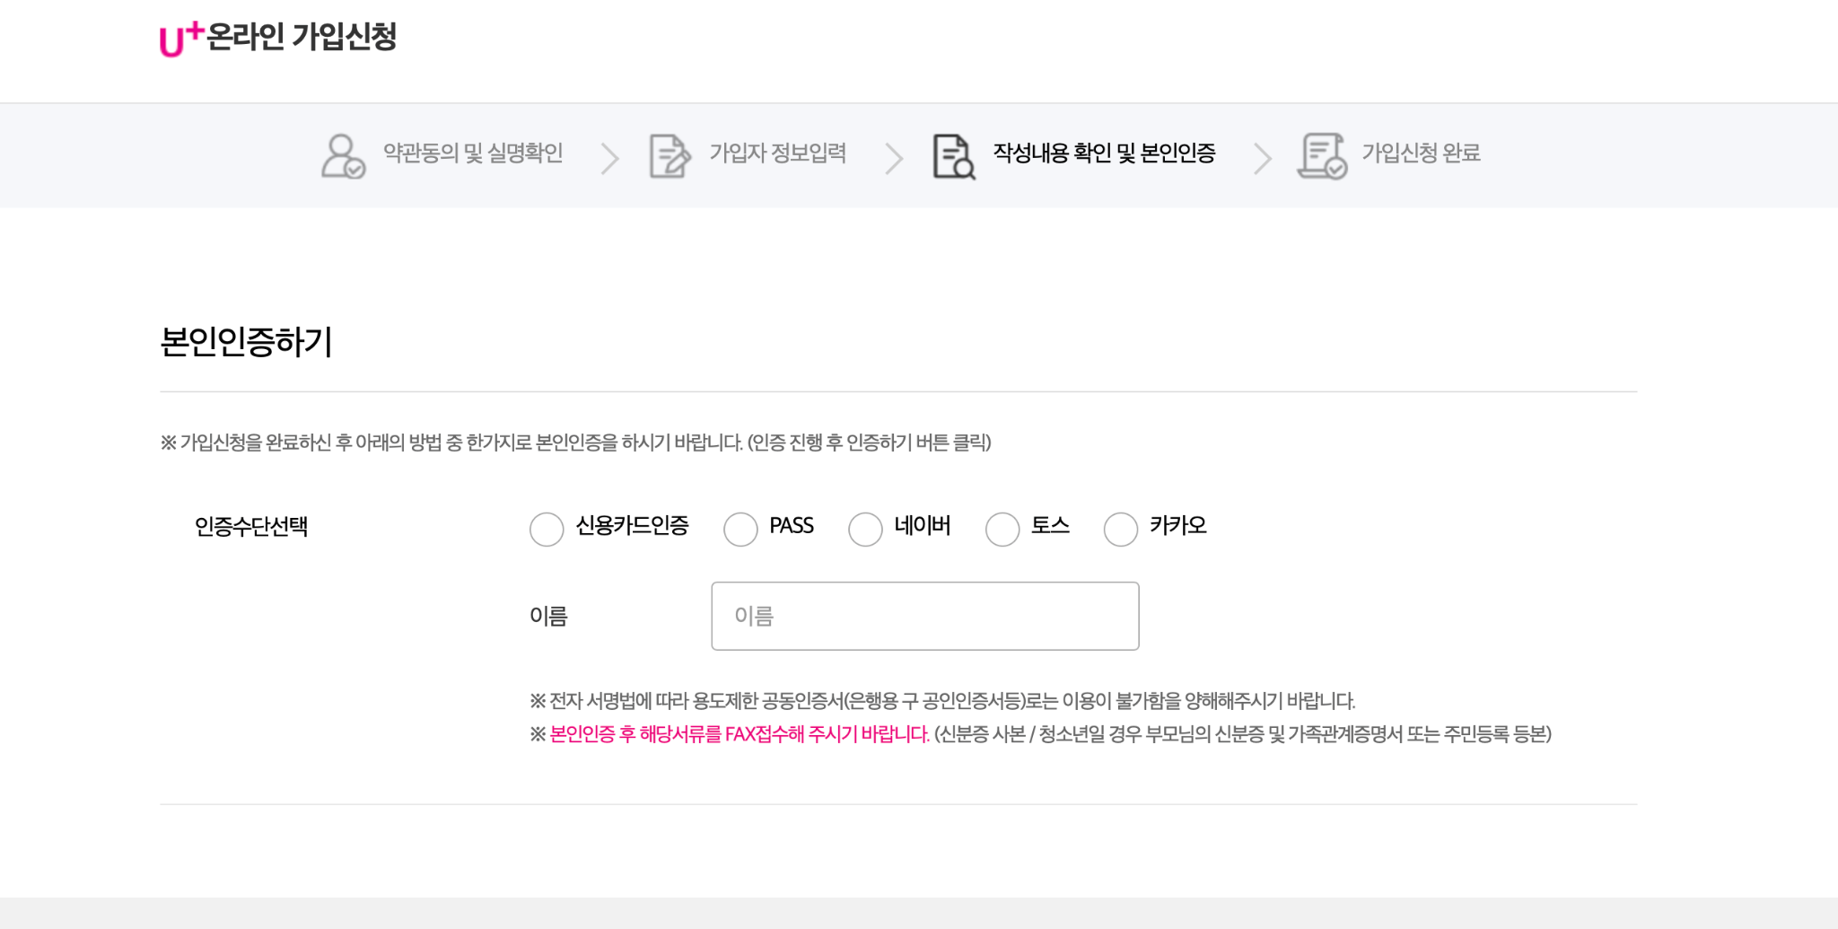
13. Easy self sign-in
Please choose one verification platform

Slide 16
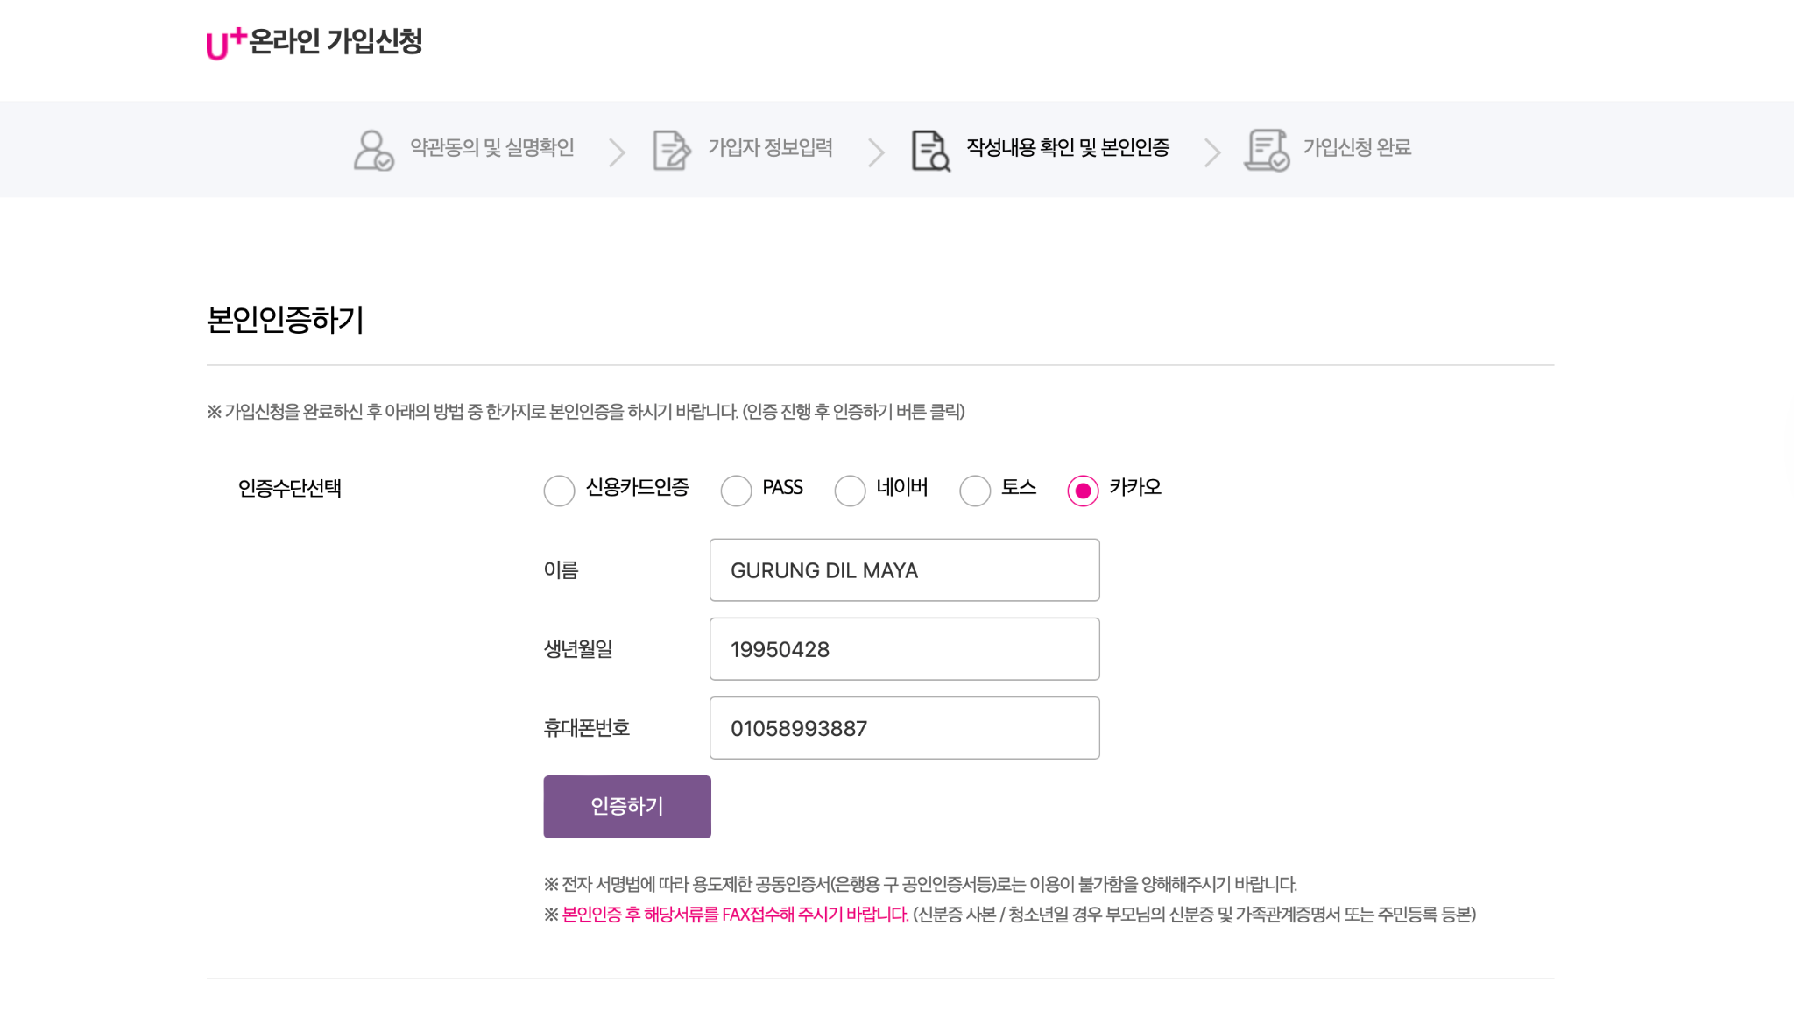
14. Easy self sign-in
⚠️ Please use the same name as your ARC.
Also, check your Kakao profile and make sure your name matches your ARC exactly.
This is important for identity verification.
Global topnet
12343427
010-1234-5678

Slide 17
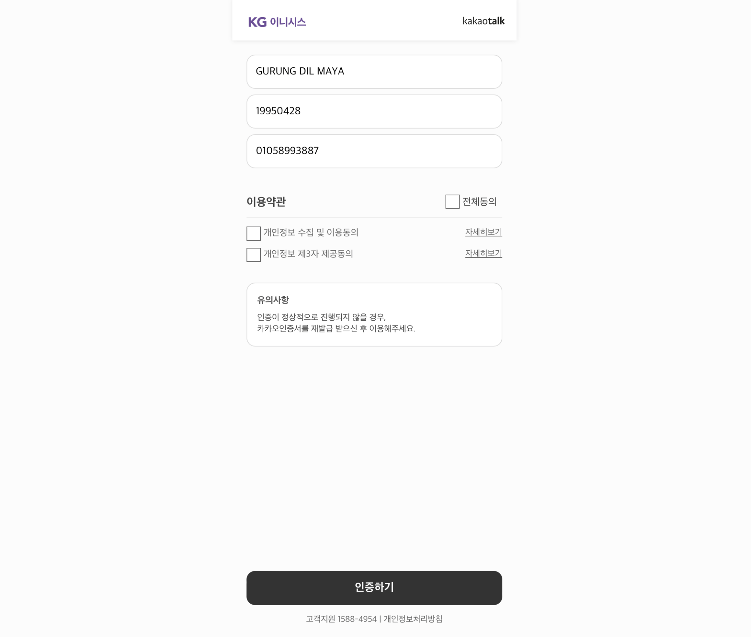
15. Easy self sign-in
Global topnet
012344632
Check Kakao and accept the request to complete verification.
012344632
Select all

Slide 18
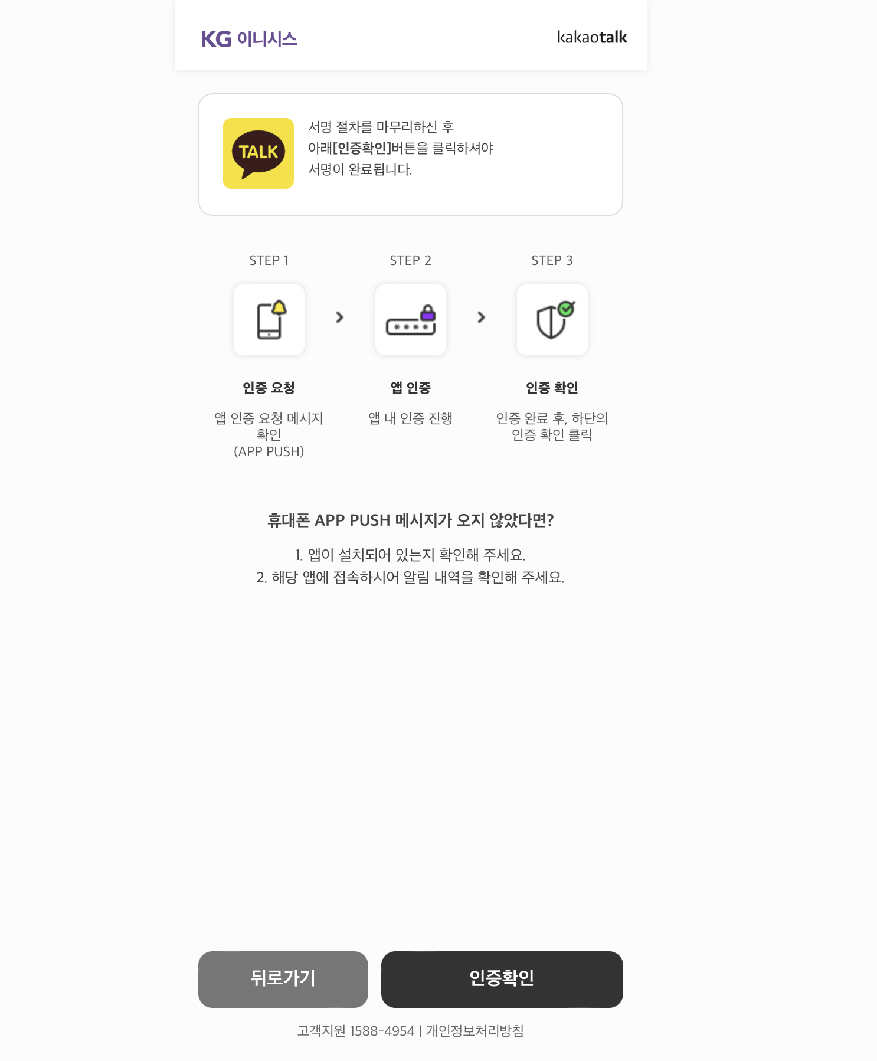
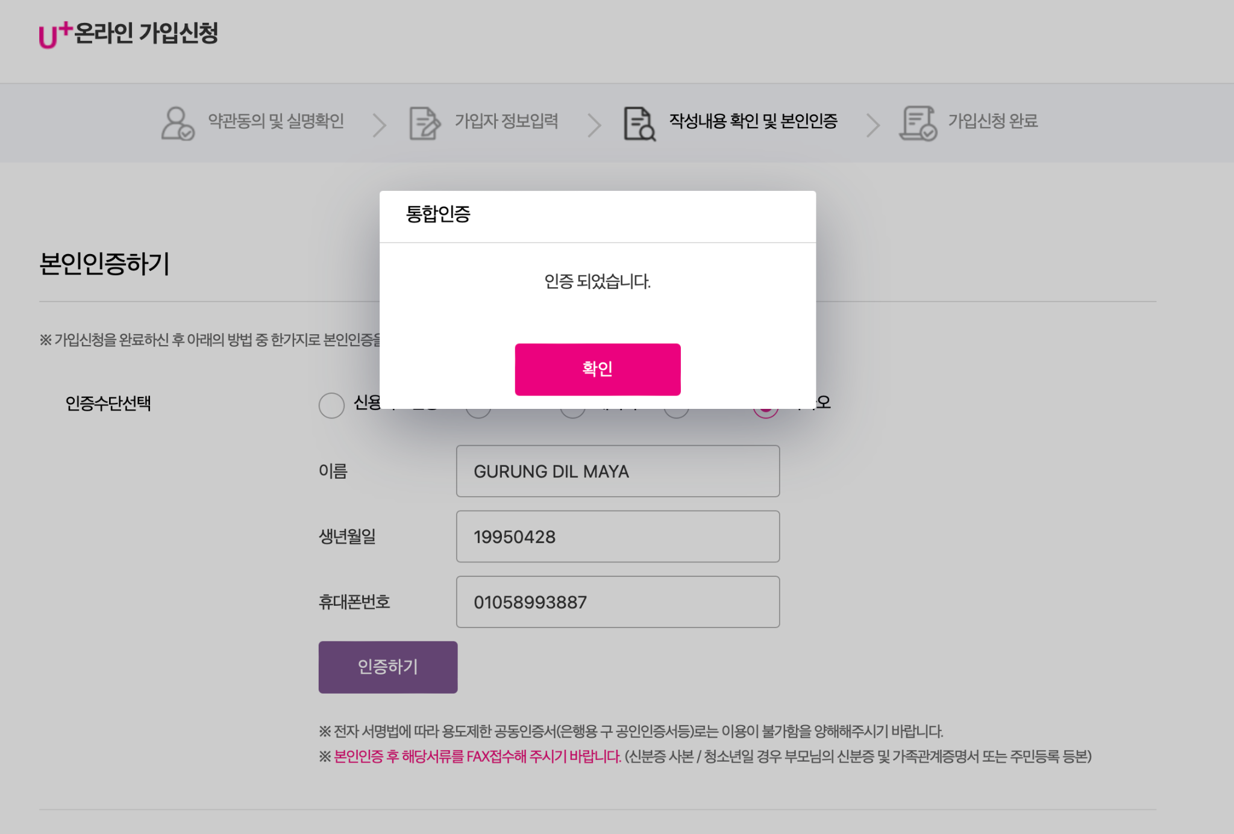
16. Easy self sign-in
Global topnet
19980101
01012341234

Slide 19
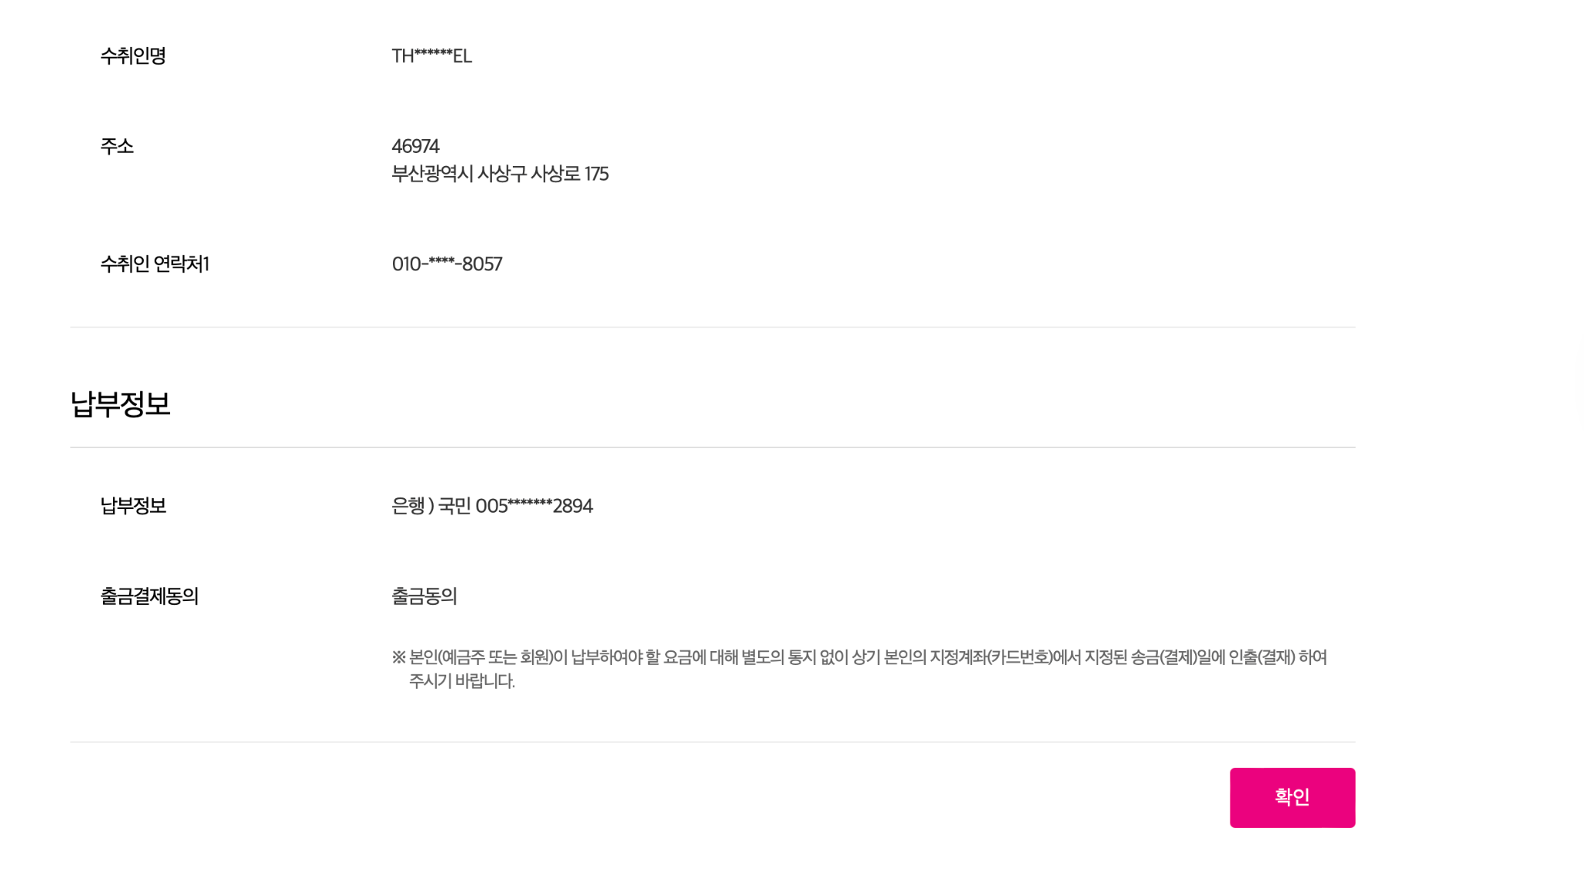
17. Easy self sign-in
Thank you for your patience. Process complete—please check your details.

Slide 20
18. Easy self sign-in
After Registration – Please Send Details
After completing the registration, please check your all details. If all good, send us the following information:
Model Name
Serial Number
IMEI 1
IMEI 2
EID
👉 You can find these details on your phone: Settings → About Phone
📸 Please take a screenshot and send it to us.

Slide 21
19. Easy self sign-in
Need Help? We’re Here for You! If you face any issues during registration, don’t worry. We can assist you step by step.
📩 Contact us anytime : 010-5899-3887

