Slide 1
CPU Scheduler
2006190702 장용현

Slide 2
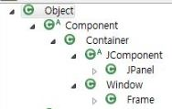
Type Hierarchy 1

Slide 3
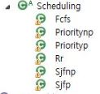
Type Hierarchy 2

Slide 4

Type Hierarchy 3

Slide 5
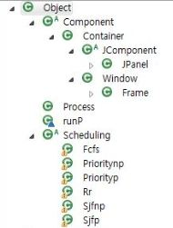
Type Hierarchy

Slide 6
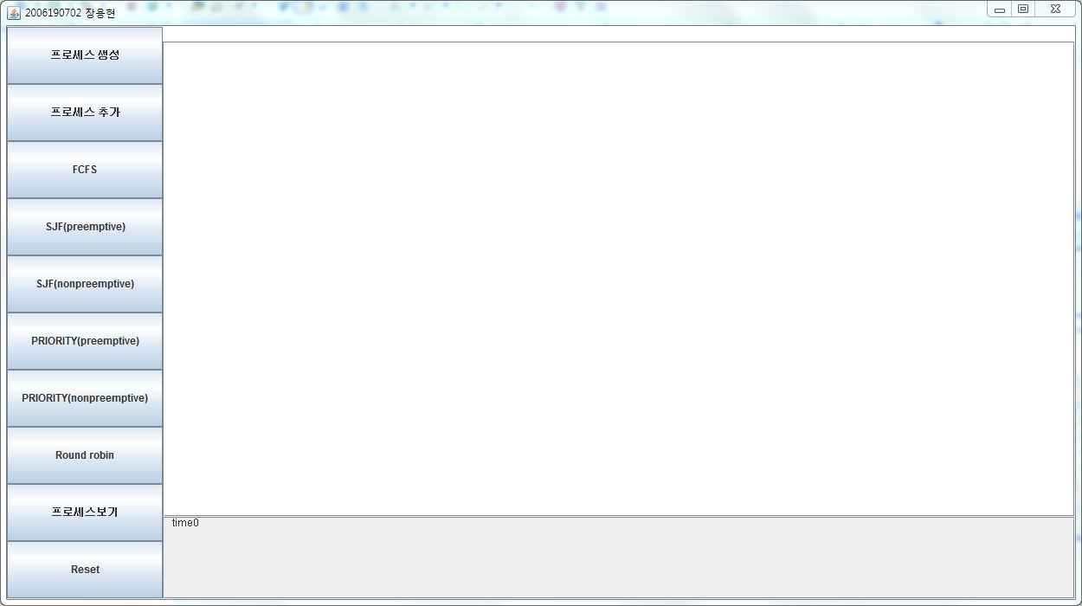
실행화면1

Slide 7
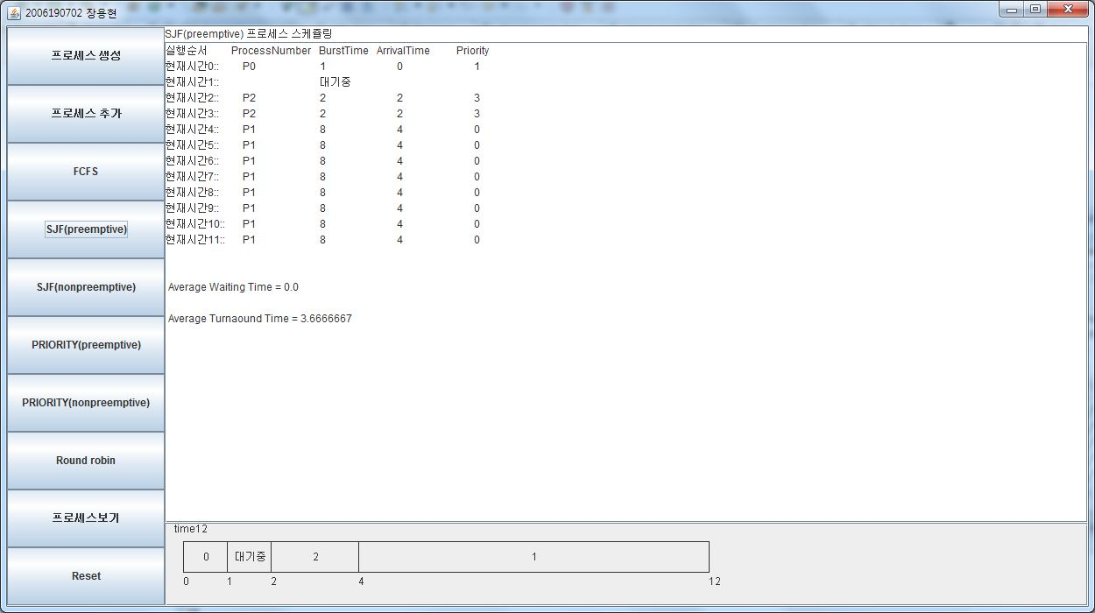
실행화면2

