Slide 1
MAPD112-Web Techs-Mobile Platforms Project Name : HEALTH & CARE
Group Number: 5
Deepshi (301089444)
Loveleen Kaur(301093331)
Bhavya Shah(301076681)
Huen Oh(301082798)
Under the Guidance of
Przemyslaw Pawluk

Slide 2
Introduction & Scope
We have developed a Patient Clinical Data Management Application for the health care providers.
It helps the health care providers to manage a group of patients and view the detailed clinical data for an individual patient.

Slide 3
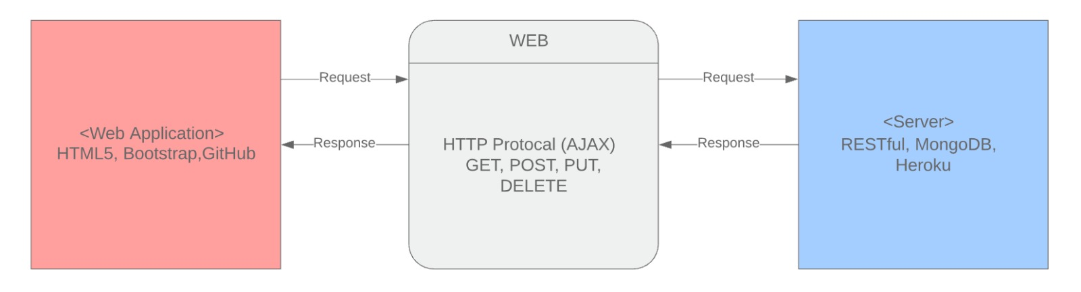
Application Flow

Slide 4
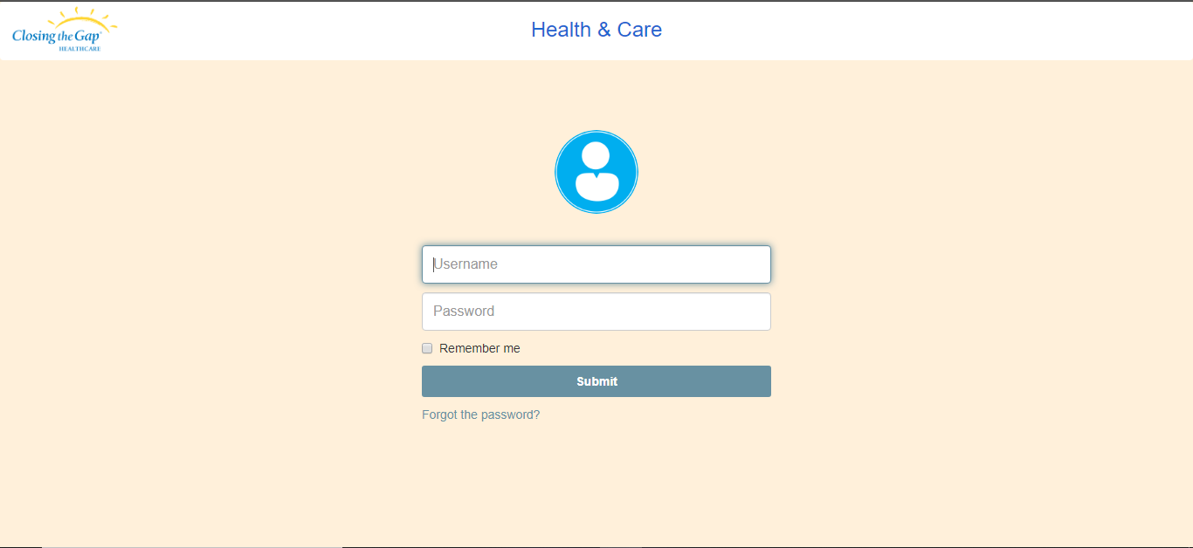
Desktop View
Login Page

Slide 5
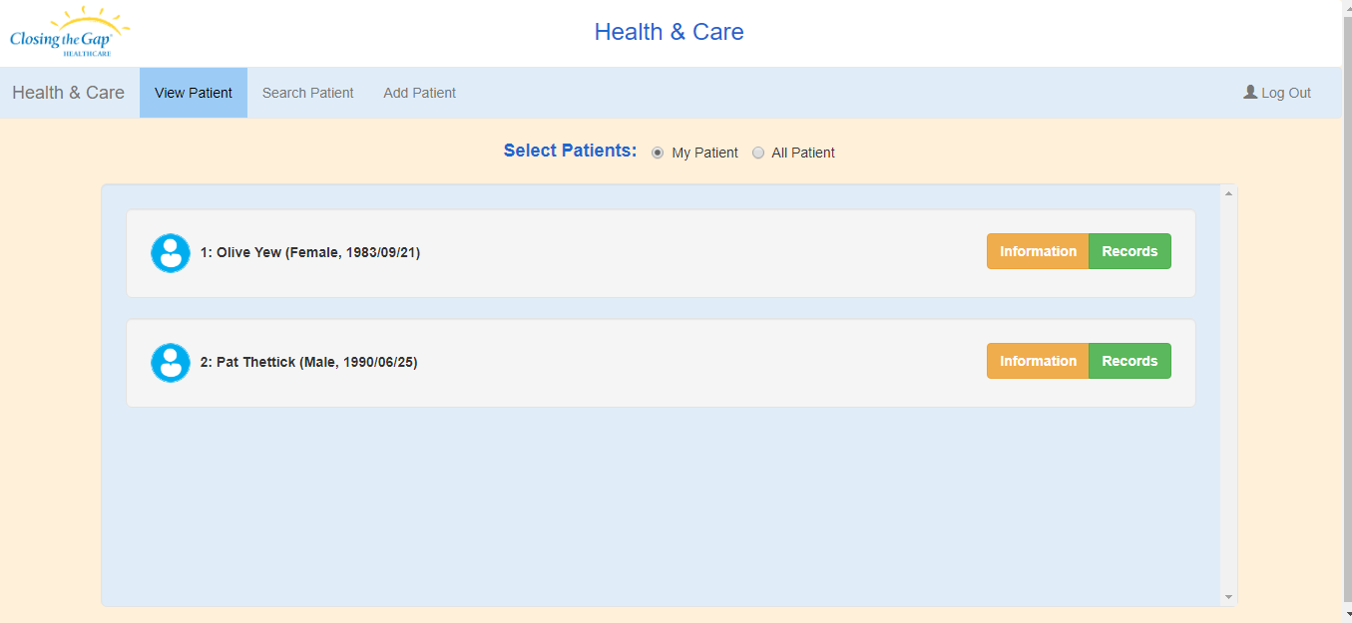
Desktop View
View Patient Page

Slide 6
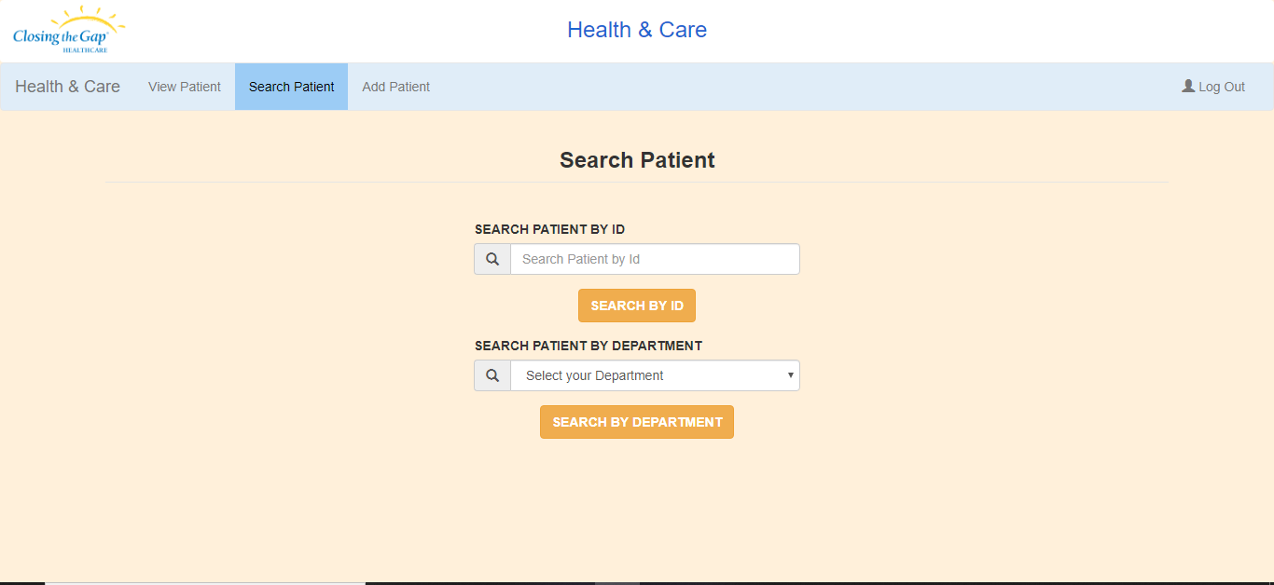
Desktop View
SearchPatient Page

Slide 7
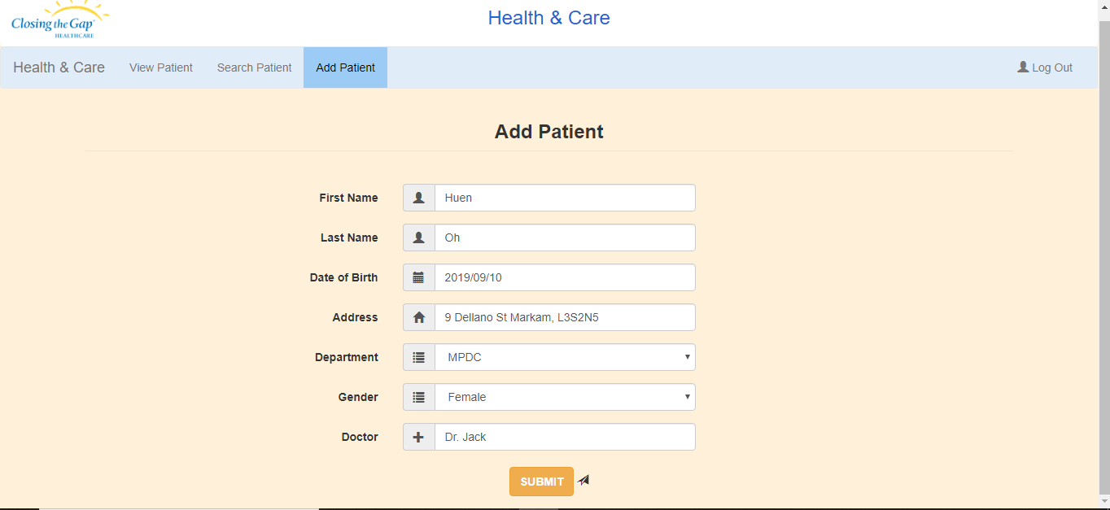
Desktop View
Add Patient Page

Slide 8
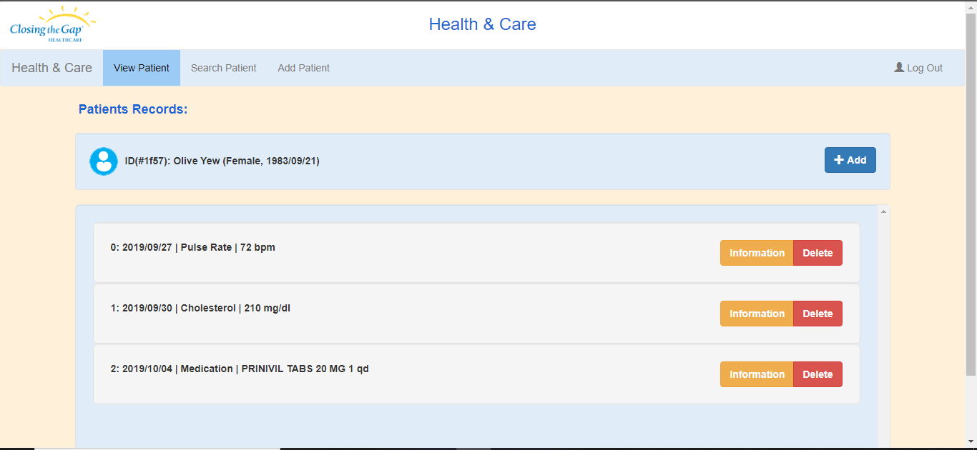
Desktop View
View Patient’s Record Page

Slide 9
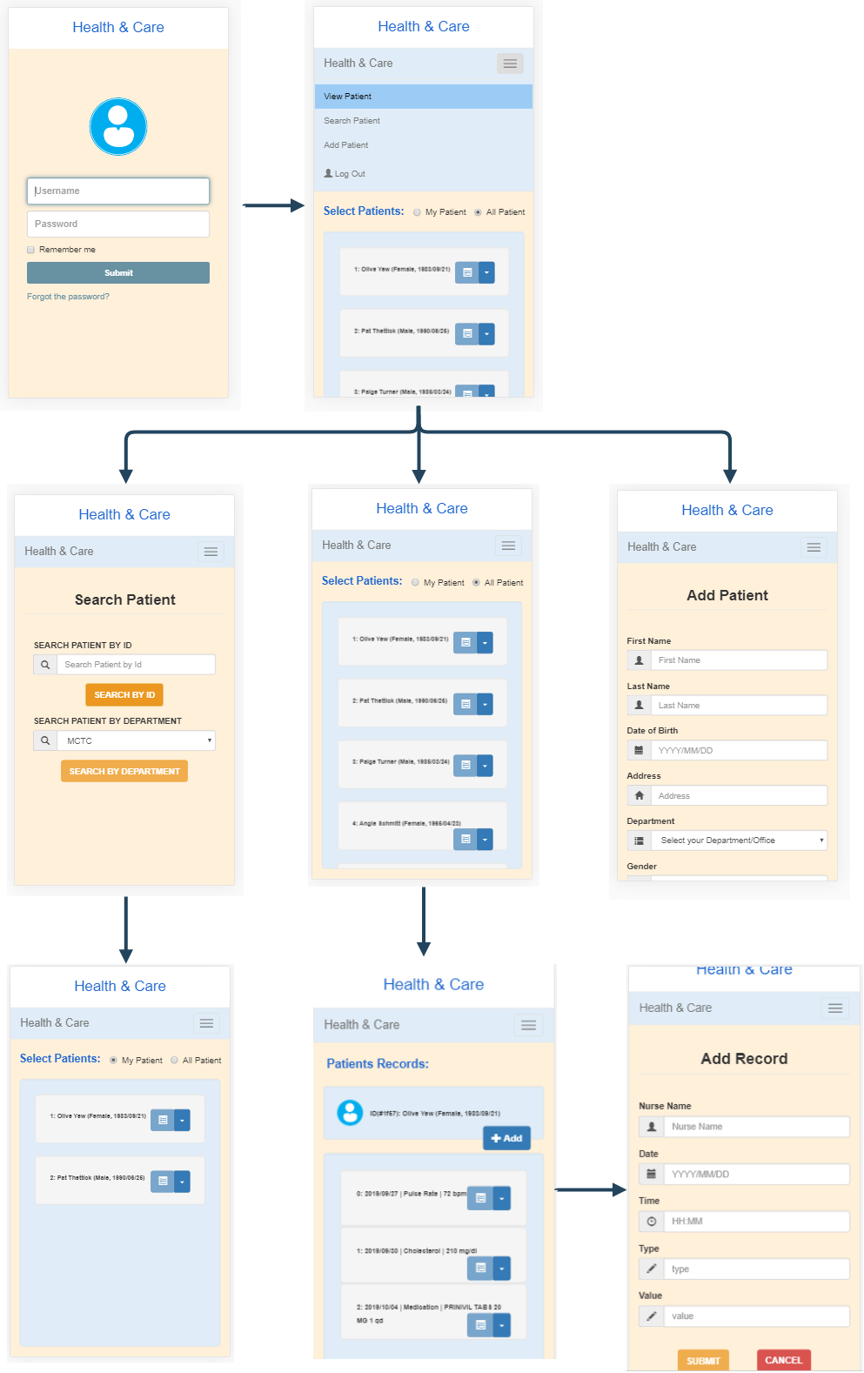
Mobile View

Slide 10
Tools & Technologies Used
Frontend
Responsive Design : Bootstrap, JavaScript
Client-Server request : AJAX
Authentication : JWT(JSON Web Token)
Deployment : GitHub

Slide 11
Tools & Technologies Used
Backend
RESTful : restify, JavaScript, Typescript
DB : MongoDB Atlas cloud - cloud.mongodb.com
Deployment : Heroku, Swagger
Unit test : mocha, chai-http

Slide 12
Challanges
Time constraint with multiple projects
New languages, New concepts
Mostly from backend : No connection, errors…
To solve??? : Google search, experiments, apply

Slide 13
DEMO

Slide 14
Thank You!!!!

