Slide 1
Adversarial examples, adversarial spheres, and learning in high-dimensions
A hastily-prepared Journal Club Talk
By
Jamie
Primarily based on papers by these more qualified people:
Szegedy et al. arXiv:1312.6199
Goodfellow et al. arXiv:1412.6572
Papernot et al. arXiv:1611.03814
Gilmer et al. arXiv: 1801.02774

Slide 2
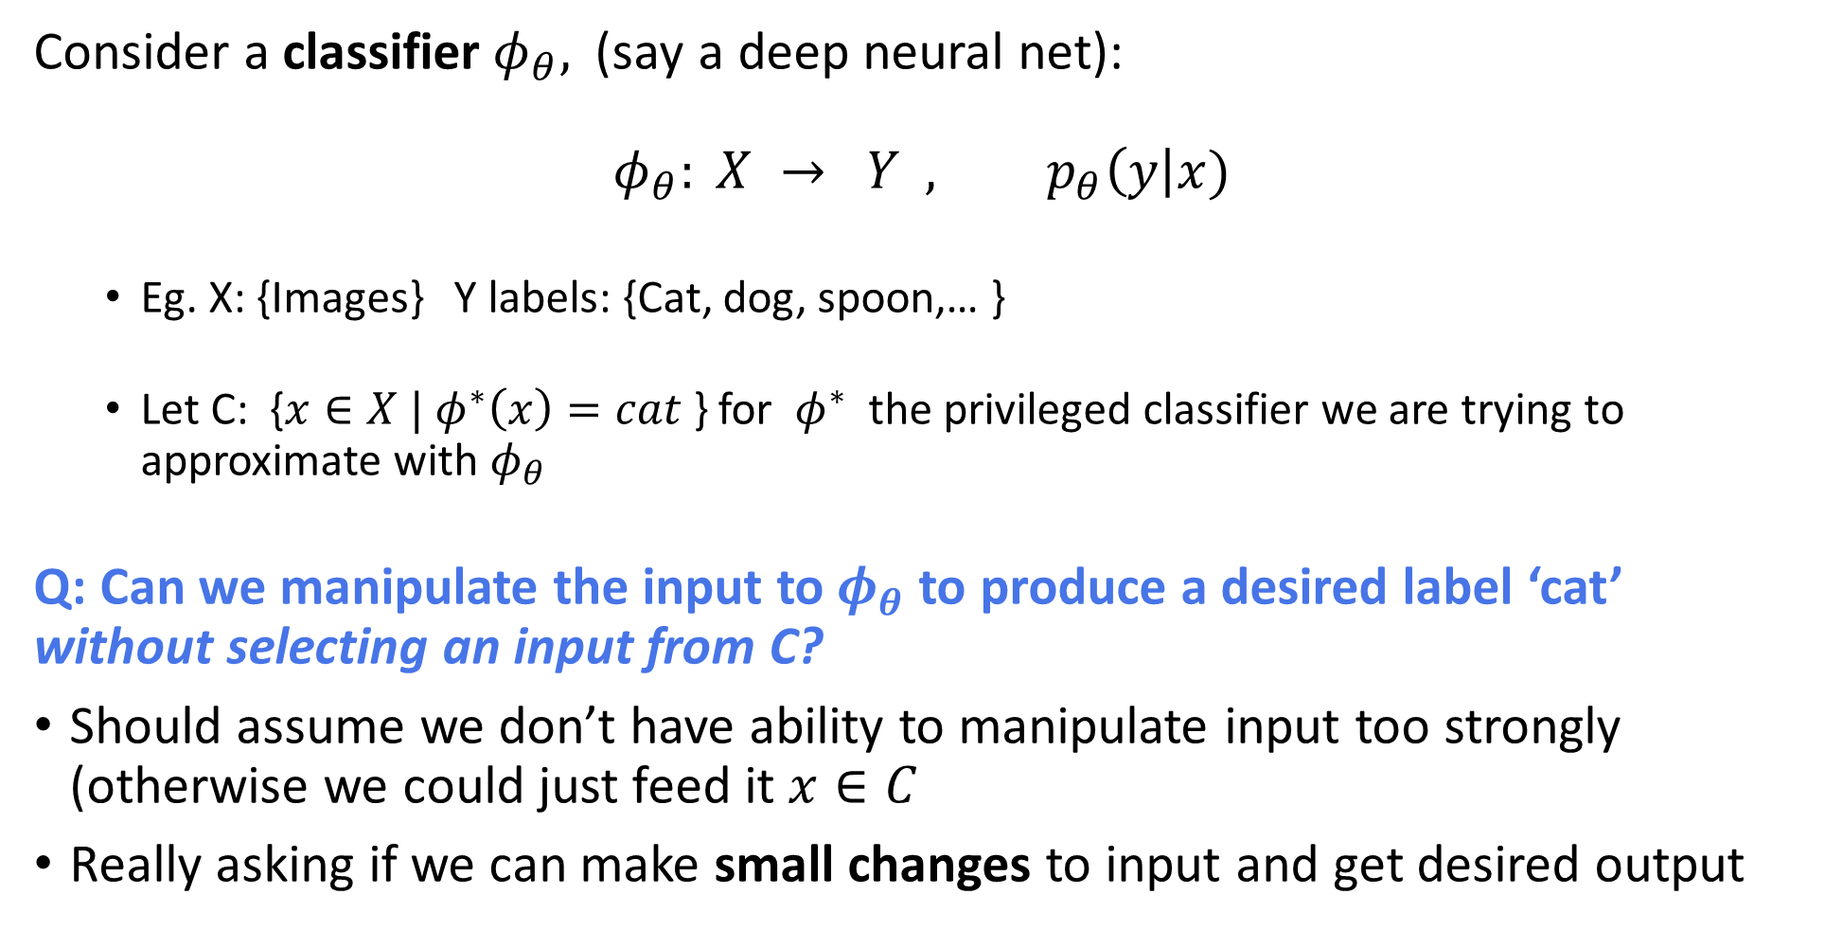
What are adversarial examples?
Consider a classifier$φ_{θ},$(say a deep neural net):
$$φ_{θ}: X → Y , p_{θ}\left(y\right|x)$$
Eg. X: {Images} Y labels: {Cat, dog, spoon,… }
Let C: {$x∈X | φ^{∗}\left(x\right)=cat$} for $φ^{∗}$ the privileged classifier we are trying to approximate with $φ_{θ}$
Q: Can we manipulate the input to$φ_{θ}$ to produce a desired label ‘cat’ without selecting an input from C?
Should assume we don’t have ability to manipulate input too strongly (otherwise we could just feed it $x∈C$
Really asking if we can make small changes to input and get desired output

Slide 3
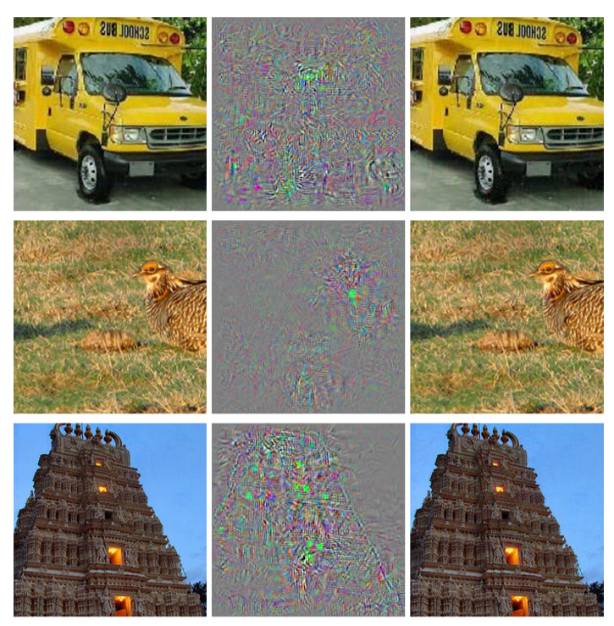
What are adversarial examples?
A: Yes. [Szegedy et al. arXiv:1312.6199]
Can add imperceptible non-random perturbations to a test image and change the network’s prediction
Found by optimizing the input to maximize prediction error
Adversarial examples are robust:
AE generated to fool one neural network often fool a completely different network trained on different examples or with different hyper- parameters

Slide 4
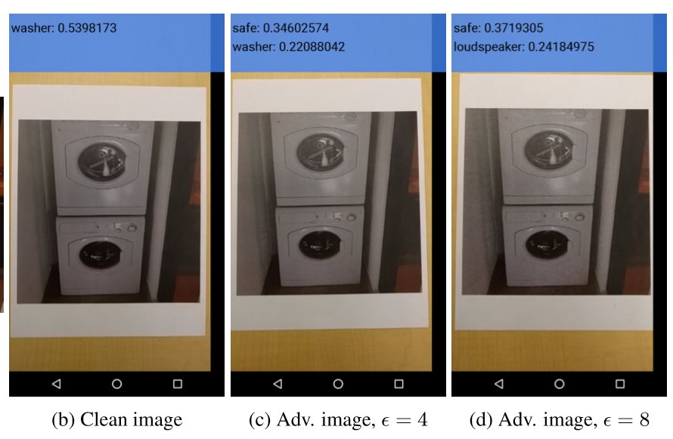
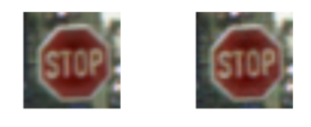
Why might you care?
Theoretical Reasons:
AE suggest that classifiers, even ones that perform amazingly well, are not learning the underlying concepts that determine the correct output label.
Practical Reasons:
If we can trick a classifier by small (eg. low-cost/low-effort) perturbations we can adversely affect classifiers at work in the real world:
Eg. would like self-driving cars to be as robust as possible to malicious manipulation of sensor input
[Papernot et al. arXiv:1602.02697]
[Kurakin et al. arXiv:1607.02533]

Slide 5
What allows for adversarial examples?
Many different hypotheses made to explain adversarial examples.
Some of the things that have been said:
Hypothesis: AE represent low-probability regions of the data manifold that aren’t efficiently found in training, but are nevertheless ‘dense.’ [Szegedy et al. arXiv:1312.6199]
Hypothesis: AE represent overfitting the training data and insufficient regularization; a failure to generalize to the entire data manifold [Szegedy et al. arXiv:1312.6199]
Hypothesis: AE represent non-linear instability [Szegedy et al. arXiv:1312.6199]

Slide 6
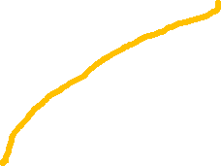
What allows for adversarial examples?
Hypothesis: AE are off the ‘data manifold’
Although they look visibly similar, they have very different statistics than ‘real’ images found in the training set.
Conjecture: Easy to prove a ‘No Free Lunch’ type proof for these
CNN
cat pics
Pics
People think look like dogs
Pics
People think look like cats
CNN
dog pics
AE?
AE
Real dog pics
Real cat pics
CNN
dog pics
CNN
cat pics
Notes:
We begin by pointing out that if a classiﬁer is perfect, i.e., predicts the right class for every possible input, then it cannot be manipulated. Thus, the presence of adversarial examples is a manifestation of the classiﬁer being inaccurate on many inputs. [Papernot et al.]

Slide 7
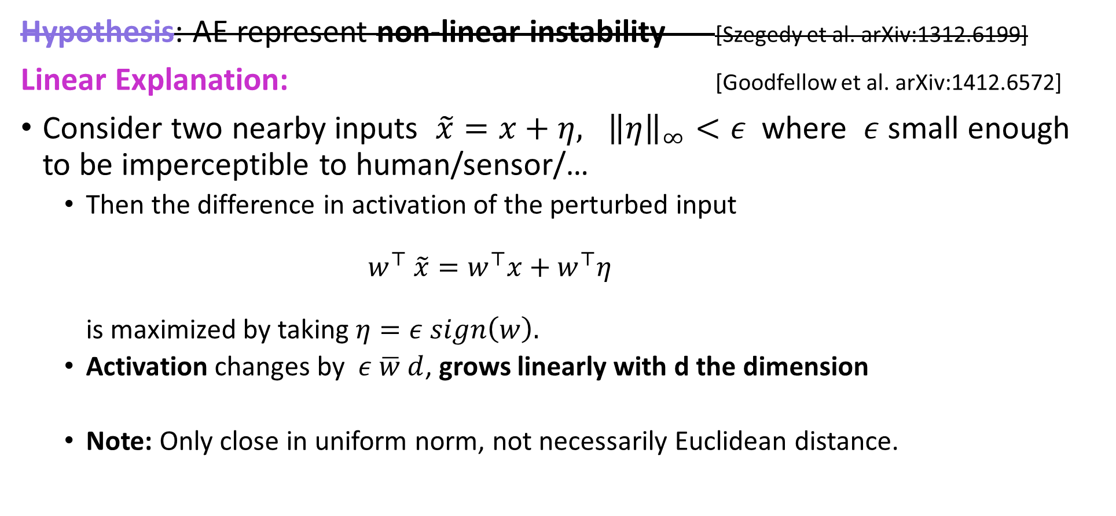
Ruling out some hypotheses
Hypothesis: AE represent non-linear instability [Szegedy et al. arXiv:1312.6199]
Linear Explanation: [Goodfellow et al. arXiv:1412.6572]
Consider two nearby inputs $\tilde{x}=x+η, {\left\|η\right\|}_{∞}<ε$ where $ε$ small enough to be imperceptible to human/sensor/…
Then the difference in activation of the perturbed input $w^{⊤} \tilde{x}=w^{⊤}x+w^{⊤}η$ is maximized by taking $η=ε sign\left(w\right).$
Activation changes by $ε \overline{w} d$, grows linearly with d the dimension
Note: Only close in uniform norm, not necessarily Euclidean distance.

Slide 8
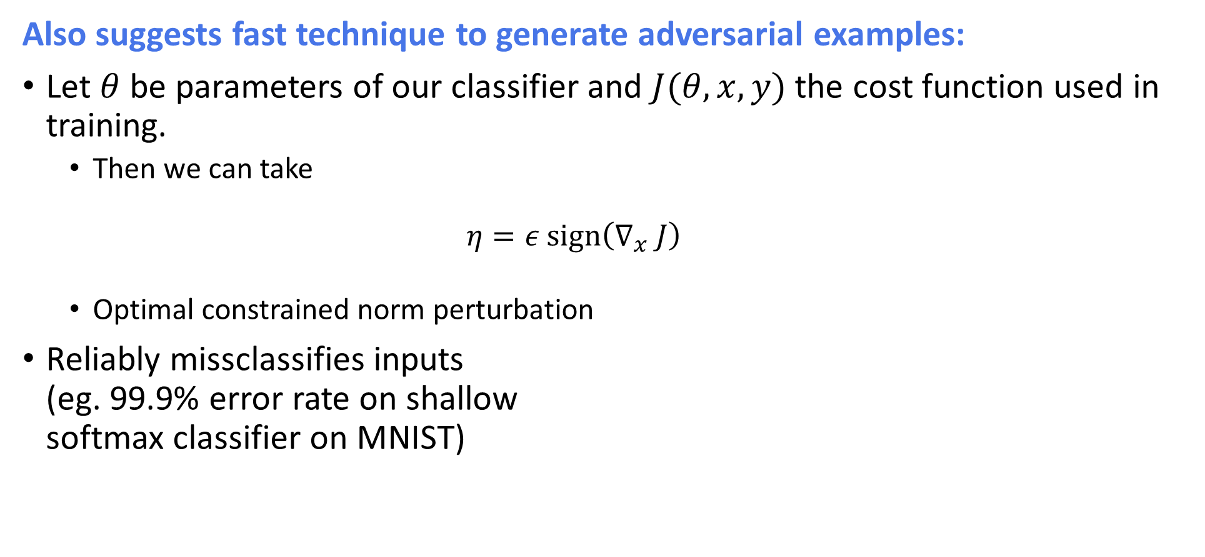
Linear adversarial perturbations
Also suggests fast technique to generate adversarial examples:
Let $θ$ be parameters of our classifier and $J(θ,x,y)$ the cost function used in training.
Then we can take $η=ε sign\left(∇_{x} J\right)$
Optimal constrained norm perturbation
Reliably missclassifies inputs (eg. 99.9% error rate on shallow softmax classifier on MNIST)

Slide 9
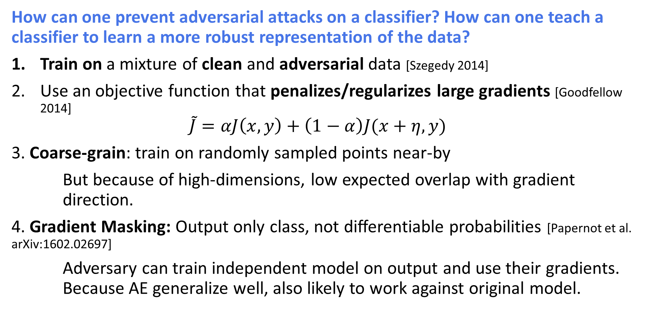
Training for adversarial combat
How can one prevent adversarial attacks on a classifier? How can one teach a classifier to learn a more robust representation of the data?
Train on a mixture of clean and adversarial data [Szegedy 2014]
Use an objective function that penalizes/regularizes large gradients [Goodfellow 2014] $\tilde{J}=αJ\left(x,y\right)+\left(1−α\right)J(x+η,y)$
3. Coarse-grain: train on randomly sampled points near-by
But because of high-dimensions, low expected overlap with gradient direction.
4. Gradient Masking: Output only class, not differentiable probabilities [Papernot et al. arXiv:1602.02697]
Adversary can train independent model on output and use their gradients. Because AE generalize well, also likely to work against original model.

Slide 10
Training for adversarial combat
In general, all such attempts suffer from similar problems:
Protect against some subset of attacks, but not others
Protect against certain size perturbation, but no larger
Require a more general explanation for why AE appear if one wants to remove them.

Slide 11
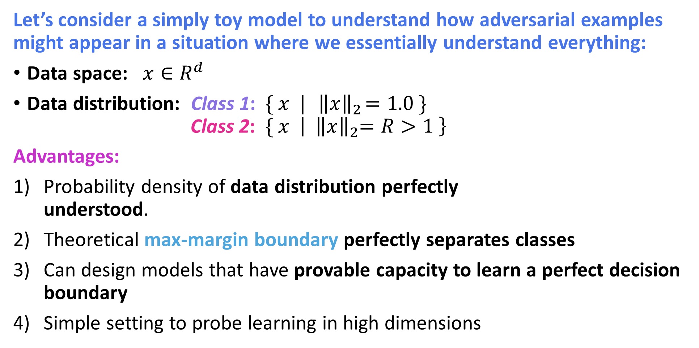
A Toy Model: Adversarial Spheres [Gilmer at al. 1801.02774]
Let’s consider a simply toy model to understand how adversarial examples might appear in a situation where we essentially understand everything:
Data space: $x∈R^{d}$
Data distribution: Class 1: $\{ x | { \left\|x\right\|}_{2}=1.0 \}$ Class 2: $\{ x \left| { \left\|x\right\|}_{2}=R>1 \right\}$
Advantages:
Probability density of data distribution perfectly understood.
Theoretical max-margin boundary perfectly separates classes
Can design models that have provable capacity to learn a perfect decision boundary
Simple setting to probe learning in high dimensions
(R+1)/2
Class 1
Class 2

Slide 12
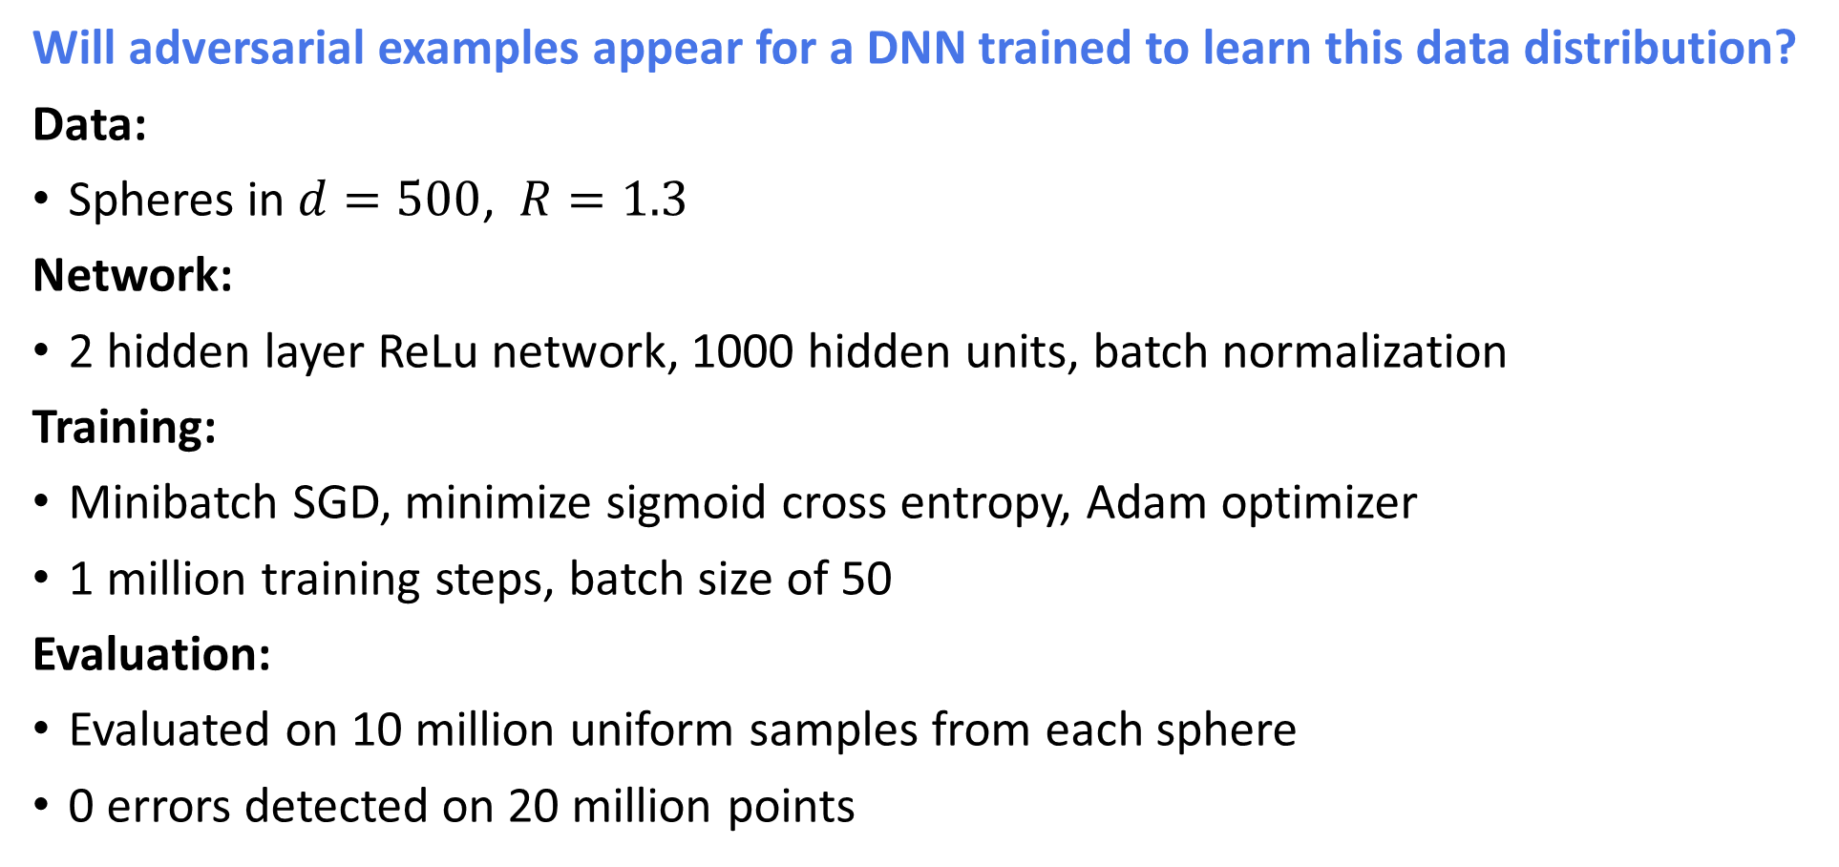
Adv. Spheres and Deep ReLu Network
[Gilmer at al. 1801.02774]
Will adversarial examples appear for a DNN trained to learn this data distribution?
Data:
Spheres in $d=500$, $R=1.3$
Network:
2 hidden layer ReLu network, 1000 hidden units, batch normalization
Training:
Minibatch SGD, minimize sigmoid cross entropy, Adam optimizer
1 million training steps, batch size of 50
Evaluation:
Evaluated on 10 million uniform samples from each sphere
0 errors detected on 20 million points

Slide 13
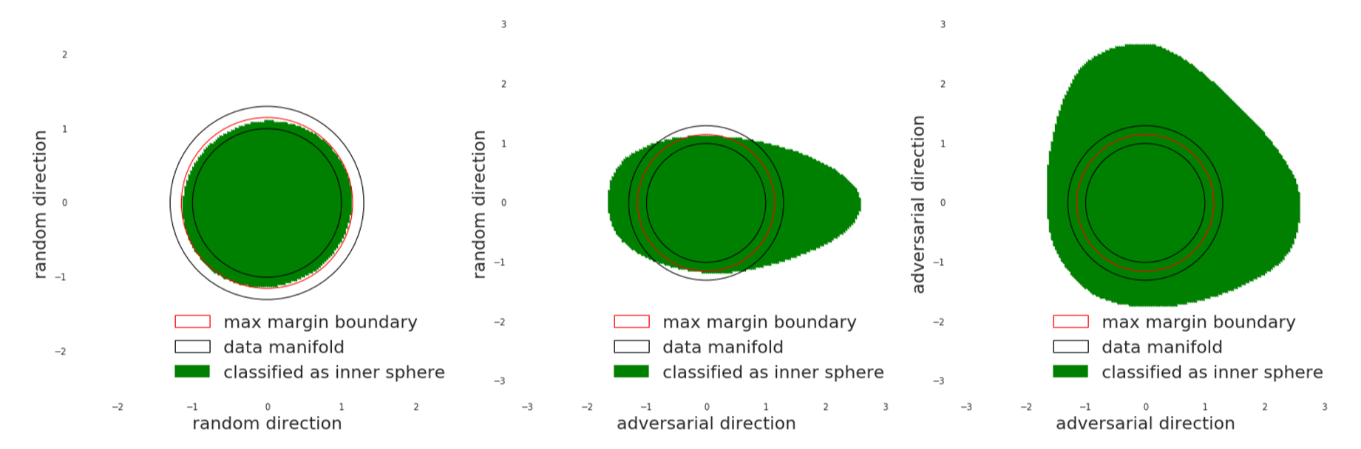
Adv. Spheres and Deep ReLu Network
[Gilmer at al. 1801.02774]
Random projection: model closely follows max margin boundary

Slide 14
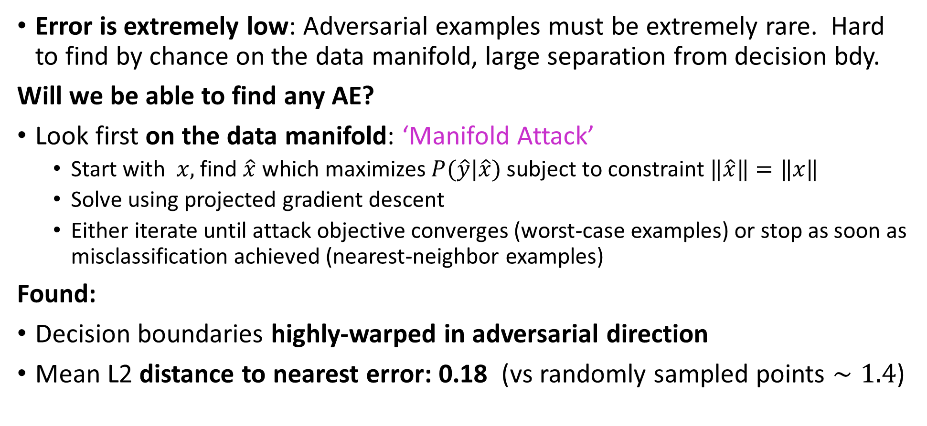
Adv. Spheres and Deep ReLu Network
[Gilmer at al. 1801.02774]
Error is extremely low: Adversarial examples must be extremely rare. Hard to find by chance on the data manifold, large separation from decision bdy.
Will we be able to find any AE?
Look first on the data manifold: ‘Manifold Attack’
Start with $x,$ find $\hat{x}$ which maximizes $P(\hat{y}|\hat{x})$ subject to constraint $‖\hat{x}‖=‖x‖$
Solve using projected gradient descent
Either iterate until attack objective converges (worst-case examples) or stop as soon as misclassification achieved (nearest-neighbor examples)
Found:
Decision boundaries highly-warped in adversarial direction
Mean L2 distance to nearest error: 0.18 (vs randomly sampled points $∼1.4$)

Slide 15
Adv. Spheres and Deep ReLu Network
[Gilmer at al. 1801.02774]

Slide 16
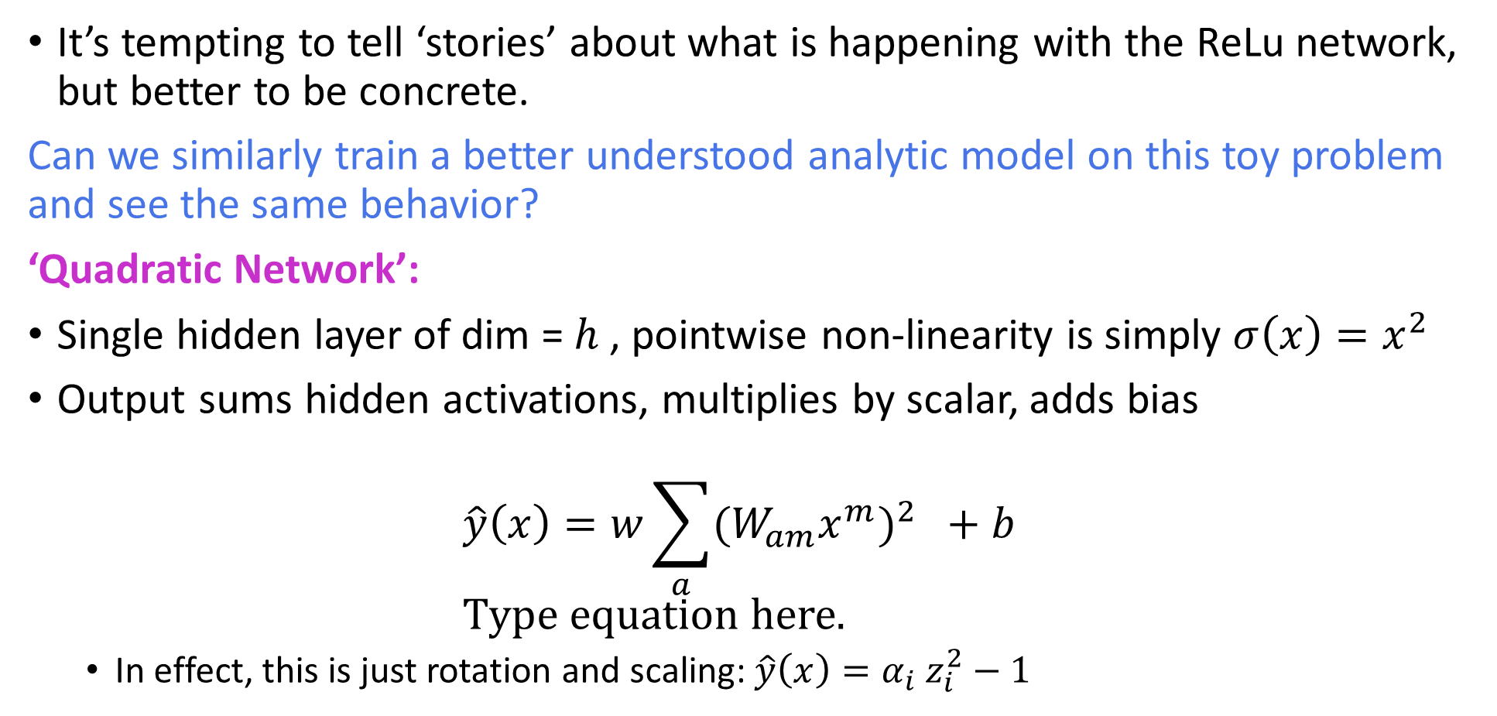
Using analytic models for interpretation
[Gilmer at al. 1801.02774]
It’s tempting to tell ‘stories’ about what is happening with the ReLu network, but better to be concrete.
Can we similarly train a better understood analytic model on this toy problem and see the same behavior?
‘Quadratic Network’:
Single hidden layer of dim = $h$, pointwise non-linearity is simply $σ\left(x\right){=x}^{2}$
Output sums hidden activations, multiplies by scalar, adds bias $\hat{y}\left(x\right)=w\sum_{a}{{{(W}_{am}x^{m})}^{2} }+b$
In effect, this is just rotation and scaling: $\hat{y}\left(x\right)=α_{i} z_{i}^{2}−1$

Slide 17
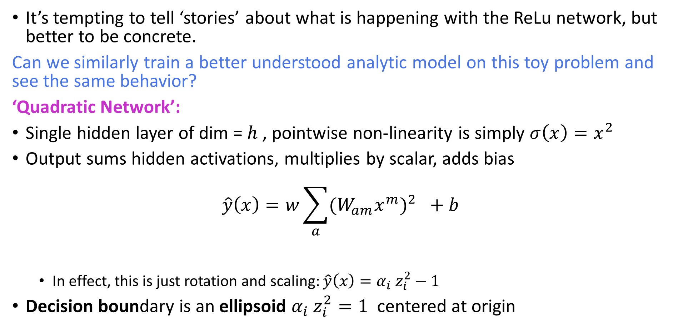
Using analytic models for interpretation
[Gilmer at al. 1801.02774]
It’s tempting to tell ‘stories’ about what is happening with the ReLu network, but better to be concrete.
Can we similarly train a better understood analytic model on this toy problem and see the same behavior?
‘Quadratic Network’:
Single hidden layer of dim = $h$, pointwise non-linearity is simply $σ\left(x\right){=x}^{2}$
Output sums hidden activations, multiplies by scalar, adds bias $\hat{y}\left(x\right)=w\sum_{a}{{{(W}_{am}x^{m})}^{2} }+b$
In effect, this is just rotation and scaling: $\hat{y}\left(x\right)=α_{i} z_{i}^{2}−1$
Decision boundary is an ellipsoid $α_{i} z_{i}^{2}=1$ centered at origin

Slide 18
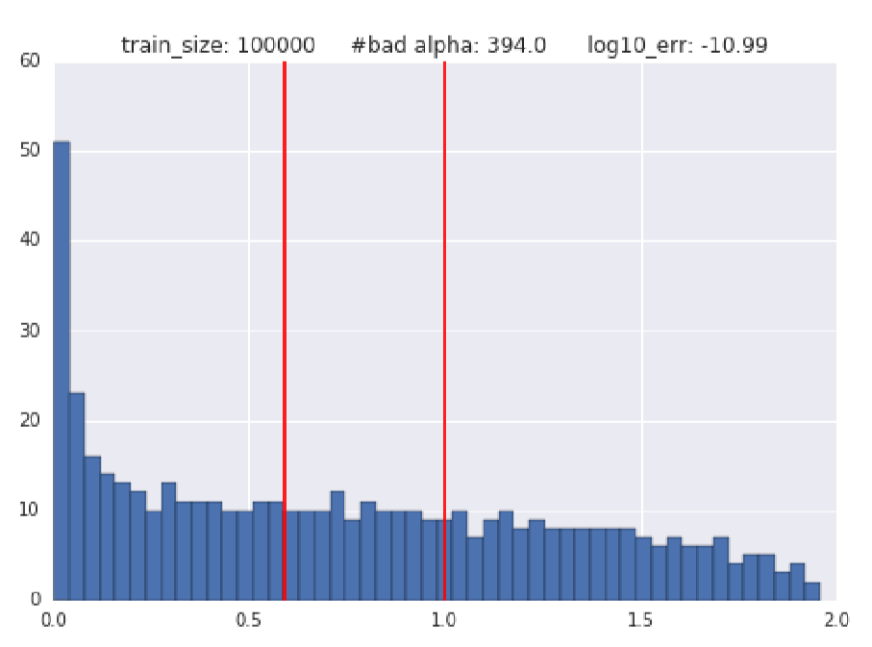
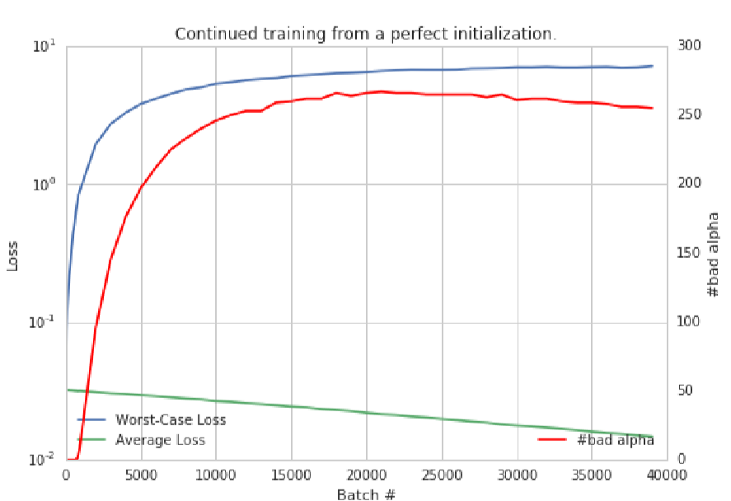
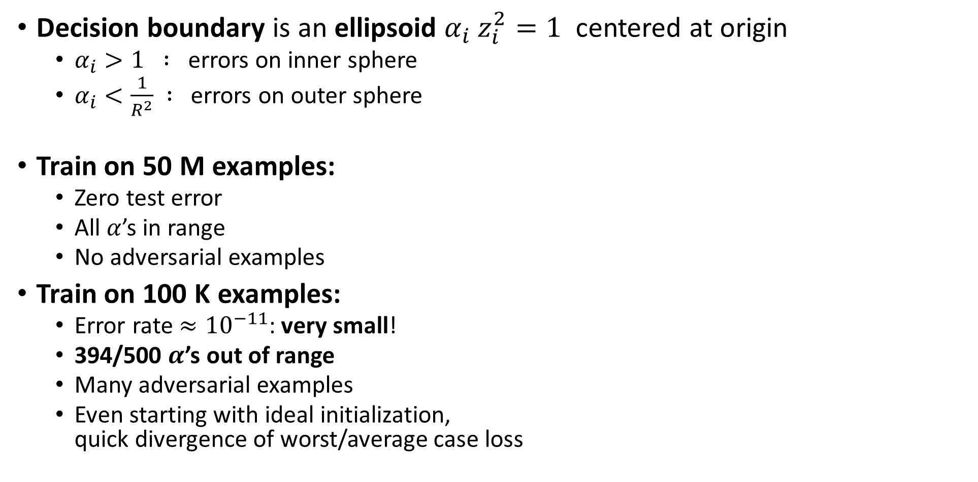
Using analytic models for interpretation
Decision boundary is an ellipsoid $α_{i} z_{i}^{2}=1$ centered at origin
$α_{i}>1 :$ errors on inner sphere
$α_{i}<\frac{1}{R^{2}} :$ errors on outer sphere
Train on 50 M examples:
Zero test error
All $α$’s in range
No adversarial examples
Train on 100 K examples:
Error rate $≈{10}^{−11}$: very small!
394/500 $α$’s out of range
Many adversarial examples
Even starting with ideal initialization, quick divergence of worst/average case loss

Slide 19
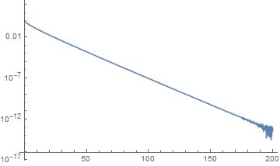
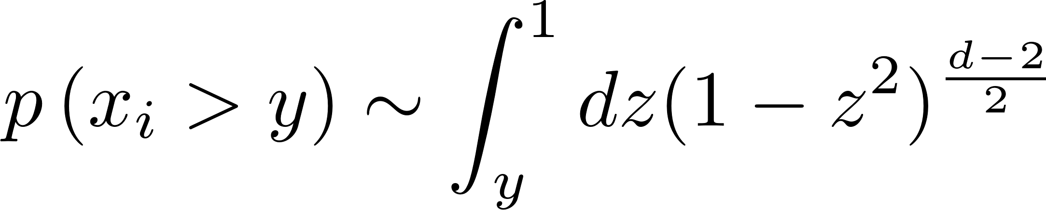
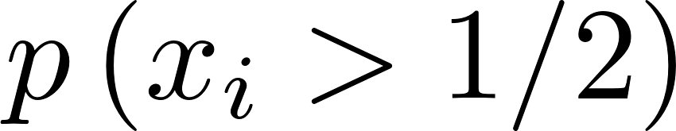

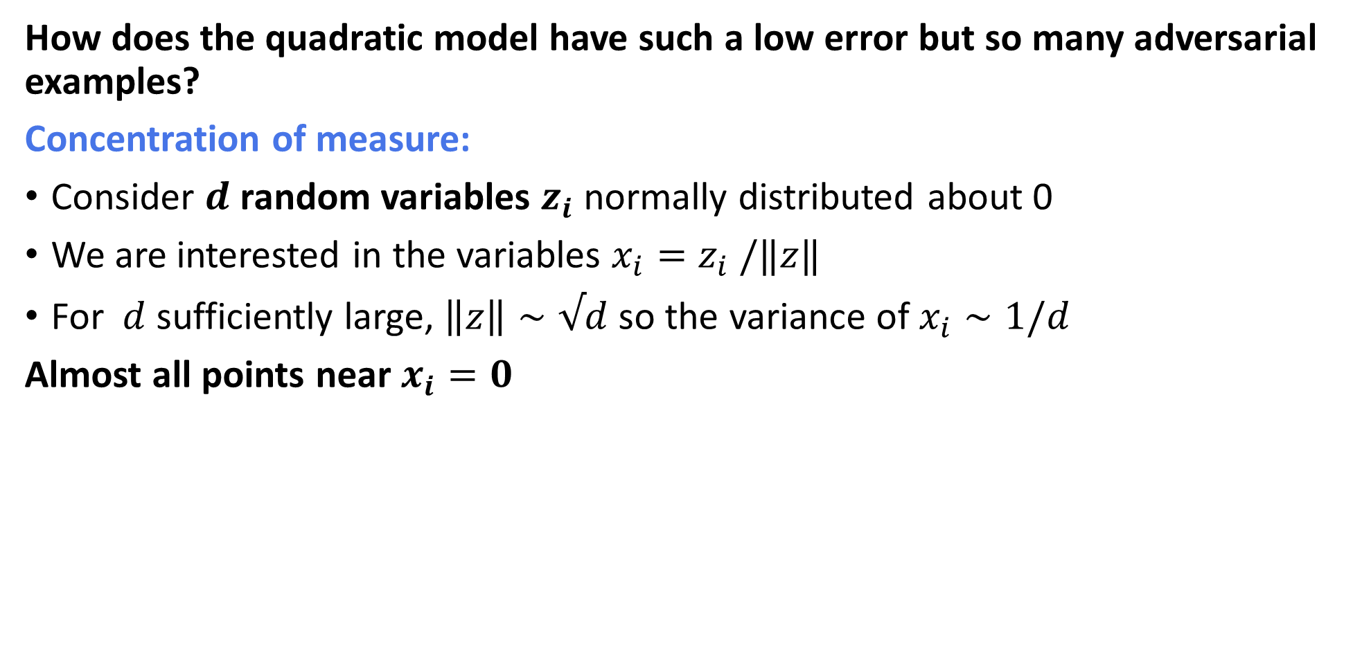

Large dimensions and learning
How does the quadratic model have such a low error but so many adversarial examples?
Concentration of measure:
Consider $d$ random variables $z_{i}$ normally distributed about 0
We are interested in the variables $x_{i}=z_{i} /‖z‖$
For $d$ sufficiently large, $\left\|z\right\|∼√d$ so the variance of $x_{i}∼1/d$
Almost all points near$x_{i}=0$
1
0
-1
$$d$$

Slide 20
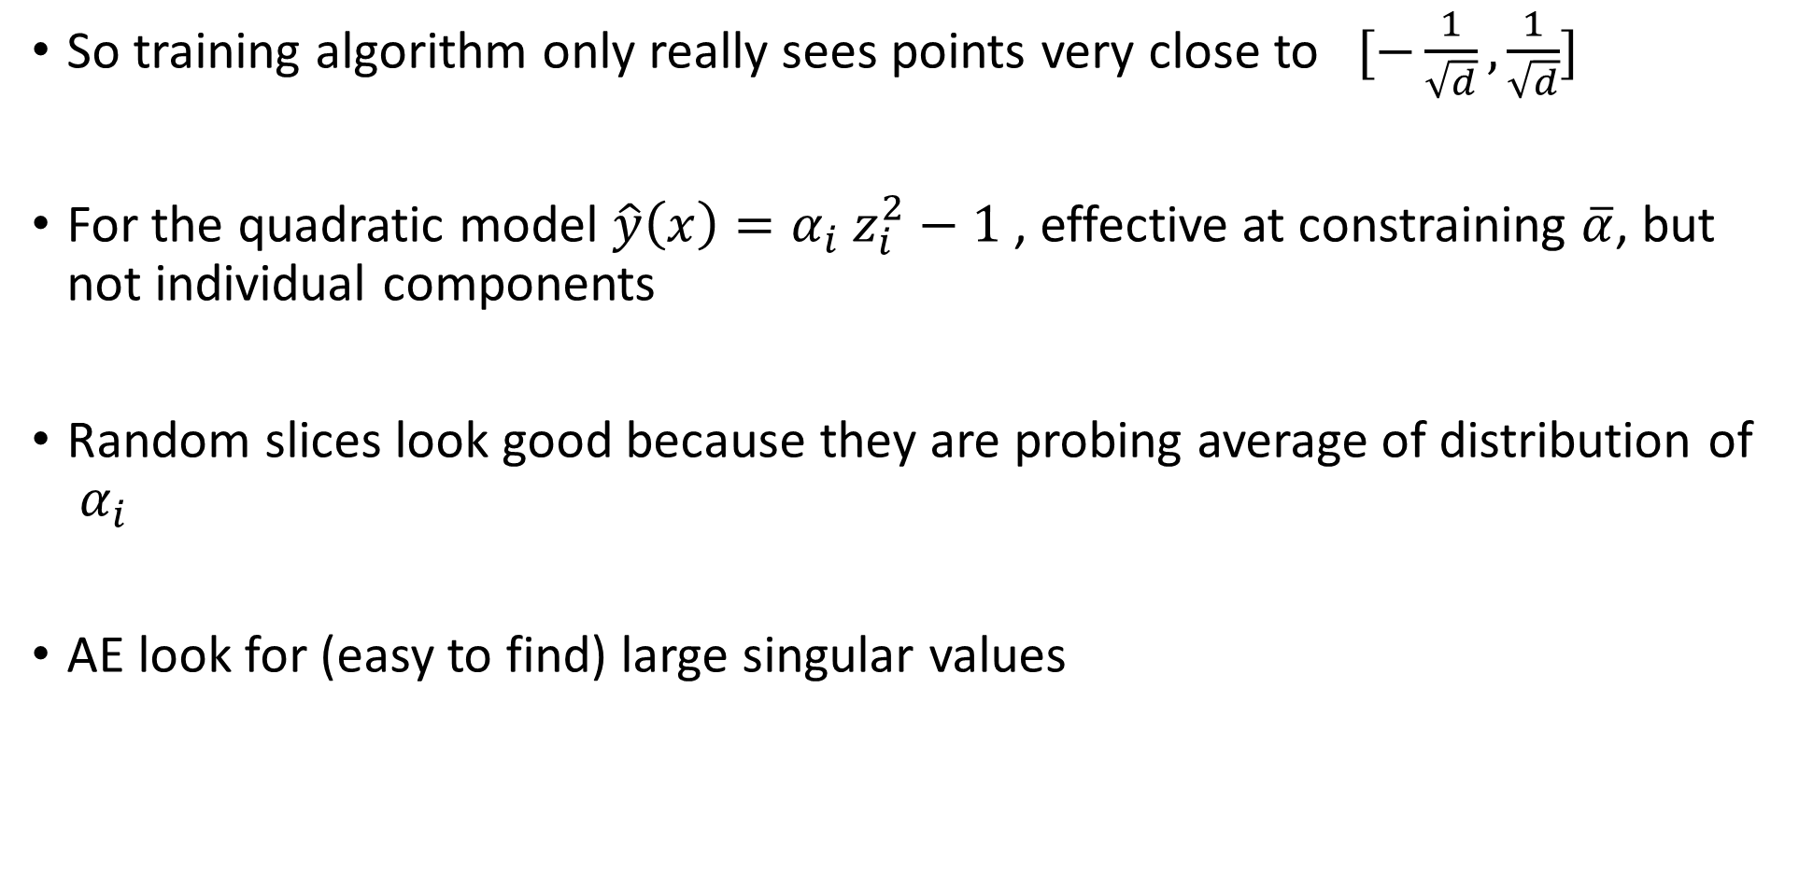
Large dimensions and learning
So training algorithm only really sees points very close to $[−\frac{1}{\sqrt{d}}, \frac{1}{\sqrt{d}}]$
For the quadratic model $\hat{y}\left(x\right)=α_{i} z_{i}^{2}−1$, effective at constraining $\overline{α}$, but not individual components
Random slices look good because they are probing average of distribution of $α_{i}$
AE look for (easy to find) large singular values

Slide 21


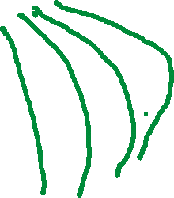


Large dimensions and learning
For ReLu network, likewise, can imagine a one-parameter family of changes to network:
Will also be very hard to train not to miss regions of data manifold because they are low probability
$$θ_{4}$$
$$θ_{3}$$
$$θ_{1}$$
$$θ_{2}$$

Slide 22
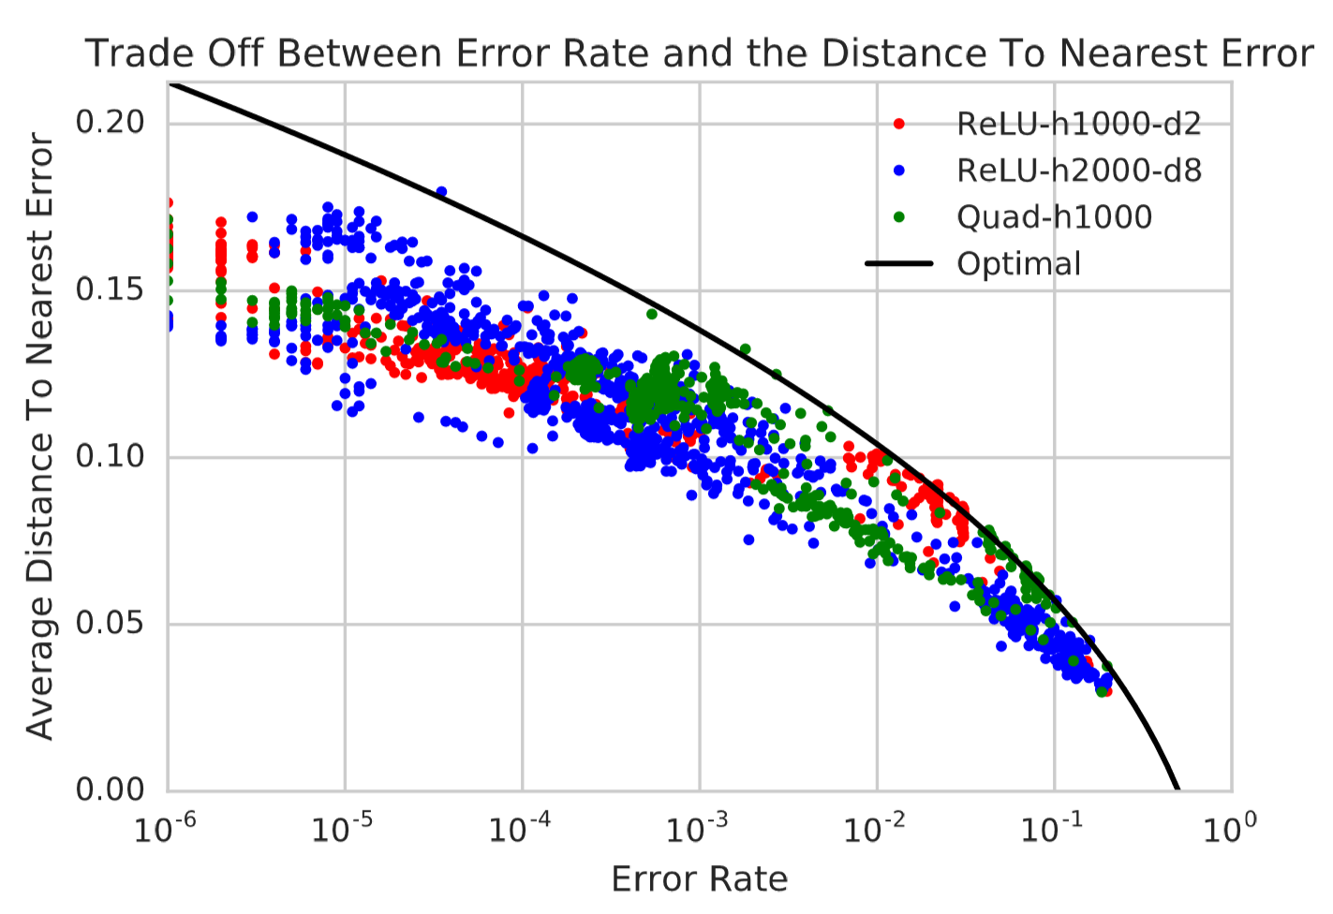












Adversarial examples are near-by
Can easily upper-bound distance to errors:
Put as far away as possible by concentrating all at poles:
$$∫dμ\left(E\right)=p$$
$$d\left(E\right)$$
$$d\left(E\right)∼Φ^{−1}(p)/√d$$

Slide 23
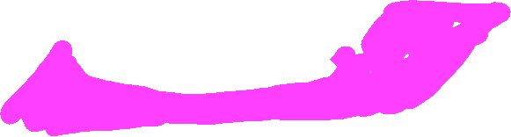



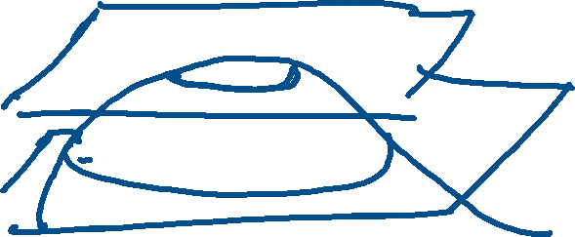
Geometry of the data manifold
How well does this ‘geometric’ picture generalize beyond the simple toy model?
Depends on dimensionality: No concentration of measure if data manifold is low-dimension subspace.
Depends on curvature: But still rather generic feature of smooth manifolds
$$S^{d−3}$$

Slide 24
Lessons from toy model
What have we learned?
Models can perform extremely well on average by learning about the data distribution on average
Projections of data seen by particular family of parameters can quite generically have large regions of low probability
Nevertheless, AE can be close by

Slide 25
Lessons from toy model
What doesn’t this model explain?
Generalization: the direction of AE are random in this toy model. Different training sets will have different adversarial directions
In real world, adversarial directions generalize between training sets and hyperparameters
Do real world data sets have low-probability regions that are under-sampled by any training set?
Are real world AE ‘off the data manifold’ and have spurious correlations that confuse all models?

Slide 28
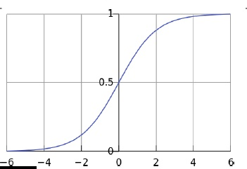
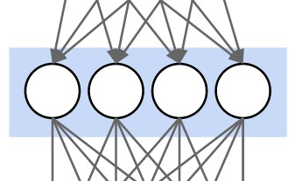
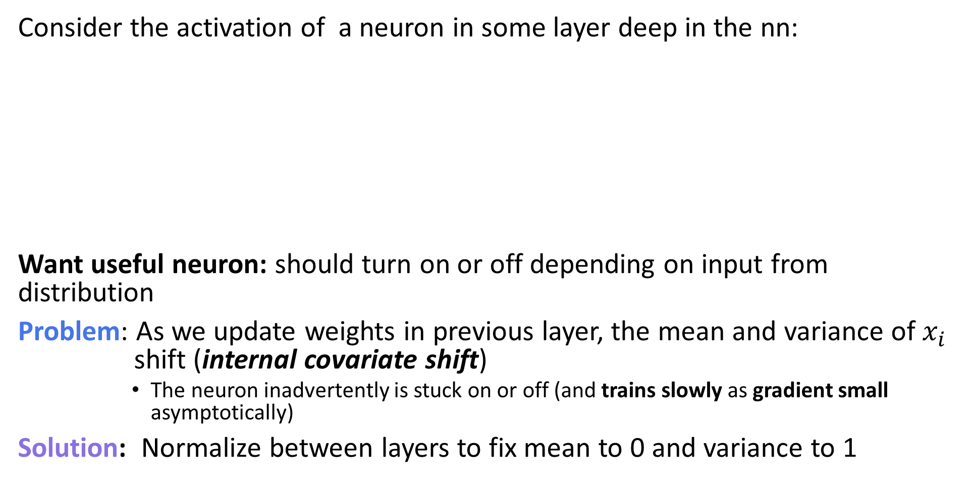


Batch normalization
Consider the activation of a neuron in some layer deep in the nn:
Want useful neuron: should turn on or off depending on input from distribution
Problem: As we update weights in previous layer, the mean and variance of $x_{i}$ shift (internal covariate shift)
The neuron inadvertently is stuck on or off (and trains slowly as gradient small asymptotically)
Solution: Normalize between layers to fix mean to 0 and variance to 1
$$x_{i}$$
$$y_{i}$$

Slide 29
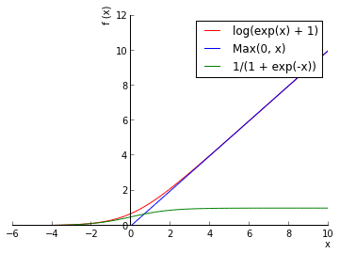
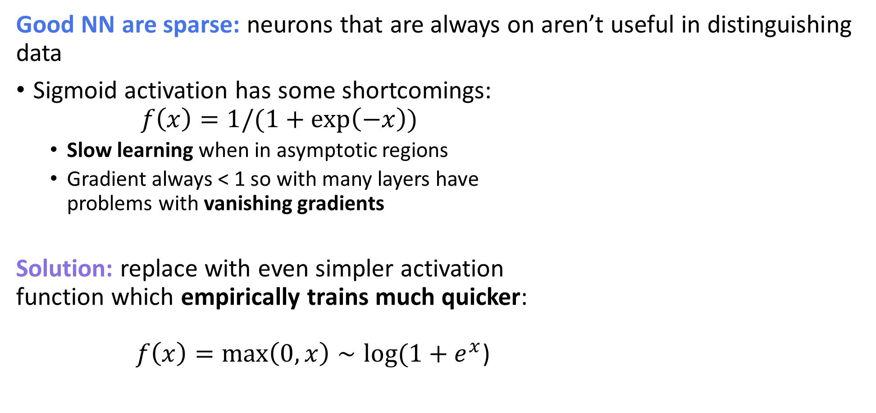
Rectifier nonlinearities
Good NN are sparse: neurons that are always on aren’t useful in distinguishing data
Sigmoid activation has some shortcomings: $f\left(x\right)=1/(1+\exp\left(−x\right))$
Slow learning when in asymptotic regions
Gradient always < 1 so with many layers have problems with vanishing gradients
Solution: replace with even simpler activation function which empirically trains much quicker: $f\left(x\right)=\max\left(0,x\right)∼log⁡(1+e^{x}$)

