Slide 1

SESSION-11:
SERVERLESS

Slide 2
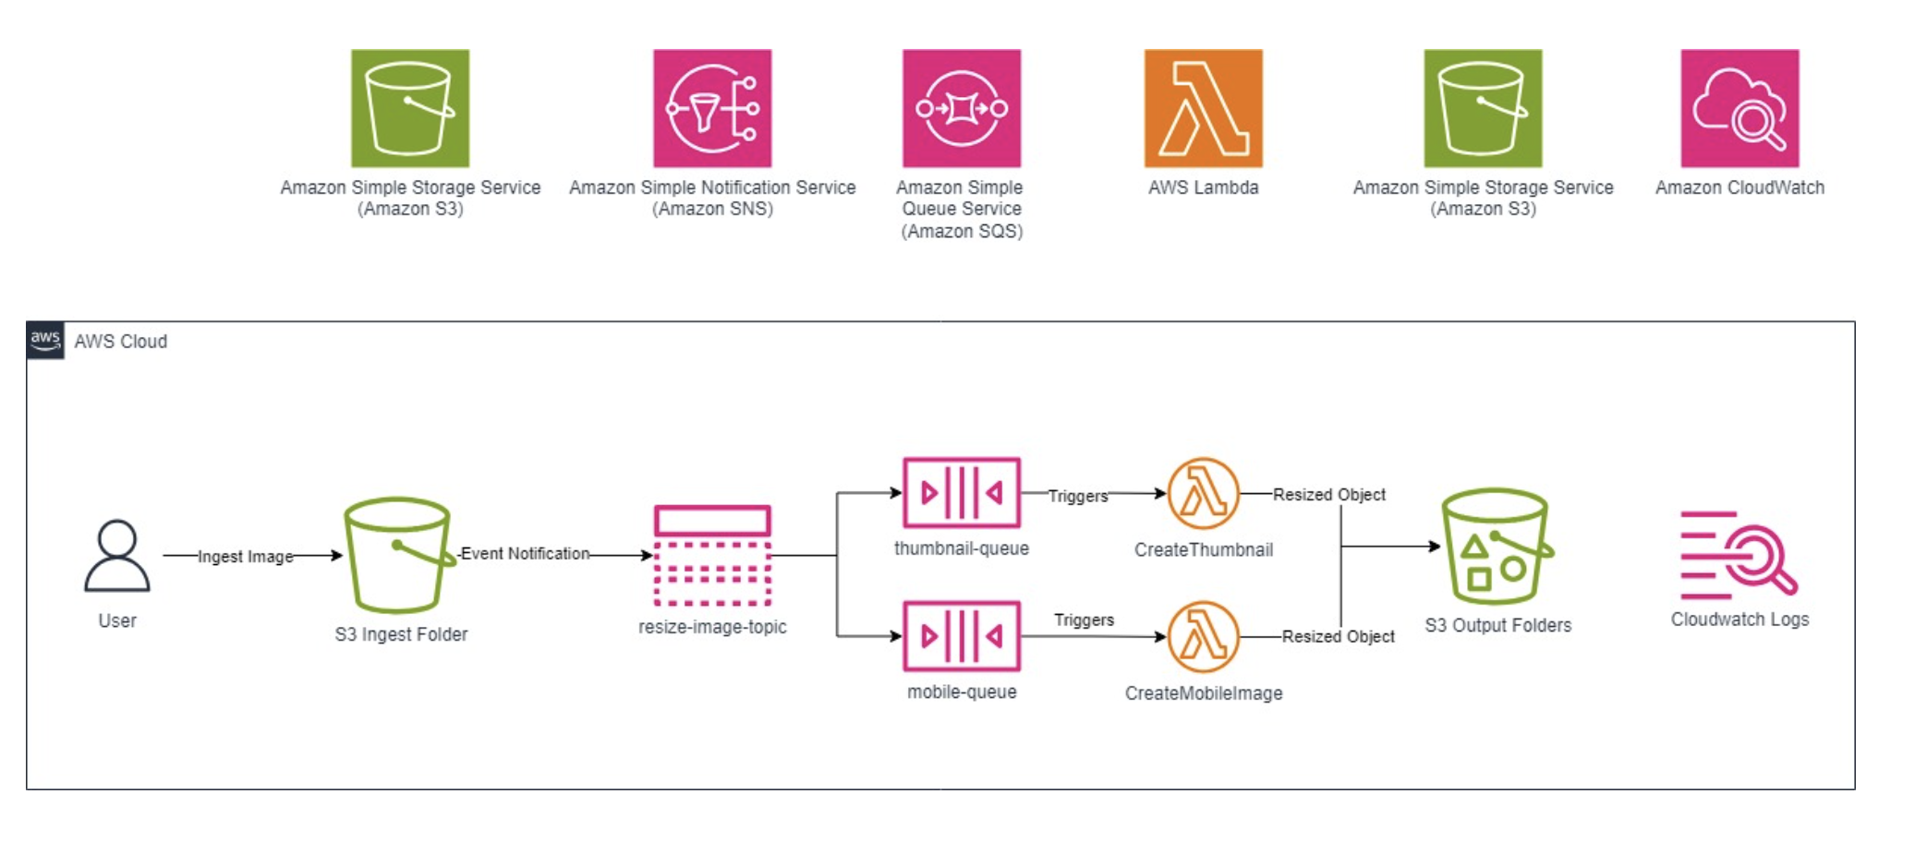
Advantages of Serverless
No infrastructure to provision or manage
Scales automatically by unit of consumption
Consumption-based pricing
Built-in security, highly available compute

Slide 3
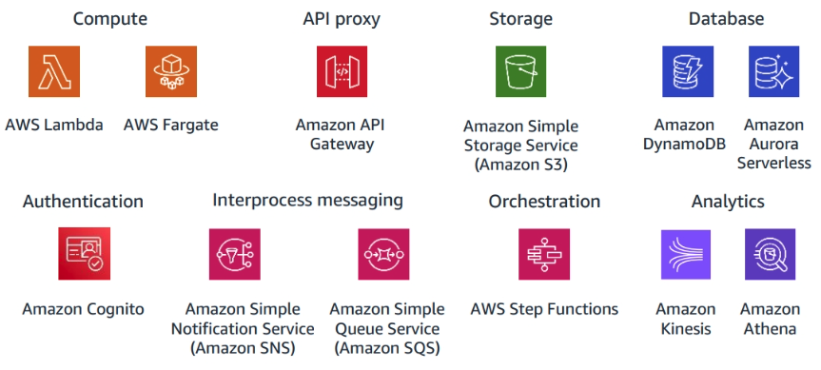
AWS Serverless Services

Slide 4
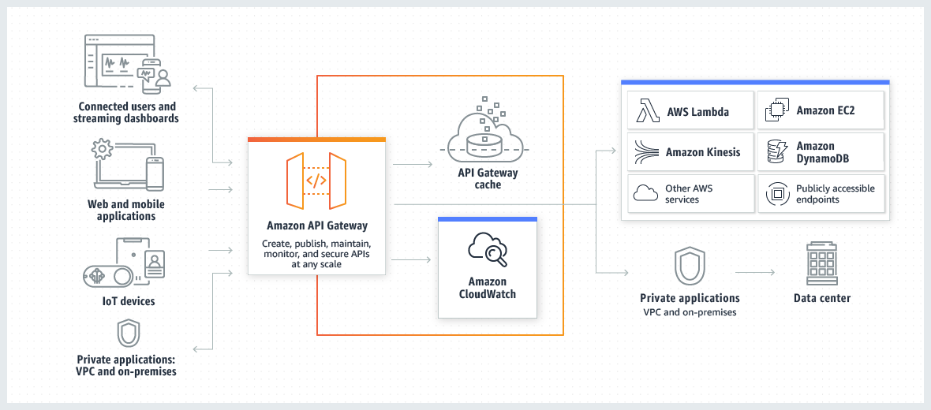
Amazon API Gateway
Create an entry point for your applications.
Process thousands of concurrent API calls.
Choose internet-facing or internal only.

Slide 5
Amazon API Gateway - Features
Creates a unified API frontend for multiple microservices.
Provides distributed denial-of-service (DDoS) protection and throttling for your backend.
Authenticates and authorizes requests to a backend
Throttles, meters, and monetizes API usage by third-party developers.

Slide 6
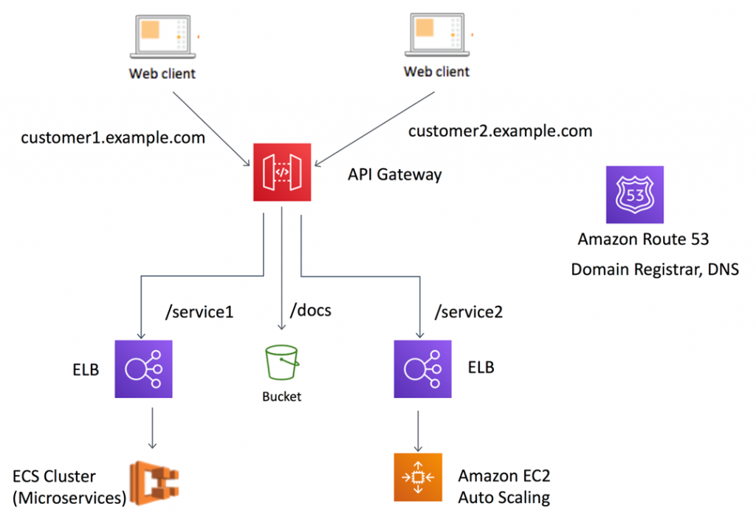
Amazon API Gateway - Example

Slide 7
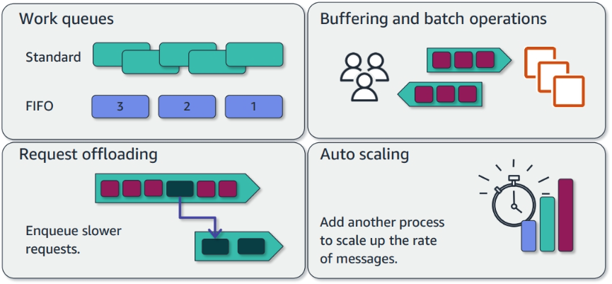
Amazon SQS
Fully managed message queueing service.
Stores messages until they are processed and deleted.
Acts as a buffer between senders and receivers.

Slide 8
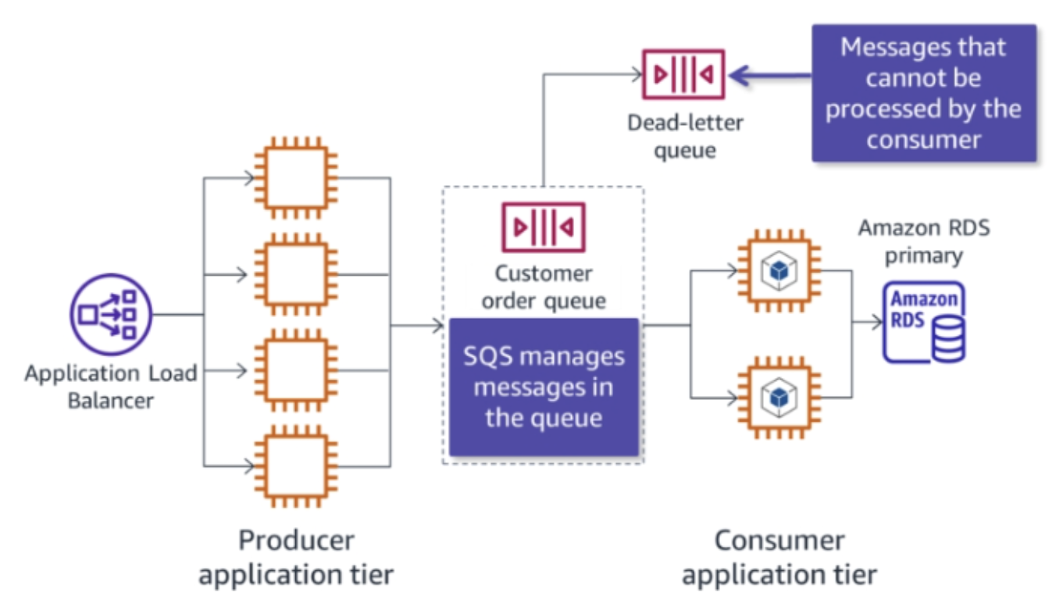
Amazon SQS - Loose Coupling
Loosely couples application components.
Uses asynchronous processing.
Creates tolerance for failed steps.
Absorbs demand spikes.

Slide 9
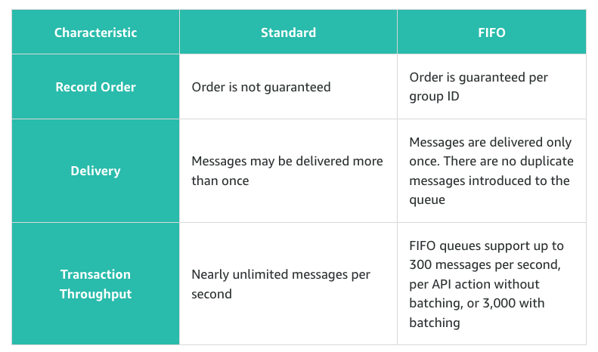
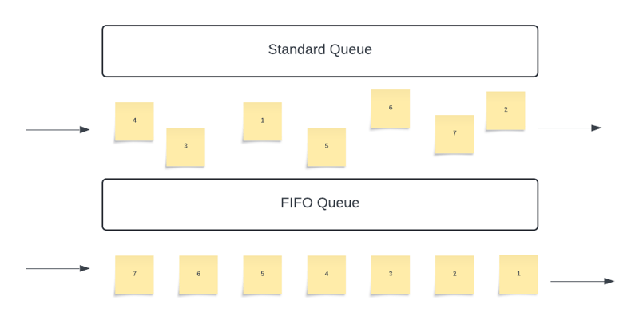
Amazon SQS - Queue Types

Slide 10
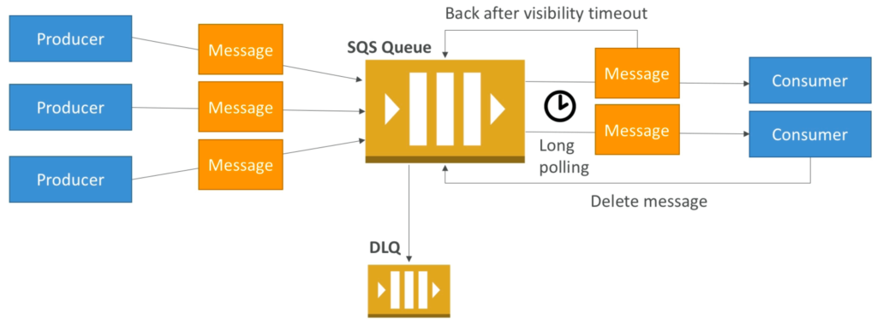
Amazon SQS - Dead Letter Queue and Polling

Slide 11
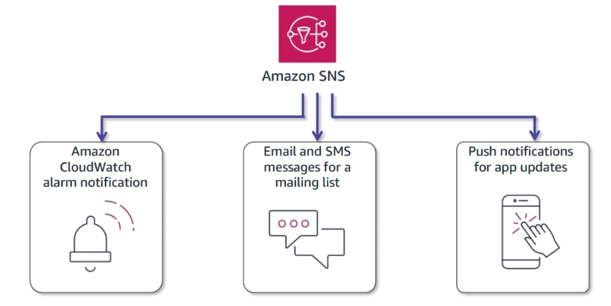
Amazon SNS
Subscriber types: Email, SMS, HTTP(S), AWS Lambda, Amazon SQS, Kinesis Data Firehose
Single published message
No recall options
Standard or FIFO Topics

Slide 12
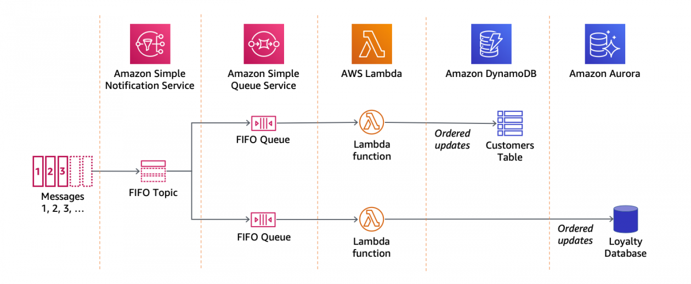
Amazon SNS Publish to Multiple SQS Queues

Slide 13
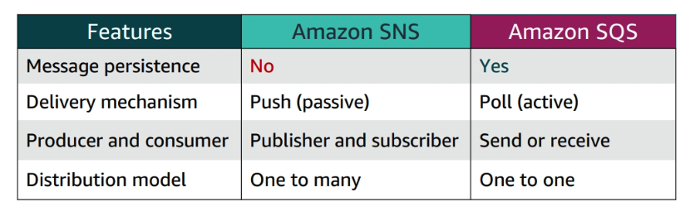
SNS and SQS

Slide 14
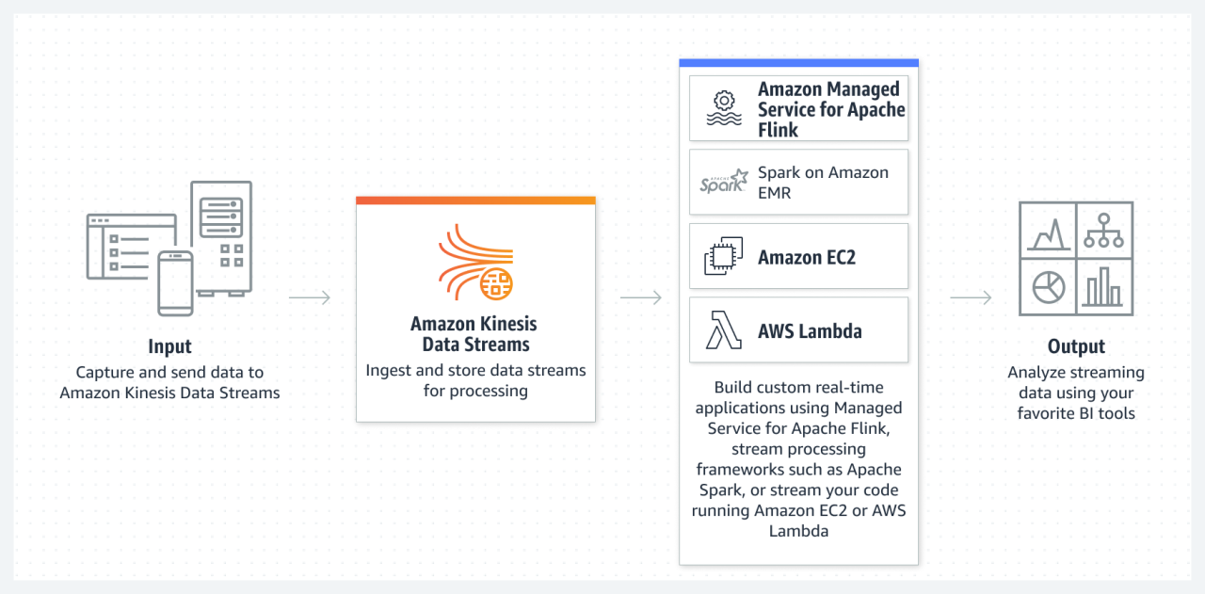
Amazon Kinesis Data Streams

Slide 15
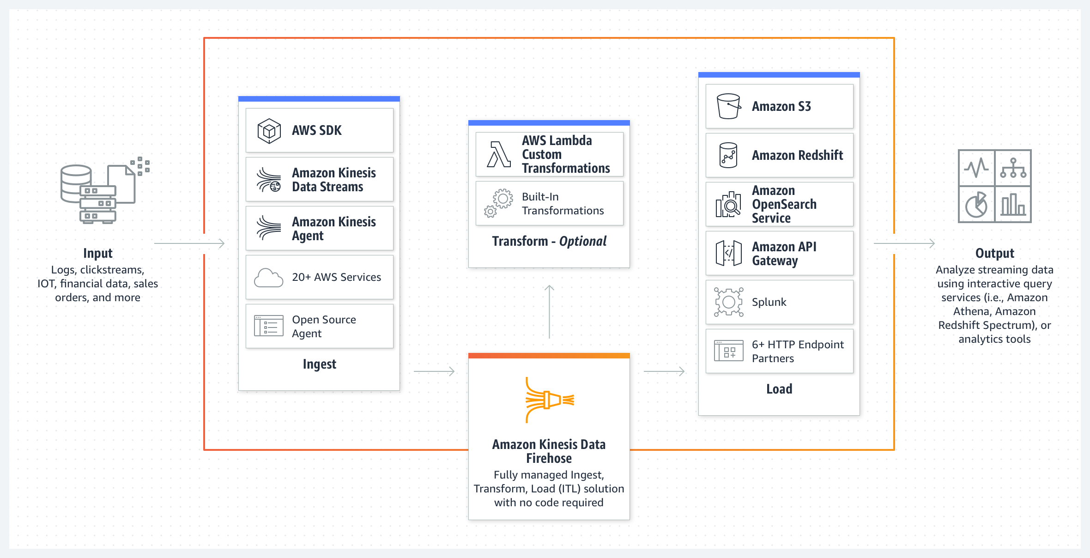
Amazon Kinesis Data Firehose

Slide 16

Amazon Step Functions
Coordinates microservices using visual workflows
Permits you to step through the functions of your application
Automatically initiates and tracks each step
Provides simple error catching and logging if a step fails

Slide 17
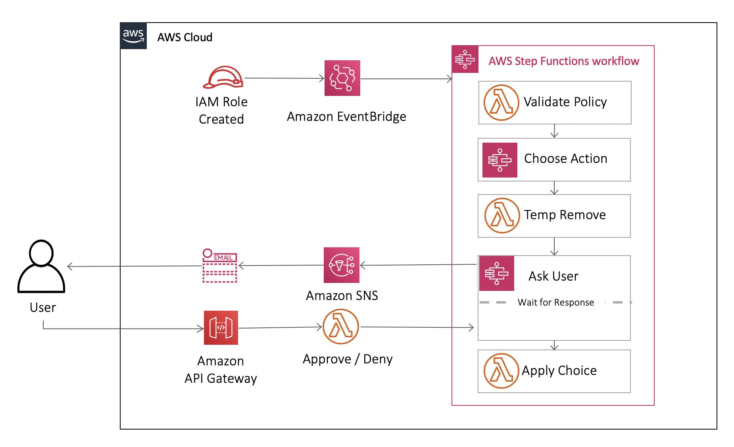
Amazon Step Functions - Sample Architecture
Step Functions supports the following state types: Task, Choice, Fail or Succeed, Pass, Wait, Parallel and Map

Slide 18
THANKS FOR LISTENING

