Slide 1

SESSION-13:
CAPSTONE

Slide 2
SCENARIO
Example Corp. creates marketing campaigns for small-sized to medium-sized businesses. They recently hired you to work with the engineering teams to build out a proof of concept for their business. To date, they have hosted their client-facing application in an on-premises data center, but they recently decided to move their operations to the cloud in an effort to save money and transform their business with a cloud-first approach. Some members of their team have cloud experience and recommended the AWS Cloud services to build their solution.
In addition, they decided to redesign their web portal. Customers use the portal to access their accounts, create marketing plans, and run data analysis on their marketing campaigns. They would like to have a working prototype in two weeks. You must design an architecture to support this application. Your solution must be fast, durable, scalable, and more cost-effective than their existing on-premises infrastructure

Slide 3
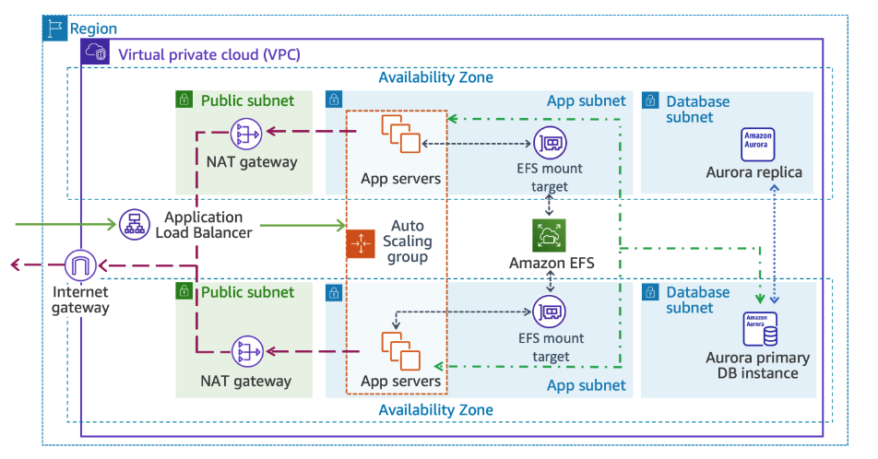
ARCHITECTURE

Slide 4
NOTE
Section 1: High-level instructions provide students with a limited set of high-level instructions, a list of requirements and configurations, and hints.
Section 2: Detailed instructions provide students with step-by-step instructions for each task.
Students are strongly encouraged to attempt the lab only using the high-level instructions.

Slide 5
TASK 1 - SCENARIO
The company wants to deploy a new web application on WordPress on their existing web hosting account. The first step is to gather the requirements for the architecture design. To help you get started, the network team gave you a list of requirements to ensure there are no issues with the existing landscape. This includes the Classless Inter-Domain Routing (CIDR) range for the Amazon Virtual Private Cloud (Amazon VPC). Using this address range, build a VPC with two public subnets, two private application subnets, and two private database subnets. Make sure you attach an internet gateway to the VPC with a NAT gateway for routing traffic. They also requested two Elastic IP addresses. Ensure that you associate the following:
The public subnet with the internet gateway
The private application subnet and private database subnet with the NAT gateway
The network team also provided the route tables needed with their subnet associations.
Your cloud engineer has transferred the information request to a CloudFormation template and set up the security groups and outputs needed for future deployments. Please review the CloudFormation template with your cloud engineer, deploy the template, and check back with the network team to validate that the build meets all of their requirements.

Slide 6
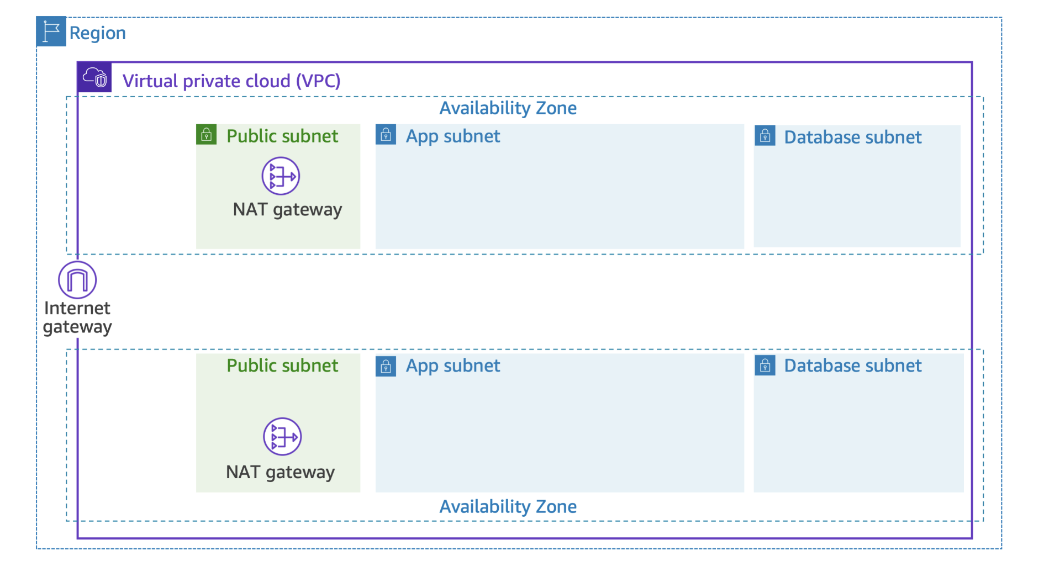
TASK 1 - ARCHITECTURE

Slide 7
TASK 2 - SCENARIO
The network team verified the previous deployment requirements and everything looks good. The next phase of the project is to establish a secure backend database to give the database administrator (DBA) access for any migration operations before go-live.
The current database requires a lot of administrative overhead and the business has agreed to move to a managed database service. They want their architecture to be highly available, so you recommend that they set up a Multi-AZ RDS Aurora database layer. After reviewing the proposed design, the DBA has outlined the database requirements. Because of previous performance issues, the database does not require encryption, and you agree that this is the best choice.
The existing monitoring solution polls data every 10 minutes. The engineering team doesn’t have room in the budget for additional features; therefore, enhanced monitoring is not required.

Slide 8
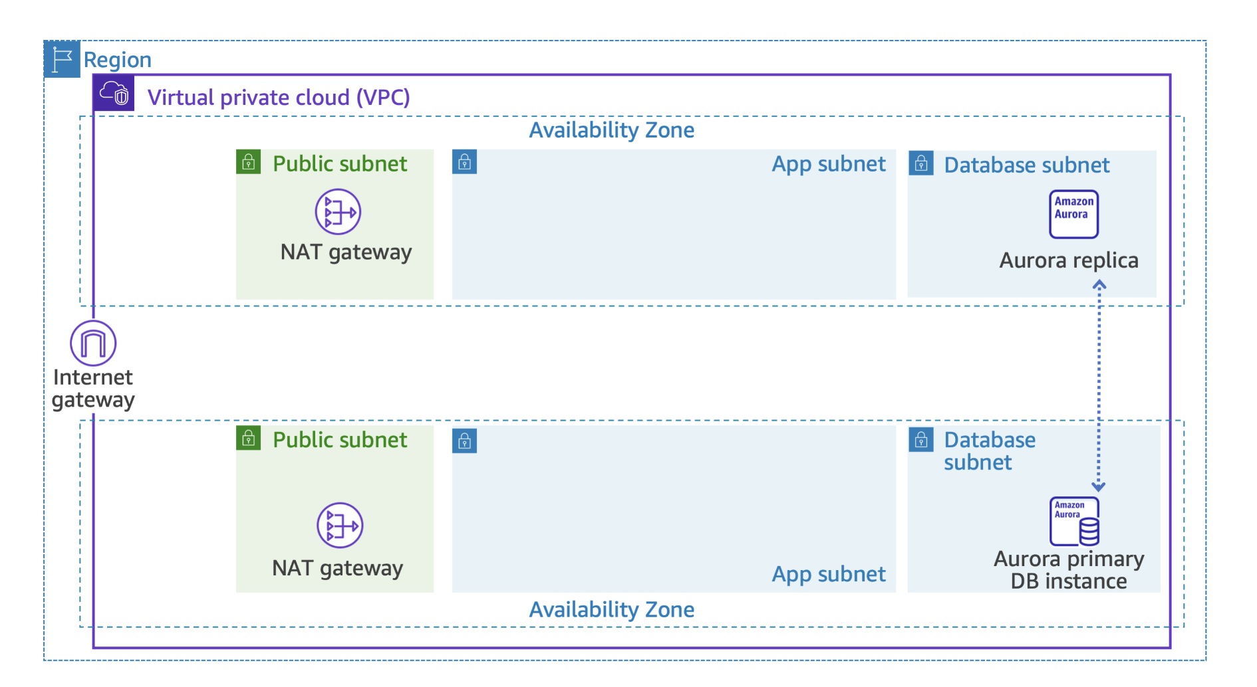
TASK 2 - ARCHITECTURE

Slide 9
TASK 3 - SCENARIO
Example Corp. is having issues with the lead time on ordering new hardware. This is slowing down their ability to onboard new customers and expand the business. The SysOps team has a request for a storage solution built for the cloud. They need to be able to confirm that the backup policies and encryption settings meet their internal and regulatory compliance requirements. Managing time, cost, and compliance gives Example Corp. a competitive advantage.
You recommend Amazon EFS to the business as a simple, serverless, set-and-forget, elastic file system. With Amazon EFS, they can share data securely, without provisioning or managing storage.
Your task is to create an Amazon EFS file system that meets the SysOps team’s requirements.

Slide 10
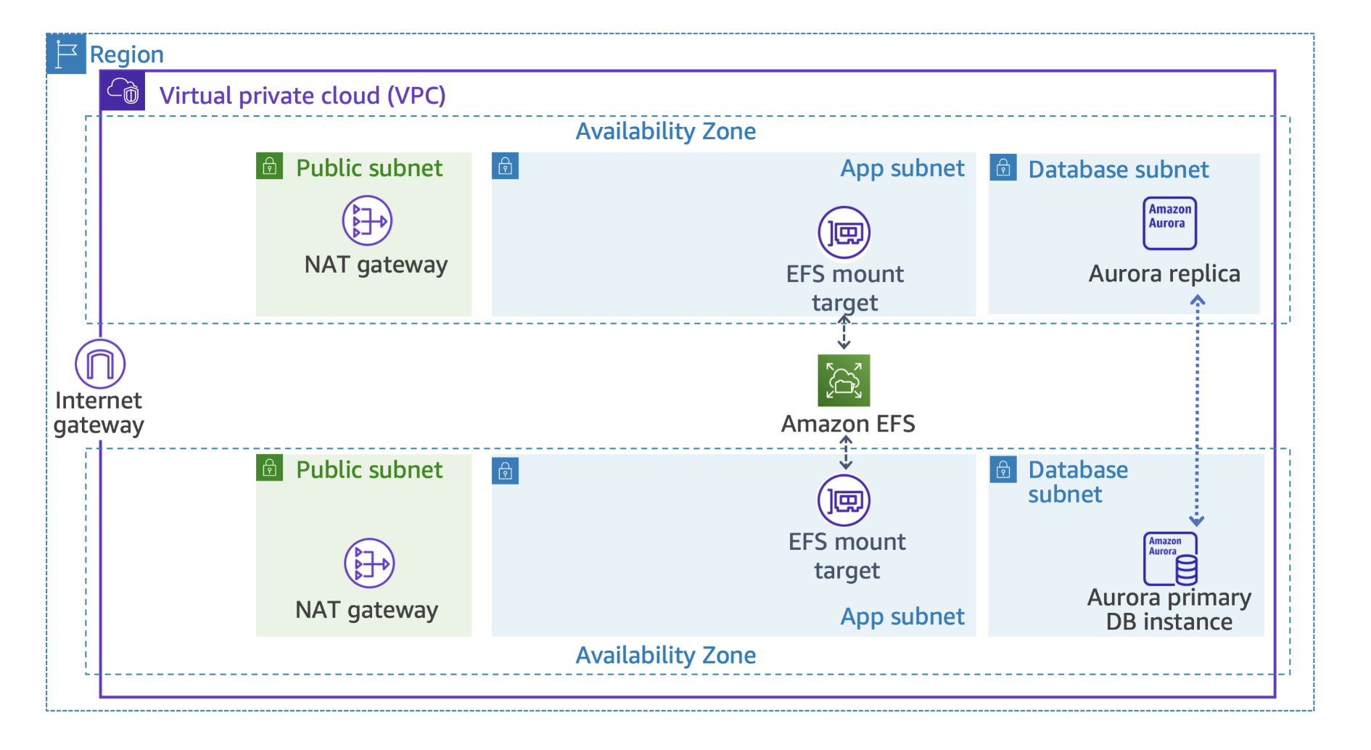
TASK 3 - ARCHITECTURE

Slide 11
TASK 4 - SCENARIO
The SysOps team is excited about the new Amazon EFS configuration and eager to address their next pain point. The current application experiences frequent outages because of variable, unexpected traffic loads. The SysOps team wants to know if AWS has a service to address this issue that can be used at the application layer (Layer 7). On further investigation, you recognize the need for an Application Load Balancer for the application servers in the private subnet. Your task is to deploy and configure an Application Load Balancer with a health check, and register the required targets.

Slide 12
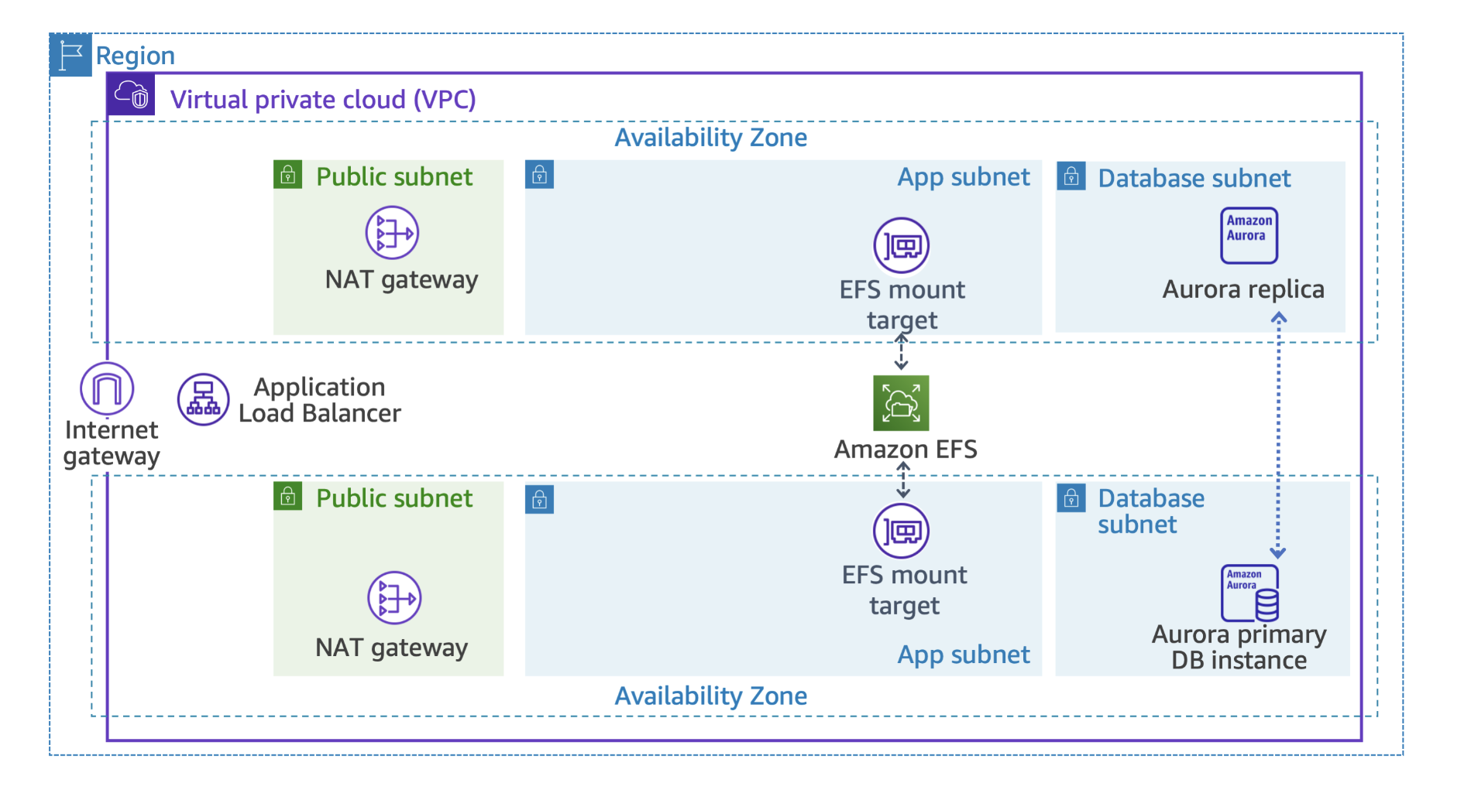
TASK 4 - ARCHITECTURE

Slide 13
TASK 5 - SCENARIO
Up to this point, you created the underlying network resources, the database, an Amazon EFS file system, and an Application Load Balancer. It’s time to put it all together. Example Corp. already has a WordPress account, so the cloud engineer uses the settings and configuration from their existing environment to create a CloudFormation template. This includes all of the new resources you provisioned to set up a launch template.
Review the CloudFormation template and create all of the necessary resources. Pay special attention to the user data script. Check for any errors in the deployment and address those, if needed. After that is completed, you can create the application servers to support traffic to the new environment.

Slide 14
TASK 6 - SCENARIO
Now that your template has been deployed, it’s time to create the application servers and auto scaling mechanism. In the previous task, you chose to implement auto scaling for the app servers to meet the scaling requirements of the project plan.
Create an Auto Scaling group and scaling policy. Verify that the instance status is healthy, and test the load balancer availability. Hand the environment over to the engineering teams to validate full functionality when the unit test is complete, and ask them for feedback.
When the team is satisfied, ask them to migrate the WordPress site to the AWS environment and test the app functionality. A common practice is to introduce examples of failure. If the app is working as intended, you would introduce some examples of failure, for example, delete an app server or roll back the database to a recent backup. This step is not a part of this lab.

Slide 15
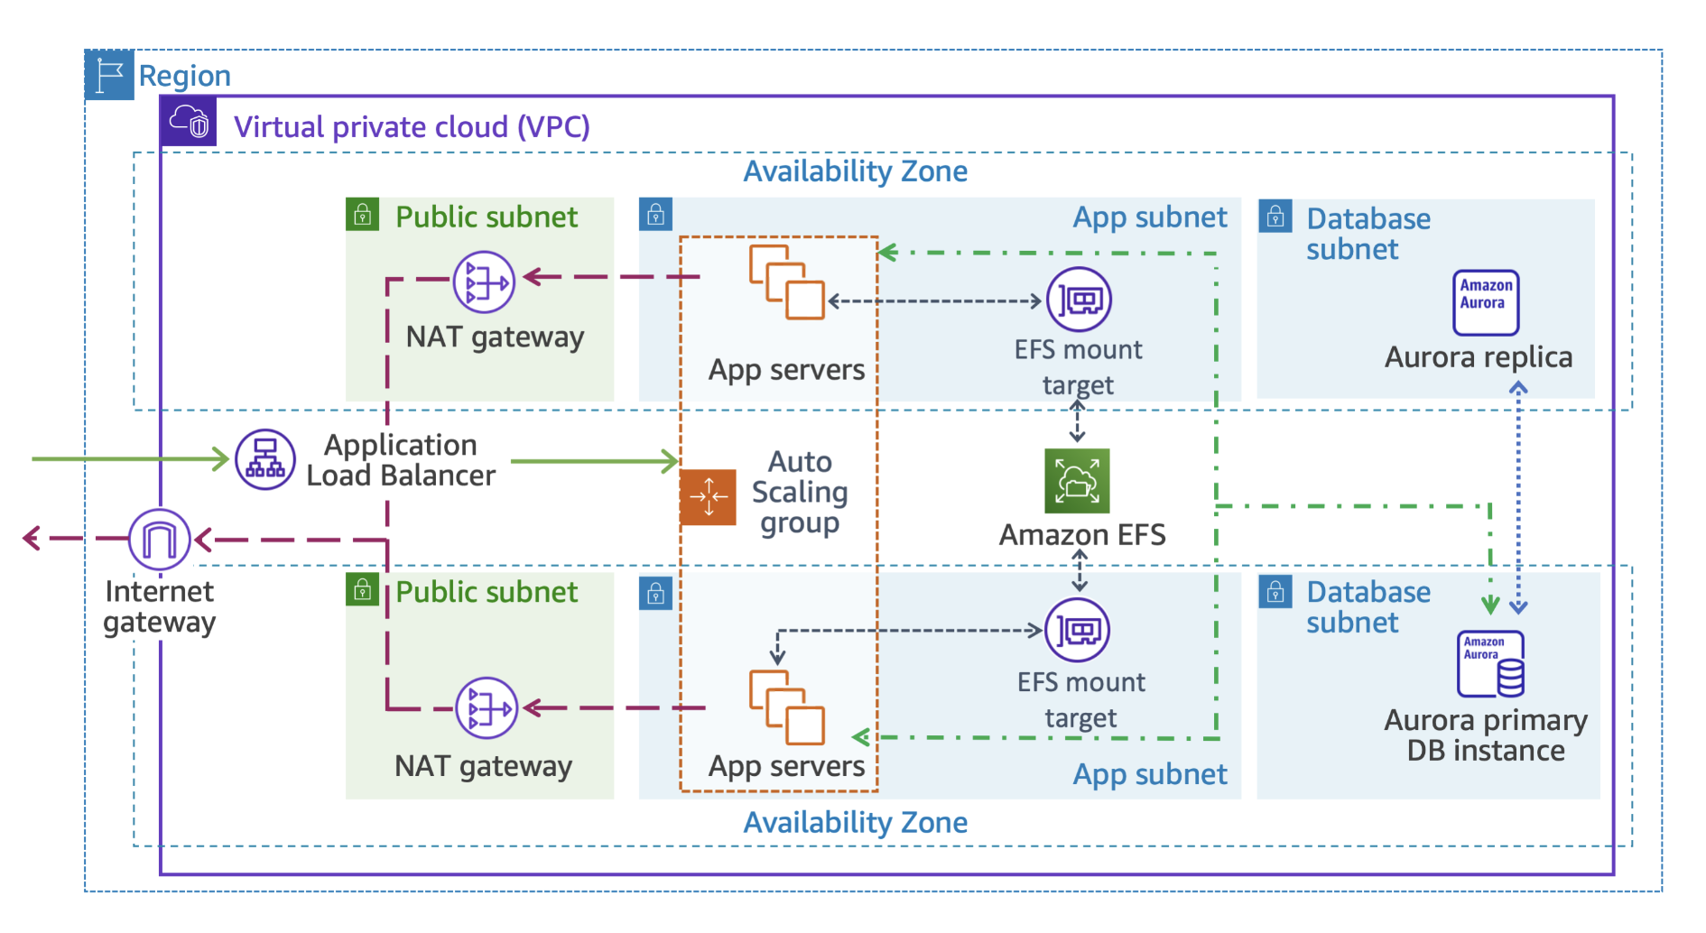
TASK 6 - ARCHITECTURE

Slide 16
THANKS FOR LISTENING

