Slide 1
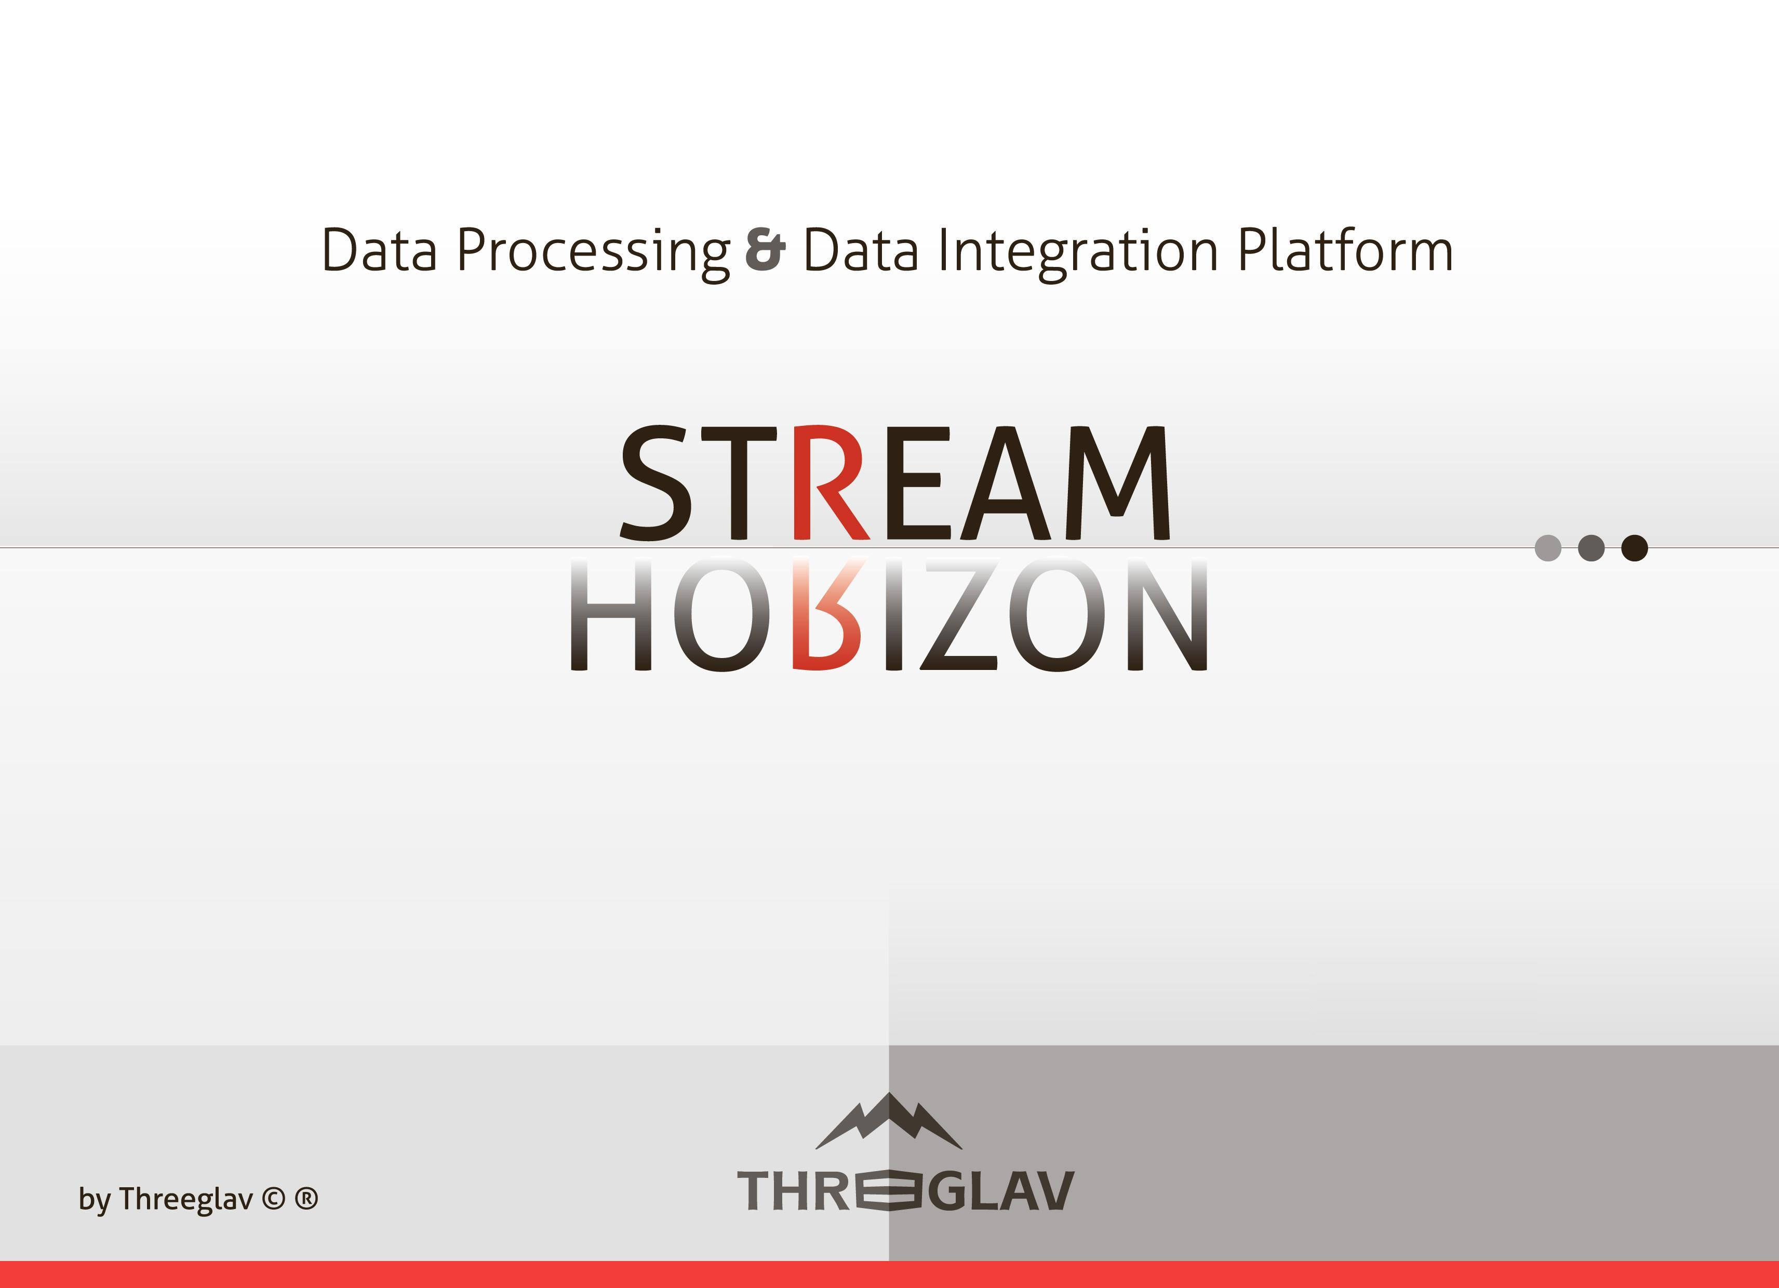
Big Data Analytics - Accelerated
stream-horizon.com

Slide 2
Legacy ETL platforms & conventional Data Integration approach
Unable to meet latency & data throughput demands of Big Data integration challenges
  Based on batch (rather than streaming) design paradigms
  Insufficient level of parallelism of data processing
  Require specific ETL platform skills
High TCO
  Inefficient software delivery lifecycle
  Require coding of ETL logic & staff with niche skills
  High risk & unnecessarily complex release management
  Vendor lock-in
  Often require exotic hardware appliances
  Complex environment management
  Repository ownership (maintenance & database licenses)

Slide 3
StreamHorizon’s “adaptiveETL” platform - Performance
Next generation ETL Big Data processing platform
Delivering performance critical Big Data projects
  Massively parallel data streaming engine
  Backed with In Memory Data Grid (Coherence, Infinispan, Hazelcast, any other.)
  ETL processes run in memory & interact with cache (In Memory Data Grid)
  Unnecessary Staging (I/O expensive) ETL steps are eliminated
  Quick Time to Market (measured in days)

Slide 4
StreamHorizon’s “adaptiveETL” platform - Effectiveness
Low TCO
  Fully Configurable via XML
  Requires no ETL platform specific knowledge
  Shift from 'coding' to 'XML configuration' reduces IT skills required to deliver, manage, run & outsource projects
  Eliminated 90% manual coding
  Flexible & Customizable – override any default behavior of StreamHorizon platform with custom Java, OS script or SQL implementation
  No vendor lock-in (all custom written code runs outside StreamHorizon platform-no need to re-develop code if migrating your solution)
  No ETL tool specific language
  Out of the box features like Type 0,1,2, Custom dimensions, dynamic In Memory Cache formation transparent to developer

Slide 5
AdaptiveETL enables:
Increased data velocity & reduced cost of delivery:
  Quick Time to Market – deploy StreamHorizon & deliver fully functional Pilot of your Data integration project in a single week
  Total Project Cost / Data Throughput ratio = 0.2 (20% of budget required in comparison with Market Leaders)
  1 Hour Proof of Concept – download and test-run StreamHorizon’s demo Data Warehousing project
Big Data architectures supported:
  Hadoop ecosystem - Fully integrated with Apache Hadoop ecosystem (Spark, Storm, Pig, Hive, HDFS etc.)
  Conventional ETL deployments - Data processing throughput of 1 million records per second (single commodity server, single database table)
  Big Data architectures with In Memory Data Grid acting as a Data Store (Coherence, Infinispan, Hazelcast etc.)

Slide 6
AdaptiveETL enables:
Achievable data processing throughput:
  Conventional (RDBMS) ETL deployments - 1 million records per second (single database table, single commodity server, HDD Storage)
  Hadoop ecosystem (StreamHorizon & Spark) - over 1 million records per second for every node of your cluster
  File system (conventional & Hadoop HDFS) - 1 million records per second per server (or cluster node) utilizing HDD Storage
Supported Architectural paradigms:
  Lambda Architecture - Hadoop real time & batch oriented data streaming/processing architecture
  Data Streaming & Micro batch Architecture
  Massively parallel conventional ETL Architecture
  Batch oriented conventional ETL Architecture

Slide 7
AdaptiveETL enables:
Scalability & Compatibility:
  Virtualizable & Clusterable
  Horizontally & Vertically scalable
  Highly Available (HA)
  Running on Linux, Solaris, Windows, Compute Clouds (EC2 & others)
Deployment Architectures:
  Runs on Big Data clusters: Hadoop, HDFS, Kafka, Spark, Storm, Hive, Impala and more…
  Runs as StreamHorizon Data Processing Cluster (ETL grid)
  Runs on Compute Grid (alongside grid libraries like Quant Library or any other)

Slide 8

Targeted Program & Project profiles
Greenfield project candidates:
Data Warehousing
Data Integration
Business Intelligence & Management Information
OLTP Systems (Online Transactional Processing)
Brownfield project candidates:
Quickly enable existing Data Warehouses & Databases which:
Struggle to keep up with loading of large volumes of data
Don’t satisfy SLA from query latency perspective
Latency Profile:
Real Time (Low Latency – 0.666 microseconds per record - average)
Batch Oriented
Delivery Profile:
<5 days Working Prototypes
Quick Time to Market Projects
Compliance & Legislation Critical Deliveries
Skill Profile
Low-Medium Skilled IT workforce
Offshore based deliveries
Data Volume Profile
VLDB (Very Large Databases)
Small-Medium Databases

Slide 9





Industries (not limited to…)
Finance - Market Risk, Credit Risk, Foreign Exchange, Tick Data, Operations
Telecom - Processing PM and FM data in real time (both radio and core)
Insurance - Policy Pricing, Claim Profiling & Analysis
Health – Activity Tracking, Care Cost Analysis, Treatment Profiling
ISP - User Activity Analysis & Profiling, Log Data Mining, Behavioral Analysis

Slide 10

Architecture

Slide 11
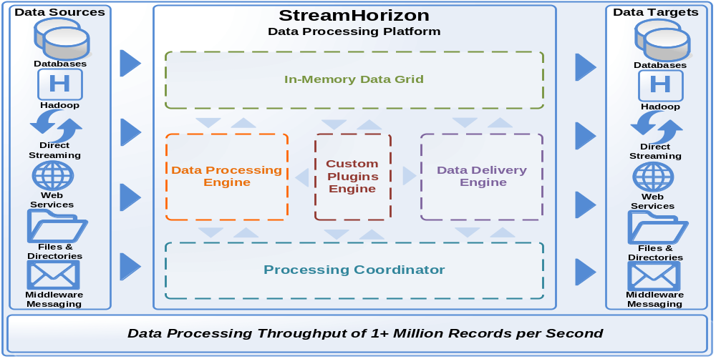
High Level Architecture

Slide 12
Benchmarks

Slide 13
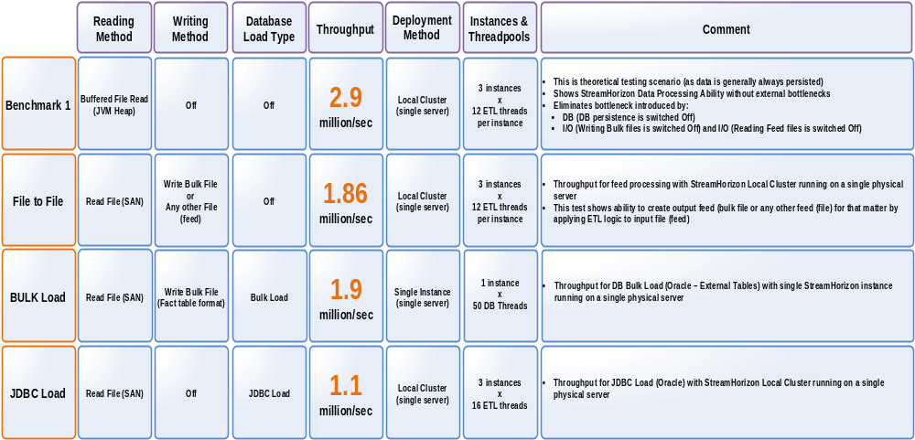
Benchmarks

Slide 14
Cost - Effectiveness

Slide 15



Functional & Hardware Profile
StreamHorizon
Market Leaders
Horizontal scalability (at no extra cost)
Vertical scalability
Clusterability, Recoverability & High Availability (at no extra cost)
Runs on Commodity hardware*
Exotic database cluster licences
Not Required
Often Required
Specialized Data Warehouse Appliances (Exotic Hardware)
Not Required
Often Required
Linux, Solaris, Windows and Compute Cloud (EC2)
Ability to run on personal hardware (laptops & workstations)*
* - Implies efficiency of StreamHorizon Platform in hardware resource consumption compared to Market Leaders

Slide 16
Cost-Effectiveness Analysis - I
Target Throughput of 1million records per second
StreamHorizon
Market Leaders
Hardware Cost
1 unit
3 - 20 units
Time To Market (installation, setup & full production ready deployment)*
4 days
40+ days
Throughput (records per hour) **
3.69 billion
(Single Engine)
1.83 billion
(3 Engines)
Throughput (records per second) **
1 million
(Single Engine)
510K
(3 Engines)
Requires Human Resources with specialist ETL Vendors skill
No
Yes
Setup and administration solely based on intuitive XML configuration
Yes
No
FTE headcount required to support solution
0.25
2
* - Assuming that file data feeds to be processed by StreamHorizon (project dependency) are available at the time of installation
** - Please refer to end of this document for detailed description of hardware environment

Slide 17
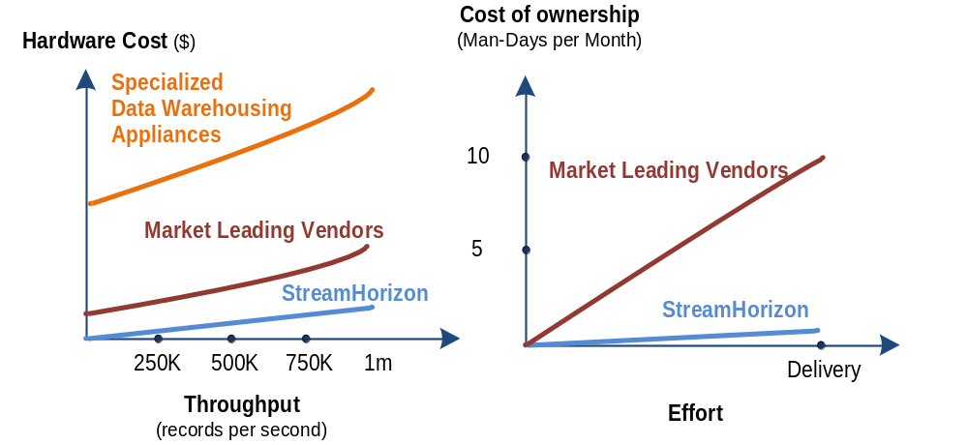
Cost-Effectiveness Analysis - II

Slide 18
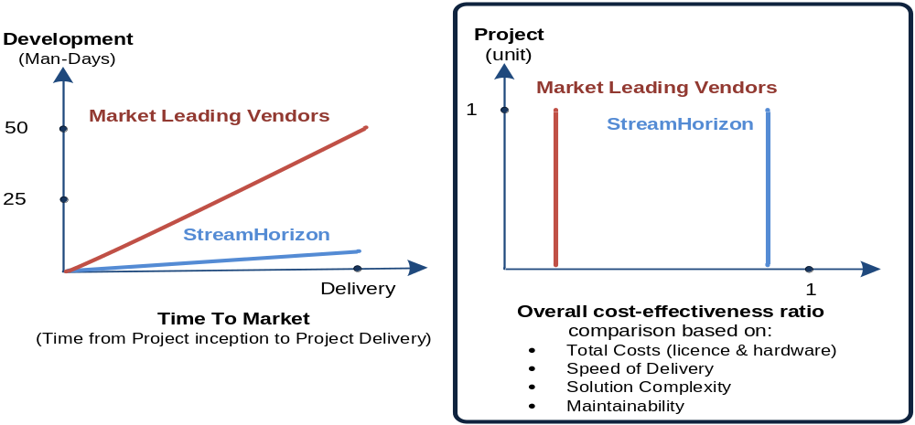
Cost-Effectiveness Analysis - III

Slide 19
Use Case study

Slide 20
Use Case Study
Delivering Market Risk system for Tier 1 Bank
Increasing throughput of the system for the factor of 10
Reducing code base from 10,000+ lines of code to 420 lines of code
Outsourcing model is now realistic target (delivered solution has almost no code base and is fully configurable via XML)
Workforce Savings:
Reduced number of FTE & part-time staff engaged on the project (due to simplification)
Hardware Savings:
$200K of recycled (hardware no longer required) servers (4 in total)
Software Licence Savings:
$400K of recycled software licences (no longer required due to stack simplification)
Total
Negative project cost (due to savings achieved in recycled hardware and software licences)
BAU / RTB budged reduced for 70% due to reduced implementation complexity & IT stack simplification

Slide 21
Use Case Study - continued
Single server acts as both StreamHorizon (ETL Server) and as a database server
Single Vanilla database instance delivers query performance better than previously utilized OLAP Cube
(MOLAP mode of operation).
By eliminating OLAP engine from software stack:
  User query latency was reduced
  ETL load latency reduced for factor of 10+
  Ability to support number of concurrent users is increased
Tier 1 Bank was able to run complete Risk batch data processing on a single desktop (without breaking SLA).

Slide 22
Q&A
stream-horizon.com

