Slide 1
Model View Controller

Slide 2
Who I Am And Why You Should Care About Everything I Say Today
Software Engineer at feature[23]
Graduate of UNF (Computing === Awesome && $$$) and Florida State (Guitar === Awesome)
I like cool buzzwords like Domain Driven Design, Functional Reactive Programming, The Internet of Things, Software Ethics, Software Architecture, and Software Archaeology

Slide 3
Review

Slide 4
Client
Server
Client (Your Laptop)
Web Browser
Request
Web Application
Response
Request
Http Verbs: GET, POST, PUT, DELETE
Form Submission
AJAX
Response
Content-Type: HTML, JSON, XML, etc.
Message Body: The actual bytes (data)
Response Codes: 200, 300, 400, 500, etc.
Read (Query)
Write (Save, Update, Delete)
Database
API Tutorial

Slide 5
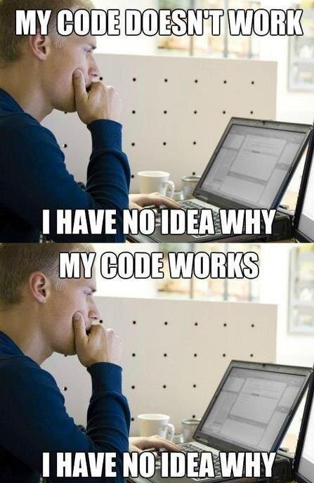
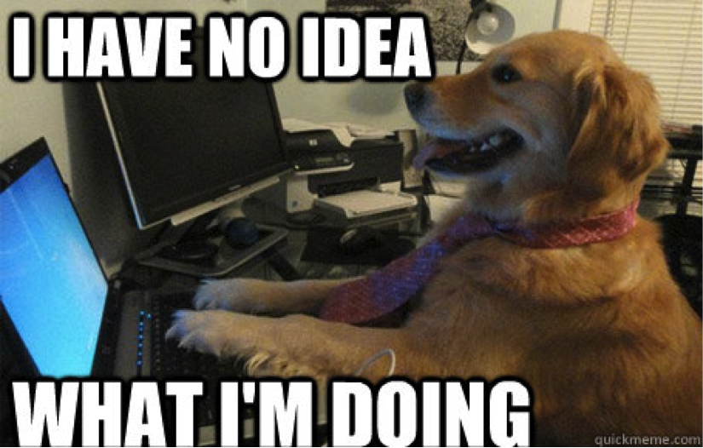
Right now, this is probably you…
Or…

Slide 6
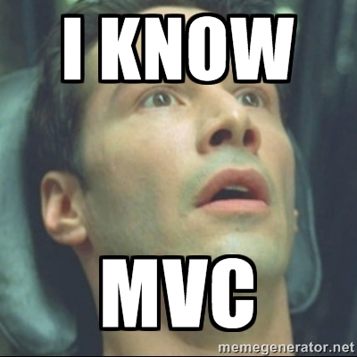
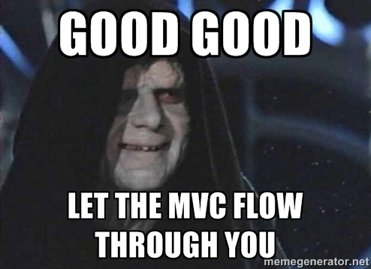
After the presentation, this should be you…
And Dr. Umapathy should be like…

Slide 7
History

Slide 8
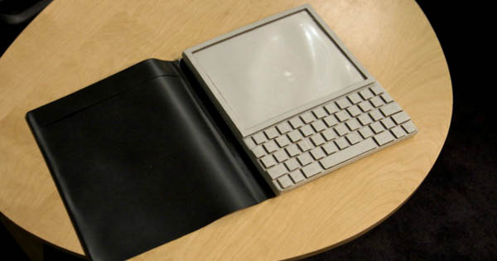
Notes:
Does anyone know what this is?
I will buy you a beer or give you a cookie if you do…

Slide 9
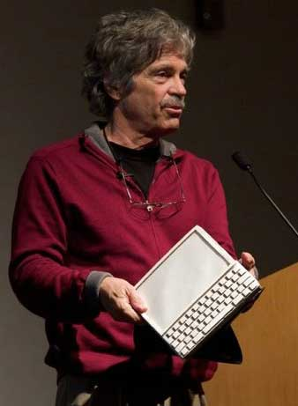
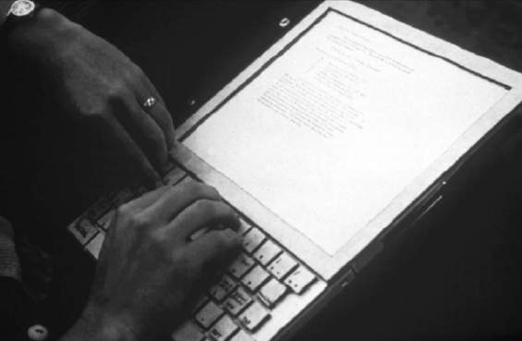
The Dynabook (aka the 1960s iPad)
Alan Kay
You should probably go read his stuff. Sort of an important/super smart person. (He’s kind of a big deal)
Notes:
It’s the 1960s, let me repeat that, the 1960s version of the iPad.
The KiddiComp concept, envisioned by Alan Kay in 1968, while a PhD candidate^{[1][2]} and later developed and described as the Dynabook in his 1972 proposal A personal computer for children of all ages
Part of the motivation and funding for the Dynabook project came from the need for portable militarymaintenance, repair, and operations documentation. Eliminating the need to move large amounts of difficult-to-access paper in a dynamic military theatre provided significant US Department of Defense funding.

Slide 10
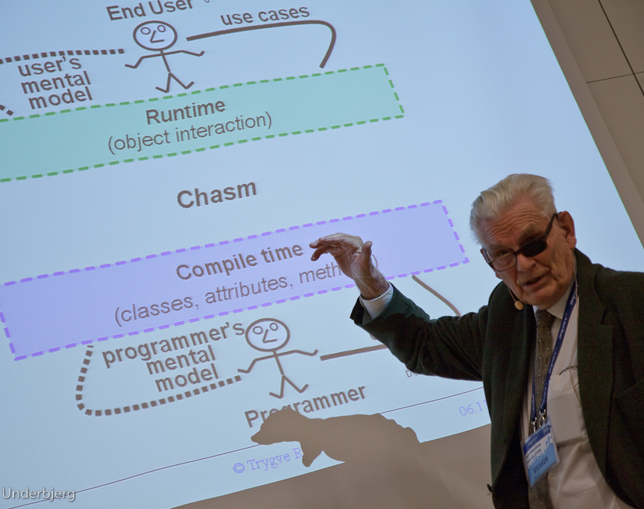
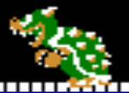
Xerox PARC
Late 1978-79
Trygve Reenskaugh was visiting the Learning Research Group at Xerox PARC
Co-created or posited the ideas and notions of MVC (with Adele Goldberg and others) prior to the creation of Smalltalk
Original intent was to shorten to gap between the User’s mental model of the data and the computer’s model of the data
Koopa
Trygve Reenskaug
Notes:
I spent a very happy and inspiring year as a visiting scientist with the Learning Research Gorup (LRG) at Xerox PARC from the summer og 1978 to the summer of 1979. This group was dedicated to Alan Kay's vision of the Dynabook; a portable computer that should contain all data of interest to its owner/user. Very importantly, these data included the programs the owner used to manipulate them. The owner/user should be able to understand and write the programs, thus gaining ascendancy over the computer.

Slide 11
The MVC Pattern

Slide 12
Models
Represent knowledge (data)
Should represent specific domain/area of business concern(s)
Have and maintain State
Single Object, or a grouping of Objects (Composition/Aggregation)
Notes:
Television Comparison (TV (View), Cable Provider (Model), Remote (Controller))

Slide 13
Views
What the User sees
Visual representation of the Model
“Presentation Filter”
Observes changes in the Model
May also receive messages (updates) from the Controller

Slide 14
Controllers
What the User interacts with
Arranges the View(s)
May handle complex application logic external to Models
Responds to Commands from the User
Sends (passes) messages to the View
Notes:
Handles logic that doesn’t belong in the View or the Model.
i.e. Security, Persistence, Logging, etc.

Slide 15
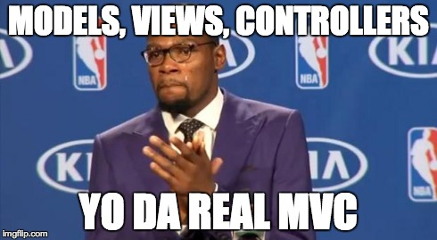

Slide 16
Separated Presentation

Slide 17
Ensure that any code that manipulates presentation only manipulates presentation, pushing all domain and data source logic into clearly separated areas of the program.

Slide 18
As well as a separation, there is also a strict visibility rule. The presentation is able to call the domain but not vice-versa.

Slide 19
The point here is that the domain should be utterly unaware of what presentations may be used with it. This both helps keep the concerns separate and also supports using multiple presentations with the same domain code.

Slide 20
Although the domain cannot call the presentation it's often necessary for the domain to notify the presentation if any changes occur. Observer is the usual solution to this problem. The domain fires an event which is observed the by presentation, the presentation then re-reads data from the domain as needed.

Slide 21
Desktop

Slide 22
Single Application Domain
The User updates some information in the UI and clicks a Save button.
The Controller responds to the user’s interaction and sends the data to the Model.
The Model updates its internal state (data), and notifies its observers.
View
Controller
Model
The View observes the change in the Model and updates (refreshes) itself with the new data.
View
View
View
Other Views can read from the same Model as it updates

Slide 23
Demo

Slide 24
Web

Slide 25
The Controller decides what to do in response to the interaction.
The Controller may retrieve an existing Model, or create a new one, and update its state (properties).
User interactions in the UI trigger Actions (Methods/Functions) in the Controller
Controller
View
Model
The Controller creates a new View with the update Model and returns it to the browser over HTTP.
The browser renders the new state of the Model, and the user may continue to interact with the updated Model’s data.
Typically, the state of the Model will be persisted (usually via a database).

Slide 26
Client
(aka Browser)
Server
(Web Application)
Controller
View
Model
Responsibilities
GET/POST data to/from Server
Render HTML from the Server
Respond to User interactions
Responsibilities
Accept/Respond to HTTP Requests
Handle/Direct Application Logic
Data Persistence and Retrieval

Slide 27
SQL
Database
Controller
View
Model

Slide 28
View Models & Mutant Models

Slide 29
Group multiple Objects or Values into one Object
View reads from this Object instead of your Model
ViewModels can also hide properties of the Model you don’t want exposed to the User
ViewModels keep View-specific logic from polluting Models (Domain Objects)

Slide 30
Data Transfer Objects

Slide 31
Data Transfer Objects were originally for reducing the number of Remote Procedure Calls
Need to be serializable for over the wire transmissions
Encapsulating the serialization logic in the DTO prevents that logic from polluting your domain Objects

Slide 32
Demo

Slide 33
Questions?

Slide 34
Resources
http://martinfowler.com/eaaDev/uiArchs.html
https://msdn.microsoft.com/en-us/library/ff649643.aspx
http://blog.codinghorror.com/understanding-model-view-controller/
https://heim.ifi.uio.no/~trygver/themes/mvc/mvc-index.html

