Slide 1
年终
公司总结报告
How to identify Majorana zero modes and Dirac fermionic modes in
the transport experiment
美仑设计是PPT设计、PPT美化、PPT定制、PPT模板综合一体的PPT服务提供商。

Slide 2
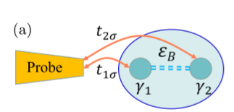
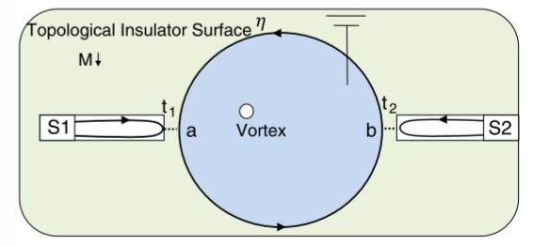
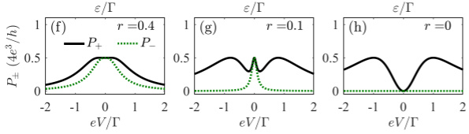
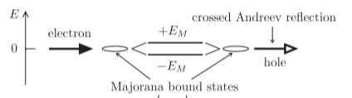
Noise evidence for detecting Majorana zero modes
Transportation process of Majorana
Crossed Andreev reflections dominate
Majorana fermion induced resonant Andreev reflection (MFIRAR).
an MBS/QMBS (a zero-bias dip) and ABS (a zero-bias peak) in current shot noise
J.-S. Hong, T.-F. J. Poon, L. Zhang, and X.-J. Liu, Phys. Rev. B 105, 024503 (2022)
Law K T, Lee P A, Ng T K. Majorana fermion induced resonant Andreev reflection[J]. Physical review letters, 2009, 103(23): 237001.
Nilsson J, Akhmerov A R, Beenakker C W J. Splitting of a Cooper pair by a pair of Majorana bound states[J]. Physical review letters, 2008, 101(12): 120403.

Slide 3
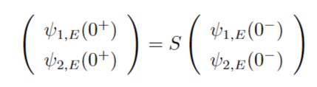


















S-matrix method for judging if Jackiw rebbi modes can be used for braiding
lead 1
$$v$$
w
lead 2
Two Jackiw-Rebbi modes exists at the edge of the SSH chain
$T(E) = {|S_{12}|}^{2}$ =
$2∆$ are the energy difference between two Jackiw-Rebbi zero-modes
$$F_{12 } =$$
$$F_{11 } =$$

Slide 4
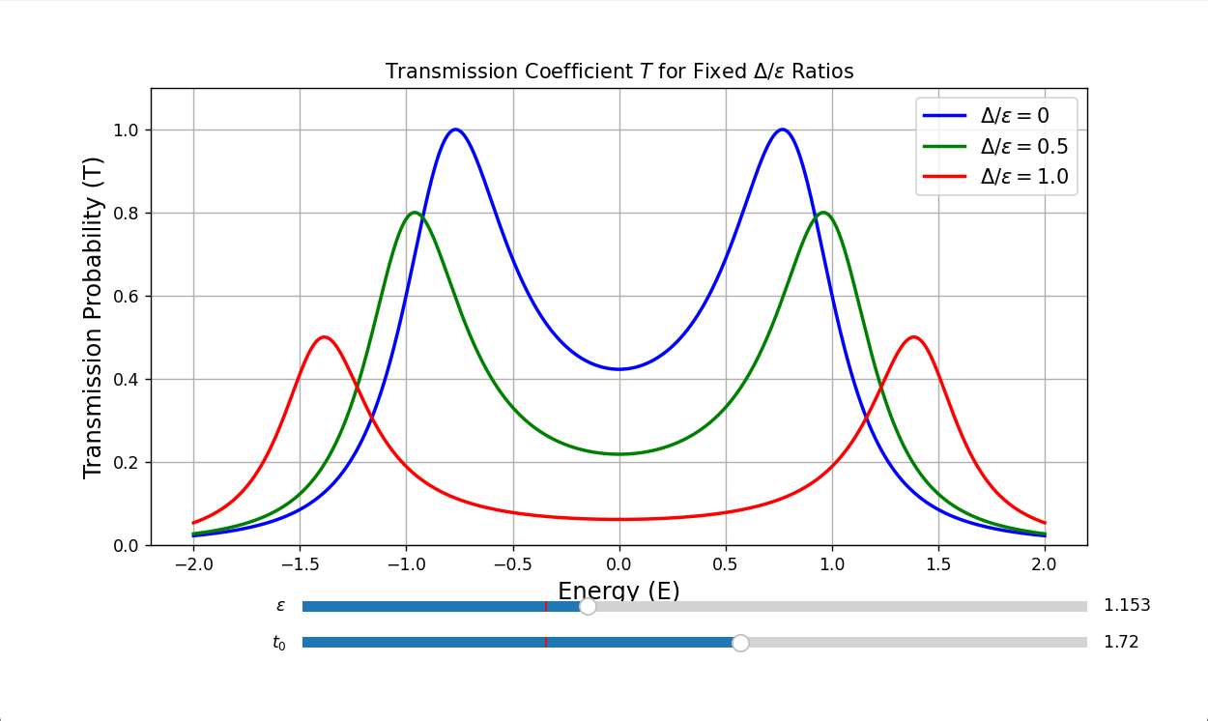
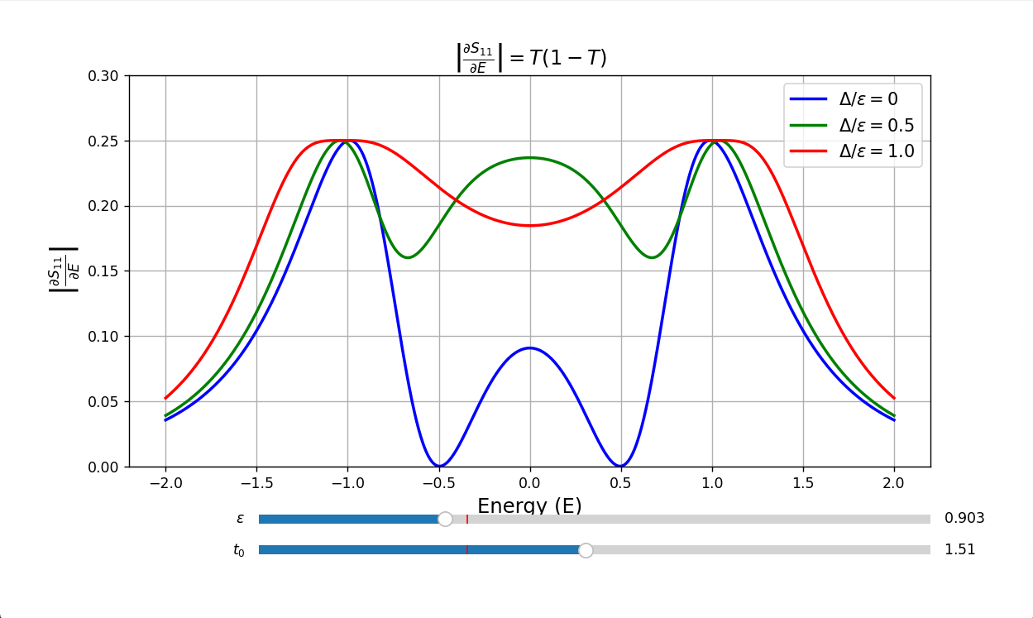
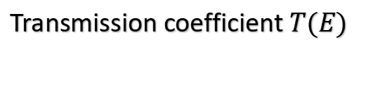
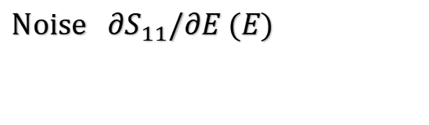
S-matrix method for judging if Jackiw rebbi modes can be used for braiding
Transmission coefficient $T(E)$
Noise ${∂S}_{11}/∂E (E)$

Slide 5
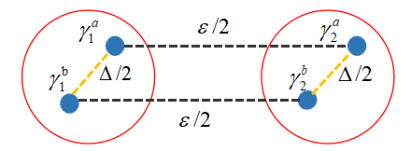
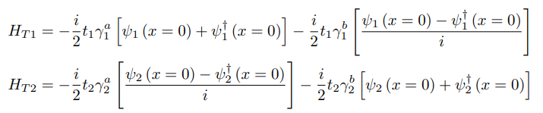
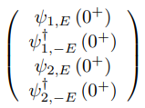
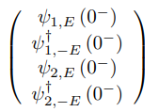
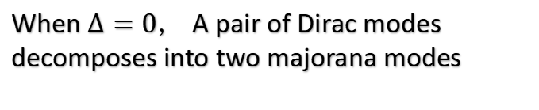

S-matrix method for judging if Jackiw rebbi modes can be used for braiding
In the Majorana representation
When $∆=0，$A pair of Dirac modes decomposes into two majorana modes
In the electron-hole representation
$$S$$

Slide 6
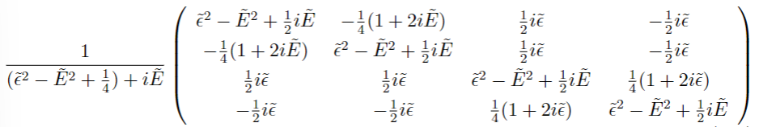
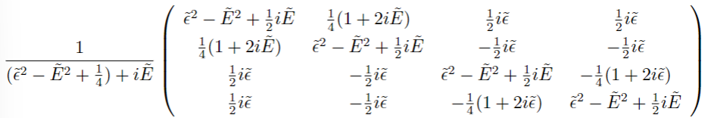



S-matrix method for judging if Jackiw rebbi modes can be used for braiding
A pair of Majorana transport process
channel
$$S =$$
channel
$$S =$$

Slide 7
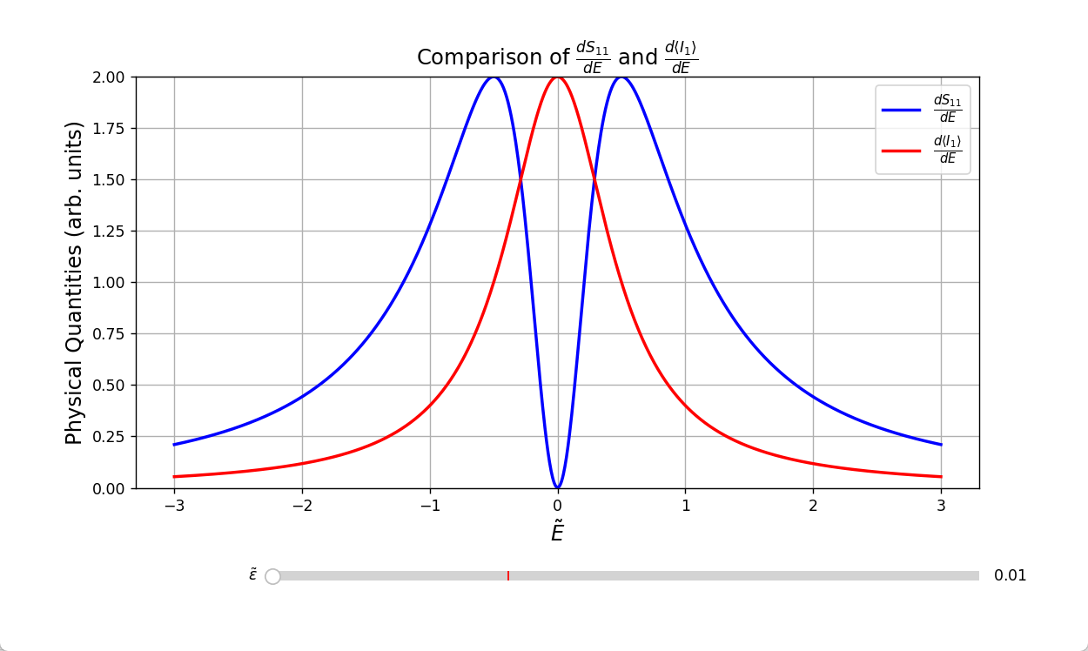

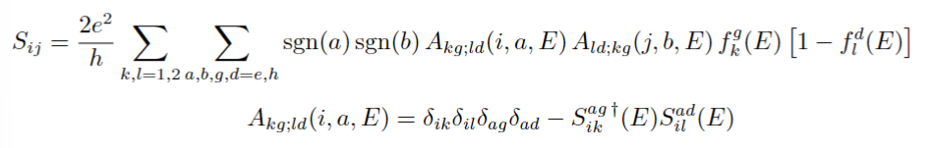
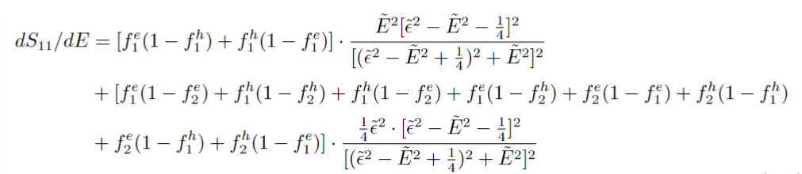
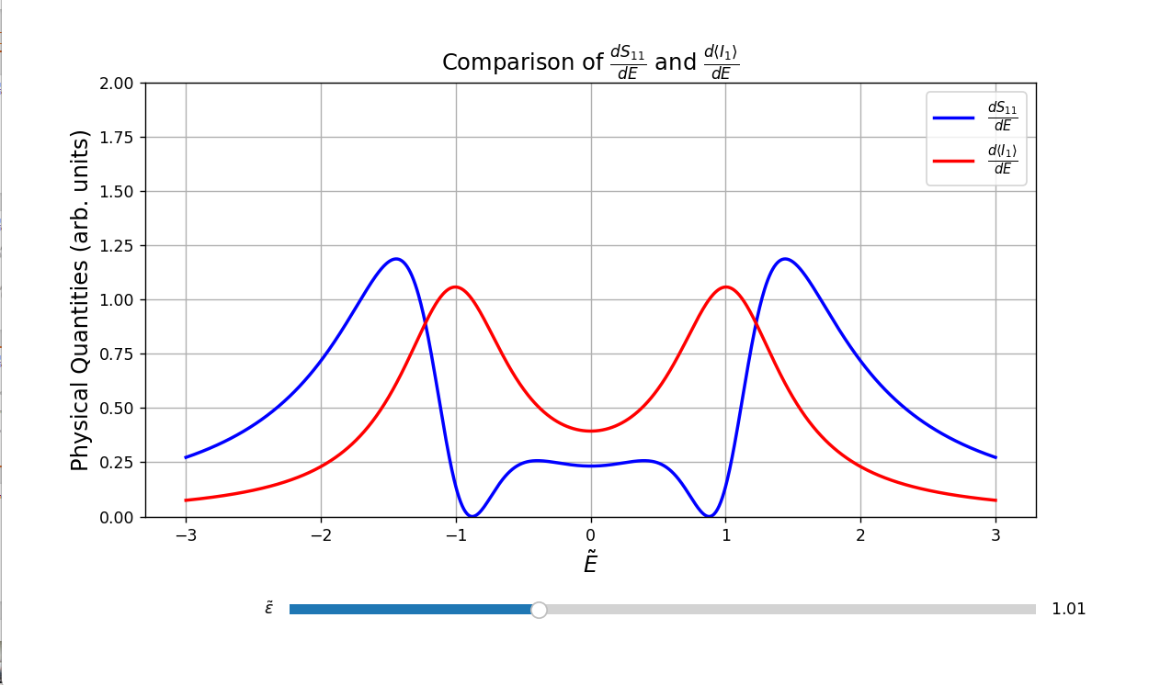


S-matrix method for judging if Jackiw rebbi modes can be used for braiding
Shot noise and Fano factor for a single pair of Majorana
The lowest point of the noise is suppressed to 0
Anantram M P, Datta S. Current fluctuations in mesoscopic systems with Andreev scattering[J]. Physical Review B, 1996, 53(24): 16390.

Slide 8
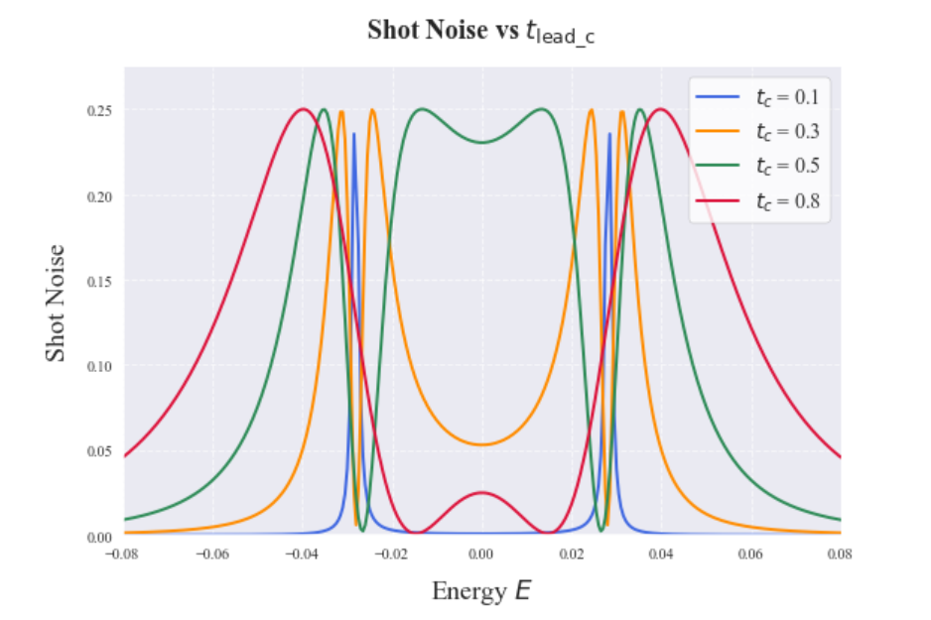


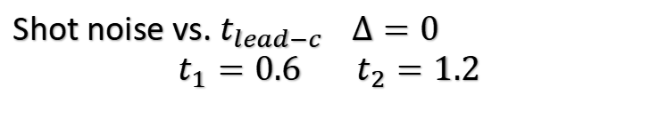
Numercial method for solving SSH-chain
Shot noise vs. $t_{lead−c } ∆=0$
$$t_{1}=0.6 { t}_{2}=1.2$$
topological nontrival
on-site energy difference $∆=|ε_{A}−ε_{B}|$
NEGF method

Slide 9
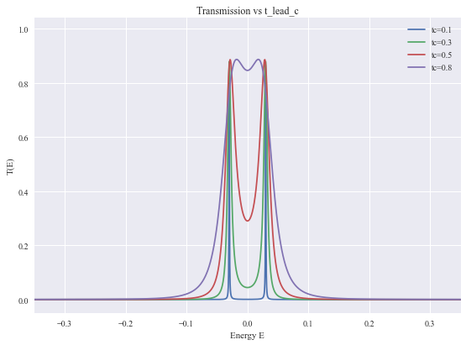
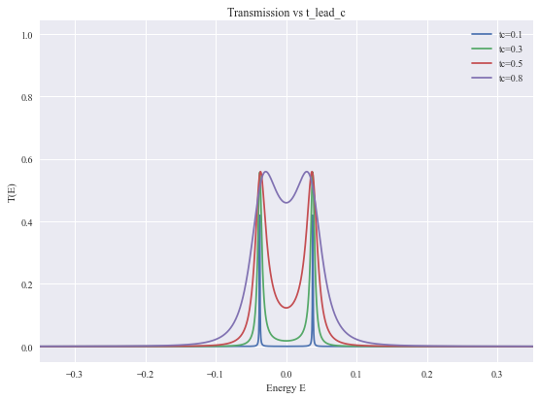
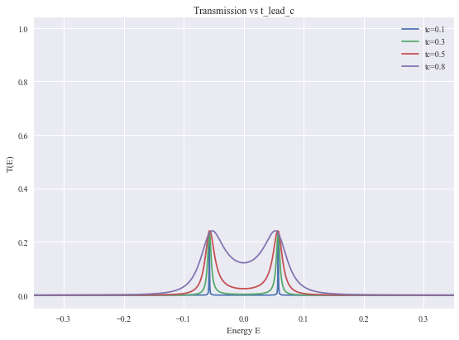
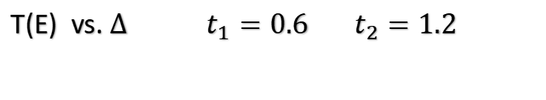




Numercial method for solving SSH-chain
T(E) vs. $∆$ $t_{1}=0.6 { t}_{2}=1.2$
Physical quantities vs. S-matrix
$t_{lead−c }\sim t { t}_{1}, t_{2}\sim ε ∆\sim ∆$
$∆$ = 0.02
$∆$ = 0.05
$∆$ = 0.1
The NEGF method is consistent with the results obtained by the S-matrix method

Slide 10
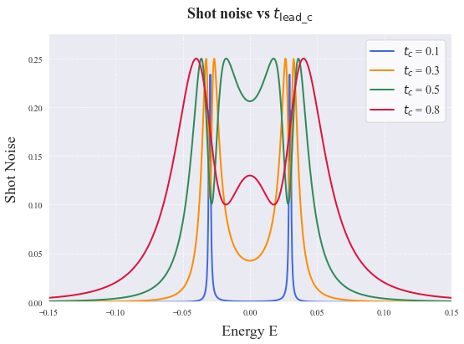
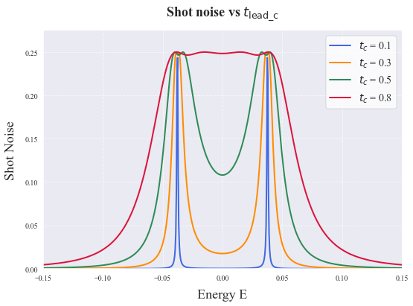
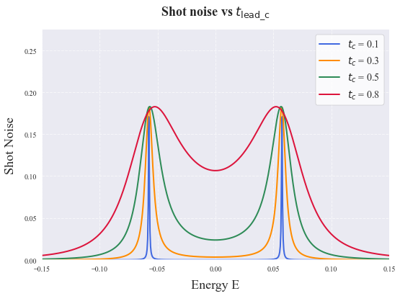
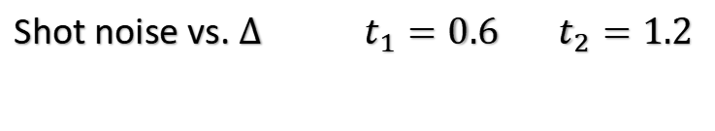
Numercial method for solving SSH-chain
Shot noise vs. $∆$ $t_{1}=0.6 { t}_{2}=1.2$
Physical quantities vs. S-matrix
$t_{lead−c }\sim t { t}_{1}, t_{2}\sim ε ∆\sim ∆$
$∆$ = 0.02
$∆$ = 0.05
$∆$ = 0.1

