Slide 1
Viral Dark Matter: Protein Structure Prediction
Cathrine Aivati
April 26, 2012
Notes:
I’m going to talk a bit about what I’ve been working on with Jeremy which is protein structure prediction

Slide 2
Introduction
Amino acid sequences – poorly match/do not match anything based upon sequence alone
What about structural similarities?
Structure determines function
Secondary and Tertiary prediction software
Supplementary to crystallography
Notes:
The amino acid sequences we have for the metabolic proteins haven’t provided us with a lot of information about the proteins. Conventional alignment techniques such as BlastP return little if any information due to lack of sequence similarity.
My thought was just because the sequences aren’t identical doesn’t mean that the amino acids in both sequences aren’t necessarily similar (with respect to hydrophobicity, charge, size, etc.). Amino acids that are similar based upon these characteristics may contribute to similar folding patterns between two seemingly unrelated amino acid sequences.
If we can predict the structure of an unknown protein and it resembles a protein with known function, perhaps they function similarly, as structure largely determines function.
I thought it would be cool to try this out by implementing secondary and tertiary structure prediction tools.
Because we’re still working out a lot of kinks and the accuracy of these types of programs is uncertain, it makes for a good supplement in addition to crystallography.
Structural similarities may still occur. Similar but not exact amino acids (similar based upon principles of charge, hydrophobicity, aromatic groups, etc.) may contribute to folding homologous to proteins or domains of proteins of known structure and function.

Slide 3
Pipeline
AA sequence
2° structure prediction
(SSPro 3 and 8 class)
Choose 36 AA window
PEPFOLD 3° prediction
PDBe FSSP
(3D alignment)
Evaluation
Notes:
First we begin with the full length amino acid sequence. Inputting the sequence into a secondary prediction site yields predictions of where coils, helices, and beta sheets may lie. From here, a 36 amino acid window is selected. 36 is not an arbitrary number, but rather the limit that the tertiary prediction site will process per request. Pepfold generates 5 3D models, which are then put through a 3D alignment site (which compares our structures to identified and well classified proteins from PDB). Many of the proteins that are deemed “similar” fall under certain protein families, which may give insight as to the function of the unknowns.

Slide 4
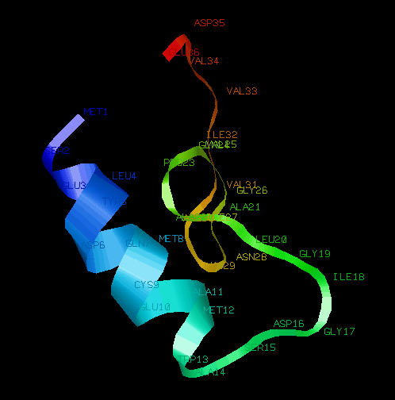
Preliminary Results
PDF (control) - 3° structure prediction and comparison from first 36 AA’s in PDBe Fold = metaloprotease
Notes:
PDF served as a control. Below is a 3D model of the first 36 amino acids generated by pepfold. According to PDBe’s 3D alignment, it is structurally similar to metaloproteases.

Slide 5
Preliminary Results
Sugar Nucleotide Epimerase
AAs 1-36 → Tautomerase
AAs 37-73 → Ribosomal protein
AAs 74-110 → Ubiquitase domain?
AAs 111-147 → RAP74 (subunit of TF; recruits RNA Pol II)
AAs 148-184 → Ribosomal protein
AAs 185-211 → KIA7 (“prebiotic”)/metaloprotease
AAs 212-248 → Ribosome protein
AAs 249-285 → LXR-alpha??
AAs 286-302 → EIF4E (TF?)
Aas 303-317 → Exportin
Notes:
Over the past few days, I have played around with sugar nucleotide epimerase. The first 36 amino acids bear resemblence to tautomerase, which is somewhat similar to epimerase. The other segments are inconsistent, which may or may not make sense (different portions of proteins could have different functions). It’s a bit difficult to reach a clear conclusion about the protein as a whole from this type of data.

Slide 6
Future Direction
Optimize selection of “windows”
Ideal to have full length predictions (3DPro)
Input VCIDs associated with physiological data
Run more sequences with known functional domains
Notes:
In order to make more sense of the data, it would probably be best to either optimize the selection of “windows” rather than take random chunks that may or may not interrupt secondary structure. Ideally, a full length 3D prediction would be best, however 3DPro is currently not working. We will continue to use sequences with physiological data and run sequences with known functional domains for better understanding of predictive capabilities.

