Slide 1
Too Good To Go — Mexico Demand Visuals
Prepared for internal expansion planning (CDMX focus)
Author: Yenam Dossou — Visual pack generated by Copilot

Slide 2
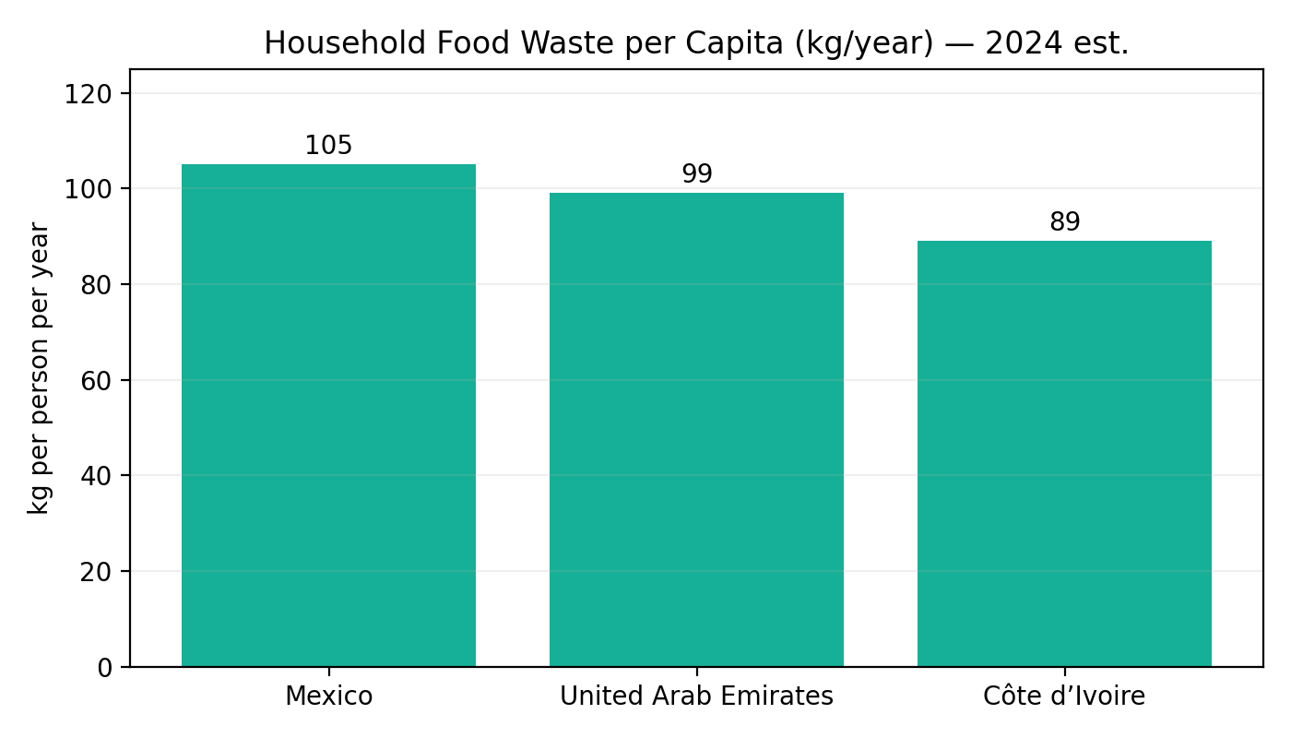
Household Food Waste per Capita (Mexico vs UAE vs Côte d’Ivoire)
Sources: WorldPopulationReview (compiled from UNEP Food Waste Index 2024) | UNEP Food Waste Index 2024

Slide 3
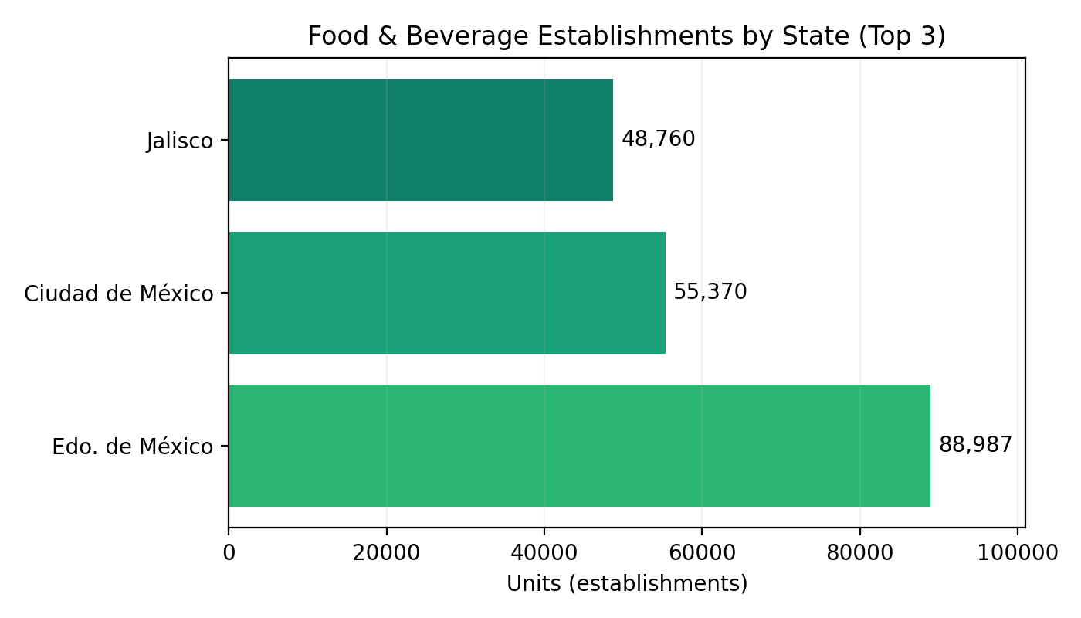
Food & Beverage Establishments — Top 3 States
Sources: Data México (DENUE, May 2025). "Servicios de Preparación de Alimentos y Bebidas"

Slide 4
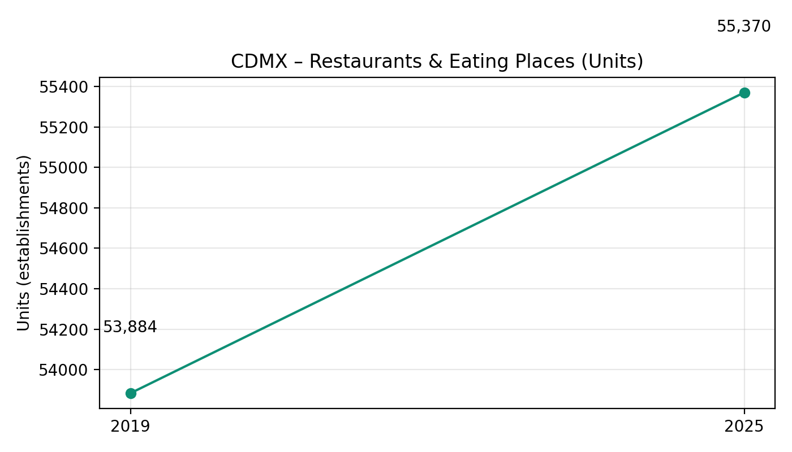
CDMX — Restaurants & Eating Places: Units (2019 vs 2025)
Sources: INEGI, Censos Económicos 2019 (CDMX) | Data México (DENUE, May 2025)

Slide 5
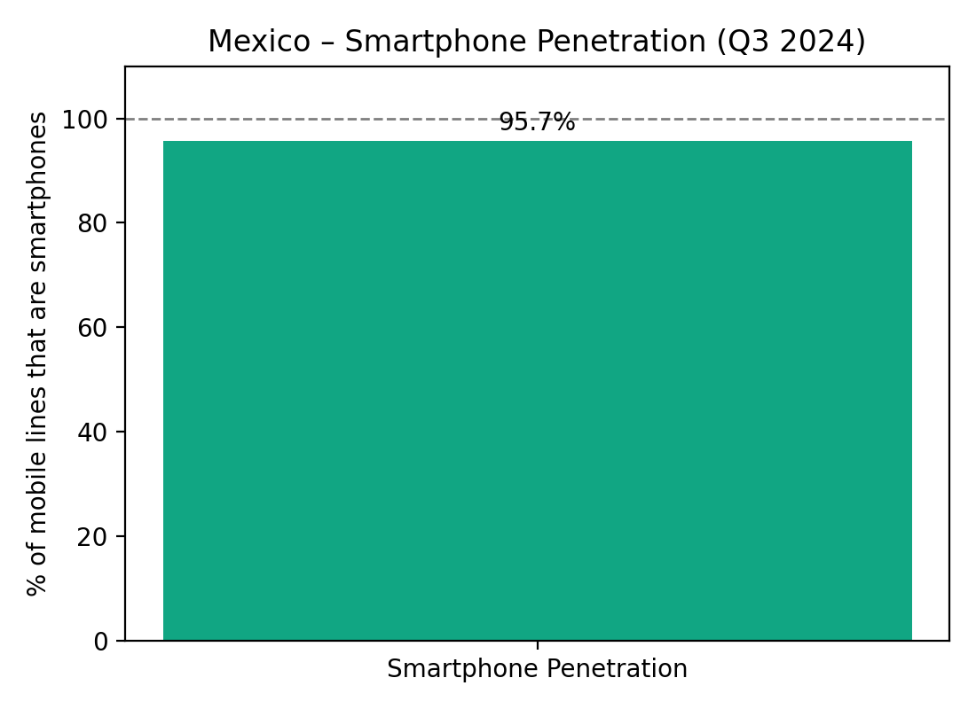
Mexico — Smartphone Penetration (Q3 2024)
Sources: The Competitive Intelligence Unit (The CIU), 3T‑2024

Slide 6
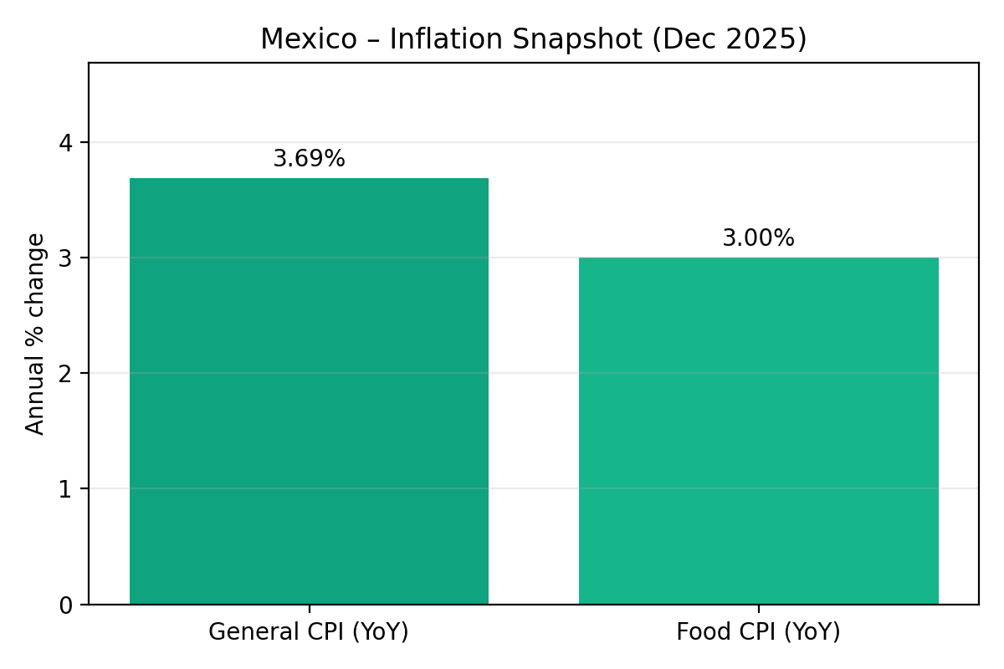
Mexico — Inflation Snapshot (Dec 2025)
Sources: INEGI Consumer Price Index | INEGI via TradingEconomics (Food CPI)

Slide 7
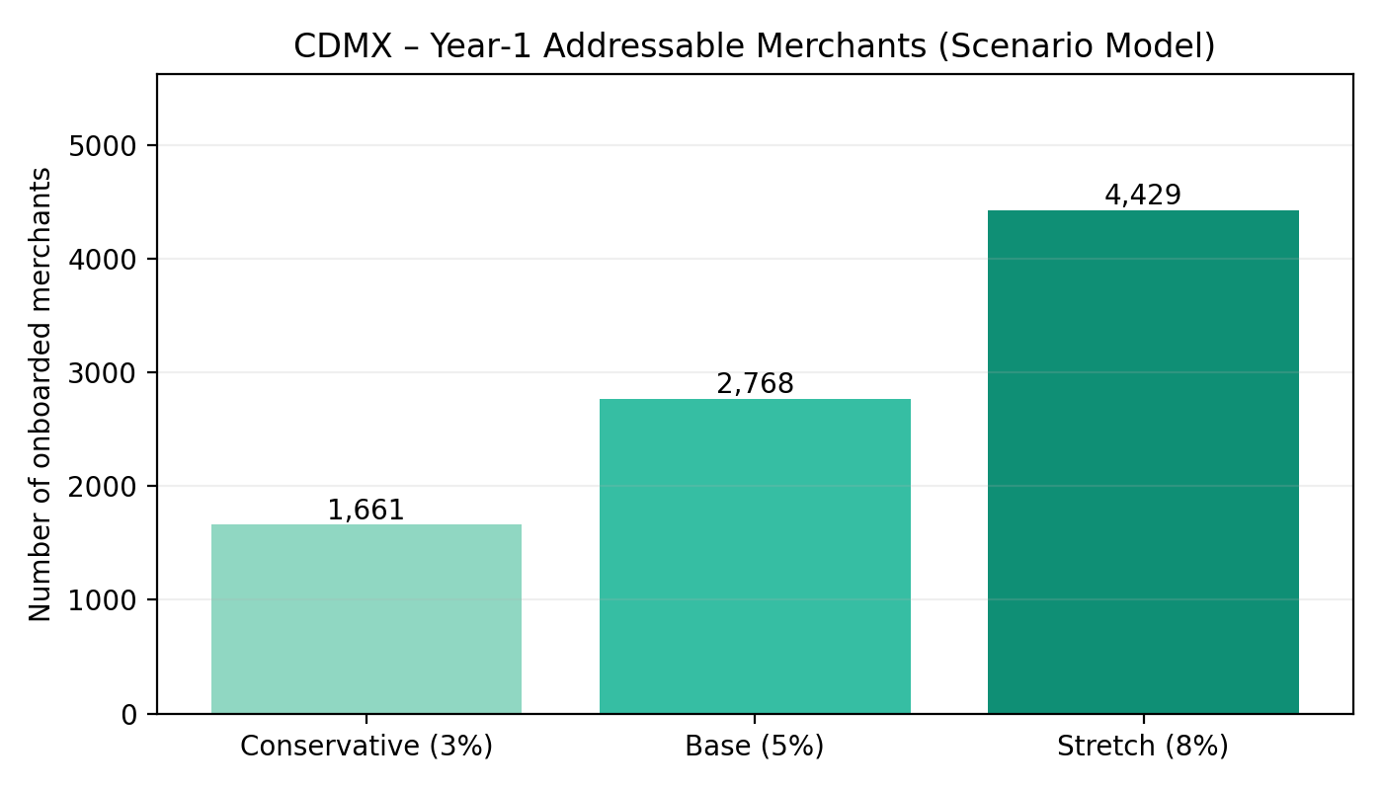
CDMX — Year‑1 Addressable Merchants (Scenario Model)
Sources: Assumes adoption of 3%/5%/8% of 55,370 units (DENUE May 2025) — illustrative

Slide 8
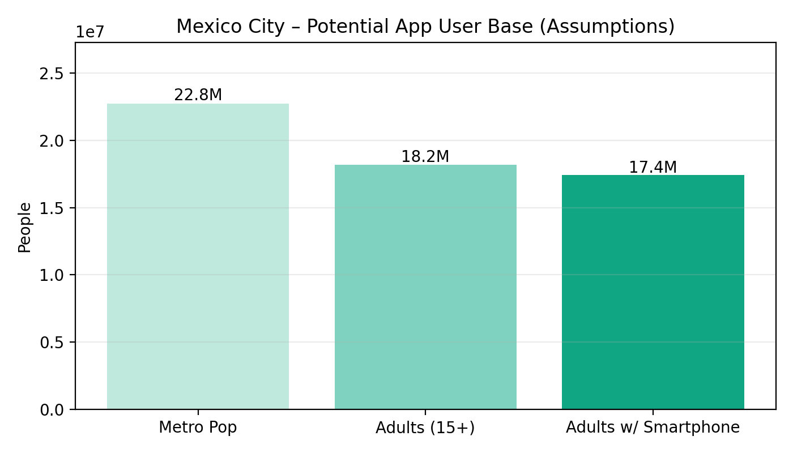
Mexico City — Potential App User Base (Assumptions)
Sources: Macrotrends: Mexico City metro population 2025 | Adults≈80% (assumption) | Smartphone penetration 95.7% (The CIU, Q3 2024)

