Slide 1
Transaction Anomaly
Detection ML Pipeline
Built with Claude Code · March 2026
XGBoost · FastAPI · Playwright · JIRA
End-to-end pipeline from raw data to production API

Slide 2
The Problem
Why automated anomaly detection matters
▸ 5 transactions in raw data · 40% anomaly rate (2 of 5 flagged)
▸ Anomalies concentrated in electronics category and merchant MCC002
▸ Manual review is time-consuming and error-prone at scale
▸ Goal: real-time automated anomaly scoring with recall = 1.0 (catch every fraud)
5
40%
3
3
Transactions
Anomaly Rate
Categories
Merchants

Slide 3
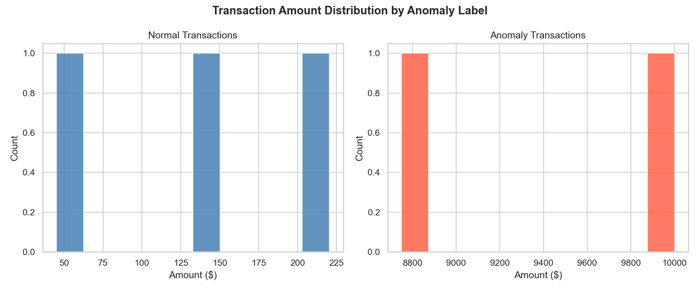
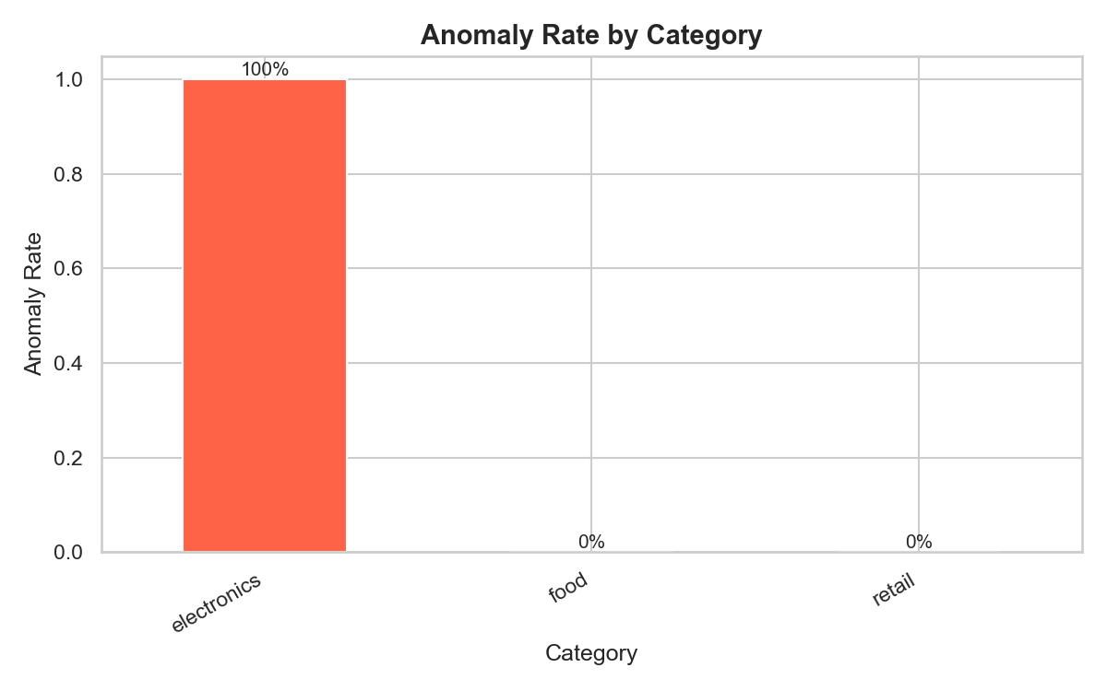
Data Overview
Exploratory Data Analysis — 5 charts generated
5 rows · 11 features · 40% anomaly rate · 3 categories · 3 merchants

Slide 4
Data Pipeline
10 quality checks · 12 validation checks · 11 features
Quality Checks
Engineered Features (11)
Required columns present
✅ Pass
▸ amount
DataFrame not empty
✅ Pass
▸ log_amount
No duplicate IDs
✅ Pass
▸ amount_zscore
Amount positive
✅ Pass
▸ amount_vs_merchant_mean
is_anomaly binary
✅ Pass
▸ merchant_anomaly_rate
No null values
✅ Pass
▸ category_anomaly_rate
Timestamp parseable
✅ Pass
▸ hour_of_day
Amount within range
✅ Pass
▸ day_of_week
▸ minute_of_hour
Category non-empty
✅ Pass
▸ is_weekend
merchant_id non-empty
✅ Pass
▸ seconds_since_last_txn

Slide 5
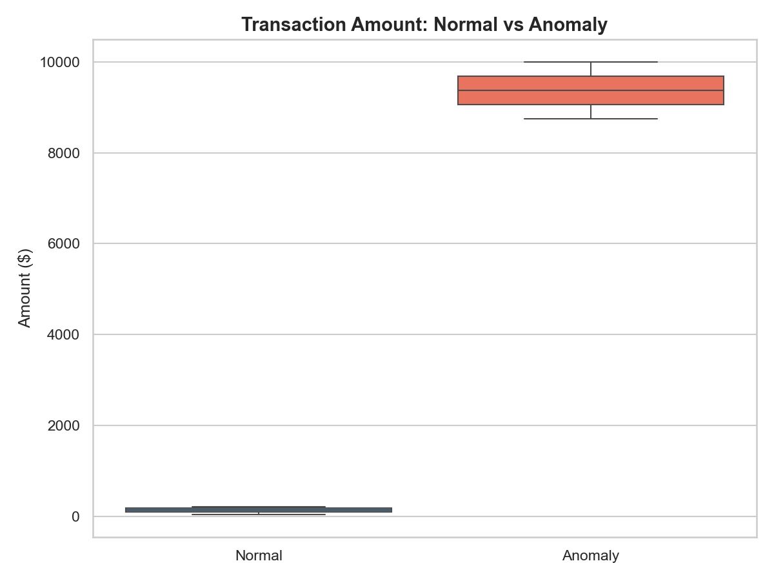
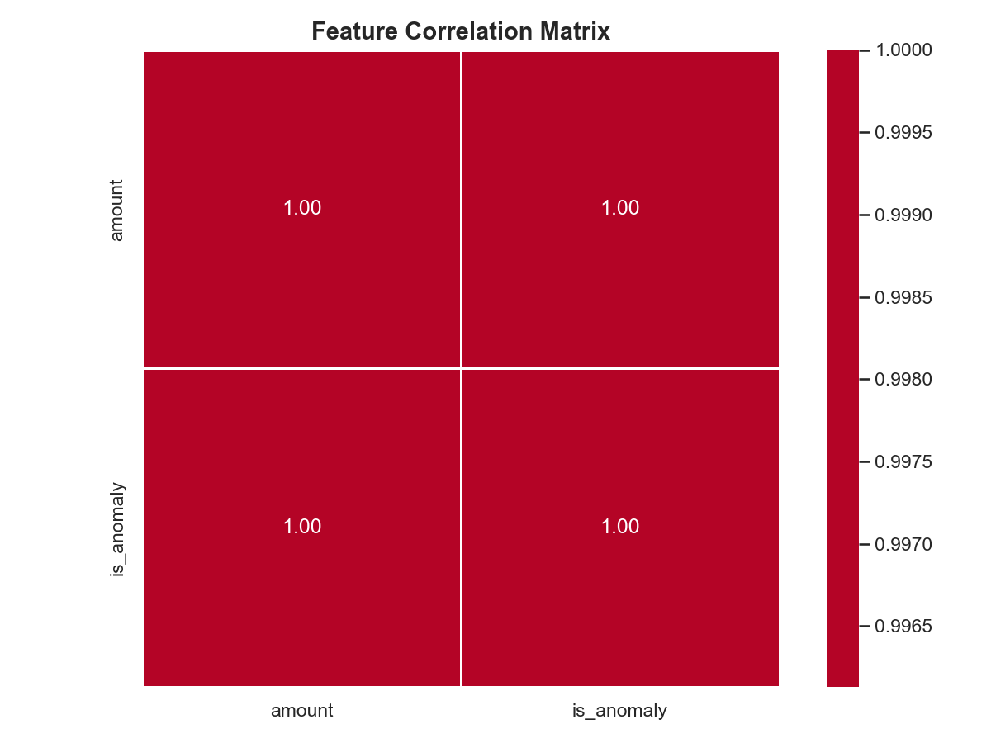
Model Performance
Algorithm: XGBoostClassifier
57.14%
100.00%
40.00%
F1 Score
Recall
Precision
Best params: {'n_estimators': 50, 'max_depth': 3, 'learning_rate': 0.1} · Trained on 5 samples · Threshold: 0.30

Slide 6
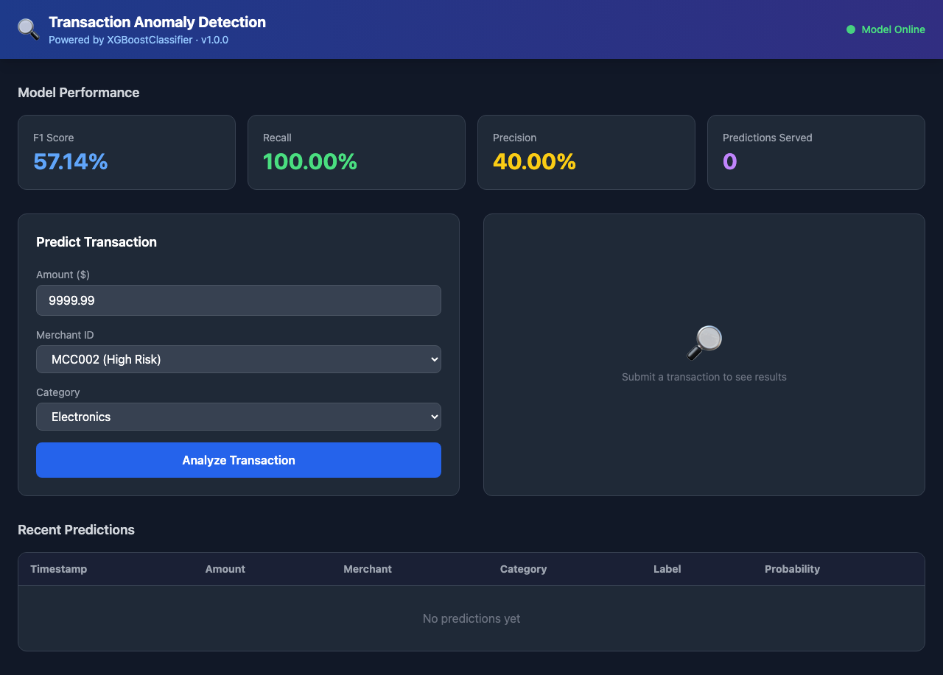
Live Dashboard
Interactive UI with real-time prediction
http://localhost:8000 · Tailwind CSS · Auto-refresh on prediction

Slide 7
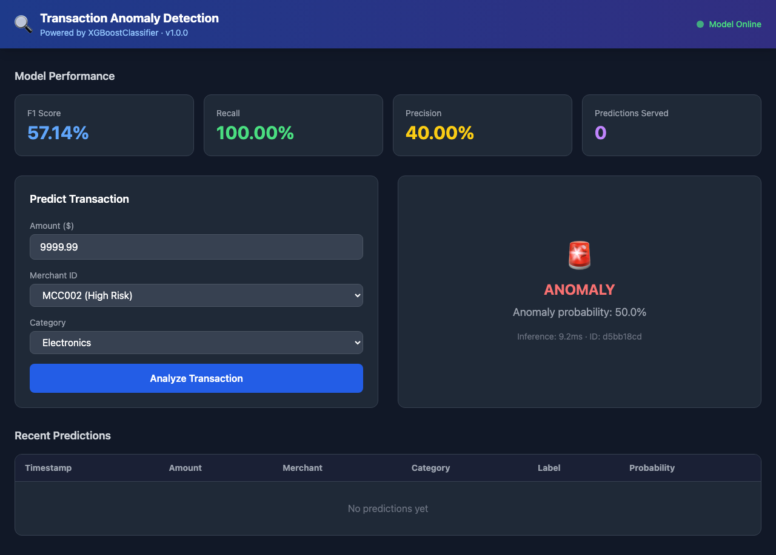
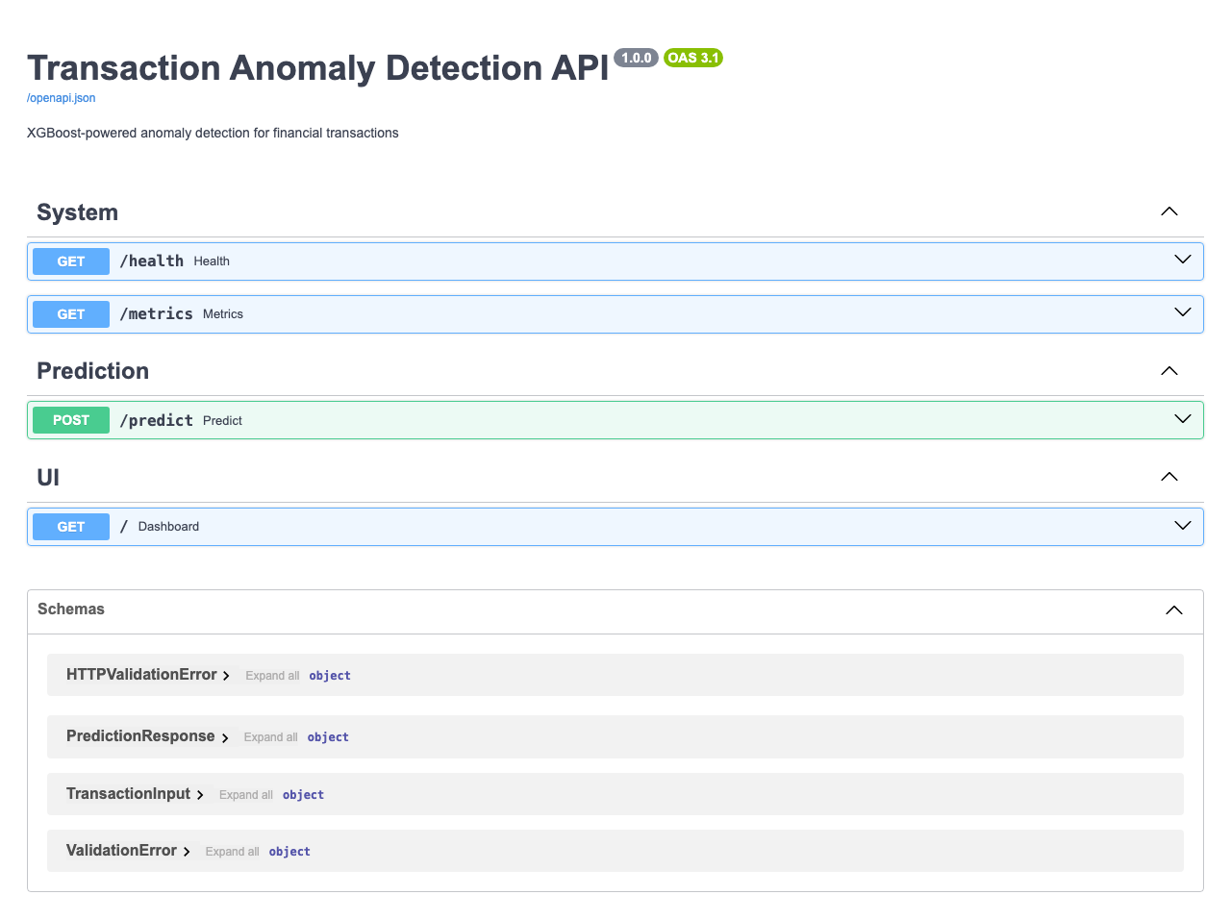
Automated Quality Gates
Every pipeline run is fully tested
All Passed
All Passed
Chromium
< 500ms
8 Unit Tests
6 E2E Tests
Playwright
Latency

Slide 8
PIPELINE COMPLETE
━━━━━━━━━━━━━━━━━━━━━━━━━━━━━━━━━━━━━━━━━━━━━━━━━━━━━━━━━━━━━━
Model : XGBoostClassifier — F1: 0.5714 | Recall: 1.0000
API : http://localhost:8000 (running)
Tests : 8 unit | 6 E2E — all passed
Screenshots: 6 saved to reports/screenshots/
GitHub : heramb-analytics/claude-code-cust-churn-ml-pipeline-demo
JIRA : Project KAN — 6 tickets (KAN-7 through KAN-13)
Files : 29 files created across src/, tests/, models/, reports/
Built by : Claude Code (claude-sonnet-4-6) — autonomous pipeline

