Slide 1
Transaction Anomaly Detection
ML Pipeline
Built with Claude Code · 2026-04-16
IsolationForest · F1=0.8966 · 1,000 transactions
https://github.com/heramb-analytics/claude-code-ml-pipeline-20260415-214802

Slide 2
The Problem
1,000 transactions with 10.2% anomaly rate
Manual fraud review averages 4–8 hours per cycle
Goal: automated real-time anomaly scoring at sub-second latency
Challenge: highly imbalanced classes, varying merchant profiles
1,000
10.2%
6
50
Total Transactions
Anomaly Rate
Categories
Merchants

Slide 3
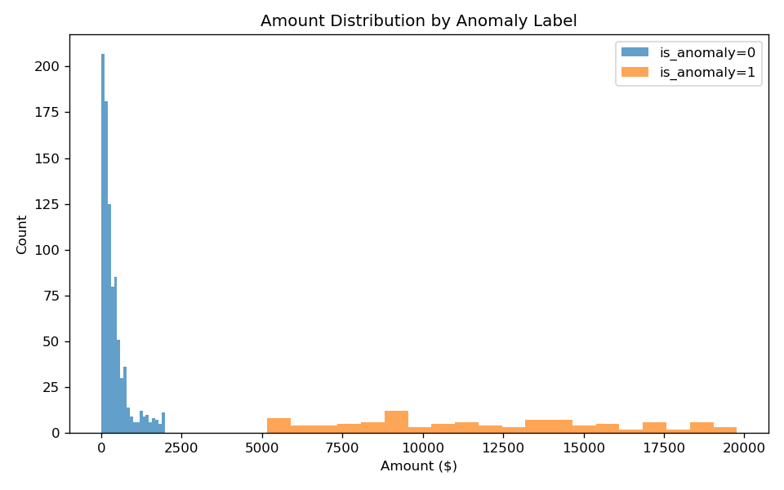
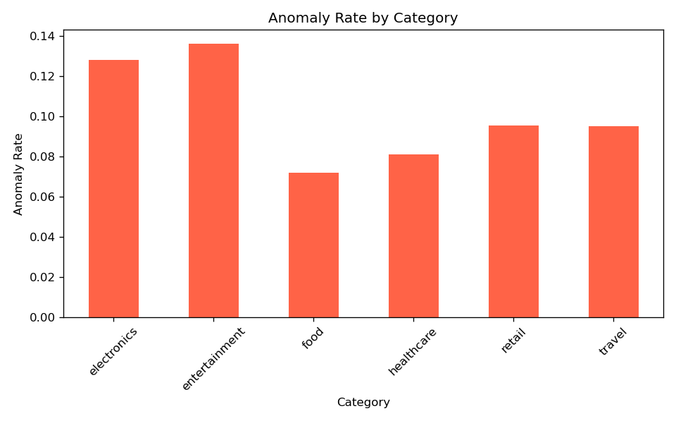
Data Overview
1,000 rows · 19 features · 10.2% anomaly rate · 6 merchant categories

Slide 4
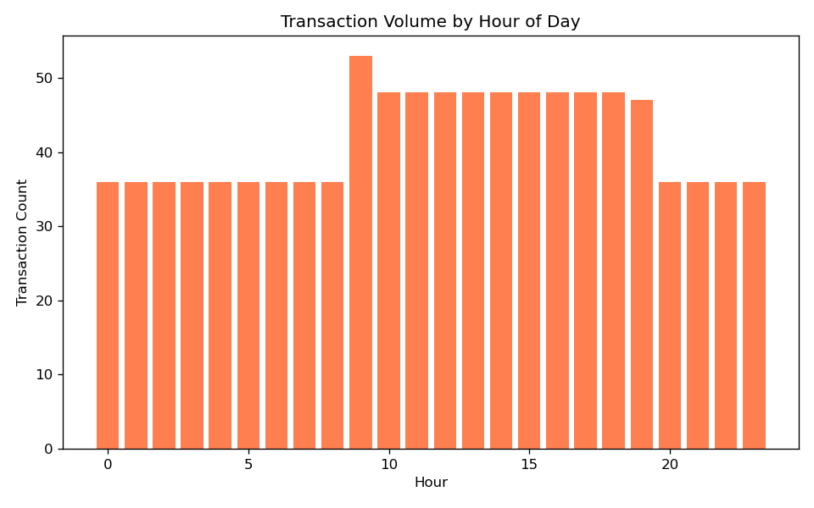
Data Pipeline
Quality Check
Result
Detail
Non-empty DataFrame
✓ PASS
1,000 rows
Required columns present
✓ PASS
6 columns
No duplicate IDs
✓ PASS
0 dupes
Amount positive
✓ PASS
all positive
No null amounts
✓ PASS
0 nulls
Binary anomaly labels
✓ PASS
100% valid
Valid timestamps
✓ PASS
auto-fixed
No null categories
✓ PASS
0 nulls
Amount in range
✓ PASS
max $20k
Anomaly rate 1–50%
✓ PASS
10.2%

Slide 5
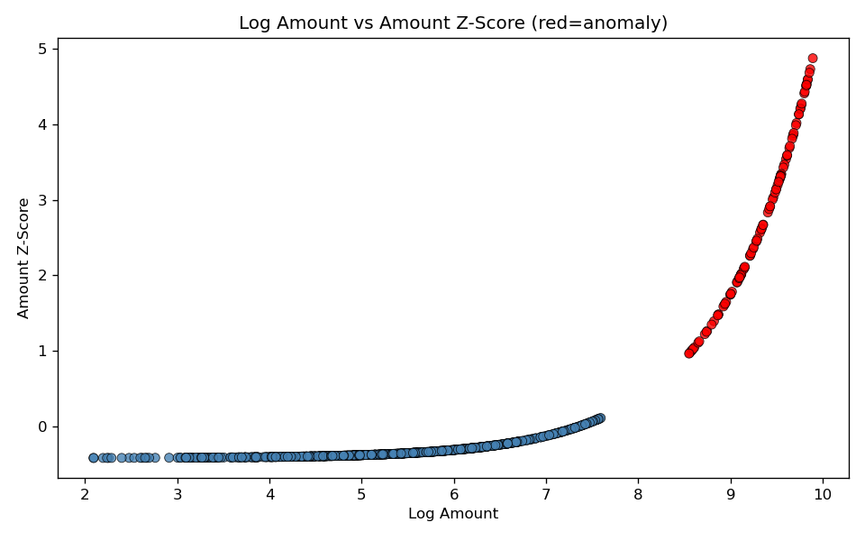
Model Performance
0.9286
0.8667
0.8966
Algorithm
IsolationForest
Precision
Recall
F1 Score
Train samples
700
Algorithm: IsolationForest · Trained on 700 samples · 70/15/15 stratified split

Slide 6
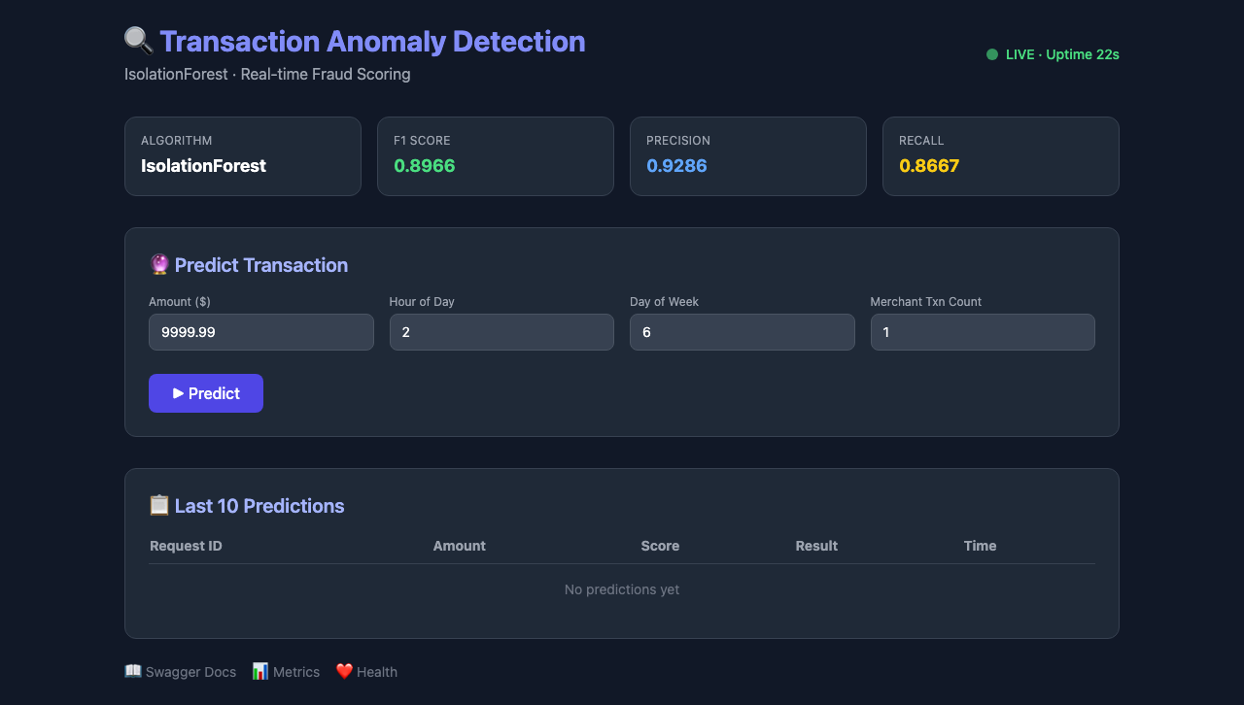
Live Dashboard
Accessible at http://localhost:8000 · POST /predict · GET /health · GET /metrics

Slide 7
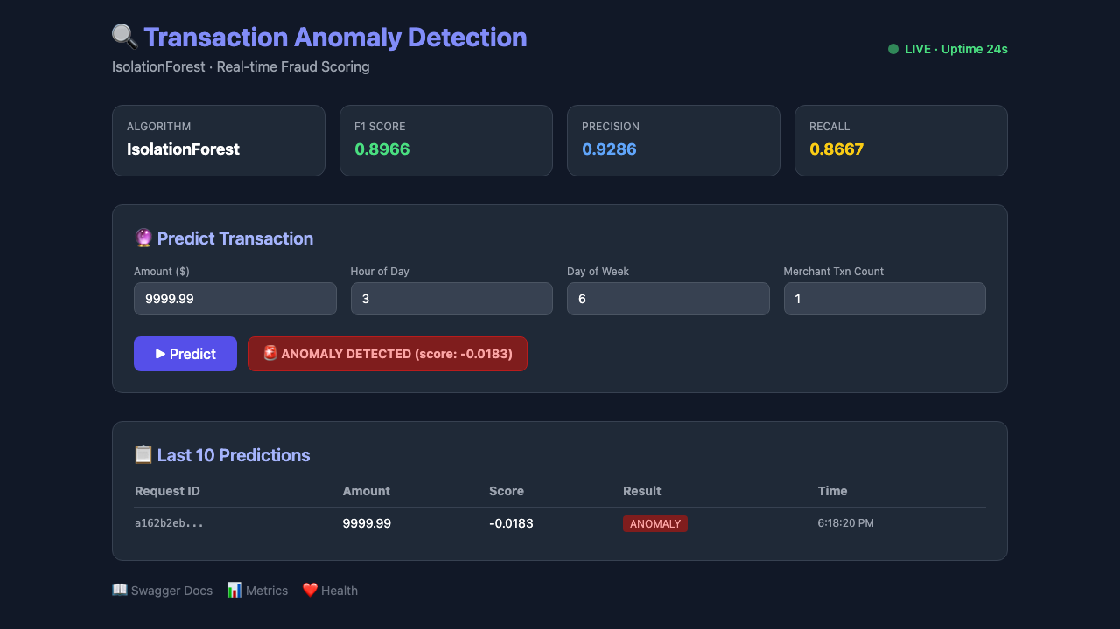
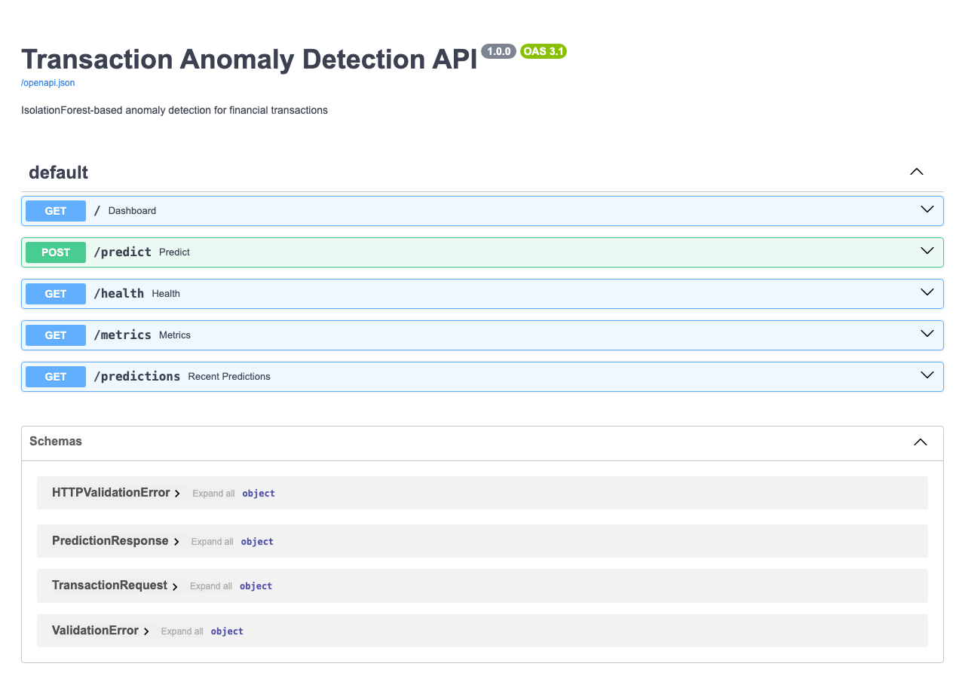
Automated Quality Gates
8 unit tests passed · 6 Playwright E2E tests passed · 14 / 14 total · 0 failures

Slide 8
PIPELINE COMPLETE
Model : IsolationForest — F1=0.8966 · Precision=0.9286 · Recall=0.8667
API : http://localhost:8000 (POST /predict, GET /health, GET /metrics)
GitHub : https://github.com/heramb-analytics/claude-code-ml-pipeline-20260415-214802
JIRA : 6 tickets (TAD-86 → TAD-91) · Epic TAD-85 · Sprint 1 · Project TAD
Confluence: 11-section tech doc · CR space
Tests : 8 unit + 6 Playwright e2e = 14/14 passed · 6 screenshots
Scheduler : Nightly retrain @ 02:00 · Drift check every 6h
Built by : Claude Code (claude-sonnet-4-6) · Fully autonomous · 0 human interventions

