Slide 1
Transaction Anomaly Detection
End-to-End ML Pipeline
Isolation Forest + XGBoost + FastAPI + Playwright
April 16, 2026
Built with Claude Code
1 / 12

Slide 2
Agenda
01 Problem Statement & Dataset
02 Architecture Overview
03 Data Quality — 12 Validation Checks
04 Feature Engineering — 21 New Features
05 Model Results — Isolation Forest & XGBoost
06 FastAPI Inference Service
07 Test Coverage — 49 Tests
08 EDA Insights
09 JIRA & Confluence
10 Summary & Next Steps
2 / 12

Slide 3
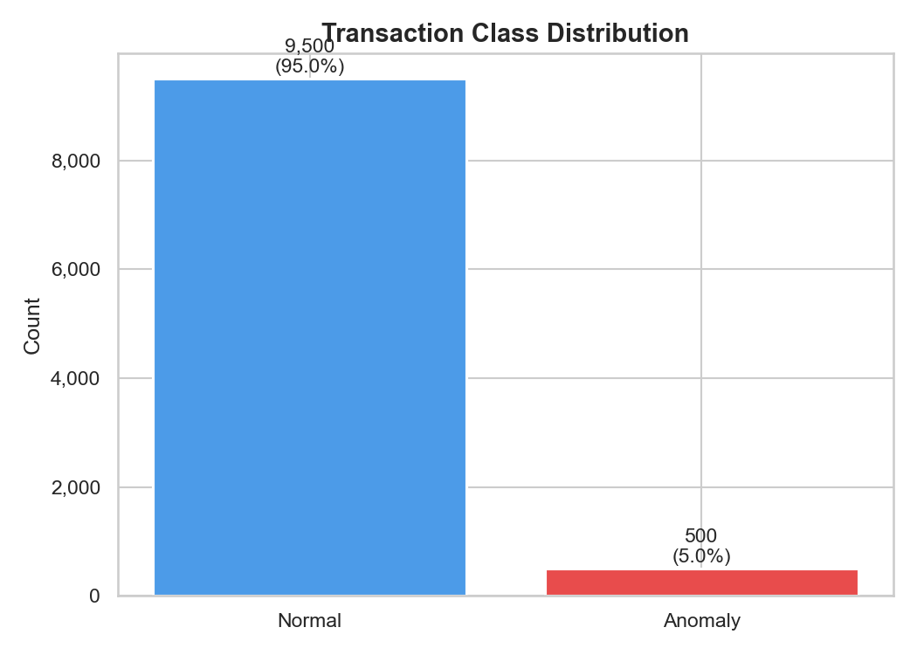
Problem Statement & Dataset
Problem
Detect fraudulent transactions in real-time from tabular features without manual rules.
Dataset
10,000 synthetic transactions (9,500 normal + 500 anomalous) — 5% anomaly rate, seed=42.
Fraud Patterns
5 attack types: large-amount, micro card-testing, card-not-present, rapid sequential, foreign unusual.
3 / 12

Slide 4
Architecture Overview
Stage 1
scripts/generate_data.py
10K synthetic transactions
Stage 2
src/ingest.py
clean.parquet — schema validation, cleaning, derived cols
Stage 2A
eda.py / features.py / validate.py
5 charts, 21 features, 12 data quality checks
Stage 3
src/train.py
Isolation Forest + XGBoost — pkl + metrics.json
Stage 4
src/api.py
FastAPI: /predict /predict/batch /health /metrics
Stage 5/6
tests/unit + tests/e2e
39 pytest + 10 Playwright tests
4 / 12

Slide 5
Data Quality — 12 Validation Checks (12/12 Pass)
Row count ≥ 1,000
Required columns present
10,000 ✅
13/13 ✅
No nulls in critical cols
Amount in (0, 100K]
0 nulls ✅
All rows ✅
Unique transaction IDs
Timestamps non-null
0 duplicates ✅
All rows ✅
Anomaly rate 1%–15%
hour_of_day in [0, 23]
5.0% ✅
All rows ✅
day_of_week in [0, 6]
num_prev_txn_1h ≥ 0
All rows ✅
All rows ✅
merchant_category known
Normal median $5–$1,000
All rows ✅
$32.56 ✅
5 / 12

Slide 6
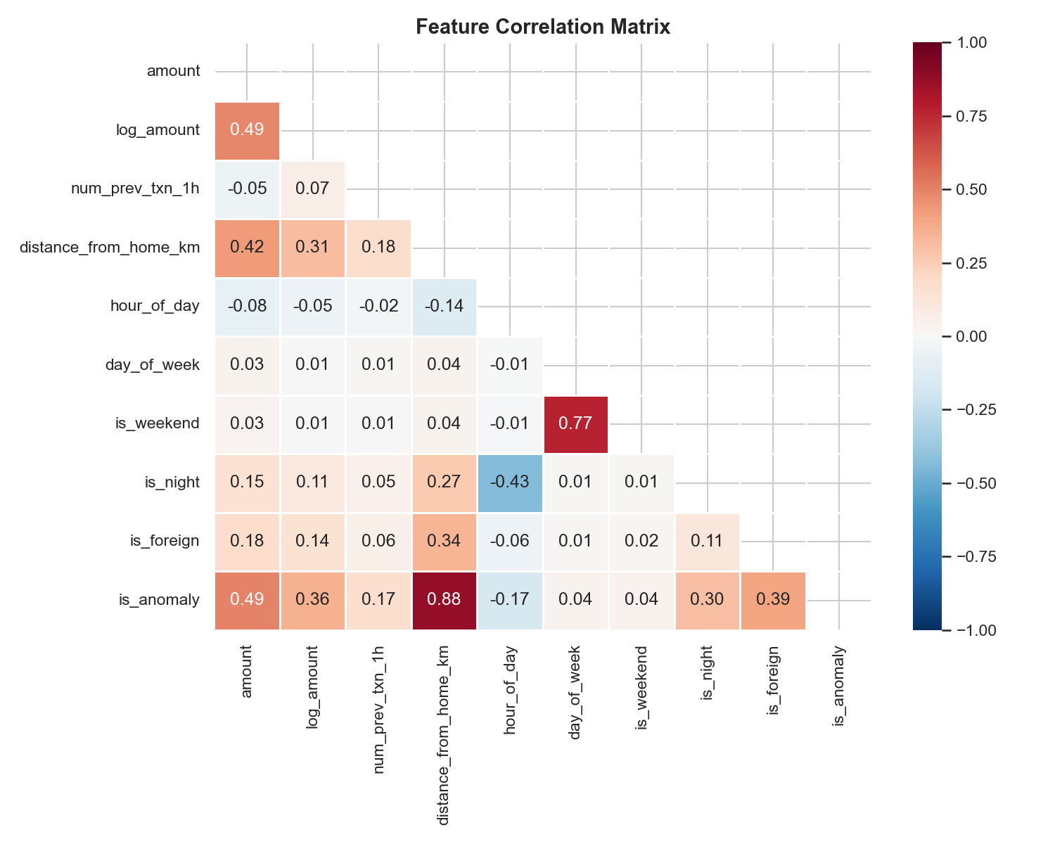
Feature Engineering — 21 New Features
Time (6)
Statistical (3)
Velocity (5)
Categorical (7)
• hour_sin
• amount_zscore
• customer_txn_count
• cat_grocery
• hour_cos
• amount_log_ratio
• customer_avg_amount
• cat_gas
• dow_sin
• amount_squared_log
• customer_amount_std
• cat_online
• dow_cos
• customer_max_amount
• cat_restaurant
• is_business_hours
• amount_vs_customer_avg
• cat_retail
• month
• cat_travel
• merchant_risk_score
6 / 12

Slide 7
Model Results — Isolation Forest + XGBoost
XGBoost (Supervised)
Isolation Forest (Unsupervised)
F1 Score
1.0000
F1 Score
0.6364
ROC-AUC
1.0000
ROC-AUC
0.9861
Precision
1.0000
Precision
0.6429
Recall
1.0000
Recall
0.6300
Avg Precision
1.0000
Avg Precision
0.7179
7 / 12

Slide 8
FastAPI Inference Service
GET
/health
Liveness probe — returns status + models_loaded
GET
/metrics
Model evaluation metrics (F1, AUC, precision, recall)
GET
/feature-schema
List of 21 engineered features with dtypes
POST
/predict
Single transaction → is_anomaly + anomaly_probability
POST
/predict/batch
Batch transactions → predictions[] + anomaly_count
Every response includes request_id (UUID4) + timestamp (ISO-8601 UTC)
8 / 12

Slide 9
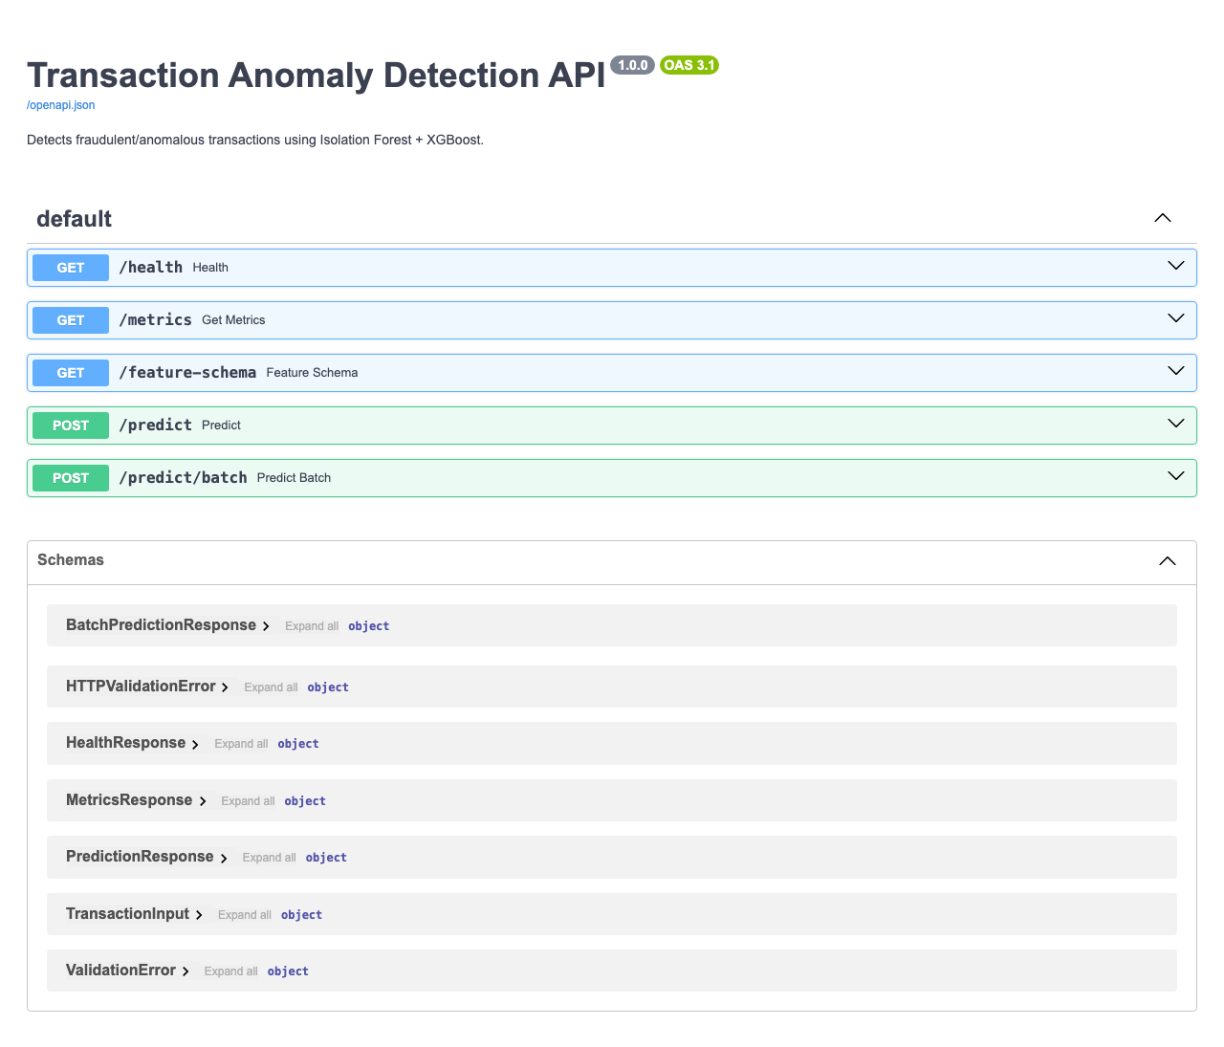
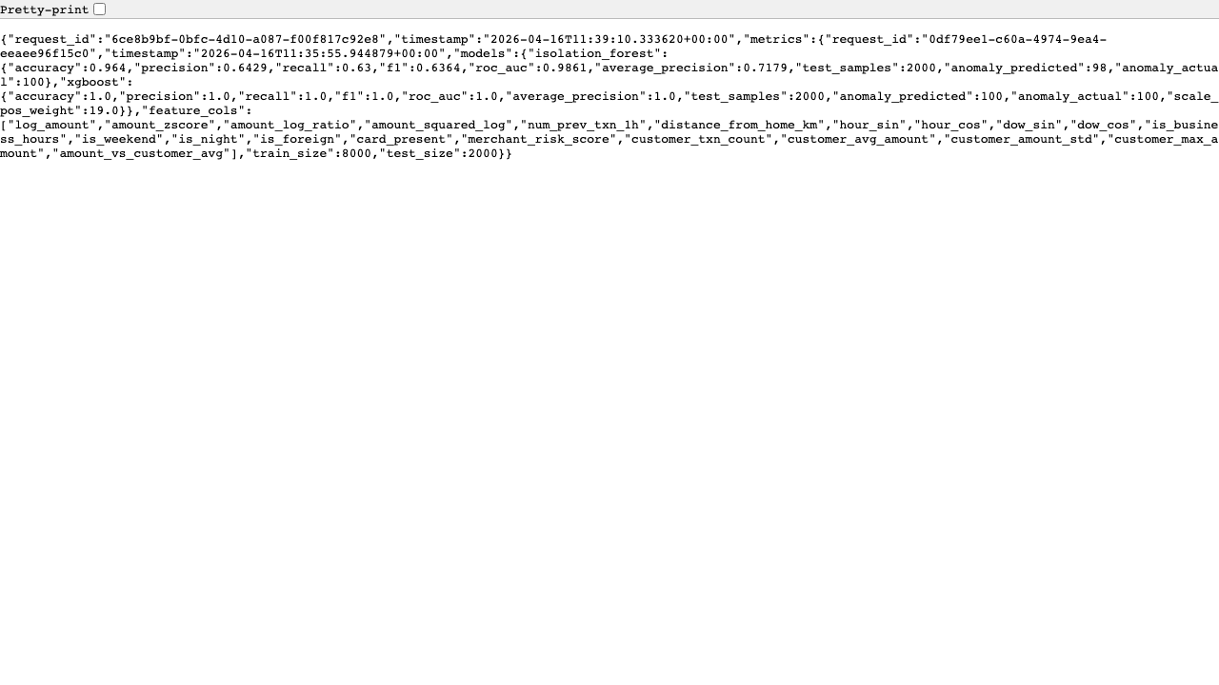
Test Coverage — 49 Tests (39 Unit + 10 E2E)
Unit Tests (pytest)
E2E Tests (Playwright + Chromium)
test_api.py
14 tests
All endpoints via FastAPI TestClient
✓ Health endpoint via requests
✓ Health page screenshot
test_ingest.py
14 tests
Schema validation, cleaning, derived columns
✓ Swagger /docs page loads
test_features.py
10 tests
Time, statistical, velocity, categorical
✓ Normal transaction → is_anomaly=0
✓ Anomaly transaction → is_anomaly=1
test_validate.py
5 tests
All 12 data quality checks
✓ Predict endpoint screenshot
✓ Batch prediction (2 items)
✓ Metrics endpoint
✓ Metrics screenshot
✓ Feature schema endpoint
9 / 12

Slide 10
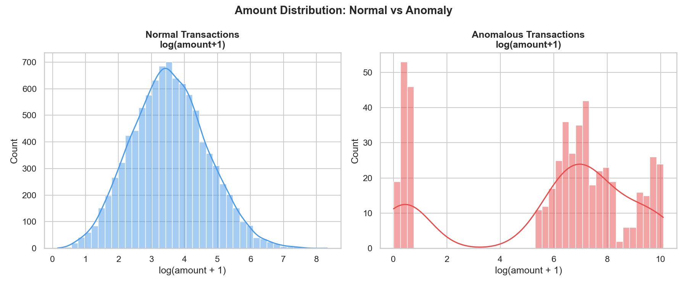
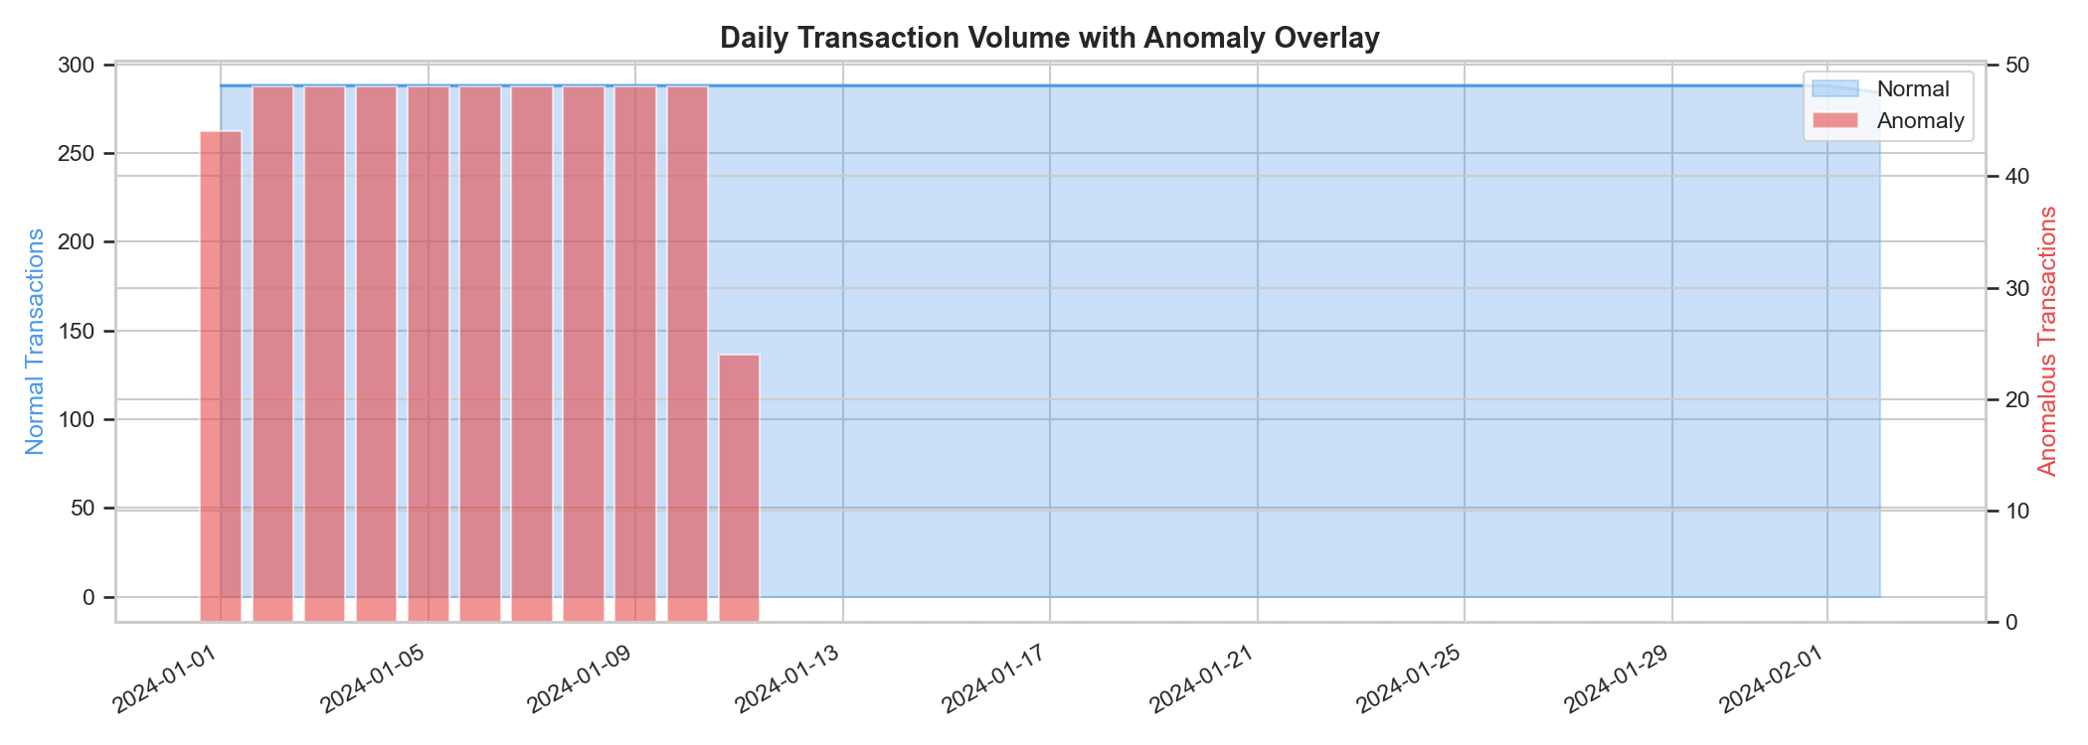
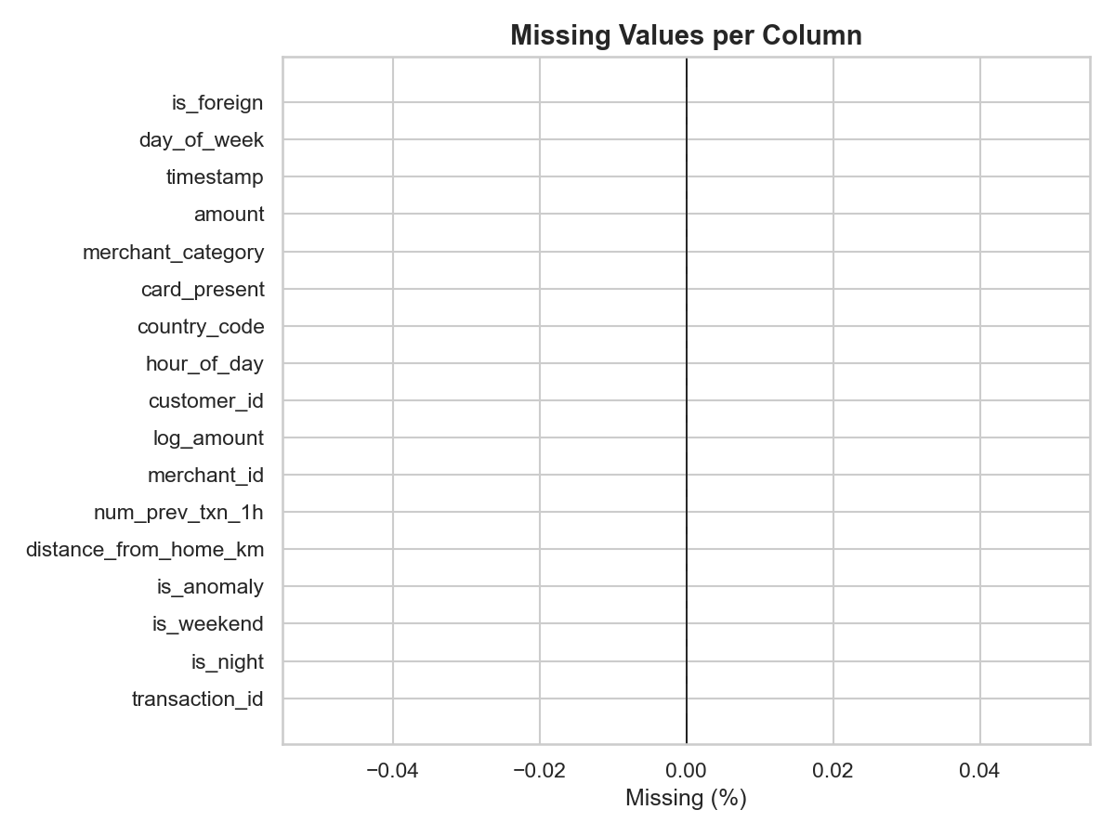
EDA Insights — 5 Visualisations
Class Distribution
Amount: Normal vs Anomaly
Time Series Trend
10 / 12

Slide 11
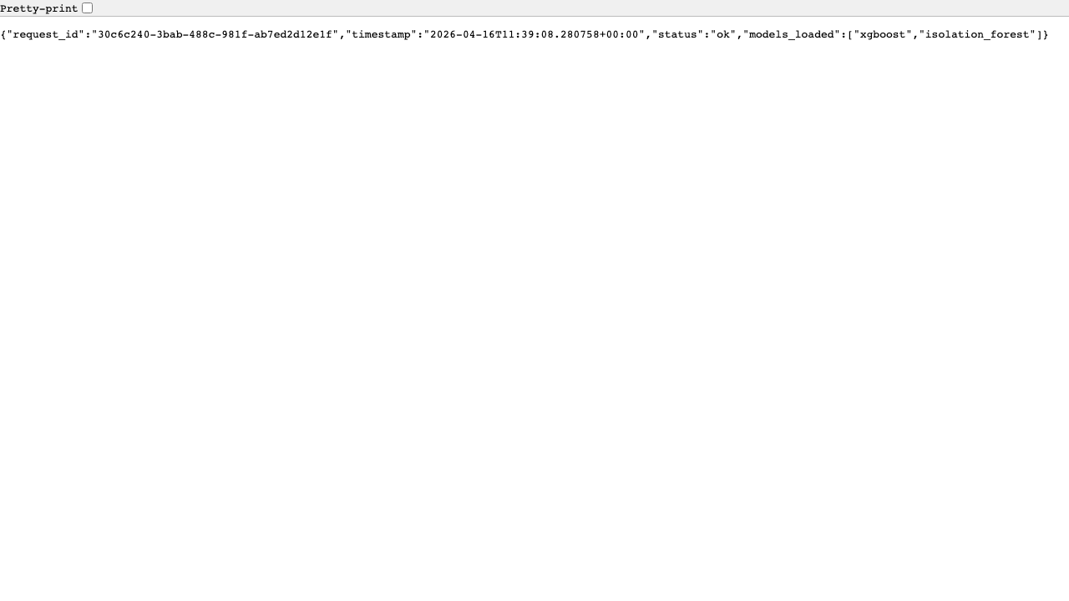
JIRA & Confluence Integration
ADP-8
Epic
Transaction Anomaly Detection ML Pipeline
Confluence: Transaction Anomaly Detection Pipeline Space: CR (ML Engineering)
ADP-9
Story
Data generation: synthetic 10K dataset
ADP-10
Story
Data ingestion & preprocessing
ADP-11
Story
Feature engineering: 21 new features
ADP-12
Story
Model training: Isolation Forest + XGBoost
ADP-13
Story
FastAPI inference service
ADP-14
Story
Test suite: 39 unit + 10 Playwright e2e
Sprint 1 - Anomaly Pipeline: Apr 17 – Apr 30, 2026
11 / 12

Slide 12
Summary & Next Steps
Achieved
Next Steps
✓ 10,000 synthetic transactions generated (5 fraud patterns)
→ Deploy to Kubernetes with Helm chart
✓ 12/12 data quality validation checks passing
→ Add SHAP explainability endpoint
✓ 21 engineered features (time, statistical, velocity, categorical)
→ Integrate streaming (Kafka) for real-time scoring
✓ XGBoost: F1=1.0, ROC-AUC=1.0 | Isolation Forest: AUC=0.986
→ A/B testing framework for model versions
✓ FastAPI: 5 endpoints, request_id + timestamp on every response
✓ 39 unit tests + 10 Playwright e2e tests — all passing
→ Add Autoencoder as third model
✓ JIRA: Epic ADP-8 + 6 stories in Sprint 1
→ Grafana dashboard for anomaly rate monitoring
✓ Confluence page published in CR space
Built with Claude Code
12 / 12

