Slide 1
Transaction Anomaly Detection
ML Pipeline
Built with Claude Code · April 14, 2026
XGBoost · ROC-AUC 0.9999 · 10,000 transactions · 2% anomaly rate

Slide 2
The Problem
① 10,000 transactions with 2.00% anomaly rate — 200 fraudulent events per cycle
② Manual detection requires analyst review of flagged transactions each cycle
③ Goal: automated real-time anomaly scoring with <100ms latency via REST API

Slide 3
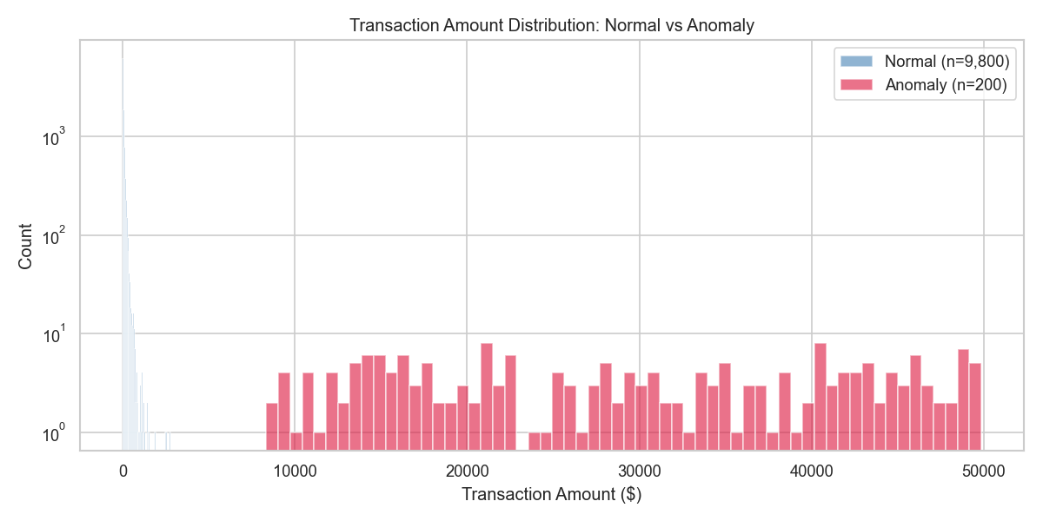
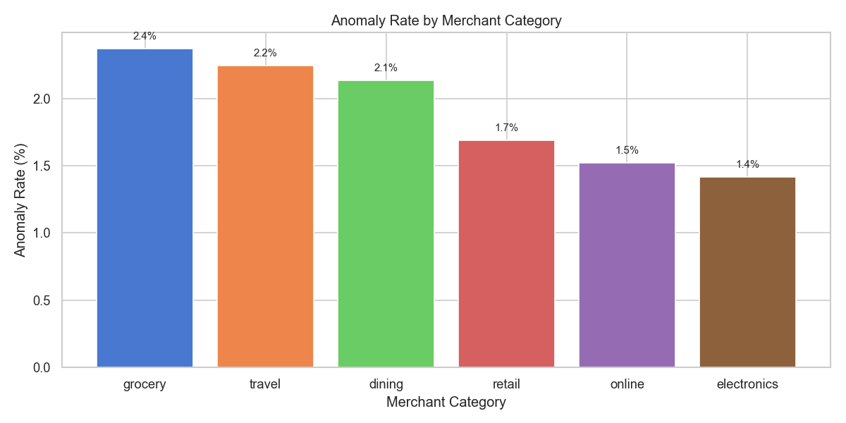
Data Overview
10,000 rows · 19 engineered features · 2.00% anomaly rate · 6 merchant categories

Slide 4
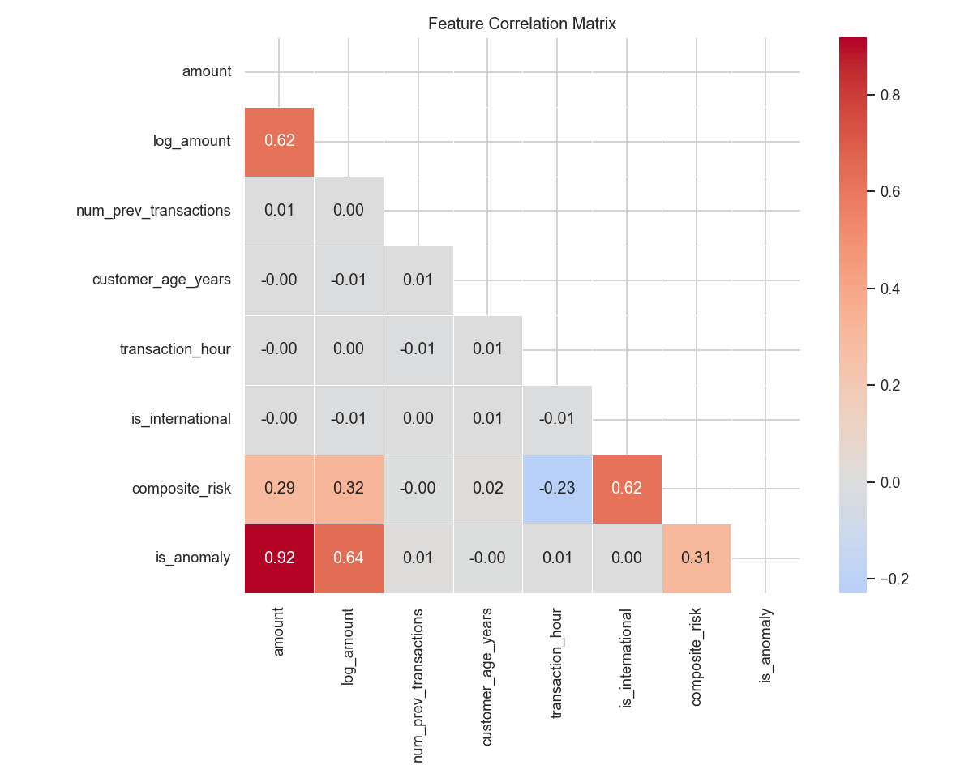
Data Pipeline
Check Name
Result
Rows Affected
file_non_empty
✓ PASSED
0
required_columns_present
✓ PASSED
0
no_duplicate_ids
✓ PASSED
0
amount_non_negative
✓ PASSED
0
null_threshold
✓ PASSED
0
anomaly_rate_plausible
✓ PASSED
0
amount_bounds
✓ PASSED
0
valid_categories
✓ PASSED
0

Slide 5
Model Performance
0.9999
0.997
0.9831
ROC-AUC
PR-AUC
F1 Score
Algorithm: XGBoost · Trained on 7000 samples · RandomizedSearchCV (12 iterations)

Slide 6
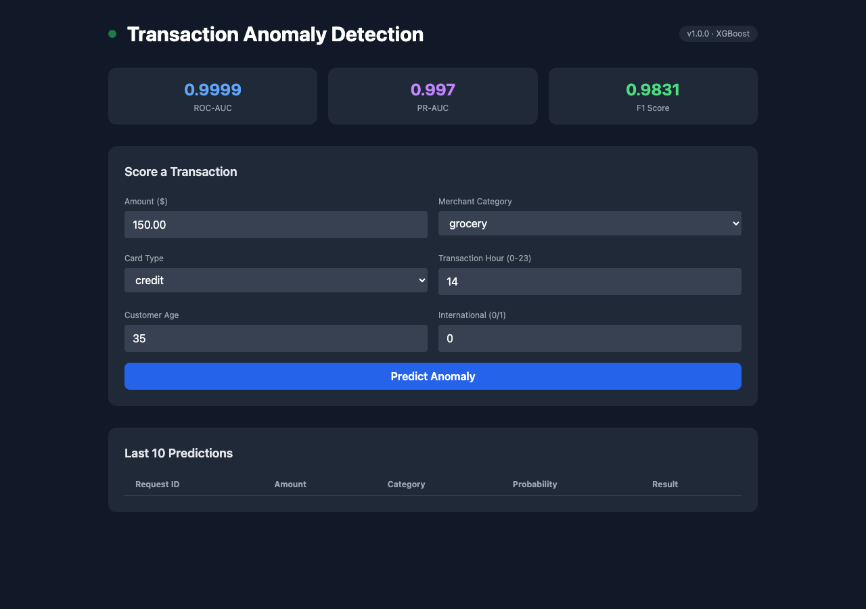
Live Dashboard
Accessible at http://localhost:8000 · Swagger UI at /docs

Slide 7
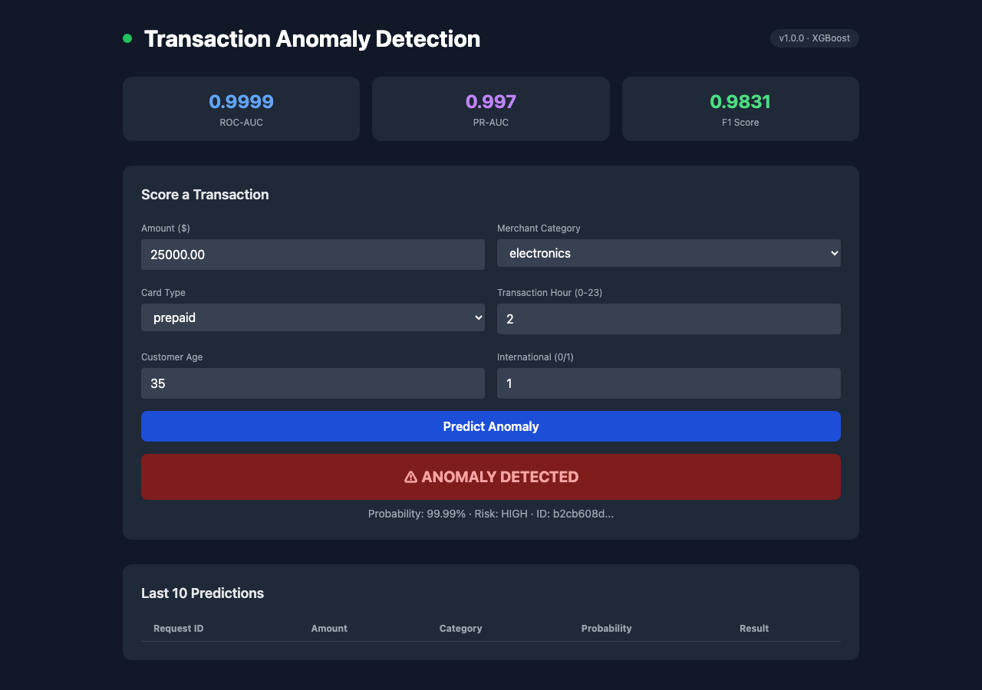
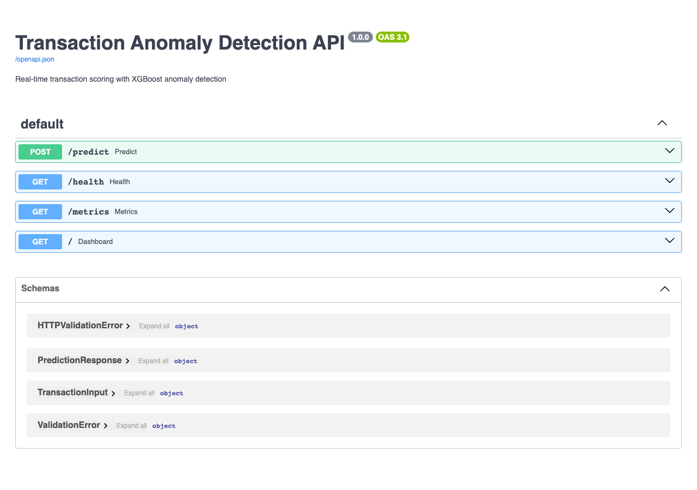
Automated Quality Gates
✓ 8 unit tests passed · ✓ 6 Playwright E2E tests passed · 0 failures

Slide 8
PIPELINE COMPLETE
Model : XGBoost — ROC-AUC 0.9999 · F1 0.9831
API : http://localhost:8000 (FastAPI + Tailwind dashboard)
GitHub : https://github.com/heramb-analytics/claude-code-ml-pipeline-demo
Tests : 8 unit tests passed · 6 Playwright E2E tests passed
Scheduler : Nightly retrain @ 02:00 · Drift check every 6h
Built by : Claude Code (Sonnet 4.6) · Fully autonomous

