Slide 1


Slide 2


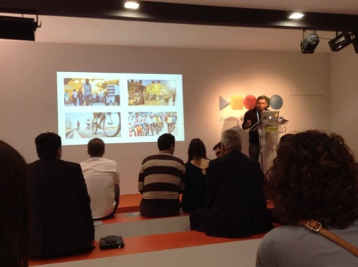

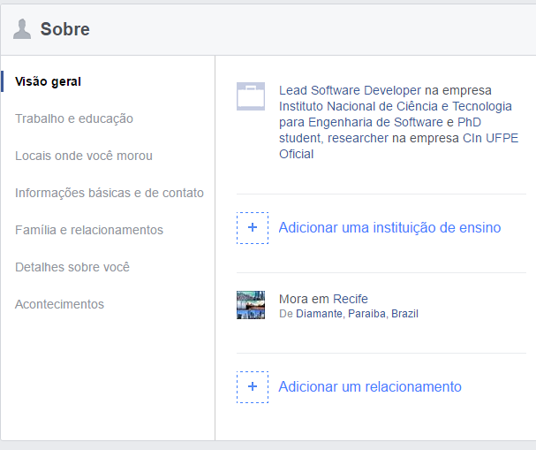
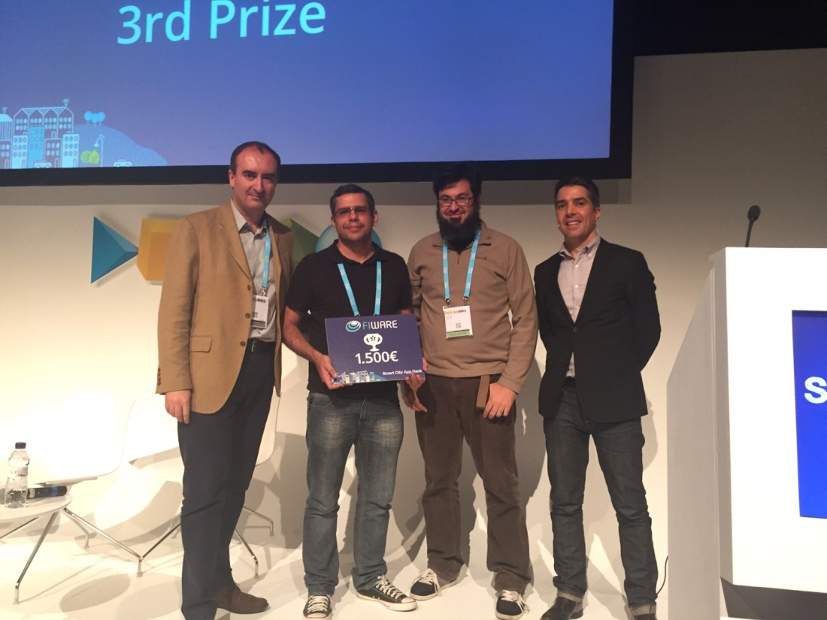



CHAMPION!
Herbertt Diniz
Twitter: @herbertt_b
Email: hbmd@cin.ufpe.br

Slide 3
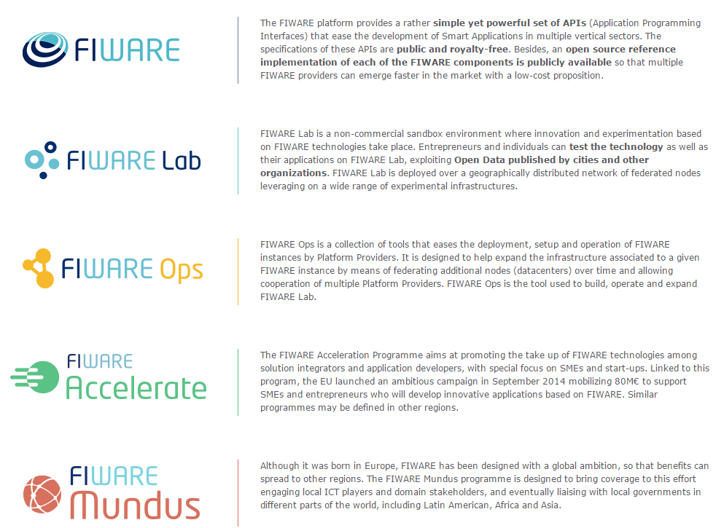

Slide 4
Why FIWARE
Driver | What does FIWARE bring?
Technology | Open specifications backed by open source reference implementations (see [1], [2]) 100+ M€ of investment (2011-2016)
Experimental environment | 15 cities (7 in Spain) already working on setting up a connection to FIWARE Lab [3] 3000+ cores, 16Tb RAM and 750+ Tb HD will be the free computing capacity provided by the FIWARE Lab Cloud across 16 nodes distributed in Europe
Incentives for creating the ecosystem | 52 partners, 13 countries (just FIWARE) 100 M€ devoted to fund entrepreneurs in 2014-2016. Additional opportunities in Horizon 2020. 6,2+ M€ devoted to dissemination
Global footprint | FIWARE Lab nodes in Mexico and Brazil. Conversations between EC and public authorities in Mexico and Brazil to explore collaboration opportunities
[1] – http://wiki.fi-ware.org/Summary_of_FIWARE_Open_Specifications
[2] – http://catalogue.fi-ware.org
[3] – http://lab.fi-ware.org

Slide 5

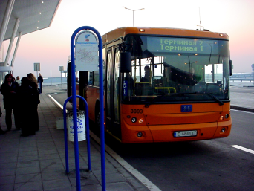
Context Management in FIWARE
Get notified when an update on context information takes place
Notify me when bus “X” arrives at the bus stop “A”
API
Bus = “X”, last_stop = “A”, arrived= “Yes”
push

Slide 6
Orion Context Broker in a nutshell
Orion Context Broker
Context Consumers
subscriptions
query
Context
Producers
1026
update
notify
update
1026
notify
update
DB
Notes:
Orion Context Broker is an implementation of a context information broker with persistent storage
It implements OMA NGSI9/10 specification
NGSI9 is about context information availability (i.e. sources of context information) management
NGSI10 is about context information itself

Slide 7

Orion Context Broker – check health
curl <cb_host>:1026/version
<orion>
<version>0.14.1</version>
<uptime>0 d, 0 h, 0 m, 11 s</uptime>
<git_hash>3fdb55b96913b3e4d9f9a344e990164650f69b91</git_hash>
<compile_time>Wed Sep 30 15:31:29 CET 2014</compile_time>
<compiled_by>fermin</compiled_by>
<compiled_in>centollo</compiled_in>
</orion>
Notes:
Do the following sequence (showing the XML)
registerContext Room1-temperature
updateContext Room1-temperture = 30ºC
queryContext Room1-temperature
updateContext Room1-temperture = 31ºC
queryContext Room1-temperature

Slide 8
Orion Context Broker - Operations
 | Functions | Operations
NGSI9 | Register, Search and Subscribe for context sources | registerContext discoverContextAvailability subscribeContextAvailability updateContextAvailabilitySubscription unsubscribeContextAvailability
NGSI10 | Query, Update and Subscribe to context elements | updateContext queryContext subscribeContext updateContextSubscription unsubscribeContextSubscription
Notes:
1. En la primera slide poned una lista de puntos de lo que se puede hacer con ese GE/set de GEs. Me refiero en plan titulares, sin muchas explicaciones.
2. Mostrad un ejemplo representativo de uno o varios de los puntos anteriores.
Recordad: si lo hacéis como demo, poned slides con capturas y explicaciones también (así sirve también por si la demo os falla en ese momento ;-) ).
3. Mostrad un enlace donde pondremos esta semana las slides de la Campus que tienen los detalles de todos los puntos mencionados en 1.
(Poned la lista de ficheros pero dejad el enlace en blanco que ya lo pondremos a última hora).

Slide 9
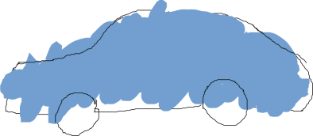

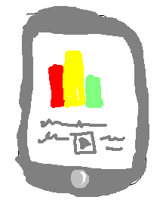
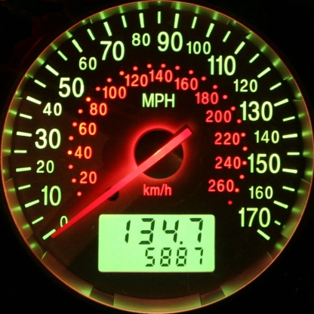
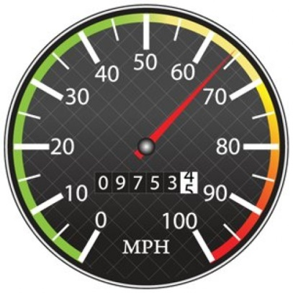
Context Broker operations: create & pull data
Context Producers publish data/context elements by invoking the updateContext operation on a Context Broker.
Context Consumers can retrieve data/context elements by invoking the queryContext operation on a Context Broker
updateContext
queryContext
Context Producer
Context Broker
Context Consumer

Slide 10

Quick Usage Example: Car Create
POST localhost:1026/v1/updateContext
...
{
"contextElements": [
{
"type": "Car",
"isPattern": "false",
"id": "Car1",
"attributes": [
{
"name": "speed",
"type": "km/h",
"value": “98"
}
]
}
],
"updateAction": “APPEND"
}
200 OK
...
{
"contextResponses": [
{
"contextElement": {
"attributes": [
{
"name": "speed",
"type": "km/h",
"value": ""
}
],
"id": "Car1",
"isPattern": "false",
"type": "Car"
},
"statusCode": {
"code": "200",
"reasonPhrase": "OK"
}
}
]
}
Notes:
Do the following sequence (showing the XML)
registerContext Room1-temperature
updateContext Room1-temperture = 30ºC
queryContext Room1-temperature
updateContext Room1-temperture = 31ºC
queryContext Room1-temperature

Slide 11

Quick Usage Example: Car UpdateContext (1)
POST localhost:1026/v1/updateContext
...
{
"contextElements": [
{
"type": "Car",
"isPattern": "false",
"id": "Car1",
"attributes": [
{
"name": "speed",
"type": "km/h",
"value": "110"
}
]
}
],
"updateAction": "UPDATE"
}
200 OK
...
{
"contextResponses": [
{
"contextElement": {
"attributes": [
{
"name": "speed",
"type": "km/h",
"value": ""
}
],
"id": "Car1",
"isPattern": "false",
"type": "Car"
},
"statusCode": {
"code": "200",
"reasonPhrase": "OK"
}
}
]
}
Notes:
Do the following sequence (showing the XML)
registerContext Room1-temperature
updateContext Room1-temperture = 30ºC
queryContext Room1-temperature
updateContext Room1-temperture = 31ºC
queryContext Room1-temperature

Slide 12
Quick Usage Example: Car QueryContext (1)
200 OK
...
{
"contextResponses": [
{
"contextElement": {
"attributes": [
{
"name": "speed",
"type": "km/h",
"value": "110"
}
],
"id": "Car1",
"isPattern": "false",
"type": "Car"
},
"statusCode": {
"code": "200",
"reasonPhrase": "OK"
}
}
]
}
POST <cb_host>:1026/v1/queryContext
...
{
"entities": [
{
"type": "Car",
"isPattern": "false",
"id": "Car1"
}
]
}
Notes:
Do the following sequence (showing the XML)
registerContext Room1-temperature
updateContext Room1-temperture = 30ºC
queryContext Room1-temperature
updateContext Room1-temperture = 31ºC
queryContext Room1-temperature

Slide 13
Quick Usage Example: Car UpdateContext (2)
POST localhost:1026/v1/updateContext
...
{
"contextElements": [
{
"type": "Car",
"isPattern": "false",
"id": "Car1",
"attributes": [
{
"name": "speed",
"type": "km/h",
"value": "115"
}
]
}
],
"updateAction": "UPDATE"
}
200 OK
...
{
"contextResponses": [
{
"contextElement": {
"attributes": [
{
"name": "speed",
"type": "km/h",
"value": ""
}
],
"id": "Car1",
"isPattern": "false",
"type": "Car"
},
"statusCode": {
"code": "200",
"reasonPhrase": "OK"
}
}
]
}
Notes:
Do the following sequence (showing the XML)
registerContext Room1-temperature
updateContext Room1-temperture = 30ºC
queryContext Room1-temperature
updateContext Room1-temperture = 31ºC
queryContext Room1-temperature

Slide 14
Quick Usage Example: Car QueryContext (2)
200 OK
...
{
"contextResponses": [
{
"contextElement": {
"attributes": [
{
"name": "speed",
"type": "km/h",
"value": "115"
}
],
"id": "Car1",
"isPattern": "false",
"type": "Car"
},
"statusCode": {
"code": "200",
"reasonPhrase": "OK"
}
}
]
}
POST <cb_host>:1026/v1/queryContext
...
{
"entities": [
{
"type": "Car",
"isPattern": "false",
"id": "Car1"
}
]
}
Notes:
Do the following sequence (showing the XML)
registerContext Room1-temperature
updateContext Room1-temperture = 30ºC
queryContext Room1-temperature
updateContext Room1-temperture = 31ºC
queryContext Room1-temperature

Slide 15

Quick Usage Example: Room Create (1)
POST localhost:1026/v1/updateContext
...
{
"contextElements": [
{
"type": "Room",
"isPattern": "false",
"id": "Room1",
"attributes": [
{
"name": "temperature",
"type": "centigrade",
"value": "24"
},
{
"name": "pressure",
"type": "mmHg",
"value": "718"
}
]
}
],
"updateAction": "APPEND"
}
200 OK
...
{
"contextResponses": [
{
"contextElement": {
"attributes": [
{
"name": "temperature",
"type": "centigrade",
"value": ""
},
{
"name": "pressure",
"type": "mmHg",
"value": ""
}
],
"id": "Room1",
"isPattern": "false",
"type": "Room"
},
"statusCode": {
"code": "200",
"reasonPhrase": "OK"
}
}
]
}
Notes:
Do the following sequence (showing the XML)
registerContext Room1-temperature
updateContext Room1-temperture = 30ºC
queryContext Room1-temperature
updateContext Room1-temperture = 31ºC
queryContext Room1-temperature

Slide 16
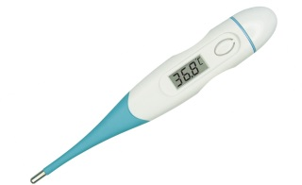
Quick Usage Example: Room UpdateContext (2)
POST localhost:1026/v1/updateContext
...
{
"contextElements": [
{
"type": "Room",
"isPattern": "false",
"id": "Room1",
"attributes": [
{
"name": "temperature",
"type": "centigrade",
"value": "25"
},
{
"name": "pressure",
"type": "mmHg",
"value": "720"
}
]
}
],
"updateAction": "UPDATE"
}
200 OK
...
{
"contextResponses": [
{
"contextElement": {
"attributes": [
{
"name": "temperature",
"type": "centigrade",
"value": ""
},
{
"name": "pressure",
"type": "mmHg",
"value": ""
}
],
"id": "Room1",
"isPattern": "false",
"type": "Room"
},
"statusCode": {
"code": "200",
"reasonPhrase": "OK"
}
}
]
}
Notes:
Do the following sequence (showing the XML)
registerContext Room1-temperature
updateContext Room1-temperture = 30ºC
queryContext Room1-temperature
updateContext Room1-temperture = 31ºC
queryContext Room1-temperature

Slide 17
Quick Usage Example: Room QueryContext (1)
200 OK
...
{
"contextResponses": [
{
"contextElement": {
"attributes": [
{
"name": "temperature",
"type": "centigrade",
"value": "25"
}
],
"id": "Room1",
"isPattern": "false",
"type": "Room"
},
"statusCode": {
"code": "200",
"reasonPhrase": "OK"
}
}
]
}
POST <cb_host>:1026/v1/queryContext
...
{
"entities": [
{
"type": "Room",
"isPattern": "false",
"id": "Room1"
} ,
"attributes": [
"temperature"
]
]
}
Notes:
Do the following sequence (showing the XML)
registerContext Room1-temperature
updateContext Room1-temperture = 30ºC
queryContext Room1-temperature
updateContext Room1-temperture = 31ºC
queryContext Room1-temperature

Slide 18
Quick Usage Example: Room QueryContext (2)
200 OK
...
{
"contextResponses": [
{
"contextElement": {
"attributes": [
{
"name": "temperature",
"type": "centigrade",
"value": "25"
},
{
"name": "pressure",
"type": "mmHg",
"value": "720"
}
],
"id": "Room1",
"isPattern": "false",
"type": "Room"
},
"statusCode": {
"code": "200",
"reasonPhrase": "OK"
}
}
]
}
POST <cb_host>:1026/v1/queryContext
...
{
"entities": [
{
"type": "Room",
"isPattern": "false",
"id": "Room1"
}
]
}
Notes:
Do the following sequence (showing the XML)
registerContext Room1-temperature
updateContext Room1-temperture = 30ºC
queryContext Room1-temperature
updateContext Room1-temperture = 31ºC
queryContext Room1-temperature

Slide 19
Quick Usage Example: Room Create (2)
POST localhost:1026/v1/updateContext
...
{
"contextElements": [
{
"type": "Room",
"isPattern": "false",
"id": "Room2",
"attributes": [
{
"name": "temperature",
"type": "centigrade",
"value": "33"
},
{
"name": "pressure",
"type": "mmHg",
"value": "722"
}
]
}
],
"updateAction": "APPEND"
}
200 OK
...
{
"contextResponses": [
{
"contextElement": {
"attributes": [
{
"name": "temperature",
"type": "centigrade",
"value": ""
},
{
"name": "pressure",
"type": "mmHg",
"value": ""
}
],
"id": "Room1",
"isPattern": "false",
"type": "Room"
},
"statusCode": {
"code": "200",
"reasonPhrase": "OK"
}
}
]
}
Notes:
Do the following sequence (showing the XML)
registerContext Room1-temperature
updateContext Room1-temperture = 30ºC
queryContext Room1-temperature
updateContext Room1-temperture = 31ºC
queryContext Room1-temperature

Slide 20
Quick Usage Example: Room UpdateContext (2)
POST localhost:1026/v1/updateContext
...
{
"contextElements": [
{
"type": "Room",
"isPattern": "false",
"id": "Room2",
"attributes": [
{
"name": "temperature",
"type": "centigrade",
"value": "29"
},
{
"name": "pressure",
"type": "mmHg",
"value": "730"
}
]
}
],
"updateAction": "UPDATE"
}
200 OK
...
{
"contextResponses": [
{
"contextElement": {
"attributes": [
{
"name": "temperature",
"type": "centigrade",
"value": ""
},
{
"name": "pressure",
"type": "mmHg",
"value": ""
}
],
"id": "Room1",
"isPattern": "false",
"type": "Room"
},
"statusCode": {
"code": "200",
"reasonPhrase": "OK"
}
}
]
}
Notes:
Do the following sequence (showing the XML)
registerContext Room1-temperature
updateContext Room1-temperture = 30ºC
queryContext Room1-temperature
updateContext Room1-temperture = 31ºC
queryContext Room1-temperature

Slide 21
Quick Usage Example: Room QueryContext (3)
200 OK
...
{
"contextResponses": [
{
"contextElement": {
"attributes": [
{
"name": "temperature",
"type": "centigrade",
"value": "25"
}
],
"id": "Room1",
"isPattern": "false",
"type": "Room"
},
"statusCode": {
"code": "200",
"reasonPhrase": "OK"
}
},
{
"contextElement": {
"attributes": [
{
"name": "temperature",
"type": "centigrade",
"value": "29"
}
],
"id": "Room2",
"isPattern": "false",
"type": "Room"
},
"statusCode": {
"code": "200",
"reasonPhrase": "OK"
}
}
]
}
POST <cb_host>:1026/v1/queryContext
...
{
"entities": [
{
"type": "Room",
"isPattern": "true",
"id": "Room.*"
}] ,
"attributes": [
"temperature"
]
}
Notes:
Do the following sequence (showing the XML)
registerContext Room1-temperature
updateContext Room1-temperture = 30ºC
queryContext Room1-temperature
updateContext Room1-temperture = 31ºC
queryContext Room1-temperature

Slide 22
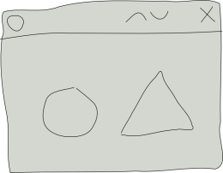
Context Broker operations: push data
Context Consumers can subscribe to receive context information that satisfy certain conditions using the subscribeContext. Such subscriptions may have a duration.
The Context Broker notifies updates on context information to subscribed Context Consumers by invoking the notifyContext operation they export
Application
subscription_id = subscribeContext (consumer, expr, duration)
notifyContext (subscription_id, data/context)
Context Consumer
Context Broker

Slide 23
Quick Usage Example: Subscription
POST <cb_host>:1026/v1/subscribeContext
…
{
"entities": [
{
"type": "Room",
"isPattern": "false",
"id": "Room1"
}
],
"attributes": [
"temperature"
],
"reference": "http://<host>:<port>/publish",
"duration": "P1M",
"notifyConditions": [
{
"type": "ONCHANGE",
"condValues": [
"temperature"
]
}
],
"throttling": "PT5S"
}
200 OK
...
{
"subscribeResponse": {
"duration": "P1M",
"subscriptionId": "51c0ac9ed714fb3b37d7d5a8",
"throttling": "PT5S"
}
}
Notes:
Do the following sequence (showing the XML)
registerContext Room1-temperature
updateContext Room1-temperture = 30ºC
queryContext Room1-temperature
updateContext Room1-temperture = 31ºC
queryContext Room1-temperature

Slide 24

Quick Usage Example: Notification
25
19
Notes:
Do the following sequence (showing the XML)
registerContext Room1-temperature
updateContext Room1-temperture = 30ºC
queryContext Room1-temperature
updateContext Room1-temperture = 31ºC
queryContext Room1-temperature

Slide 25
Quick Usage Example: Notification
POST http://<host>:<port>/publish
…
{
"subscriptionId" : "51c0ac9ed714fb3b37d7d5a8",
"originator" : "localhost",
"contextResponses" : [
{
"contextElement" : {
"attributes" : [
{
"name" : "temperature",
"type" : "centigrade",
"value" : "19"
}
],
"type" : "Room",
"isPattern" : "false",
"id" : "Room1"
},
"statusCode" : {
"code" : "200",
"reasonPhrase" : "OK"
}
}
]
}
Notes:
Do the following sequence (showing the XML)
registerContext Room1-temperature
updateContext Room1-temperture = 30ºC
queryContext Room1-temperature
updateContext Room1-temperture = 31ºC
queryContext Room1-temperature

Slide 26
Convenience Operations
They are equivalent to previous standard operations in functionality
Avoid the need for POST-ing payloads in many cases or simplifying them considerably
Simple to write, more REST-like
They are not a substitute but a complement to standard NGSI operations
Four examples (there are many others):
Entities
Attributes
Subscriptions
Types

Slide 27
Convenience Operations – Example 1
Entities
GET /v1/contextEntities/{entityID}
Retrieves an entity
POST /v1/contextEntities/{entityID}
Creates an entity
PUT /v1/contextEntities/{entityID}
Updates an entity
DELETE /v1/contextEntities/{entityID}
Deletes an entity

Slide 28
Convenience Operations – Example 2
Attributes
GET /v1/contextEntities/{entityID}/attributes/{attrID}
Retrieves an attribute’s value
POST /v1/contextEntities/{entityID}/attributes/{attrID}
Creates a new attribute for an entity
PUT /v1/contextEntities/{entityID}/attributes/{attrID}
Updates an attribute’s value
DELETE /v1/contextEntities/{entityID}/attributes/{attrID}
Deletes an attribute

Slide 29
Convenience Operations – Example 3
Subscriptions
POST /v1/contextSubscriptions
Creates a subscription
PUT /v1/contextSubscriptions/{subID}
Updates a subscription
DELETE /v1/contextSubscriptions/{subID}
Cancel a subscription

Slide 30
Convenience Operations – Example 4
Entity Types
GET /v1/contextTypes
Retrieve a list of all entity types currently in Orion, including their corresponding attributes
GET /v1/contextTypes/{typeID}
Retrieve attributes associated to an entity type
PRO TIP
GET /v1/contextTypes?collapse=true
Retrieves a list of all entity types without attribute info

Slide 31
Advanced Features
Pagination
Compound attribute values
Geo-location
Metadata
Orion Context Broker

Slide 32
Pagination
Pagination helps clients organize query and discovery requests with a large number of responses.
Three URI parameters:
limit
Number of elements per page (default: 20, max: 1000)
offset
Number of elements to skip (default: 0)
details
Returns total elements (default: "off")

Slide 33
Pagination
Example, querying the first 100 entries:
POST <orion_host>:1026/v1/queryContext?limit=100&details=on
The first 100 elements are returned, along with the following errorCode in the response:
<errorCode>
<code>200</code>
<reasonPhrase>OK</reasonPhrase>
<details>Count: 322</details>
</errorCode>
Now we now there are 322 entities, we can keep querying the broker for them:
POST <orion_host>:1026/v1/queryContext?offset=100&limit=100
POST <orion_host>:1026/v1/queryContext?offset=200&limit=100
POST <orion_host>:1026/v1/queryContext?offset=300&limit=100

Slide 34
Compound Attribute Values
An attribute can have a structured value. Vectors and key-value maps are supported.
It maps directly to JSON's objects and arrays.

Slide 35
Compound Attribute Values
{
"contextElements": [
{
"type": "Car",
"isPattern": "false",
"id": "Car1",
"attributes": [
{
"name": "tirePressure",
"type": "kPa",
"value": {
"frontRight": "120",
"frontLeft": "110",
"backRight": "115",
"backLeft": "130"
}
}
]
}
],
"updateAction": "APPEND"
}
Example: we have a car whose four wheels' pressure we want to represent as a compound attribute for a car entity. We would create the car entity like this:

Slide 36
Metadata
Users may attach metadata to attributes
Reserved metadatas: ID, Location, creDate and modDate
Examples:
…
"attributes": [
{
"name": "temperature",
"type": "centigrade",
"value": "26.5",
"metadatas": [
{
"name": "accuracy",
"type": "float",
"value": "0.9"
}
]
}
]
…
…
"attributes": [
{
"name": "temperature",
"type": "centigrade",
"value": "26.5",
"metadatas": [
{
"name": "average",
"type": "centigrade",
"value": "22.4"
}
]
}
]
…

Slide 37

Geo-location
POST <cb_host>:1026/v1/updateContext
{
"contextElements": [
{
"type": "City",
"isPattern": "false",
"id": "Madrid",
"attributes": [
{
"name": "position",
"type": "coords",
"value": "40.418889, -3.691944",
"metadatas": [
{
"name": "location",
"type": "string",
"value": "WSG84"
}
]
}
]
}
],
"updateAction": "APPEND"
}
Entities can have an attribute that specifies its location
Using a "location" metadata
Example: create an entity called Madrid
…and create a couple more towns:
Leganés
Alcobendas

Slide 38
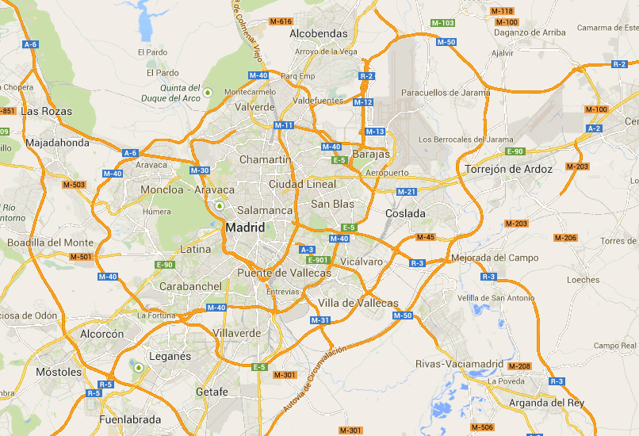
Geo-location – Circle

Slide 39
Geo-location – Circle
POST <cb_host>:1026/v1/queryContext
…
{
"entities": [
{
"type": "City",
"isPattern": "true",
"id": ".*"
}
],
"restriction": {
"scopes": [
{
"type" : "FIWARE_Location",
"value" : {
"circle": {
"centerLatitude": "40.418889",
"centerLongitude": "-3.691944",
"radius": "13500"
}
}
}
]
}
}
13.5 km radius

Slide 40
Geo-location – Inverse Circle
POST <cb_host>:1026/v1/queryContext
…
{
"entities": [
{
"type": "City",
"isPattern": "true",
"id": ".*"
}
],
"restriction": {
"scopes": [
{
"type" : "FIWARE_Location",
"value" : {
"circle": {
"centerLatitude": "40.418889",
"centerLongitude": "-3.691944",
"radius": "13500",
"inverted": "true"
}
}
}
]
}
}
13.5 km radius

Slide 41


