Slide 1
IoT-Internet of Things
+
Fiware
Herbertt Diniz
hbmd@cin.ufpe.br

Slide 2
IoT-Internet of Things

Slide 3
INTERNET OF THINGS - IOT
Is a term that represents a collection of ideas, devices, and processes.
Each thing is represented by a device or sensor.
These things are usually working together to create larger solutions by sending and reacting to data from an eco-system.
Fonte: http://bit.ly/21lMhQR

Slide 4
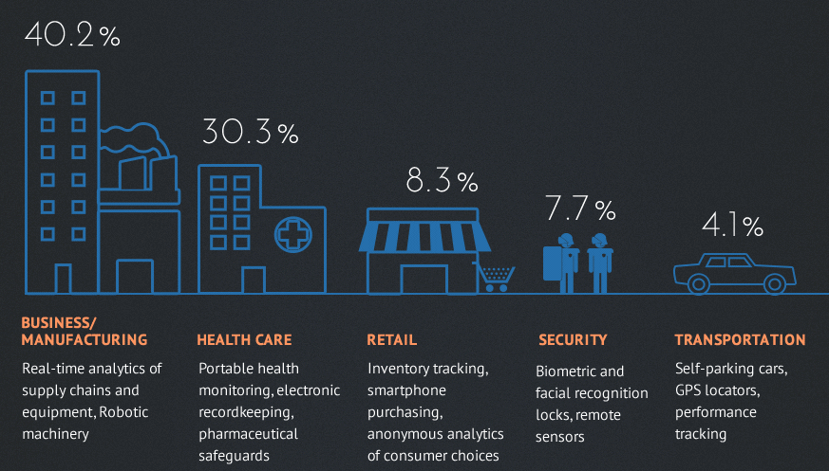
Cadê a IoT?
http://bit.ly/1RbgGvs

Slide 5
Big Data!
50 Bilhões de dispositivos até 2020 conectados.

Slide 6
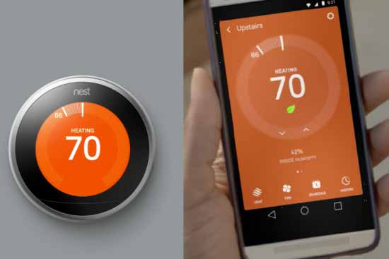
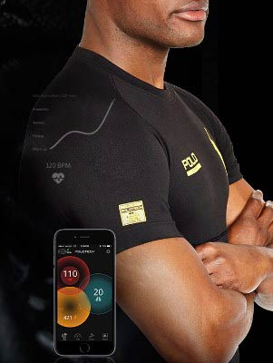
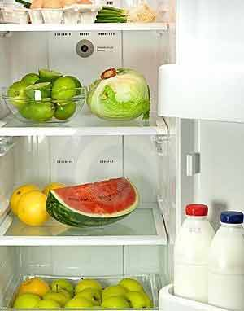
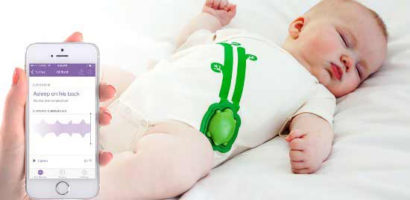
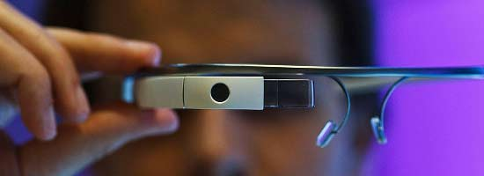
Exemplos...
Smart thermostats
Ralph Lauren Polotech Shirt
Smart Refrigerator
Mimo Monitor
Google Glass

Slide 7

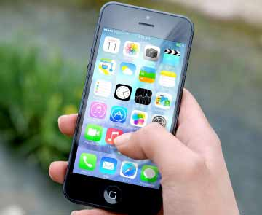

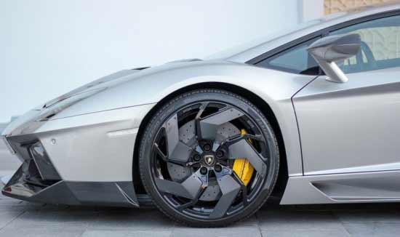
Exemplos...
Philips hue bulbs
Smart Phones
Apple Watch and HomeKit
Smart cars

Slide 8
Questões-Chave
Interoperabilidade e padronização
Segurança
Privacidade

Slide 9


Slide 10
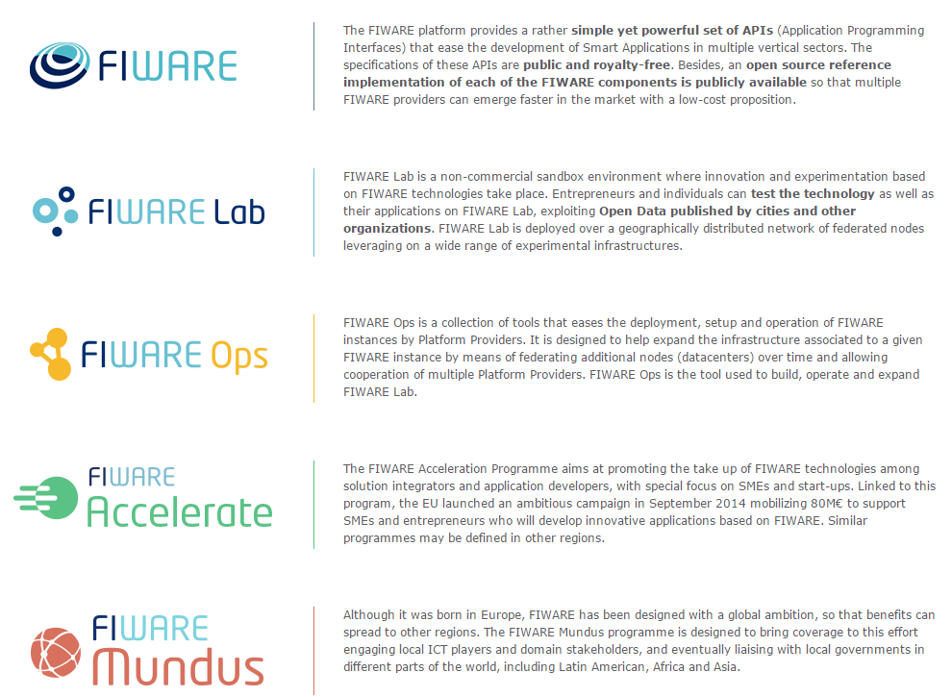

Slide 11
Why FIWARE
Driver | What does FIWARE bring?
Technology | Open specifications backed by open source reference implementations (see [1], [2]) 100+ M€ of investment (2011-2016)
Experimental environment | 15 cities (7 in Spain) already working on setting up a connection to FIWARE Lab [3] 3000+ cores, 16Tb RAM and 750+ Tb HD will be the free computing capacity provided by the FIWARE Lab Cloud across 16 nodes distributed in Europe
Incentives for creating the ecosystem | 52 partners, 13 countries (just FIWARE) 100 M€ devoted to fund entrepreneurs in 2014-2016. Additional opportunities in Horizon 2020. 6,2+ M€ devoted to dissemination
Global footprint | FIWARE Lab nodes in Mexico and Brazil. Conversations between EC and public authorities in Mexico and Brazil to explore collaboration opportunities
[1] – http://wiki.fi-ware.org/Summary_of_FIWARE_Open_Specifications
[2] – http://catalogue.fi-ware.org
[3] – http://lab.fi-ware.org

Slide 12
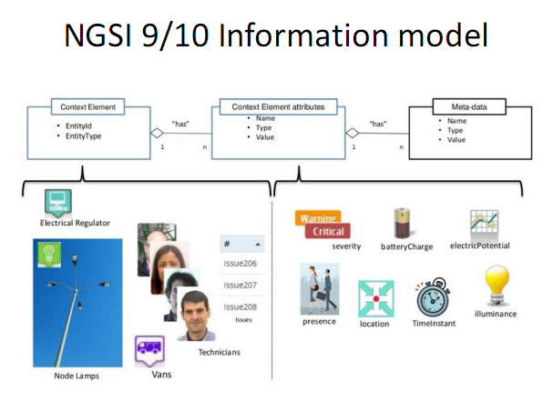

Slide 13
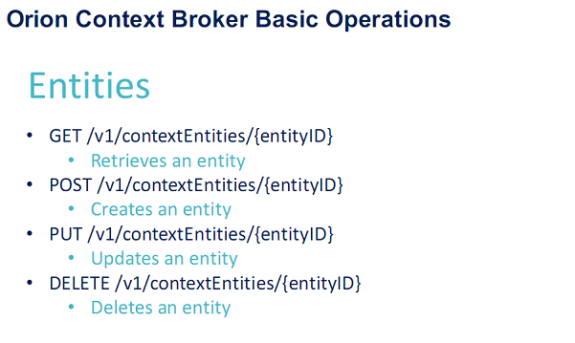

Slide 14
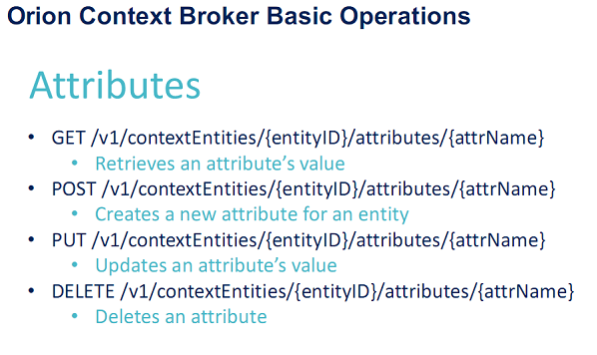

Slide 15
FIDEMO: City
Integration: Context Broker & WebUI, POI, ...

Slide 16
What’s this FIDEMO?
FIWARE demo integrating GEs across chapters
Concrete visual easy to understand end user service
Scenario: City of Helsinki
Available as a base & example for smart city apps
http://playsign.github.io/fidemo/ - https://github.com/playsign/fidemo

Slide 17


Slide 18
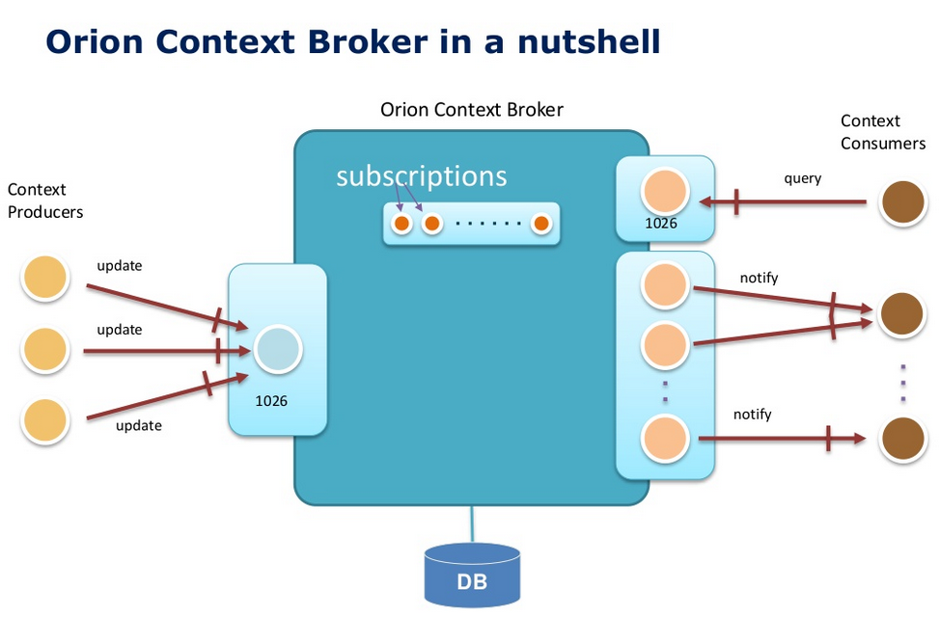

Slide 19
Orion Context Broker
Main functions:
Context availability management (NGSI9)
Context management (NGSI10)
HTTP and REST-based
XML payload support
JSON payload support
Context in NGSI is based in an entity-attribute model:
Entity
Attributes
EntityId
EntityType
“has”
Name
Type
Value
1
n
Notes:
1. En la primera slide poned una lista de puntos de lo que se puede hacer con ese GE/set de GEs. Me refiero en plan titulares, sin muchas explicaciones.
2. Mostrad un ejemplo representativo de uno o varios de los puntos anteriores.
Recordad: si lo hacéis como demo, poned slides con capturas y explicaciones también (así sirve también por si la demo os falla en ese momento ;-) ).
3. Mostrad un enlace donde pondremos esta semana las slides de la Campus que tienen los detalles de todos los puntos mencionados en 1.
(Poned la lista de ficheros pero dejad el enlace en blanco que ya lo pondremos a última hora).

Slide 20

Orion Context Broker – check health
curl <cb_host>:1026/version
<orion>
<version>0.14.1</version>
<uptime>0 d, 0 h, 0 m, 11 s</uptime>
<git_hash>3fdb55b96913b3e4d9f9a344e990164650f69b91</git_hash>
<compile_time>Wed Sep 30 15:31:29 CET 2014</compile_time>
<compiled_by>fermin</compiled_by>
<compiled_in>centollo</compiled_in>
</orion>
Notes:
Do the following sequence (showing the XML)
registerContext Room1-temperature
updateContext Room1-temperture = 30ºC
queryContext Room1-temperature
updateContext Room1-temperture = 31ºC
queryContext Room1-temperature

Slide 21
Orion Context Broker - Operations
 | Functions | Operations
NGSI9 | Register, Search and Subscribe for context sources | registerContext discoverContextAvailability subscribeContextAvailability updateContextAvailabilitySubscription unsubscribeContextAvailability
NGSI10 | Query, Update and Subscribe to context elements | updateContext queryContext subscribeContext updateContextSubscription unsubscribeContextSubscription
Notes:
1. En la primera slide poned una lista de puntos de lo que se puede hacer con ese GE/set de GEs. Me refiero en plan titulares, sin muchas explicaciones.
2. Mostrad un ejemplo representativo de uno o varios de los puntos anteriores.
Recordad: si lo hacéis como demo, poned slides con capturas y explicaciones también (así sirve también por si la demo os falla en ese momento ;-) ).
3. Mostrad un enlace donde pondremos esta semana las slides de la Campus que tienen los detalles de todos los puntos mencionados en 1.
(Poned la lista de ficheros pero dejad el enlace en blanco que ya lo pondremos a última hora).

Slide 22
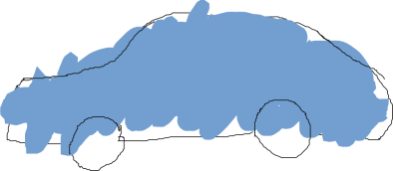

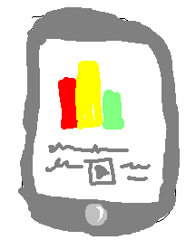
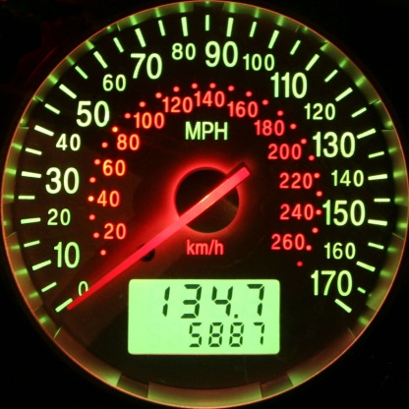
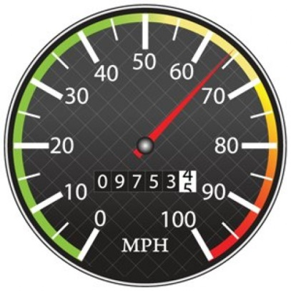
Context Broker operations: create & pull data
Context Producers publish data/context elements by invoking the updateContext operation on a Context Broker.
Context Consumers can retrieve data/context elements by invoking the queryContext operation on a Context Broker
updateContext
queryContext
Context Producer
Context Broker
Context Consumer

Slide 23

Quick Usage Example: Car Create
POST localhost:1026/V1/updateContext
...
{
"contextElements": [
{
"type": "Car",
"isPattern": "false",
"id": "Car1",
"attributes": [
{
"name": "speed",
"type": "km/h",
"value": “98"
}
]
}
],
"updateAction": “APPEND"
}
200 OK
...
{
"contextResponses": [
{
"contextElement": {
"attributes": [
{
"name": "speed",
"type": "km/h",
"value": ""
}
],
"id": "Car1",
"isPattern": "false",
"type": "Car"
},
"statusCode": {
"code": "200",
"reasonPhrase": "OK"
}
}
]
}
Notes:
Do the following sequence (showing the XML)
registerContext Room1-temperature
updateContext Room1-temperture = 30ºC
queryContext Room1-temperature
updateContext Room1-temperture = 31ºC
queryContext Room1-temperature

Slide 24

Quick Usage Example: Car UpdateContext (1)
POST localhost:1026/V1/updateContext
...
{
"contextElements": [
{
"type": "Car",
"isPattern": "false",
"id": "Car1",
"attributes": [
{
"name": "speed",
"type": "km/h",
"value": "110"
}
]
}
],
"updateAction": "UPDATE"
}
200 OK
...
{
"contextResponses": [
{
"contextElement": {
"attributes": [
{
"name": "speed",
"type": "km/h",
"value": ""
}
],
"id": "Car1",
"isPattern": "false",
"type": "Car"
},
"statusCode": {
"code": "200",
"reasonPhrase": "OK"
}
}
]
}
Notes:
Do the following sequence (showing the XML)
registerContext Room1-temperature
updateContext Room1-temperture = 30ºC
queryContext Room1-temperature
updateContext Room1-temperture = 31ºC
queryContext Room1-temperature

Slide 25
Quick Usage Example: Car QueryContext (1)
200 OK
...
{
"contextResponses": [
{
"contextElement": {
"attributes": [
{
"name": "speed",
"type": "km/h",
"value": "110"
}
],
"id": "Car1",
"isPattern": "false",
"type": "Car"
},
"statusCode": {
"code": "200",
"reasonPhrase": "OK"
}
}
]
}
POST <cb_host>:1026/V1/queryContext
...
{
"entities": [
{
"type": "Car",
"isPattern": "false",
"id": "Car1"
}
]
}
Notes:
Do the following sequence (showing the XML)
registerContext Room1-temperature
updateContext Room1-temperture = 30ºC
queryContext Room1-temperature
updateContext Room1-temperture = 31ºC
queryContext Room1-temperature

Slide 26
Quick Usage Example: Car UpdateContext (2)
POST localhost:1026/V1/updateContext
...
{
"contextElements": [
{
"type": "Car",
"isPattern": "false",
"id": "Car1",
"attributes": [
{
"name": "speed",
"type": "km/h",
"value": "115"
}
]
}
],
"updateAction": "UPDATE"
}
200 OK
...
{
"contextResponses": [
{
"contextElement": {
"attributes": [
{
"name": "speed",
"type": "km/h",
"value": ""
}
],
"id": "Car1",
"isPattern": "false",
"type": "Car"
},
"statusCode": {
"code": "200",
"reasonPhrase": "OK"
}
}
]
}
Notes:
Do the following sequence (showing the XML)
registerContext Room1-temperature
updateContext Room1-temperture = 30ºC
queryContext Room1-temperature
updateContext Room1-temperture = 31ºC
queryContext Room1-temperature

Slide 27
Quick Usage Example: Car QueryContext (2)
200 OK
...
{
"contextResponses": [
{
"contextElement": {
"attributes": [
{
"name": "speed",
"type": "km/h",
"value": "115"
}
],
"id": "Car1",
"isPattern": "false",
"type": "Car"
},
"statusCode": {
"code": "200",
"reasonPhrase": "OK"
}
}
]
}
POST <cb_host>:1026/V1/queryContext
...
{
"entities": [
{
"type": "Car",
"isPattern": "false",
"id": "Car1"
}
]
}
Notes:
Do the following sequence (showing the XML)
registerContext Room1-temperature
updateContext Room1-temperture = 30ºC
queryContext Room1-temperature
updateContext Room1-temperture = 31ºC
queryContext Room1-temperature

Slide 28

Quick Usage Example: Room Create (1)
POST localhost:1026/V1/updateContext
...
{
"contextElements": [
{
"type": "Room",
"isPattern": "false",
"id": "Room1",
"attributes": [
{
"name": "temperature",
"type": "centigrade",
"value": "24"
},
{
"name": "pressure",
"type": "mmHg",
"value": "718"
}
]
}
],
"updateAction": "APPEND"
}
200 OK
...
{
"contextResponses": [
{
"contextElement": {
"attributes": [
{
"name": "temperature",
"type": "centigrade",
"value": ""
},
{
"name": "pressure",
"type": "mmHg",
"value": ""
}
],
"id": "Room1",
"isPattern": "false",
"type": "Room"
},
"statusCode": {
"code": "200",
"reasonPhrase": "OK"
}
}
]
}
Notes:
Do the following sequence (showing the XML)
registerContext Room1-temperature
updateContext Room1-temperture = 30ºC
queryContext Room1-temperature
updateContext Room1-temperture = 31ºC
queryContext Room1-temperature

Slide 29
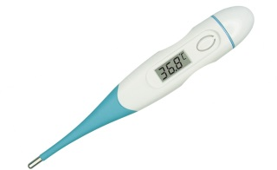
Quick Usage Example: Room UpdateContext (2)
POST localhost:1026/V1/updateContext
...
{
"contextElements": [
{
"type": "Room",
"isPattern": "false",
"id": "Room1",
"attributes": [
{
"name": "temperature",
"type": "centigrade",
"value": "25"
},
{
"name": "pressure",
"type": "mmHg",
"value": "720"
}
]
}
],
"updateAction": "UPDATE"
}
200 OK
...
{
"contextResponses": [
{
"contextElement": {
"attributes": [
{
"name": "temperature",
"type": "centigrade",
"value": ""
},
{
"name": "pressure",
"type": "mmHg",
"value": ""
}
],
"id": "Room1",
"isPattern": "false",
"type": "Room"
},
"statusCode": {
"code": "200",
"reasonPhrase": "OK"
}
}
]
}
Notes:
Do the following sequence (showing the XML)
registerContext Room1-temperature
updateContext Room1-temperture = 30ºC
queryContext Room1-temperature
updateContext Room1-temperture = 31ºC
queryContext Room1-temperature

Slide 30
Quick Usage Example: Room QueryContext (1)
200 OK
...
{
"contextResponses": [
{
"contextElement": {
"attributes": [
{
"name": "temperature",
"type": "centigrade",
"value": "25"
}
],
"id": "Room1",
"isPattern": "false",
"type": "Room"
},
"statusCode": {
"code": "200",
"reasonPhrase": "OK"
}
}
]
}
POST <cb_host>:1026/V1/queryContext
...
{
"entities": [
{
"type": "Room",
"isPattern": "false",
"id": "Room1"
} ,
"attributes": [
"temperature"
]
]
}
Notes:
Do the following sequence (showing the XML)
registerContext Room1-temperature
updateContext Room1-temperture = 30ºC
queryContext Room1-temperature
updateContext Room1-temperture = 31ºC
queryContext Room1-temperature

Slide 31
Quick Usage Example: Room QueryContext (2)
200 OK
...
{
"contextResponses": [
{
"contextElement": {
"attributes": [
{
"name": "temperature",
"type": "centigrade",
"value": "25"
},
{
"name": "pressure",
"type": "mmHg",
"value": "720"
}
],
"id": "Room1",
"isPattern": "false",
"type": "Room"
},
"statusCode": {
"code": "200",
"reasonPhrase": "OK"
}
}
]
}
POST <cb_host>:1026/V1/queryContext
...
{
"entities": [
{
"type": "Room",
"isPattern": "false",
"id": "Room1"
}
]
}
Notes:
Do the following sequence (showing the XML)
registerContext Room1-temperature
updateContext Room1-temperture = 30ºC
queryContext Room1-temperature
updateContext Room1-temperture = 31ºC
queryContext Room1-temperature

Slide 32
Quick Usage Example: Room Create (2)
POST localhost:1026/V1/updateContext
...
{
"contextElements": [
{
"type": "Room",
"isPattern": "false",
"id": "Room2",
"attributes": [
{
"name": "temperature",
"type": "centigrade",
"value": "33"
},
{
"name": "pressure",
"type": "mmHg",
"value": "722"
}
]
}
],
"updateAction": "APPEND"
}
200 OK
...
{
"contextResponses": [
{
"contextElement": {
"attributes": [
{
"name": "temperature",
"type": "centigrade",
"value": ""
},
{
"name": "pressure",
"type": "mmHg",
"value": ""
}
],
"id": "Room1",
"isPattern": "false",
"type": "Room"
},
"statusCode": {
"code": "200",
"reasonPhrase": "OK"
}
}
]
}
Notes:
Do the following sequence (showing the XML)
registerContext Room1-temperature
updateContext Room1-temperture = 30ºC
queryContext Room1-temperature
updateContext Room1-temperture = 31ºC
queryContext Room1-temperature

Slide 33
Quick Usage Example: Room UpdateContext (2)
POST localhost:1026/V1/updateContext
...
{
"contextElements": [
{
"type": "Room",
"isPattern": "false",
"id": "Room2",
"attributes": [
{
"name": "temperature",
"type": "centigrade",
"value": "29"
},
{
"name": "pressure",
"type": "mmHg",
"value": "730"
}
]
}
],
"updateAction": "UPDATE"
}
200 OK
...
{
"contextResponses": [
{
"contextElement": {
"attributes": [
{
"name": "temperature",
"type": "centigrade",
"value": ""
},
{
"name": "pressure",
"type": "mmHg",
"value": ""
}
],
"id": "Room1",
"isPattern": "false",
"type": "Room"
},
"statusCode": {
"code": "200",
"reasonPhrase": "OK"
}
}
]
}
Notes:
Do the following sequence (showing the XML)
registerContext Room1-temperature
updateContext Room1-temperture = 30ºC
queryContext Room1-temperature
updateContext Room1-temperture = 31ºC
queryContext Room1-temperature

Slide 34
Quick Usage Example: Room QueryContext (3)
200 OK
...
{
"contextResponses": [
{
"contextElement": {
"attributes": [
{
"name": "temperature",
"type": "centigrade",
"value": "25"
}
],
"id": "Room1",
"isPattern": "false",
"type": "Room"
},
"statusCode": {
"code": "200",
"reasonPhrase": "OK"
}
},
{
"contextElement": {
"attributes": [
{
"name": "temperature",
"type": "centigrade",
"value": "29"
}
],
"id": "Room2",
"isPattern": "false",
"type": "Room"
},
"statusCode": {
"code": "200",
"reasonPhrase": "OK"
}
}
]
}
POST <cb_host>:1026/V1/queryContext
...
{
"entities": [
{
"type": "Room",
"isPattern": "true",
"id": "Room.*"
} ,
"attributes": [
"temperature"
]
]
}
Notes:
Do the following sequence (showing the XML)
registerContext Room1-temperature
updateContext Room1-temperture = 30ºC
queryContext Room1-temperature
updateContext Room1-temperture = 31ºC
queryContext Room1-temperature

Slide 35
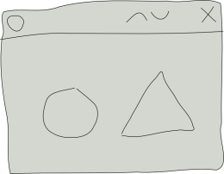
Context Broker operations: push data
Context Consumers can subscribe to receive context information that satisfy certain conditions using the subscribeContext. Such subscriptions may have a duration.
The Context Broker notifies updates on context information to subscribed Context Consumers by invoking the notifyContext operation they export
Application
subscription_id = subscribeContext (consumer, expr, duration)
notifyContext (subscription_id, data/context)
Context Consumer
Context Broker

Slide 36
Quick Usage Example: Subscription
POST <cb_host>:1026/V1/subscribeContext
…
{
"entities": [
{
"type": "Room",
"isPattern": "false",
"id": "Room1"
}
],
"attributes": [
"temperature"
],
"reference": "http://<host>:<port>/publish",
"duration": "P1M",
"notifyConditions": [
{
"type": "ONCHANGE",
"condValues": [
"temperature"
]
}
],
"throttling": "PT5S"
}
200 OK
...
{
"subscribeResponse": {
"duration": "P1M",
"subscriptionId": "51c0ac9ed714fb3b37d7d5a8",
"throttling": "PT5S"
}
}
Notes:
Do the following sequence (showing the XML)
registerContext Room1-temperature
updateContext Room1-temperture = 30ºC
queryContext Room1-temperature
updateContext Room1-temperture = 31ºC
queryContext Room1-temperature

Slide 37

Quick Usage Example: Notification
25
19
Notes:
Do the following sequence (showing the XML)
registerContext Room1-temperature
updateContext Room1-temperture = 30ºC
queryContext Room1-temperature
updateContext Room1-temperture = 31ºC
queryContext Room1-temperature

Slide 38
Quick Usage Example: Notification
POST http://<host>:<port>/publish
…
{
"subscriptionId" : "51c0ac9ed714fb3b37d7d5a8",
"originator" : "localhost",
"contextResponses" : [
{
"contextElement" : {
"attributes" : [
{
"name" : "temperature",
"type" : "centigrade",
"value" : "19"
}
],
"type" : "Room",
"isPattern" : "false",
"id" : "Room1"
},
"statusCode" : {
"code" : "200",
"reasonPhrase" : "OK"
}
}
]
}
Notes:
Do the following sequence (showing the XML)
registerContext Room1-temperature
updateContext Room1-temperture = 30ºC
queryContext Room1-temperature
updateContext Room1-temperture = 31ºC
queryContext Room1-temperature

Slide 39
Convenience Operations
They are equivalent to previous standard operations in functionality
Avoid the need for POST-ing payloads in many cases or simplifying them considerably
Simple to write, more REST-like
They are not a substitute but a complement to standard NGSI operations
Four examples (there are many others):
Entities
Attributes
Subscriptions
Types

Slide 40
Convenience Operations – Example 1
Entities
GET /v1/contextEntities/{entityID}
Retrieves an entity
POST /v1/contextEntities/{entityID}
Creates an entity
PUT /v1/contextEntities/{entityID}
Updates an entity
DELETE /v1/contextEntities/{entityID}
Deletes an entity

Slide 41
Convenience Operations – Example 2
Attributes
GET /v1/contextEntities/{entityID}/attributes/{attrID}
Retrieves an attribute’s value
POST /v1/contextEntities/{entityID}/attributes/{attrID}
Creates a new attribute for an entity
PUT /v1/contextEntities/{entityID}/attributes/{attrID}
Updates an attribute’s value
DELETE /v1/contextEntities/{entityID}/attributes/{attrID}
Deletes an attribute

Slide 42
Convenience Operations – Example 3
Subscriptions
POST /v1/contextSubscriptions
Creates a subscription
to create the subscription, using the same payload as standard susbcribeContext operation.
PUT /v1/contextSubscriptions/{subID}
Updates a subscription
to update the subscription identified by {subID}, using the same payload as standard updateContextSubscription operation. The ID in the payload must match the ID in the URL.
DELETE /v1/contextSubscriptions/{subID}
Cancel a subscription
to cancel the subscription identified by {subID}. In this case, payload is not used.

Slide 43
Convenience Operations – Example 4
Entity Types
GET /v1/contextTypes
Retrieve a list of all entity types currently in Orion, including their corresponding attributes
GET /v1/contextTypes/{typeID}
Retrieve attributes associated to an entity type
PRO TIP
GET /v1/contextTypes?collapse=true
Retrieves a list of all entity types without attribute info

Slide 44

Integrando-se com Fiware!!!

Slide 45

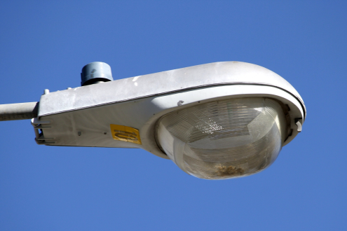
Context Management in FIWARE
Acting on devices can be as easy as changing the value of attributes linked to its corresponding entity
Street Lamp lamp1.status ← “on”
API
Street lamp = “lamp1”, status= “on”

Slide 46
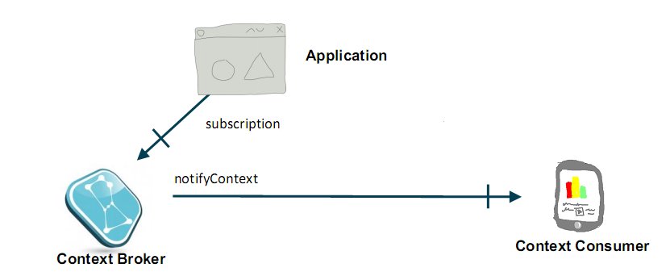
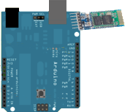

Orion Context Broker Arquitetura Básica IoT
Bluetooth

Slide 47
Exemplinho ☺...

