Slide 1
IoT-Internet of Things
+
Fiware
Herbertt Diniz
hbmd@cin.ufpe.br

Slide 2


Slide 3
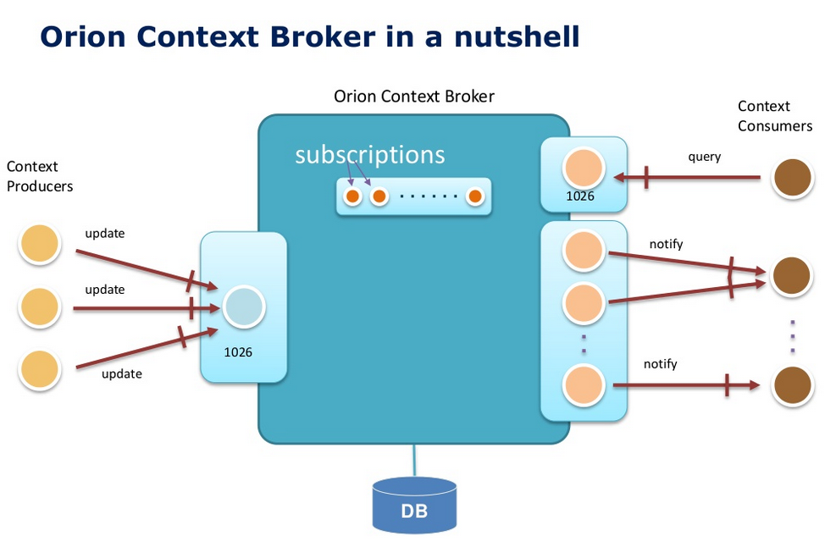

Slide 4
Orion Context Broker
Main functions:
Context availability management (NGSI9)
Context management (NGSI10)
HTTP and REST-based
XML payload support
JSON payload support
Context in NGSI is based in an entity-attribute model:
Entity
Attributes
EntityId
EntityType
“has”
Name
Type
Value
1
n
Notes:
1. En la primera slide poned una lista de puntos de lo que se puede hacer con ese GE/set de GEs. Me refiero en plan titulares, sin muchas explicaciones.
2. Mostrad un ejemplo representativo de uno o varios de los puntos anteriores.
Recordad: si lo hacéis como demo, poned slides con capturas y explicaciones también (así sirve también por si la demo os falla en ese momento ;-) ).
3. Mostrad un enlace donde pondremos esta semana las slides de la Campus que tienen los detalles de todos los puntos mencionados en 1.
(Poned la lista de ficheros pero dejad el enlace en blanco que ya lo pondremos a última hora).

Slide 5

Orion Context Broker – check health
curl <cb_host>:1026/version
<orion>
<version>0.14.1</version>
<uptime>0 d, 0 h, 0 m, 11 s</uptime>
<git_hash>3fdb55b96913b3e4d9f9a344e990164650f69b91</git_hash>
<compile_time>Wed Sep 30 15:31:29 CET 2014</compile_time>
<compiled_by>fermin</compiled_by>
<compiled_in>centollo</compiled_in>
</orion>
Notes:
Do the following sequence (showing the XML)
registerContext Room1-temperature
updateContext Room1-temperture = 30ºC
queryContext Room1-temperature
updateContext Room1-temperture = 31ºC
queryContext Room1-temperature

Slide 6
Orion Context Broker - Operations
 | Functions | Operations
NGSI9 | Register, Search and Subscribe for context sources | registerContext discoverContextAvailability subscribeContextAvailability updateContextAvailabilitySubscription unsubscribeContextAvailability
NGSI10 | Query, Update and Subscribe to context elements | updateContext queryContext subscribeContext updateContextSubscription unsubscribeContextSubscription
Notes:
1. En la primera slide poned una lista de puntos de lo que se puede hacer con ese GE/set de GEs. Me refiero en plan titulares, sin muchas explicaciones.
2. Mostrad un ejemplo representativo de uno o varios de los puntos anteriores.
Recordad: si lo hacéis como demo, poned slides con capturas y explicaciones también (así sirve también por si la demo os falla en ese momento ;-) ).
3. Mostrad un enlace donde pondremos esta semana las slides de la Campus que tienen los detalles de todos los puntos mencionados en 1.
(Poned la lista de ficheros pero dejad el enlace en blanco que ya lo pondremos a última hora).

Slide 7
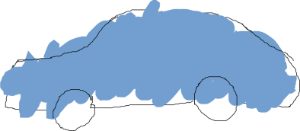

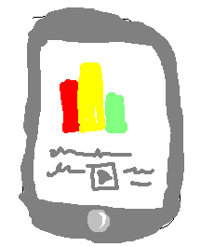
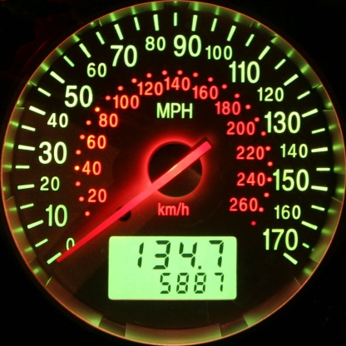
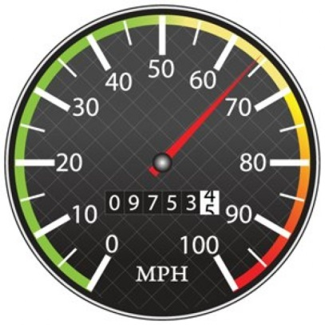
Context Broker operations: create & pull data
Context Producers publish data/context elements by invoking the updateContext operation on a Context Broker.
Context Consumers can retrieve data/context elements by invoking the queryContext operation on a Context Broker
updateContext
queryContext
Context Producer
Context Broker
Context Consumer

Slide 8

Quick Usage Example: Car Create
POST localhost:1026/V1/updateContext
...
{
"contextElements": [
{
"type": "Car",
"isPattern": "false",
"id": "Car1",
"attributes": [
{
"name": "speed",
"type": "km/h",
"value": “98"
}
]
}
],
"updateAction": “APPEND"
}
200 OK
...
{
"contextResponses": [
{
"contextElement": {
"attributes": [
{
"name": "speed",
"type": "km/h",
"value": ""
}
],
"id": "Car1",
"isPattern": "false",
"type": "Car"
},
"statusCode": {
"code": "200",
"reasonPhrase": "OK"
}
}
]
}
Notes:
Do the following sequence (showing the XML)
registerContext Room1-temperature
updateContext Room1-temperture = 30ºC
queryContext Room1-temperature
updateContext Room1-temperture = 31ºC
queryContext Room1-temperature

Slide 9

Quick Usage Example: Car UpdateContext (1)
POST localhost:1026/V1/updateContext
...
{
"contextElements": [
{
"type": "Car",
"isPattern": "false",
"id": "Car1",
"attributes": [
{
"name": "speed",
"type": "km/h",
"value": "110"
}
]
}
],
"updateAction": "UPDATE"
}
200 OK
...
{
"contextResponses": [
{
"contextElement": {
"attributes": [
{
"name": "speed",
"type": "km/h",
"value": ""
}
],
"id": "Car1",
"isPattern": "false",
"type": "Car"
},
"statusCode": {
"code": "200",
"reasonPhrase": "OK"
}
}
]
}
Notes:
Do the following sequence (showing the XML)
registerContext Room1-temperature
updateContext Room1-temperture = 30ºC
queryContext Room1-temperature
updateContext Room1-temperture = 31ºC
queryContext Room1-temperature

Slide 10
Quick Usage Example: Car QueryContext (1)
200 OK
...
{
"contextResponses": [
{
"contextElement": {
"attributes": [
{
"name": "speed",
"type": "km/h",
"value": "110"
}
],
"id": "Car1",
"isPattern": "false",
"type": "Car"
},
"statusCode": {
"code": "200",
"reasonPhrase": "OK"
}
}
]
}
POST <cb_host>:1026/V1/queryContext
...
{
"entities": [
{
"type": "Car",
"isPattern": "false",
"id": "Car1"
}
]
}
Notes:
Do the following sequence (showing the XML)
registerContext Room1-temperature
updateContext Room1-temperture = 30ºC
queryContext Room1-temperature
updateContext Room1-temperture = 31ºC
queryContext Room1-temperature

Slide 11
Quick Usage Example: Car UpdateContext (2)
POST localhost:1026/V1/updateContext
...
{
"contextElements": [
{
"type": "Car",
"isPattern": "false",
"id": "Car1",
"attributes": [
{
"name": "speed",
"type": "km/h",
"value": "115"
}
]
}
],
"updateAction": "UPDATE"
}
200 OK
...
{
"contextResponses": [
{
"contextElement": {
"attributes": [
{
"name": "speed",
"type": "km/h",
"value": ""
}
],
"id": "Car1",
"isPattern": "false",
"type": "Car"
},
"statusCode": {
"code": "200",
"reasonPhrase": "OK"
}
}
]
}
Notes:
Do the following sequence (showing the XML)
registerContext Room1-temperature
updateContext Room1-temperture = 30ºC
queryContext Room1-temperature
updateContext Room1-temperture = 31ºC
queryContext Room1-temperature

Slide 12
Quick Usage Example: Car QueryContext (2)
200 OK
...
{
"contextResponses": [
{
"contextElement": {
"attributes": [
{
"name": "speed",
"type": "km/h",
"value": "115"
}
],
"id": "Car1",
"isPattern": "false",
"type": "Car"
},
"statusCode": {
"code": "200",
"reasonPhrase": "OK"
}
}
]
}
POST <cb_host>:1026/V1/queryContext
...
{
"entities": [
{
"type": "Car",
"isPattern": "false",
"id": "Car1"
}
]
}
Notes:
Do the following sequence (showing the XML)
registerContext Room1-temperature
updateContext Room1-temperture = 30ºC
queryContext Room1-temperature
updateContext Room1-temperture = 31ºC
queryContext Room1-temperature

Slide 13

Quick Usage Example: Room Create (1)
POST localhost:1026/V1/updateContext
...
{
"contextElements": [
{
"type": "Room",
"isPattern": "false",
"id": "Room1",
"attributes": [
{
"name": "temperature",
"type": "centigrade",
"value": "24"
},
{
"name": "pressure",
"type": "mmHg",
"value": "718"
}
]
}
],
"updateAction": "APPEND"
}
200 OK
...
{
"contextResponses": [
{
"contextElement": {
"attributes": [
{
"name": "temperature",
"type": "centigrade",
"value": ""
},
{
"name": "pressure",
"type": "mmHg",
"value": ""
}
],
"id": "Room1",
"isPattern": "false",
"type": "Room"
},
"statusCode": {
"code": "200",
"reasonPhrase": "OK"
}
}
]
}
Notes:
Do the following sequence (showing the XML)
registerContext Room1-temperature
updateContext Room1-temperture = 30ºC
queryContext Room1-temperature
updateContext Room1-temperture = 31ºC
queryContext Room1-temperature

Slide 14
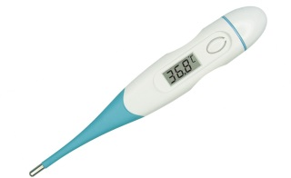
Quick Usage Example: Room UpdateContext (2)
POST localhost:1026/V1/updateContext
...
{
"contextElements": [
{
"type": "Room",
"isPattern": "false",
"id": "Room1",
"attributes": [
{
"name": "temperature",
"type": "centigrade",
"value": "25"
},
{
"name": "pressure",
"type": "mmHg",
"value": "720"
}
]
}
],
"updateAction": "UPDATE"
}
200 OK
...
{
"contextResponses": [
{
"contextElement": {
"attributes": [
{
"name": "temperature",
"type": "centigrade",
"value": ""
},
{
"name": "pressure",
"type": "mmHg",
"value": ""
}
],
"id": "Room1",
"isPattern": "false",
"type": "Room"
},
"statusCode": {
"code": "200",
"reasonPhrase": "OK"
}
}
]
}
Notes:
Do the following sequence (showing the XML)
registerContext Room1-temperature
updateContext Room1-temperture = 30ºC
queryContext Room1-temperature
updateContext Room1-temperture = 31ºC
queryContext Room1-temperature

Slide 15
Quick Usage Example: Room QueryContext (1)
200 OK
...
{
"contextResponses": [
{
"contextElement": {
"attributes": [
{
"name": "temperature",
"type": "centigrade",
"value": "25"
}
],
"id": "Room1",
"isPattern": "false",
"type": "Room"
},
"statusCode": {
"code": "200",
"reasonPhrase": "OK"
}
}
]
}
POST <cb_host>:1026/V1/queryContext
...
{
"entities": [
{
"type": "Room",
"isPattern": "false",
"id": "Room1"
} ,
"attributes": [
"temperature"
]
]
}
Notes:
Do the following sequence (showing the XML)
registerContext Room1-temperature
updateContext Room1-temperture = 30ºC
queryContext Room1-temperature
updateContext Room1-temperture = 31ºC
queryContext Room1-temperature

Slide 16
Quick Usage Example: Room QueryContext (2)
200 OK
...
{
"contextResponses": [
{
"contextElement": {
"attributes": [
{
"name": "temperature",
"type": "centigrade",
"value": "25"
},
{
"name": "pressure",
"type": "mmHg",
"value": "720"
}
],
"id": "Room1",
"isPattern": "false",
"type": "Room"
},
"statusCode": {
"code": "200",
"reasonPhrase": "OK"
}
}
]
}
POST <cb_host>:1026/V1/queryContext
...
{
"entities": [
{
"type": "Room",
"isPattern": "false",
"id": "Room1"
}
]
}
Notes:
Do the following sequence (showing the XML)
registerContext Room1-temperature
updateContext Room1-temperture = 30ºC
queryContext Room1-temperature
updateContext Room1-temperture = 31ºC
queryContext Room1-temperature

Slide 17
Quick Usage Example: Room Create (2)
POST localhost:1026/V1/updateContext
...
{
"contextElements": [
{
"type": "Room",
"isPattern": "false",
"id": "Room2",
"attributes": [
{
"name": "temperature",
"type": "centigrade",
"value": "33"
},
{
"name": "pressure",
"type": "mmHg",
"value": "722"
}
]
}
],
"updateAction": "APPEND"
}
200 OK
...
{
"contextResponses": [
{
"contextElement": {
"attributes": [
{
"name": "temperature",
"type": "centigrade",
"value": ""
},
{
"name": "pressure",
"type": "mmHg",
"value": ""
}
],
"id": "Room1",
"isPattern": "false",
"type": "Room"
},
"statusCode": {
"code": "200",
"reasonPhrase": "OK"
}
}
]
}
Notes:
Do the following sequence (showing the XML)
registerContext Room1-temperature
updateContext Room1-temperture = 30ºC
queryContext Room1-temperature
updateContext Room1-temperture = 31ºC
queryContext Room1-temperature

Slide 18
Quick Usage Example: Room UpdateContext (2)
POST localhost:1026/V1/updateContext
...
{
"contextElements": [
{
"type": "Room",
"isPattern": "false",
"id": "Room2",
"attributes": [
{
"name": "temperature",
"type": "centigrade",
"value": "29"
},
{
"name": "pressure",
"type": "mmHg",
"value": "730"
}
]
}
],
"updateAction": "UPDATE"
}
200 OK
...
{
"contextResponses": [
{
"contextElement": {
"attributes": [
{
"name": "temperature",
"type": "centigrade",
"value": ""
},
{
"name": "pressure",
"type": "mmHg",
"value": ""
}
],
"id": "Room1",
"isPattern": "false",
"type": "Room"
},
"statusCode": {
"code": "200",
"reasonPhrase": "OK"
}
}
]
}
Notes:
Do the following sequence (showing the XML)
registerContext Room1-temperature
updateContext Room1-temperture = 30ºC
queryContext Room1-temperature
updateContext Room1-temperture = 31ºC
queryContext Room1-temperature

Slide 19
Quick Usage Example: Room QueryContext (3)
200 OK
...
{
"contextResponses": [
{
"contextElement": {
"attributes": [
{
"name": "temperature",
"type": "centigrade",
"value": "25"
}
],
"id": "Room1",
"isPattern": "false",
"type": "Room"
},
"statusCode": {
"code": "200",
"reasonPhrase": "OK"
}
},
{
"contextElement": {
"attributes": [
{
"name": "temperature",
"type": "centigrade",
"value": "29"
}
],
"id": "Room2",
"isPattern": "false",
"type": "Room"
},
"statusCode": {
"code": "200",
"reasonPhrase": "OK"
}
}
]
}
POST <cb_host>:1026/V1/queryContext
...
{
"entities": [
{
"type": "Room",
"isPattern": "true",
"id": "Room.*"
} ,
"attributes": [
"temperature"
]
]
}
Notes:
Do the following sequence (showing the XML)
registerContext Room1-temperature
updateContext Room1-temperture = 30ºC
queryContext Room1-temperature
updateContext Room1-temperture = 31ºC
queryContext Room1-temperature

Slide 20
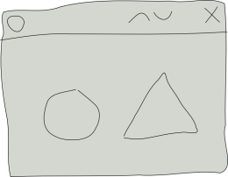
Context Broker operations: push data
Context Consumers can subscribe to receive context information that satisfy certain conditions using the subscribeContext. Such subscriptions may have a duration.
The Context Broker notifies updates on context information to subscribed Context Consumers by invoking the notifyContext operation they export
Application
subscription_id = subscribeContext (consumer, expr, duration)
notifyContext (subscription_id, data/context)
Context Consumer
Context Broker

Slide 21
Quick Usage Example: Subscription
POST <cb_host>:1026/V1/subscribeContext
…
{
"entities": [
{
"type": "Room",
"isPattern": "false",
"id": "Room1"
}
],
"attributes": [
"temperature"
],
"reference": "http://<host>:<port>/publish",
"duration": "P1M",
"notifyConditions": [
{
"type": "ONCHANGE",
"condValues": [
"temperature"
]
}
],
"throttling": "PT5S"
}
200 OK
...
{
"subscribeResponse": {
"duration": "P1M",
"subscriptionId": "51c0ac9ed714fb3b37d7d5a8",
"throttling": "PT5S"
}
}
Notes:
Do the following sequence (showing the XML)
registerContext Room1-temperature
updateContext Room1-temperture = 30ºC
queryContext Room1-temperature
updateContext Room1-temperture = 31ºC
queryContext Room1-temperature

Slide 22

Quick Usage Example: Notification
25
19
Notes:
Do the following sequence (showing the XML)
registerContext Room1-temperature
updateContext Room1-temperture = 30ºC
queryContext Room1-temperature
updateContext Room1-temperture = 31ºC
queryContext Room1-temperature

Slide 23
Quick Usage Example: Notification
POST http://<host>:<port>/publish
…
{
"subscriptionId" : "51c0ac9ed714fb3b37d7d5a8",
"originator" : "localhost",
"contextResponses" : [
{
"contextElement" : {
"attributes" : [
{
"name" : "temperature",
"type" : "centigrade",
"value" : "19"
}
],
"type" : "Room",
"isPattern" : "false",
"id" : "Room1"
},
"statusCode" : {
"code" : "200",
"reasonPhrase" : "OK"
}
}
]
}
Notes:
Do the following sequence (showing the XML)
registerContext Room1-temperature
updateContext Room1-temperture = 30ºC
queryContext Room1-temperature
updateContext Room1-temperture = 31ºC
queryContext Room1-temperature

Slide 24
Convenience Operations
They are equivalent to previous standard operations in functionality
Avoid the need for POST-ing payloads in many cases or simplifying them considerably
Simple to write, more REST-like
They are not a substitute but a complement to standard NGSI operations
Four examples (there are many others):
Entities
Attributes
Subscriptions
Types

Slide 25
Convenience Operations – Example 1
Entities
GET /v1/contextEntities/{entityID}
Retrieves an entity
POST /v1/contextEntities/{entityID}
Creates an entity
PUT /v1/contextEntities/{entityID}
Updates an entity
DELETE /v1/contextEntities/{entityID}
Deletes an entity

Slide 26
Convenience Operations – Example 2
Attributes
GET /v1/contextEntities/{entityID}/attributes/{attrID}
Retrieves an attribute’s value
POST /v1/contextEntities/{entityID}/attributes/{attrID}
Creates a new attribute for an entity
PUT /v1/contextEntities/{entityID}/attributes/{attrID}
Updates an attribute’s value
DELETE /v1/contextEntities/{entityID}/attributes/{attrID}
Deletes an attribute

Slide 27
Convenience Operations – Example 3
Subscriptions
POST /v1/contextSubscriptions
Creates a subscription
to create the subscription, using the same payload as standard susbcribeContext operation.
PUT /v1/contextSubscriptions/{subID}
Updates a subscription
to update the subscription identified by {subID}, using the same payload as standard updateContextSubscription operation. The ID in the payload must match the ID in the URL.
DELETE /v1/contextSubscriptions/{subID}
Cancel a subscription
to cancel the subscription identified by {subID}. In this case, payload is not used.

Slide 28
Convenience Operations – Example 4
Entity Types
GET /v1/contextTypes
Retrieve a list of all entity types currently in Orion, including their corresponding attributes
GET /v1/contextTypes/{typeID}
Retrieve attributes associated to an entity type
PRO TIP
GET /v1/contextTypes?collapse=true
Retrieves a list of all entity types without attribute info

Slide 29

Integrando-se com Fiware!!!

Slide 30

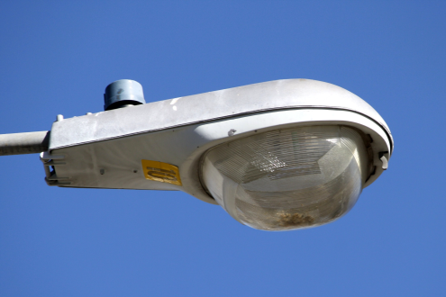
Context Management in FIWARE
Acting on devices can be as easy as changing the value of attributes linked to its corresponding entity
Street Lamp lamp1.status ← “on”
API
Street lamp = “lamp1”, status= “on”

Slide 31
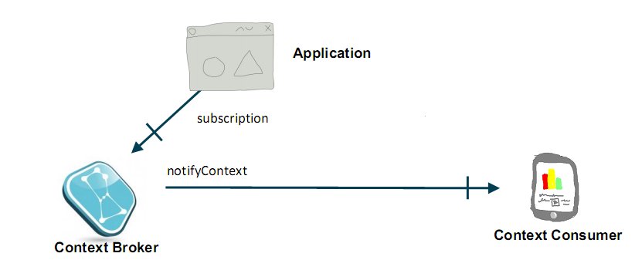
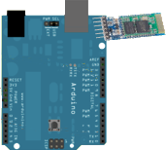

Orion Context Broker Arquitetura Básica IoT
Bluetooth

Slide 32
Exemplinho ☺...

