Slide 1
Overview of the Code
ECE/MAE 5340 Planning for Mobile Robotics
Dr. Greg Droge

Slide 2
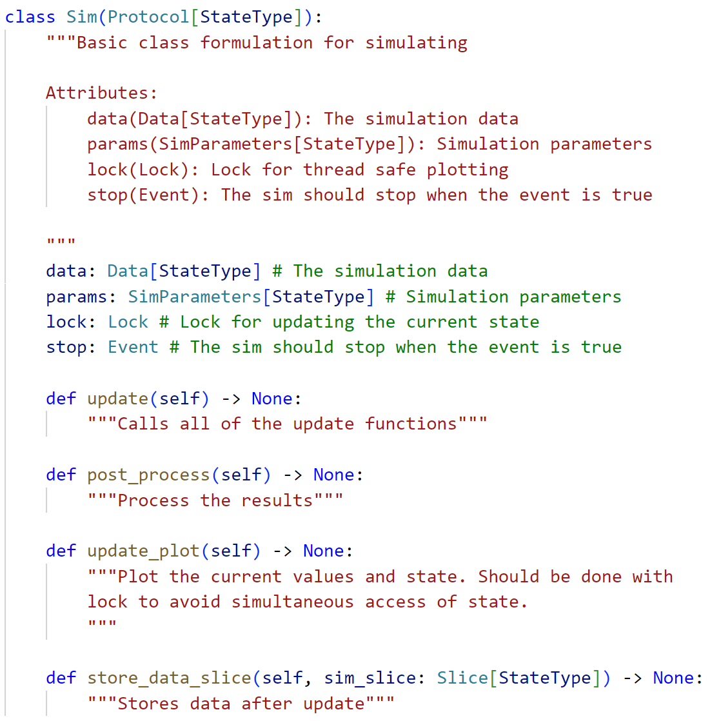
A Sim is an Object with Variables and Four Functions
Variables
Stores the current state, time, measurements, and any other data produced by the sim
Stores how the simulation will run (frequency of update, plotting, size of simulation time step, end time)
Used to lock the thread for accessing the “data” object for safe parallel processing
Used to tell the sim to stop running
Functions
Called whenever the sim state should be updated
Called after sim is finished to process results
Called when plotting
Used to store the latest data
Note: Any class that has all of these attributes and functions is a sim (Duck Typing)

Slide 3
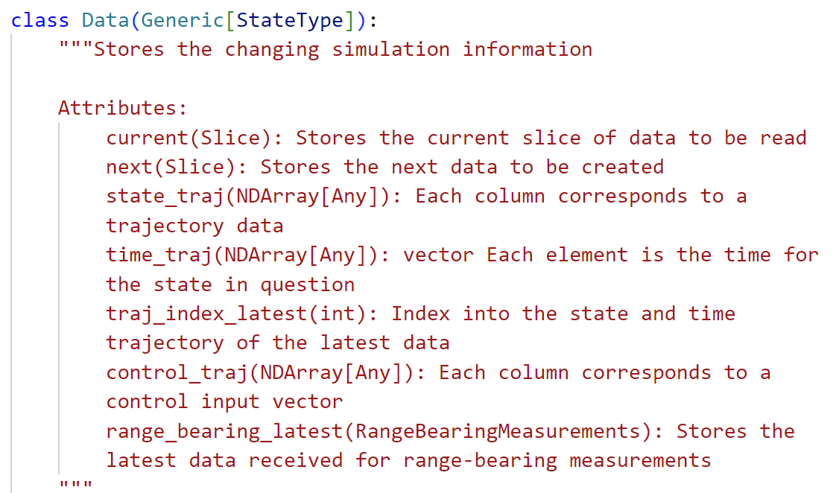
Data Stored in the Data Object
State, time, and control input data at single point in time
State, time, and control input data over the entirety of the simulation
Sensor data at current point in time

Slide 4
Using the start_sim() Function
Basic function that uses Python’s asyncio library to call two functions asynchronously
run_simulation(…)
While sim time is valid and stop not set
Copy over latest data
Call simulation update(…)
Call simulation store_data_slice(…)
Wait for sim_update_period seconds
Store final data
Call simulation post_process(…)
continuous_plotting(…)
Create the plot
While stop not set
Call simulation update_plot(…)
Wait for sim_plot_period seconds
Show plots until closed
These wait statements allow the other loop to run
Note, the asyncio call will run the two functions on the same thread

Slide 5
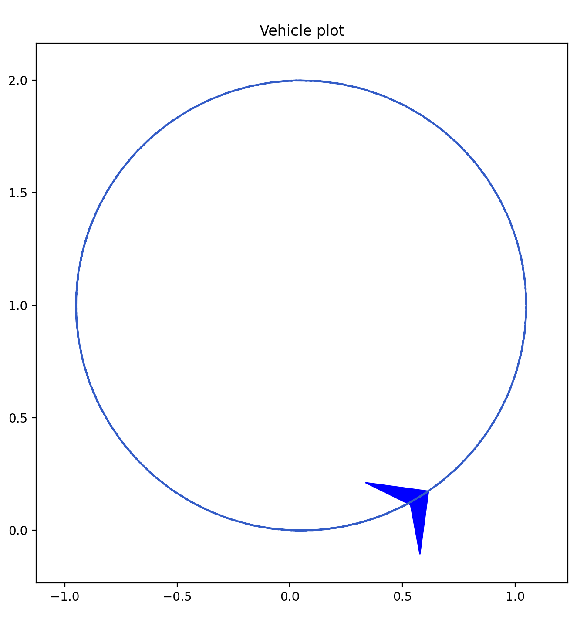
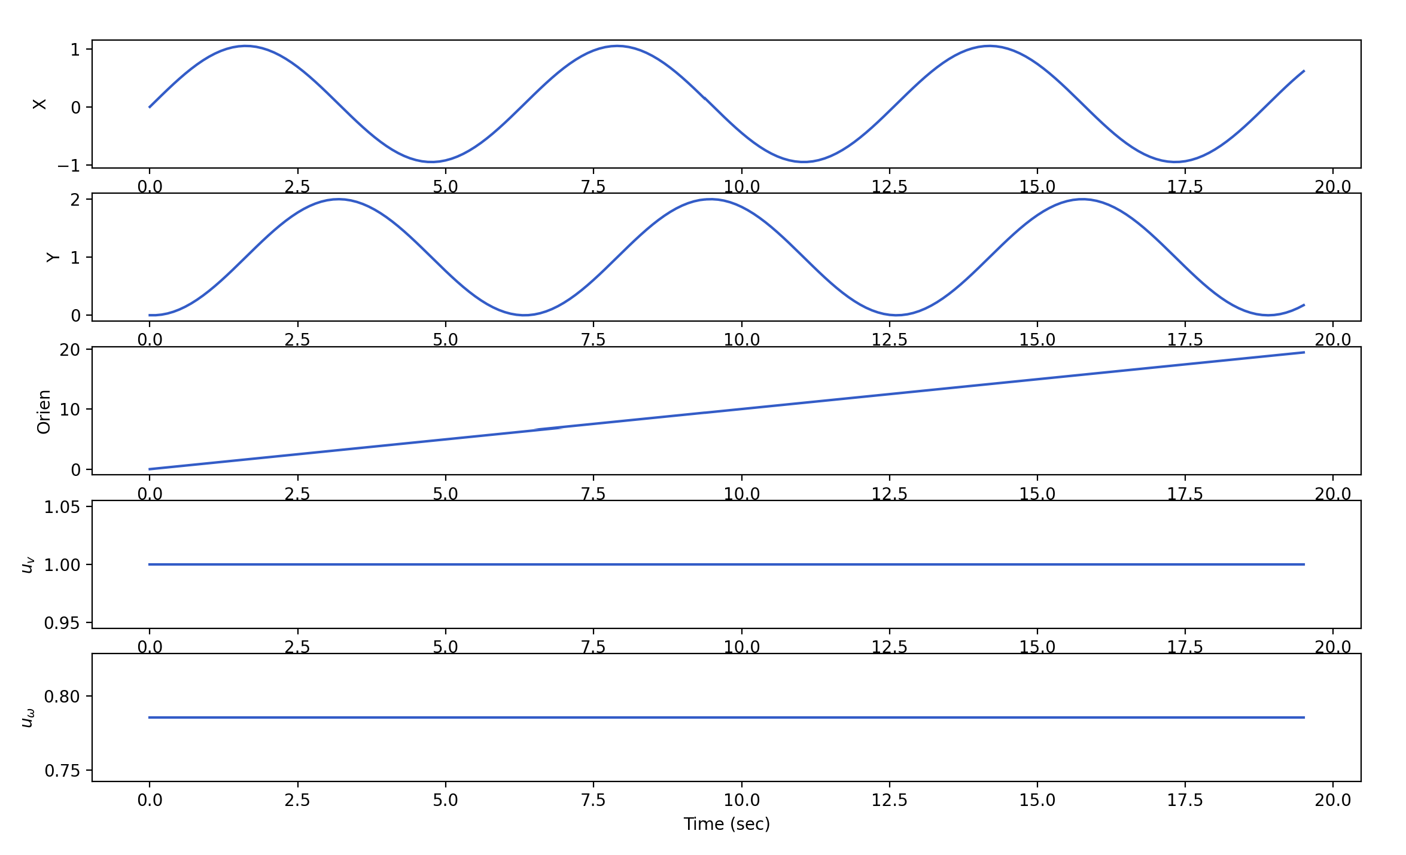
Example using the start_sim() Function
Simple sim (python .\py_sim\launch\simple_sim.py) has a vehicle move in a circular motion while plotting its state and position over time
run_simulation(…)
Updates the state based on a unicycle motion model to move in circle
Stores the state and trajectory information
continuous_plotting(…)
Plots the state, 2D trajectory, and the individual state values over time

Slide 6
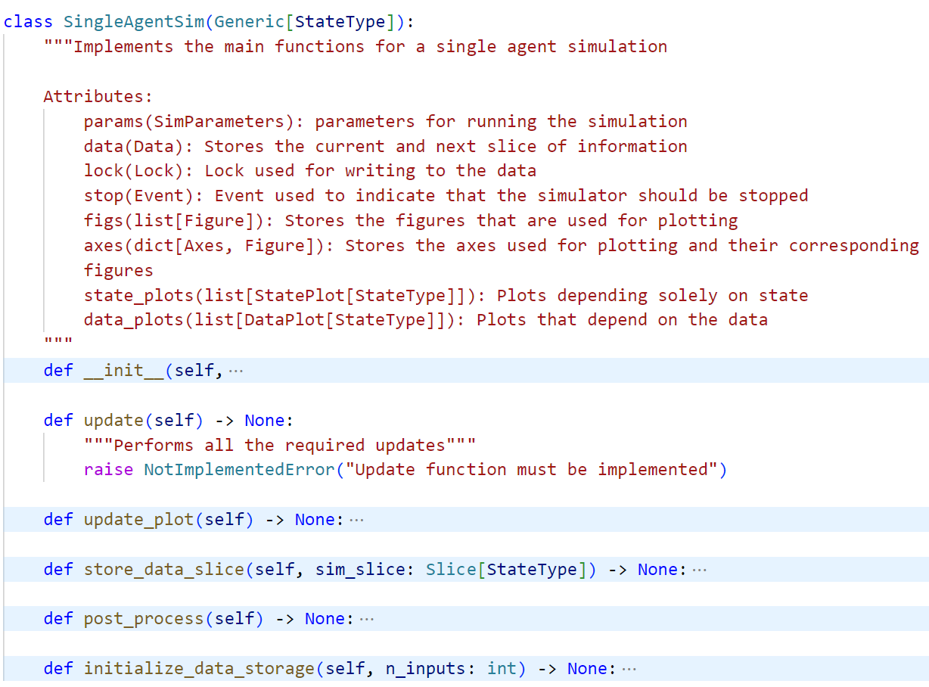
SingleAgentSim – The Major Sim Implemented
Note: A data-driven design is used in the sim. All data is defined as sim attributes and other functions just update those attributes as needed
Main sim object attributes
Parameters for plotting
Main sim functions
update(…) is left for children classes
update_plot(…) loops through all plotters and draws the figure
store_data_slice(…) stores the current data info into the trajectory variables
post_process(…) prints final state (kind of pointless)
Initialize the storage values for the entirety of the sim – called from the constructor

Slide 7
The Different Simulations – SimpleSim and VectorFollower
The simulations all inherit the SingleAgentSim, differing in additional attributes and the update(…) function implementation
SimpleSim
Attributes
dynamics: Function used to update the state
controller: Function used to calculate the controller
dynamic_params: parameters for the dynamics
control_params: parameters for the controller
update(…)
Calculates the controller given the state
Updates the state given the control input
Updates the time
VectorFollower
Attributes
dynamics: Function used to update the state
controller: Vector-based controller
dynamic_params: parameters for the dynamics
control_params: parameters for the controller
vector_field: Function to calculate vector based on state
update(…)
Calculates a vector to be followed
Calculates the controller given the state and vector
Updates the state given the control input
Updates the time
Green is used to show the differences from the SimpleSim

Slide 8
NavFieldFollower and NavVectorFollower
NavFieldFollower
Attributes
dynamics: Function used to update the state
controller: Vector-based controller
dynamic_params: parameters for the dynamics
control_params: parameters for the controller
vector_field: Function to calculate vector based on state
world: Polygon world in which navigation occurs
sensor: Range sensor used to detect obstacles (note that sensors aren’t actually used)
update(…)
Updates sensor measurements
Calculates a vector to be followed from state and time
Calculates the controller given the state and vector
Updates the state given the control input
Updates the time
NavVectorFollower
Attributes
dynamics: Function used to update the state
controller: Vector-based controller
dynamic_params: parameters for the dynamics
control_params: parameters for the controller
vector_field: Go-to-goal vector field
world: Polygon world in which navigation occurs
sensor: Range sensor used to detect obstacles
carrot: Object used to calculate a goal point
update(…)
Updates sensor measurement
Updates carrot goal point
Calculates a vector to be followed from state, goal, and obstacles
Calculates the controller given the state and vector
Updates the state given the control input
Updates the time
Green is used to show the differences from the SimpleSim

Slide 9
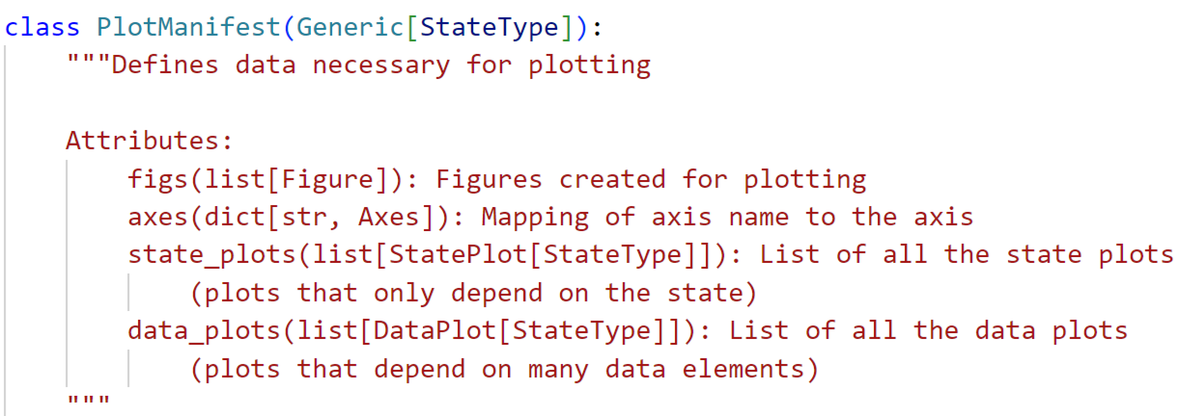
Plotting in the SingleAgentSim
The SingleAgentSim (and, thus, all of its children) require a plot manifest
The PlotManifest can be created using create_plot_manifest() – The following are some plots that can be created
State/input time series
Position (as triangle or dot)
Occupancy grid
Polygon world
2D Position trajectory
The state and data plots have a plot(…) function that is called within the SingleAgentSim.update_plots(…) function
Range measurement location and/or lines
Plan being followed
Graph of points
Goal, carrot points

Slide 10
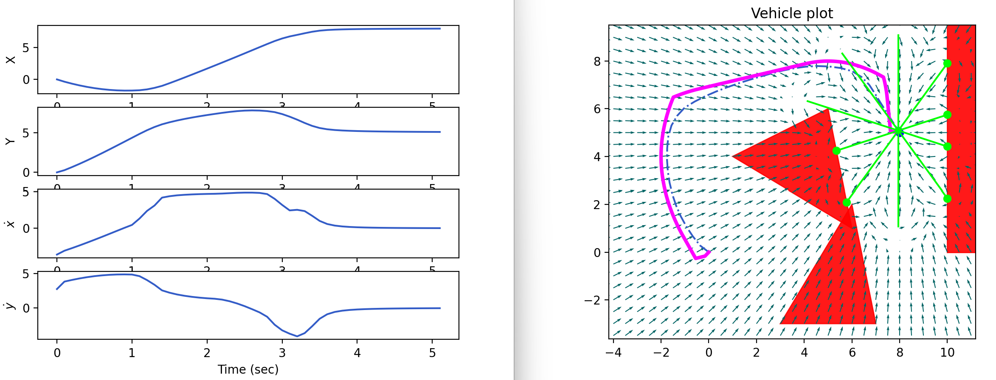
Plot Example with Most Plot Options Enabled
Example created from “python .\py_sim\00_homework\02_Point_following.py”

