Slide 1
Augeas – a configuration API
David Lutterkort
Red Hat, Inc.

Slide 2
Configuration Management
Sitewide configuration
Local configuration
Notes:
Sitewide configuration
puppet, bcfg2, cfengine
Express similarities and differences between systems
Make setup of large numbers of machines understandable
Local configuration
Mechanics of making changes
Configuration data in many text files
Many different formats for that data

Slide 3
Editing of Configuration Data
Keyhole approaches
Greenfield approaches
Templating
Notes:
Keyhole approaches
sed, awk, adhoc parsers
Targetted at specific change
Greenfield approaches
Elektra, Uniconf, CIM
Grand unified config API
Address also permissioning, remote API, ...
Templating
Alchemist, some system-config-* tools
New master store for config data
Clobber previously authoritative files
Only one owner

Slide 4
Missing pieces
Handle configuration data uniformly
Policy/delegation
Remotable API
Augeas lays the foundation for addressing these

Slide 5
Design Goals
(1) Deal with configuration data in its current place
Notes:
Deal with configuration data in its current place
No need for upstream support
No new “master” store
Existing scripts continue to work
Expose abstract view of configuration data
Preserve “unimportant” detail
Intuitive correspondence between tree and file changes
Describe new file formats easily and safely
Language neutral implementation (yes, that means C)
Focus on configuration editing
Augeas as basic building block

Slide 6
Design Goals
(2) Expose abstract tree view of configuration data
Notes:
Deal with configuration data in its current place
No need for upstream support
No new “master” store
Existing scripts continue to work
Expose abstract view of configuration data
Preserve “unimportant” detail
Intuitive correspondence between tree and file changes
Describe new file formats easily and safely
Language neutral implementation (yes, that means C)
Focus on configuration editing
Augeas as basic building block

Slide 7
Design Goals
(3) Preserve “unimportant” detail
Notes:
Deal with configuration data in its current place
No need for upstream support
No new “master” store
Existing scripts continue to work
Expose abstract view of configuration data
Preserve “unimportant” detail
Intuitive correspondence between tree and file changes
Describe new file formats easily and safely
Language neutral implementation (yes, that means C)
Focus on configuration editing
Augeas as basic building block

Slide 8
Design Goals
(4) Describe new file formats easily and safely
Notes:
Deal with configuration data in its current place
No need for upstream support
No new “master” store
Existing scripts continue to work
Expose abstract view of configuration data
Preserve “unimportant” detail
Intuitive correspondence between tree and file changes
Describe new file formats easily and safely
Language neutral implementation (yes, that means C)
Focus on configuration editing
Augeas as basic building block

Slide 9
Design Goals
(5) Language neutral implementation
Notes:
Deal with configuration data in its current place
No need for upstream support
No new “master” store
Existing scripts continue to work
Expose abstract view of configuration data
Preserve “unimportant” detail
Intuitive correspondence between tree and file changes
Describe new file formats easily and safely
Language neutral implementation (yes, that means C)
Focus on configuration editing
Augeas as basic building block

Slide 10
Design Goals
(6) Focus on configuration editing
Notes:
Deal with configuration data in its current place
No need for upstream support
No new “master” store
Existing scripts continue to work
Expose abstract view of configuration data
Preserve “unimportant” detail
Intuitive correspondence between tree and file changes
Describe new file formats easily and safely
Language neutral implementation (yes, that means C)
Focus on configuration editing
Augeas as basic building block

Slide 11
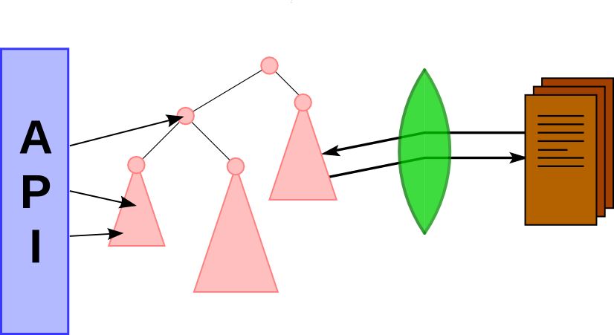
Overall architecture

Slide 12
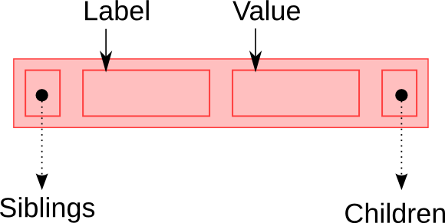
The Augeas Tree
Notes:
Parse configuration files into a tree
Expose tree through public API
Tree nodes have
Label (string)
Value (string)
Children (list of trees)
Siblings are ordered
foo/ bar/
bar/ ≠ foo/
Multiple siblings can have same label
Xpath-like notation

Slide 13
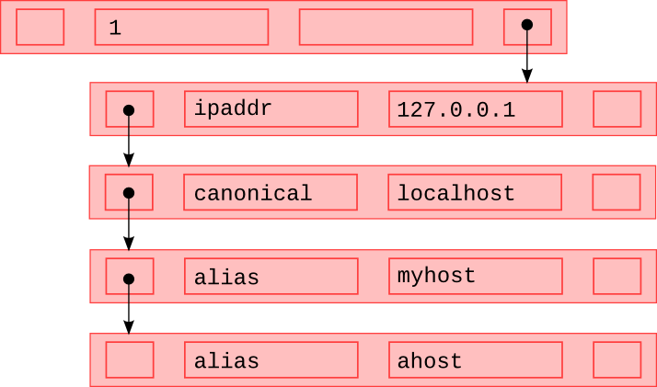
The Augeas Tree

Slide 14
The public Augeas API
Small number of calls to modify tree
  init/close
  get/set value associated with a node
  match nodes with path expression
  insert before/after existing node
  rm subtree
  save tree back to file
Possible additions
  copy/move subtrees
  load specific files

Slide 15
The public Augeas API
C API (libaugeas.so)
Command line tool augtool
Language bindings for Python, Ruby, Ocaml, Perl, Java, ...

Slide 16
Example: /etc/hosts
Format:
# ipaddr □ canonical (□ alias)* \n
127.0.0.1 □ localhost □ localhost.localdomain □ host.domain
Schema:
/files/etc/hosts
1/
ipaddr = 127.0.0.1
canonical = localhost
alias = localhost.localdomain
alias = host.domain

Slide 17
Example: /etc/hosts
augtool> set /files/etc/hosts/1/alias[2] myhost.domain
Schema:
/files/etc/hosts
1/
ipaddr = 127.0.0.1
canonical = localhost
alias = localhost.localdomain
alias = myhost.domain

Slide 18
Example: /etc/hosts
augtool> ins alias after /files/etc/hosts/1/alias[1]
Schema:
/files/etc/hosts
1/
ipaddr = 127.0.0.1
canonical = localhost
alias = localhost.localdomain
alias
alias = myhost.domain

Slide 19
Example: /etc/hosts
augtool> set /files/etc/hosts/1/alias[2] myhost
Schema:
/files/etc/hosts
1/
ipaddr = 127.0.0.1
canonical = localhost
alias = localhost.localdomain
alias = myhost
alias = myhost.domain

Slide 20
Example: /etc/hosts
augtool> save
New /etc/hosts:
# ipaddr □ canonical (□ alias)* \n
127.0.0.1 □ localhost □ localhost.localdomain □ myhost □ myhost.domain

Slide 21
Example: yum configuration
Trees underneath
/files/etc/yum.conf
/files/etc/yum.repos.d/some.repo
Schema
/section/key = value
Switch Fedora repo to internal mirror:
R=/files/etc/yum.repos.d/fedora.repo
augtool> rm $R/fedora/mirrorlist
augtool> set $R/fedora/baseurl mirror1
augtool> ins baseurl after $R/fedora/baseurl
augtool> set $R/fedora/baseurl[last()] mirror2

Slide 22
Overall architecture

Slide 23
Example: hosts.aug
module Hosts =
autoload xfm
let ws = del /[ \t]+/ “ “
let eol = del “\n” “\n”
let comment = [ del /(#.*|[ \t]*)\n/ "\n" ]
let word = /[^# \n\t]+/
let record =
[ seq "host" . [ label "ipaddr" . store word ] . ws . [ label "canonical" . store word ] .
[ label "alias" . ws . store word ]* .
eol ]
let lns = ( comment | record ) *
let xfm = transform lns (incl "/etc/hosts")

Slide 24
Schema description
module Yum =
autoload xfm
let lns = ...
let filter = (incl "/etc/yum.conf")
. (incl "/etc/yum.repos.d/*")
. Util.stdexcl
let xfm = transform lns filter

Slide 25
Schema description
module Yum =
autoload xfm
let lns = ...
let filter = (incl "/etc/yum.conf")
. (incl "/etc/yum.repos.d/*")
. Util.stdexcl
let xfm = transform lns filter

Slide 26
Schema description
module Yum =
autoload xfm
let lns = ...
let filter = (incl "/etc/yum.conf")
. (incl "/etc/yum.repos.d/*")
. Util.stdexcl
let xfm = transform lns filter

Slide 27
Schema description
module Yum =
autoload xfm
let lns = ...
let filter = (incl "/etc/yum.conf")
. (incl "/etc/yum.repos.d/*")
. Util.stdexcl
let xfm = transform lns filter

Slide 28
Schema description
module Yum =
autoload xfm
let lns = ...
let filter = (incl "/etc/yum.conf")
. (incl "/etc/yum.repos.d/*")
. Util.stdexcl
let xfm = transform lns filter

Slide 29
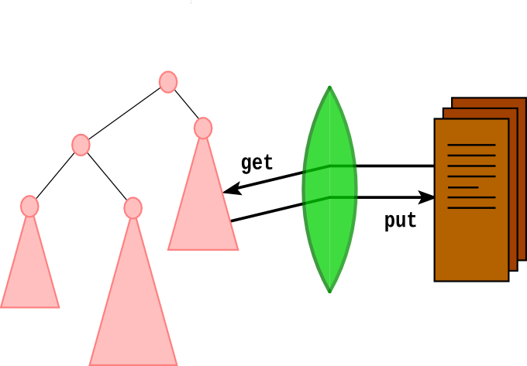
Lenses

Slide 30
Lenses
Concrete View↔Abstract View
Bidirectional programming
  Concrete →Abstract + Abstract→Concrete
Harmony (U Penn) does it for trees
Boomerang (U Penn) does it for strings
Theoretical groundwork by B. Pierce, N. Foster et.al.

Slide 31
Lenses for Augeas
String↔Tree
get: String →Tree
put: Tree x String →String

Slide 32
Lens Laws
The get and put of every lens must fulfill:
put (get c) c = c
get (put a c) = a
  Capture intuitive notions of “minimal” edits
  Constraints enforced by typechecker

Slide 33
Lens primitives
Tree labels
  key re
  label str
  seq str
Tree values
  store re
Omit from tree
  del re str

Slide 34
Lens combinators
l1 . l2 : Lens concatenation
l1 | l2 : Lens union
l*, l+ : Lens iteration
[ l ] : Subtree combinator

Slide 35
Lens development
Build up lenses from small parts
Reuse common constructs
  Comment goes from # to end of line
Unit test facility in Augeas language
  Run get direction
  Run get direction, modify tree, run put direction
  Compare to fixed value
  Assert exception
  Print result

Slide 36
Lens development
Process “key=value”

Slide 37
Lens development
Process “key=value”
let eq = del “=” “=”

Slide 38
Lens development
Process “key=value”
let eq = del “=” “=”
let lns =[ key /[a-z]+/ . eq . store /.+/ ]

Slide 39
Lens development
Process “key=value”
let eq = del “=” “=”
let lns =[ key /[a-z]+/ . eq . store /.+/ ]

Slide 40
Lens development
Process “key=value”
let eq = del “=” “=”
let lns =[ key /[a-z]+/ . eq . store /.+/ ]

Slide 41
Lens development
Process “key=value”
let eq = del “=” “=”
let lns =[ key /[a-z]+/ . eq . store /.+/ ]
test lns get “foo=bar” = ?

Slide 42
Lens development
Process “key=value”
let eq = del “=” “=”
let lns =[ key /[a-z]+/ . eq . store /.+/ ]
test lns get “foo=bar” = { “foo” = “bar” }

Slide 43
Lens development
Process “key=value”
let eq = del “=” “=”
let lns =[ key /[a-z]+/ . eq . store /.+/ ]
test lns get “foo2=bar1” = *

Slide 44
Lens development
Process “key=value”
let eq = del “=” “=”
let lns = [key /[a-z]+/ . eq . store /.+/ ]
test lns put “foo=bar”
after set “foo” “baz”
= ?

Slide 45
Lens development
Process “key=value”
let eq = del “=” “=”
let lns = [key /[a-z]+/ . eq . store /.+/ ]
test lns put “foo=bar”
after set “foo” “baz”
= ?

Slide 46
Lens development
Process “key=value”
let eq = del “=” “=”
let lns = [key /[a-z]+/ . eq . store /.+/ ]
test lns put “foo=bar”
after set “foo” “baz”
= “foo=baz”

Slide 47
Lens development
Process “key=value”
let eq = del /[ \t]+=[ \t]+/ “=”
let lns =[ key /[a-z]+/ . eq . store /.+/ ]

Slide 48
Lens development
Process “key=value”
let eq = del /[ \t]+=[ \t]+/ “=”
let lns =[ key /[a-z]+/ . eq . store /.+/ ]

Slide 49
Lens development
Process “key=value”
let eq = del /[ \t]+=[ \t]+/ “=”
let lns =[ key /[a-z]+/ . eq . store /[a-z]+/ ]
test lns put “foo \t= bar”
after set “foo” “baz”
= “foo \t= baz”

Slide 50
Arrays – using seq
hosts/
1/
ipaddr
canonical
alias
alias
2/
ipaddr
canonical
alias

Slide 51
Arrays – using identical labels
hosts/
1/
ipaddr
canonical
alias
alias
2/
ipaddr
canonical
alias

Slide 52
Handling comments
let comment = del /#.*\n/ “#\n”
let lns = (record|comment)*

Slide 53
Handling comments
let comment = [ del /#.*\n/ “#\n” ]
let lns = (record|comment)*

Slide 54
The lens typechecker
Each lens has associated ctype and atype
  Regular languages
Checks during lens construction
  del re str : str must match re
  l1 . l2 : unambiguously splittable
  l1 | l2 : disjoint regular languages
libfa for finite automata computations
Restricts Augeas to regular file formats

Slide 55
Supported file formats
/etc/hosts /etc/inittab yum config /etc/fstab /etc/exports
/etc/aliases /etc/ssh/sshd_config ntp
shell vars in /etc/sysconfig/ logrotate
ifcfg-*
apt preferences/sources dput pam.d
grub.conf xinetd.d vsftpd.conf
your contribution here

Slide 56
What about httpd.conf ?
Mostly tedious boilerplate
Except:
...
<IfModule mod_proxy.c>
...
</IfModule>
...
Arbitrary nesting, not regular
  Need recursion + regular approximation

Slide 57
A higher level service
Dbus service backed by Augeas
+
PolicyKit mechanism for authentication
=
Local configuration service
UI independent
File format independent
Fine grained permissioning
Harald Hoyer has prototype for system-config-boot

Slide 58
Supported platforms
Red Hat Linux flavors
  Fedora, RHEL, CentOS, ...
Other Linux flavors
  Debian
FreeBSD
OS/X port on the way
Minimal dependencies
Anything with a GNU libc (or equivalent gnulib support)

Slide 59
More information
Project website http://augeas.net/
  Read the “Quick Tour” first
Mailing list augeas-devel@redhat.com
IRC #augeas on freenode

