Slide 1
Technical Analysis
Cumulative Returns Strategy
By- Atrishi Jha
2nd year Undergrad
22114014
Computer Science and Engineering
IIT ROORKEE

Slide 2
Hypothesis
My strategy is based upon the common hypothesis that short term trends mimic long term trends. I have used this theory upon various trade indicators in order to create trade signals accordingly.
I have calculated Exponentially moving averages(EMA) for three time durations, short, middle and long; with the masking that the stock closed above it’s opening price. I have analysed their crossovers and made predictions about the nature of closing price via this hypothesis.

Slide 3
Strategy
If the EMA middle lies between EMA short and EMA long, we short the stock, because it is expected that EMA middle would increase to mimic the nature of EMA long and thus the stock would close above it’s opening price.
Similarly, we have made more such comparisons to analyze the closing price and it’s fluctuations. If EMA middle is greater than EMA long, it is expected that the closing price of stock would go below it’s opening price, and thus the stock should be longed.
On this basis, for each stock; each of the technical indicator creates its own list of trade signals. We execute these trade signals and see what returns are obtained.

Slide 4
Strategy
By seeing a stock’s historical performance under a particular trade indicator, we decide which EMA to use. The EMA (EMA,DEMA,TEMA,QEMA,PEMA) under which maximum sharpe is obtained is chosen, and the trade signals arising from them are executed.
My strategy primarily focusses on market adaptability and it’s strength lies in the way we have predicted the closing price’s outcome, by assessing the historical data.

Slide 5
Indicators
The indicators chosen are exponentially moving averages, as they assign more weight to recent dataset. This ensures that the trading strategy is smoother, and more adaptable to market fluctuations.
In the calculation of these indicators (EMA, DEMA ,TEMA ,QEMA ,PEMA) we have applied the masking that closing price would be greater than opening price. This ensures that EMAs are calculated only over those days where this condition is met.
The varied EMAs provide us with the freedom of choice based upon the historical performance.

Slide 6
Further Development of my strategy
Risk Management:-
Use of RSI (Relative Strength Index):- RSI helps to determine whether a stock is overbought or oversold. This means that suppose RSI value is greater than 70, the assets needs to undergo a price correction or pullback.
RSI levels can also be used as entry , exit signals.
In my strategy , when my trading strategy sends a buy signal, I would confirm it with the RSI indicator.

Slide 7
Further Development of my strategy
2. Diversification:-
Incorporating different stocks in my portfolio:- Currently my trading strategy only revolves around tech companies, as they saw a huge boom during the time period I have considered. (Beginning 2020 to beginning 2022). I would add stocks of different areas too along side adding other tech company stocks which are not such giants.
Portfolio Variation :- I would add bonds or commodities to ensure further diversification. This would not only bring market flexibility, but would also add much more depth to my current strategy.

Slide 8
Further Development of my strategy
Market Condition:-
Historical analysis of my stock currently has a two year period, where tech companies saw a market boom. I believe it’s important to ensure that the strategy not only works under bullish condition, but also performs in bearish periods.
Thus, I would add both bullish and bearish periods to my time period under analysis, for analyzing the strength of the stock.

Slide 9
Further Development of my strategy
4. High Benchmark Returns:-
In my strategy, for stocks – GOOGLE, APPLE and MICROSOFT we have extremely high benchmark returns, in comparison to returns obtained from my strategy. This shows how the price of these stocks had grown over time.
The reason behind this is that our strategy is purely logical, whereas the rise in price of these stocks was due to pandemic. It might look that my strategy fails in these cases, as it would have been better if we would have just held the stocks throughout, however this is not the case.

Slide 10
Further Development of my strategy
I believe I should have added more time periods and low end companies , so that a right analysis of my strategy could have been made.
I believe my strategy has performed well even for these stocks, as it could not have expected a sudden rise in market price. This shows that my strategy has good performance in bullish markets as well.

Slide 11
Insights gained
EMAs:-
I have thoroughly understood how exponentially moving averages are calculated, and how they are much better than simple moving averages. The need for assigning weights to recent datapoints and how they provide a much smoother and responsive market strategy, had become clear to me while working for my project.
I have also worked on even more smoother averages, DEMA ,TEMA ,QEMA and PEMA. Their calculations, their reasoning and their needs has been my prime focus of research for my project.

Slide 12
Insights gained
2. EMA Crossover:-
I have thoroughly researched my hypothesis, back tested it and have found excellent results. My strategy primarily focusses on EMA Crossover between short, middle and long time durations; and their nature i.e. the way they mimic each other.
I have also focused on visualizing graphs for the three crossovers, their nature and how we can predict buy and sell signals by assessing their nature over time. The graphs that I have demonstrated are visual demonstration of the ideas and theories I have researched throughout the project.

Slide 13
Insights gained
3. EMA selection:-
I personally feel the strength of my strategy and the reason behind the positive returns achieved is the market adaptability I have brought in my strategy. This has been possible by choosing the right indicator on the basis of it’s historical performance.
I have chosen that indicator which has the maximum sharpe. This choice has been made by seeing it’s historical performance. I have learned how we can use indicators in the best possible way, to assess market dynamics.

Slide 14
Insights gained
4. Technical Criteria:-
I have researched various technical criterias while writing their python codes. Their functions, their calculations and the way they assess a strategy, has cleared various concepts. I now consider these conditions, while formulating a strategy.
I believe learning about these criterias has made me visualize strategies in a better way. Their functions , calculations and the reasoning behind them has been extremely instrumental in forming my project.

Slide 15
Summary
To summarize my strategy, I would like to bring our attention back to the hypothesis. The theory that short term strategies mimic long term strategies has been the basis of my project.
I have further added a masking of Closing price of a stock being greater than it’s opening price. This helps me to make a prediction , about the nature of a stock’s closing price.
Bringing market adaptability was my next most important focal point in my project. I have ensured market flexibility by assessing historical performance of stock under different indicator and choosing the strategy having the best sharpe.

Slide 16
Summary
I have made an investment of 1,00,000 rupees and have got good returns for each stock , even ADANI which underperformed during the duration chosen. This I believe shows the strength of my stock and it’s ability to perform in different circumstances.
I have analyzed 5 stocks , GOOGLE, MICROSOFT, ADANI, TESLA, APPLE; all of these are giant tech companies (except ADANI ). I have analyzed them during pre covid period, when these companies saw a boom in their prices.

Slide 17
Summary
I have formulated my strategy on the basis of EMAs. I have plotted the necessary graphs to provide visual demonstration of my project and tried my best to analyze these stocks.
I have then provided buy and sell signals through graphical demonstration for each stock under each of the indicators. I have focused on analyzing these buy and sell points.
I have also calculated other important factors like sharpe, returns, drawdown, win ratio, ROI, AROI, number of loss making trades, total number of trades, maximum profit through a trade, maximum loss through a trade, benchmark returns.

Slide 18
Summary
All these calculations along with plotting the necessary graphs has been the major goal of the project. I have also provided the python code, which clearly explains my process and reasoning behind doing all of this.
I have considered this project as an opportunity to learn about trading strategies, technical indicators and market response to it. I have also learned how to write python codes about these functions. Not only have I become more comfortable in python, I feel I have also learned a lot about market dynamics.

Slide 19
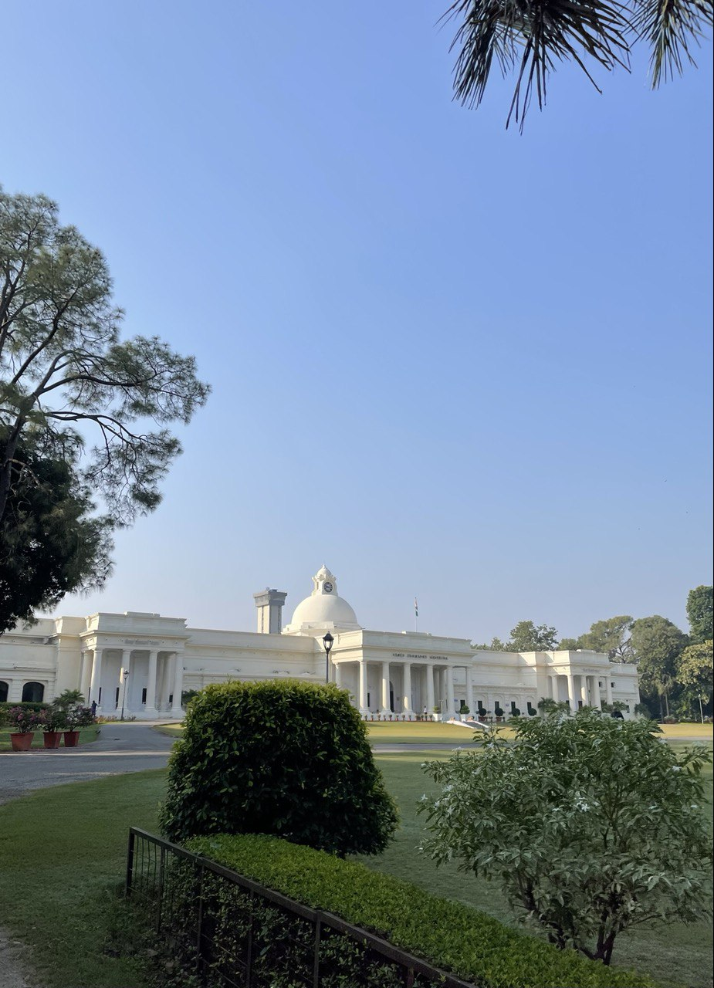
Thank You.

