Slide 1
The Battle of Neighborhoods
Toronto neighborhood - Vegan restaurants
Author: Hércules Sant'Ana da Silva José

Slide 2
Summary
Introduction
Data
Methodology
Results
Discussion
Conclusion

Slide 3
Introduction
Our motivation
About 8% of the world's population is vegan;
Sometimes be difficult to find great vegan restaurants;
Toronto is one of the most ethnic and culturally diverse cities in the world;
Companies specialized in vegan product want to sell our products.

Slide 4
Introduction
Business problem
Identify existing vegan restaurants in Toronto, and identify the best neighborhoods where vegan companies can partner with restaurants to promote their products or open new physical stores.
Audience
Vegan audience that comes to Toronto to come to work, study or tourism, and also companies interested in selling and promoting their vegan products.

Slide 5
Data
Source
Geografic data from borough and neighborhood of Toronto;
Foursquare API with all venues in Toronto.
Preparation
Data cleansing;
Formatting of geographic data;
Verification of data returned from the Foursquare API.

Slide 6
Methodology
Search a specific category for vegan restaurants;
Compare the amount of vegan restaurants with other types of restaurants;
Determine best neighboorhoods are promising for for companies to partner with local restaurants.

Slide 7
Results
Found the "Vegetarian / Vegan Restaurant";
Found only 18 venues using Foursquare API;
Found 47 different categories for restaurant;
Created a clustered dataset for neighborhoods using K-Means technique.

Slide 8
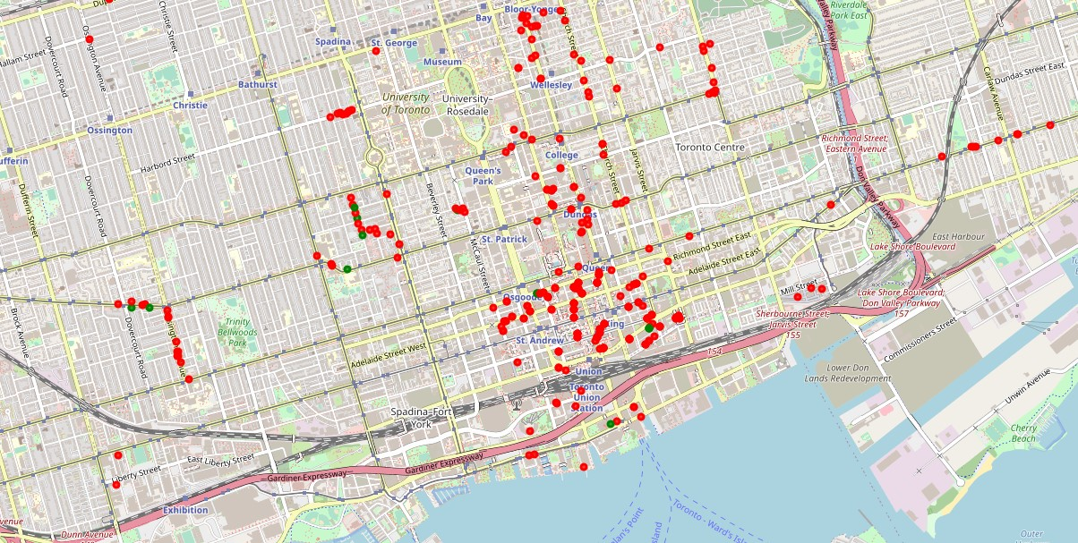
Discussion
Small number of vegan restaurants compared to the other types found in the Foursquare API;
Green – Vegan restaurants.
Red – Other types of restaurants.

Slide 9
Discussion
Neighborhoo clusterization pointed out the following:
High concentration of restaurants in the city center;
Specific neighborhoods without much concentration of restaurants;
Lots of neighborhoods without restaurants.

Slide 10
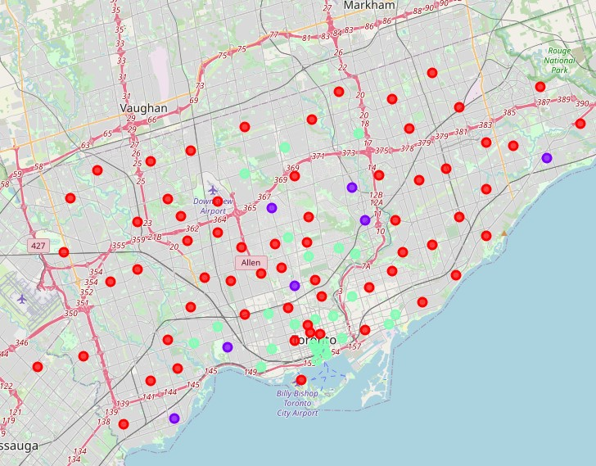
Discussion
Green – high concentration
Blue – low concentration
Red – do not have restaurants

Slide 11
Conclusion
Vegan dining options are concentrated in Toronto downtown;
Identified neighborhoods with few concentrations of restaurants, ideal to establish partnerships to open physical stores;
Most of Toronto's neighborhoods don't have venue classified as a restaurant.

Slide 12
The Battle of Neighborhoods
Toronto neighborhood - Vegan restaurants
Thank You!
Author: Hércules Sant'Ana da Silva José

