Slide 1
Screen Design

Slide 2

Electricity
For A Better Life
username
password
Mobile App to support user mobility
login

Slide 3
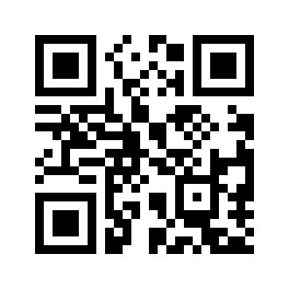
Electricity
For A Better Life
Setting
MDU in
MDU out
Material Code
Scan QRCode
QR Code Sample
Name
This QRCode will be placed in every
asset of PLN to ease user in perfoming data input to the system
Trans. Date
dd/mm/yyy
????????????
Input

Slide 4
Electricity
For A Better Life
Setting
MDU in
MDU out
Material Code
Scan QRCode
Name
Trans. Date
dd/mm/yyy
????????????
Input

