Slide 1
Data sources for biomedical reanalysis study: omics and clinical data
Herdiantri Sufriyana

Slide 2
Objectives
To understand nature of omics and obtain the raw data
To understand nature of clinical data and obtain the raw data

Slide 3
Raw data
Mean anything
Literally the data everyone gets for the first time (might be previously processed though)
Here, raw data mean minimum data you need before doing any step of analysis

Slide 4









Open data The database examples
https://data.mendeley.com/
https://www.ncbi.nlm.nih.gov/geo/
https://e-ppid.bpjs-kesehatan.go.id/
https://data.bpjs-kesehatan.go.id

Slide 5
Proposed framework
Causal diagram
Systematic human learning
Clinical data
(i.e. medical history)
https://www.medrxiv.org/content/10.1101/2021.06.16.21258884v1
Disease model
Covariates
Metabolite
Outcome
Omics
(i.e. gene expression)
Wet lab

Slide 6
Physiology/medicine in a nutshell
Genotype
Phenotype
Omics
Clinical data

Slide 7
Clinical data
Medical history (diagnosis and procedure)
Clinical notes
Lab/imaging test

Slide 8
Why medical history?
The Indonesian ‘big’ data available
Easy to deploy
Tell you the disease pathophysiology the doctor psychology in diagnosis and procedure; yet, much benefit to reveal

Slide 9

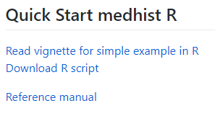
Dataset
https://github.com/herdiantrisufriyana/medhist
Install medhist (an R package) for practicing
Read this vignette:

Slide 10
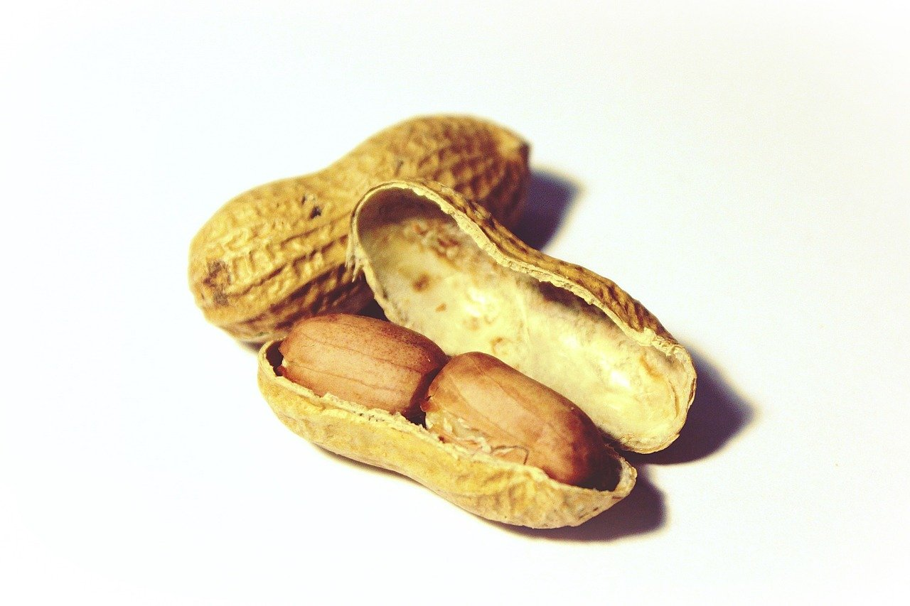
Medical record database in a nutshell
patient_id | birth_date
0001 | 2000-06-01
0002 | 1980-05-25
0003 | 1994-12-10
patient_id | visit_date | code
0001 | 2015-01-31 | A01
0002 | 2015-02-02 | F221
0001 | 2015-07-11 | J001
0001 | 2015-07-11 | A01
0003 | 2016-03-17 | I1121
Patient table
Visit table

Slide 11
Data wrangling (tidyverse)
3
patient_id | visit_date | A01 | F221 | J001 | I1121
0001 | 2015-01-31 | 1 | 0 | 0 | 0
0002 | 2015-02-02 | 0 | 1 | 0 | 0
0001 | 2015-07-11 | 1 | 0 | 1 | 0
0003 | 2016-03-17 | 0 | 0 | 0 | 1
2
patient_id | visit_date | code | value
0001 | 2015-01-31 | A01 | 1
0002 | 2015-02-02 | F221 | 1
0001 | 2015-07-11 | J001 | 1
0001 | 2015-07-11 | A01 | 1
0003 | 2016-03-17 | I1121 | 1
1
patient_id | visit_date | code
0001 | 2015-01-31 | A01
0002 | 2015-02-02 | F221
0001 | 2015-07-11 | J001
0001 | 2015-07-11 | A01
0003 | 2016-03-17 | I1121
visit %>%
mutate(value=1) %>%
spread(code,value,fill=0)

Slide 12
Data wrangling (tidyverse)
3
patient_id | visit_date | A01 | F221 | J001 | I1121
0001 | 2015-01-31 | 1 | 0 | 0 | 0
0002 | 2015-02-02 | 0 | 1 | 0 | 0
0001 | 2015-07-11 | 1 | 0 | 1 | 0
0003 | 2016-03-17 | 0 | 0 | 0 | 1
4
patient_id | visit_date | A01 | F221 | J001 | I1121
0001 | 2015-01-31 | 1 | 0 | 0 | 0
0002 | 2015-02-02 | 0 | 1 | 0 | 0
0001 | 2015-07-11 | 2 | 0 | 1 | 0
0003 | 2016-03-17 | 0 | 0 | 0 | 1
visit %>%
mutate(value=1) %>%
spread(code,value,fill=0) %>%
group_by(patient_id) %>%
summarize_all(cumsum)

Slide 13
Data wrangling (tidyverse)
visit %>%
mutate(value=1) %>%
spread(code,value,fill=0) %>%
group_by(patient_id) %>%
summarize_all(cumsum) %>%
left_join(patient,by=‘patient_id’)
patient_id | visit_date | A01 | F221 | J001 | I1121 | birth_date
0001 | 2015-01-31 | 1 | 0 | 0 | 0 | 2000-06-01
0002 | 2015-02-02 | 0 | 1 | 0 | 0 | 1980-05-25
0001 | 2015-07-11 | 2 | 0 | 1 | 0 | 2000-06-01
0003 | 2016-03-17 | 0 | 0 | 0 | 1 | 1994-12-10
5
patient_id | visit_date | A01 | F221 | J001 | I1121
0001 | 2015-01-31 | 1 | 0 | 0 | 0
0002 | 2015-02-02 | 0 | 1 | 0 | 0
0001 | 2015-07-11 | 2 | 0 | 1 | 0
0003 | 2016-03-17 | 0 | 0 | 0 | 1
patient_id | birth_date
0001 | 2000-06-01
0002 | 1980-05-25
0003 | 1994-12-10

Slide 14
Data wrangling (tidyverse+lubridate)
proc_visit=visit %>%
visit %>%
mutate(value=1) %>%
spread(code,value,fill=0) %>%
group_by(patient_id) %>%
summarize_all(cumsum) %>%
left_join(patient,by=‘patient_id’)
mutate(
age=
as.duration(visit_date-birth_date)
/dyears(1)
) %>%
select(-birth_date)
patient_id | visit_date | A01 | F221 | J001 | I1121 | birth_date
0001 | 2015-01-31 | 1 | 0 | 0 | 0 | 2000-06-01
0002 | 2015-02-02 | 0 | 1 | 0 | 0 | 1980-05-25
0001 | 2015-07-11 | 2 | 0 | 1 | 0 | 2000-06-01
0003 | 2016-03-17 | 0 | 0 | 0 | 1 | 1994-12-10
6
patient_id | visit_date | A01 | F221 | J001 | I1121 | age
0001 | 2015-01-31 | 1 | 0 | 0 | 0 | 14.63
0002 | 2015-02-02 | 0 | 1 | 0 | 0 | 34.87
0001 | 2015-07-11 | 2 | 0 | 1 | 0 | 15.01
0003 | 2016-03-17 | 0 | 0 | 0 | 1 | 21.32

Slide 15
Data wrangling (tidyverse+lubridate)
proc_visit %>%
left_join(
filter(.,J001>0) %>%
group_by(patient_id) %>%
summarize(
outcome_date=min(visit_date)
)
by=‘patient_id’
) %>%
select(-J001) %>%
7
patient_id | visit_date | A01 | F221 | I1121 | age | outcome_date
0001 | 2015-01-31 | 1 | 0 | 0 | 14.63 | 2015-07-11
0002 | 2015-02-02 | 0 | 1 | 0 | 34.87 | NA
0001 | 2015-07-11 | 2 | 0 | 0 | 15.01 | 2015-07-11
0003 | 2016-03-17 | 0 | 0 | 1 | 21.32 | NA
patient_id | visit_date | A01 | F221 | J001 | I1121 | age
0001 | 2015-01-31 | 1 | 0 | 0 | 0 | 14.63
0002 | 2015-02-02 | 0 | 1 | 0 | 0 | 34.87
0001 | 2015-07-11 | 2 | 0 | 1 | 0 | 15.01
0003 | 2016-03-17 | 0 | 0 | 0 | 1 | 21.32

Slide 16
Data wrangling (tidyverse+lubridate)
tidy_visit=proc_visit %>%
proc_visit %>%
left_join(
filter(.,J001>0) %>%
group_by(patient_id) %>%
summarize(
outcome_date=min(visit_date)
)
by=‘patient_id’
) %>%
select(-J001) %>%
mutate(
outcome=!is.na(outcome_date)
,outcome_date=
outcome_date %>%
replace_na(as.Date(‘2016-12-31’))
) %>%
filter(visit_date<outcome_date) %>%
select(-patient_id,-visit_date,-outcome_date)
7
patient_id | visit_date | A01 | F221 | I1121 | age | outcome_date
0001 | 2015-01-31 | 1 | 0 | 0 | 14.63 | 2015-07-11
0002 | 2015-02-02 | 0 | 1 | 0 | 34.87 | NA
0001 | 2015-07-11 | 2 | 0 | 0 | 15.01 | 2015-07-11
0003 | 2016-03-17 | 0 | 0 | 1 | 21.32 | NA
8
patient_id | visit_date | A01 | F221 | I1121 | age | outcome_date | outcome
0001 | 2015-01-31 | 1 | 0 | 0 | 14.63 | 2015-07-11 | TRUE
0002 | 2015-02-02 | 0 | 1 | 0 | 34.87 | 2016-12-31 | FALSE
0001 | 2015-07-11 | 2 | 0 | 0 | 15.01 | 2015-07-11 | TRUE
0003 | 2016-03-17 | 0 | 0 | 1 | 21.32 | 2016-12-31 | FALSE

Slide 17
Data wrangling (tidyverse+lubridate)
9
A01 | F221 | I1121 | age | outcome
1 | 0 | 0 | 14.63 | TRUE
0 | 1 | 0 | 34.87 | FALSE
0 | 0 | 1 | 21.32 | FALSE

Slide 18
The analysis pipeline: clinical data to omics
You make a model of a condition as the outcome using medical histories as the covariates
The medical histories are the other medical conditions
You search for the omics data related to the outcome and covariates
You get significant covariates of each condition to the control
Which of these covariates overlapped among the conditions?
Which pathways are overrepresented by the overlapped covariates?
Conclude a potential biomarker or therapeutic target.

Slide 19
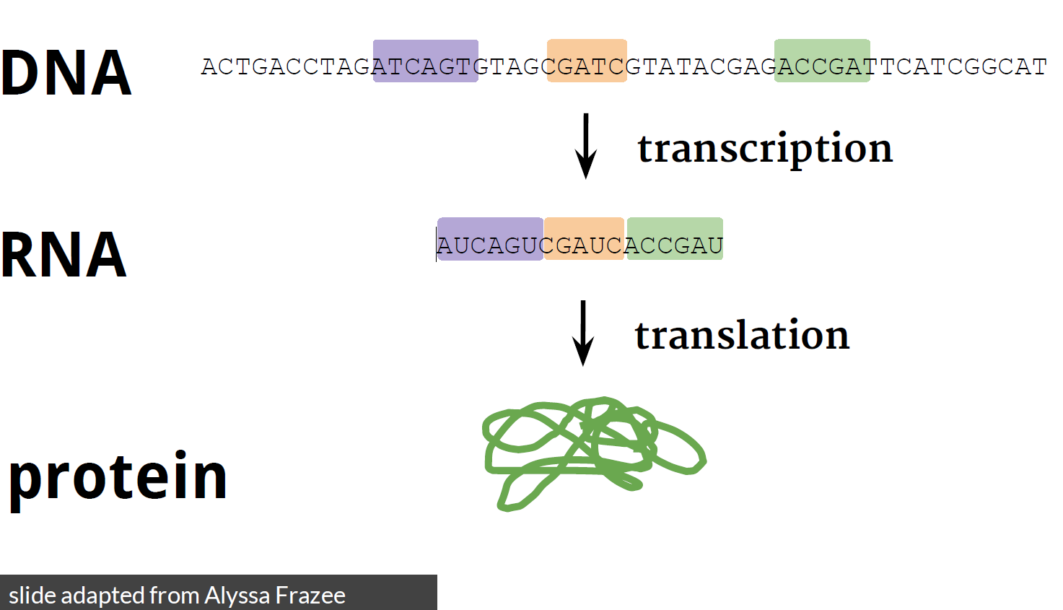
The central dogma tells us how information flows in a cell
The ‘central dogma’ term coined by Francis Crick
But it is a little more complicated
than that
Courtesy of Steven Salzberg. 2019. Why genomics? John Hopkins University.

Slide 20
More completed, yet still oversimplified
non-coding RNA
Transcription
Translation
DNA
mRNA
Protein
Metabolite
PTMs
SNP
Mutation
DNA methylation
Histone modification
Transcription factors
Gene expression
MicroRNA

Slide 21
Other (species) cells in human body
Human cell → genome
Microbe cells → genomes:
#1 Bacteria
#2 Fungus
#3 Virus
Not just one genome → metagenome
In practice, the metagenome refers to microbes → microbiome

Slide 22
Terminology
Single term | Collective term | Systematic study
Gene | Genome | Genomics
Non-coding RNA | Epigenetic factors | Epigenetics
Coding RNA | Transcriptome | Transcriptomics
Protein (any; inside and outside of a cell) | Proteome | Proteomics
Metabolite (secreted protein; outside of cell) | Metabolome | Metabolomics
Interaction | Interactome (not common) | Interactomics
Microbes | Metagenome (microbiome) | Metagenomics
Partly, courtesy of Yuan-Chii Gladys Lee. 2019. Gene, Genome, and Epigenetics. Taipei Medical University.

Slide 23
Enormous amount of (opened) data, yet still not fully explored (understood)
non-coding RNA
Transcription
Translation
DNA
mRNA
Protein
Metabolite
PTMs
Mass spec
(protein profiling by mass spec)
SNP
Mutation
DNA methylation
Histone modification
Transcription factors
Gene expression
MicroRNA
DNA-seq
(genome variation profiling by high-throughput sequencing)
ChIP-seq
(genome binding/occupancy profiling by high-throughput sequencing)
Microarray & RNA-seq
(expression profiling by array and high-throughput sequencing)
(non-coding RNA profiling by array and high-throughput sequencing)
(methylation profiling by array and high-throughput sequencing)

Slide 24
Let’s (over)simplify the protocols
Sample
Blood, exosomes (in blood/urine/CSF/tissue), swab, tissue excision, etc.
Tissues
* Sample preparation for:
Total nucleic acid (DNA + RNA)
https://www.thermofisher.com/tw/zt/home/life-science/dna-rna-purification-analysis/rna-extraction/rna-types.html
Total RNA
mRNA
Other small RNA (e.g. siRNA, etc.)
https://www.thermofisher.com/tw/zt/home/life-science/sequencing/epigenetic-sequencing/chromatin-immunoprecipitation/chromatin-immunoprecipitation-sequencing-chip-seq-sample-prep-for-next-generation-sequencing.html
miRNA
Sequence-, tissue-, species-specific RNA
Any cells
Chromatin ImmunoPrecipitation (ChIP)
+PCR
Targeted gene
Real-time (RT-PCR) or quantitative PCR (qPCR)
https://en.wikipedia.org/wiki/Real-time_polymerase_chain_reaction
Global*
Sanger (=first generation) sequencing
https://en.wikipedia.org/wiki/DNA_sequencing
Microarray
Next (=second & third) generation sequencing (NGS)
Short-read (second generation) sequencing
Long-read (third generation) sequencing
Single (type) cells
Single-cell sequencing
https://en.wikipedia.org/wiki/Single_cell_sequencing

Slide 25
Demo

