Slide 1


Data Governance @ SneakerPark
Prepared by: Kien Dang
Submitted on: 06/04/2023

Slide 2
Background
SneakerPark is an online shoe reseller that allows people to buy and sell used and new shoes. Buyers can bid for shoes or buy them outright, and sellers can set a price or sell to the highest bidder.
Each buyer and seller must have an active account in order to sell, bid, or purchase sneakers using SneakerPark’s website.
SneakerPark authenticates the shoes before shipping them to the buyer, so before listing an item, the seller must ship it to SneakerPark’s warehouse. Upon receipt, SneakerPark assigns an item number to each pair of sneakers and notifies the seller that they are now free to list their item. If the item is not listed within 45 days, SneakerPark returns it to the seller and sends an invoice to the seller for the shipping cost.
If the item is found to be inauthentic or in an unacceptable condition, it is also returned back to the seller in a similar fashion.
When the item sells, the buyer’s account is credited with the purchase price minus the SneakerPark service fee and shipping fees to deliver the item to the buyer.
Currently, SneakerPark only supports sales within the United States.

Slide 3
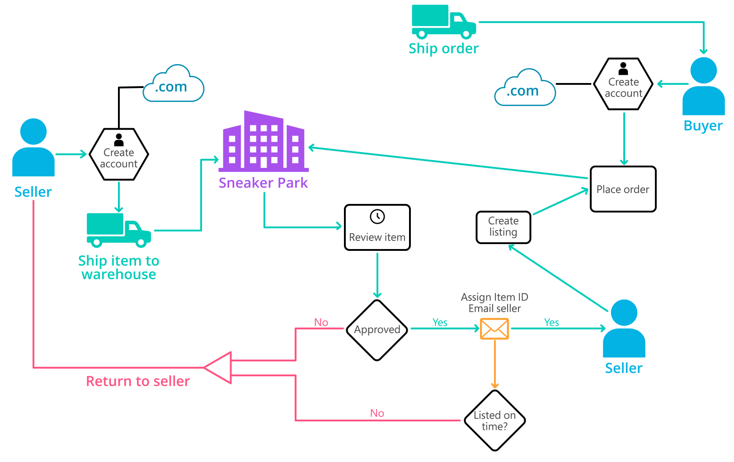
Background (cont’d)
Below you can see a diagram that will hopefully help you visualize some of SneakerPark's business processes. Keep in mind that it does not capture ALL processes and every nuance, but simply serves as another artifact to use in your project.

Slide 4
Step 1
Enterprise Data Catalog Part 1: Enterprise Data Model

Slide 5
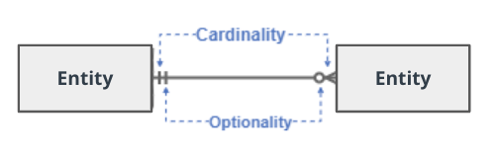
Create a conceptual data model that will provide SneakerPark with a holistic view of its data systems and help you grasp the organization's important entities and relationships, which will be instrumental as you move further in the project. You can use Lucidchart or any other diagramming tool of your choice, but please use the Crow’s Foot/IE Notation and please be sure to indicate both cardinality (the type of a relationship such as 1:N or N:N) and optionality (whether the relationship is optional or mandatory).

Slide 6
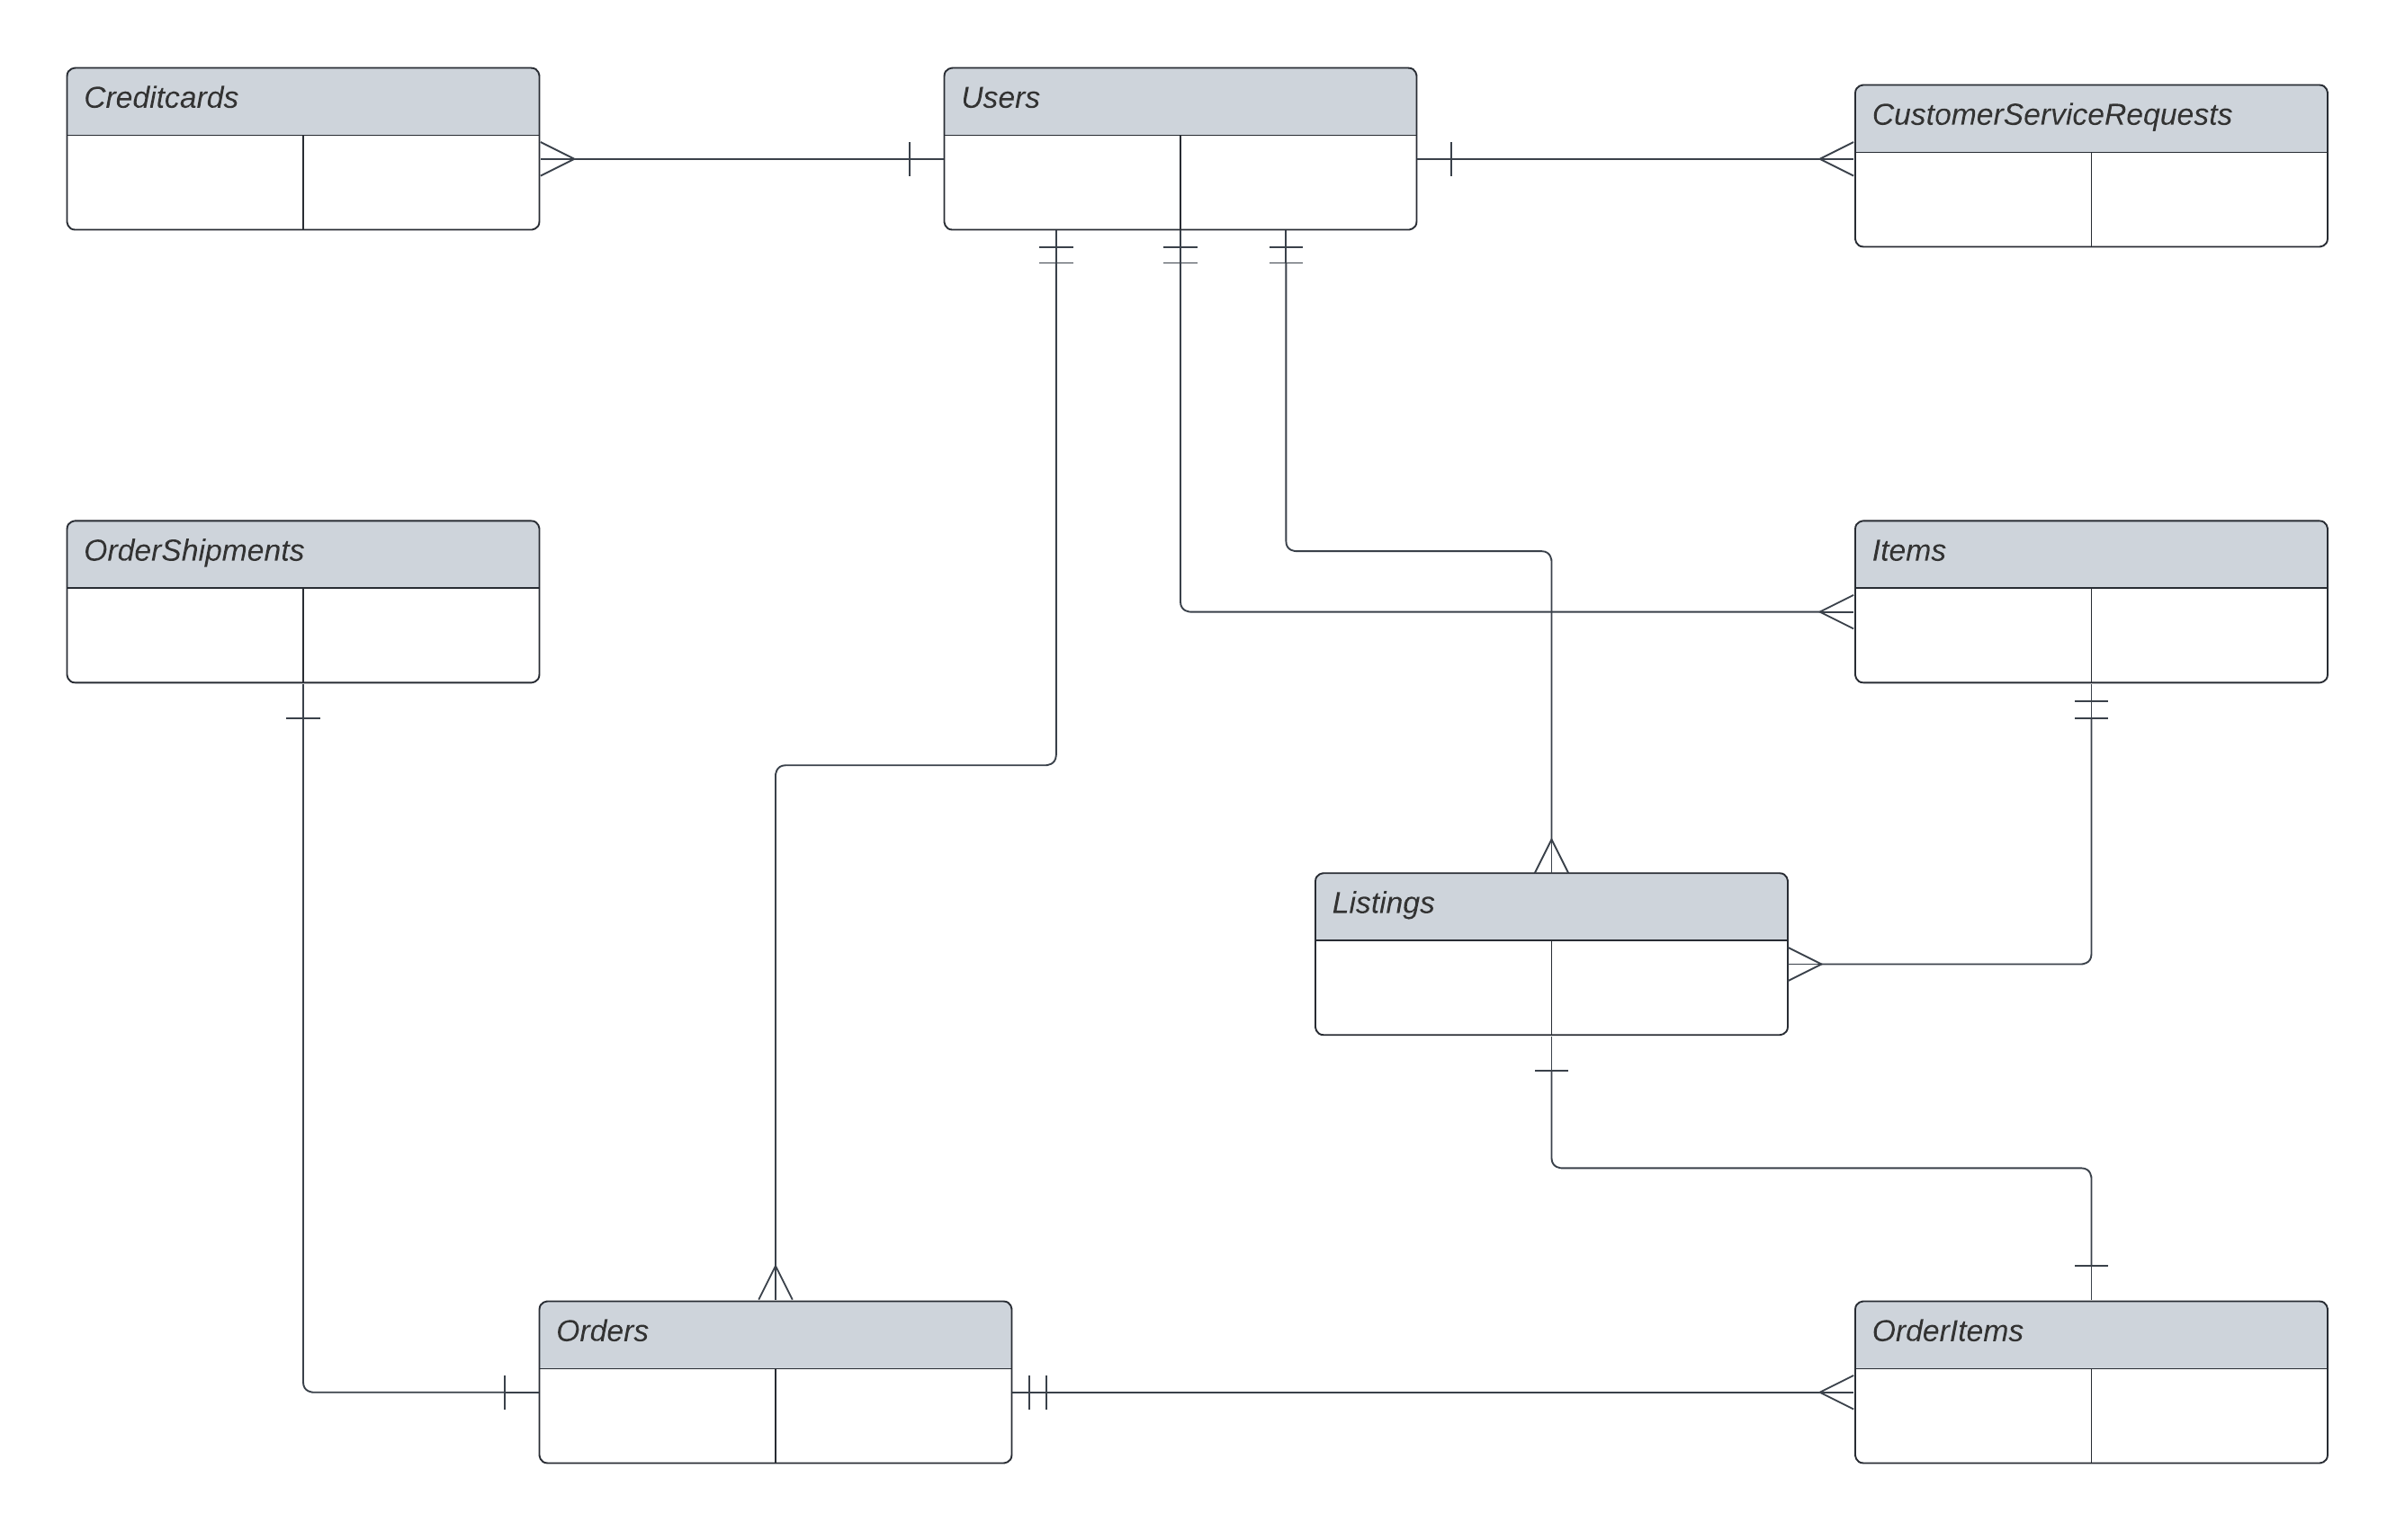
Replace the example below with your own solutions (obviously feel free to take more space):

Slide 7
Step 2
Enterprise Data Catalog Part 2: Metadata

Slide 8
Create the first version of the Metadata Catalog by documenting the metadata from all systems in the "Data Dictionary" and the “Enterprise Data Catalog” tabs of the provided Sheets template.
Please note that you are required to fill out all fields in both tabs.

Slide 9
Step 3
Data Quality
Part 1: Profiling and Cleansing

Slide 10
Profile the data to identify at least 3 data quality issues you see in the data. Also provide at least 1 data quality issue that you haven’t yet seen in the data, but can foresee occurring in the future. Based on the issues you’ve identified, come up with the data quality rule for each data quality issue, including for the one that you foresee.
Make sure you fill out all columns in the "Data Quality Issues" tab with your answers in the provided Sheets template.

Slide 11
Step 4
Data Quality
Part 2: Monitoring

Slide 12
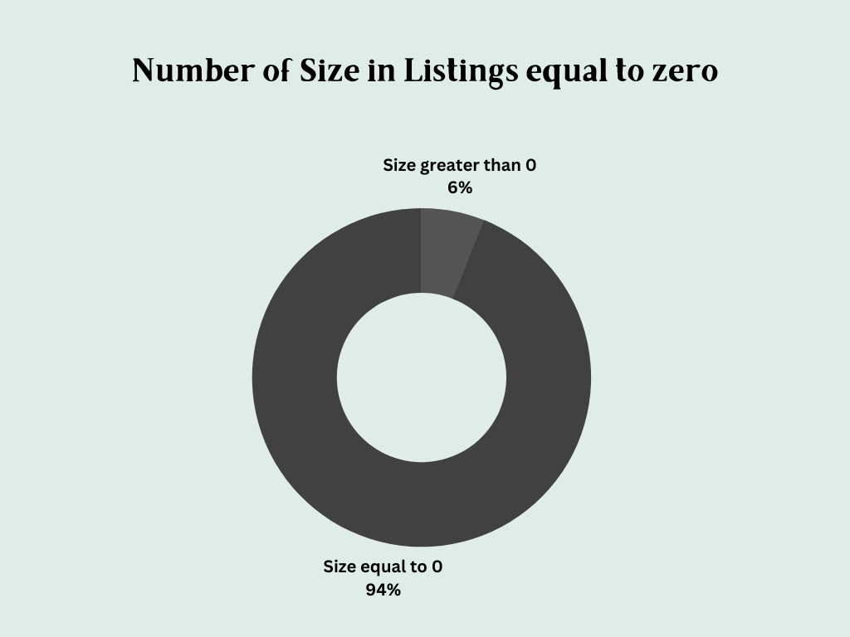
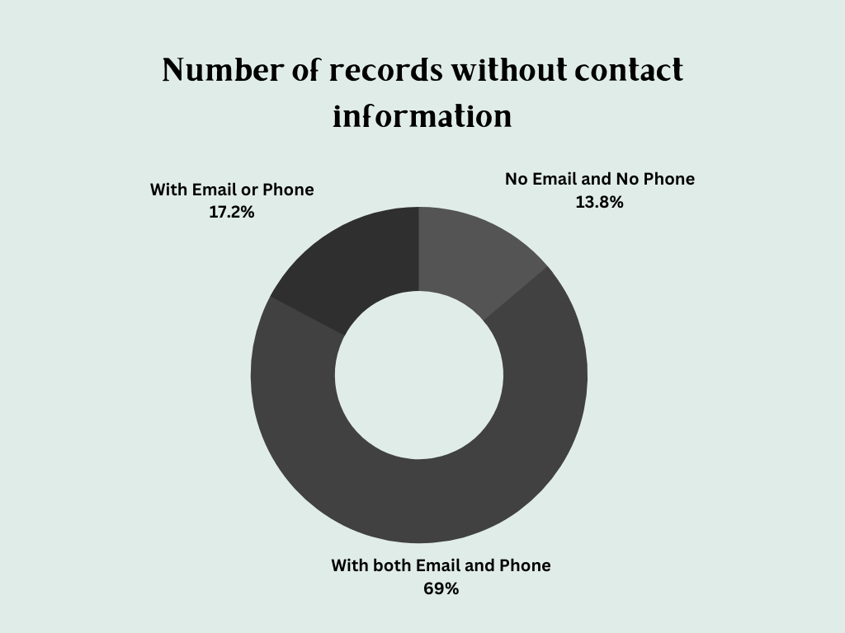
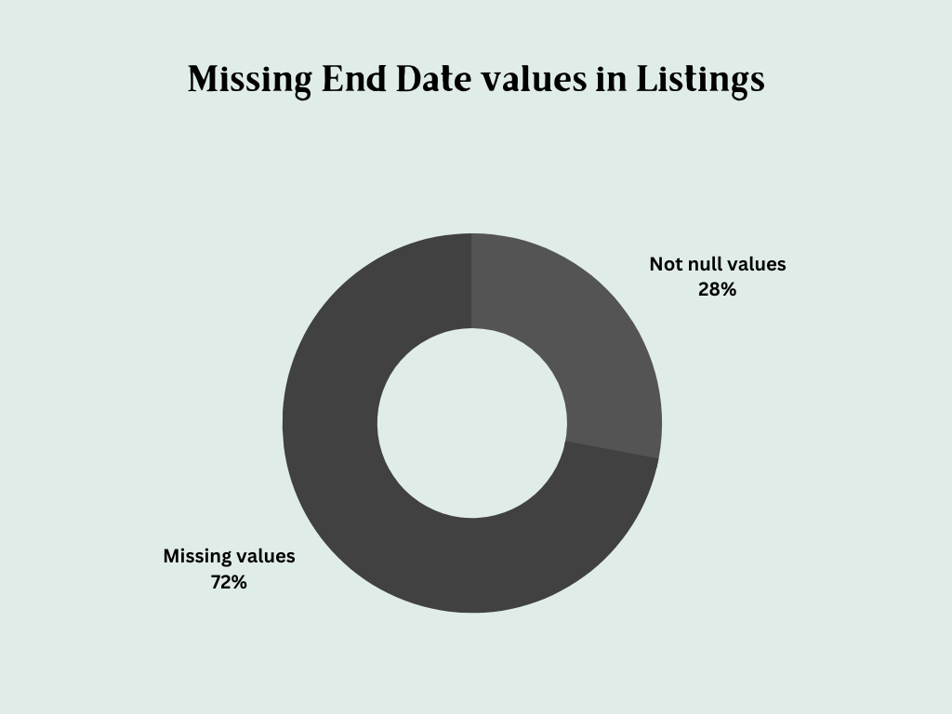
Using the metrics you've created in the last step, please create a mock-up of a data quality monitoring dashboard that will be used to monitor the data to ensure compliance with your data quality rules.
Please make sure to label your metrics clearly on your mock-up.
Replace the example dashboard below with your own. (obviously feel free to take more space).

Slide 13
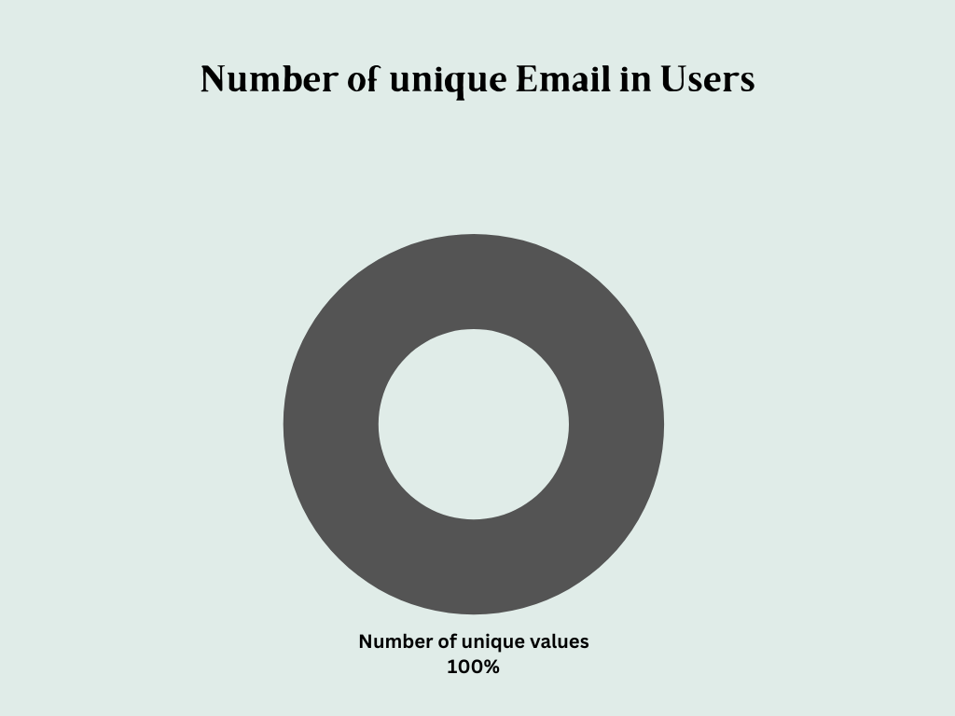
Using the metrics you've created in the last step, please create a mock-up of a data quality monitoring dashboard that will be used to monitor the data to ensure compliance with your data quality rules.
Please make sure to label your metrics clearly on your mock-up.
Replace the example dashboard below with your own. (obviously feel free to take more space).

Slide 14
Step 5
Master Data Management
Part 1: MDM Architecture

Slide 15
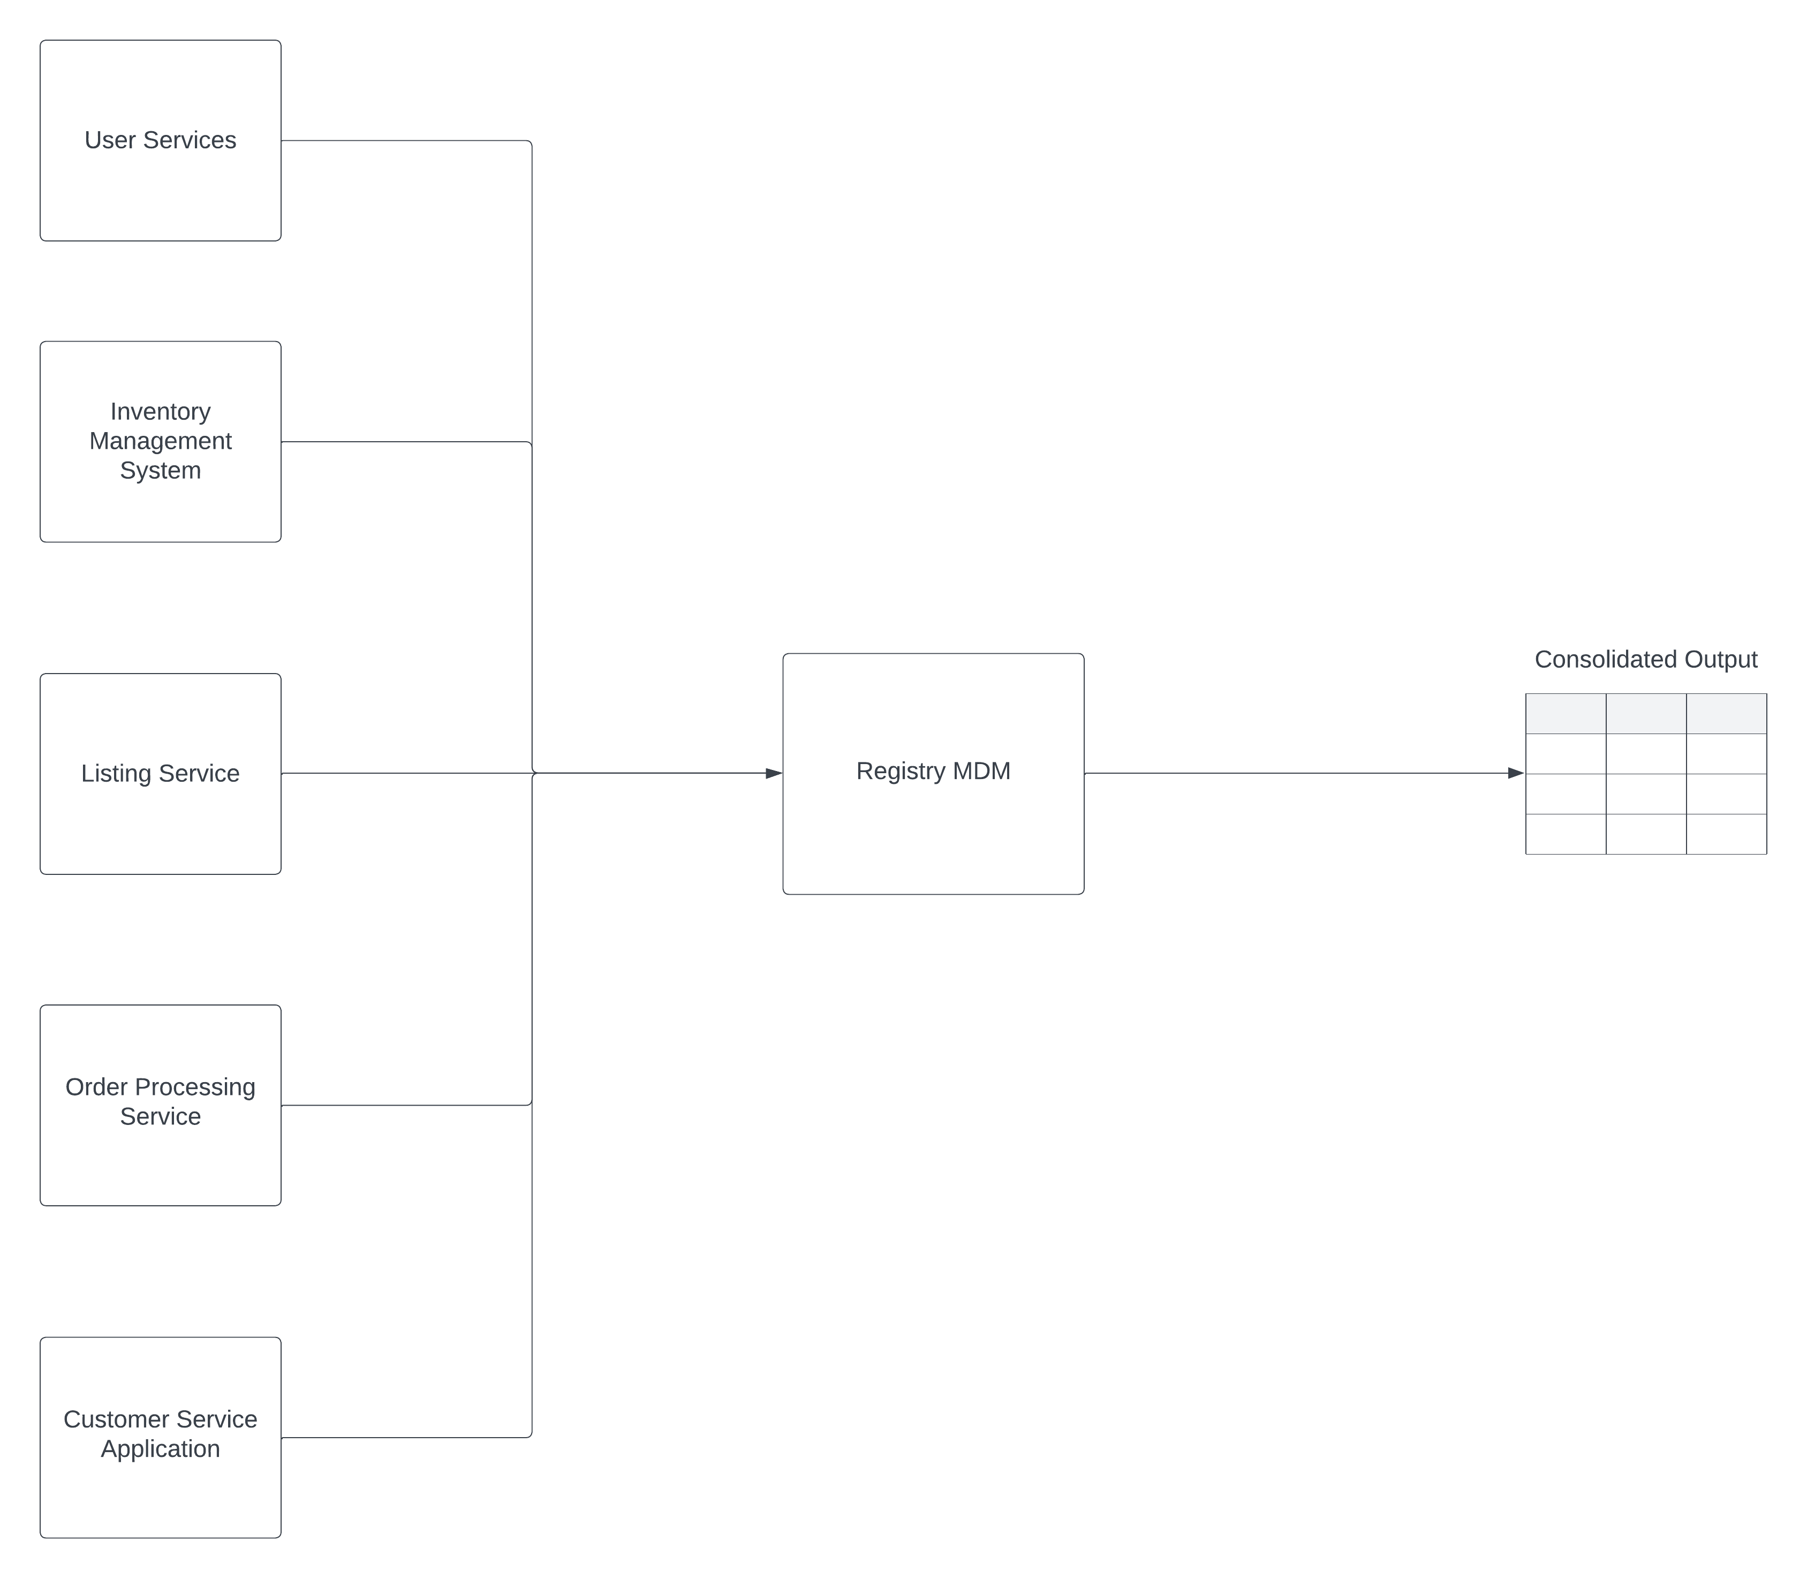
Based on what you’ve read about SneakerPark’s systems and business model, sketch out a proposed MDM implementation architecture, and write a detailed explanation of why you chose this specific approach.
Tip: Think about how your plan and its implementation might affect existing systems.
Replace example screenshot below with your own solutions (obviously feel free to take more space).
Next, please write at least a paragraph explaining your choice.

Slide 16
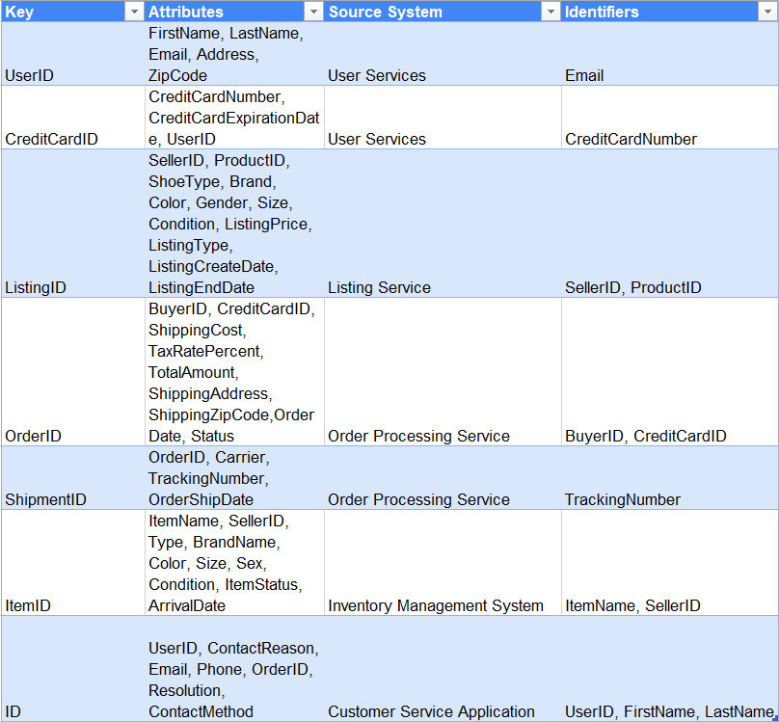
REGISTRY MDM – Table

Slide 17
Explanation: I choose Registry as MDM Architecture because it is the first time that the company try Enterprise Data Management Program and Registry MDM is the most suitable architecture, and it is easy to implement.

Slide 18
Step 6
Master Data Management
Part 2: Master Record

Slide 19
In this step, you will define a set of matching rules that will be used by the SneakerPark's MDM Hub to match item and customer entities between the company's different systems.
Please come up with 4 rules - 2 for Items and 2 for Customers and list them below.
Table | Rules
Item | Same ItemName & SellerID. Match ItemID records on the ItemName from Item & SellerID from Listings.
Item | BrandName, ArrivalDate, SellerID. Match ItemID records on the Brand Name and Arrival Date from Item and Seller ID from Listings.
Customer | Email and OrderID. Match UserID records on the Email from Users and OrderID from Customer Service Requests.
Customer | LastName, CreditCardNumber CreditCardExpirationdate. Match UserID records on the LastName of Users and CreditCardNumber and CreditCardExpirationDate from Credit Cards.

Slide 20
Step 7
Data Governance:
Roles and Responsibilities

Slide 21
Write 1-2 paragraphs discussing what data governance roles and responsibilities will be necessary to oversee this new Data Management initiative. Please be sure to discuss the responsibilities in the context of at least 3 different aspects of Data Governance (such as Data Quality Management, Metadata Management, MDM, etc). Based on what you know, do SneakerPark's current employees have the necessary skills for these roles or should the company make new hires?
Data Steward: Data Steward should be responsible for updating the data dictionary business context in the SneakerPark’s Metadata Management in case of either a new addition (tables or columns) as well as business description changes. This role can be taken by Jessica as she already has business understanding or every part of the organization along with new hire to join Jessica on this role because she already has another responsibilities, Jess can divide the workload with a new employee.
Data Architecture: Should be responsible for defining the workflow of the Data Quality Management and Metrics, as well as Master Data Management architecture for the entire system, in order to find and automated and smart way to identify breaches and data quality issues. This role can be taken by Daniel Freitas as he is a data architect that has a solid experience on building platforms.
Data Engineer: The Data Engineer focused on ProdOps will be responsible for providing IT production support on the Data Quality Management as well as the Master Data Management. Production support is key to keep consistency, accuracy and timeliness of the data. Jake can take this role.

