Slide 1
Agenda
What is a Data Lake
Components of a Data Lake
Data Lake vs Data Warehouse
Business Value of Data Lake Solution
Proposed Data Lake Architecture for Medical Data Processing system
Udacity IPS Ver. 1 2/2020

Slide 2
What is a Data Lake
Executive summary
A data lake is a centralized repository that allows users to store all structured and and structured data at any scale. Data lake can store data in its raw form, allows for flexible processing and analysis of large volumes of data. Data lakes are often used I big data scenarios where data from multiple sources and in different formats, used for variety of purposes like data exploration, machine learning, data analytics

Slide 3
Components of Data Lake
The components of a data lake include:
Ingestion layer: extracts data from various sources, such as websites, mobile apps, social media, IoT devices, and existing Data Management systems, is required.
Storage layer: able to store and process raw data and support encryption and compression while remaining cost-effective.
Processing layer: using data analytics and machine learning tools to derive valuable insights and move vetted data into a data warehouse.
Serving layer: consists of data that can be readily served to consumer applications. Hence this is mostly the processed data. The processed data in this layer could be exposed via any of the data repositories and multiple protocols.

Slide 4
Data Lake vs Data Warehouse

Slide 5
Data Warehouse (DW)
Data Lake (DL)
Data Structure: DW stores data in a relational database management system (RDBMS)
Data Processing: DW processes data using ETL to transform data to common format
Data Storage: DW stores data in a schema-on-write format (data is structured, organized before it is stored)
Data Usage: DW is used for business intelligence (BI) and reporting purposes, optimized for complex queries and analysis.
Data Structure: DL stores both structured and unstructured data in its raw format.
Data Processing: DL processes data using ELT processes to load data into the data lake and transform it as needed.
Data Storage: DL stores data in a schema-on-read format, which means that data is structured and organized when it is read.
Data Usage: DL is used for a variety of purposes, including data exploration, machine learning, and real-time analytics.
Udacity IPS Ver. 1 2/2020

Slide 6
Business Value of Data Lake
There are several business values of a data lake:
Centralized Data Storage
Scalability and Flexibility
Cost-Effective
Data Exploration and Analysis
Machine Learning and AI
Real-Time Analytics

Slide 7
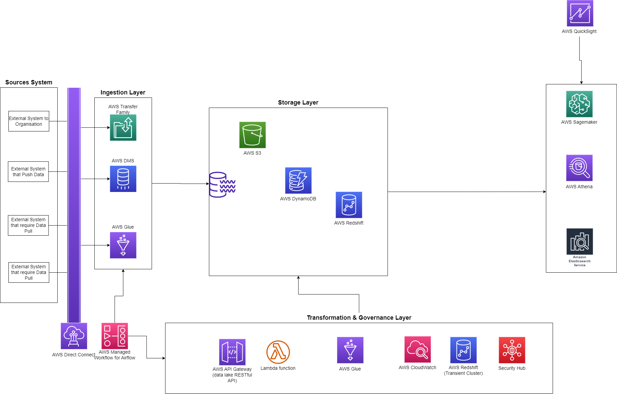
Data Lake Architecture

Slide 8

THANK YOU
Udacity IPS Version 1.0

