Slide 1
Binary Search Tree

Slide 2

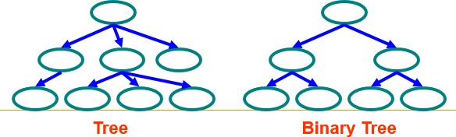
Trees
Tree
Each node can have 0 or more children
A node can have at most one parent
Binary tree
Tree with 0–2 children per node
Also known as Decision Making Tree

Slide 3
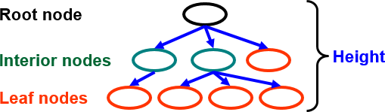
Trees
Terminology
Root ⇒ no parent
Leaf ⇒ no child
Interior ⇒ non-leaf
Height ⇒ distance from root to leaf (H)

Slide 4
Why is h important?
The Tree operations like insert, delete, retrieve etc. are typically expressed in terms of the height of the tree h.
So, it can be stated that the tree height h determines running time!

Slide 5
Binary Tree Implementation
Class Node
{
int data; // Could be int, a class, etc Node *left, *right; // null if empty
void insert ( int data ) { … } void delete ( int data ) { … } Node *find ( int data ) { … }
…
}

Slide 6
Binary Search Tree
Key property is value at node
Smaller values in left subtree
Larger values in right subtree Example
X > Y
X < Z
X
Y
Z

Slide 7
Binary Search Tree
Examples
5
10
10
2
45
5
30
5
45
30
2
25
45
2
25
30
10
25
Binary search trees
Not a binary search tree

Slide 8
Difference between BT and BST
A binary tree is simply a tree in which each node can have at most two children.
A binary search tree is a binary tree in which the nodes are assigned values, with the following restrictions :
No duplicate values.
The left subtree of a node can only have values less than the node
The right subtree of a node can only have values greater than the node and recursively defined
The left subtree of a node is a binary search tree.
The right subtree of a node is a binary search tree.

Slide 9







BST Operations
Four basic BST operations
1
Traversal
2
Search
3
Insertion
4
Deletion

Slide 10
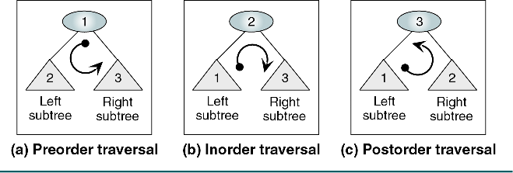
BST Traversal

Slide 11
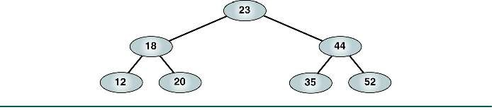
Preorder Traversal
Root Left Right
23 18 12 20 44 35 52

Slide 12
Postorder Traversal
Left Right Root
12 20 18 35 52 44 23

Slide 13
Inorder Traversal
Left Root Right
12 18 20 23 35 44 52
Produces a sequenced list

Slide 14


Inorder Traversal
1 | 10 | 8 | 4 | 6 | 3 | 2 | 5
1
10
8
4
3
6
2
5

Slide 15
Inorder Traversal
1 | 10 | 8 | 4 | 6 | 3 | 2 | 5
1
10
8
4
3
6
2
5

Slide 16
Inorder Traversal
1 | 10 | 8 | 4 | 6 | 3 | 2 | 5
1
10
8
4
3
6
2
5

Slide 17
Inorder Traversal
1 | 10 | 8 | 4 | 6 | 3 | 2 | 5
1
10
8
4
3
6
2
5
1

Slide 18
Inorder Traversal
1 | 10 | 8 | 4 | 6 | 3 | 2 | 5
1
10
8
4
3
6
2
5
1

Slide 19
Inorder Traversal
1 | 10 | 8 | 4 | 6 | 3 | 2 | 5
1
10
8
4
3
6
2
5
1

Slide 20
Inorder Traversal
1 | 10 | 8 | 4 | 6 | 3 | 2 | 5
1
10
8
4
3
6
2
5
1

Slide 21
Inorder Traversal
1 | 10 | 8 | 4 | 6 | 3 | 2 | 5
1
10
8
4
3
6
2
5
1

Slide 22
Inorder Traversal
1 | 10 | 8 | 4 | 6 | 3 | 2 | 5
1
10
8
4
3
6
2
5
1

Slide 23
Inorder Traversal
1 | 10 | 8 | 4 | 6 | 3 | 2 | 5
1
10
8
4
3
6
2
5
1

Slide 24
Inorder Traversal
1 | 10 | 8 | 4 | 6 | 3 | 2 | 5
1
10
8
4
3
6
2
5
1
2

Slide 25
Inorder Traversal
1 | 10 | 8 | 4 | 6 | 3 | 2 | 5
1
10
8
4
3
6
2
5
1
2

Slide 26
Inorder Traversal
1 | 10 | 8 | 4 | 6 | 3 | 2 | 5
1
10
8
4
3
6
2
5
1
2

Slide 27
Inorder Traversal
1 | 10 | 8 | 4 | 6 | 3 | 2 | 5
1
10
8
4
3
6
2
5
1 | 2 | 3

Slide 28
Inorder Traversal
1 | 10 | 8 | 4 | 6 | 3 | 2 | 5
1
10
8
4
3
6
2
5
1 | 2 | 3

Slide 29
Inorder Traversal
1 | 10 | 8 | 4 | 6 | 3 | 2 | 5
1
10
8
4
3
6
2
5
1 | 2 | 3

Slide 30
Inorder Traversal
1 | 10 | 8 | 4 | 6 | 3 | 2 | 5
1
10
8
4
3
6
2
5
1 | 2 | 3 | 4

Slide 31
Inorder Traversal
1 | 10 | 8 | 4 | 6 | 3 | 2 | 5
1
10
8
4
3
6
2
5
1 | 2 | 3 | 4

Slide 32
Inorder Traversal
1 | 10 | 8 | 4 | 6 | 3 | 2 | 5
1
10
8
4
3
6
2
5
1 | 2 | 3 | 4

Slide 33

Inorder Traversal
1 | 10 | 8 | 4 | 6 | 3 | 2 | 5
1
10
8
4
3
6
2
5
1 | 2 | 3 | 4

Slide 34
Inorder Traversal
1 | 10 | 8 | 4 | 6 | 3 | 2 | 5
1
10
8
4
3
6
2
5
1 | 2 | 3 | 4 | 5

Slide 35
Inorder Traversal
1 | 10 | 8 | 4 | 6 | 3 | 2 | 5
1
10
8
4
3
6
2
5
1 | 2 | 3 | 4 | 5

Slide 36
Inorder Traversal
1 | 10 | 8 | 4 | 6 | 3 | 2 | 5
1
10
8
4
3
6
2
5
1 | 2 | 3 | 4 | 5

Slide 37
Inorder Traversal
1 | 10 | 8 | 4 | 6 | 3 | 2 | 5
1
10
8
4
3
6
2
5
1 | 2 | 3 | 4 | 5 | 6

Slide 38
Inorder Traversal
1 | 10 | 8 | 4 | 6 | 3 | 2 | 5
1
10
8
4
3
6
2
5
1 | 2 | 3 | 4 | 5 | 6

Slide 39
Inorder Traversal
1 | 10 | 8 | 4 | 6 | 3 | 2 | 5
1
10
8
4
3
6
2
5
1 | 2 | 3 | 4 | 5 | 6

Slide 40
Inorder Traversal
1 | 10 | 8 | 4 | 6 | 3 | 2 | 5
1
10
8
4
3
6
2
5
1 | 2 | 3 | 4 | 5 | 6

Slide 41
Inorder Traversal
1 | 10 | 8 | 4 | 6 | 3 | 2 | 5
1
10
8
4
3
6
2
5
1 | 2 | 3 | 4 | 5 | 6 | 8

Slide 42
Inorder Traversal
1 | 10 | 8 | 4 | 6 | 3 | 2 | 5
1
10
8
4
3
6
2
5
1 | 2 | 3 | 4 | 5 | 6 | 8

Slide 43
Inorder Traversal
1 | 10 | 8 | 4 | 6 | 3 | 2 | 5
1
10
8
4
3
6
2
5
1 | 2 | 3 | 4 | 5 | 6 | 8

Slide 44
Inorder Traversal
1 | 10 | 8 | 4 | 6 | 3 | 2 | 5
1
10
8
4
3
6
2
5
1 | 2 | 3 | 4 | 5 | 6 | 8 | 10

Slide 45
Inorder Traversal
1 | 10 | 8 | 4 | 6 | 3 | 2 | 5
1
10
8
4
3
6
2
5
1 | 2 | 3 | 4 | 5 | 6 | 8 | 10

Slide 46
Binary Tree Insertion

Slide 47
Binary Tree Insertion
1 | 10 | 8 | 4 | 6 | 3 | 2 | 5

Slide 48
Binary Tree Insertion
1 | 10 | 8 | 4 | 6 | 3 | 2 | 5

Slide 49
Binary Tree Insertion
1 | 10 | 8 | 4 | 6 | 3 | 2 | 5
1

Slide 50
Binary Tree Insertion
1 | 10 | 8 | 4 | 6 | 3 | 2 | 5
1

Slide 51
Binary Tree Insertion
1 | 10 | 8 | 4 | 6 | 3 | 2 | 5
1

Slide 52
Binary Tree Insertion
1 | 10 | 8 | 4 | 6 | 3 | 2 | 5
1

Slide 53
Binary Tree Insertion
1 | 10 | 8 | 4 | 6 | 3 | 2 | 5
1
10

Slide 54
Binary Tree Insertion
1 | 10 | 8 | 4 | 6 | 3 | 2 | 5
1
10

Slide 55
Binary Tree Insertion
1 | 10 | 8 | 4 | 6 | 3 | 2 | 5
1
10

Slide 56
Binary Tree Insertion
1 | 10 | 8 | 4 | 6 | 3 | 2 | 5
1
10

Slide 57
Binary Tree Insertion
1 | 10 | 8 | 4 | 6 | 3 | 2 | 5
1
10

Slide 58
Binary Tree Insertion
1 | 10 | 8 | 4 | 6 | 3 | 2 | 5
1
10
8

Slide 59
Binary Tree Insertion
1 | 10 | 8 | 4 | 6 | 3 | 2 | 5
1
10
8

Slide 60
Binary Tree Insertion
1 | 10 | 8 | 4 | 6 | 3 | 2 | 5
1
10
8

Slide 61
Binary Tree Insertion
1 | 10 | 8 | 4 | 6 | 3 | 2 | 5
1
10
8

Slide 62
Binary Tree Insertion
1 | 10 | 8 | 4 | 6 | 3 | 2 | 5
1
10
8

Slide 63
Binary Tree Insertion
1 | 10 | 8 | 4 | 6 | 3 | 2 | 5
1
10
8

Slide 64
Binary Tree Insertion
1 | 10 | 8 | 4 | 6 | 3 | 2 | 5
1
10
8
4

Slide 65
Binary Tree Insertion
1 | 10 | 8 | 4 | 6 | 3 | 2 | 5
1
10
8
4

Slide 66
Binary Tree Insertion
1 | 10 | 8 | 4 | 6 | 3 | 2 | 5
1
10
8
4

Slide 67
Binary Tree Insertion
1 | 10 | 8 | 4 | 6 | 3 | 2 | 5
1
10
8
4

Slide 68
Binary Tree Insertion
1 | 10 | 8 | 4 | 6 | 3 | 2 | 5
1
10
8
4

Slide 69
Binary Tree Insertion
1 | 10 | 8 | 4 | 6 | 3 | 2 | 5
1
10
8
4

Slide 70
Binary Tree Insertion
1 | 10 | 8 | 4 | 6 | 3 | 2 | 5
1
10
8
4

Slide 71
Binary Tree Insertion
1 | 10 | 8 | 4 | 6 | 3 | 2 | 5
1
10
8
4
6

Slide 72
Binary Tree Insertion
1 | 10 | 8 | 4 | 6 | 3 | 2 | 5
1
10
8
4
6

Slide 73
Binary Tree Insertion
1 | 10 | 8 | 4 | 6 | 3 | 2 | 5
1
10
8
4
6

Slide 74
Binary Tree Insertion
1 | 10 | 8 | 4 | 6 | 3 | 2 | 5
1
10
8
4
6

Slide 75
Binary Tree Insertion
1 | 10 | 8 | 4 | 6 | 3 | 2 | 5
1
10
8
4
6

Slide 76
Binary Tree Insertion
1 | 10 | 8 | 4 | 6 | 3 | 2 | 5
1
10
8
4
6

Slide 77
Binary Tree Insertion
1 | 10 | 8 | 4 | 6 | 3 | 2 | 5
1
10
8
4
6

Slide 78
Binary Tree Insertion
1 | 10 | 8 | 4 | 6 | 3 | 2 | 5
1
10
8
4
3
6

Slide 79
Binary Tree Insertion
1 | 10 | 8 | 4 | 6 | 3 | 2 | 5
1
10
8
4
3
6

Slide 80
Binary Tree Insertion
1 | 10 | 8 | 4 | 6 | 3 | 2 | 5
1
10
8
4
3
6

Slide 81
Binary Tree Insertion
1 | 10 | 8 | 4 | 6 | 3 | 2 | 5
1
10
8
4
3
6

Slide 82
Binary Tree Insertion
1 | 10 | 8 | 4 | 6 | 3 | 2 | 5
1
10
8
4
3
6

Slide 83
Binary Tree Insertion
1 | 10 | 8 | 4 | 6 | 3 | 2 | 5
1
10
8
4
3
6

Slide 84
Binary Tree Insertion
1 | 10 | 8 | 4 | 6 | 3 | 2 | 5
1
10
8
4
3
6

Slide 85
Binary Tree Insertion
1 | 10 | 8 | 4 | 6 | 3 | 2 | 5
1
10
8
4
3
6

Slide 86
Binary Tree Insertion
1 | 10 | 8 | 4 | 6 | 3 | 2 | 5
1
10
8
4
3
6
2

Slide 87
Binary Tree Insertion
1 | 10 | 8 | 4 | 6 | 3 | 2 | 5
1
10
8
4
3
6
2

Slide 88
Binary Tree Insertion
1 | 10 | 8 | 4 | 6 | 3 | 2 | 5
1
10
8
4
3
6
2

Slide 89
Binary Tree Insertion
1 | 10 | 8 | 4 | 6 | 3 | 2 | 5
1
10
8
4
3
6
2

Slide 90
Binary Tree Insertion
1 | 10 | 8 | 4 | 6 | 3 | 2 | 5
1
10
8
4
3
6
2

Slide 91
Binary Tree Insertion
1 | 10 | 8 | 4 | 6 | 3 | 2 | 5
1
10
8
4
3
6
2

Slide 92
Binary Tree Insertion
1 | 10 | 8 | 4 | 6 | 3 | 2 | 5
1
10
8
4
3
6
2

Slide 93
Binary Tree Insertion
1 | 10 | 8 | 4 | 6 | 3 | 2 | 5
1
10
8
4
3
6
2

Slide 94
Binary Tree Insertion
1 | 10 | 8 | 4 | 6 | 3 | 2 | 5
1
10
8
4
3
6
2
5

Slide 95
Binary Tree Insertion
1 | 10 | 8 | 4 | 6 | 3 | 2 | 5
1
10
8
4
3
6
2
5

Slide 96
Binary Tree Deletion

Slide 97
Deleting nodes
Three scenarios
No children: If there is no leaf node, directly remove the node One child: In this case, we swap the value of that node with its child, and then
delete the node
Two children: In this case, we first find the in-order successor or predecessor, swap the value with it, and then delete that node

Slide 98
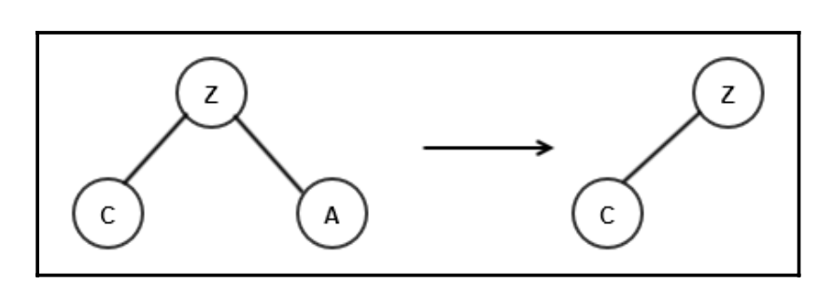
No children

Slide 99
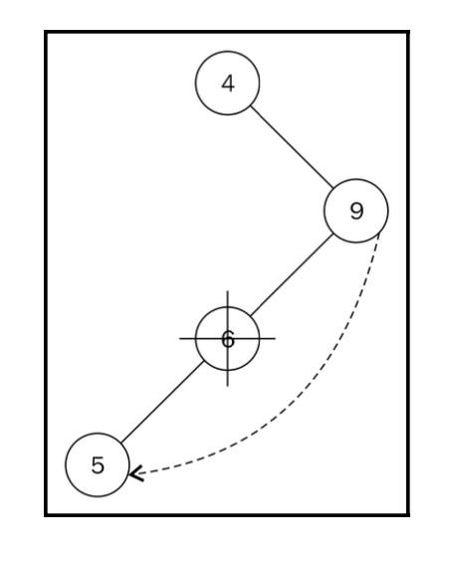
One child
when the node we want to remove has one child, the parent of that node is made to point to the child of that particular node. Let's take a look at the following diagram, where we want to delete node 6 who has one child, that is, node 5:

Slide 100
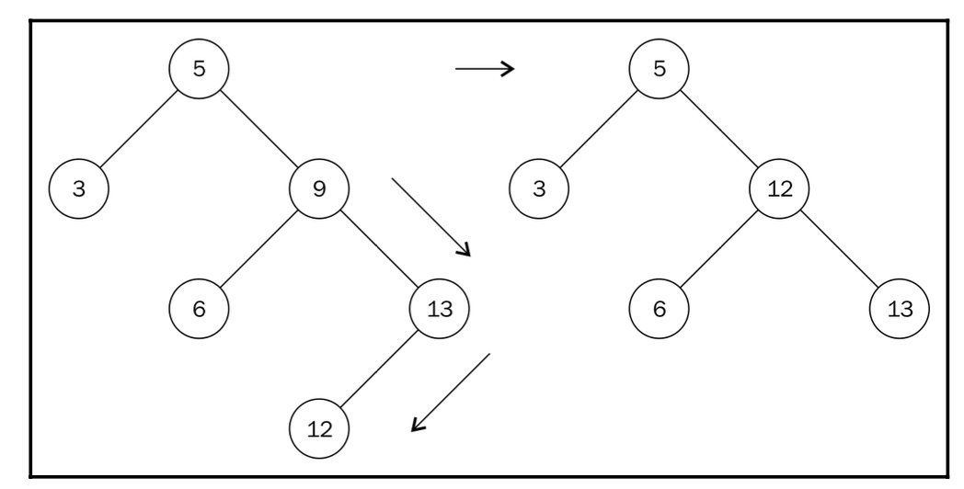
Two child
We cannot simply replace node 9 with either node 6 or 13. What we need to do is find the next biggest descendant of node 9.
Node 12 is called the in-order successor of node 9. The second step resembles the move to find the maximum node in a sub-tree.
Replace the node with the in-order successor of the node to be deleted.

Slide 101
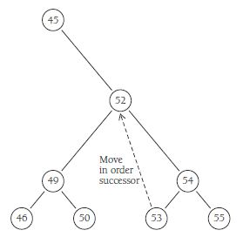

Slide 102
Binary Tree Deletion
1 | 10 | 8 | 4 | 6 | 3 | 2 | 5
1
10
8
4
3
6
2
5

Slide 103
Binary Tree Deletion
1 | 10 | 8 | 4 | 6 | 3 | 2 | 5
1
10
8
4
3
6
2
5

Slide 104
Binary Tree Deletion
1 | 10 | 8 | 4 | 6 | 3 | 2 | 5
1
10
8
4
3
6
5

Slide 105
Binary Tree Deletion
1 | 10 | 8 | 4 | 6 | 3 | 2 | 5
1
10
8
4
3
6
5

Slide 106
Binary Tree Deletion
1 | 10 | 8 | 4 | 6 | 3 | 5
1
10
8
4
3
6
5

Slide 107
Binary Tree Deletion
1 | 10 | 8 | 4 | 6 | 3 | 5
1
10
8
4
3
6
5

Slide 108
Binary Tree Deletion
1 | 10 | 8 | 4 | 6 | 3 | 5
1
10
8
4
3
6
5

Slide 109
Binary Tree Deletion
1 | 10 | 8 | 4 | 6 | 3 | 5
1
10
4
3
6
5

Slide 110
Binary Tree Deletion
1 | 10 | 8 | 4 | 6 | 3 | 5
1
10
4
3
6
5

Slide 111
Binary Tree Deletion
1 | 10 | 8 | 4 | 6 | 3 | 5
1
10
4
3
6
5

Slide 112
Binary Tree Deletion
1 | 10 | 4 | 6 | 3 | 5
1
10
4
3
6
5

Slide 113
Binary Tree Deletion
1 | 10 | 4 | 6 | 3 | 5
1
10
4
3
6
5

Slide 114
Binary Tree Deletion
1 | 10 | 4 | 6 | 3 | 5
1
10
4
3
6
5

Slide 115
Binary Tree Deletion
1 | 10 | 4 | 6 | 3 | 5
1
10
4
3
6
5

Slide 116
Binary Tree Deletion
1 | 10 | 4 | 6 | 3 | 5
1
10
4
3
6
5

Slide 117
Binary Tree Deletion
1 | 10 | 4 | 6 | 3 | 5
1
10
5
3
6
5

Slide 118
Binary Tree Deletion
1 | 10 | 4 | 6 | 3 | 5
1
10
5
3
6
5

Slide 119
Binary Tree Deletion
1 | 10 | 4 | 6 | 3 | 5
1
10
5
3
6
5

Slide 120
Binary Tree Deletion
1 | 10 | 4 | 6 | 3 | 5
1
10
5
3
6

Slide 121
Binary Tree Deletion
1 | 10 | 4 | 6 | 3 | 5
1
10
5
3
6

Slide 122
Binary Tree Deletion
1 | 10 | 6 | 3 | 5
1
10
5
3
6

Slide 123

Types of BST
Red- Black Tree

Slide 124
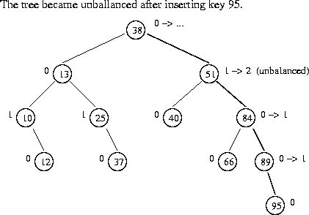
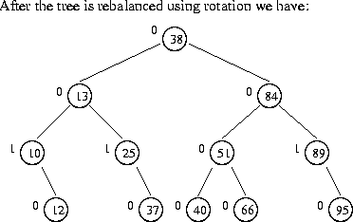
AVL Tree
AVL tree is a self-balancing Binary Search Tree (BST) where the difference between heights of left and right subtrees cannot be more than one for all nodes.

Slide 125
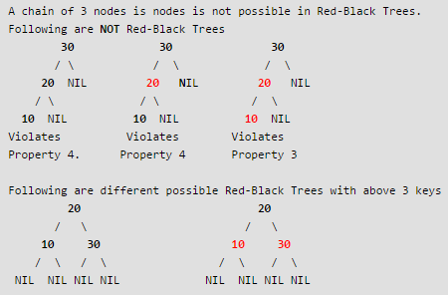
Red Black Tree
Every node has a color either red or black.
Root of black.
There
tree is always
are no two
adjacent red nodes (A red node cannot have a red parent or red child).
Every path from root to a NULL node has same number of black nodes.

Slide 126
Splay Tree
Automatically moves frequently accessed elements nearer to the root for quick to access

Slide 127
Complexity in BST
Operation | Average | Worst Case | Best Case
Search | O(log n) | O(n) | O(1)
Insertion | O(log n) | O(n) | O(1)
Deletion | O(log n) | O(n) | O(1)

Slide 128
Applications of BST
Used in many search applications where data is constantly entering/leaving, such as the map and set objects in many languages' libraries.
Storing a set of names, and being able to lookup based on a prefix of the name. (Used in internet routers.)
Storing a path in a graph, and being able to reverse any subsection of the path in O(log n) time. (Useful in travelling salesman problems).
Finding square root of given number
allows you to do range searches efficiently.

Slide 129

Thank you

