Slide 1
Graphs
1

Slide 2
Lecture Content
Graph Basics
Definitions and Terminologies
Data Structures Used to Store Graphs
Graph Traversal
Depth-First Search (DFS)
2.2. Breadth-First Search (BFS)
2

Slide 3
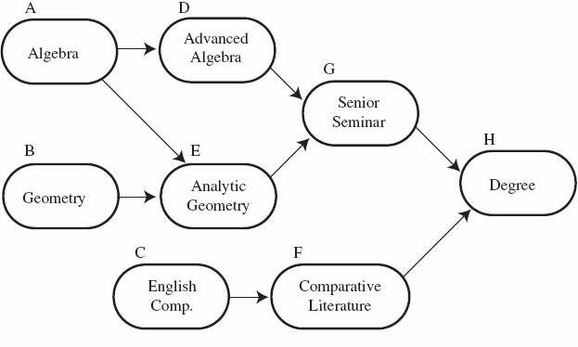
Lecture Content
3. Topological Sorting
Course prerequisites Topologically sorted order: C F B A E D G H
3

Slide 4
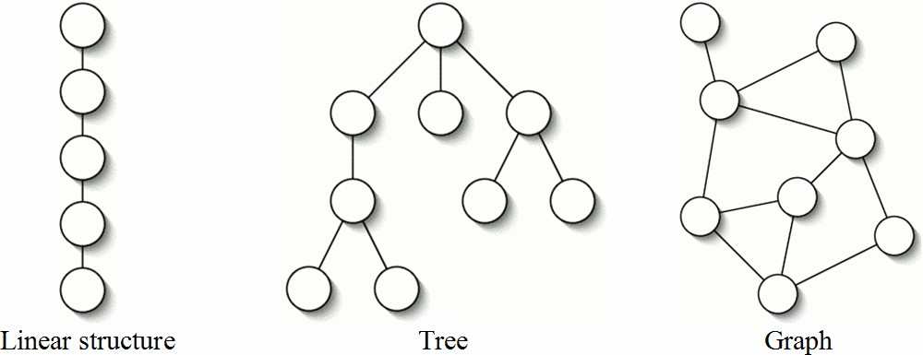
1. Graph Basics
Tree generalizes linear structures (i.e., singly linked list), graph generalizes tree.
4

Slide 5
1. Graph Basics
The key difference between tree and graph is that, in a graph, there may be more than one path between two nodes.
Many real-world problems can be modeled by using graphs. For example,
- finding the fastest routes for a mass
the question:
transportation system (answers to
what is the shortest driving route from city A to city
B),
5

Slide 6
1. Graph Basics
finding a minimum spanning tree (answers to the question: how can computers be connected with the least amount of cable)
routing electronic email through a computer network.
6

Slide 7
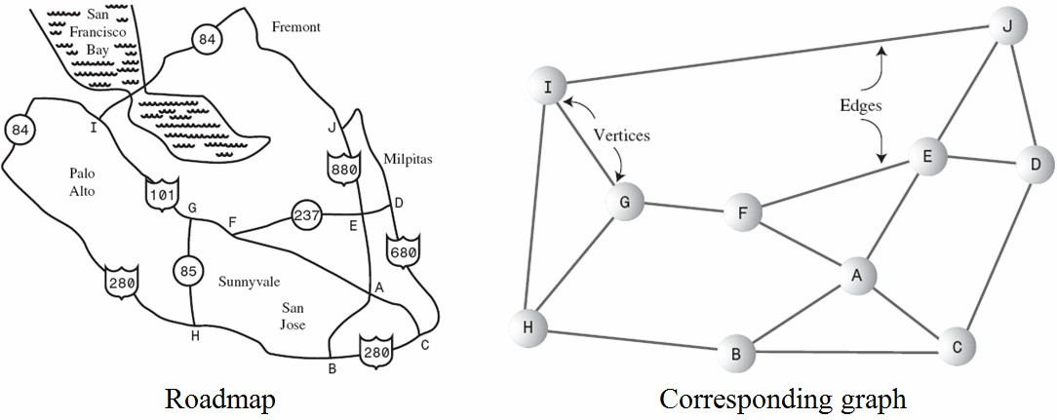
1. Graph Basics
.
7

Slide 8
1.1 Definitions and Terminologies
A graph G consists of a set of vertices (also called nodes) V and a set of edges (also called arcs) E that connect the vertices.
That is, G = (V, E), where V is a set of n vertices
{v₀, v₁, …, v_{n-1}} and E is a set of m edges {e₀, e₁,
…, e_{m-1}}.
Each edge e ∈ E is a pair (u, v), where u, v ∈ V
(i.e., e = (u, v)).
8

Slide 9
1.1 Definitions and Terminologies
The number of vertices and edges of a graph G is denoted as |V| and |E|, respectively (i.e., |V| = n and
|E| = m).
If each edge e = (u, v) in G is ordered (i.e., (u, v) ≠ (v, u)), the graph is called directed graph (also called digraph). Otherwise, the graph is called undirected graph.
9

Slide 10
1.1 Definitions and Terminologies
If a graph is directed, the in-degree of a vertex is the number of edges entering it.
The out-degree of a vertex is the number of edges leaving it.
The degree of a vertex is the sum of its in-degree and out-degree.

Slide 11
1.1 Definitions and Terminologies
If each edge e = (u, v) in G has a weight w (also called cost or length), the graph is called weighted graph.
Vertex v is adjacent (also called neighbor) to vertex u if there is an edge from u to v.
A path in a graph is a sequence of vertices connected by edges.

Slide 12
1.1 Definitions and Terminologies
In unweighted graphs, a path length is the number of edges on the path.
The distance between two vertices is the length of the shortest path between them.
A weighted path length is the sum of weights (costs or lengths) on the path.

Slide 13
1.1 Definitions and Terminologies
If |E| = Θ(|V|²), then the graph G is called dense graph.
If |E| = Θ(|V|), then the graph G is called sparse graph.
A cycle is a path from a vertex back to itself.

Slide 14
1.1 Definitions and Terminologies
A graph with no cycle is called acyclic graph. A directed acyclic graph is called a DAG.
A graph in which every pair of vertices is connected by a path is said to be connected.
Let G be a simple graph (i.e., no parallel edges and no self-loop/cycle) with n vertices and m edges. If G is undirected, then m ≤ n(n - 1)/2. If G is directed, then m ≤ n(n - 1).

Slide 15
1.2 Data Structures Used to Store Graphs
A graph can be stored by using an adjacency matrix (i.e., two-dimensional array, also called neighbor matrix) or an adjacency list (i.e., singly linked list).
Normally, dense and sparse graphs are represented by using adjacency matrix and an adjacency list, respectively.

Slide 16
Adjacency Matrix
An adjacency matrix (e.g., int adjMat[][]) is a two-dimensional array in which the elements indicate whether an edge is present between two vertices. If a graph has n vertices, an n×n adjacency matrix is needed to store the graph.

Slide 17
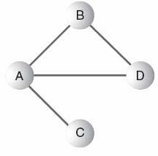
Adjacency Matrix
Example: Consider the following graph

Slide 18
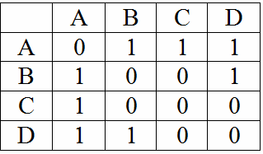
Adjacency Matrix
The adjacency matrix for the graph is as follows.

Slide 19
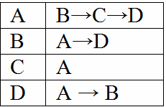
Adjacency List
An adjacency list is an array of singly linked lists. Each individual list shows what vertices a given vertex is adjacent to.
The adjacency lists for the graph is given next.

Slide 20
Lecture Content
Graph Basics
Definitions and Terminologies
Data Structures Used to Store Graphs
Graph Traversal
Depth-First Search (DFS)
2.2. Breadth-First Search (BFS)

Slide 21
2. Graph Traversal
Three traversals of a tree are preorder, inorder, and postorder. Tree traversal is always starts at the root of the tree.
Two traversals of a graph are depth-first search (DFS) and breadth-first search (BFS). Since a graph has no root, we must specify a vertex at which to begin a traversal.
Depth-first search is essentially a generalization of the preorder traversal of a rooted tree.

Slide 22
Depth-first search
Again, a simple and powerful algorithm
Given a starting vertex s
Pick an adjacent vertex, visit it.
Then visit one of its adjacent vertices
…..
Until impossible, then backtrack, visit another

Slide 23
DFS(graph g, vertex s) Assume all vertices initially unmarked
mark s
visit s // e.g., print its data
for each edge <s, V>
if V is not marked
DFS(G, V)

Slide 24
Current vertex: A
A
B
E
G
C
D
F
Start with A. Mark it.

Slide 25
Current: B
A
B
E
G
C
D
F
Expand A’s adjacent vertices. Pick one (B).
Mark it and re-visit.

Slide 26
Current: C
A
B
E
G
C
D
F
Now expand B, and visit its neighbor, C.

Slide 27
Current: F
A
B
E
G
C
D
F
Visit F.
Pick one of its neighbors, E.

Slide 28
Current: E
A
B
E
G
C
D
F
E’s adjacent vertices are A, D and F.
A and F are marked, so pick D.

Slide 29
Current: D
A
B
E
G
C
D
F
Visit D. No new vertices available. Backtrack to
E. Backtrack to F. Backtrack to C. Backtrack to B

Slide 30
Current: G
A
B
E
G
C
D
F
Visit G. No new vertices from here. Backtrack to
B. Backtrack to A. E already marked so no new.

Slide 31
Current:
1
A
2
5
B
E
6
3
7
C
D
G
4
F
Done. We have explored the graph in order:
A B C F E D G

Slide 32
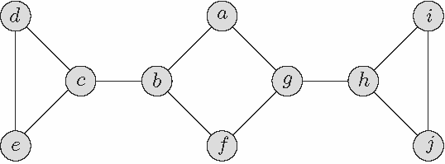
2.1 Depth-First Search (DFS)
Example: List the order in which the nodes of the undirected graph shown in the figure below are visited by a depth-first traversal that starts from vertex a. Assume that we choose to visit adjacent vertices in alphabetical order.

Slide 33
2.1 Depth-First Search (DFS)
Algorithm DFS // M.H. Alsuwaiyel
Input: A directed or undirected graph G = (V, E).
Output: Numbering of the vertices in depth-first search order.
predfn ← 1; postdfn ← 1
for each vertex v ∈ V
mark v unvisited
end for
for each vertex v ∈ V
if v is marked unvisited then dfs(v) // starting vertex
end for
23

Slide 34
2.1 Depth-First Search (DFS)
Procedure dfs(v) // v is starting vertex, using stack
S ← {v} // insert v into stack
mark v visited
while S ≠ {}
v ← Peek(S) // v is current vertex
find an unvisited neighbor w of v

Slide 35
2.1 Depth-First Search (DFS)
if w exists then
Push(w, S)
mark w visited
predfn ← predfn + 1
else
Pop(S); postdfn ← postdfn + 1
end if
end while

Slide 36
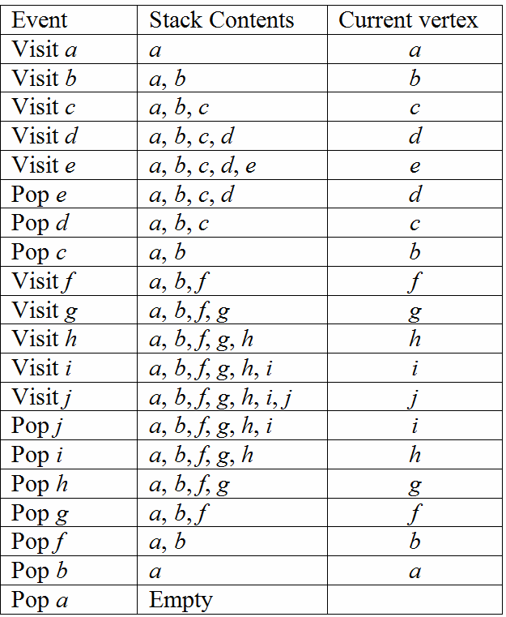
2.1 Depth-First Search (DFS)
The stack contents during DFS are given below.

Slide 37
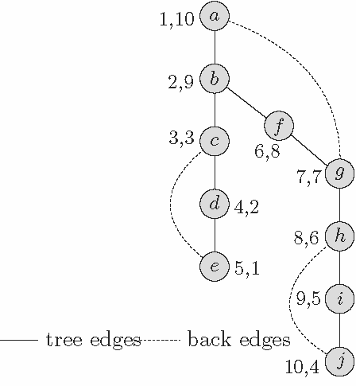
2.1 Depth-First Search (DFS)
The order in which the nodes are visited by a DFS that starts from vertex a is a, b, c, d, e, f, g, h, i, j.
The resulting tree (i.e., the depth-first search tree) is

Slide 38
Depth-First Traversal
A recursive algorithm implicitly recording a “backtracking” path from the root to the node currently under consideration.

Slide 39
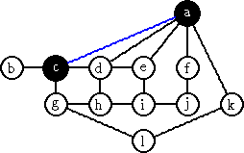
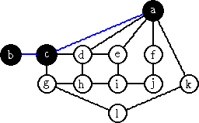
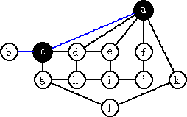
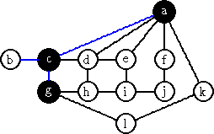
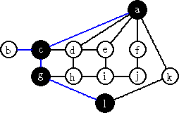
Depth-First Traversal

Slide 40
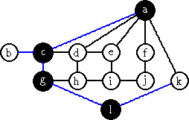
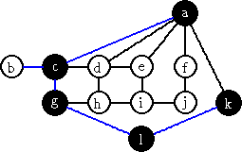
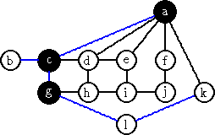
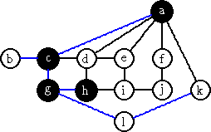
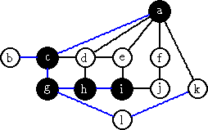
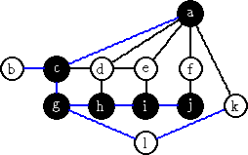
Depth-First Traversal

Slide 41
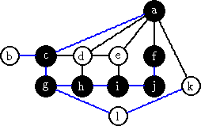

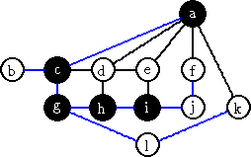
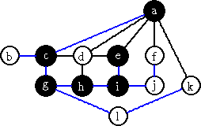
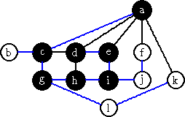
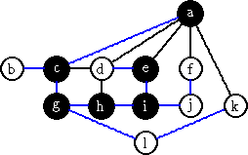
Depth-First Traversal

Slide 42
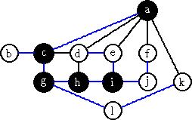
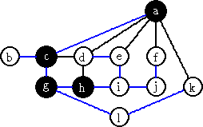
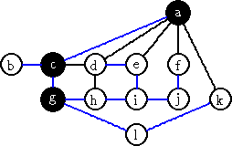
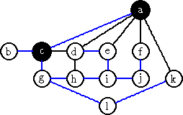
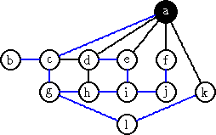
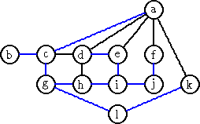
Depth-First Traversal

Slide 43
DFS
A
B
C
D
E
F
Mark current as visited
Explore all the unvisited nodes from this node
G
H
I

Slide 44
DFS
A
B
C
D
E
F
Mark current as visited
Explore all the unvisited nodes from this node
G
H
I

Slide 45
DFS
A
B
C
D
E
F
Mark current as visited
Explore all the unvisited nodes from this node
G
H
I

Slide 46
DFS
A
B
C
D
E
F
Mark current as visited
Explore all the unvisited nodes from this node
G
H
I

Slide 47
DFS
A
B
C
D
E
F
Mark current as visited
Explore all the unvisited nodes from this node
G
H
I

Slide 48
DFS
A
B
C
D
E
F
Mark current as visited
Explore all the unvisited nodes from this node
G
H
I

Slide 49
DFS
A
B
C
D
E
F
Mark current as visited
Explore all the unvisited nodes from this node
G
H
I

Slide 50
DFS
A
B
C
D
E
F
Mark current as visited
Explore all the unvisited nodes from this node
G
H
I

Slide 51
DFS
A
B
C
D
E
F
Mark current as visited
Explore all the unvisited nodes from this node
G
H
I

Slide 52
DFS
A
B
C
D
E
F
Mark current as visited
Explore all the unvisited nodes from this node
G
H
I

Slide 53
DFS
A
B
C
D
E
F
Mark current as visited
Explore all the unvisited nodes from this node
G
H
I

Slide 54
DFS
A
B
C
D
E
F
Mark current as visited
Explore all the unvisited nodes from this node
G
H
I

Slide 55
DFS
A
B
C
D
E
F
Mark current as visited
Explore all the unvisited nodes from this node
G
H
I

Slide 56
DFS
A
B
C
D
E
F
Mark current as visited
Explore all the unvisited nodes from this node
G
H
I

Slide 57
DFS
A
B
C
D
E
F
Mark current as visited
Explore all the unvisited nodes from this node
G
H
I

Slide 58
DFS
A
B
C
D
E
F
Mark current as visited
Explore all the unvisited nodes from this node
G
H
I

Slide 59
DFS
A
B
C
D
E
F
Mark current as visited
Explore all the unvisited nodes from this node
G
H
I

Slide 60
DFS
A
B
C
D
E
F
Mark current as visited
Explore all the unvisited nodes from this node
G
H
I

Slide 61
DFS
A
B
C
D
E
F
Mark current as visited
Explore all the unvisited nodes from this node
G
H
I

Slide 62
DFS
A
B
C
D
E
F
Mark current as visited
Explore all the unvisited nodes from this node
G
H
I

Slide 63
DFS
A
B
C
D
E
F
Mark current as visited
Explore all the unvisited nodes from this node
G
H
I

Slide 64
DFS
A
B
C
D
E
F
Mark current as visited
Explore all the unvisited nodes from this node
G
H
I

Slide 65
DFS
A
B
C
D
E
F
Mark current as visited
Explore all the unvisited nodes from this node
G
H
I

Slide 66
DFS
A
B
C
D
E
F
Mark current as visited
Explore all the unvisited nodes from this node
G
H
I

Slide 67
DFS
A
B
C
D
E
F
Mark current as visited
Explore all the unvisited nodes from this node
G
H
I

Slide 68
DFS
A
B
C
D
E
F
Mark current as visited
Explore all the unvisited nodes from this node
G
H
I

Slide 69
DFS
A
B
C
D
E
F
Mark current as visited
Explore all the unvisited nodes from this node
G
H
I

Slide 70
DFS
A
B
C
D
E
F
Mark current as visited
Explore all the unvisited nodes from this node
G
H
I

Slide 71
Depth-First Traversal
Depth first search is another way of traversing graphs, which is closely related to preorder traversal of a tree.
the Breath-first search tree is typically "short and bushy", the DFS tree is typically "long and stringy".

Slide 72
2.1 Depth-First Search (DFS)
Procedure dfs(v) // v is starting vertex, using recursion
mark v visited
predfn ← predfn + 1
for each edge (v, w) ∈ E
if w is marked unvisited then dfs(w)
end for
postdfn ← postdfn + 1

Slide 73
2.2 Breadth-First Search (BFS)
Depth-first search algorithm gets as far away from the starting point as quickly as possible. DFS is implemented using a stack.
In contrast, breadth-first search algorithm stays as close as possible to the starting point. BFS visits all the vertices adjacent to the starting vertex, and then goes further afield. BFS is implemented using a queue.
The level-order traversal of a tree is an example of the breadth-first traversal.

Slide 74
2.2 Breadth-First Search (BFS)
Example: List the order in which the nodes of the undirected graph shown in the figure below are visited by a breadth-first traversal that starts from vertex a. Assume that we choose to visit adjacent vertices in alphabetical order.

Slide 75
2.2 Breadth-First Search (BFS)
Algorithm BFS // M.H. Alsuwaiyel
Input: A directed or undirected graph G = (V, E).
Output: Numbering of the vertices in BFS order.
bfn ← 1
for each vertex v ∈ V
mark v unvisited
end for
for each vertex v ∈ V
if v is marked unvisited then bfs(v) // starting vertex
end for

Slide 76
2.2 Breadth-First Search (BFS)
Procedure bfs(v) // v is starting vertex, using queue
Q ← {v} // insert v into queue
mark v visited
while Q ≠ {}
v ← dequeue(Q) // v is current vertex
for each edge (v, w) ∈ E
if w is marked unvisited then
enqueue(w, Q)
mark w visited
bfn ← bfn + 1
end if
35

Slide 77
2.2 Breadth-First Search (BFS)
end for
end while

Slide 78
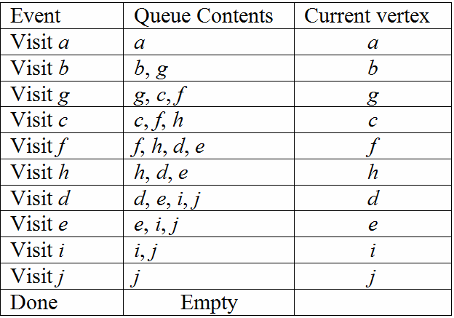
2.2 Breadth-First Search (BFS)
The queue contents during BFS are given below.

Slide 79
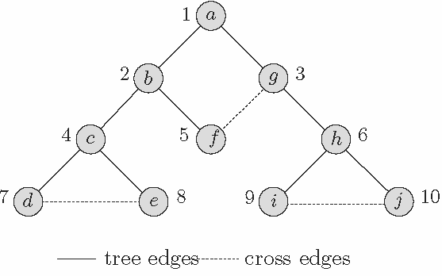
2.2 Breadth-First Search (BFS)
The order in which the nodes are visited by a BFS that starts from vertex a is a, b, g, c, f, h, d, e, i, j.
The resulting tree (i.e., the breadth-first search tree) is

Slide 80
2.2 Breadth-First Search (BFS)
Tree edges: edges in the breadth-first search tree. An edge (v, w) is a tree edge if w was first visited when exploring the edge (v, w).
Cross edges: All other edges.

Slide 81
Breadth-First Search (BFS)
Keep a Queue of nodes as our TODO list
Idea: dequeue a node, enqueue all its neighbors
Still will return the same nodes as reachable, just might have shorter paths

Slide 82

BFS
a
b
c
d
e
f
Dequeue a node add all its unseen
neighbors to the queue
g
h
i
queue: a

Slide 83
BFS
a
b
c
d
e
f
Dequeue a node add all its unseen
neighbors to the queue
g
h
i
queue: e, g

Slide 84
BFS
a
b
c
d
e
f
Dequeue a node add all its unseen
neighbors to the queue
g
h
i
queue: e, g

Slide 85
BFS
a
b
c
d
e
f
Dequeue a node add all its unseen
neighbors to the queue
g
h
i
queue: g, f

Slide 86
BFS
a
b
c
d
e
f
Dequeue a node add all its unseen
neighbors to the queue
g
h
i
queue: g, f

Slide 87
BFS
a
b
c
d
e
f
Dequeue a node add all its unseen
neighbors to the queue
g
h
i
queue: f, h

Slide 88
BFS
a
b
c
d
e
f
Dequeue a node add all its unseen
neighbors to the queue
g
h
i
queue: f, h

Slide 89
BFS
a
b
c
d
e
f
Dequeue a node add all its unseen
neighbors to the queue
g
h
i
queue: h

Slide 90
BFS
a
b
c
d
e
f
Dequeue a node add all its unseen
neighbors to the queue
g
h
i
queue: h

Slide 91
BFS
a
b
c
d
e
f
Dequeue a node add all its unseen
neighbors to the queue
g
h
i
queue: i

Slide 92
BFS
a
b
c
d
e
f
Dequeue a node add all its unseen
neighbors to the queue
g
h
i
queue: i

Slide 93
BFS
a
b
c
d
e
f
Dequeue a node add all its unseen
neighbors to the queue
g
h
i
queue: c

Slide 94
BFS
a
b
c
d
e
f
Dequeue a node add all its unseen
neighbors to the queue
g
h
i
queue: c

Slide 95
BFS
a
b
c
d
e
f
Dequeue a node add all its unseen
neighbors to the queue
g
h
i
queue: c

Slide 96
BFS Details
In an n-node, m-edge graph, takes O(m + n) time with an adjacency list
– Visit each edge once, visit each node at most once
bfs from v₁ to v₂:
create a queue of vertexes to visit, initially storing just v₁.
mark v₁ as visited.
while queue is not empty and v₂ is not seen: dequeue a vertex v from it,
mark that vertex v as visited,
and add each unvisited neighbor n of v to the queue.
How could we modify the pseudocode to look for a specific path?
76

Slide 97
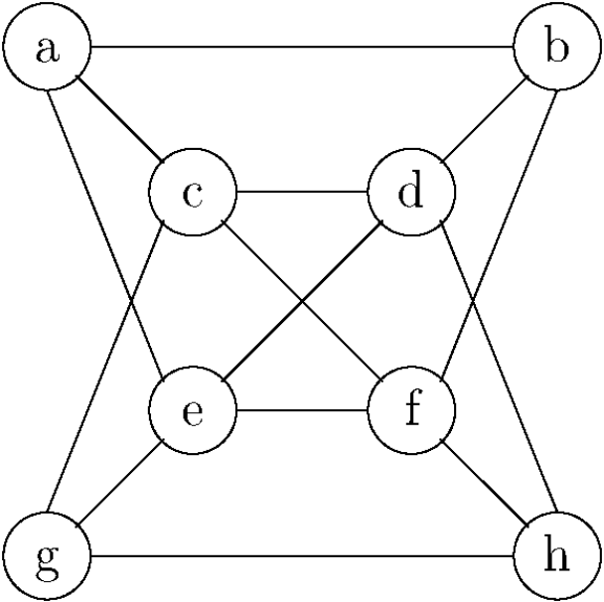
Exercises
4. List the order in which the nodes of the undirected graph shown in the figure below are visited by a depth-first traversal that starts from vertex a. Repeat this exercise for a depth-first traversal starting from vertex d.

Slide 98
Exercises
5. List the order in which the nodes of the undirected graph shown in the figure below are visited by a breadth-first traversal that starts from vertex a. Repeat this exercise for a breadth-first traversal starting from vertex d.

