Slide 1
Linked List

Slide 2
Introduction
A linked list is a data structure which can change during execution.
  Successive elements are connected by pointers.
  Last element points to NULL.
  It can grow or shrink in size during execution of a program.
  It can be made just as long as required.
  It does not waste memory space.
head
A
B
C

Slide 3
Keeping track of a linked list:
  Must know the pointer to the first element of the list (called start, head, etc.).
Linked lists provide flexibility in allowing the items to be rearranged efficiently.
  Insert an element.
  Delete an element.

Slide 4
Illustration: Insertion
A
B
C
tmp
X
Item to be inserted
A
A
B
C
curr
X

Slide 5
Pseudo-code for insertion
typedef struct nd {
struct item data;
struct nd * next;
} node;
void insert(node *curr)
{
node * tmp;
tmp=(node *) malloc(sizeof(node));
tmp->next=curr->next;
curr->next=tmp;
}

Slide 6
Illustration: Deletion
Item to be deleted
A
B
C
tmp
curr
A
B
C

Slide 7
Pseudo-code for deletion
typedef struct nd {
struct item data;
struct nd * next;
} node;
void delete(node *curr)
{
node * tmp;
tmp=curr->next;
curr->next=tmp->next;
free(tmp);
}

Slide 8
In essence ...
For insertion:
  A record is created holding the new item.
  The next pointer of the new record is set to link it to the item which is to follow it in the list.
  The next pointer of the item which is to precede it must be modified to point to the new item.
For deletion:
  The next pointer of the item immediately preceding the one to be deleted is altered, and made to point to the item following the deleted item.

Slide 9
Array versus Linked Lists
Arrays are suitable for:
  Inserting/deleting an element at the end.
  Randomly accessing any element.
  Searching the list for a particular value.
Linked lists are suitable for:
  Inserting an element.
  Deleting an element.
  Applications where sequential access is required.
  In situations where the number of elements cannot be predicted beforehand.

Slide 10
Types of Lists
Depending on the way in which the links are used to maintain adjacency, several different types of linked lists are possible.
  Linear singly-linked list (or simply linear list)
    One we have discussed so far.
head
A
B
C

Slide 11
  Circular linked list
    The pointer from the last element in the list points back to the first element.
head
A
B
C

Slide 12
  Doubly linked list
    Pointers exist between adjacent nodes in both directions.
    The list can be traversed either forward or backward.
    Usually two pointers are maintained to keep track of the list, head and tail.
head
tail
A
B
C

Slide 13
Basic Operations on a List
Creating a list
Traversing the list
Inserting an item in the list
Deleting an item from the list
Concatenating two lists into one

Slide 14
List is an Abstract Data Type
What is an abstract data type?
  It is a data type defined by the user.
  Typically more complex than simple data types like int, float, etc.
Why abstract?
  Because details of the implementation are hidden.
  When you do some operation on the list, say insert an element, you just call a function.
  Details of how the list is implemented or how the insert function is written is no longer required.

Slide 15
Conceptual Idea
List
implementation
and the
related functions
Insert
Delete
Traverse

Slide 16
Example: Working with linked list
Consider the structure of a node as follows:
  struct stud {
  int roll;
  char name[25];
  int age;
  struct stud *next;
  };
  /* A user-defined data type called “node” */
  typedef struct stud node;
  node *head;

Slide 17
Creating a List

Slide 18
How to begin?
To start with, we have to create a node (the first node), and make head point to it.
  head = (node *) malloc(sizeof(node));
head
roll
name
next
age

Slide 19
Contd.
If there are n number of nodes in the initial linked list:
  Allocate n records, one by one.
  Read in the fields of the records.
  Modify the links of the records so that the chain is formed.
head
A
B
C

Slide 20
node *create_list()
{
int k, n;
node *p, *head;
printf ("\n How many elements to enter?");
scanf ("%d", &n);
for (k=0; k<n; k++)
{
if (k == 0) {
head = (node *) malloc(sizeof(node));
p = head;
}
else {
p->next = (node *) malloc(sizeof(node));
p = p->next;
}
scanf ("%d %s %d", &p->roll, p->name, &p->age);
}
p->next = NULL;
return (head);
}

Slide 21
To be called from main() function as:
node *head;
………
head = create_list();

Slide 22
Traversing the List

Slide 23
What is to be done?
Once the linked list has been constructed and head points to the first node of the list,
  Follow the pointers.
  Display the contents of the nodes as they are traversed.
  Stop when the next pointer points to NULL.

Slide 24
void display (node *head)
{
int count = 1;
node *p;
p = head;
while (p != NULL)
{
printf ("\nNode %d: %d %s %d", count,
p->roll, p->name, p->age);
count++;
p = p->next;
}
printf ("\n");
}

Slide 25
To be called from main() function as:
node *head;
………
display (head);

Slide 26
Inserting a Node in a List

Slide 27
How to do?
The problem is to insert a node before a specified node.
  Specified means some value is given for the node (called key).
  In this example, we consider it to be roll.

Slide 28
Contd.
When a node is added at the beginning,
  Only one next pointer needs to be modified.
    head is made to point to the new node.
    New node points to the previously first element.
When a node is added at the end,
  Two next pointers need to be modified.
    Last node now points to the new node.
    New node points to NULL.
When a node is added in the middle,
  Two next pointers need to be modified.
    Previous node now points to the new node.
    New node points to the next node.

Slide 29
Illustration: Insertion
A
B
C
tmp
X
Item to be inserted
A
A
B
C
curr
X

Slide 30
Pseudo-code for insertion
typedef struct nd {
struct item data;
struct nd * next;
} node;
void insert(node *curr)
{
node * tmp;
tmp=(node *) malloc(sizeof(node));
tmp->next=curr->next;
curr->next=tmp;
}

Slide 31
void insert (node **head)
{
int k = 0, rno;
node *p, *q, *new;
new = (node *) malloc(sizeof(node));
printf ("\nData to be inserted: ");
scanf ("%d %s %d", &new->roll, new->name, &new->age);
printf ("\nInsert before roll (-ve for end):");
scanf ("%d", &rno);
p = *head;
if (p->roll == rno) /* At the beginning */
{
new->next = p;
*head = new;
}

Slide 32
else
{
while ((p != NULL) && (p->roll != rno))
{
q = p;
p = p->next;
}
if (p == NULL) /* At the end */
{
q->next = new;
new->next = NULL;
}
else if (p->roll == rno)
/* In the middle */
{
q->next = new;
new->next = p;
}
}
}
The pointers
q and p
always point
to consecutive
nodes.

Slide 33
To be called from main() function as:
node *head;
………
insert (&head);

Slide 34
Deleting a node from the list

Slide 35
Illustration: Deletion
Item to be deleted
A
B
C
tmp
curr
A
B
C

Slide 36
Pseudo-code for deletion
typedef struct nd {
struct item data;
struct nd * next;
} node;
void delete(node *curr)
{
node * tmp;
tmp=curr->next;
curr->next=tmp->next;
free(tmp);
}

Slide 37
What is to be done?
Here also we are required to delete a specified node.
  Say, the node whose roll field is given.
Here also three conditions arise:
  Deleting the first node.
  Deleting the last node.
  Deleting an intermediate node.

Slide 38
void delete (node **head)
{
int rno;
node *p, *q;
printf ("\nDelete for roll :");
scanf ("%d", &rno);
p = *head;
if (p->roll == rno)
/* Delete the first element */
{
*head = p->next;
free (p);
}

Slide 39
else
{
while ((p != NULL) && (p->roll != rno))
{
q = p;
p = p->next;
}
if (p == NULL) /* Element not found */
printf ("\nNo match :: deletion failed");
else if (p->roll == rno)
/* Delete any other element */
{
q->next = p->next;
free (p);
}
}
}

Slide 40
Types of Lists
Depending on the way in which the links are used to maintain adjacency, several different types of linked lists are possible.
  Linear singly-linked list (or simply linear list)
    One we have discussed so far.
head
A
B
C

Slide 41
  Circular linked list
    The pointer from the last element in the list points back to the first element.
head
A
B
C

Slide 42
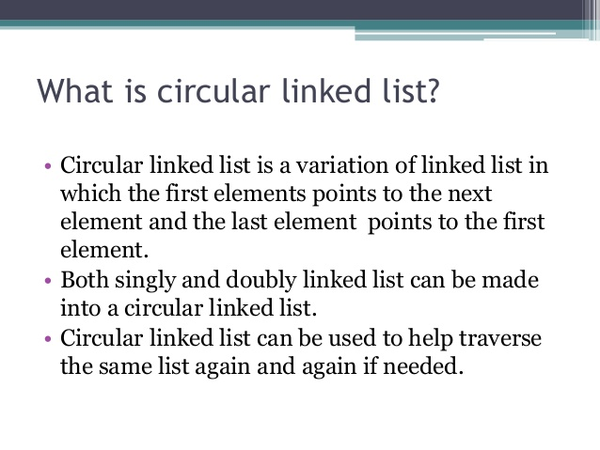


Slide 43
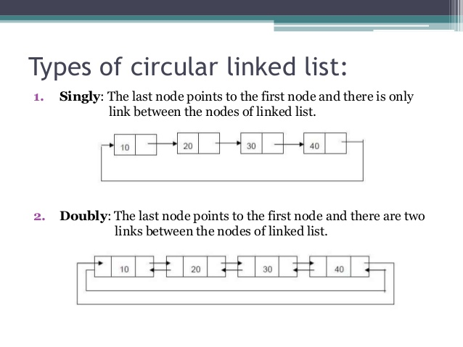

Slide 44
Insert to head of a Circular Linked List
New->next = Cur; // same as: New->next = Rear->next;
Prev->next = New; // same as: Rear->next = New;
10
20
40
55
70
New
Cur
Prev
Rear

Slide 45
Insert to middle of a Circular Linked List between Pre and Cur
New->next = Cur;
Prev->next = New;
10
20
55
70
40
Prev
Cur
Rear
New

Slide 46
Insert to end of a Circular Linked List
New->next = Cur; // same as: New->next = Rear->next;
Prev->next = New; // same as: Rear->next = New;
Rear = New;
10
20
40
55
70
Cur
Prev
New
Rear

Slide 47
void insertNode(NodePtr& Rear, int item){
NodePtr New, Cur, Prev;
New = new Node;
New->data = item;
if(Rear == NULL){ // insert into empty list
Rear = New;
Rear->next = Rear;
return;
}
Prev = Rear;
Cur = Rear->next;
do{ // find Prev and Cur
if(item <= Cur->data)
break;
Prev = Cur;
Cur = Cur->next;
}while(Cur != Rear->next);
New->next = Cur; // revise pointers
Prev->next = New;
if(item > Rear->data) //revise Rear pointer if adding to end
Rear = New;
}

Slide 48
Delete a node from a single-node Circular Linked List
Rear = NULL;
delete Cur;
10
Rear = Cur = Prev

Slide 49
Delete Node
Delete the head node from a Circular Linked List
Prev->next = Cur->next; // same as: Rear->next = Cur->next
delete Cur;
10
20
40
55
70
Rear
Prev
Cur

Slide 50
Delete a middle node Cur from a Circular Linked List
Prev->next = Cur->next;
delete Cur;
10
20
40
55
70
Prev
Cur
Rear

Slide 51

Delete the end node from a Circular Linked List
Prev->next = Cur->next; // same as: Rear->next;
delete Cur;
Rear = Prev;
10
20
40
55
70
Prev
Cur
Rear

Slide 52
void deleteNode(NodePtr& Rear, int item){
NodePtr Cur, Prev;
if(Rear == NULL){
cout << "Trying to delete empty list" << endl;
return;
}
Prev = Rear;
Cur = Rear->next;
do{ // find Prev and Cur
if(item <= Cur->data) break;
Prev = Cur;
Cur = Cur->next;
}while(Cur != Rear->next);
if(Cur->data != item){ // data does not exist
cout << "Data Not Found" << endl;
return;
}
if(Cur == Prev){ // delete single-node list
Rear = NULL;
delete Cur;
return;
}
if(Cur == Rear) // revise Rear pointer if deleting end
Rear = Prev;
Prev->next = Cur->next; // revise pointers
delete Cur;
}

Slide 53
void main(){
NodePtr Rear = NULL;
insertNode(Rear, 3);
insertNode(Rear, 1);
insertNode(Rear, 7);
insertNode(Rear, 5);
insertNode(Rear, 8);
print(Rear);
deleteNode(Rear, 1);
deleteNode(Rear, 3);
deleteNode(Rear, 8);
print(Rear);
insertNode(Rear, 1);
insertNode(Rear, 8);
print(Rear);
}
Result is:
1 3 5 7 8
5 7
1 5 7 8

Slide 54
Few Exercises to Try Out
Write a function to:
  Concatenate two given list into one big list.
    node *concatenate (node *head1, node *head2);
  Insert an element in a linked list in sorted order. The function will be called for every element to be inserted.
    void insert_sorted (node **head, node *element);
  Always insert elements at one end, and delete elements from the other end (first-in first-out QUEUE).
    void insert_q (node **head, node *element)
    node *delete_q (node **head) /* Return the deleted node */

Slide 55
A First-in First-out (FIFO) List
Out
In
A
B
C
B
A
Also called a QUEUE

Slide 56
A Last-in First-out (LIFO) List
In
Out
C
B
A
B
C
Also called a
STACK

Slide 57
Abstract Data Types

Slide 58
Example 1 :: Complex numbers
struct cplx {
float re;
float im;
}
typedef struct cplx complex;
complex *add (complex a, complex b);
complex *sub (complex a, complex b);
complex *mul (complex a, complex b);
complex *div (complex a, complex b);
complex *read();
void print (complex a);
Structure definition
Function prototypes

Slide 59
add
Complex
Number
sub
mul
div
read
print

Slide 60
Example 2 :: Set manipulation
struct node {
int element;
struct node *next;
}
typedef struct node set;
set *union (set a, set b);
set *intersect (set a, set b);
set *minus (set a, set b);
void insert (set a, int x);
void delete (set a, int x);
int size (set a);
Structure definition
Function prototypes

Slide 61
union
Set
intersect
minus
insert
delete
size

Slide 62
Example 3 :: Last-In-First-Out STACK
Assume:: stack contains integer elements
void push (stack *s, int element);
/* Insert an element in the stack */
int pop (stack *s);
/* Remove and return the top element */
void create (stack *s);
/* Create a new stack */
int isempty (stack *s);
/* Check if stack is empty */
int isfull (stack *s);
/* Check if stack is full */

Slide 63
push
STACK
pop
create
isempty
isfull

Slide 64
Contd.
We shall look into two different ways of implementing stack:
  Using arrays
  Using linked list

Slide 65
Example 4 :: First-In-First-Out QUEUE
Assume:: queue contains integer elements
void enqueue (queue *q, int element);
/* Insert an element in the queue */
int dequeue (queue *q);
/* Remove an element from the queue */
queue *create();
/* Create a new queue */
int isempty (queue *q);
/* Check if queue is empty */
int size (queue *q);
/* Return the no. of elements in queue */

Slide 66
enqueue
QUEUE
dequeue
create
isempty
size

Slide 67
Stack Implementations: Using Array and Linked List

Slide 68
STACK USING ARRAY
PUSH
top
top

Slide 69
STACK USING ARRAY
POP
top
top

Slide 70
Stack: Linked List Structure
PUSH OPERATION
top

Slide 71
Stack: Linked List Structure
POP OPERATION
top

Slide 72
Basic Idea
We would:
  Declare an array of fixed size (which determines the maximum size of the stack).
  Keep a variable which always points to the “top” of the stack.
    Contains the array index of the “top” element.

Slide 73
Basic Idea
In the array implementation, we would:
  Declare an array of fixed size (which determines the maximum size of the stack).
  Keep a variable which always points to the “top” of the stack.
    Contains the array index of the “top” element.
In the linked list implementation, we would:
  Maintain the stack as a linked list.
  A pointer variable top points to the start of the list.
  The first element of the linked list is considered as the stack top.

Slide 74
Declaration
#define MAXSIZE 100
struct lifo
{
int st[MAXSIZE];
int top;
};
typedef struct lifo
stack;
stack s;
struct lifo
{
int value;
struct lifo *next;
};
typedef struct lifo
stack;
stack *top;
ARRAY
LINKED LIST

Slide 75
Stack Creation
void create (stack *s)
{
s->top = -1;
/* s->top points to
last element
pushed in;
initially -1 */
}
void create (stack **top)
{
*top = NULL;
/* top points to NULL,
indicating empty
stack */
}
LINKED LIST
ARRAY

Slide 76
Pushing an element into the stack
void push (stack *s, int element)
{
if (s->top == (MAXSIZE-1))
{
printf (“\n Stack overflow”);
exit(-1);
}
else
{
s->top ++;
s->st[s->top] = element;
}
}
ARRAY

Slide 77
void push (stack **top, int element)
{
stack *new;
new = (stack *) malloc(sizeof(stack));
if (new == NULL)
{
printf (“\n Stack is full”);
exit(-1);
}
new->value = element;
new->next = *top;
*top = new;
}
LINKED LIST

Slide 78
Popping an element from the stack
int pop (stack *s)
{
if (s->top == -1)
{
printf (“\n Stack underflow”);
exit(-1);
}
else
{
return (s->st[s->top--]);
}
}
ARRAY

Slide 79
int pop (stack **top)
{
int t;
stack *p;
if (*top == NULL)
{
printf (“\n Stack is empty”);
exit(-1);
}
else
{
t = (*top)->value;
p = *top;
*top = (*top)->next;
free (p);
return t;
}
}
LINKED LIST

Slide 80
Checking for stack empty
int isempty (stack *s)
{
if (s->top == -1)
return 1;
else
return (0);
}
int isempty (stack *top)
{
if (top == NULL)
return (1);
else
return (0);
}
ARRAY
LINKED LIST

Slide 81
Checking for stack full
int isfull (stack *s)
{
if (s->top ==
(MAXSIZE–1))
return 1;
else
return (0);
}
Not required for linked list implementation.
In the push() function, we can check the return value of malloc().
  If -1, then memory cannot be allocated.
ARRAY
LINKED LIST

Slide 82
Example main function :: array
#include <stdio.h>
#define MAXSIZE 100
struct lifo
{
int st[MAXSIZE];
int top;
};
typedef struct lifo stack;
main()
{
stack A, B;
create(&A); create(&B);
push(&A,10);
push(&A,20);
push(&A,30);
push(&B,100); push(&B,5);
printf (“%d %d”, pop(&A),
pop(&B));
push (&A, pop(&B));
if (isempty(&B))
printf (“\n B is empty”);
}

Slide 83
Example main function :: linked list
#include <stdio.h>
struct lifo
{
int value;
struct lifo *next;
};
typedef struct lifo stack;
main()
{
stack *A, *B;
create(&A); create(&B);
push(&A,10);
push(&A,20);
push(&A,30);
push(&B,100); push(&B,5);
printf (“%d %d”,
pop(&A), pop(&B));
push (&A, pop(&B));
if (isempty(B))
printf (“\n B is empty”);
}

Slide 84
Queue Implementation using Linked List

Slide 85
Basic Idea
Basic idea:
  Create a linked list to which items would be added to one end and deleted from the other end.
  Two pointers will be maintained:
    One pointing to the beginning of the list (point from where elements will be deleted).
    Another pointing to the end of the list (point where new elements will be inserted).
Rear
Front
DELETION
INSERTION

Slide 86
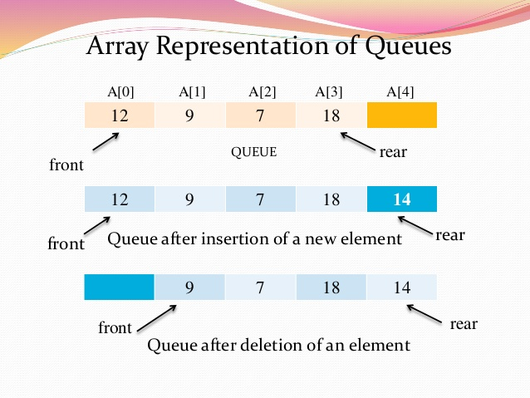

Slide 87
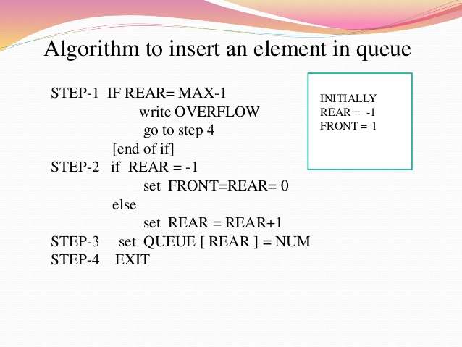

Slide 88
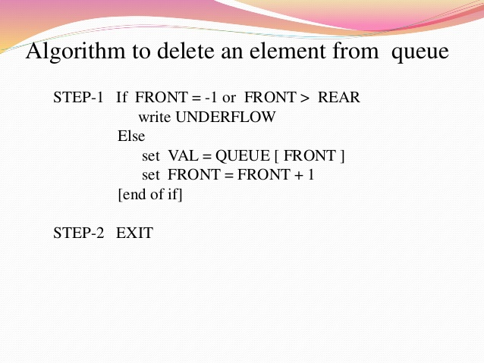

Slide 89
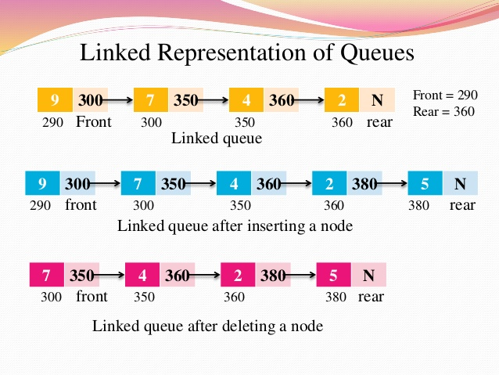

Slide 90
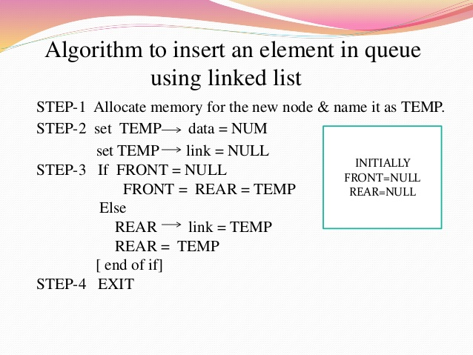

Slide 91
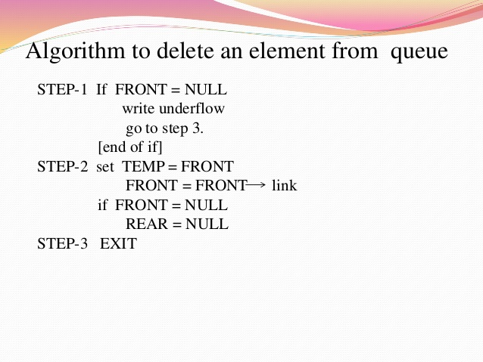

Slide 92
QUEUE: LINKED LIST STRUCTURE
ENQUEUE
front
rear

Slide 93
QUEUE: LINKED LIST STRUCTURE
DEQUEUE
front
rear

Slide 94

Enqueue
Enqueue(Front,Rear,8)
Queue is empty
Front
Rear
baru
8

Slide 95
Enqueue
Enqueue(Front,Rear,3)
Front Rear
Queue isn’t empty
8
baru
3

Slide 96
Enqueue
Enqueue(Front,Rear,5)
Queue isn’t empty
Front
Rear
8
3
baru
5

Slide 97
Dequeue
Steps of dequeue operation in linked list
form is similar with front deletion.

Slide 98
Dequeue
Dequeue(Front,Rear,Item)
{Queue > One node}
Phapus Front
Rear
8
3
5
Item

Slide 99
Dequeue
Dequeue(Front,Rear,Item)
{Queue > one node}
Phapus Front
Rear
3
5
Item

Slide 100
Dequeue
Dequeue(Front,Rear,Item)
{Queue = one node}
Front Rear
Front
Rear
Phapus
5
Item

Slide 101
QUEUE using Linked List
#include <stdio.h>
#include <stdlib.h>
#include <string.h>
struct node{
char name[30];
struct node *next;
};
typedef struct node _QNODE;
typedef struct {
_QNODE *queue_front, *queue_rear;
} _QUEUE;

Slide 102
_QNODE *enqueue (_QUEUE *q, char x[])
{
_QNODE *temp;
temp= (_QNODE *)
malloc (sizeof(_QNODE));
if (temp==NULL){
printf(“Bad allocation \n");
return NULL;
}
strcpy(temp->name,x);
temp->next=NULL;
if(q->queue_rear==NULL)
{
q->queue_rear=temp;
q->queue_front=
q->queue_rear;
}
else
{
q->queue_rear->next=temp;
q->queue_rear=temp;
}
return(q->queue_rear);
}

Slide 103
char *dequeue(_QUEUE *q,char x[])
{
_QNODE *temp_pnt;
if(q->queue_front==NULL){
q->queue_rear=NULL;
printf("Queue is empty \n");
return(NULL);
}
else{
strcpy(x,q->queue_front->name);
temp_pnt=q->queue_front;
q->queue_front=
q->queue_front->next;
free(temp_pnt);
if(q->queue_front==NULL)
q->queue_rear=NULL;
return(x);
}
}

Slide 104
void init_queue(_QUEUE *q)
{
q->queue_front= q->queue_rear=NULL;
}
int isEmpty(_QUEUE *q)
{
if(q==NULL) return 1;
else return 0;
}

Slide 105
main()
{
int i,j;
char command[5],val[30];
_QUEUE q;
init_queue(&q);
command[0]='\0';
printf("For entering a name use 'enter <name>'\n");
printf("For deleting use 'delete' \n");
printf("To end the session use 'bye' \n");
while(strcmp(command,"bye")){
scanf("%s",command);

Slide 106
if(!strcmp(command,"enter")) {
scanf("%s",val);
if((enqueue(&q,val)==NULL))
printf("No more pushing please \n");
else printf("Name entered %s \n",val);
}
if(!strcmp(command,"delete")) {
if(!isEmpty(&q))
printf("%s \n",dequeue(&q,val));
else printf("Name deleted %s \n",val);
}
} /* while */
printf("End session \n");
}

Slide 107
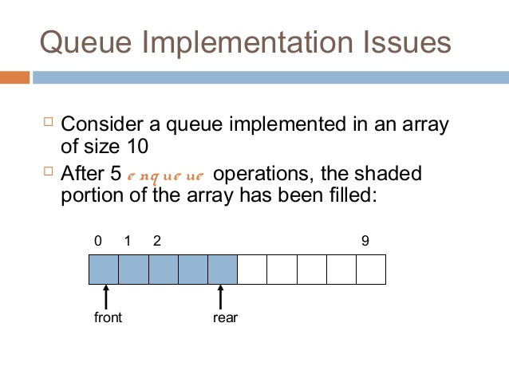

Slide 108
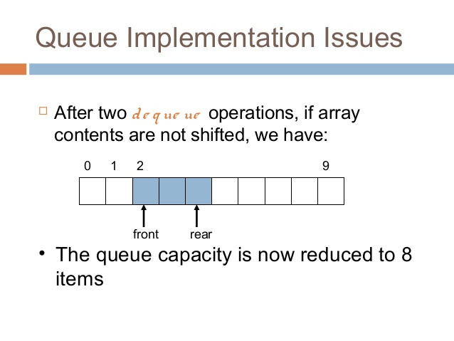

Slide 109
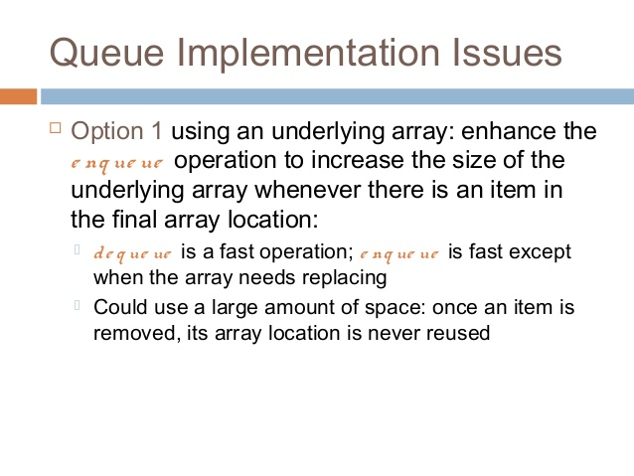

Slide 110
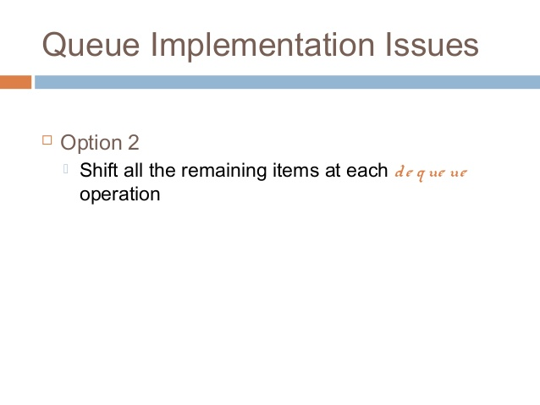

Slide 111
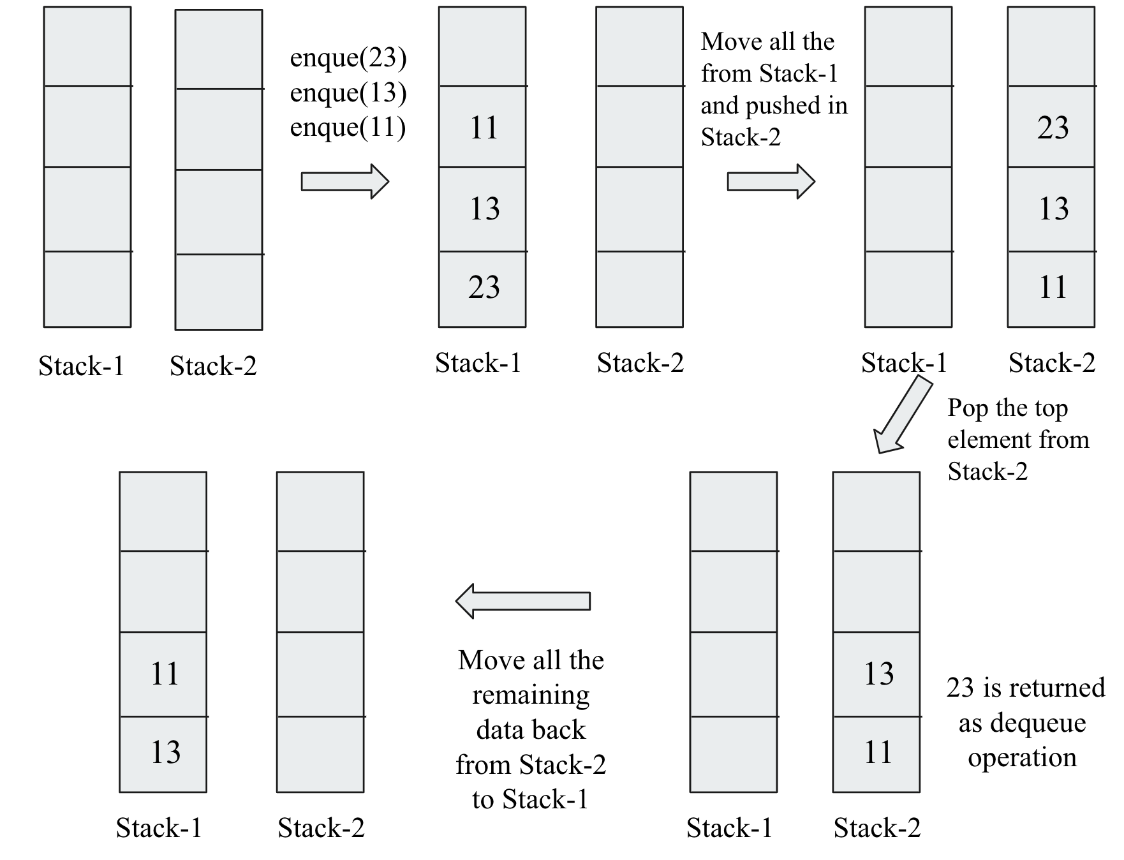
Implement Queue using Stack

Slide 112
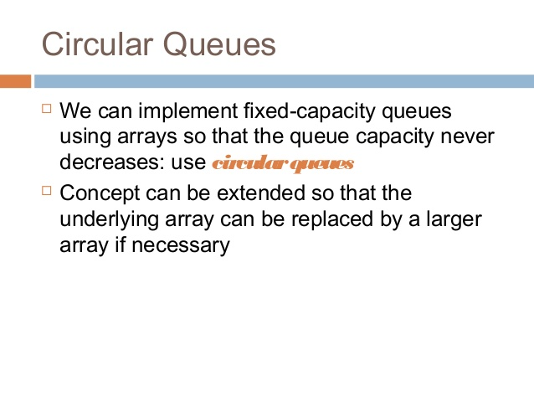

Slide 113
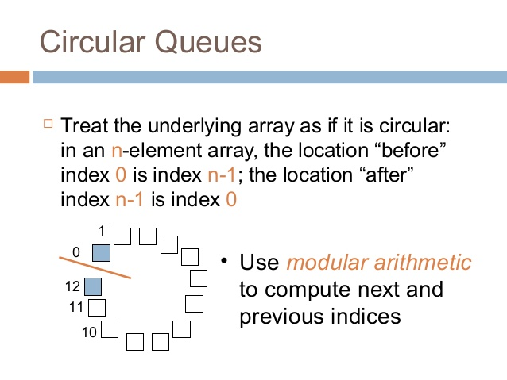

Slide 114
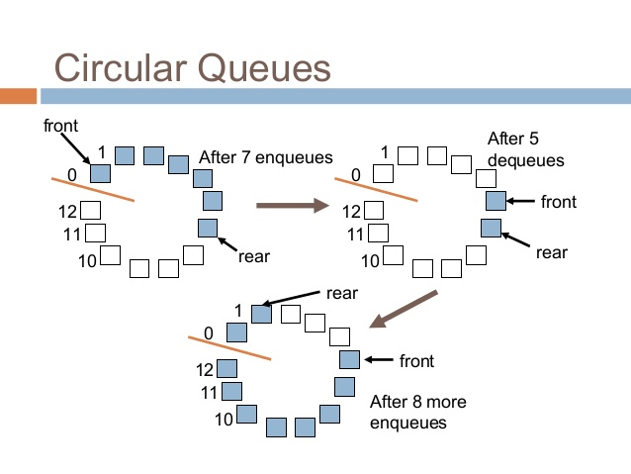

Slide 115
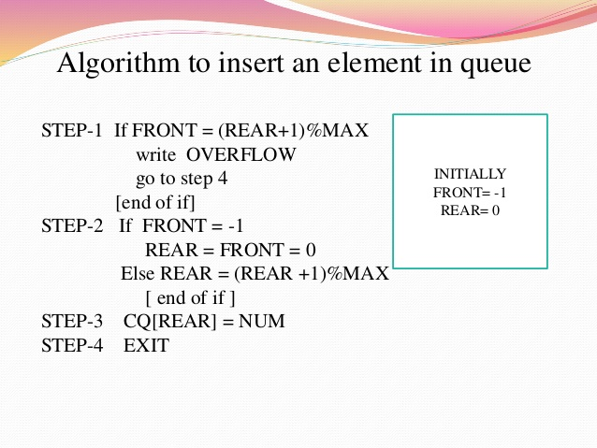

Slide 116
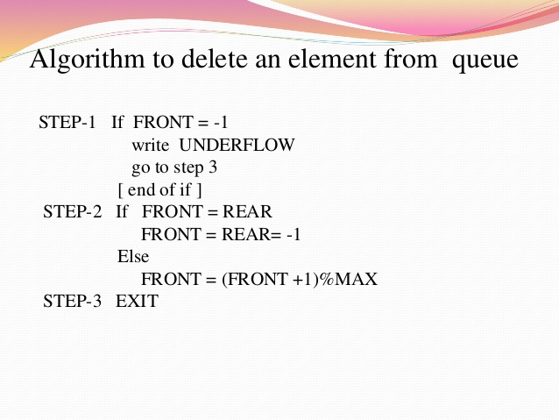

Slide 117
Problem With Array Implementation
ENQUEUE
DEQUEUE
Effective queuing storage area of array gets reduced.
0
N
front
rear
rear
front
Use of circular array indexing

Slide 118
Queue: Example with Array Implementation
#define MAX_SIZE 100
typedef struct { char name[30];
} _ELEMENT;
typedef struct {
_ELEMENT q_elem[MAX_SIZE];
int rear;
int front;
int full,empty;
} _QUEUE;

Slide 119
Queue Example: Contd.
void init_queue(_QUEUE *q)
{q->rear= q->front= 0;
q->full=0; q->empty=1;
}
int IsFull(_QUEUE *q)
{return(q->full);}
int IsEmpty(_QUEUE *q)
{return(q->empty);}

Slide 120
Queue Example: Contd.
void AddQ(_QUEUE *q, _ELEMENT ob)
{
if(IsFull(q)) {printf("Queue is Full \n"); return;}
q->rear=(q->rear+1)%(MAX_SIZE);
q->q_elem[q->rear]=ob;
if(q->front==q->rear) q->full=1; else q->full=0;
q->empty=0;
return;
}

Slide 121
Queue Example: Contd.
_ELEMENT DeleteQ(_QUEUE *q)
{
_ELEMENT temp;
temp.name[0]='\0';
if(IsEmpty(q)) {printf("Queue is EMPTY\n");return(temp);}
q->front=(q->front+1)%(MAX_SIZE);
temp=q->q_elem[q->front];
if(q->rear==q->front) q->empty=1; else q->empty=0;
q->full=0;
return(temp);
}

Slide 122
Queue Example: Contd.
main()
{
int i,j;
char command[5];
_ELEMENT ob;
_QUEUE A;
init_queue(&A);
command[0]='\0';
printf("For adding a name use 'add [name]'\n");
printf("For deleting use 'delete' \n");
printf("To end the session use 'bye' \n");
#include <stdio.h>
#include <stdlib.h>
#include <string.h>

Slide 123
Queue Example: Contd.
while (strcmp(command,"bye")!=0){
scanf("%s",command);
if(strcmp(command,"add")==0) {
scanf("%s",ob.name);
if (IsFull(&A))
printf("No more insertion please \n");
else {
AddQ(&A,ob);
printf("Name inserted %s \n",ob.name);
}
}

Slide 124
Queue Example: Contd.
if (strcmp(command,"delete")==0) {
if (IsEmpty(&A))
printf("Queue is empty \n");
else {
ob=DeleteQ(&A);
printf("Name deleted %s \n",ob.name);
}
}
} /* End of while */
printf("End session \n");
}

