Slide 1
TREE data structure
1

Slide 2
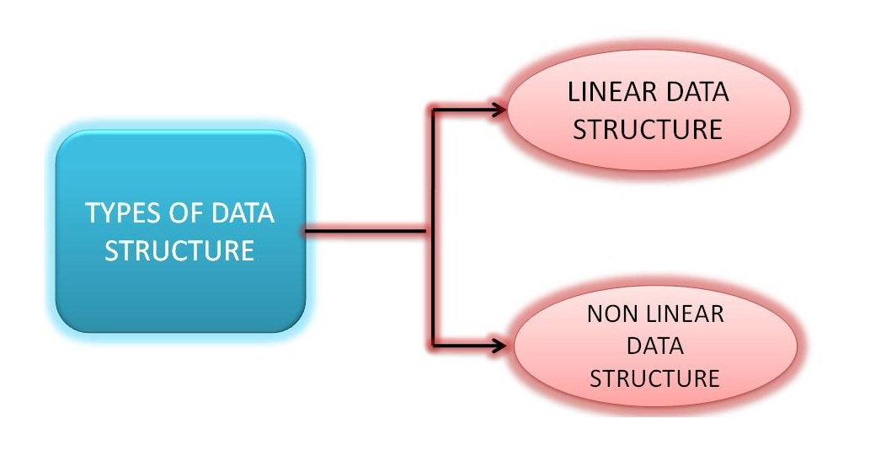
Types of Data Structure

Slide 3
Linear Data Structures
In linear data structure, member elements form a sequence. Such linear structures can be represented in memory by using one of the two basic strategies
By having the linear relationship between the elements represented by means of sequential memory locations. These linear structures are called arrays. By having relationship between the elements represented by pointers. These structures are called linked lists.

Slide 4
When to use them
Arrays are useful when number of elements to be stored is fixed.
Operations like traversal searching and sorting can easily be performed on arrays.
On the other hand, linked lists are useful when the number of data items in the collection are likely to change.

Slide 5
Nonlinear Data Structures
In nonlinear data structures, data elements are not organized in a sequential fashion. A data item in a nonlinear data structure could be attached to several other data elements to reflect a special relationship among them and all the data items cannot be traversed in a single run.
Data structures like trees and graphs are some examples of widely used nonlinear data structures.

Slide 6
Examples
A Tree is a data structure that is made up of a set of linked nodes, which can be used to represent a hierarchical relationship among data elements.
A Graph is a data structure that is made up of a finite set of edges and vertices. Edges represent connections or relationships among vertices that stores data elements.

Slide 7
Difference
Main difference between linear and nonlinear data structures lie in the way they organize data elements.
In linear data structures, data elements are organized sequentially and therefore they are easy to implement in the computer’s memory.
In nonlinear data structures, a data element can be attached to several other data elements to represent specific relationships that exist among them.

Slide 8
Difficult to Implement
Due to this nonlinear structure, they might be difficult to implement in computer’s linear memory compared to implementing linear data structures.
Selecting one data structure type over the other should be done carefully by considering the relationship among the data elements that needs to be stored.

Slide 9
A Specific Example
Imagine that you are hired by company XYZ to organize all of their records into a computer database.
The first thing you are asked to do is create a database of names with all the company's management and employees.
To start your work, you make a list of everyone in the company along with their position and other details.

Slide 10
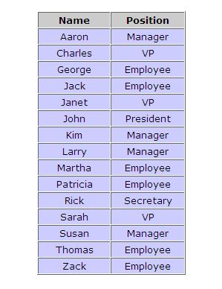
Employees Table

Slide 11
Disadvantages of Tables
But this list only shows one view of the company. You also want your database to represent the relationships between management and employees at XYZ.
Although your list contains both name and position, it does not tell you which managers are responsible for which workers and so on.
After thinking about the problem for a while, you decide that a tree diagram is a much better structure for showing the work relationships at XYZ.

Slide 12
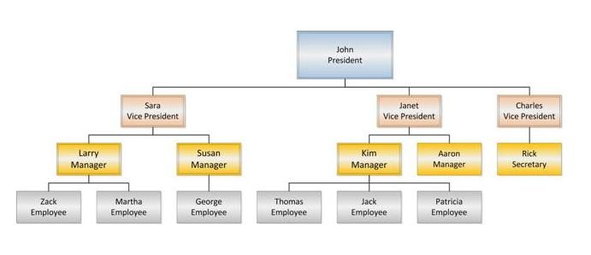
Better Representation

Slide 13
Comparison
These two diagrams are examples of different data structures.
In one of the data structures, your data is organized into a list. This is very useful for keeping the names of the employees in alphabetical order so that we can locate the employee's record very quickly.
However, this structure is not very useful for showing the relationships between employees. A tree structure is much better suited for this purpose.

Slide 14
Tree Data Structure
A Tree is a nonlinear data structure that models a hierarchical organization.
The characteristic features are that each element may have several successors (called its “children”) and every element except one (called the “root”) has a unique predecessor (called its “parent”).
Trees are common in computer science: Computer file systems are trees, the inheritance structure for C++/Java classes is a tree.

Slide 15
What is a Tree ?
In Computer Science, a tree is an abstract model of a hierarchical structure
A tree consists of nodes with a parent-child relation
Applications:
  Organization Charts
  File Systems
  Programming Environment

Slide 16
Tree Definition
Here is the recursive definition of an (unordered) tree:
  A tree is a pair (r, S), where r is a node and S is a set of disjoint trees, none of which contains r.
The node r is called the root of the tree T, and the elements of the set S are called its subtrees.
The set S, of course, may be empty.
The elements of a tree are called its nodes.

Slide 17
Basic Terminology
A node with no children is called a leaf. A node with at least one child is called an internal node.
The Node having further sub-branches is called parent node.
Every node c other than the root is connected by an edge to some one other node p called the parent of c.
We also call c a child of p.

Slide 18
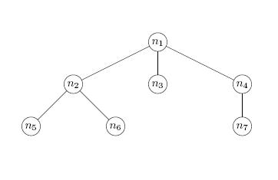
An Example
n₁ is the parent of n₂ ,n₃ and n₄, while n₂ is the parent of n₅ and n₆. Said another way, n₂, n₃, and n₄ are children of n₁, while n₅ and n₆ are children of n₂.

Slide 19
Ancestors and Descendants
The parent-child relationship can be extended naturally to ancestors and descendants.
Informally, the ancestors of a node are found by following the unique path from the node to its parent, to its parent’s parent, and so on.
The descendant relationship is the inverse of the ancestor relationship, just as the parent and child relationships are inverses of each other.

Slide 20
Path and Path Length
More formally, suppose m₁,m₂, . . . ,m_{k} is a sequence of nodes in a tree such that m₁ is the parent of m₂, which is the parent of m₃, and so on, down to m_{k−1}, which is the parent of m_{k}. Then m₁,m₂, . . . ,m_{k} is called a path from m1 to m_{k} in the tree. The path length or length of the path is k −1, one less than the number of nodes on the path.
Example
n₁, n₂, n₆ is a path of length 2 from the root n₁ to the node n₆.

Slide 21
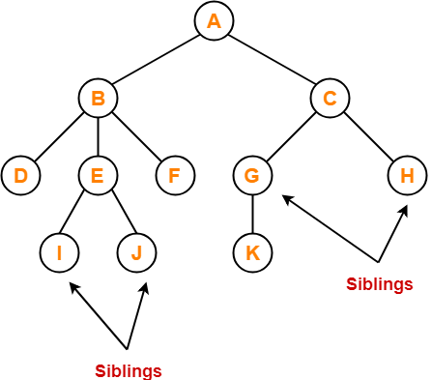
siblings
Nodes which belong to the same parent are called as siblings.
In other words, nodes with the same parent are sibling nodes.
The nodes with common parent are called siblings or brothers

Slide 22
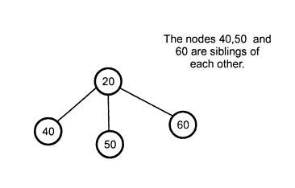
Siblings

Slide 23
Height and Depth
In a tree, the height of a node n is the length of a longest path from n to a leaf. The height of the tree is the height of the root.
Total number of edges that lies on the longest path from any leaf node to a particular node is called as height of that node.
Height of a tree is the height of root node.
Height of all leaf nodes = 0
node n₁ has height 2, n₂ has height 1, and leaf n₃ has height 0. In fact, any leaf has height 0. The height of the tree is 2. The depth of n₁ is 0, the depth of n₂ is 1, and the depth of n₅ is 2.

Slide 24
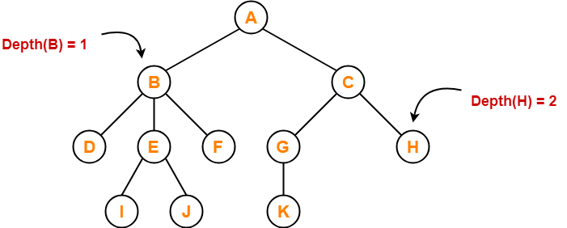
The depth, of a node n is the length of the path from the root to n.
Total number of edges from root node to a particular node is called as depth of that node.
Depth of a tree is the total number of edges from root node to a leaf node in the longest path.
Depth of the root node = 0
The terms “level” and “depth” are used interchangeably.

Slide 25
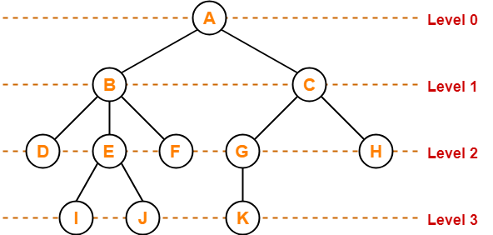
Level
In a tree, each step from top to bottom is called as level of a tree.
The level count starts with 0 and increments by 1 at each level or step.

Slide 26
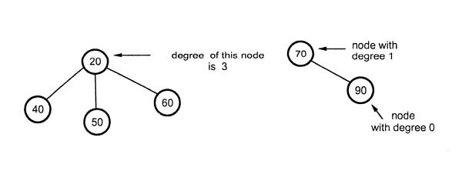
Degree
Degree of a node is the total number of children of that node.
Degree of a tree is the highest degree of a node among all the nodes in the tree.

Slide 27
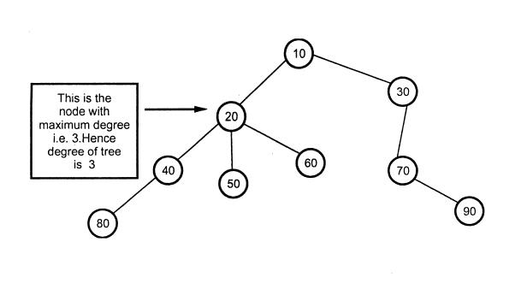
Degree of the Tree

Slide 28
Other Terms
The size of a tree is the number of nodes it contains.

Slide 29
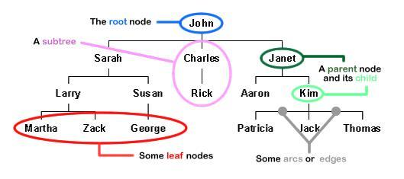
Terminology Explained

Slide 30
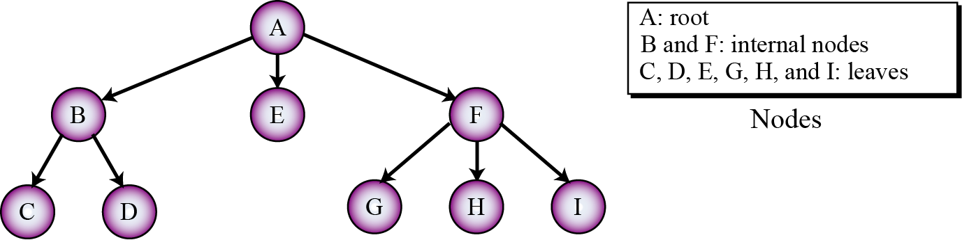
Another Example

Slide 31
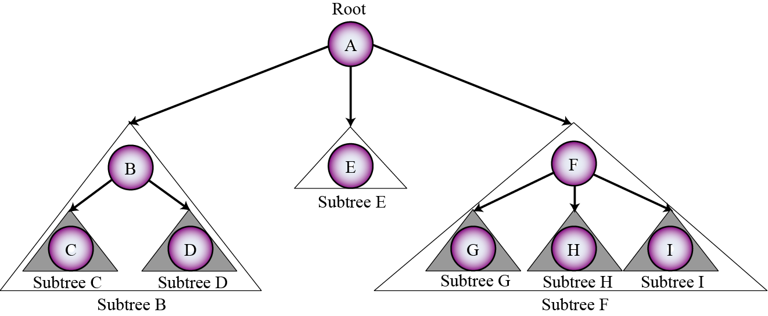
Subtrees

Slide 32
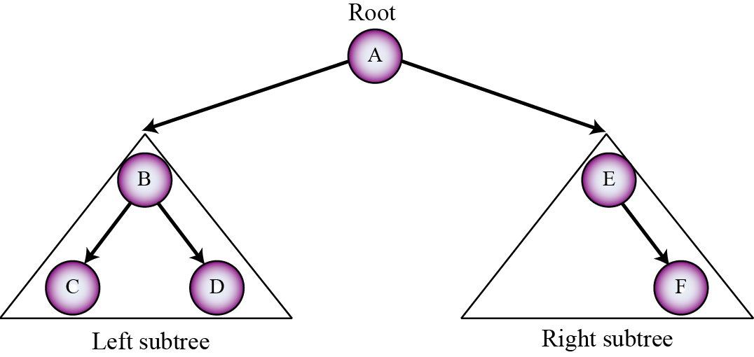
Binary Tree
A binary tree is a tree in which no node can have more than two subtrees. In other words, a node can have zero, one or two subtrees.

Slide 33
Binary Trees
A binary tree is either the empty set or a triple T = (x, L, R), where x is a node and L and R are disjoint binary trees, neither of which contains x.
The node x is called the root of the tree T, and the subtrees L and R are called the left subtree and the right subtree of T rooted at x.

Slide 34
Binary Tree

Slide 35
Terminologies
The definitions of the terms size, path, length of a path, depth of a node, level, height, interior node, ancestor, descendant, and subtree are the same for binary trees as for general trees.

Slide 36
Trees and Binary Trees - Difference
It is important to understand that while binary trees require us to distinguish whether a child is either a left child or a right child, ordinary trees require no such distinction.

Slide 37
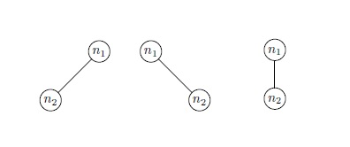
Difference Continued
That is, binary trees are not just trees all of whose nodes have two or fewer children.
Not only are the two trees in the above Figure are different from each other, but they have no relation to the ordinary tree consisting of a root and a single child of the root:

Slide 38
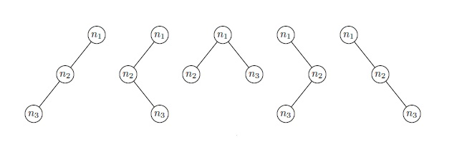
Five binary trees with three nodes

Slide 39
Full and Complete Binary Trees
A binary tree is said to be full if all its leaves are at the same level and every interior node has two children.
A complete binary tree is either a full binary tree or one that is full except for a segment of missing leaves on the right side of the bottom level.

Slide 40
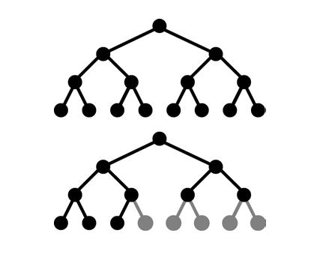
Full and Complete Binary Trees

Slide 41
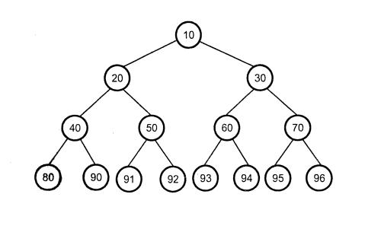
Full Binary Tree

Slide 42
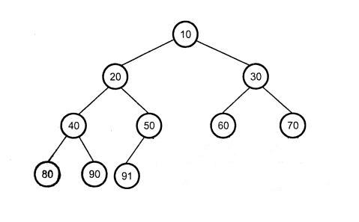
Complete Binary Tree

Slide 43
Full Binary Trees
The full binary tree of height h has l = 2^{h} leaves and m = 2^{h} – 1 internal nodes.
The full binary tree of height h has a total of n = 2^{h+1} – 1 nodes.
The full binary tree with n nodes has height h = lg(n+1) – 1.

Slide 44
Complete Binary Tree
In a complete binary tree of height h,
h + 1 ≤ n ≤ 2^{h+1} – 1 and h = └ lg n ┘

Slide 45
Make a Note
Complete binary trees are important because they have a simple and natural implementation using ordinary arrays.
The natural mapping is actually defined for any binary tree: Assign the number 1 to the root; for any node, if i is its number, then assign 2i to its left child and 2i+1 to its right child (if they exist).
This assigns a unique positive integer to each node. Then simply store the element at node i in a[i], where a[] is an array.

Slide 46
Binary Tree Representations
If a complete binary tree with n nodes (depth = log n + 1) is represented sequentially, then for any node with index i, 1 ≤ i ≤ n, we have:
  parent(i) is at i/2 if i!=1. If i=1, i is at the root and has no parent.
  leftChild(i) is at 2i if 2i ≤ n. If 2i > n, then i has noleft child.
  rightChild(i) is at 2i+1 if 2i +1 ≤ n. If 2i +1 >n,
  then i has no right child.

Slide 47
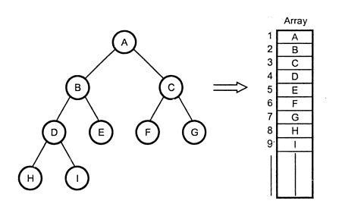
Array Implementation

Slide 48
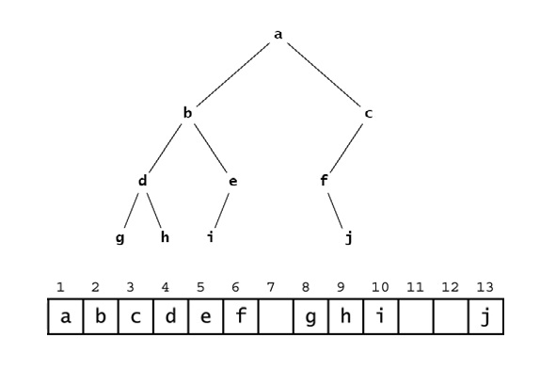
The Disadvantage
Figure above shows the incomplete binary tree and the natural mapping of its nodes into an array which leaves some gaps.

Slide 49
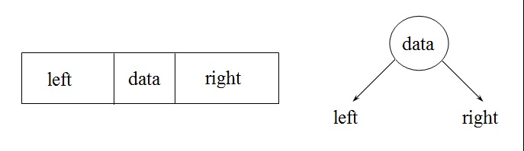
Linked List Implementation
typedef struct tnode *ptnode;
typedef struct tnode
{
int data;
ptnode left, right;
};

Slide 50
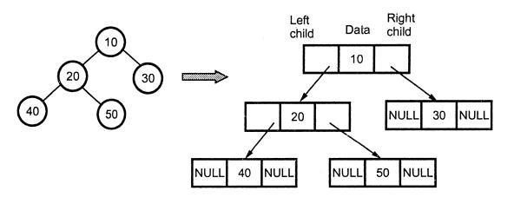
Linked List Implementation

Slide 51
Include One more Pointer
A natural way to implement a tree T is to use a linked structure, where we represent each node p of T by a position object with the following fields:
  A link to the parent of p, A link to the LeftChild named Left, a link to the RightChild named Right and the Data.
Parent
Data
Left Right

Slide 52
Array Implementation
Advantages
  Direct Access
  Finding the Parent / Children is fast
Disadvantages
  Wastage of memory
  Insertion and Deletion will be costlier
  Array size and depth

Slide 53
Linked List Implementation
Advantages
  No wastage of memory
  Insertion and Deletion will be easy
Disadvantages
  Does not provide direct access
  Additional space in each node.

Slide 54
Binary Tree Traversals
The three traversal algorithms that are used for general trees apply to binary trees as well: the preorder traversal, the postorder traversal, and the level order traversal.
In addition, binary trees support a fourth traversal algorithm: the inorder traversal. These four traversal algorithms are given next.

Slide 55
Traversals of Binary Trees
Often want iterate over and process nodes of a tree
  Can walk the tree and visit the nodes in order
  This process is called tree traversal
Three kinds of binary tree traversal:
  Preorder
  Inorder
  Postorder
According to order of subtree root w.r.t. its children

Slide 56
Level Order Traversal
To traverse a nonempty binary tree:
  1. Initialize a queue.
  2. Enqueue the root.
  3. Repeat steps 4–7 until the queue is empty.
  4. Dequeue a node x from the queue.
  5. Visit x.
  6. Enqueue the left child of x if it exists.
  7. Enqueue the right child of x if it exists.

Slide 57
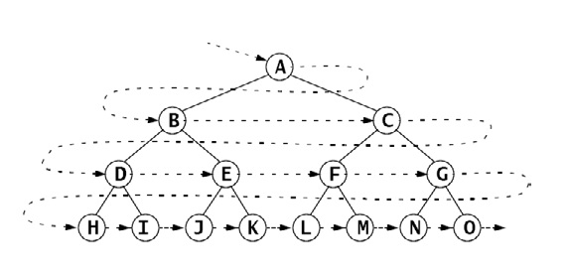
Level Order

Slide 58
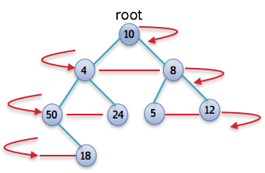

Slide 59
Preorder Traversal
To traverse a nonempty binary tree:
  1. Visit the root.
  2. If the left subtree is nonempty, do a preorder traversal on it.
  3. If the right subtree is nonempty, do a preorder traversal on it.

Slide 60
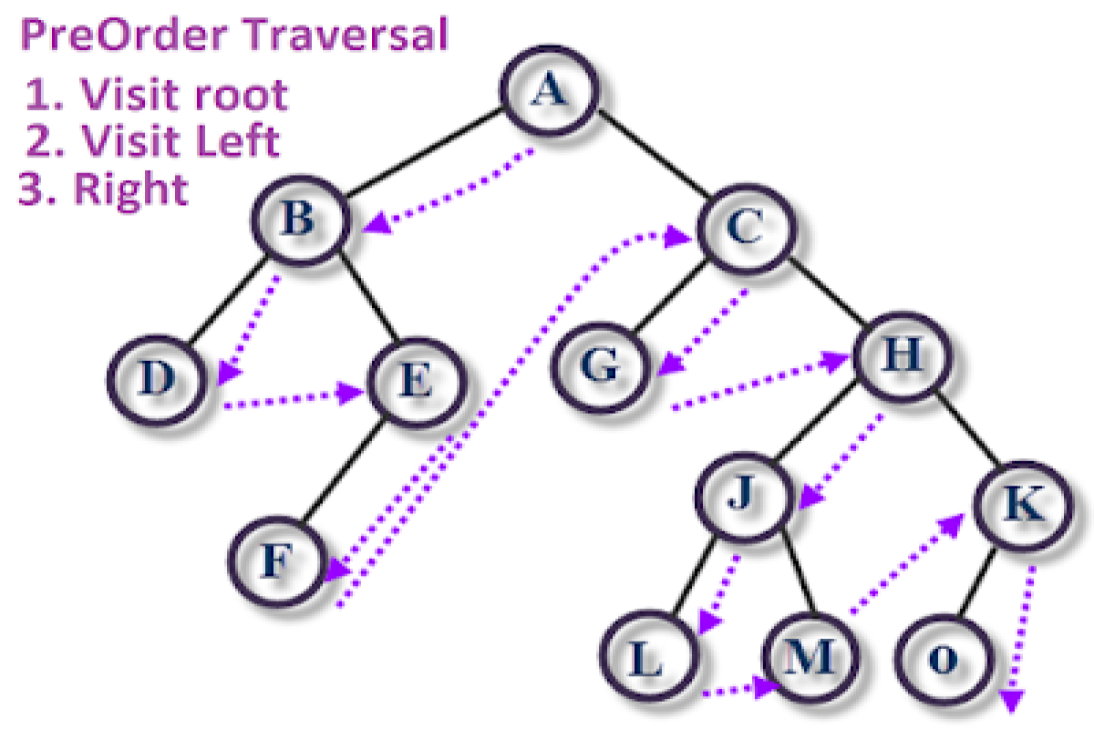

Slide 61
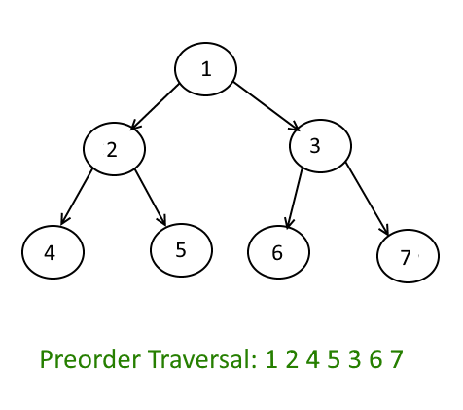
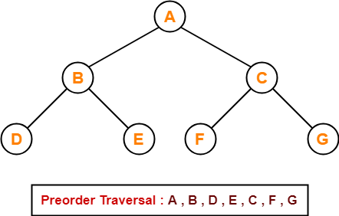

Slide 62
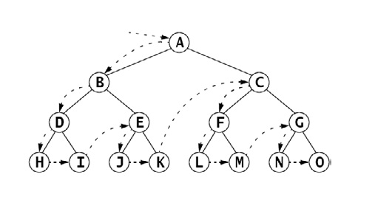
Preorder

Slide 63
Postorder Traversal
To traverse a nonempty binary tree:
  1. If the left subtree is nonempty, do a postorder traversal on it.
  2. If the right subtree is nonempty, do a postorder traversal on it.
  3. Visit the root.

Slide 64
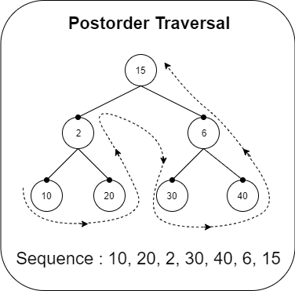
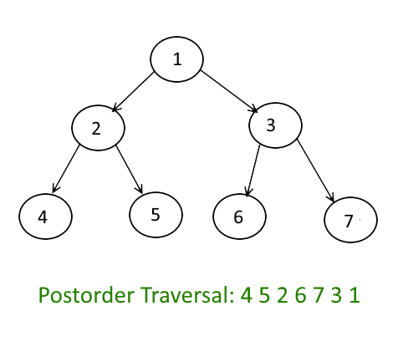

Slide 65
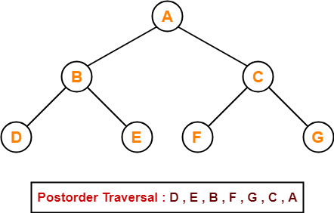
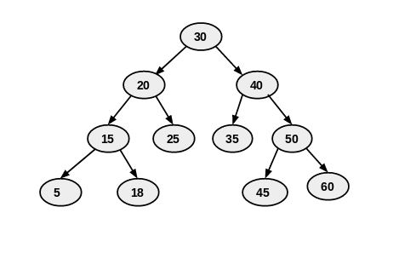

Slide 66
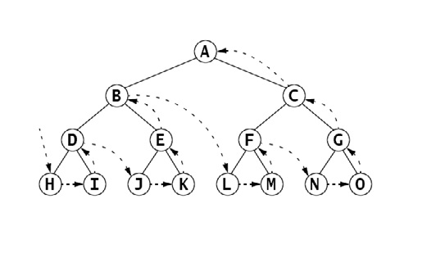
Postorder

Slide 67
Inorder Traversal
To traverse a nonempty binary tree:
  1. If the left subtree is nonempty, do a preorder traversal on it.
  2. Visit the root.
  3. If the right subtree is nonempty, do a preorder traversal on it.

Slide 68
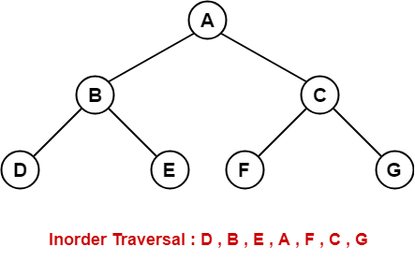

Slide 69
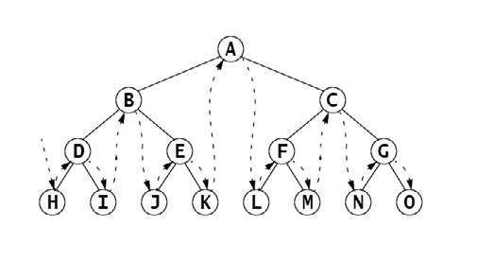
Inorder

Slide 70
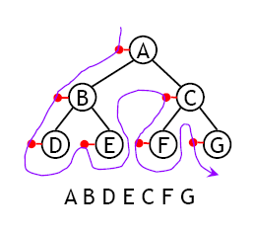

Traversal Using Flag
The order in which the nodes are visited during a tree traversal can be easily determined by imagining there is a “flag” attached to each node, as follows:
To traverse the tree, collect the flags:

Slide 71

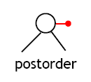
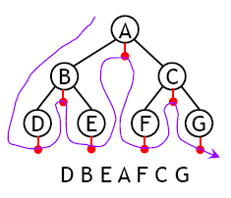
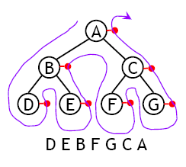
Inorder and Postorder

Slide 72
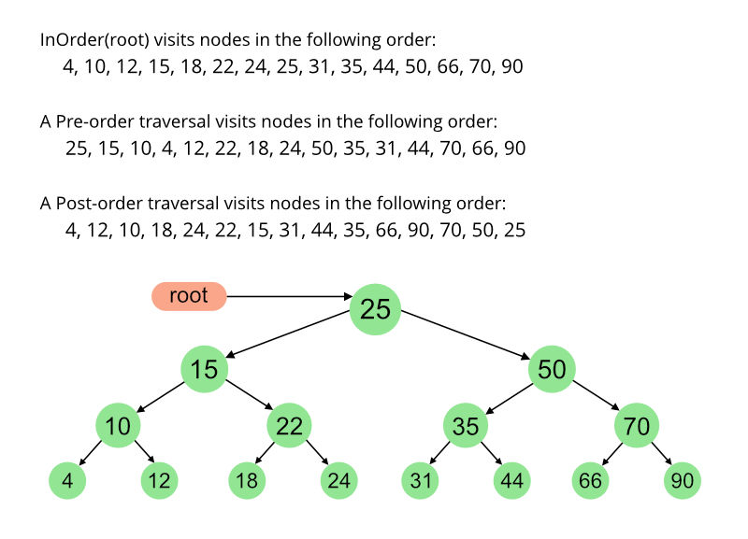

Slide 73
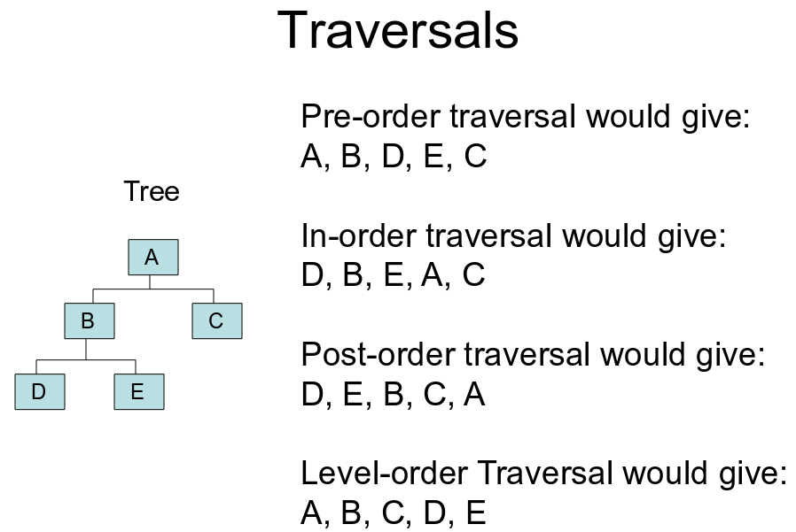

Slide 74


Slide 75
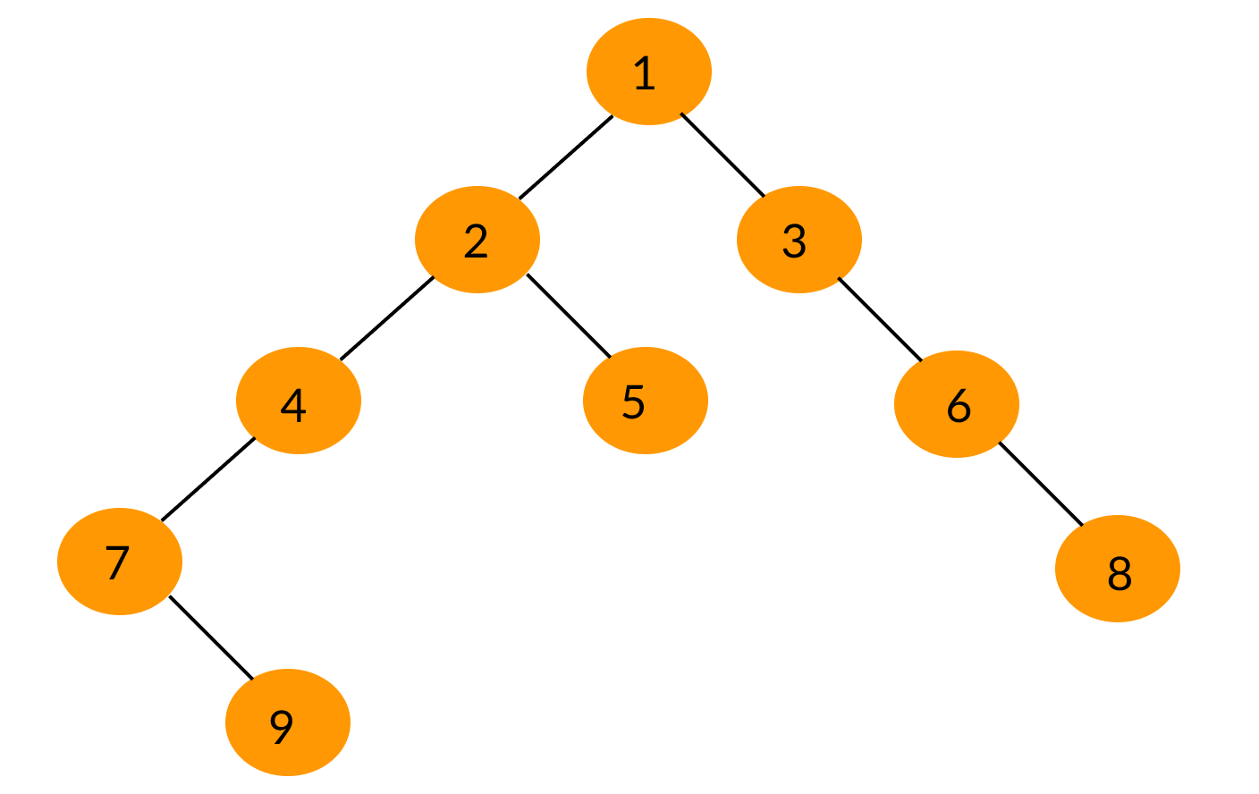

Slide 76
Traversal Algorithms (In general)
A traversal (circumnavigation) algorithm is a method for processing a data structure that applies a given operation to each element of the structure.
For example, if the operation is to print the contents of the element, then the traversal would print every element in the structure.
The process of applying the operation to an element is called visiting the element. So executing the traversal algorithm causes each element in the structure to be visited.

Slide 77
Level Order Traversal
The level order traversal algorithm visits the root, then visits each element on the first level, then visits each element on the second level, and so forth, each time visiting all the elements on one level before going down to the next level.
If the tree is drawn in the usual manner with its root at the top and leaves near the bottom, then the level order pattern is the same left-to-right top-to-bottom pattern that you follow to read English text.

Slide 78
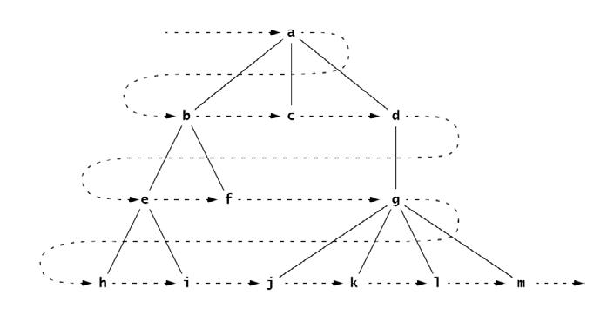
Level Order Example

Slide 79
Level order Traversal - Algorithm
To traverse a nonempty ordered tree:
  1. Initialize a queue.
  2. Enqueue the root.
  3. Repeat steps 4–6 until the queue is empty.
  4. Dequeue node x from the queue.
  5. Visit x.
  6. Enqueue all the children of x in order.

Slide 80
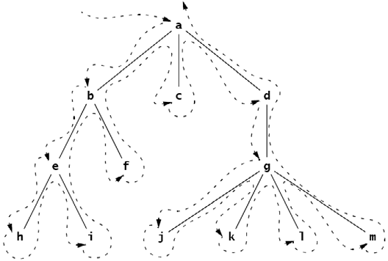
Preorder Traversal
    The preorder traversal of the tree shown above would visit the nodes in this order: a, b, e, h, i, f, c, d, g, j, k, l, m.
    Note that the preorder traversal of a tree can be obtained by circumnavigating the tree, beginning at the root and visiting each node the first time it is encountered on the left.

Slide 81
