Slide 1
Swiggy Sales Analysis — Pan-India Business Performance
January – August 2025 | Data Analysis & Insights Report
Prepared by: [Soumen Biswas]
Date: [12/09/2026]
Scope
Data Period
Purpose
993 Restaurants · 28 States · 8 Months
January 2025 – August 2025
Staffing, Promotions & Regional Strategy

Slide 2

EXECUTIVE SUMMARY
Executive KPI Summary
Nationwide Swiggy order data analyzed to assess platform health and uncover patterns for staffing, promotions, and regional strategy across 8 months of operations.
₹5.30Cr
1,97,430
Total Sales
Total Orders
Gross revenue across all cities and categories
Platform-wide orders fulfilled Jan–Aug 2025
₹268.51
4.34
Avg. Order Value
Avg. Rating
AOV across Veg and Non-Veg segments combined
Out of 5.0 — consistent across all quarters
Rating Count
Platform Footprint
5,591,574 total ratings received — a strong engagement signal across the platform
993 restaurants across 28 states — true pan-India coverage over the full 8-month window

Slide 3
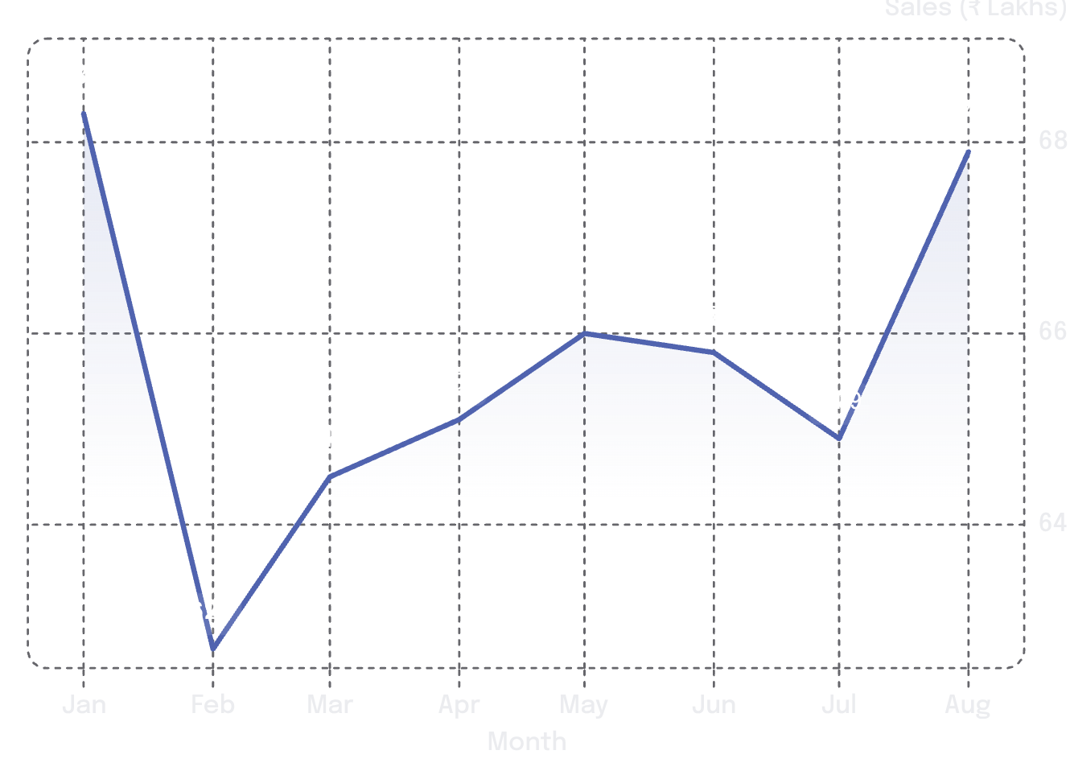
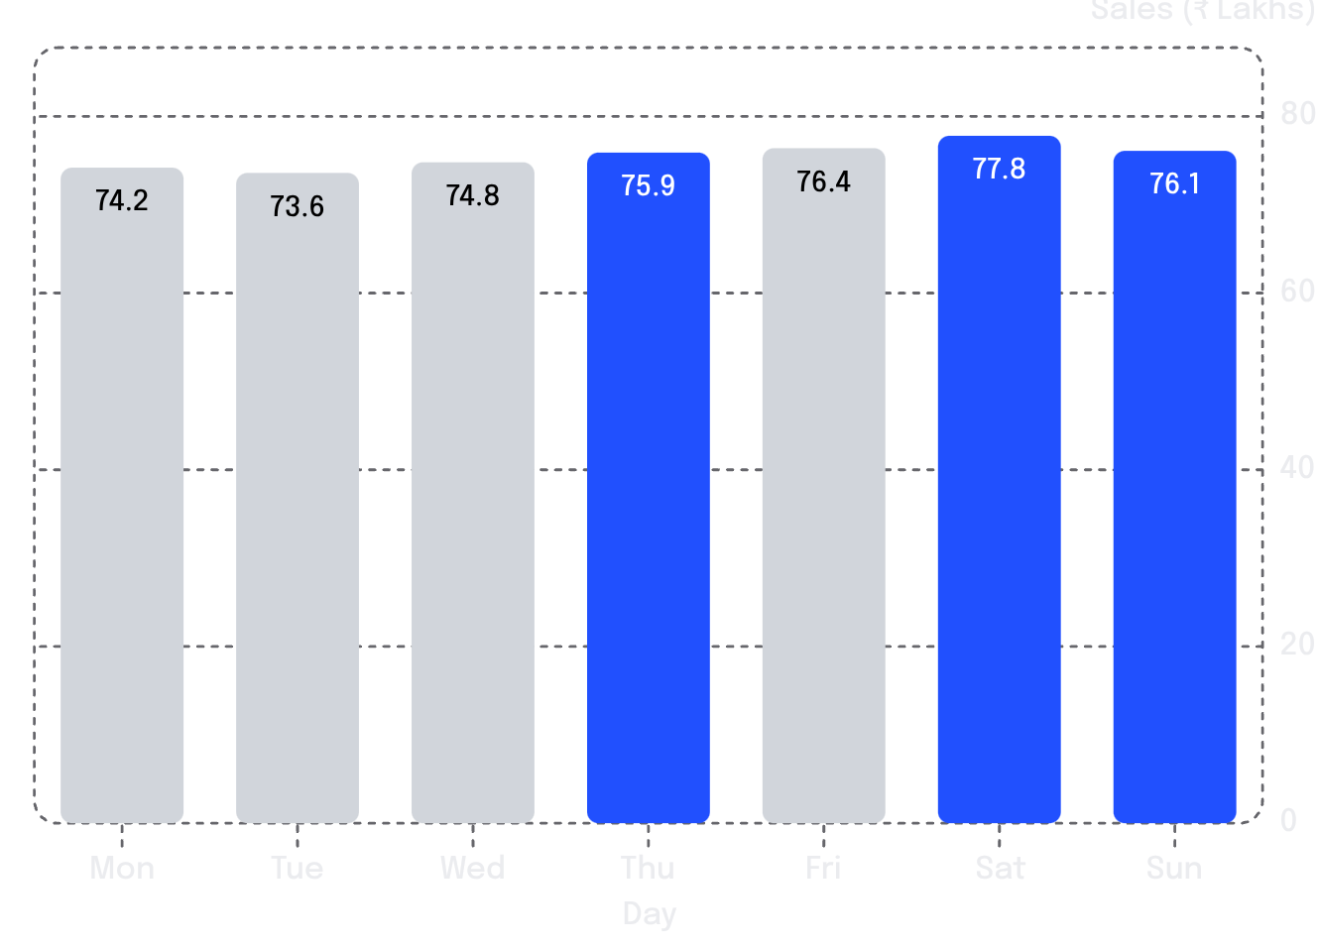

TRENDS ANALYSIS
Sales Trends: Monthly, Daily & Weekly
Monthly Sales Trend (Jan–Aug 2025)
Daily Average Sales by Day of Week (₹ Lakhs)
Monthly band stays tight between ₹62.7L – ₹68.3L. Jan & Aug are strongest; Feb is the lone dip. Demand is structurally stable with no major seasonal collapse.
Saturday peaks at ₹77.8L; Tuesday is the weakest at ₹73.6L. Thu–Sat consistently outperform early-week days — a clear staffing and promotional signal.
Key Takeaway: Stable demand overall — weekends + Thursday outperform early week. Target Tuesday promotions and optimize courier staffing for Sat/Thu/Fri peaks.

Slide 4
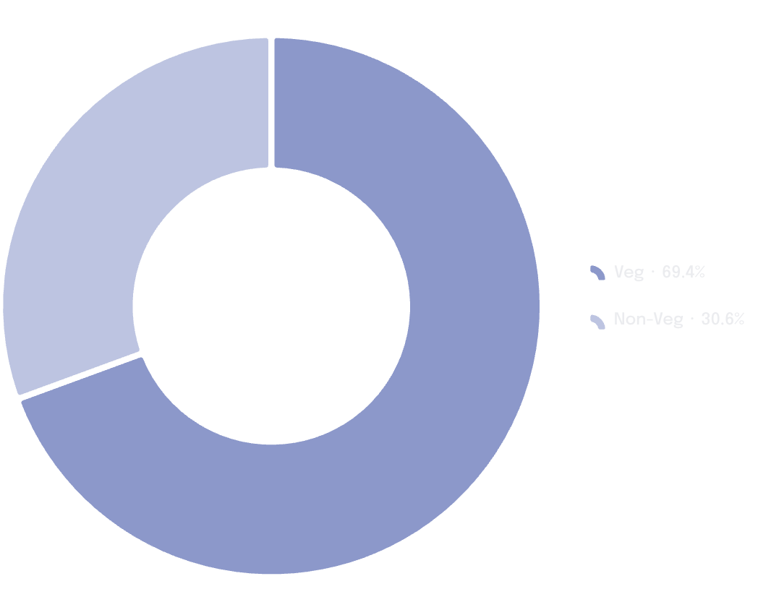
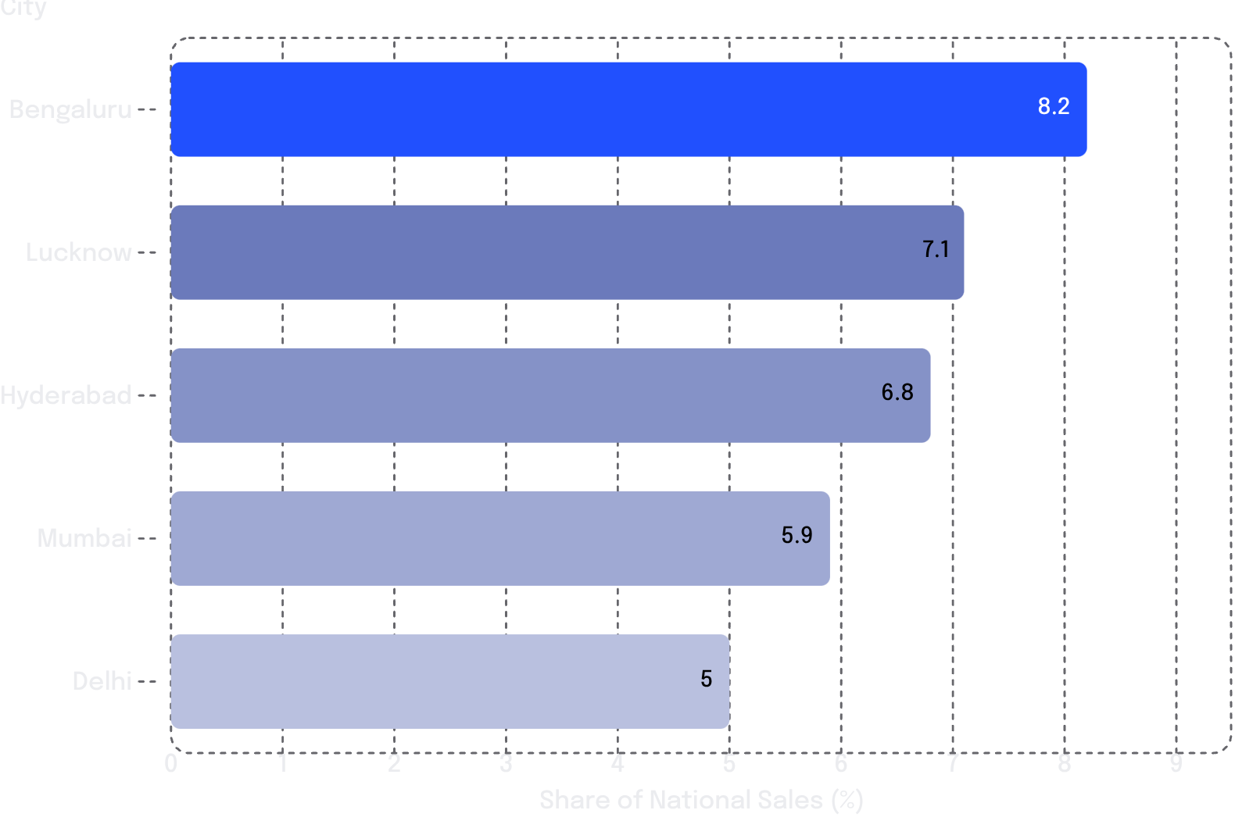
SEGMENTATION & GEOGRAPHY
Food Type & Geographic Performance
Order Split: Veg vs. Non-Veg
Top 5 Cities by Sales Contribution
Veg Segment
69.4% orders · 63% revenue · AOV ₹243.49
The Top 5 metros collectively account for ~33% of total national sales, confirming heavy revenue concentration in urban centres. The remaining 67% is spread across 23+ additional states — significant headroom for regional growth campaigns.
Non-Veg Segment
30.6% orders · 37% revenue · AOV ₹325.36 (+34% vs. Veg)

Slide 5
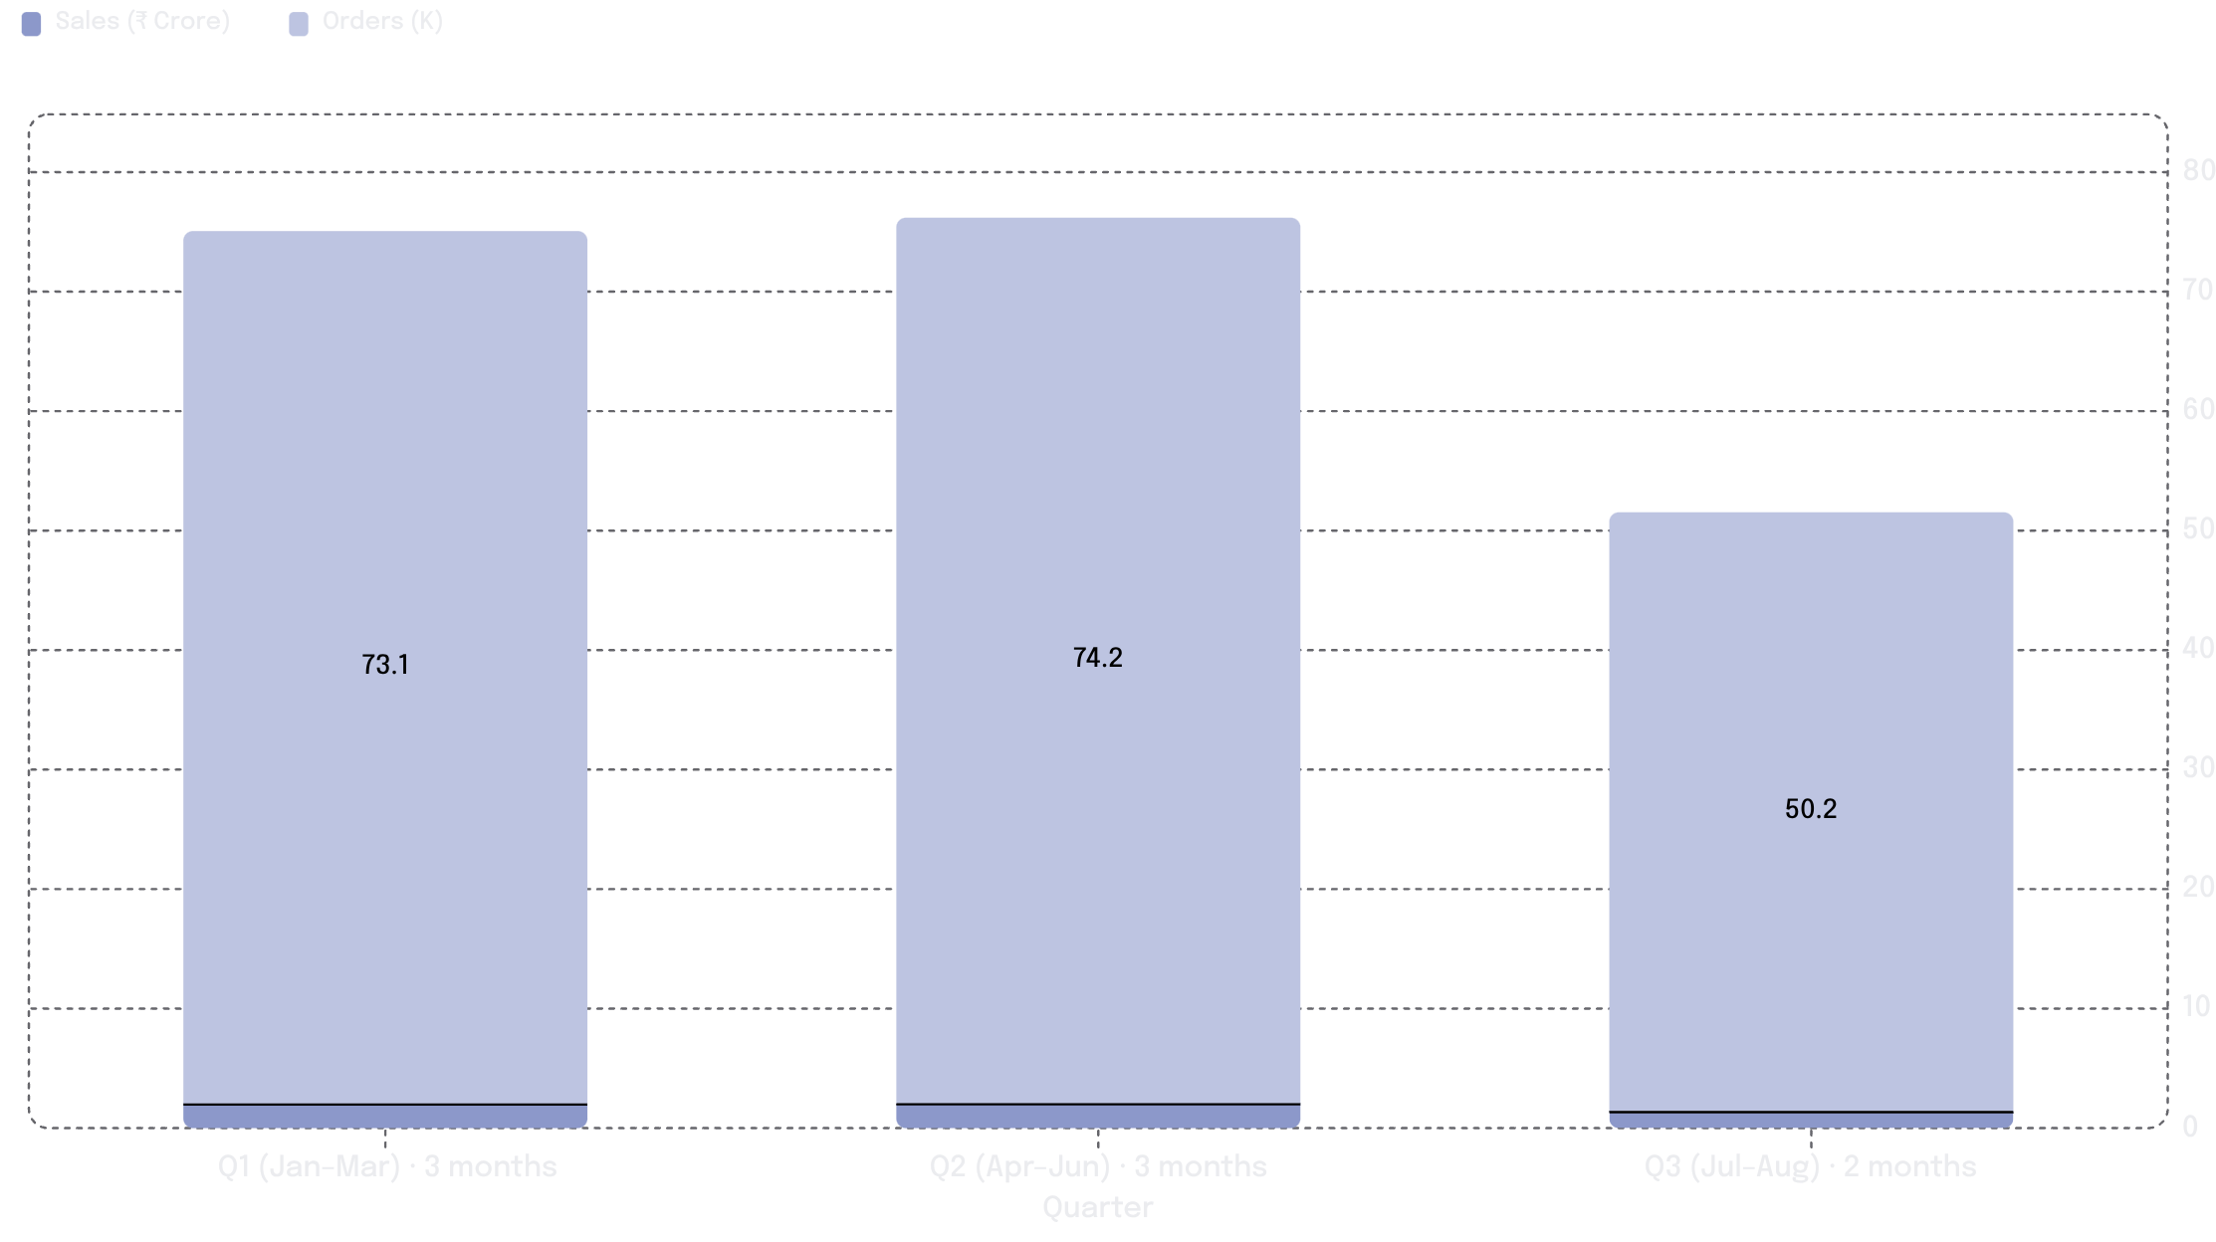
QUARTERLY PERFORMANCE
Quarterly Performance & Data Caveat
1
Q1: ₹1.97 Cr | 73,096 orders
⚠ Important Data Caveat
3-month full quarter. Monthly average: ₹65.7L/month
Q3 covers only 2 months (July–August 2025), not a full quarter. The raw ₹1.34 Cr figure is NOT a decline in performance.
When normalized to a monthly average of ₹67.2L/month, Q3 is actually the strongest monthly run rate across all three periods — reflecting continued platform momentum.
Rating consistency: ~4.34 / 5 held steady across all quarters regardless of order volume — a signal of robust and reliable service quality.
2
Q2: ₹1.99 Cr | 74,163 orders
3-month full quarter. Monthly average: ₹66.3L/month
3
Q3: ₹1.34 Cr | 50,171 orders
2-month partial period. Monthly average: ₹67.2L/month — fully in line with Q1 and Q2

Slide 6




STRATEGIC OUTLOOK
Recommendations & Next Steps
Optimize Courier Staffing
Targeted Promotions
Deploy heavier courier coverage on Saturday, Thursday, and Friday when demand peaks at ₹77.8L/day. Run leaner on Tuesday (₹73.6L) to reduce idle cost without impacting SLA.
Launch midweek offers specifically on Tuesdays to lift the week's lowest-performing day. Intensify promotional spend during the February–June window to counteract the seasonal dip observed in Feb (₹62.7L).
Non-Veg AOV Uplift
Metro Protection & Regional Expansion
Non-Veg carries a 34% AOV premium (₹325.36 vs. ₹243.49). Cross-sell and bundle Non-Veg items to Veg-dominant customers to lift blended AOV across the platform's majority segment.
Protect revenue from the Top 5 metros (Bengaluru, Lucknow, Hyderabad, Mumbai, Delhi) which drive ~33% of national sales. Run targeted acquisition campaigns in underperforming states to diversify revenue concentration across 28 markets.
Contact: [hereissoumenbiswas@gmail.com] | LinkedIn | GitHub Repository
Swiggy Sales Analysis — Pan-India | Jan–Aug 2025

