Slide 1
CS301 - Algorithms
Week #1
Hüsnü Yenigün

Slide 2
About the course: People
Instructor
  Name: Hüsnü Yenigün
  Office: FENS 2054
  Office Hours:
    By appointment: any available time → (please read the note at the top)
      http://people.sabanciuniv.edu/yenigun/calendar.php
TAs :
  Veysel Er (Office hours: TBA)
  Ege Alpay (Office hours: TBA)
  Emir Alaattin Yılmaz (Office hours: TBA)

Slide 3
About the course: Grading
Exams:
  1 Midterm (25%)
    Date: TBA – most probably on Week 8/9/10
  1 Final (40%)
    Date: to be announced (by Student Resources)
  1 Make-up
    Date: to be announced (after the final exam)
    Make-up policy
      If you miss exactly one of Midterm or Final, you can take the make-up
      (please bring me a copy of your report, official excuse letter)
      If you miss both Midterm and Final, you fail the course
      Make-up grade is considered as the grade of your missing exam
Homeworks ~ 5 (20%)
Project (15%) [ group based, needs analysis, implementation, reporting, etc.]
No end-of-term requests are granted

Slide 4
About the course: Recitations
Recitations:
  Homework/Problem solving
  Not regular
  Will be announced in advance
  (assume no recitation unless it is announced)
All communication through SUCourse

Slide 5
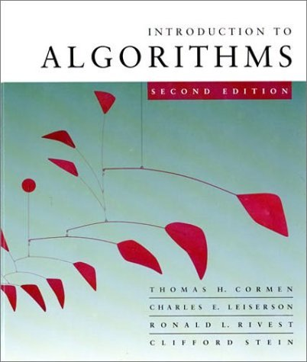
About the course: Textbook
Course material
  Textbook:
    Introduction to Algorithms
  by Cormen et al.
  Lecture slides (available on SUCourse)

Slide 6
About the course: Motivation
Very basic and intellectually enlightening course
Get to know some common computational problems and their existing solutions
Get familiar with algorithm design techniques
(that will help you come up with algorithms on your own)
Get familiar with algorithm analysis techniques
(that will help you analyze algorithms to pick the most suitable algorithm)
Computers are not infinitely fast and memory is finite
Get familiar with typical problems and learn the bounds of power of algorithms (undecidability and NP-completeness)

Slide 7
About the course: Tentative Outline
Introduction
Asymptotic Notation
Divide and Conquer Paradigm
Recurrences
Solving Recurrences
Quicksort
Sorting in linear time
Medians and order statistics
Binary search trees
Red-Black trees
Augmenting data structures
Dynamic programming
Greedy algorithms
Amortized Analysis
Graph algorithms
Sorting Networks
Computational Geometry
Undecidability
NP-Completeness
Practical Evaluation of Algorithms

Slide 8
INTRODUCTION

Slide 9
What is an algorithm?
Sequence of trivial steps
An algorithm is a well-defined computational procedure that takes a value as input, and produces a value as output, as a solution to a computational problem.
Algorithm
input
output

Slide 10
The statement of the problem defines what is the relationship between the input and the output.
The algorithm defines a specific computational procedure that explains how this relationship will be realized.

Slide 11
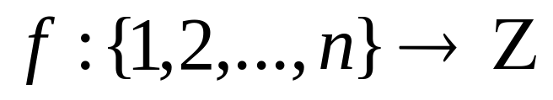
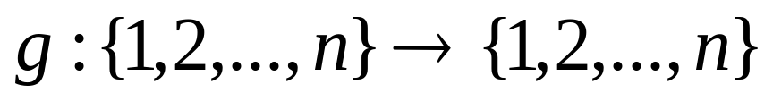
An example computational problem…
Given a function
find a bijection
such that
This is nothing but a very formal definition of
the sorting problem
(the problem as described above asks for an algorithm that sorts the input numbers in nondecreasing order)

Slide 12
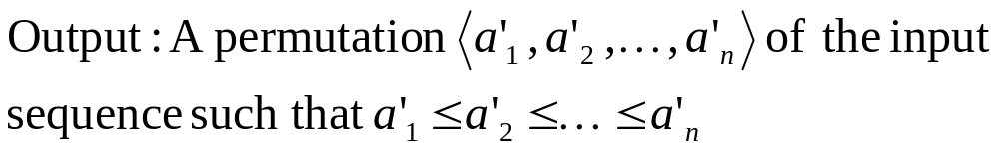
An example computational problem…
The problem definition is not always given as formal as in the previous example:

Slide 13
An example computational problem…
Or even in a more informal way:
Output: sort the numbers in nondecreasing order

Slide 14
Sorting example
Given a sequence of numbers as input such as
[ 15, 42, 17, 34, 3, 17 ]
The output should be
[ 3, 15, 17, 17, 34, 42 ]
Note that, the output for this input is in accordance with the problem definition, i.e. it conforms with the “what should be done” definition given in the problem statement .
“How it should be done” depends on the algorithm.

Slide 15
An instance of a problem
An instance of a problem consists of all the inputs that satisfy the constraints that are imposed by the problem definition.
“Sort [15, 42, 17, 34, 3, 17] in nondecreasing order” is an instance of the sorting problem.
“Sort [23, 33, 4, 1, 27] in nondecreasing order” is another instance of the sorting problem.
The input is a sequence of numbers (not a sequence of animals, not a set of sequences of numbers).

Slide 16
Not the sorting problem again !!!
Sorting is a fundamental operation in many disciplines and it is used as a part of other algorithms.
A lot of research has been made on the sorting problem.
A lot of algorithms have been developed.
It is a very simple and interesting problem to explain basic ideas of algorithm design and analysis techniques.

Slide 17
Correctness of algorithms
An algorithm is correct if for every instance of the problem, it halts (terminates) and it produces the correct answer.
Otherwise (i.e. if there are some instances for which the algorithm does not halt, or it produces an incorrect answer), it is called an incorrect algorithm.
Surprisingly, incorrect algorithms are occasionally used in practice…

Slide 18
Insertion sort
Basic idea: Given a nondecreasing sequence
[a₁, a₂, …, a_{n}] and a number k
the sequence
[a₁, a₂, … a_{i}, k, a_{i+1},…, a_{n}]
is a nondecreasing sequence if a_{i} ≤ k ≤ a_{i+1}
For example:
[a₁, a₂, a₃, a₄, a₅] k
[10, 12, 22, 34, 35] 19
the result is: [10,12,19,22,34,35]

Slide 19
Insertion sort
How can we use this idea to sort a sequence of numbers?
Suppose we are given: [ 3, 1, 7, 2 ]
Start with a single element sequence
(by definition, it is already a sorted sequence)
Insert each element one-by-one into already sorted sequence.
It is like sorting a hand of a card game (e.g. bridge)
[3]
[1,3]
[1,3,7]
[1,2,3,7]

Slide 20
An Implementation for Insertion sort
Considers each element one-by-one. Note that, the first element is assumed to form the initial sorted sequence.
Searches for the correct place to insert the next element.
Insertion-Sort(A) {
for (j=2; j≤n; j=j+1) {
num = A[j];
i = j-1;
// find the correct place for num
while (i>0 and A[i]>num) {
A[i+1] = A[i];
i=i-1;
}
A[i+1] = num;
}
}
If it sees that num is smaller than A[i], it shifts A[i] one position to the right
When the correct place is found, it will be already empty

Slide 21
Showing the correctness of Insertion Sort
Note that, “Insertion-Sort” is an iterative algorithm.
Loop invariants is a widely used method to show the correctness of iterative algorithms.
A loop invariant is a boolean statement that is correct for all the iterations of the loop.
Loop invariant method is performed in 3 steps, and related to the mathematical induction proofs.

Slide 22
3 steps of loop invariants method
Initialization: Show that the loop invariant holds before the first iteration of the loop.
Maintenance: Show that if the loop invariant holds before an iteration of the loop, then it also holds at the end of the iteration (and hence at the beginning of the the next iteration) of the loop.
Termination: When the loop terminates, the invariant gives a useful property that helps to show that the algorithm is correct.
Similar to the “induction base” in inductive proofs
Similar to “induction step” in inductive proofs

Slide 23
A loop invariant for Insertion sort
A loop invariant of the “for loop” of the insertion sort:
Insertion-Sort(A) {
for (j=2; j≤n; j=j+1) {
num = A[j];
i = j-1;
// find the correct place for num
while (i>0 and A[i]>num) {
A[i+1] = A[i];
i=i-1;
}
A[i+1] = num;
}
}
“The sub-array
A[1..j-1]
holds nondecreasing sequence of first
j-1 numbers in A”

Slide 24
Step 1
Initially, when the loop starts its first iteration we have j=2
Therefore, initially
A[1..j-1] = A[1..2-1] = A[1..1]
Since A[1..1] is a single element subarray, it is by definition a sorted sequence numbers.
Hence, the loop invariant initially holds.

Slide 25
Step 2
Assume the loop invariant holds just before an iteration.
Within the iteration, the while loop will shift all the numbers that are strictly greater than A[j] one slot to the right.
A[j] will be inserted after all the elements that are smaller or equal to A[j]
Hence after the iteration finished, A[1..j-1] (where j is now incremented by one) will be a sorted sequence.

Slide 26
Step 3
When the algorithm terminates, it means j > n
Since we increment j by 1 in each iteration, we know that j=n+1
The loop invariant for j=n+1 states that:
A[1..j-1]=A[1..n+1-1]=A[1..n] is a sorted sequence of numbers.
QED
(Quod Erat Demonstrandum)
(Latin for “that which was to be demonstrated”)

Slide 27
Is Insertion sort the solution for the sorting problem?
Insertion sort is only a solution for the sorting problem.
“But we’ve just proved that it works correctly for all the input sequences. Why do we need other algorithms to solve the sorting problem?”
There may be other algorithms better than Insertion sort…

Slide 28
What does a “better algorithm” mean?
A better algorithm uses less resources than the other algorithms.
Then, just show us the best algorithm known. We will only be using the best algorithm.
Not that simple. Using less resource depends on
  The number of input elements
  The characteristics of the input
  The resource we are interested in
Therefore, the definition of “best” changes
Time (*)
Space (i.e. memory)
Money
Area
Bandwidth
Energy
etc.

Slide 29
Selecting the best algorithm
Selecting the best algorithm, first of all, requires to have multiple algorithms for the solution of the same problem.
The resource on which our selection will be made should be known.
And, we must analyze the available algorithms to understand how much of the type of resource we are interested these algorithms use.
We must have a specific model of implementation for the analysis.
We will mainly use the RAM (random access machine) model, where the algorithms are implemented as single thread computer programs .
In RAM model, statements are executed one by one, sequentially.

Slide 30
Analysis of Insertion sort
Time taken by Insertion sort depends on
  The number of elements to be sorted
  10 elements vs. 1000 elements
  The nature of the input
  almost sorted, reverse sorted, etc.
In general, the time taken by an algorithm grows with the size of the input.
Therefore, we describe the running time of an algorithm as a function of the input size.

Slide 31
Definition of the input size
It depends on the problem and sometimes on the algorithm.
For sorting problem, it is natural to pick the number of elements as the size of the input. For some sorting algorithms, the range of the numbers to be sorted may also be used as the size of the input.
For some problems, a single measure is not sufficient to describe the size of the input.
For example, for a graph algorithm, the size of the graph is better described with the number of nodes and the number of edges given together.

Slide 32
Definition of the running time
We can use an old computer or a contemporary supercomputer to execute an implementation of the algorithm.
A good programmer can implement the algorithm, compile it with all optimization options turned on
or,
a beginner programmer can implement it using a high level language and compile it using the worst compiler (which has no optimization).
So, the running time of a given algorithm seems to depend on certain conditions.

Slide 33
Definition of the running time
To perform a running time analysis of an algorithm, our notion of “running time” should be an abstract notion that is as independent as possible from such concerns.
Let us try to compute the running time InsertionSort, by assigning some unknown but fixed running times for each line of code in the algorithm.

Slide 34
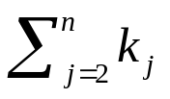
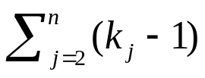
Running time of insertion sort
cost
times executed
Insertion-Sort(A) {
for (j=2; j≤n; j=j+1) {
num = A[j];
i = j-1;
// find the correct place for num
while (i>0 and A[i]>num) {
A[i+1] = A[i];
i=i-1;
}
A[i+1] = num;
}
}
c₁
n
c₂
n-1
c₃
n-1
c₄
c₅
c₆
c₇
n-1
n: the number of elements in the array A
k_{j}: the number of times the “while” loop condition is checked for that specific j value

Slide 35
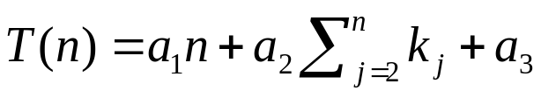
Running time of insertion sort
The total running time can be calculated as:
With a little bit of simplification:

Slide 36
Running time of insertion sort (best case)
Recall that k_{j} is the number of times that the “while loop” condition is checked to find the correct place of a number
Under the best scenario, it will never iterate for all j, hence k_{j} =1 for all j
This corresponds to the case where the input is already sorted
In this case

Slide 37
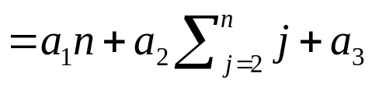
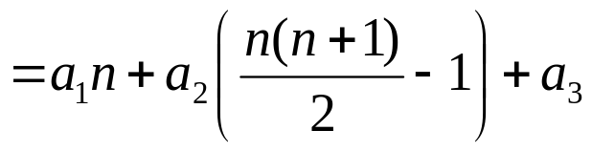

Running time of insertion sort (worst case)
Under the worst scenario, the while loop will iterate the maximum amount of time possible
Therefore, k_{j} = j for all j

Slide 38
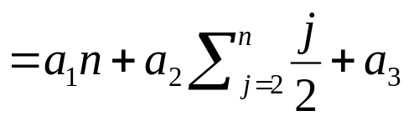
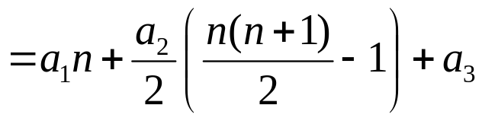

Running time of insertion sort (average case)
On the average, the while loop will iterate half of the maximum possible number of times
Therefore, k_{j} = j/2 for all j

Slide 39
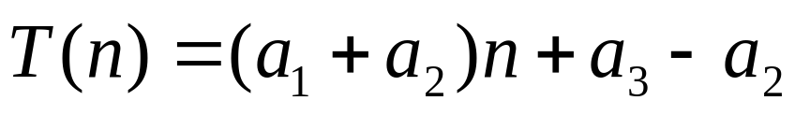
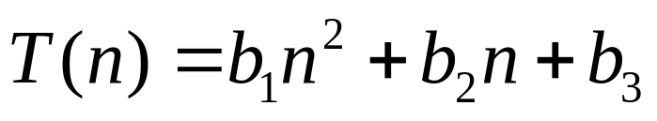
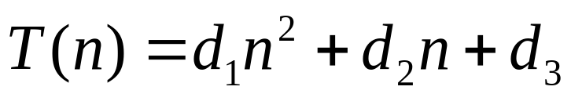
Running time of insertion sort
Best case:
Linear function of n
Average case:
Quadratic function of n
Worst case:
Quadratic function of n

Slide 40
Which running time we should use?
In order to compare the running time of algorithms, usually the “worst case running time” is used, because
  It gives an upper bound (it cannot go worse)
  Murphy’s law (the worst case happens)
  Average case is usually the same as the worst case.

Slide 41
Asymptotic Analysis
Note that, in the running time analysis of the insertion sort algorithm, we ignored the actual cost of steps by abstracting them with constants : c_{i}
We will go one step further, and show that these constants are not actually very important in practice, especially when we consider large input sizes.

Slide 42
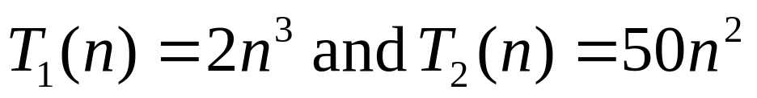
Asymptotic Analysis
Suppose we have two algorithms for sorting A₁ and A₂
Let the exact running time of them be
Assume A₁ is executed on a fast machine (10⁹ instructions per second)
Assume A₂ is executed on a slow machine (10⁶ instructions per second)
Assume we will be sorting 10⁵ numbers

Slide 43
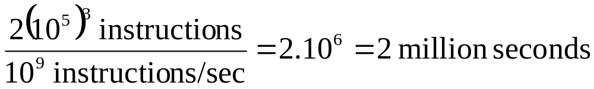
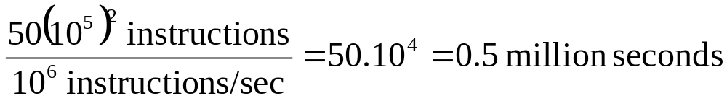
Asymptotic Analysis
A₁ on the fast computer will need
A₂ on the slow computer will need
A₂ will run four times faster

Slide 44
Asymptotic Analysis
In real life, most of the time we will be interested in the performance of the algorithms on large inputs.
Therefore, even if the coefficients of the exact running time are small, it is the growth rate of the function (highest order term) that determines the performance of the algorithms as the input size gets bigger.

Slide 45
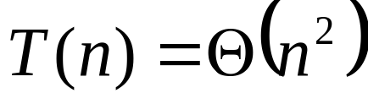
Asymptotic Analysis
Look at growth of T(n) as n → ∞
Θ-notation:
  Ignore lower order terms
  Ignore leading constants
For example:
Leading constant
Lower order terms

Slide 46

Asymptotic Analysis
time
input size

Slide 47
Algorithm Design Techniques
In general, there is no recipe for coming up with an algorithm for a given problem.
However, there are some algorithms design techniques that can be used to classify the algorithms.
Knowing these algorithm design techniques helps us to have some starting point and gives us a guideline to follow to design an algorithm from scratch.
Insertion sort uses so called “incremental approach”
Having sorted A[1..j-1], insert a new element A[j], forming a new, larger sorted sequence A[1..j]

Slide 48
Divide and Conquer
Another such design approach is
Divide and Conquer
We will examine another algorithm for the sorting problem that follows divide and conquer approach
Divide and conquer algorithms are recursive in their nature.
It is relatively easy to state their running time by using a recurrence

Slide 49
Three steps of divide and conquer
Divide: The problem is divided into several smaller subproblems
Conquer: The subproblems are attacked recursively by the same algorithm. When the size of the subproblem gets small enough, the problem is solved in a straightforward manner.
Combine: The solutions to the subproblems combined to form the solution of the original problem.
For example, divide the given sequence of numbers into smaller sequences.
Combine sorted subsequences together to form the sorted form of the original sequence.
As long as we have more than one element to sort, keep dividing. When we have a single element to sort, it is already a sorted sequence.

Slide 50
Merge Sort
Basic idea: Given two sorted sequences
[a₁,a₂,…,a_{n}] and [b₁,b₂,…b_{m}]
these two sequences can be merged into a single sorted sequence efficiently.
For example:
[1,5,7] and [2,3,6]
Can be performed in Θ(n) time.
[1]
[1,2]
[1,2,3]
[1,2,3,5]
[1,2,3,5,6]
[1,2,3,5,6,7]

Slide 51
Divide and conquer structure of the merge sort
Divide: Divide the n-element sequence to be sorted into two subsequences of n/2 elements each.
Conquer: Sort the subsequences recursively using merge sort (note that the recursion will bottom out when we have single element lists).
Combine: Merge the sorted subsequences using the merge operation explained before.

Slide 52
Execution of the merge sort
3 8 4 1
3 8 4 1
3 8 4 1
3 8 1 4
1 3 4 8
divide
divide
recursion bottoms out
merge
merge

Slide 53
Execution of the merge sort
3 8 4
3 8 4
3 8 4
3 8 4
3 4 8
Works even when the number
of items is not an exact power
of two

Slide 54
A Merge Sort Implementation
Lowest index of the subsequence
Highest index of the subsequence
Merge-Sort(A,p,r) {
if (p < r) {
q = floor((p+r)/2);
Merge-Sort(A,p,q);
Merge-Sort(A,q+1,r);
Merge(A,p,q,r);
}
}
If there are at least two numbers, we still need to divide. Otherwise do nothing…
divide the list into 2
recursively sort using Merge-Sort
combine the solutions

Slide 55
Analysis of Divide and Conquer Algorithms
If an algorithm is recursive, its running time can be described by a recurrence equation or recurrence.
A recurrence is a function that is defined recursively.

Slide 56
Analysis of Divide and Conquer Algorithms
A recurrence for running time T(n) of a divide and conquer algorithm is based on the three steps of the design approach:
  Suppose at each step the problem of size n is divided into a subproblems each of size n/b. Furthermore suppose dividing takes D(n) time.
  When the problem size is small enough (say smaller than a constant c), we will apply a straightforward technique to solve the problem in constant amount of time, denoted by Θ(1).
  Suppose combining the solutions takes C(n) time.

Slide 57
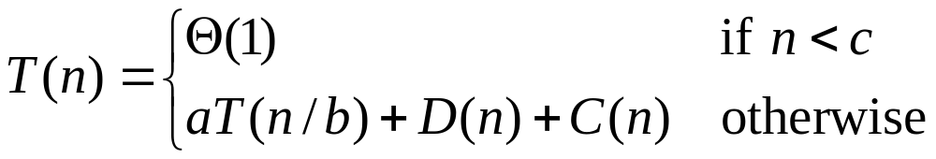
Analysis of Divide and Conquer Algorithms
The recurrence for a divide and conquer algorithm will then be:
if the problem is small enough, we spend a constant amount of time to solve it
number of subproblems
time required to solve each subproblem
size of each subproblem
work required for dividing into subproblems
work required for combining the solution of the subproblems
recursive definition of the function

Slide 58
Analysis of Merge Sort
Note that the pseudo code for Merge-Sort works correctly when the number of elements is not even.
However, we will assume that the number of elements is a power of 2 for the analysis purposes.
We will later see that, this assumption does not actually make a difference.

Slide 59
Analysis of Merge Sort
Merge-Sort(A,p,r) {
if (p<r) {
q = floor((p+r)/2);
Merge-Sort(A,p,q);
Merge-Sort(A,q+1,r);
Merge(A,p,q,r);
}
}
Merge-Sort(A,p,r) {
if (p<r) {
q = floor((p+r)/2);
Merge-Sort(A,p,q);
Merge-Sort(A,q+1,r);
Merge(A,p,q,r);
}
}
Divide: The divide step just computes the middle of the array, hence it takes a constant amount of time → D(n) = Θ(1)
Conquer: Need to solve recursively two subproblems, each of which has size n/2. Hence this step takes 2T(n/2) time.
Combine: As we have seen earlier, merging two sorted sequences with n elements takes linear time → C(n) = Θ(n)
Merge-Sort(A,p,r) {
if (p<r) {
q = floor((p+r)/2);
Merge-Sort(A,p,q);
Merge-Sort(A,q+1,r);
Merge(A,p,q,r);
}
}

Slide 60
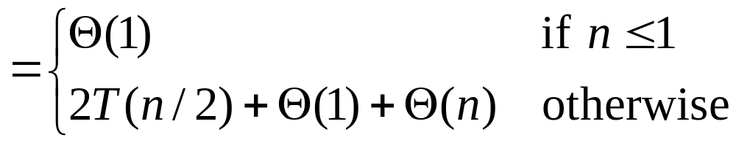
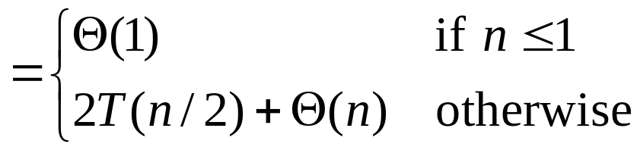

Analysis of Merge Sort
Therefore, the running time of Merge-Sort is

Slide 61
Comparison of Insertion and Merge Sort
Insertion Sort : Θ(n²)
Merge Sort: Θ(n log₂ n)
Merge Sort is asymptotically more efficient than Insertion Sort.
Does this mean we should never use Insertion Sort?
No. Note that we omitted the constant coefficients…

Slide 62
Comparison of Insertion and Merge Sort
Insertion Sort
Due to constant coefficients, Insertion Sort may still be preferable for small input sizes.
Also, Insertion Sort has a good performance on almost sorted inputs
time
Merge Sort
input size

Slide 63
GROWTH OF FUNCTIONS

Slide 64
Growth of Functions
The order of growth of running time (or of any resource usage) provides
  a simple characterization of an algorithm’s efficiency
  a tool to compare the relative asymptotic performances of algorithms
The exact running times can sometimes be derived, however, its use is limited, and not worth the effort for computing it, as when the inputs get large, the lower order terms and the constant coefficients are all dominated by the highest order term.
Usually, an algorithm that is asymptotically more efficient will be a better choice for all but very small input sizes.
We will introduce the asymptotic notations formally…

Slide 65
Asymptotic Notation
We will define the asymptotic running time of algorithms using a function T(n) whose domain is the set of natural numbers N={0,1,2,…}.
Although the notation will be introduced for only natural number input sizes, sometimes it will be abused to apply to rational input sizes.
Other abuses of the notations will also be made. Therefore, it is quite important to understand the formal definitions, to prevent the misuses due to abuses.

Slide 66
O-notation (upper bounds)
f(n)=O(g(n)) if there exist positive constants c and n₀ such that, for all n ≥ n₀, 0 ≤ f(n) ≤ cg(n)
For example, 2n² = O(n³) [take c=1, n₀=2]
g(n) bounds f(n) from above.
The rate of growth of f(n) is at most the same as the rate of growth of g(n).
Note that, for asymptotic notations,
= is a funny, one way equality.
Consider O(g(n)) as a set of function.

Slide 67

Formal Definition of O-notation
Therefore, O(g(n)) actually denotes a set of functions
When we write
2n² = O(n³)
we actually mean
2n² O(n³)

Slide 68
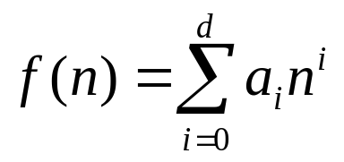

Some examples on O-notation
Example 1: Let f(n)=5n+24,
then f(n)=O(n) [take c=6, n₀=24]
[ 0 ≤ 5n+24 ≤ 6n forall n ≥ 24 ]
Example 2: Let f(n)=5n+24,
then f(n)=O(n²) [take c=1, n₀=8]
[ 0 ≤ 5n+24 ≤ n² forall n ≥ 8 ]
In general, for any polynomial
where a_{i}’s are constant and a_{d} > 0,

Slide 69

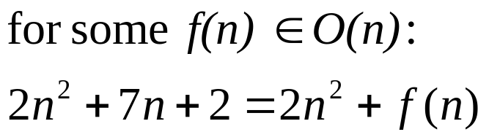
O-notation in expressions
n=O(n)
OK, we know that it means n O(n)
What’s the meaning of
It means,

Slide 70

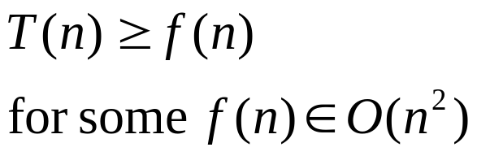

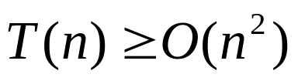
O-notation in expressions
In relational expressions as well:
means
Note that, the statement in this example is meaningless, since
Hence,
is correct for any running time

Slide 71
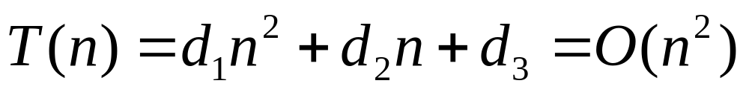
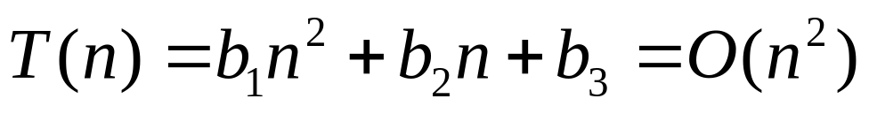
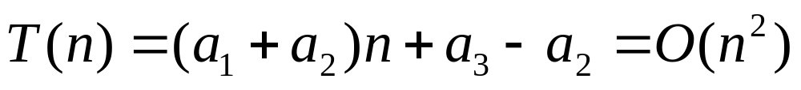
O-notation provides an upper bound
If the worst case running time of an algorithm is O(g(n)), then any running time of the algorithm is also O(g(n)).
For example, consider Insertion sort:
  Worst case:
  Average case:
  Best case:

Slide 72
O-notation provides an easy way to find worst case running time of algorithms
Insertion-Sort(A) {
for (j=2; j≤n; j=j+1) {
num = A[j];
i = j-1;
// find the correct place for num
while (i>0 and A[i]>num) {
A[i+1] = A[i];
i=i-1;
}
A[i+1] = num;
}
}
iterates n-1 times
O(n²)
iterates at most n times

Slide 73
o-notation (upper bounds that are not tight)
Bounds given by O-notation may or may not be tight:
  5n²=O(n²)
  3n=O(n²)
o-notation provides
upper bounds that are not tight.
When f(n)=o(g(n)), g(n) bounds f(n) from above.
The rate of growth of f(n) is strictly less than the rate of growth of g(n).
a tight upper bound
a loose upper bound

Slide 74
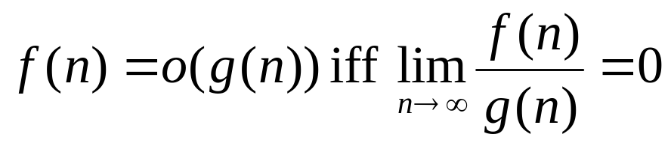
Formal Definition of o-notation
Intuitively, f(n)=o(g(n)) if as n gets bigger and bigger, f(n) becomes insignificantly small as compared to g(n).
Sometimes it is defined as

Slide 75
Examples for o-notation
3n=o(n²)
3n < cn²
[need to show how to pick n₀ for any given c]
5n² ≠ o(n²)
since for c<5, we cannot find n₀ such that for all n > n₀ : 5n² < cn²

Slide 76
Ω-notation (lower bounds)
Ω-notation provides asymptotic lower bounds.
f(n)= Ω(g(n)) if there exist positive constants c and n₀ such that, for all n ≥ n₀, 0 ≤ cg(n) ≤ f(n)
For example, 2n³ = Ω(n²) [take c=1, n₀=1]
g(n) bounds f(n) from below.
The rate of growth of f(n) is at least the same as the rate of growth of g(n).

Slide 77
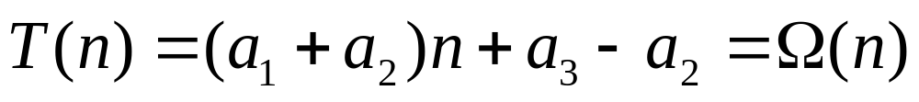
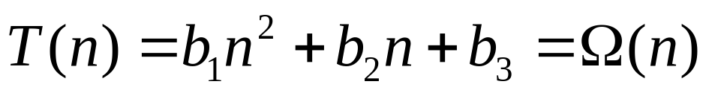
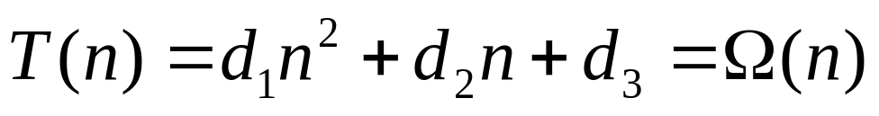
Ω-notation provides a lower bound
If the best case running time of an algorithm is Ω(g(n)), then any running time of the algorithm is also Ω(g(n)).
For example, consider Insertion sort:
  Best case:
  Average case:
  Worst case:

Slide 78
ω-notation (lower bounds that are not tight)
Bounds given by Ω-notation may or may not be tight:
  5n²= Ω(n²)
  5n²= Ω(n)
ω-notation provides lower bounds that are not tight.
When f(n)= ω(g(n)), g(n) bounds f(n) from below.
The rate of growth of f(n) is strictly more than the rate of growth of g(n).

Slide 79
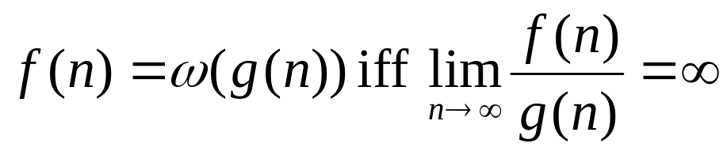
Formal definition of ω-notation
One way of defining is to say
However, by using our set notation
Note that,

Slide 80
Θ-notation (tight bounds)
If f(n)=Θ(g(n)), then g(n) is said to be an asymptotic tight bound for f(n).
If f(n)=Θ(g(n)), the rate of growth of f(n) and g(n) are the same.
Example:
5n² = Θ(n²)
5n² ≠ Θ(n)
5n² ≠ Θ(n³)

Slide 81



Some properties of asymptotic notations

Slide 82
Some more …
and this still holds when Θ above is replaced by any other asymptotic notation we have introduced (O,Ω,o,ω).

Slide 83
Not all functions are comparable
Consider f(n)=n, and g(n)=n^{1+sin n}
f(n) and g(n) cannot be compared…
n²
g(n)
f(n)
n⁰ = 1

Slide 84
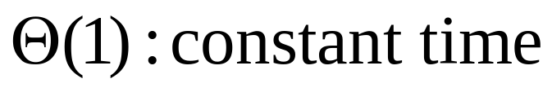
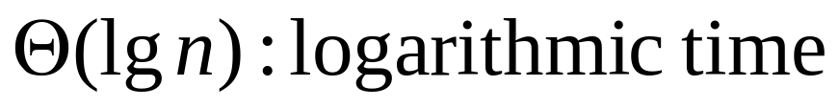
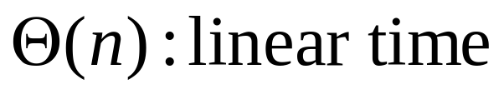
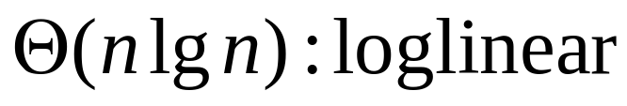
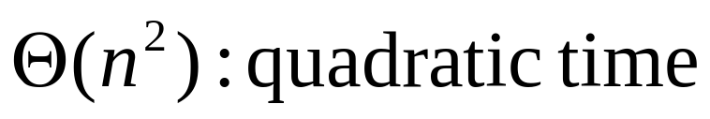
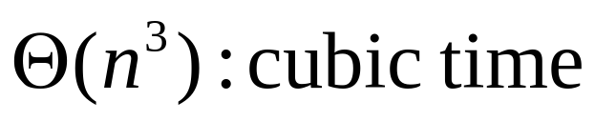
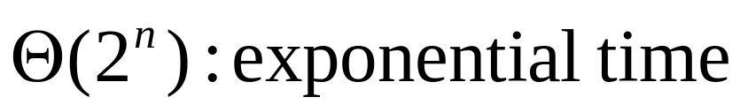
Some Complexity Classes

